Slide 1
NASA Agency Report
WGISS – 48
Hanoi, Vietnam
Andrew Mitchell
Earth Science Data and Information System (ESDIS) Project
Goddard Space Flight Center
Greenbelt, MD
October 11, 2019

Slide 2
Earth Science Data Systems Program:
Major Components
Earth Observing System Data and Information System (EOSDIS) – Managed by the ESDIS Project
  Science Investigator-led Processing Systems (SIPS)
  Distributed Active Archive Centers (DAACs)
  Common Services/Tools
  Earth Science Data System Working Group (ESDSWG)
Data System Evolution
  ACCESS: Advancing Collaborative Connections for Earth System Science
  MEaSUREs: Making Earth System Data Records for Use in Research Environments
  Citizen Science for Earth System Science
  Science Portals/Machine Learning
  System Security Support and Small Sat. Data Buy
Standards and Interoperability
  CEOS (Committee on Earth Observation Satellites) Working Group on Information Systems and Services (WGISS)
  NASA-European Space Agency (ESA) Bilateral
  Partnership activities for Google and MSFT, etc…
Inter Agency ImPlementation and Advanced Concepts (IMPACT) Team
  Addresses satellite needs assessment working group (SNWG) requests for improved tools/services for federal agencies, dedicated user support and faster access/better management of data from airborne campaigns.
  Consolidates existing activities under a single project – Independent assessments, Data.gov, GCIS, USGEO, W3C, FGDC

Slide 3

NASA EARTH FLEET
NISAR 2020
TROPICS (6) 2020
LANDSAT-9 2020
SENTINEL-6A/B 2020, 2025
OPERATING & FUTURE THROUGH 2023
TSIS-2 2020
SWOT 2021
PREFIRE (2) 2022
MAIA 2022
GEOCARB 2022
PACE 2022
INVEST/CUBESATS
RAVAN 2016
RainCube 2018
CSIM 2018
CubeRRT 2018
TEMPEST-D 2018
CIRiS 2019
HARP 2019
CTIM*
HyTI*
SNoOPI*
NACHOS*
* Launch date TBD
GLIMR ~2026
TEMPO 2022
ICESAT-2 2021
GRACE-FO (2) 2023
CYGNSS (8) 2020
NISTAR, EPIC (DSCOVR/NOAA) 2020
ISS INSTRUMENTS
EMIT 2021
CLARREO-PF 2020
GEDI 2020
SAGE III 2020
OCO-3 2022
TSIS-1 2023
ECOSTRESS 2020
LIS 2020
SORCE 2020
CLOUDSAT 2021
TERRA >2021
AQUA >2022
AURA >2022
CALIPSO >2022
GPM >2022
LANDSAT 7 (USGS) ~2022
JPSS-2, 3 & 4 INSTRUMENTS
OMPS-Limb
LANDSAT 8 (USGS) >2022
OCO-2 >2022
(PRE) FORMULATION
IMPLEMENTATON
PRIMARY OPS
EXTENDED OPS
OSTM/JASON 2 (NOAA) >2022
SMAP >2022
09.10.19
SUOMI NPP (NOAA) >2022

Slide 4
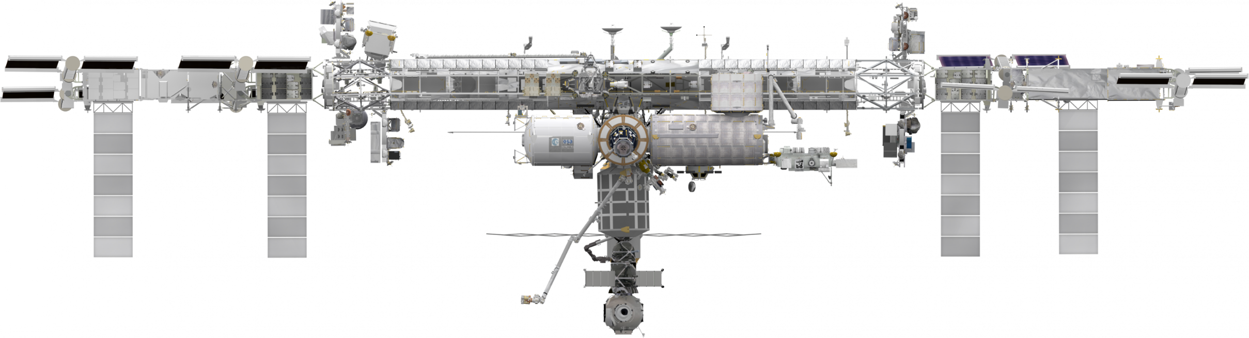
INTERNATIONAL SPACE STATION
EARTH SCIENCE OPERATING MISSIONS
EMIT (2021)
TSIS-1 (2023)
ELC-2
ELC-3
AMS
ESP-3
ELC-4
Columbus EF
JEMEF
ELC-1
SAGE III (2020)
OCO-3 (2022)
GEDI (2020)
ECOSTRESS (2020)
LIS (2020)
CLARREO-PF (2020)
External Logistics Carriers: ELC-1, ELC-2, ELC-3
External Stowage Platforms: ESP-3
Alpha Magnetic Spectrometer
Columbus External Payload Facility
Kibo External Payload Facility
(PRE) FORMULATION
IMPLEMENTATON
PRIMARY OPS
EXTENDED OPS
09.10.19
4

Slide 5










NASA EARTH FLEET
NISAR
SENTINEL 6 A/B
INTERNATIONAL COLLABORATIONS
GRACE-FO (2)
SWOT
OSTM/JASON 2 (NOAA)
(PRE) FORMULATION
IMPLEMENTATON
PRIMARY OPS
EXTENDED OPS
CALIPSO
CLOUDSAT
GPM
TERRA
AURA
AQUA
09.10.19

Slide 6
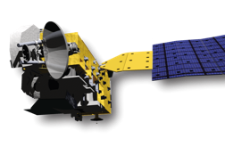
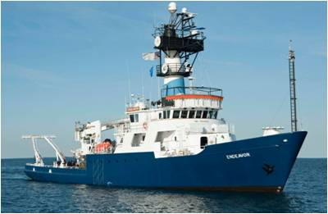
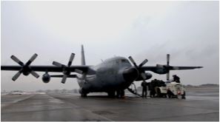
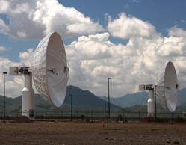
Earth Observing System Data and Information System
Users
EOSDIS
Research
distribute
Applications
Education
data downlink
subset
archive
capture and clean
process
Notes:
Image of the plane used in ICEBridge mission. Image of the Endeavor used for SPURS field campaign.

Slide 7
Role of EOSDIS
  Data Management
  Long Term Archive of Earth Science Datasets
  Interoperable Distributed Data Archives
  Science Data Processing
  Both Comprehensive and Science Discipline specific data support
  Online services for data discovery and data access
  Near-Real Time Data Access
  Earth Science Discipline-Oriented User Services
  Earth Science Standards Office
  Configuration Management and Metrics Systems
  Network Data Transport to distributed system elements

Slide 8

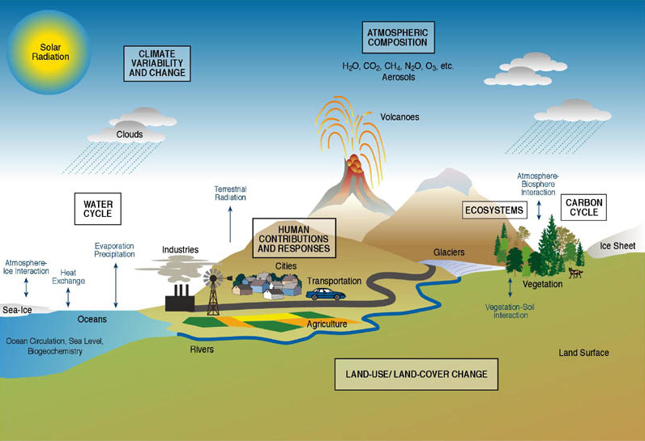
EOSDIS Comprises Data of the Whole Earth System
Atmosphere
  Winds & Precipitation
  Aerosols & Clouds
  Temperature & Humidity
  Solar radiation
Ocean
  Surface temperature
  Surface wind fields & Heat flux
  Surface topography
  Ocean color
Cryosphere
  Sea/Land Ice
  Snow Cover
Land
  Cover & Usage
  Soil Moisture
  Topography & elevation
  Temperature
Human Dimensions
  Population & Land Use
  Human & Environmental Health
Notes:
image: www.agci.org/
FEL

Slide 9
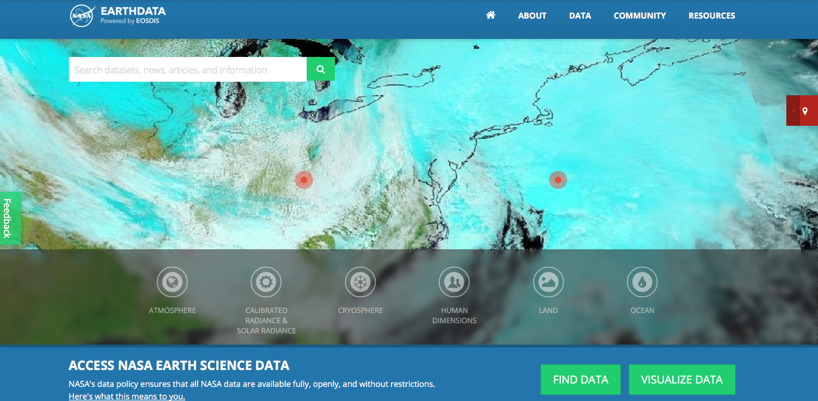
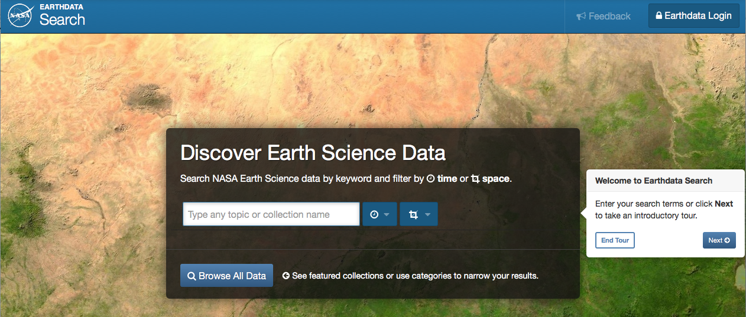
Looking for Earth Science data?
earthdata.nasa.gov
search.earthdata.nasa.gov
www.facebook.com/NASAEarthData
twitter.com/NASAEarthdata

Slide 10
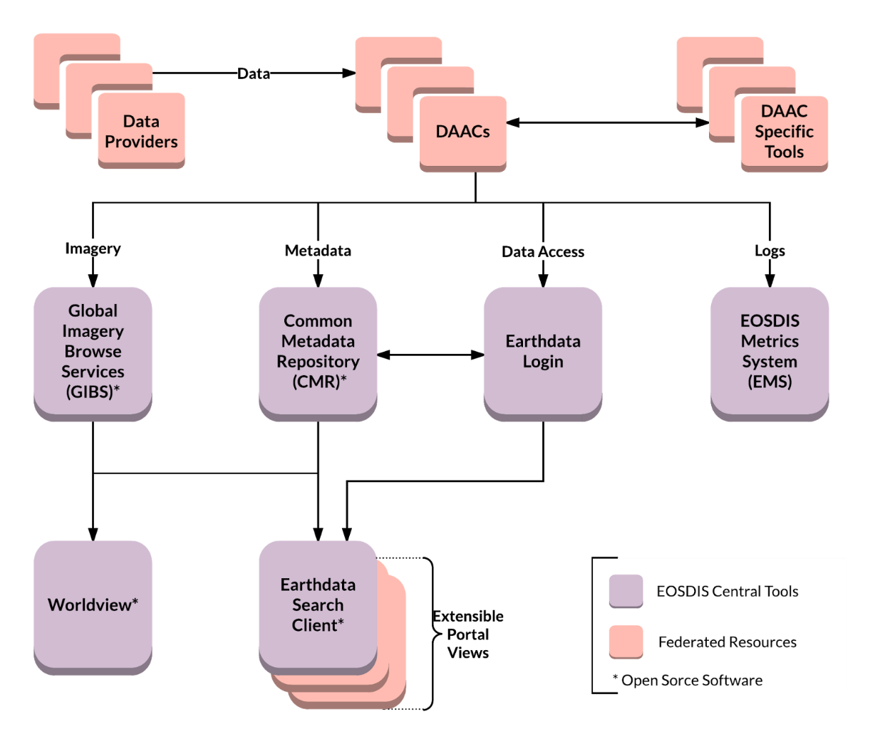
EOSDIS Core Services
Open Data APIs and Free Data Download
Open Service APIs
Open Source Clients
Notes:
Common discovery and visualization tools and services spanning all DAACs and SIPS to improve the discoverability, access and usability.
Open API architecture allows application developers maximum flexibility to “mix-and-match” services. Supports multiple
Interfaces with international organizations and U.S. government agencies to “federate” NASA metadata into their systems.

Slide 11
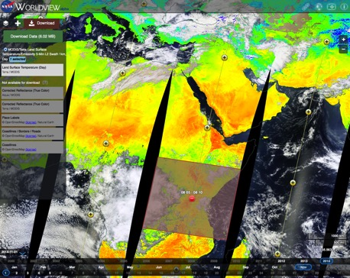
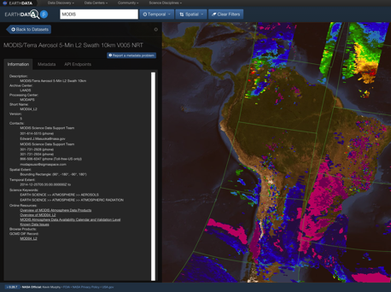
EOSDIS Data Access
Role Centralized Reusable Capabilities
Earthdata: The EOSDIS website https://earthdata.nasa.gov will increase visibility to the interdisciplinary use of data and demonstrate how data are used.
High Performance Data Search and Discovery
  Common Metadata Repository (CMR): Provide sub-second search and discovery services across the Sentinel and other EOSDIS holdings.
  Earthdata Search Client: Data search and order tool https://search.earthdata.nasa.gov
Imagery and Data Visualization Tools
  Global Imagery Browse Services (GIBS): full resolution imagery in a community standards-based set of imagery services
  Worldview: highly responsive interface to explore GIBS imagery and download the underlying data granules https://earthdata.nasa.gov/labs/worldview/
  Giovanni: Quick-start exploratory data visualization and analysis tool
Near Real-Time Capabilities: Provided by “LANCE” (Land Atmosphere Near real-time Capability for EOS) which produces products within < 3 hours of observation. Near real-time capabilities are co-located with the standard science production facilities.
EOSDIS Metrics System (EMS): collects and reports on data ingest, archive, and distribution metrics across EOSDIS
Earthdata Infrastructure (EDI DevOps): platform for requirement management, code development, testing and deployment to operations
User Support Tool (UST): user relationship management and issue resolution (Kayako)
Earthdata Log-in (User Registration System): provides a centralized and simplified mechanism for user registration and account management for all EOSDIS system components.

Slide 12
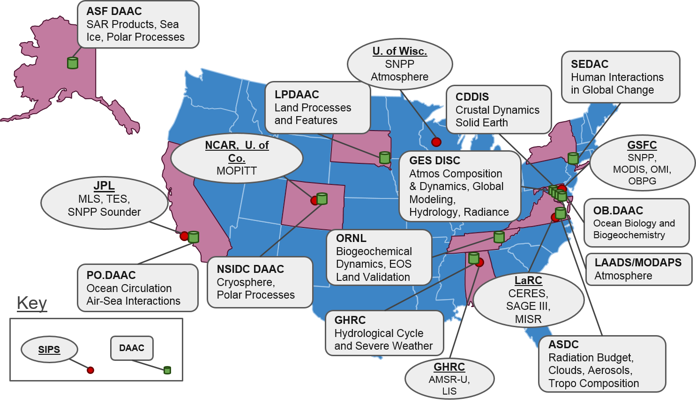
EOSDIS Components
Distributed Active Archive Centers (DAACs) , collocated with centers of science discipline expertise, archive and distribute standard data products produced by Science Investigator-led Processing Systems (SIPS)
1
6
12

Slide 13
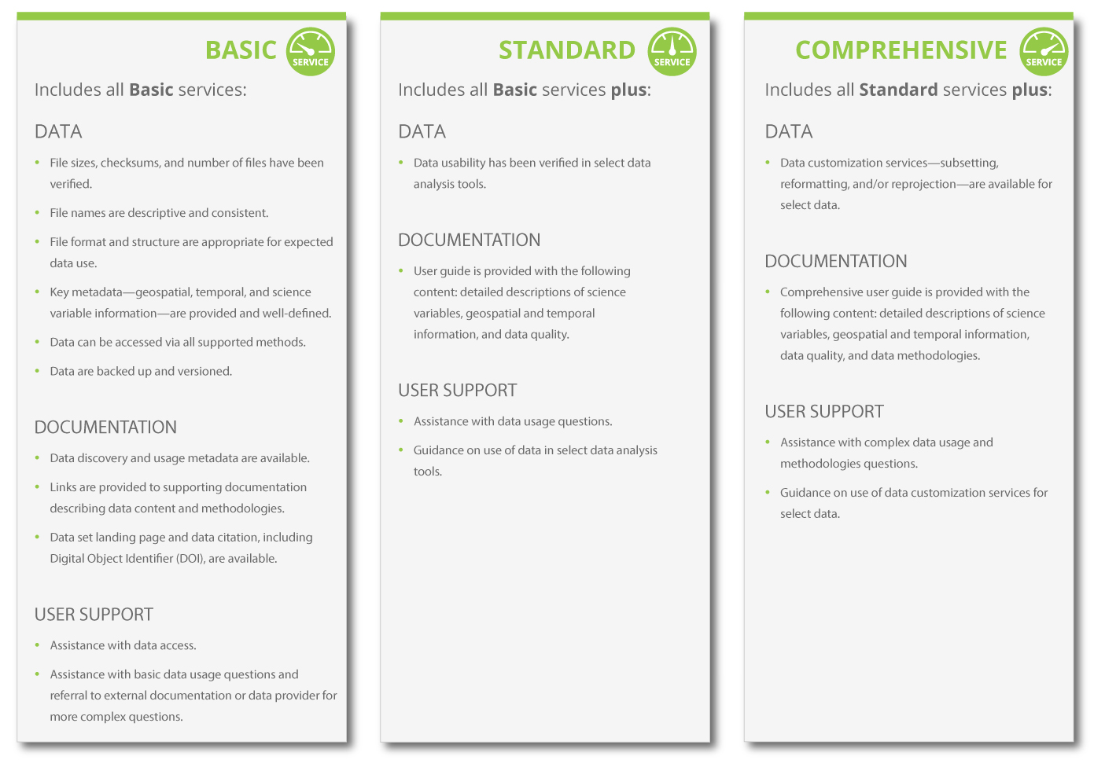
EOSDIS Levels of Service
To be cost efficient, not every dataset gets the same level of service

Slide 14
Cloud Transition

Slide 15
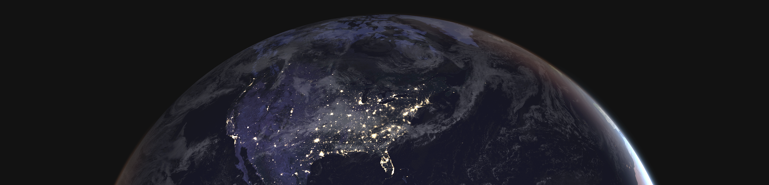
Improve the efficiency of NASA’s data systems operations – continues free and open access to data
Prepare for planned high-data-rate missions
Increase opportunity for researchers and commercial users to access/process PBs of data quickly without the need for data management
Transparent/extendable open source processing framework
Earthdata Cloud

Slide 16
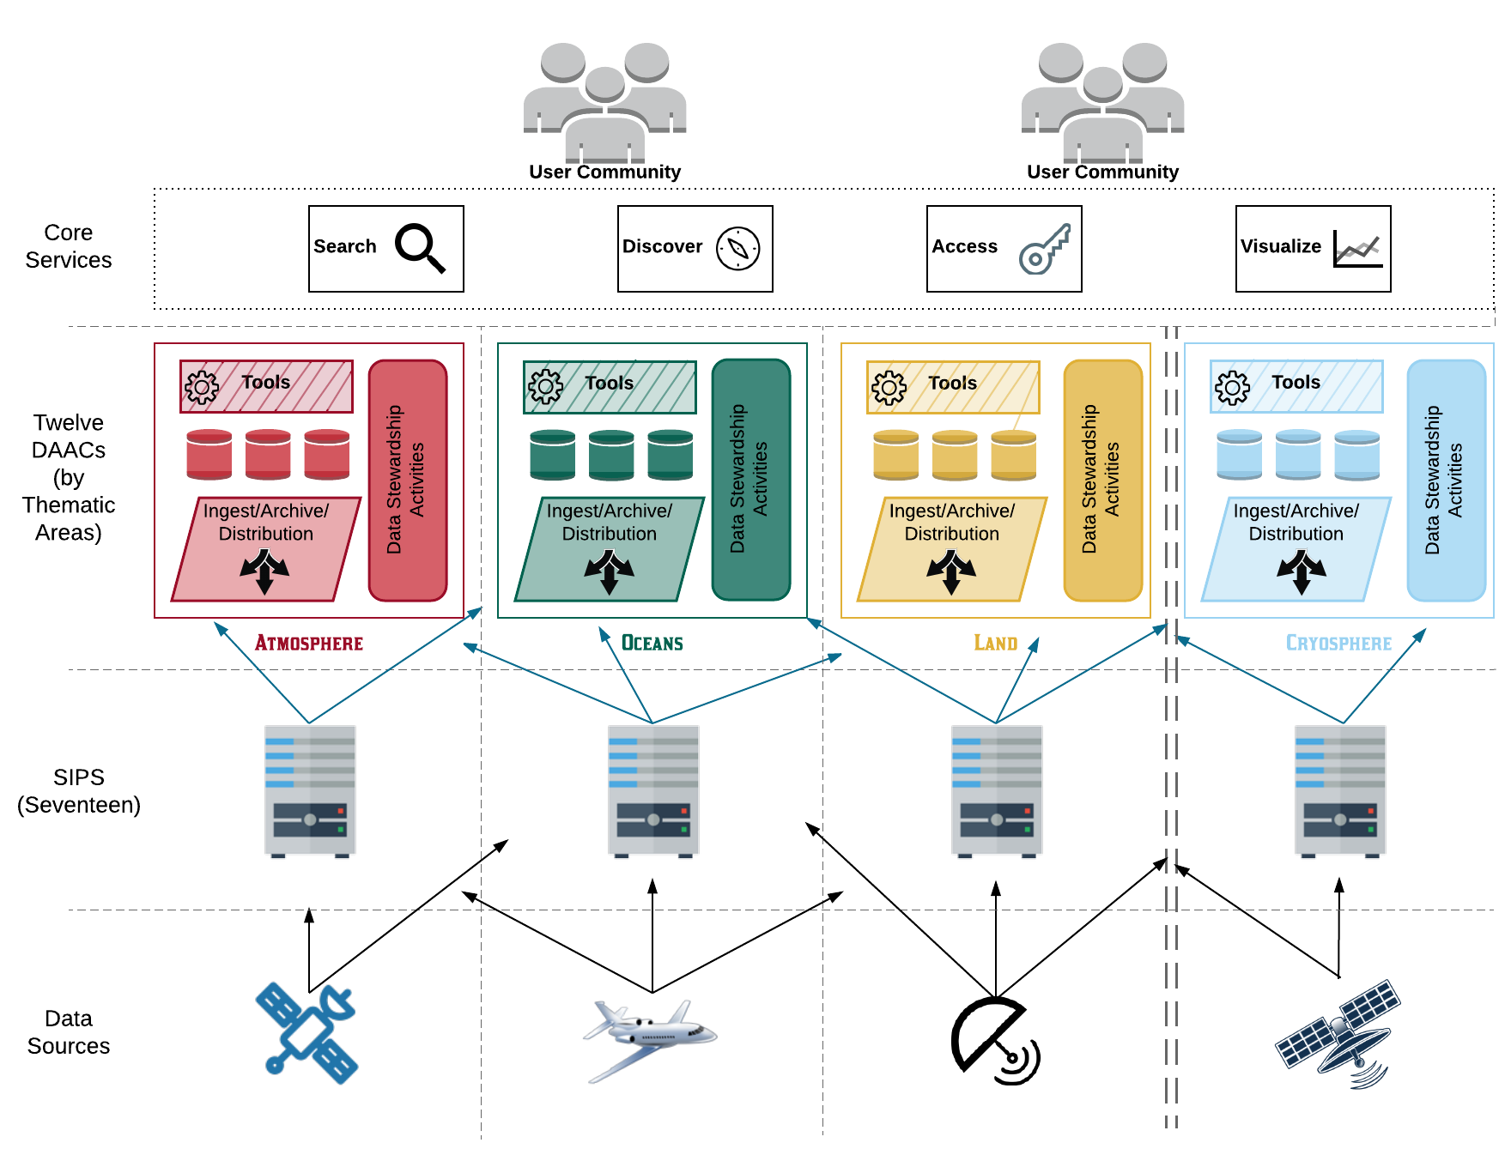
Current Architecture
Characteristics (+)
Characteristics (-)
Optimized for archive, search and distribution
Uneven levels of service and performance
Expert user support
Significant time to coordinate interfaces
Easily add new data products and producers
Limited on-demand product generation and end-user processing capabilities
Predictable
Duplication of storage
Duplication of services and software

Slide 17
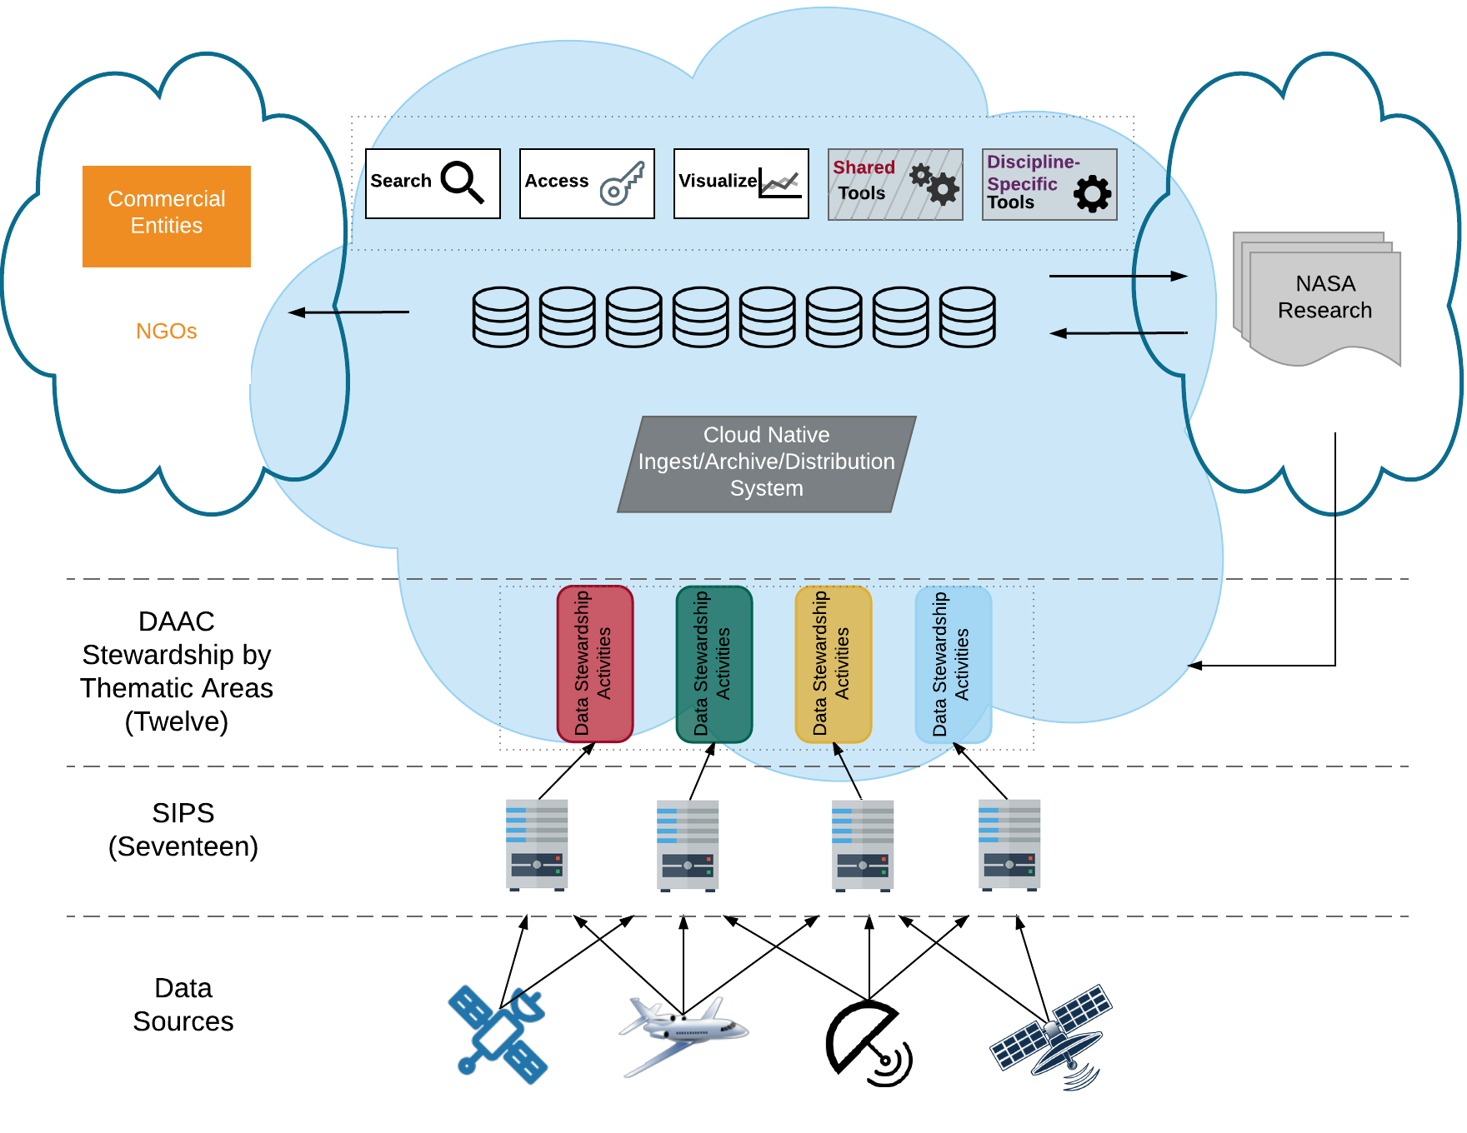
Simplified Commercial Cloud Architecture
Characteristics (+)
Characteristics (-)
Processing next to data – buy by the yard for anyone
Development coordination
Cost management
No duplication of data - Data available to all DAACs and users
Security, ITAR, SBU, EAR99
Expert user support
Business processes and skillsets
Easily add new data producers
Vendor lock-in
Apply new technology more easily (e.g. machine learning)
Developing an architecture that will allow us to efficiently provide for the larger missions

Slide 18
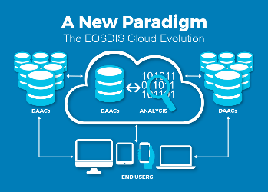
Earthdata Cloud Accomplishments
Designed and deployed a custom built cloud optimized platform (NGAP – NASA Compliant General Application Platform) which provides highly flexible cloud native infrastructure, NASA compliant IT Security controls, networking services, and business cost control in Amazon Web Services (AWS).
Developed and deployed a cloud optimized software, “Cumulus”, for performing Earth science data ingest, archive, and distribution capabilities to support all EOSDIS missions
Developed and deployed a customized “egress breaker” and “egress throttle”
Provided Earthdata Cloud access to 7 Distributed Active Archive Centers (DAACs) with NGAP to begin the process of data and tool migration to the cloud
Two key EOSDIS elements now running in Amazon Web Services (AWS) are the Common Metadata Repository (CMR) and Earthdata Search. The CMR is the central repository for NASA Earth science metadata and enables sub-second searches through the entire EOSDIS archive. Earthdata Search is the primary application developed by EOSDIS for data search and discovery. Global Imagery Browse Services (GIBS), which provides access to over 400 satellite imagery products that can be viewed using client applications such as EOSDIS Worldview, is expected to be the next EOSDIS application to evolve to the cloud.

Slide 19

Prioritizing EOSDIS Data Products For Cloud Migration
Tier 1 Factors | Prioritization Factor in Migration
End User Value | Dataset Popularity
 | Length of Observation History
 | Interoperability with other products
 | Product Level
 | Identified Level of Service
End User Value / HQ Prioritization | Existing Migration Plans
HQ Prioritization | International Collaboration Opportunity
 | Legacy Technology Pressure (retiring older systems)
 | Probability of SIPS/SDS migration to cloud
Cost Factors | Cloud Storage Cost
 | Cloud Egress Cost
 | On-Premise Cost
 | Predictability of Future Costs
 | On-going Operations Costs
Effort to Implement | Complex processing pipeline
 | Rapid Turnaround
"Fitness" for Cloud Use | Available Services
 | Availability of Algorithms
 | Multi-DAAC Usage
 | Interdisciplinary Usage
 | Opportunity for new Algorithm Development
 | Past Usage Patterns
Risk to Migrate | Data Security Requirements
 | Long-term Commitments
 | Ease to Exit from Cloud
 | Data Mobility
In addition to SWOT and NISAR, we are defining a mechanism for selecting high priority datasets to use commercial cloud technology for data management (ingest, archive, process and distribution).

Slide 20
New Missions
Designated for EOSDIS
Missions | Launch Date | Daily Data Volume GB/day | DAAC(s)
GRACE FO | May 22, 2018 (LAUNCHED) | 2 | PO.DAAC
ECOSTRESS on ISS (EVI-2) | June 29, 2018 (LAUNCHED) | 1,061 | LPDAAC
ICESat-2 | September 15, 2018 (LAUNCHED) | 893 | NSIDC
GEDI on ISS (EVI-2) | Dec 5, 2018 (LAUNCHED) | 187 | LPDAAC, ORNL DAAC
OCO-3 on ISS | May 4, 2019 | 75 | GES DISC
TROPICS (EVI-3) | January 1, 2020 | 74 | GES DISC
MAIA (EVI-3) | September 2020 | 77 | ASDC DAAC
Sentinel-6A | November 13, 2020 | 806 | PO.DAAC, GES DISC
CLARREO-PF on ISS | March 2021 | 385 | ASDC DAAC
SWOT | September 24, 2021 | 21,762 | PO.DAAC
JPSS-2 | Nov 2021 | 1,700 | GES DISC, OB.DAAC, LPDAAC, NSIDC, LAADS, ASDC DAAC
TEMPO (EVI-1) | Dec 2021 | 1,700 | ASDC DAAC
NISAR | NET Jan 30,2022 | 72,800 | ASF DAAC
GeoCarb (EVM-2) | Jun 30, 2022 | 636 | GES DISC
PACE | Nov 2022 | 1,852 | OB.DAAC
EMIT | June 15, 2021 | 923 | LPDAAC
PREFIRE | 2021 | 19 | ASDC DAAC
TOTAL |  | 105 TB/day

Slide 21
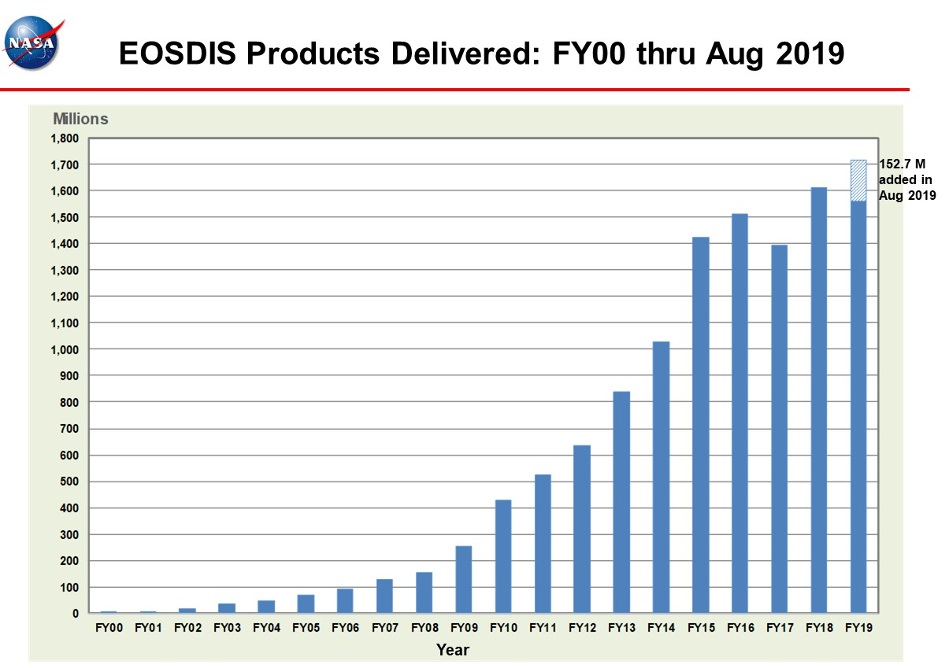

Slide 22
