Slide 1

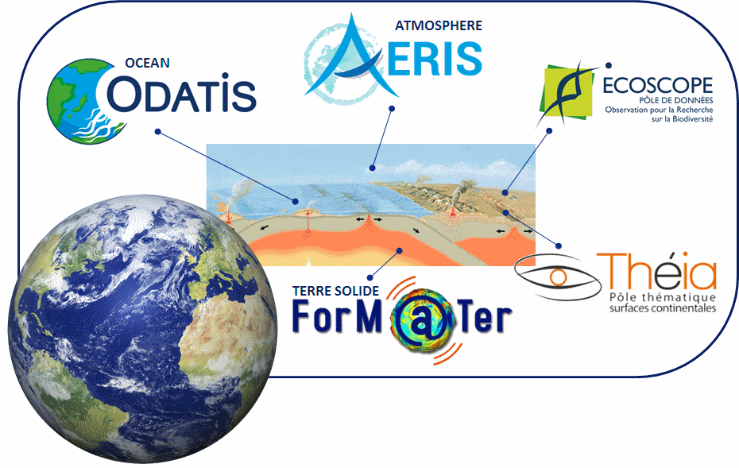
CNES agency report
WGISS meeting #48
Hanoi - 10 October 2019
French Research Infrastructure ‘Data Terra’
Richard Moreno
CNES

Slide 2
French Research Infrastructure ‘Data & Services for the Earth System’

Slide 3
French Research Infrastructure ‘Data & Services for the Earth System’

Slide 4
French Research Infrastructure ‘Data & Services for the Earth System’

Slide 5
French Research Infrastructure ‘Data & Services for the Earth System’

Slide 6
French Research Infrastructure ‘Data & Services for the Earth System’

Slide 7
French Research Infrastructure ‘Data & Services for the Earth System’

Slide 8
French Research Infrastructure ‘Data & Services for the Earth System’
Data Terra RI
A few figures (2019)
    4 Data Hubs -> soon 5
    20 Data centres -> soon 30
    30 Scientific Expertise Consortia
    170 FTE / 350 scientists, engineers & data scientists from 30+ organisms & universities
    50 000 To (2019) - 100 000 To (2021/22)

Slide 9
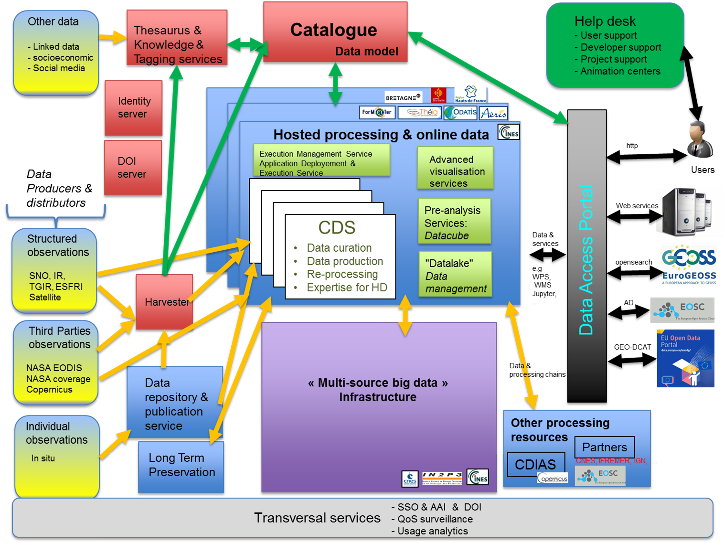


Slide 10
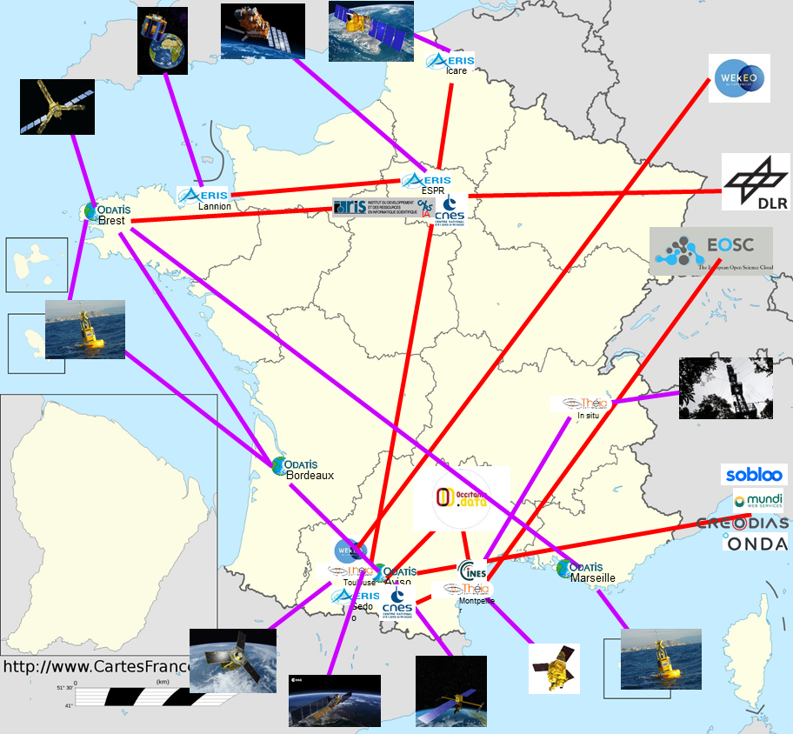
A continuum of infrastructures

Slide 11
