Slide 1
Roadmap and short term activities on interoperability of Data Cubes
Dr Robert Woodcock, CSIRO WGISS Vice Chair
9 October 2019

Slide 2
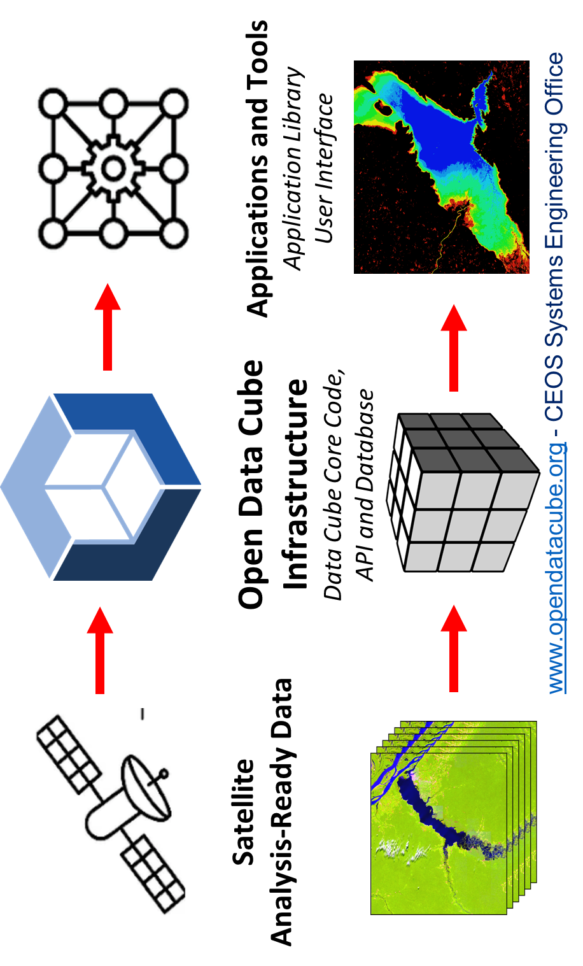
Simplified layer viewpoint
Infrastructure/resources
Storage
Compute
Notes:
Most CEOS FDA prototypes use a similar breakdown of the architectural layers for simplicity (ODC and ESA for example)
In practice they are federated service ecosystems with a variety of interface points at all levels available to users of all types – drawing that though is unhelpful to communication.
Unfortunately the simplified view also hides very important changes in the ecosystem.
We can see a few though – practically all CEOS FDA pilots include the three interface types shown:
Web based users interfaces – not just data discovery, view and download. Full analytics capabilities for common use-cases (e.g. NDVI, Carbon, Hazards). These are often themed (e.g. ESA Thematic Exploitation Platforms is an entire family of themed web portals with common with shared components and data sources.
Jupyter notebooks – Interactive data analysis directly available to users. Opens up a whole new range of possible applications
APIs – a much lower level interface to both the data and analytical capabilities. Allows for direct integration with other third party applications and development.

Slide 3
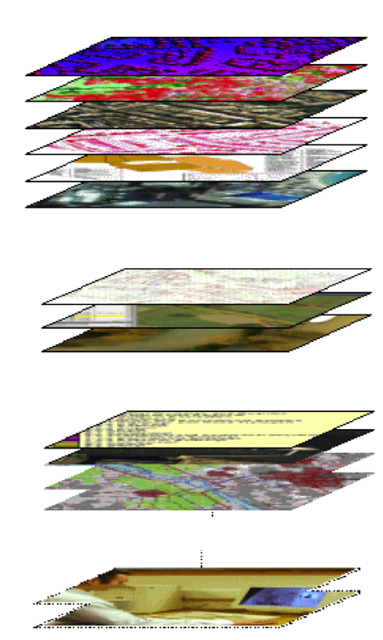
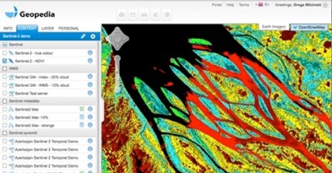
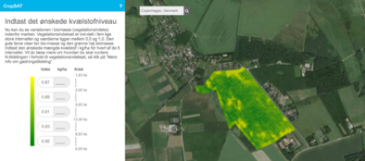
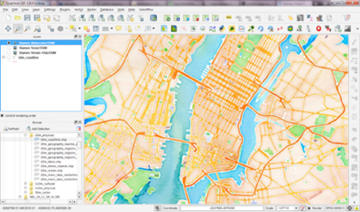
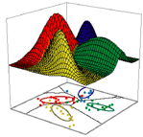
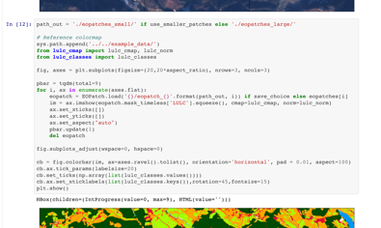
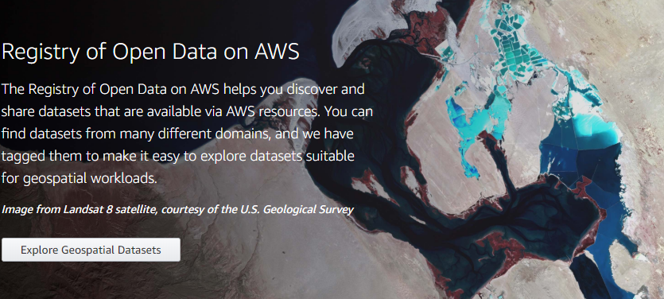
Access viewpoint
Open EO data - Sentinel-1, Sentinel-2, Landsat, etc.
OGC W*S
Interoperability
Measurement interoperability with ARD
Access
Analytics
Cloud GIS
WMTS
Commercial EO data – Planet,...
Web / Mobile apps
WMS
Aerial imagery (drone, plane)
WCS
API
Desktop (QGIS,, ArcGIS…)
Other raster data
Machine learning
Scripting (R, Python, ENVI…)
European Data Cube Facility Service (DCFS)

Slide 4
Access Viewpoint Data in Cloud

Slide 5
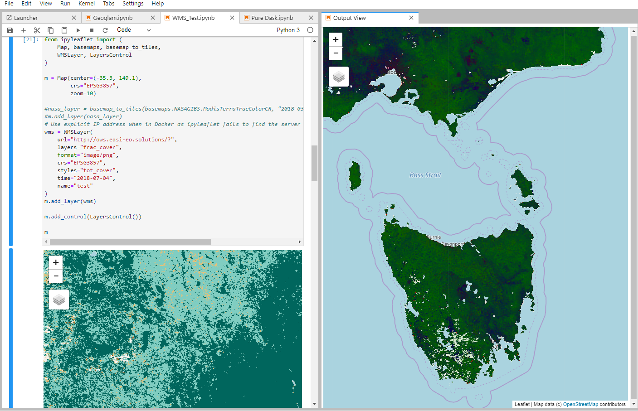
Analytics viewpoint
Data cubes..lots of data cubes
Analytics hubs
Exploitation platforms
Python/R, QGIS
Xarray data model
Jupyter
CSIRO Earth Analytics Science and Innovation Hub
Notes:
On the fly data access
Interactive analysis
APIs for analysis and visualisation
Similar but different
Scalable compute – Cloud, HPC, and even PC
Analytics (Cloud, Data hubs/Exploitation platforms, Service providers (DIAS,AWS), DataCubes (ODC, ESA Cubes, Pangeo)),
Examples include:
Open Data Cube
European Data Cube Facility Service
ESA PDGS Data Cube

Slide 6
Some choices might matter
Direct data access
Compatibility (ARD, Geotiff)
Analytics APIs
Services like OGC WPS
Direct compute access: python Dask
Cloud Compute Ready Data
COGS – Cloud optimised geotiffs
NetCDF in the Cloud
Zarr – Cloud native array storage

Slide 7
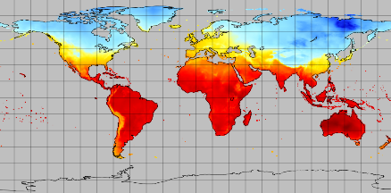
S3netCDF4: netCDF on object store
Files split into CFA-netCDF sub-array files using the variable splitting algorithm
Object Store
S3 API
Sub array file
S3netCDF
Master array file
Sub array file
Sub array file
Local cache
Sub array file
Streaming CFA-netCDF files to / from S3 object store
Zarr, CSIRO s3aio, hdfcloud – all similar
Notes:
Use (ARD and Computer Ready data formats – Zarr, netcdf Cloud, etc

Slide 8
Roadmap – Next steps
Three types of interoperability
CEOS data source to Data Cube
How all DCs interact with source CEOS data and discovery services
DC data preparation services?
Algo to Data?
Data Cube APIs
Do we want interoperability at this level?
What does it mean to have a standard EO API? Pangeo, openeo?
R/Python?
Data Cubes exposed via OGC Standards
Analytics as WPS – similar issue to EO algorithm API
Roadmap:
For each, explore what is common (e.g. xarray, Cloud optimised formats)
Define interoperability for each type (e.g. expose common algorithms as end points, or expose a detailed API, or just common cloud-based data and ARD spec)
OGC Testbed input

