Slide 1
Progress on the Open Data Cube
Dr Robert Woodcock, CSIRO WGISS Vice Chair
9 October 2019

Slide 2
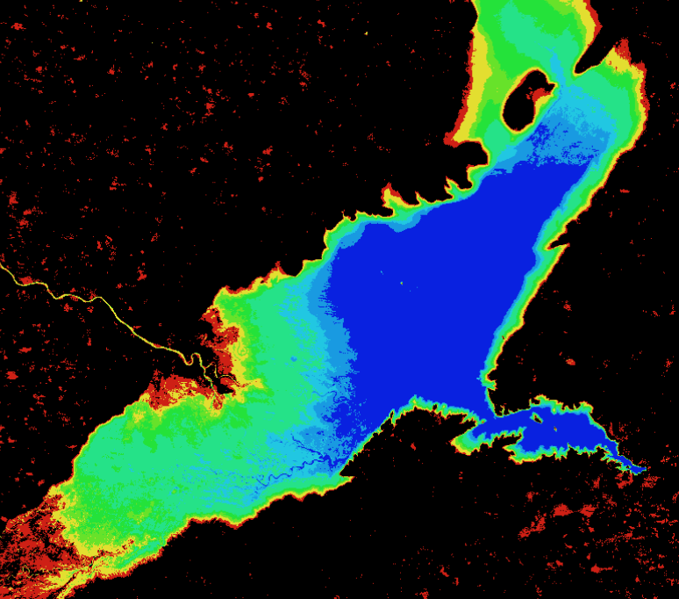
CEOS Open Data Cube
Satellite Analysis-Ready Data
Open Data Cube Infrastructure Data Cube Core Code, API and Database
Applications and Tools Application Library User Interface
www.opendatacube.org - CEOS Systems Engineering Office

Slide 3
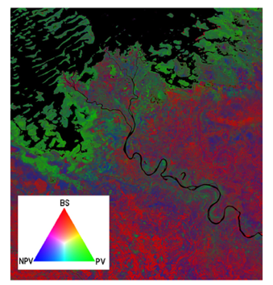
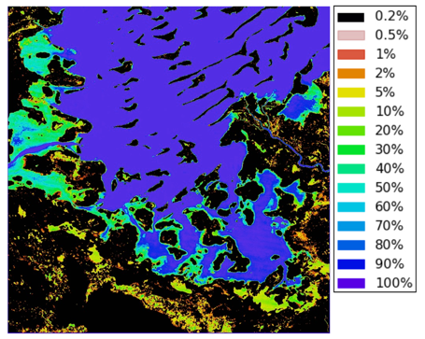
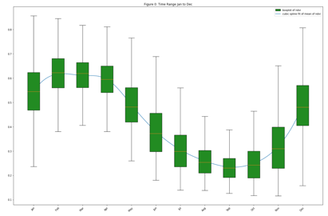
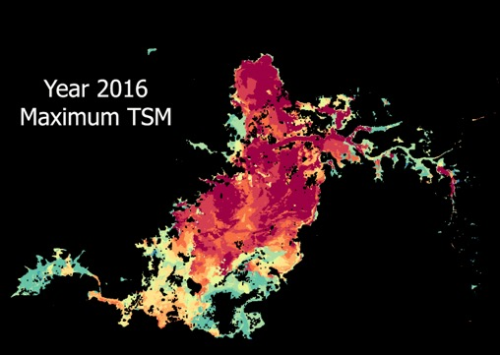
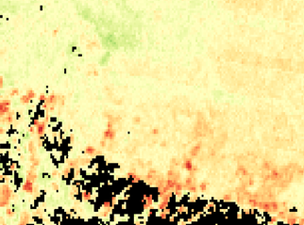
How can we use the Open Data Cube?
Cloud-free Mosaics: Recent Pixel, Median, Geomedian, Min/Max-NDVI
Spectral Indices: NDVI, NDBI, NDWI, SAVI, EVI, Fractional Cover
Land Classification: K-Means, Random Forest
Water: Landsat WOFS (Australia), Sentinel-1 WASARD (NASA), Landsat Water Quality (Australia) - Total Suspended Matter
Land Change: Spectral Threshold Anomaly, Coastal Change, PyCCD (USGS)

Slide 4
ODC – base technology
Python API
Xarray and Pangeo stack
Datacube.load() – Hides all the files, just pixels
Database – product and granuale metadata
Storage
COGS – compatibility, improved performance on Cloud over GeoTiff
CSIRO S3AIO (experimental, and deprecated) – fast!
Future -> Zarr, HDF+Zarr: Same approach as S3AIO, larger community
Data pipelines
ARD in the Cloud – CEOS ARD Strategy
CSIRO data pipelines automation – storage cache management

Slide 5
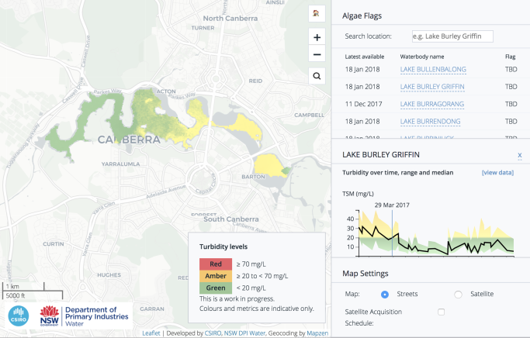
CSIRO’s Earth Analytics Science & Innovation (“EASI”) platform
Connecting Users and Industry to CSIRO science
Public-good applications
Develop and test new applications with BUs, Industry and SMEs
Partnerships and SMEs
Promote and connect ARD sources with CEOS partners
Marketplace engagement with SMEs
Training and Capacity building
ODC Training and Tailored deployments with regional partners
ODC Labs – hosted by CSIRO
R&D new features and functions
Algal bloom monitoring in Australian lakes
Scaling-up in 2019
Powered by

Slide 6
ODC Applications Library

Slide 7
Jupyter Labs

Slide 8
Terria-Cube Web Portal
Client side visualisation
Extensible
2 and 3D map visualisation
Time series capable
Datacube WMS auto scales under load
Fractional cover – 3 band RGB
Total Cover layer (brown one) is doing on the fly per pixel band math (no additional data)

Slide 9
Distributed processing with Dask

Slide 10
Architectural layers
Increasing unique organisational focus
Applications and Services
Portal application, Web services
Platforms
Service orchestration
Computation and Storage
Computation, Storage (virtual)
Physical Hardware
CPU, Memory, Network

Slide 11
Deployment options via Containers
HPC available now
Pawsey – Singularity (Docker for HPC) using image from EASI Hub
Amazon Kubernetes Services (AWS) available now
Data in S3 + scalable EC2
Dask distributed processing
Automating data pipelines (order from ESPA, etc)
Desktop – available now
Linux, Mac, Windows
Access CSIRO EO data shares
Easy install via Docker containers
https://github.com/csiro-easi > easi-training-pc
Notes:
AWS – projects share cost core resources

Slide 12
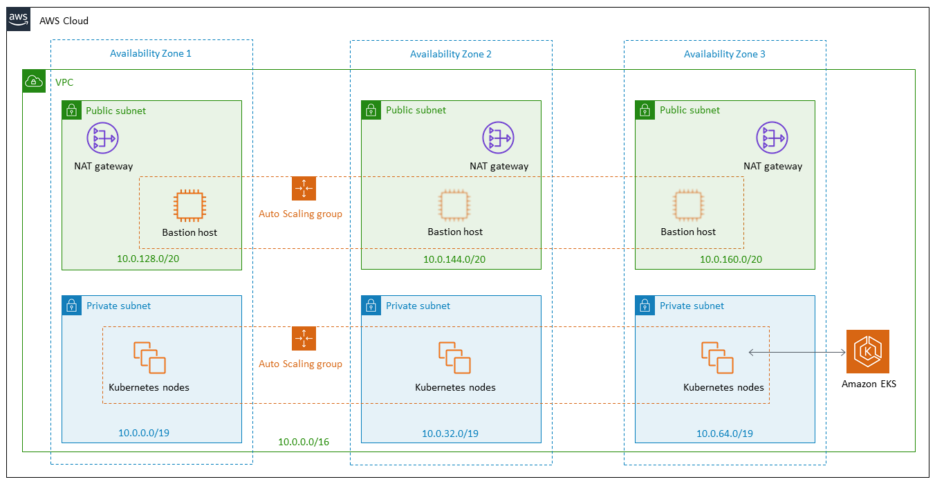
Terraform setup AWS Networking, EC2 instances…

Slide 13
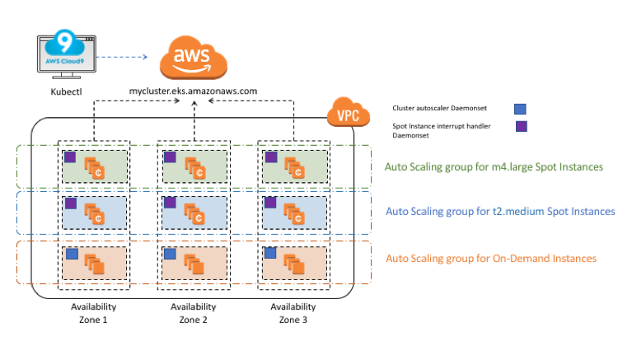
Terraform to setup AWS Kubernetes

Slide 14
User 1
User 2 (analysis)
User 100
Load balancer 1
Load balancer 2
Jupyter Lab
Jupyter Lab
Jupyter Hub
Analytical Process
Analytical Process
datacube WMS
datacube WMS
Analytical Process
datacube WMS
datacube WMS
datacube WMS
datacube WMS
datacube WMS
datacube WMS
ODC DB
datacube WMS
ODC DB
Datacube WMS
Analytical Process
Analytical Process
Analytical Process
Analytical Process
Analytical Process
Datacube WMS
Analytical Process
Storage
Storage
EASI Hub under a 100-user load. Compute node colour is pricing model: Yellow – reserved, Light Green – Spot, Dark Green – On Demand

Slide 15
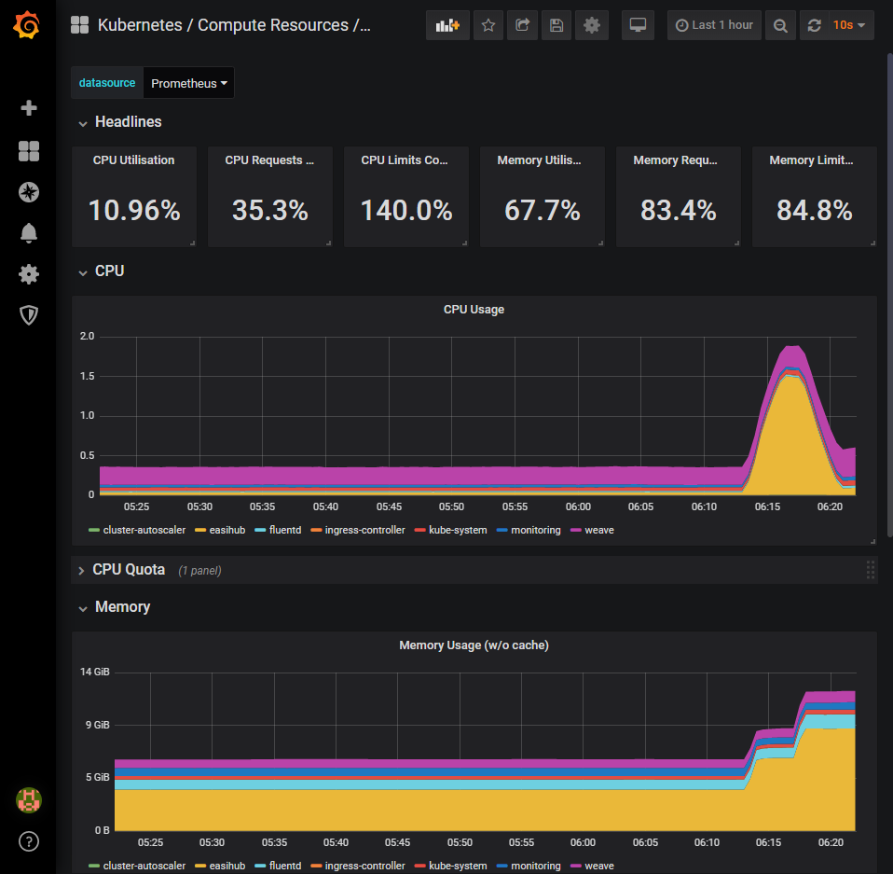
Monitoring
Prometheus and Grafana

Slide 16
Detailed Live Monitoring

Slide 17
DevOps – now and future
Terraform Cloud
CI/CD for Cloud infrastructure
Policy enforcement for teams
GitOps
Now: GitHub, TravisCI, Weaveworks Flux
Future: Jenkins X (K8s native)?
DC Applications Library
Terria Cube in K8s

Slide 18
Dask + KubeFed + WGISS IDN = Algorithms to Data
Can be different Cloud providers

Slide 19
Where can I find the Open Data Cube?
ODC Website:
https://opendatacube.org
ODC Documentation
https://opendatacube.readthedocs.io/en/latest/
ODC GitHub:
https://github.com/opendatacube
CEOS ODC Web-based User Interface:
http://tinyurl.com/datacubeui
ESRI Online Demo Ghana Sentinel-1:
http://tinyurl.com/ardcs1demo

