Slide 1
Progress on the ESA PDGS DataCube
Andrea Della Vecchia (Ransdstad), Simone Mantovani (MEEO)
Damiano Guerrucci, Mirko Albani (ESA)
CEOS WGISS#48
9th October 2019

Slide 2
Outline
Objectives and background
ESA PDGS Data Cube
  Use Cases
    EO Data Management
    In-Situ Data Management
    CEOS WGCV
  Demo
  Next Steps

Slide 3
ESA PDGS Data Cube Objectives
Brings the users to the data
Provides standardised and harmonised interfaces to manage EO and in-situ data
Innovative, and complementary, approach to access and visualize data
Permits on-the-fly pixel based processing and bulk asynchronous processing
Integration into ESA Collaborative Environment

Slide 4


Operational interface
ESA
Query and service requests
External
Conceptual Model
Data access interface
Operational Data Access
Web User Interfaces
Web User Interface for pixel-based access, analysis and processing
Web User Interface for granule-based discovery and/or retrieval
……….
International EO Information Page:
- CEOS IDN
Mission oriented GUI
  - SWARM
  - SMOS
  - Cryosat
  - External
External catalogue application
……….
ESA PDGS Data Cube GUI, VIRES GUI, etc…
ESA EO Information Page:
- ESA EO Gateway
Multi Mission GUI:
– ESA EOCAT
OpenSearch
(collections and granules)
Knowledge-Base Facility
Centralised Knowledge-Base Facility
Standard services request Interfaces (e.g., restful API)
OpenSearch
(collections
and granules)
Standardised Interoperable Interfaces
ESA PDGS DataCube in Operation
Thesauri Repository
Metadata management
Protocol for data access
(e.g., OGC, Open Datacube)
EO Data & Service Metadata Repository
Products Access Interface
Data Repositories
Data Repositories
Copernicus Data Repositories
ESA Missions Data Repositories
External Web Interface
Hosted Processing
External Web Interfaces
Standardised Interoperable Services Interfaces
IT Resources provided as services (IaaS, PaaS, SaaS)
TPMs
HMs
EEs
S-1
S-2
S-3
S-5
User Applications
ESA User Applications
Temporary
VM – Processors
Storage
VM – Browse Images Generation
VM – DataCube Engine/API

Slide 5


Operational interface
ESA
User Community
Query and service requests
External
Current Instantiation
Data access interface
Operational Data Access
Web User Interface for pixel-based access, analysis and processing
Web User Interface for granule-based discovery and/or retrieval
……….
International EO Information Page:
- CEOS IDN
Mission oriented GUI
  - SWARM
  - SMOS
  - Cryosat
  - External
External catalogue application
……….
ESA PDGS Data Cube GUI, VIRES GUI, etc…
ESA EO Information Page:
- ESA EO Gateway
Multi Mission GUI:
– ESA EOCAT
https://datacube.pdgs.eo.esa.int/
https://earth.esa.int/eogateway
https://eocat.esa.int/sec/#data-services-area
OpenSearch
(collections and granules)
Knowledge-Base Facility
Standard services request Interfaces (e.g., restful API)
OpenSearch
(collections
and granules)
Standardised Interoperable Interfaces
https://thesauri.eo.esa.int/thesaurus/en/
Thesauri Repository
Metadata management
ESA Operational Service
Protocol for data access
(e.g., OGC, Open Datacube)
EO Data & Service Metadata Repository
https://eocat.esa.int/opensearch/description.xml
Products Access Interface
https://esar-ds.eo.esa.int/oads/meta/ASA_IMP_1P/index/
https://smos-diss.eo.esa.int/oads/meta/SMOS_Open/index/
……
……
Data Repositories
https://scihub.esa.int/dhus/
Copernicus Data Repositories
ESA Missions Data Repositories
External Web Interface
Standardised Interoperable Services Interfaces
External Web Interfaces
Data management
IT Resources provided as services (IaaS, PaaS, SaaS)
TPMs
HMs
EEs
S-1
S-2
S-3
S-5
User Applications
ESA User Applications
Temporary
VM – Processors
Storage
VM – Browse Images Generation
https://datacube.pdgs.eo.esa.int/wcs?service=WCS&request=GetCapabilities
VM – DataCube Engine/API

Slide 6
Outline
ESA PDGS Data Cube
  Use Cases
    EO Data Management
    In-Situ Data Management
    CEOS WGCV
  Demo
  Next Steps

Slide 7
UC1: EO Data Discovery, Visualization and Pixel-based Access
UC2: EO Service Discovery and Processing

Slide 8
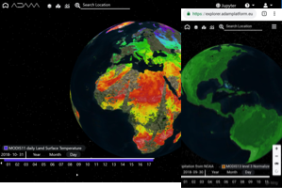





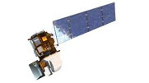
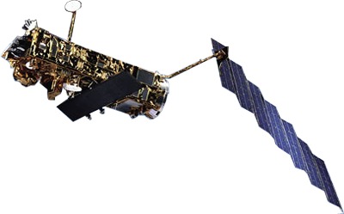
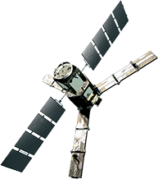
Functional View
Jupyter Notebook
Web based GUI
REST API
Visualization layer
Standardised data access interfaces allow connecting a wide range of user interfaces
Datacube Engine/API VMs
The deployment of DC-DAS in front of each data source enables effective pixel-based access services
DC-DAS
ESA
Third Party Missions
ESA
Heritage Missions
ESA
Earth Explorer
In-Situ: ACIX and
RadCalNet
Data layer
Data remain at their own location (multiple data centers) with the original data format

Slide 9




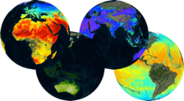
F E D E R A T I O N
Web based GUI
Jupyter Notebook
CLI / REST API
Visualization layer
Standardised data access interfaces allow connecting a wide range of user interfaces
Datacube Engine/API VMs
The deployment of DAS in front of each data source enables effective access services
DAS
DAS
DAS
DAS
DAS
DAS
DAS
Data layer
Data remain at their own location (multiple data centers) with the original data format
Mission-specific data
Thematic data
Other geospatial data

Slide 10
Outline
ESA PDGS Data Cube
  Use Cases
    EO Data Management
    In-Situ Data Management
    CEOS WGCV
  Demo
  Next Steps

Slide 11
UC2.1: In-situ / EO Data Discovery, Visualization and Pixel-based Access
  - Atmospheric Correction Inter-Comparison Exercise (ACIX)
  - Radiometric Calibration Network (RadCalNet)
UC3.1: In-situ / EO Service Discovery and Processing (on-going)
  - Atmospheric Correction Inter-Comparison Exercise (ACIX)
  - Customized UI to support AOT/WV/SR inter-comparison
  - Jupyter notebook to support live coding / sharing

Slide 12
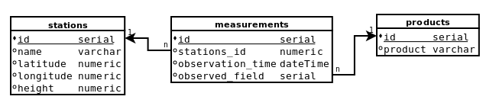
EO and In-situ Data Management
Preferred
Optional
ingestion
SQL
In-situ
rasterization
EO
WCS
Pre-processing (e.g., ARD):
Re-projection
Re-sampling
Format conversion
OpenSearch

Slide 13
Outline
ESA PDGS Data Cube
  Use Cases
    EO Data Management
    In-Situ Data Management
    CEOS WGCV
  Demo
  Next Steps

Slide 14
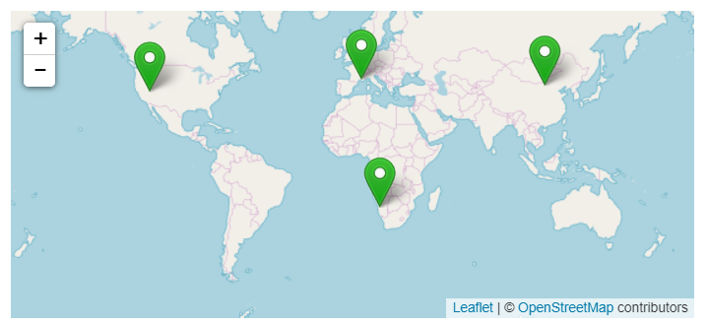
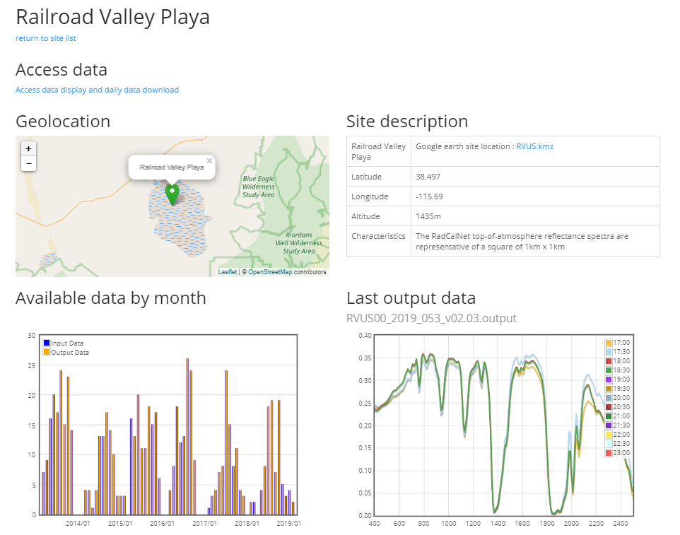
RadCalNet Exercise https://www.radcalnet.org/#!/
Support post-launch TOA radiometric calibration and validation of optical EO data
Ground nadir-view reflectance measurements (converted to TOA), and atmospheric measurements such as surface pressure, columnar water vapour, columnar ozone, aerosol optical depth and the Angstrom coefficient, over 4 sites
Nadir-view top-of-atmosphere reflectance at 30 minute intervals from 9am to 3pm local standard time at 10 nm intervals from 400 nm to 2500 nm

Slide 15
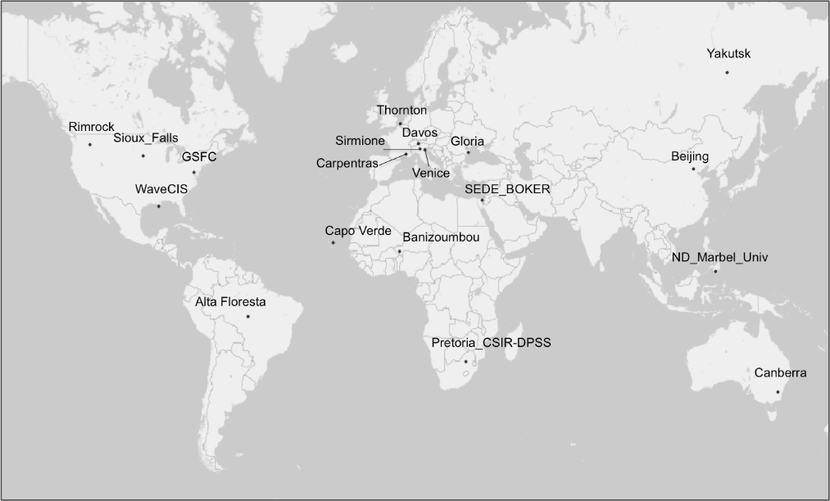
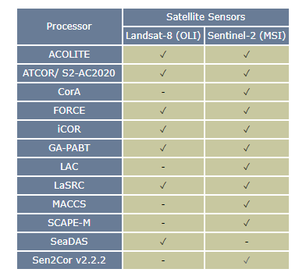
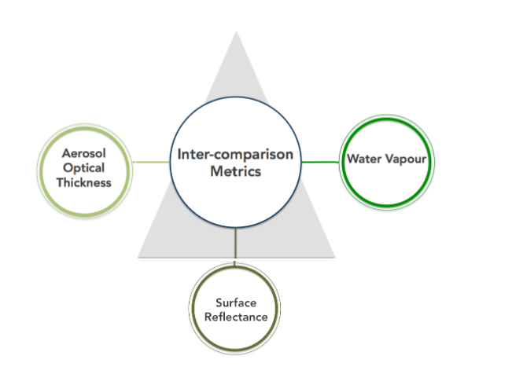
ACIX Inter-Comparison Exercise http://calvalportal.ceos.org/projects/acix
Inter-comparison of BOA radiometric calibration processors
AERONET stations over 19 sites to perform in-situ measurements of AOT, WV and SR
Landsat-8 and Sentinel-2 acquired over sites and converted to BOA with selected processors, to generate AOT, WV and SR
Inter-comparisons performed for all the products on image subset of 9km x 9km centred on every AERONET sites

Slide 16
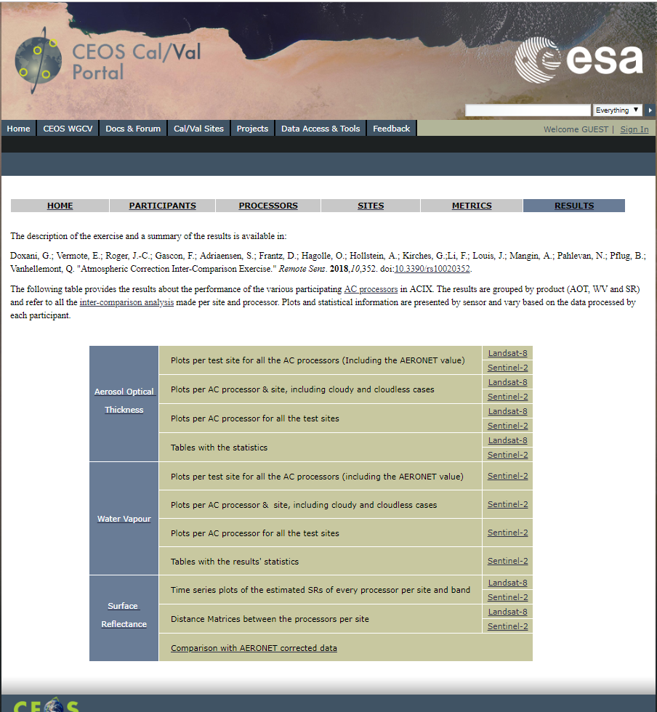
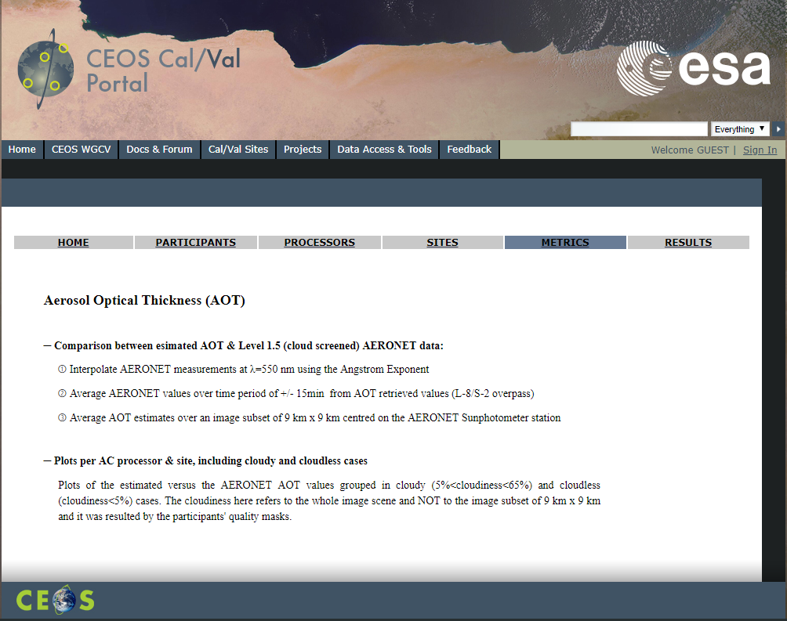
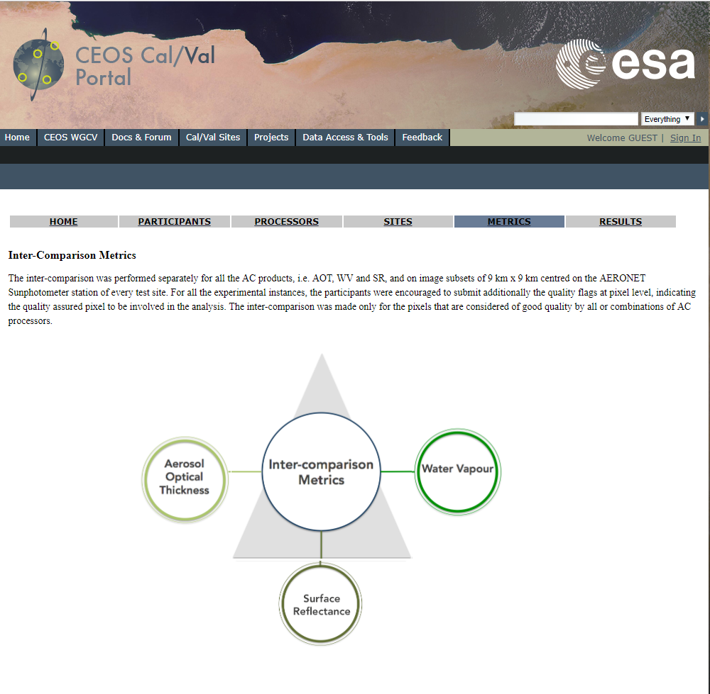
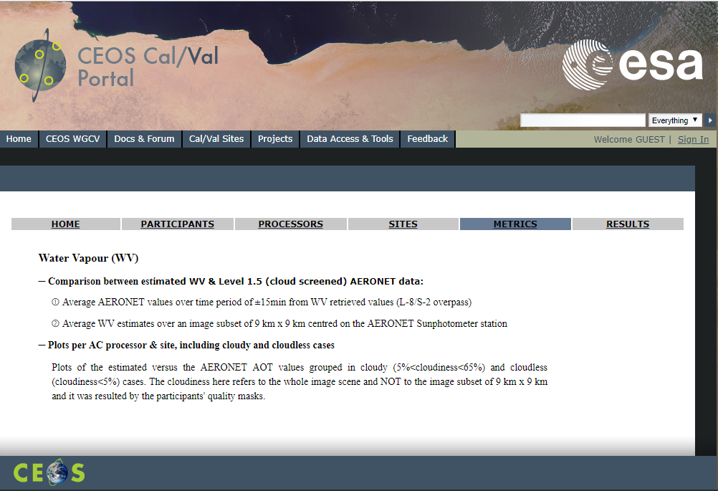
ACIX Processing

Slide 17
Outline
ESA PDGS Data Cube
  Use Cases
    EO Data Management
    In-Situ Data Management
    CEOS WGCV
  Demo
  Next Steps

Slide 18
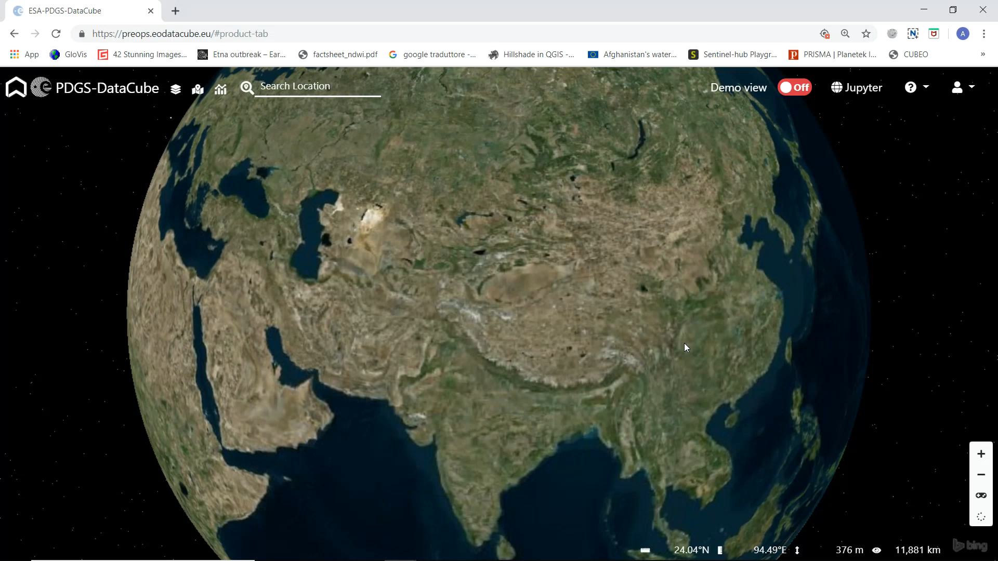

Slide 19
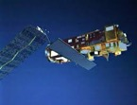
ACIX/RadCalNet Lesson Learnt
Web based GUI
Jupyter Notebook
Data Preparation: in-situ and EO Level 2 data are indexed and registered in the data cube, preserving both radiometric and geometric properties
Data Access: DAS shall offer access to both EO and In-situ data via unified interface (i.e. WCS)
Data Processing: Jupyter allows the users to perform inter-comparison scripts, sharing the code with authorise users, and accessing always the same data via WCS server.
PROs
Centralised data repository, replacing scattered ftp servers
Harmonised and standardised online data access interface, permitting data download
Reproducibility of inter-comparison exercises (via Jupyter notebook), restricted to authorised users
Easy sharing of algorithms and results
DAS
Landsat-8/Sentinel-2
Data
In-Situ: ACIX and
RadCalNet

Slide 20
Outline
ESA PDGS Data Cube
  Use Cases
    EO Data Management
    In-Situ Data Management
    CEOS WGCV
  Demo
  Next Steps

Slide 21
Next Step – 2019
  Finalization of transfer into operation, supporting new ESA missions and SSO accounting/authorization
  Synergies with European Data Cube initiative (https://eo4society.esa.int/2019/05/21/european-data-cube-facility-service-an-eo-resource-factory/)
  Cooperation with CEOS WGISS / FDA teams:
    Action WGISS-47-13: Andrea/Rob to define with SEO a roadmap and short term activities on interoperability between ODC / HMDC / DCFS Data Cubes (e.g. Jupyter notebooks with Xarray API and WCS / WPS).
    Action WGISS-47-15: Andrea/Rob to define coordinated roadmap and short term activities on WGISS-WGCV Data Cubes (ESA and ODC DEA) and possibly demo to be shown at SIT TW in September 2019.
  Cooperation with WGCV team (TBD):
    ACIX II
    Land Product Validation Supersites

