Slide 1
Progress on the
Euro Data Cube
Philippe Mougnaud, Grega Milcinski
09/10/2019

Slide 2
Agenda
Project introduction
Euro Data Cube Services
Federation and standardization

Slide 3
Project introduction
The Euro Data Cube: an ESA contract for a European Industry Service
  The Data Cube Service shall contribute to a larger strategy beyond serving ESA exploitation activities
  The Service owner shall demonstrate the ambition to attract other customers, and become a major actor at the European Digital Marketplace
    Service portfolio / price list, Marketplace
    Enhance the service by “Hosting” third parties e.g. Data providers, Algorithm providers
    Establish partnership within the EO digital ecosystems (e.g. DIAS, TEPs)

Slide 4
Project introduction
Euro Data Cube contributes to the ESA’s “EO Exploitation Platforms” initiative, part of the “EO Science for Society” programmatic line:
  implements a Platform Service for higher-level data analytics
  utilizes tiers in EO Networks of Resources for storage and processing

Slide 5
Project introduction
Challenges for an “Horizontal” platform service
Service Owner is requested to demonstrate, how high volume datasets as the ESA heritage and the Sentinel global coverage can be affordable via a data cube service, without data replication also applying user-defined projection and gridding on-the-fly
User shall be able, while working on higher-level information / variables to trace back to the original product / data, validate his application / analysis
Support for 3rd party data/algorithm providers in focus - IPR protection and revenue sharing options
Service has to be cost efficient to move potential users from ad-hoc develop.

Slide 6
Project introduction
Standardisation with OGC being the target body
Service External Interfaces provided to follow OGC-defined standards i.e. for extracting data and for direct access by algo.programming language (i.e. API’s)
Contribute to further evolve/extend/foster OGC standards and the underlying data cube interfaces, allowing to enlarge outreach to the geographic community

Slide 7
Project introduction
Standardisation (cont.) & Federation
Contribute to the CEOS ODC open source initiative, providing an open source layer (at least for non-commercial use) for interfaces with other operational instances
Provide support to ESA (customised) regional / thematic data cube instances deployment
Enable data cube instances synchronisation (among contractor deployed instances)

Slide 8
Project introduction
24 months / project Kicked-off in April 2019
Phase 1 of 12 months / with intermediate releases already in 2019
  Service deployment i.e. enhancement and integration of consortium solutions : Sentinel Hub / Xcube
  Pre-operations
  Participation to OGC
  Use Cases identification & definition
  Partnership exploration & creation
Phase 2 of 24 months
  Operations
  Service evolution including OGC and Federation

Slide 9









Slide 10
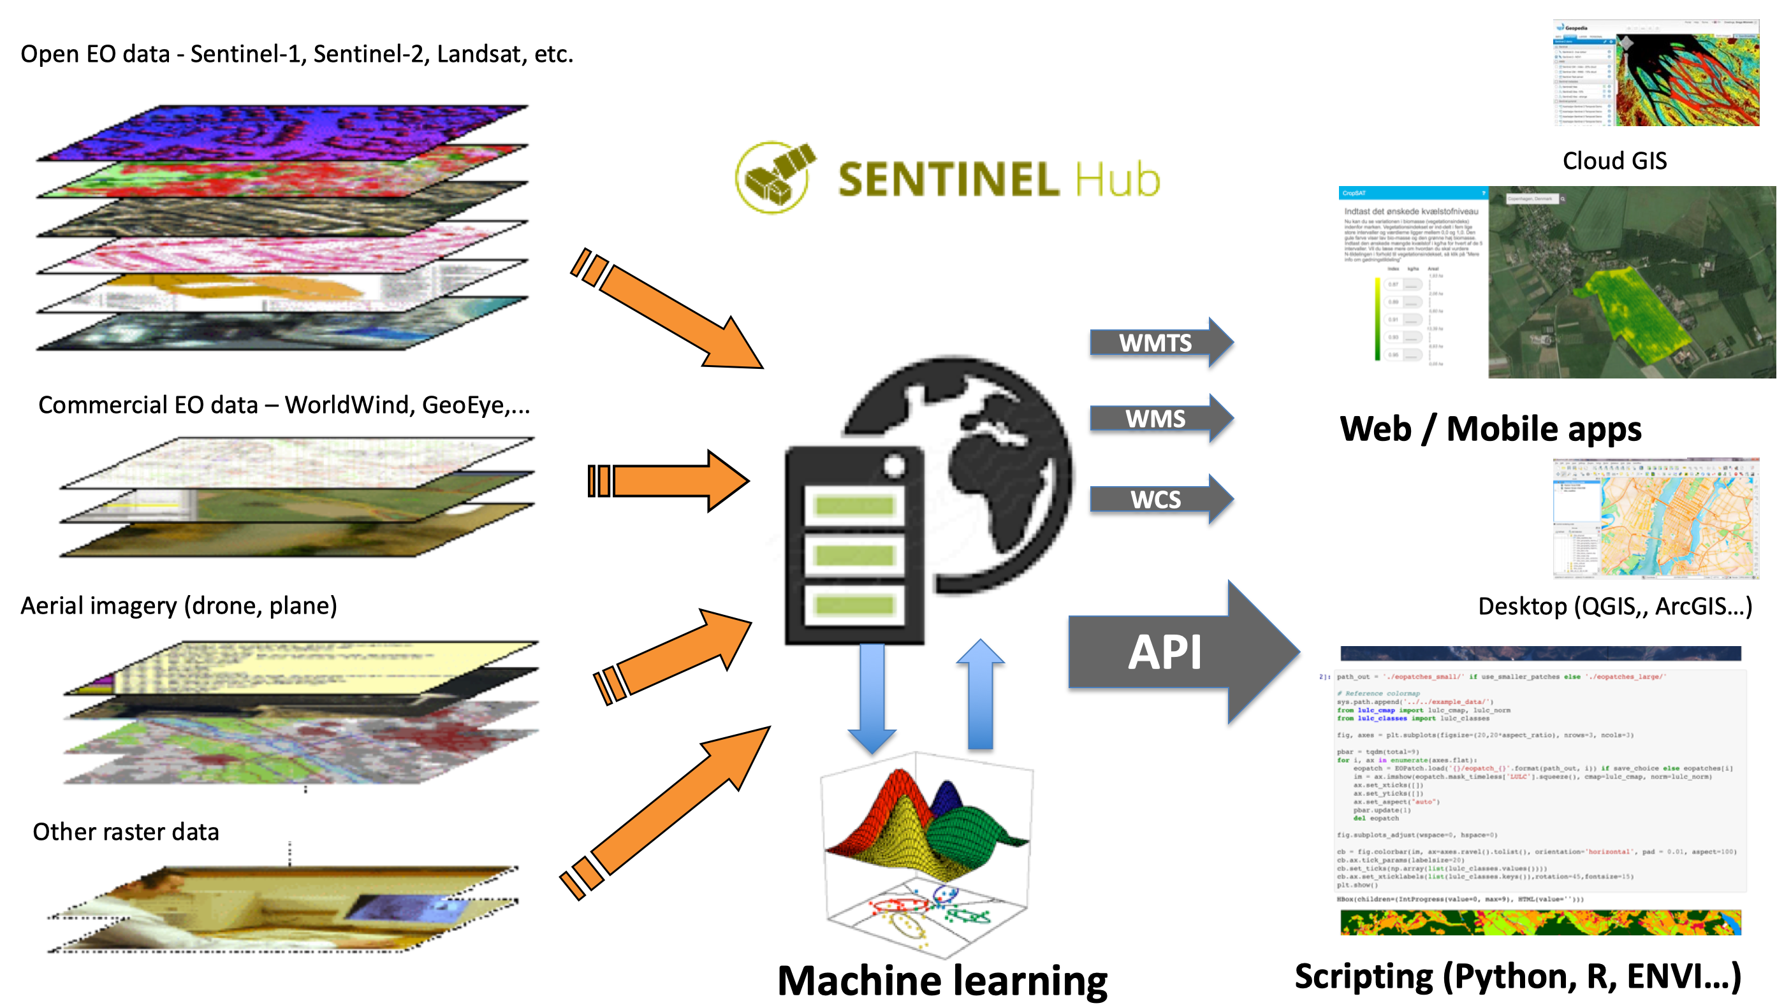
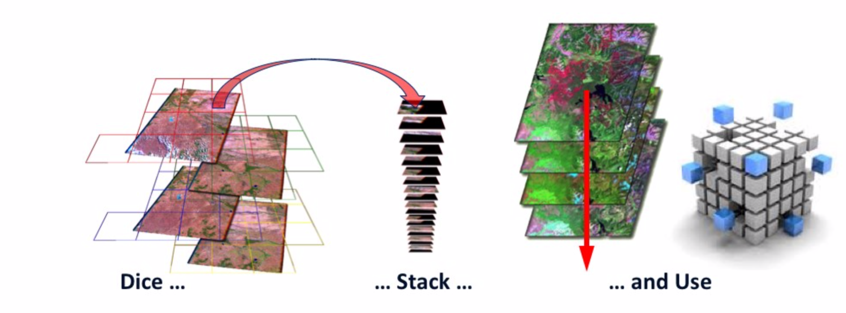


Slide 11
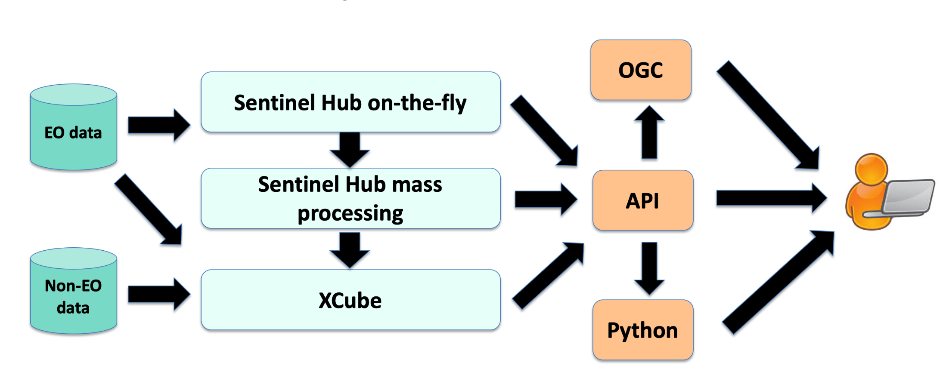


Slide 12
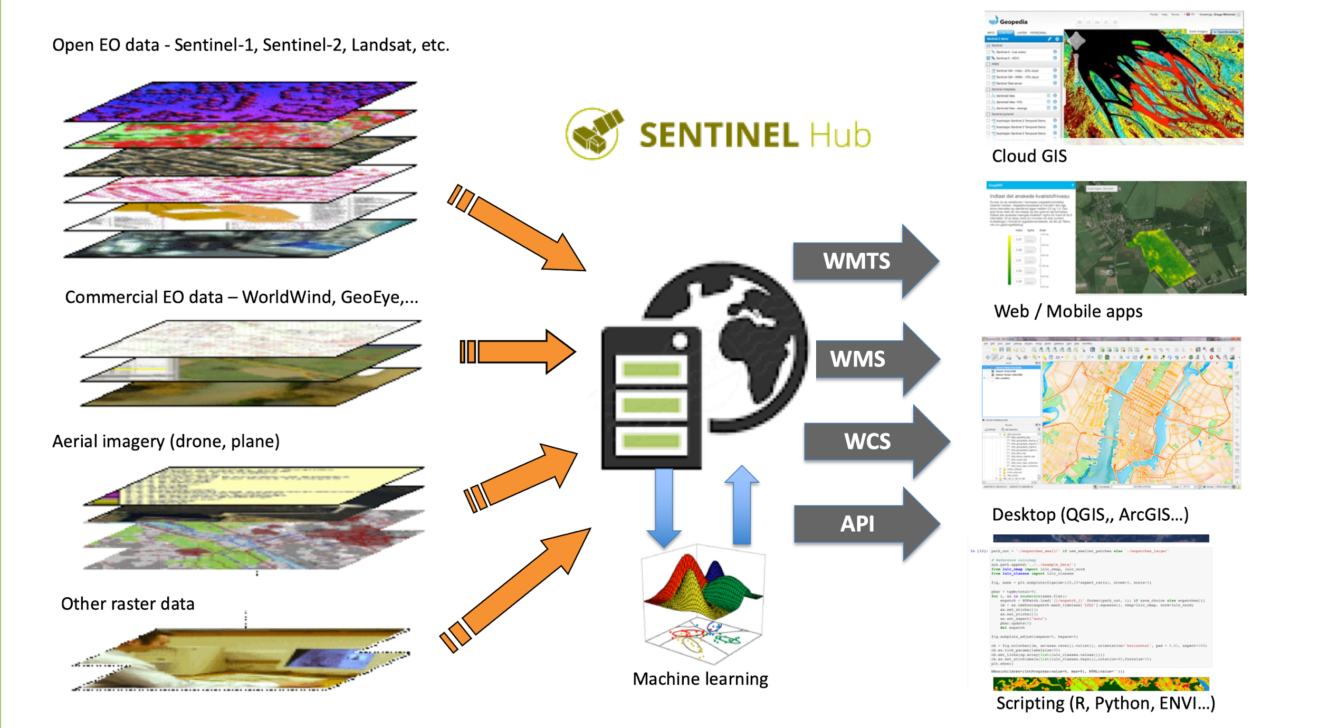

Slide 13
Data access service – Sentinel Hub
https://services.sentinel-hub.com/ogc/wcs/<INSTANCE>?SERVICE=WCS&REQUEST=GetCoverage
&COVERAGE=1_VV_ORTHORECTIFIED
&TIME=2018-07-17/2018-07-17
&BBOX=15.28815,107.07000,14.75496,106.09153
&RESX=20m&RESY=20m
&FORMAT=image/tiff&SRS=EPSG:4326
No worries about download, storage, decoding,
stitching scenes, reprojection, scaling, mosaicking,
meta-data parsing, backscatter calibration, orthorectification ...

Slide 14
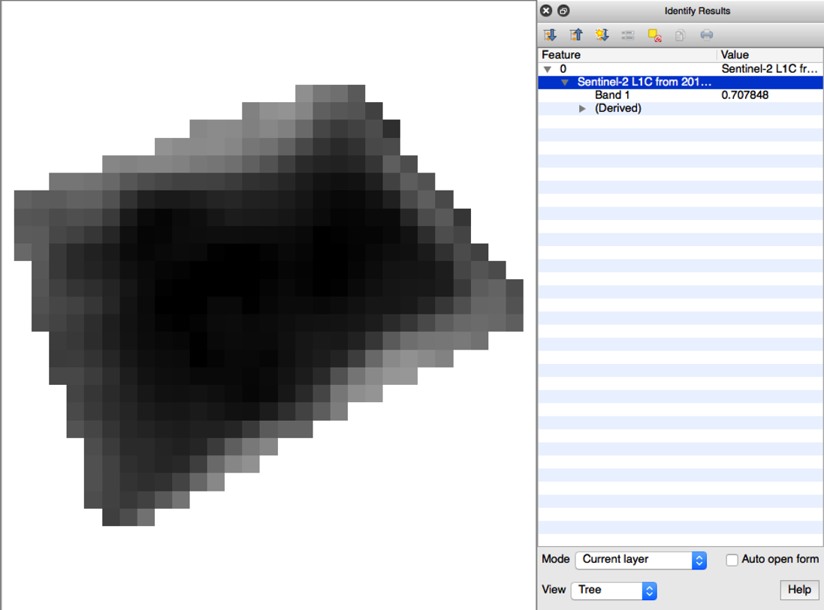
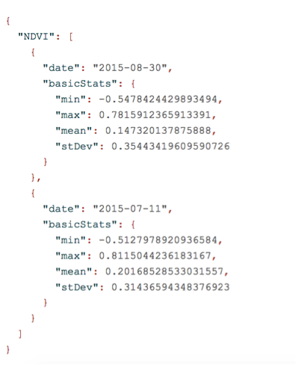
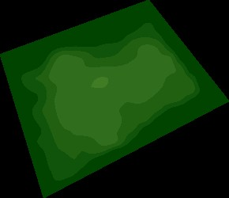
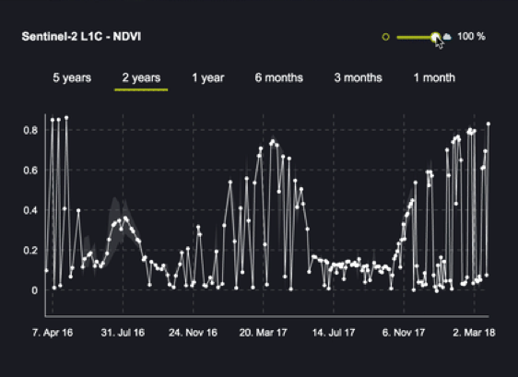
Data access service – Sentinel Hub

Slide 15
Access to global archive of EO data
Sentinel-1 GRD
Sentinel-2 L1C and L2A
Sentinel-3 OLCI and SLSTR
Sentinel-5P
Landsat-8
MODIS
DEM
(new ones coming)

Slide 16
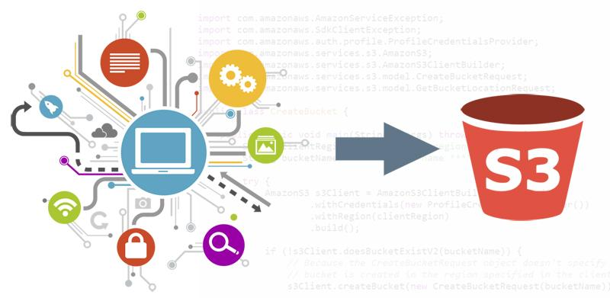
Bring your own data
Self-serve for COGs (in near future zarr)
Customizable for other formats
Data residing on AWS (EU-1 or US-West-2), Mundi, CreoDIAS
Full Sentinel Hub functionality
Satellite imagery
Derived products

Slide 17
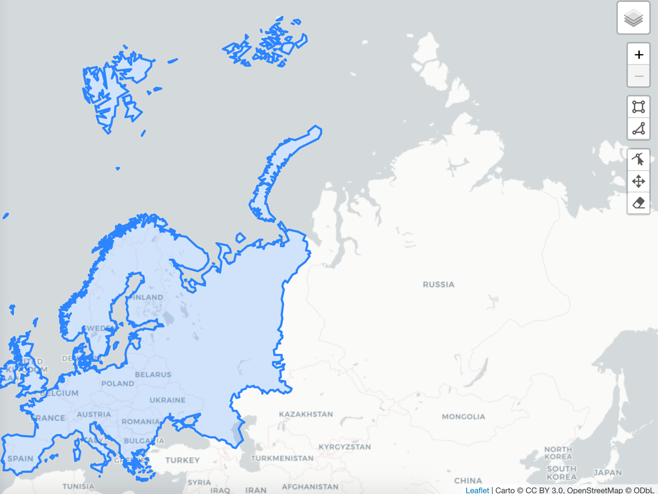
Large areas

Slide 18


Mass processing service
Request data at large scale – either spatial or temporal.
Run your algorithm for a whole continent.
Pre-process vast amount of data.
Execute, go for a coffee and have results ready.
Build yourself a pre-processed data cube

Slide 19
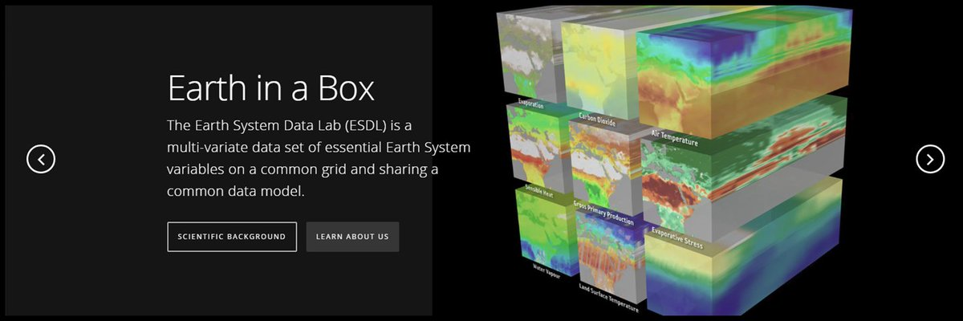
XCube
Additional data sets (including feature data)
ESA CCI, Copernicus Services, etc.
Additional algorithms
Fully customizable
Python ecosystem
https://www.earthsystemdatalab.net

Slide 20
XCube in practice
Sentinel
Hub API
Load Cube
Compute Cube
Render time step to image
Loading a cube and computing new cube does not load data immediately - just metadata. A processing graph is constructed.
y
t
B5, B6
NDVI
NDVI Colour-Mapped Image
x

Slide 21
XCube in practice
Sentinel
Hub API
Load Cube
Compute Cube
Render Time Step To RGB
The output requires data to be loaded. Requests are propagated back to the input - the data store.
?
y
t
B5, B6
NDVI
NDVI Colour-Mapped Image
x

Slide 22
XCube in practice
S2
Sentinel
Hub API
Load Cube
Compute Cube
Render Time Step To RGB
Inputs are loaded, pre-processing takes place, cube data is computed, the output is generated, e.g. an image is rendered.
y
t
B5, B6
NDVI
NDVI Colour-Mapped Image
x

Slide 23
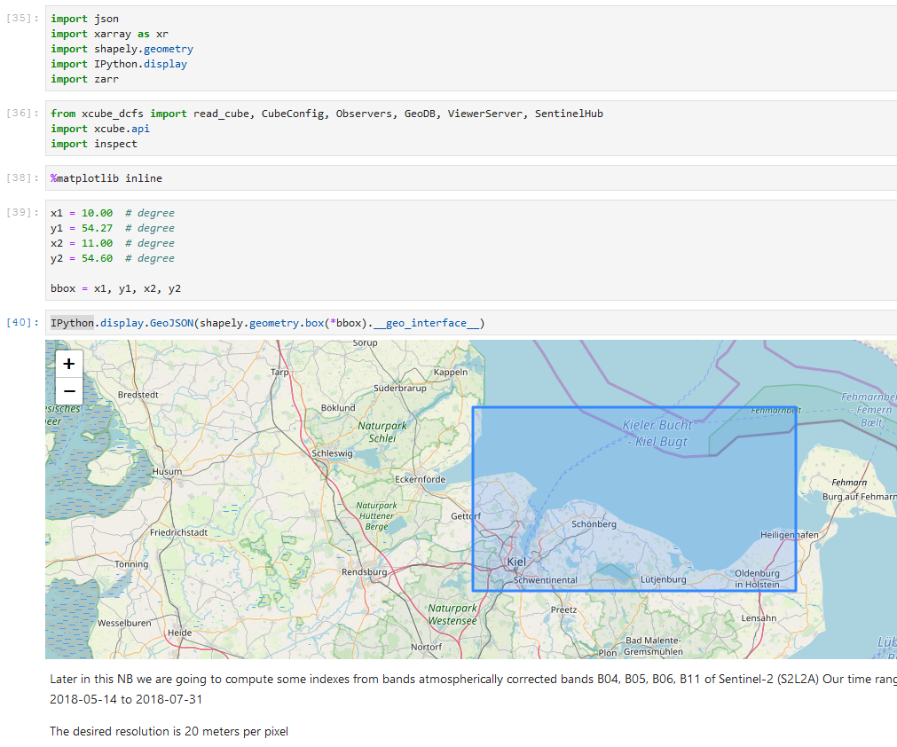
How it works in practice
Importing required packages
Defining AOI

Slide 24
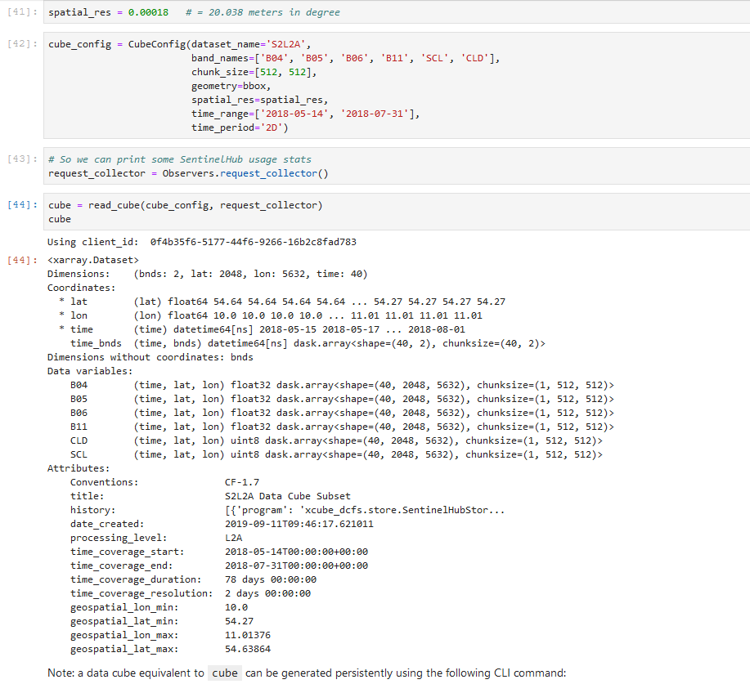
How it works in practice
Configuring Cube
Read Cube, only metadata
Get view on cube, no data transfered

Slide 25
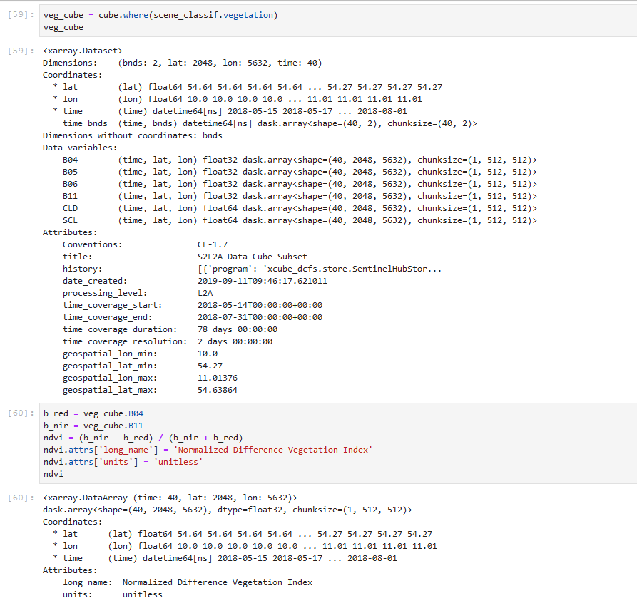
How it works in practice
Do some processing, here define a vegetation cube with scene classification
Generate NDVI
Still no data tansfer or computation

Slide 26
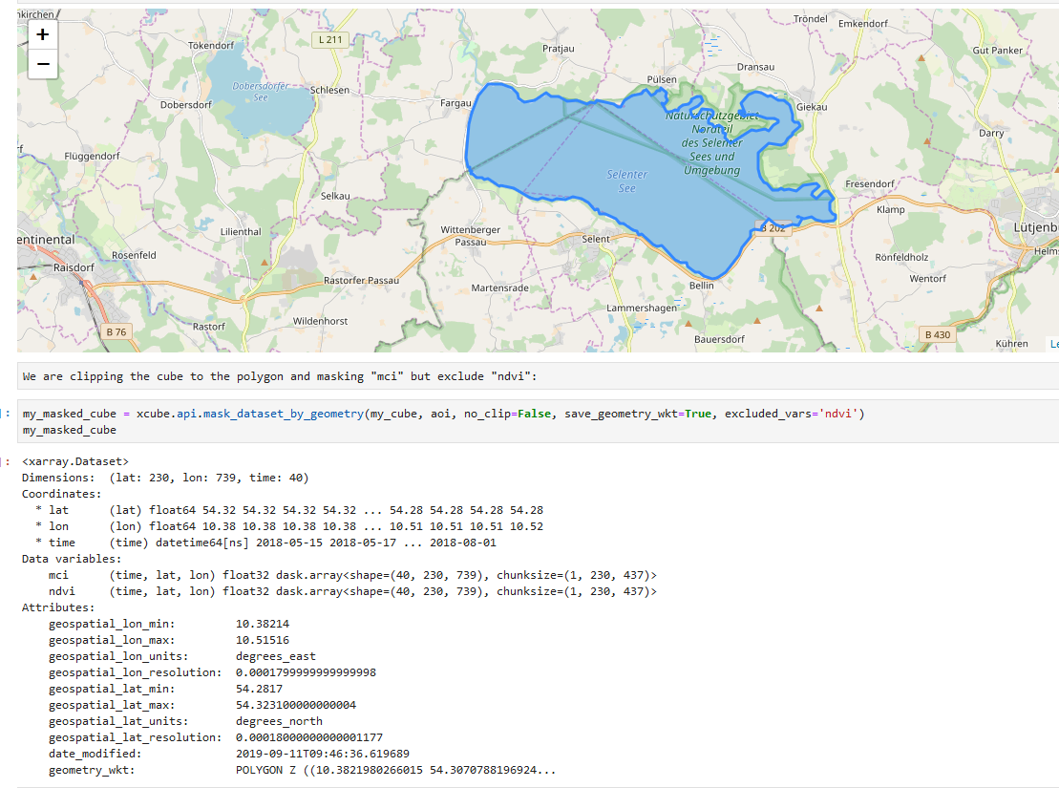
How it works in practice
Subset data cube with shape from geoDB
Clip cube to polygon

Slide 27
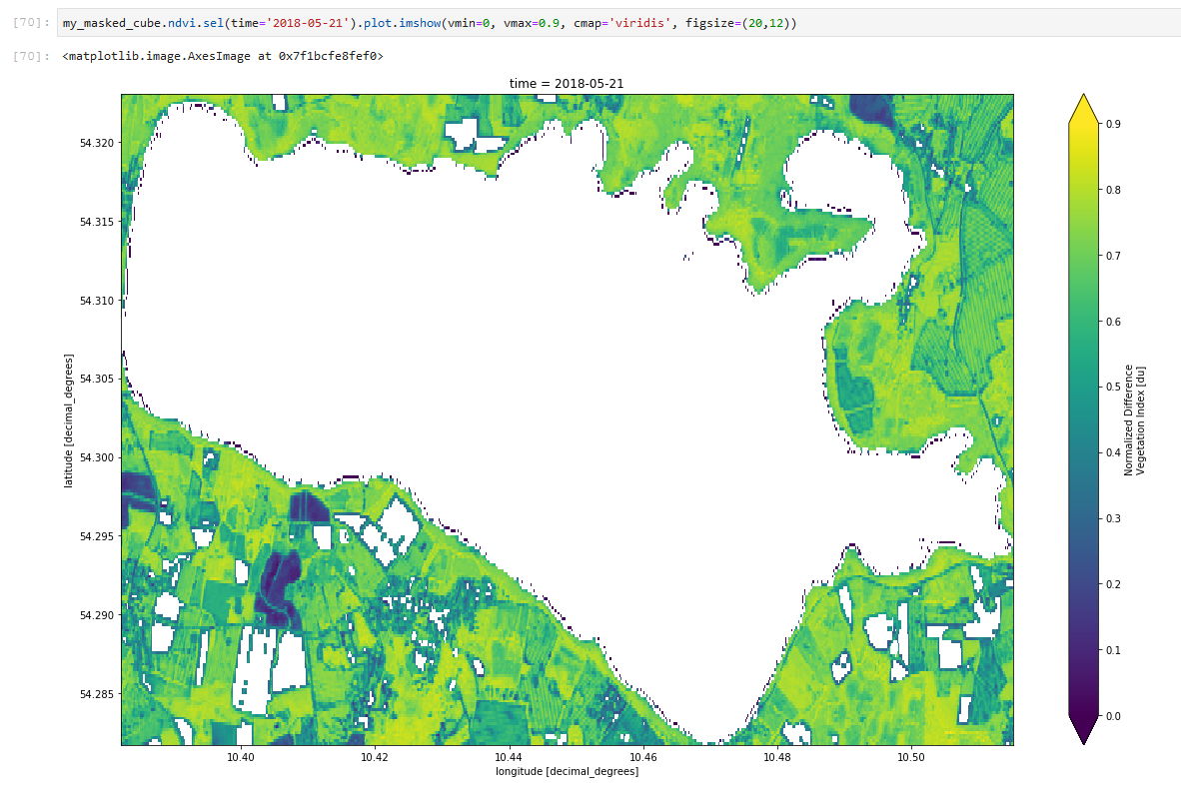
How it works in practice
Finally, plot some
data
Only now, xcube fetches data from Sentinel Hub.

Slide 28
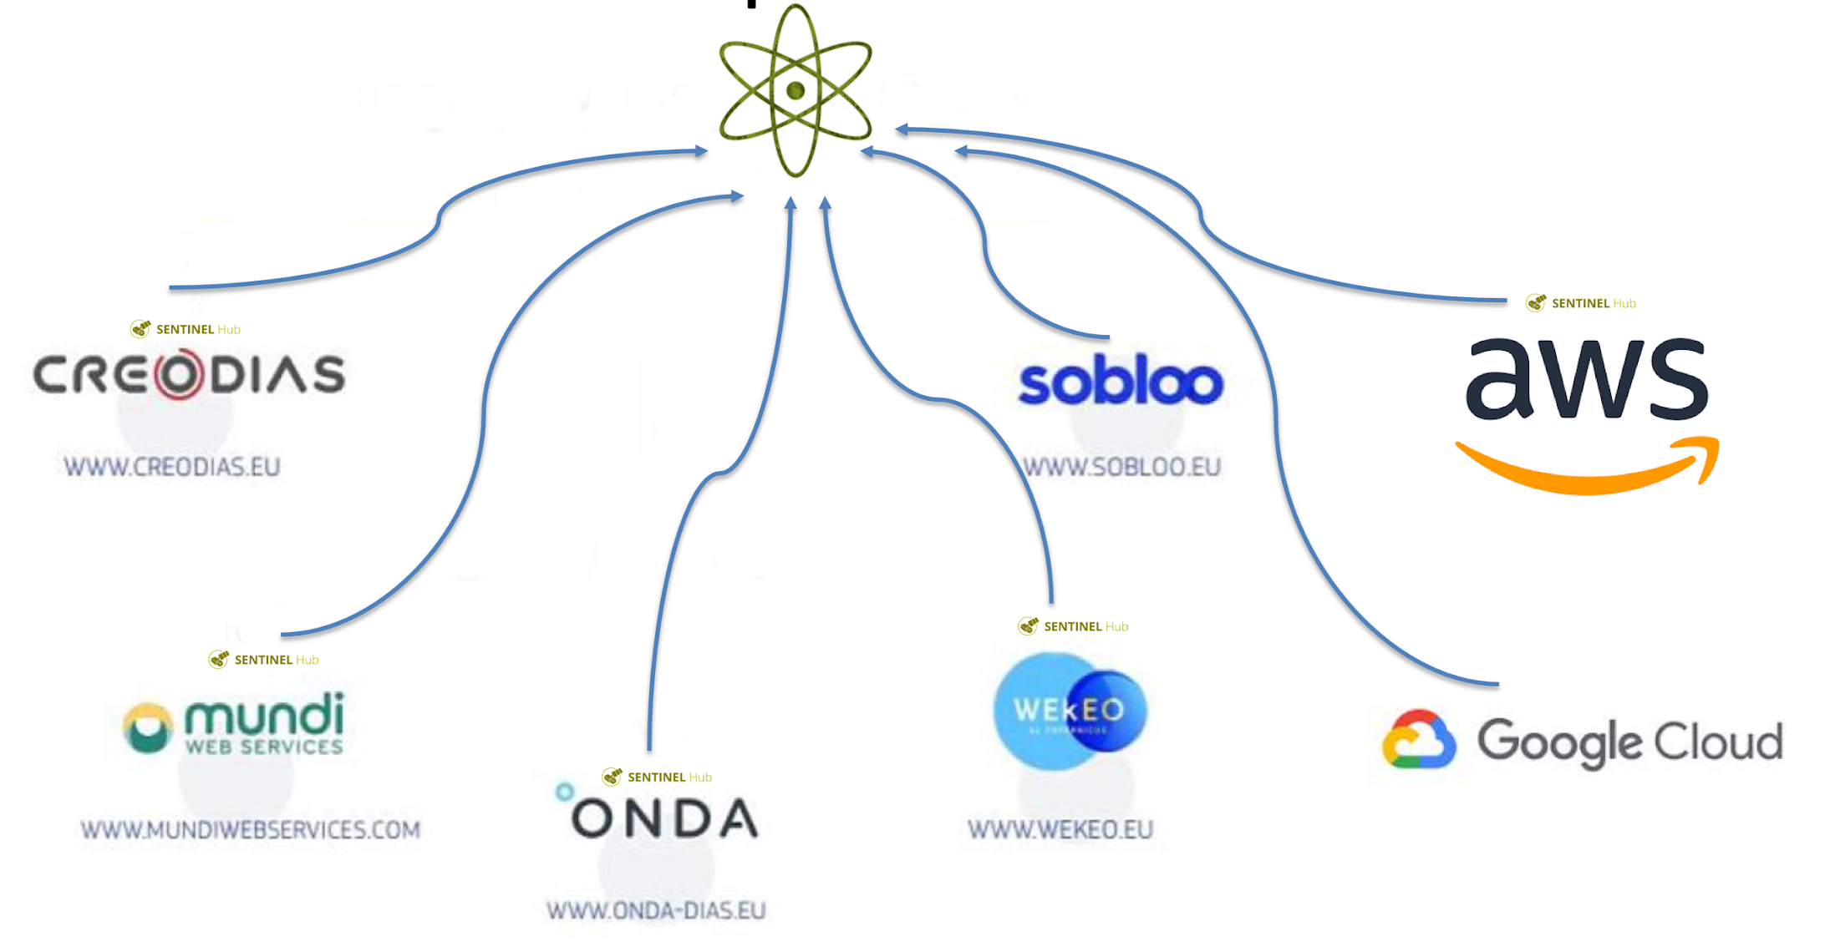
Data is not at one place - federation

Slide 29
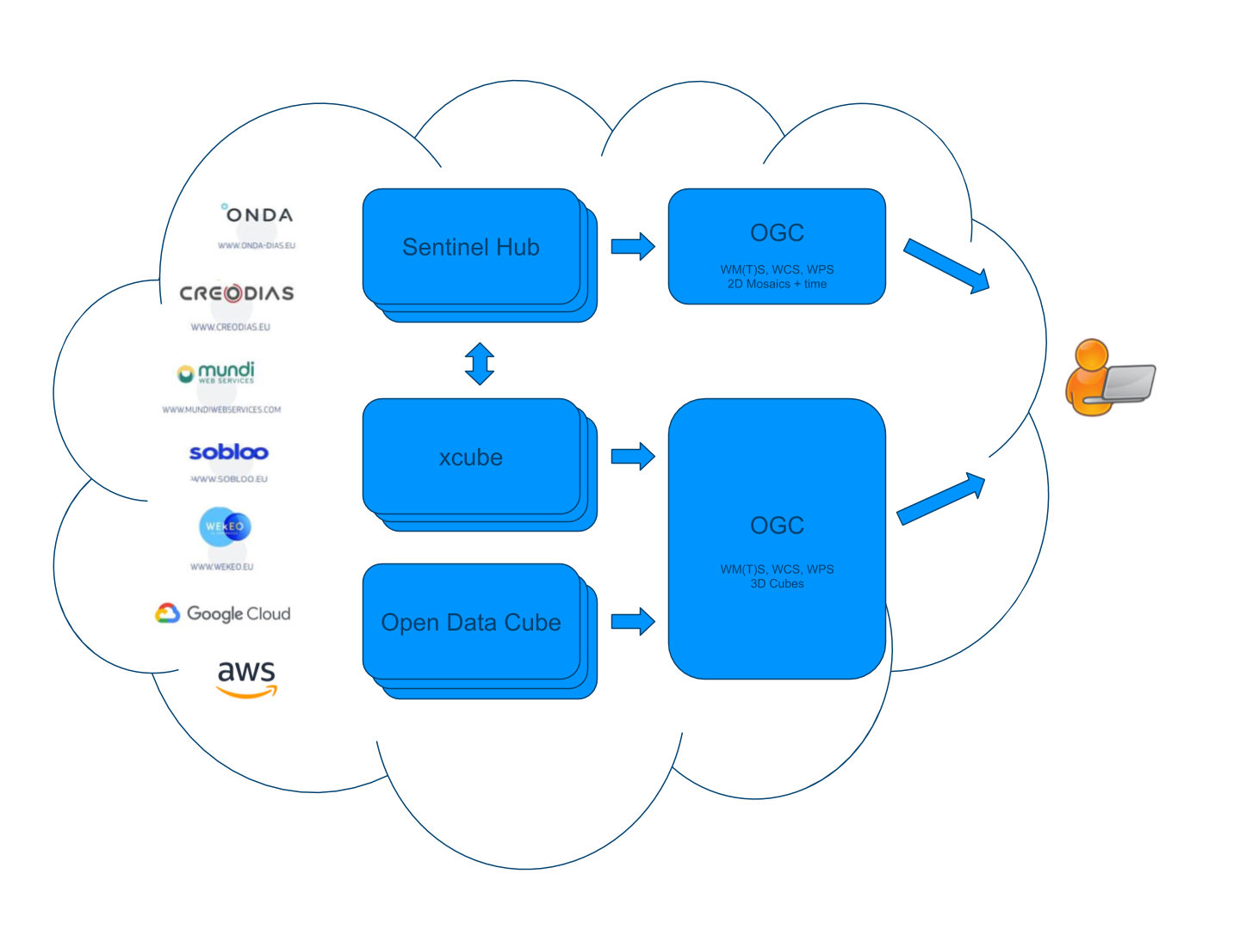
Federation and standardization
Harmonized access to
federated data on
various clouds via
Open standards

Slide 30
Federation and standardization
OGC on top of EDC APIs
  Implemented: WMS_{(1.0, 1.1, 1.3)} , EO-WMS_{(0.3.3)} , WCS_{(2.0)} , and EO-WCS_{(1.0)} available
  Planned: WCS _{(2.1)} , OGC API – Coverages _{(as adopted)} , EO-WCS _{(1.1)}
  2D mosaics + time
  Implemented as app to deploy via marketplace in customer namespace
  Demonstration via EOxC
OGC integrated with xcube and Open Data Cube
  WCS and EO-WCS implementation started
  3D cubes
  Integrated with xarray

Slide 31
Federation and standardization – next steps
Ongoing cooperation with GA on ODC
2019/11/20 - OGC TC – Coverages DWG and WCS SWG meetings
2020/01/06 – ESIP and OGC API – Coverage Analytics Sprint
Effort lead by EOX

Slide 32
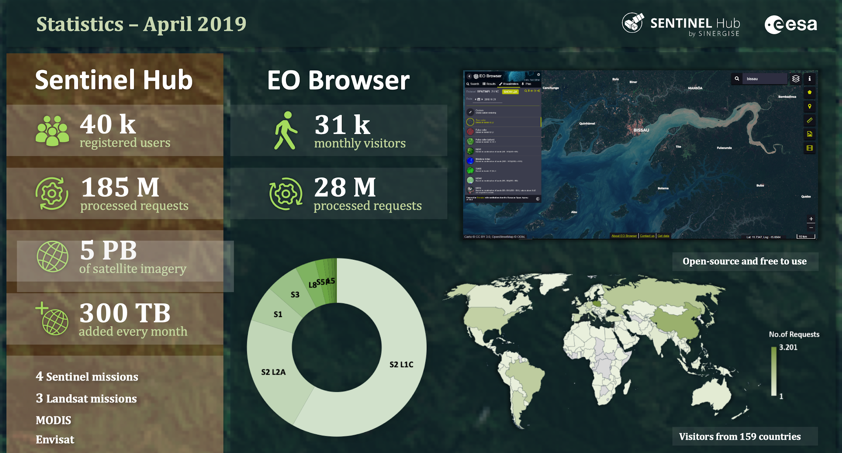
Operational service

Slide 33
Conclusion
Plethora of operational services
Combine what you need and exploit it!
Integration with ODC and Pangeo on the horizon.
OGC-compliant
Build on top of it!

Slide 34
More info
https://eurodatacube.com/
https://sentinel-hub.com/
https://apps.sentinel-hub.com/eo-browser/
https://sentinel-hub.github.io/custom-scripts/
https://github.com/sentinel-hub/eo-learn
https://education.sentinel-hub.com

