Slide 1

Working Group on Information Systems and Services (WGISS)
Committee on Earth Observation Satellites
Mirko Albani, ESA, WGISS Chair
Brian Killough, CEOS SEO
CEOS SEO Team & EMSS Team
WGISS#48 Meeting
FDA-09: Inventory and characterize existing FDAs
FDA-10: Inventory of software and tools
Hosted by VAST/VNSC, Hanoi, Vietnam
8-11 October 2019

Slide 2
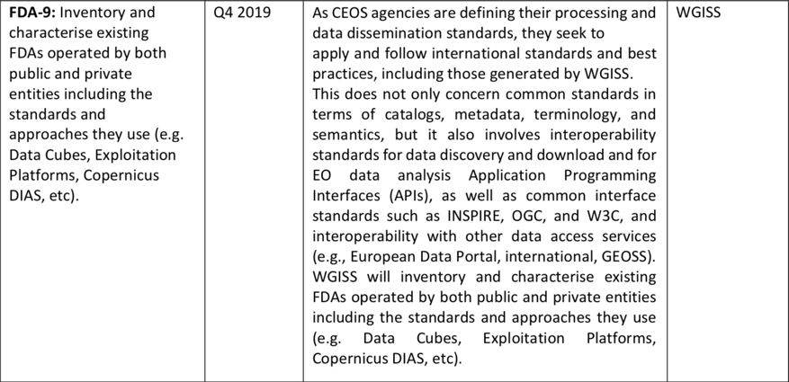
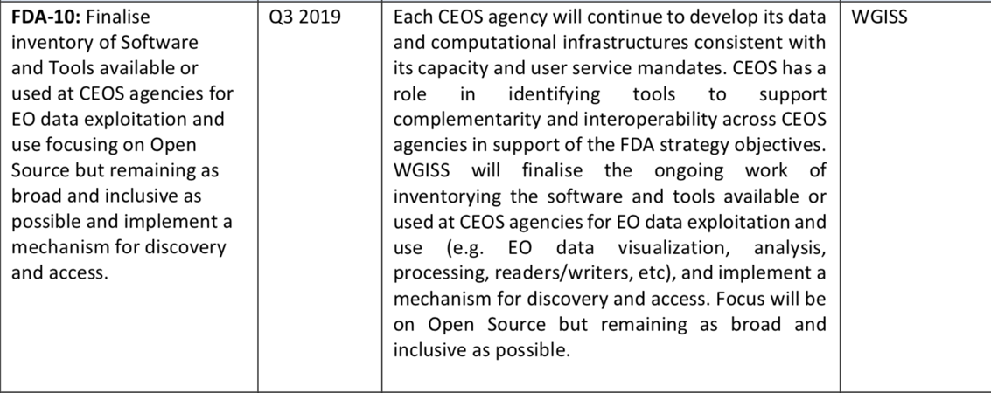
Background
OSS & FDA Inventory triggered by CEOS and WGISS Work Plan

Slide 3
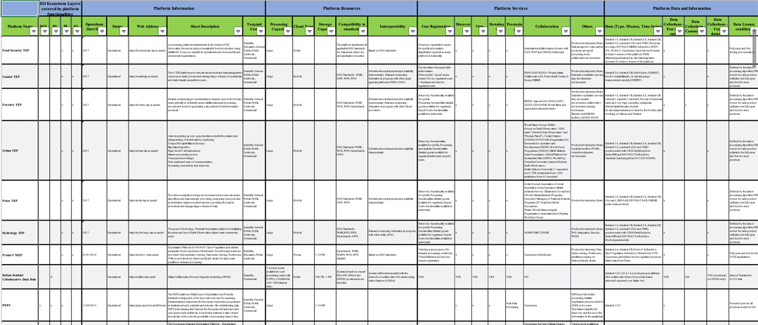

Back To The Past - FDA Inventory Table Overview
Total number of FDA elements: 45
Approximately 90% information completed

Slide 4
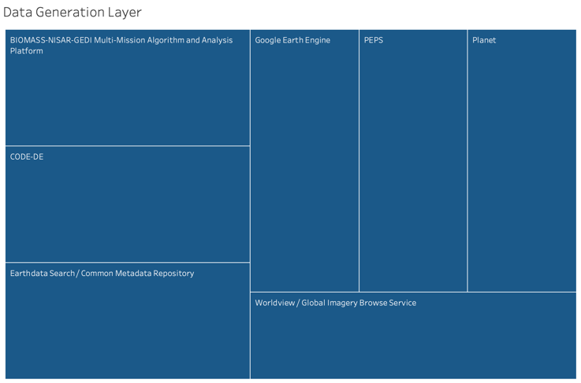
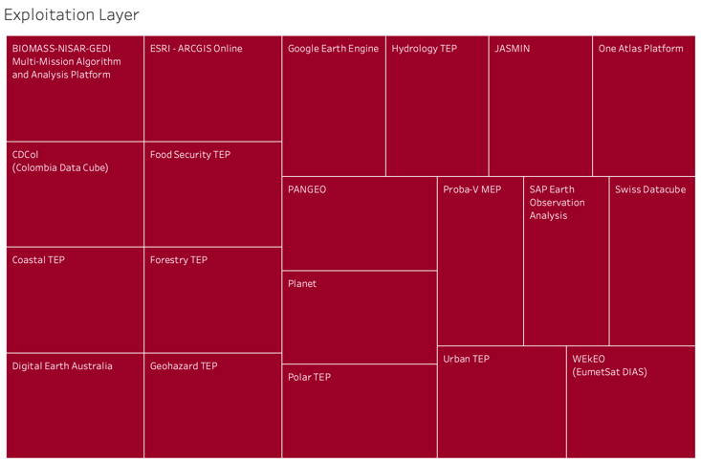
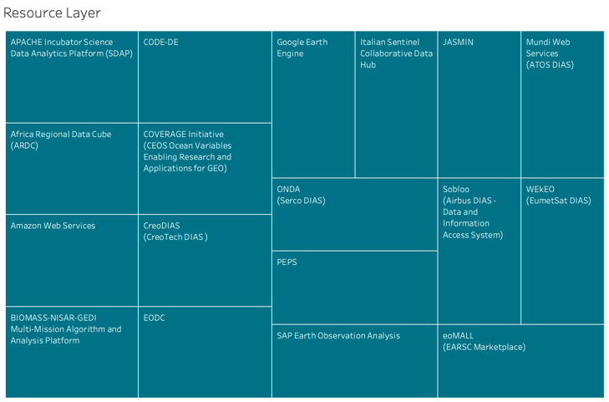
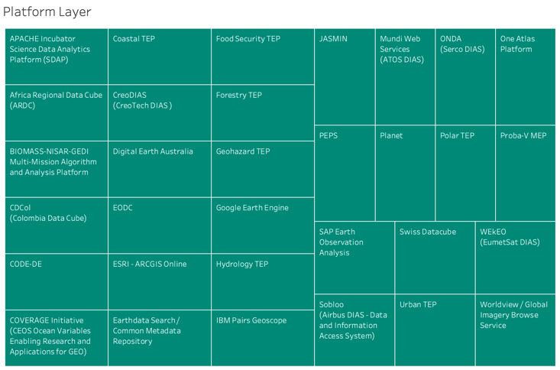
Updated Outcomes – Service Layers
Notes:
Qui ci sta una overview degli FDA elements divisi per Layers

Slide 5
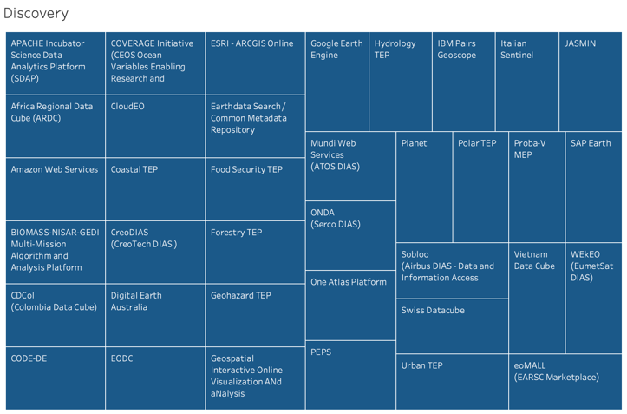
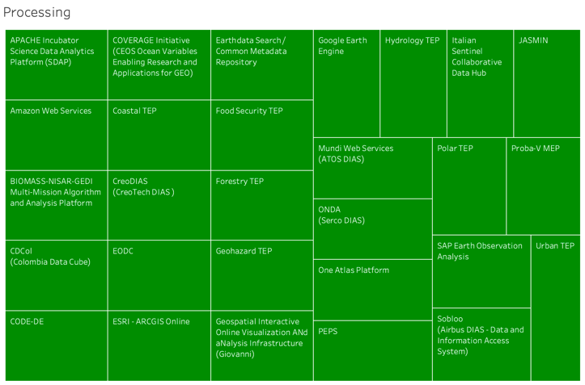
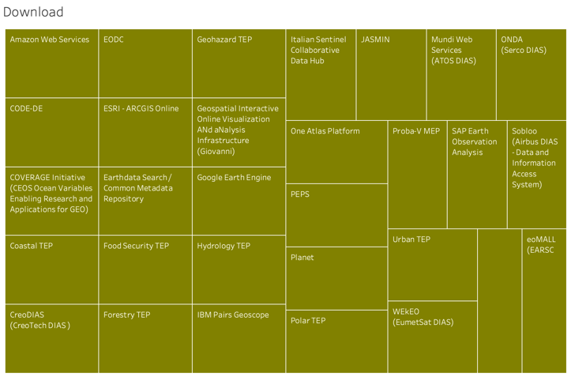
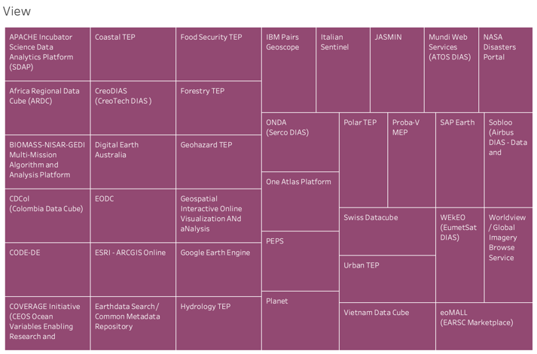
Updated Outcomes - Functionalities
BIOMASS
Notes:
Qui ci sta una overview degli FDA elements divisi per functionalities

Slide 6
Survey Updated Numbers
Layers
Data Generation Layer
9
Resource Layer
18
Platform Services Layer
32
Exploitation Layer
20
Functions
Discovery
39
Processing
29
View
40
Download
33
BIOMASS

Slide 7
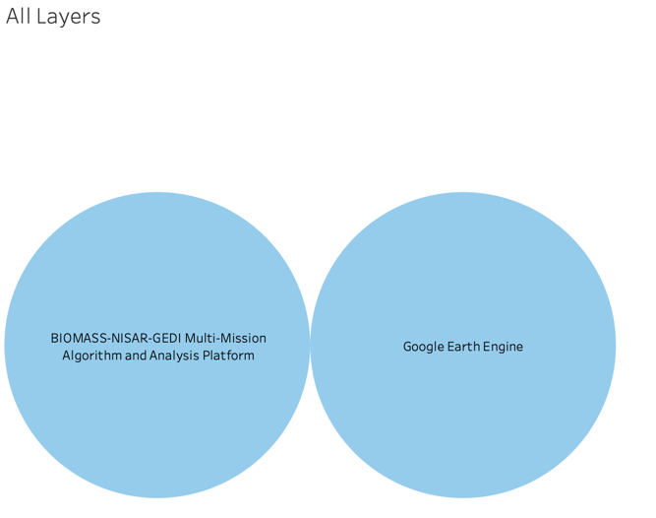
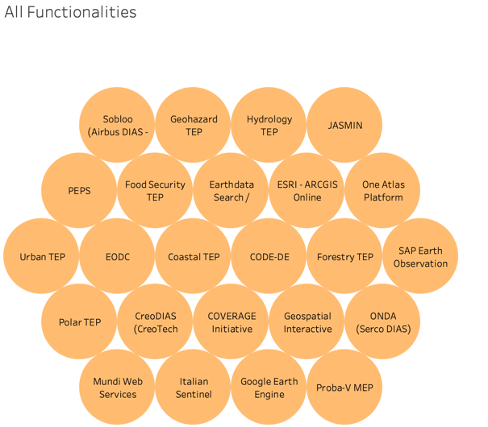
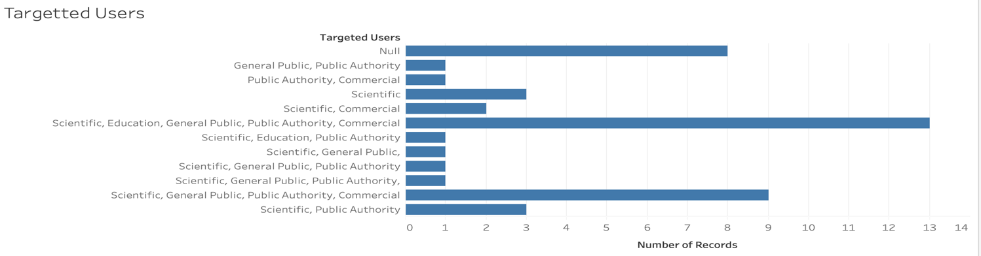
Survey Updated statistics

Slide 8
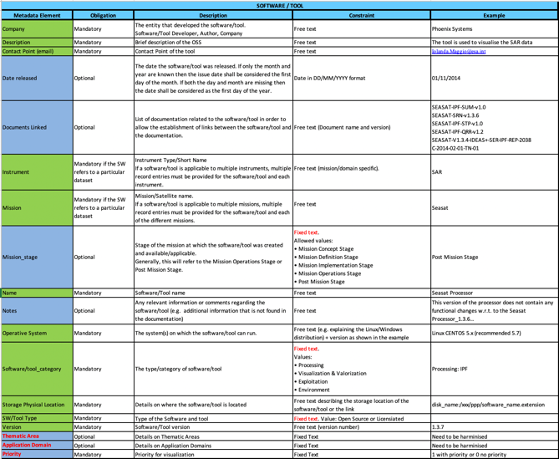
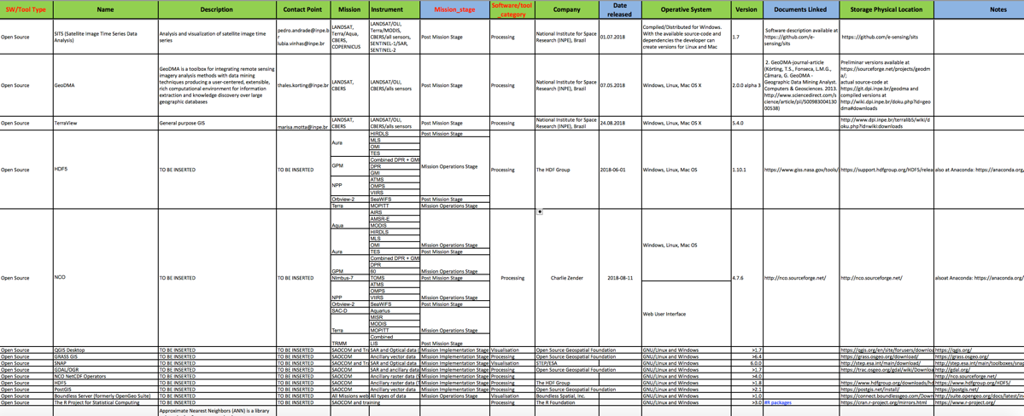
Back To The Past - OSS Inventory

Slide 9
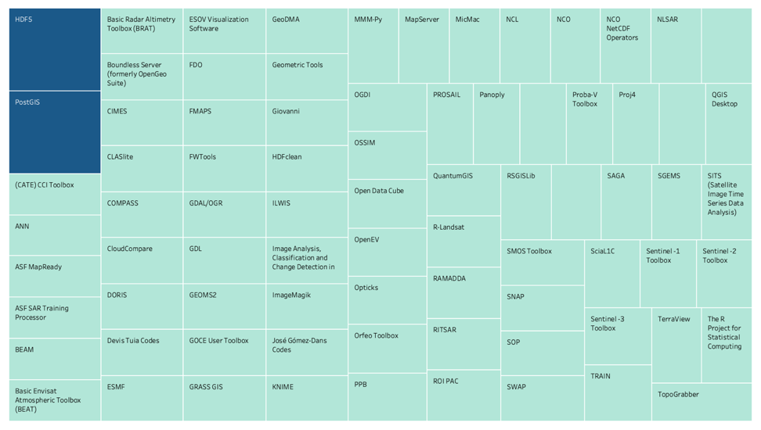
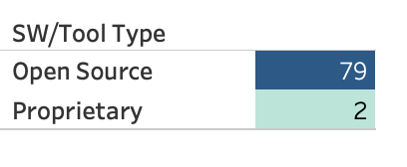
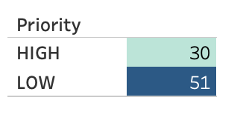
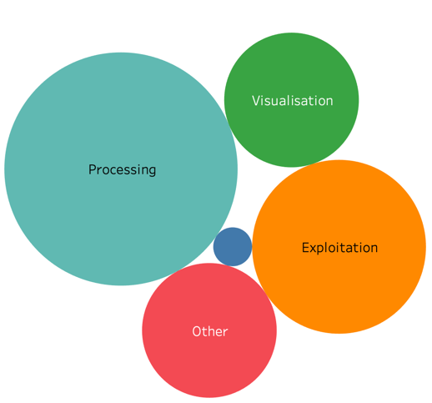
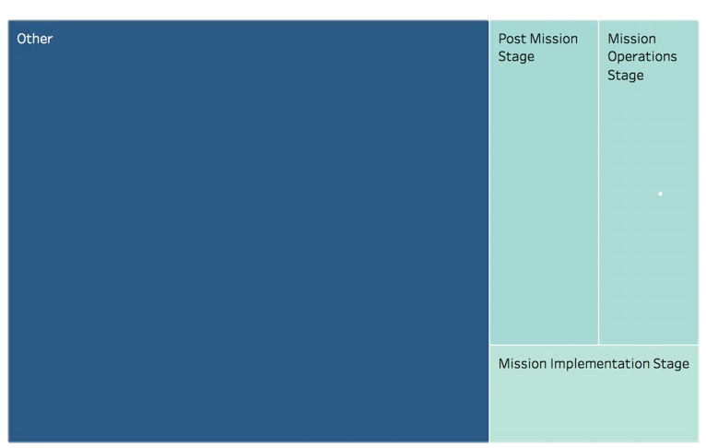
OSS Survey Statistics

Slide 10
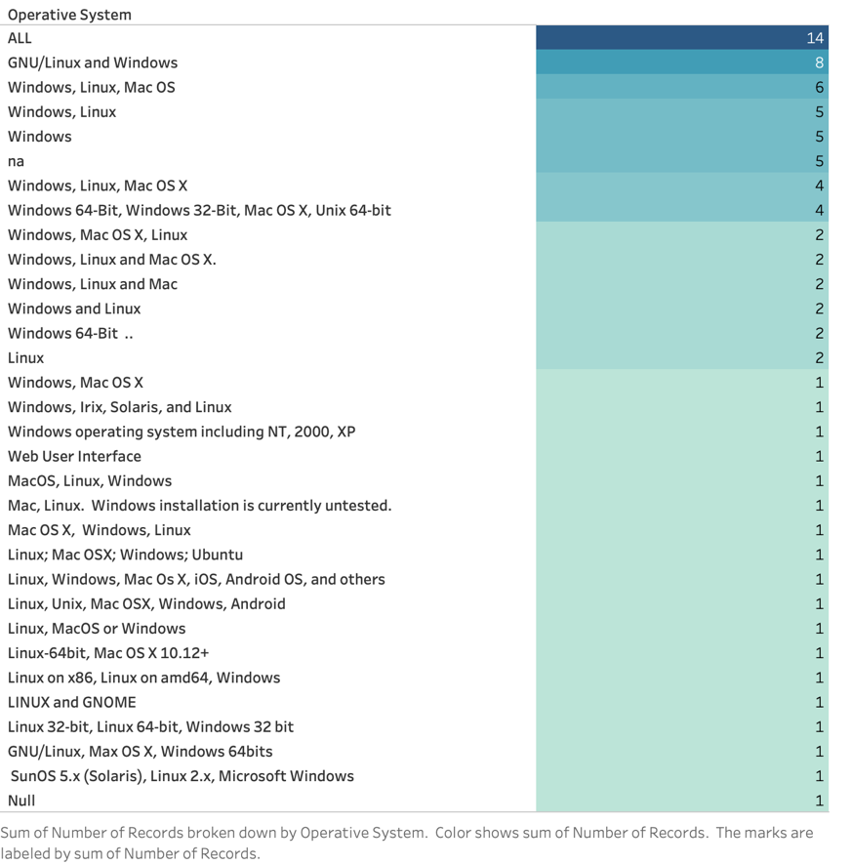
Example of Normalization

Slide 11
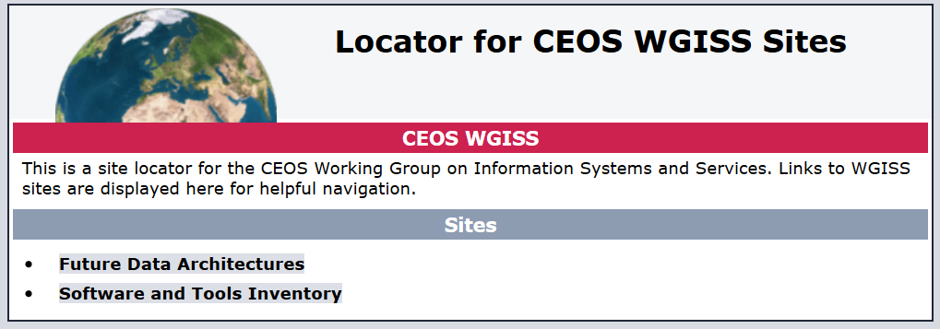

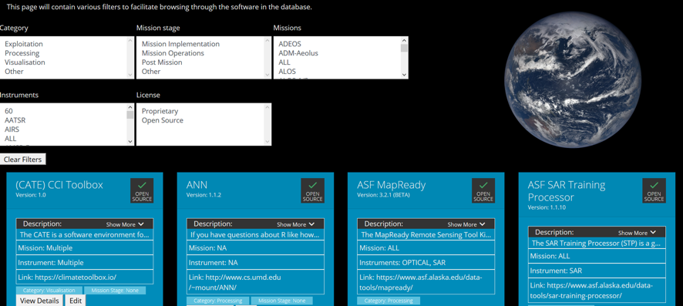


Slide 12
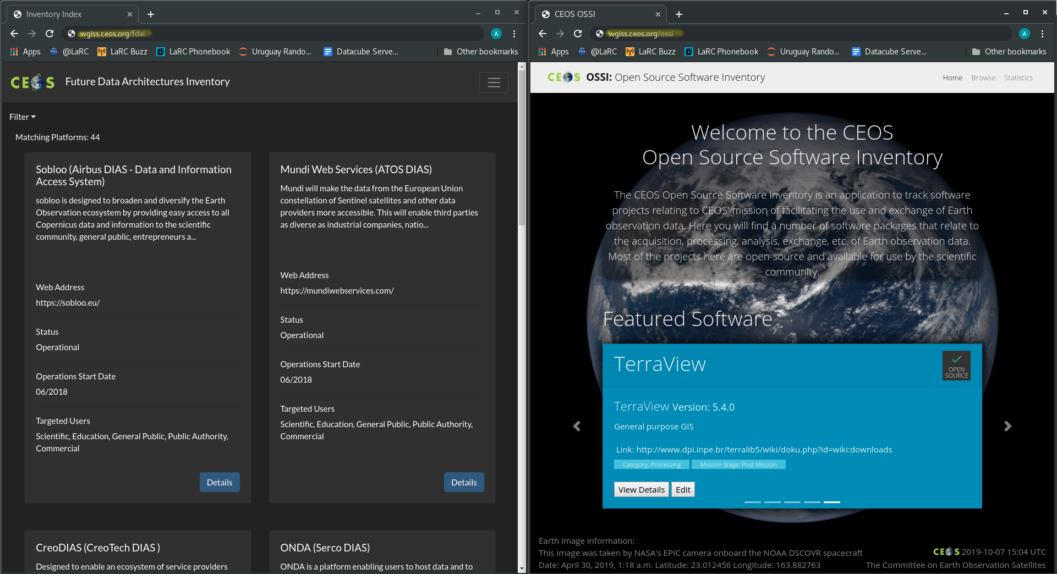
Deployment Solution - Proposal
Proposal: Have the site be managed under the WGISS sub-domain
http://wgiss.ceos.org/<site-location>
12

Slide 13
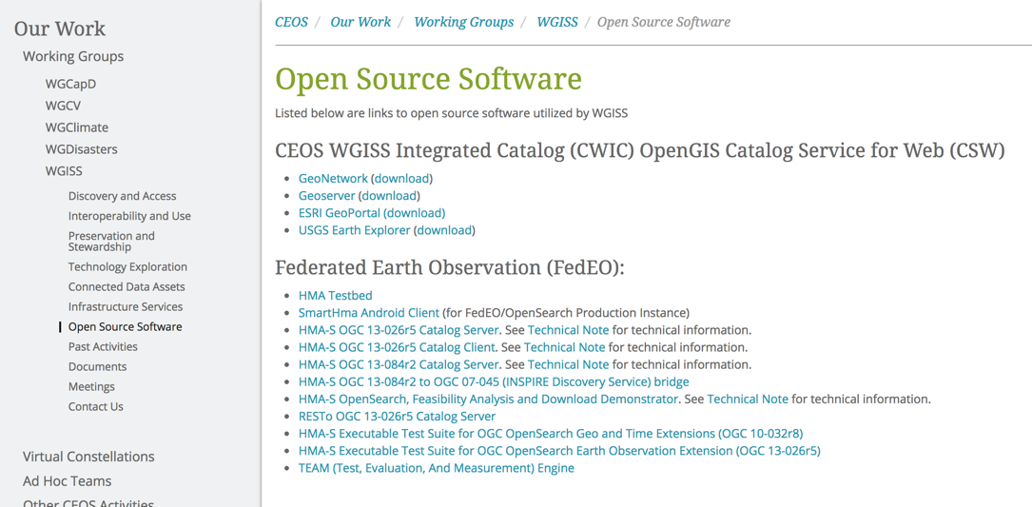
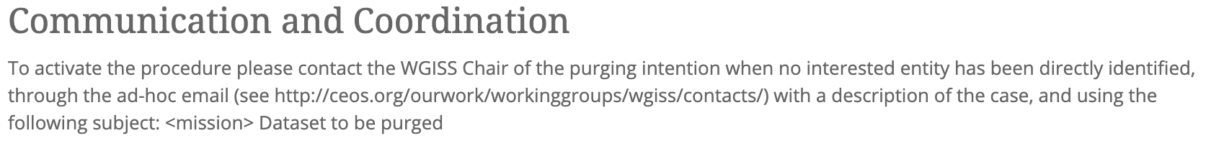
OSS & FDA Inventory in
CEOS/WGISS website
Open Source Software page to be moved into Interoperability and Use Area + Include the CWIC and FedEO in OSS in the inventory

Slide 14


Slide 15
Back-up

Slide 16

OSS Inventory USE CASE

Slide 17

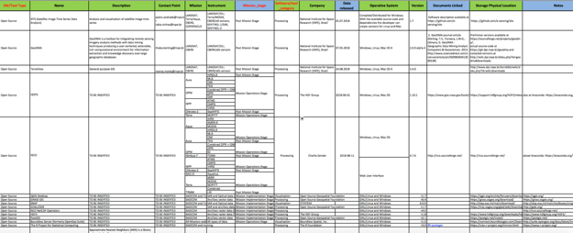

From user need to OSS Inventory utilization
WGISS OSS Inventory DB
USERS with OSS needs
The Sentinel Application Platform
(SNAP) architecture is ideal for
Earth Observation processing
and analysis

Slide 18
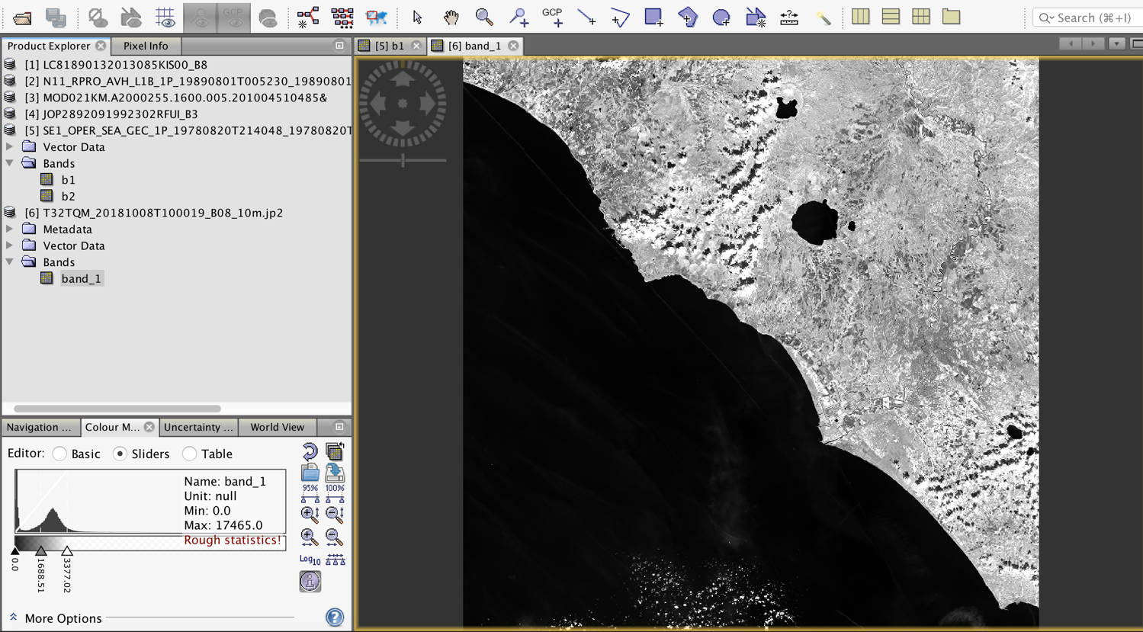
SNAP: application to other EO data

Slide 19

NEXT STEPS
Develop an inventory similar to the OSS
inventory??
Mirko: hai scritto a Raz che avresti chiarito con Nick
BIOMASS

Slide 20

Contact:
Mirko.Albani@esa.int

