Slide 1

CEOS & Work Plan
Status
Committee on Earth Observation Satellites
Steven Hosford, ESA/CNES
WGISS-48
8th October 2019

Slide 2
Summary
News/updates
Overview of CEOS upcoming meetings
CEOS Work Plan information

Slide 3

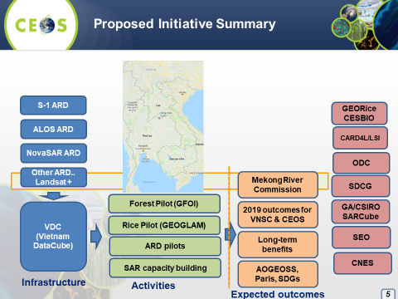
News / Updates
CEOS Chair priorities for 2019
Priority #1:
Carbon Observations (forested regions)
Priority #2:
Observations for Agriculture (rice)
Notes:
Forest change map on VDC will be prepared to display for the demonstration at CEOS plenary to
show collaboration result. There are should be 2 presentations: Forest change map on VDC
developed by VNSC and Forest change map on VDC developed by CNES CESBIO/VNSC.
Rice maps on VDC will be prepared to display for the demonstration at CEOS plenary to show
collaboration result (Deadline: September 2019).

Slide 4

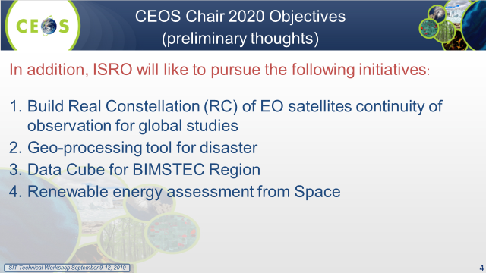
News / Updates
CEOS Chair priorities for 2020
Priority #1:
Build “Real Constellations”
Priority #2:
GEO-processing for disasters
Priority #3:
Data Cube for BIMSTEC
Priority #4:
Renewable energy assessment
Notes:
Forest change map on VDC will be prepared to display for the demonstration at CEOS plenary to
show collaboration result. There are should be 2 presentations: Forest change map on VDC
developed by VNSC and Forest change map on VDC developed by CNES CESBIO/VNSC.
Rice maps on VDC will be prepared to display for the demonstration at CEOS plenary to show
collaboration result (Deadline: September 2019).

Slide 5
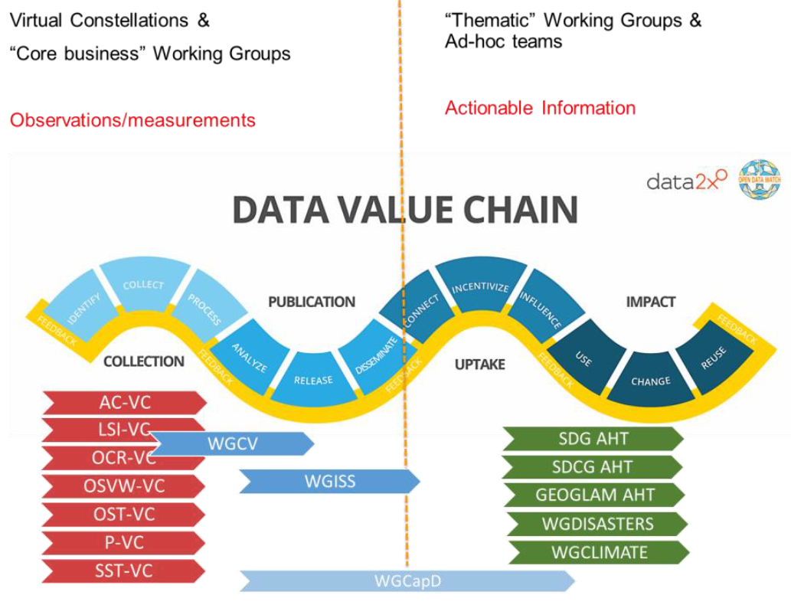
News / Updates
Since SIT-34 in April, two focused study teams
  Proposal to create a new working group (Working Group Study Team)
  Proposal to merge the 4 Ocean Virtual Constellations to create one Ocean-VC
  Recommendations from both
  Study Teams is not to move
  forward with these proposals
Interesting discussions on CEOS’s
  interface with users

Slide 6
Status of CEOS Leadership Positions
Position | 2019 | 2020 | 2021
CEOS Chair | VAST (P. A. Tuan) | ISRO (DK Das) | NASA
SIT Chair SIT Vice Chair | NOAA (S. Volz) CSIRO (A. Held) | CSIRO (A. Held) ESA | CSIRO (A. Held) ESA
CEO DCEO | ESA/CNES (S. Hosford) – | TBD TBD | TBD TBD
WGCapD Chair WGCapD Vice Chair | ISRO (P. Chauhan) NASA (N. Searby) | NASA (N. Searby) VAST-VNSC (P. T. M. Thy) | NASA (N. Searby) VAST-VNSC (P. T. M. Thy)
WGCV Chair WGCV Vice Chair | CSIRO (C. Ong) JAXA (A. Kuze) | CSIRO (C. Ong) JAXA (A. Kuze) | JAXA (A. Kuze) TBD
WGClimate Chair WGClimate Vice Chair | EUMETSAT (J. Schulz) DLR (A. von Bargen) | EUMETSAT (J. Schulz) DLR (A. von Bargen) | DLR (A. von Bargen) TBD
WGDisasters Chair WGDisasters Vice Chair | ASI (S. Zoffoli) NASA (D. Green) | NASA (D. Green) CNES | NASA (D. Green) CNES
WGISS Chair WGISS Vice Chair | ESA (M. Albani) CSIRO (R. Woodcock) | CSIRO (R. Woodcock) JAXA | CSIRO (R. Woodcock) JAXA

Slide 7
CEOS upcoming meetings
WGCalVal Perth, 15th-19th July
July
June
Joint meeting LSI-VC-8, SDCG-16, GEOGLAM.
WGClimate-11,
Anchorage, 4th-6th Sep
August
May
April
SIT Technical Workshop, 2019
Fairbanks, 9th-13th Sept
September
WGDisasters-12, Rekjavik,
23rd-27th Sep
SIT-35, Hobart, Australia,
? March/April
March
WGISS-48,
Hanoi, 8th-11th Oct
October
CEOS 33rd Plenary, Hanoi,
14th-16th Oct
WGCapD-9 Mountain View, USA 9th-13th March
November
February
GEO-XVI Plenary, Canberra, 4th-9th Nov
December
January
COP-25/SBSTA-51, Santiago, Chile,
2nd -13th Dec
CEOS/GEO bilateral, 3rd - 4th February, 2020

Slide 8

Status of CEOS 2019-2021 WP
CEOS 2019-2021 Work Plan was submitted to principals on 14th March
Virtual endorsement completed on 22nd March
Endorsement 3 weeks earlier
than in 2018
Endorsed version now available.

Slide 9
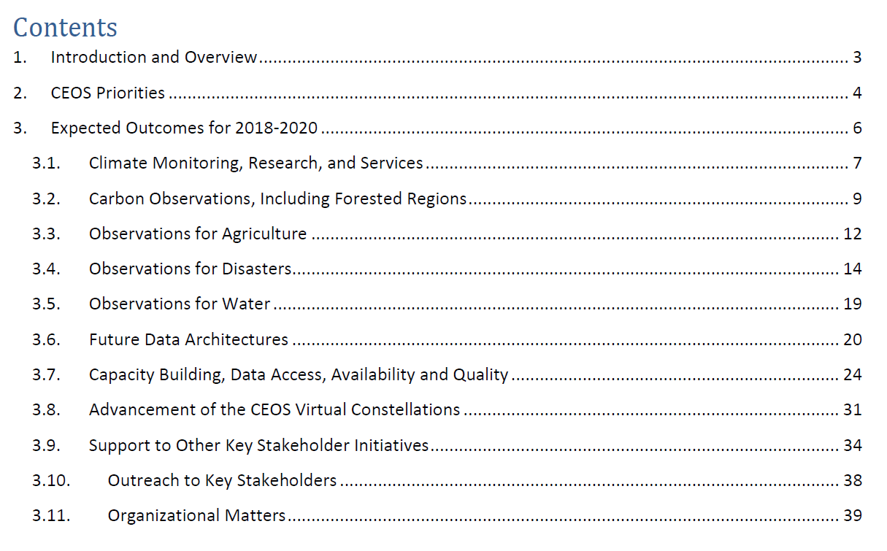
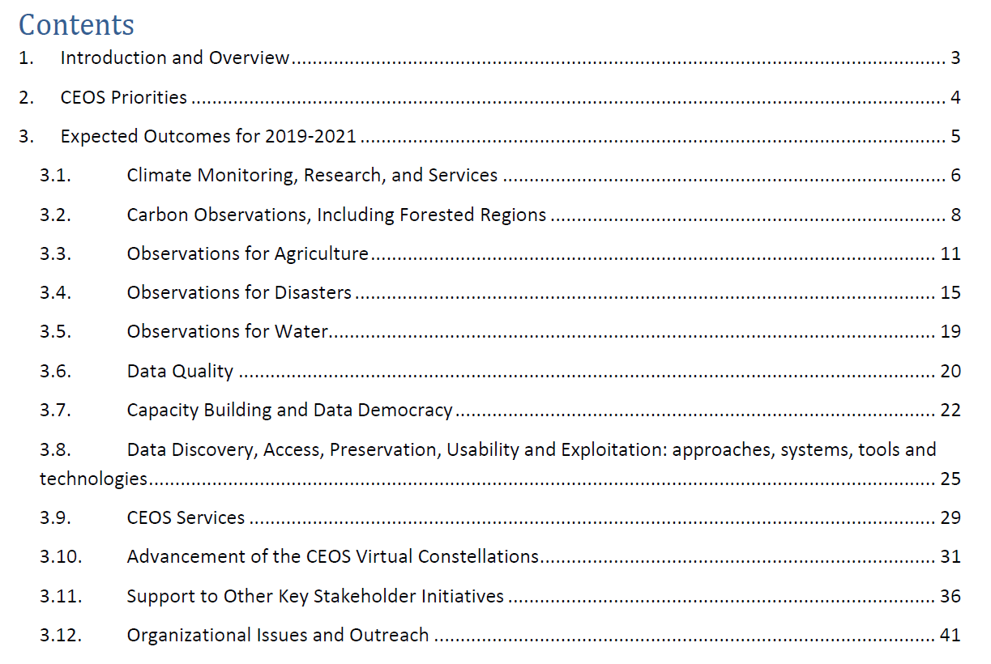
Status of CEOS 2019-2021 WP
Some changes to the structure
Thematic: Climate, Carbon, Agriculture, Disasters, Water, SDGs, Oceans and coasts, Polar, Biodiversity
Cross-cutting: Capacity building, Data access, Data quality, VCs, Outreach
2018
2018
2019
2019

Slide 10


2018 to 2019 …
Evolutions 2018 to 2019 …
103 open deliverables
(91 in 2018, 88 in 2017)
  76 deliverables to be closed in 2019 (69 in 2018)
  42 newly created in 2019 (29 in 2018)
~28 open 2018 deliverables had completion data pushed back (29 in 2017)
+ 13%
+ 10%
+ 38%
- 0.3%

Slide 11
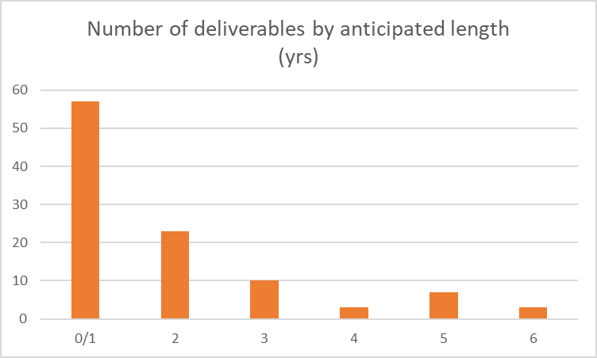
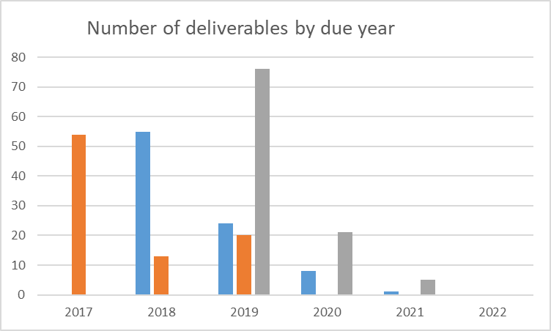
WP 2019-2021 in figures
103 open deliverables of which 42 newly created in 2019
Of these 42 new deliverables
  83% scheduled to be
  completed in 2019
  16% in 2020
  1% in 2022
WP 2017-19
WP 2018-20
WP 2019-21

Slide 12
CEOS WP Annual Cycle
July
June
August
May
SIT TW
April
Deliverable
Updates
September
SIT
WP Progress
Report (CEO)
March
2019-2021
CEOS Work Plan
ENDORSED 22nd
March
October
CEOS
Plenary
November
February
December
January
Work Plan development

Slide 13
Work Plan Progress Updates
Major change between 2018-2020 and 2019-2021 Work Plans
A « responsible person » is in charge of every Work Plan deliverable
WG/VC/AHT chair have oversight over all deliverables that involve their entity
Work Plan updates phase launched on 12/09
Email sent to every responsible person
Login credentials provided to all for new deliverables.ceos.org website
Updates must be provided to deliverables.ceos.org database by 30/09
New website functionality
Bugs removed
Inputs are restricted, nominative and time-stamped
Need to provide information on deliverable due date changes to CEO

Slide 14
Take away messages
CEOS Leadership
CEOS Chair - VNSC, Vietnam in 2019; ISRO subsequently
CEOS SIT Chair – NOAA until October 2019; CSIRO/GA subsequently
Candidate for CEOS Executive Officer urgently required!
Two Study Teams formed on creation of new WG and merging of Ocean VCs recommend no immediate changes
CEOS Work Plan
CEOS 2019-2021 Work Plan available online
Slight structural changes
CEOS “Services” concept created (7 “deliverables” in 2019-2021 WP)
Some “best practice” proposed in this presentation
CEOS 2019-2021 Work Plan Progress Report out soon!

