Slide 1
WGISS Working Group on Information Systems & Services
Chair report
Committee on Earth Observation Satellites
Mirko Albani – European Space Agency (ESA)
WGISS-48
Hosted by VAST/VNSC, Ha Noi, Vietnam
8-11 October 2019

Slide 2
WGISS Structure
Chair, Mirko Albani, ESA
Vice-Chair, Robert Woodcock, CSIRO
WGISS Principals
CAS/AOE: Guangyu Liu
CAS/RADI: Lizhe Wang
CSA: Paul Briand
CNES: Richard Moreno
CONAE: Homero Lozza
CSIRO: Robert Woodcock
DLR: Katrin Molch
EC: Astrid Koch
ESA: Mirko Albani
EUMETSAT: Michael Schick
GA: Simon Oliver
HSO: Gabor Remetey
INPE: Lubia Vinhas
ISRO: Nitant Dube
JAXA: Makoto Natsuisaka
NASA: Andrew Mitchell
NOAA: Kenneth Casey
NRSCC: Chuang Liu
ROSCOSMOS: Tamara Ganina
USGS: Kristi Kline
UKSA: Esther Conway
WGISS Secretariat (Michelle Piepgrass, ESA)
Data Preservation and Stewardship Interest Group
(Mirko Albani, ESA)
Discovery and Access - WGISS Connected Data Assets System Level Team (Yonsook Enloe, NASA)
- IDN (Michael Morahan, NASA)
- FedEO (Mirko Albani (ESA)
- CWIC (Yonsook Enloe, NASA)
- OpenSearch II (Olivier Barois, ESA)
Interoperability and Use Interest Group
(Robert Woodcock, CSIRO; Richard Moreno, CNES)
- Future Data Architectures (Robert Woodcock, CSIRO)
- Carbon Portal (Kenneth Casey, NOAA; Liping Di, NOAA)
- Data Analytics Software and Tools (Mirko Albani, ESA)
Technology Exploration Interest Group
(Chris Lynnes, NASA; Yousuke Ikehata, JAXA)

Slide 3
Sustainable Commitment
Interagency coordination working well, very good cooperation spirit and healthy participation to meetings (average 20 people)
Some members attending all meetings (e.g. NASA, NOAA, USGS, CNES, ESA, CSIRO, JAXA, CAS/RADI, CAS/AOE, HSO)
Others attending some meetings depending on location/topics (e.g. CSA, EUMETSAT, ROSCOSMOS, INPE, CONAE, DLR, UKSA, ISRO)
Additional agencies expressed interest in WGISS activities with potential future (stable) participation (e.g. GISTDA, VNSC/VAST, ASI)
Chairmanship after 2019 Plenary:
WGISS Chair: Robert Woodcock (CSIRO)
WGISS Vice Chair: Makoto Natsuisaka (JAXA)
WGISS Infrastructure Services Project (WISP) core services/support (e.g webconf, website, mailing list, meetings archive) shared between WGISS Secretariat and SEO team.

Slide 4
CEOS Work Plan 2019-21
WGISS Deliverables
WGISS Deliverables progress updated in CEOS Deliverables Tracking Tool
CARB-15: Carbon Data Portal - Action Closed
DATA-2: CEOS Agency datasets through
WGISS CDA - Q2 Every Year
DATA-9: ECVs/CDRs - Q4 2019
DATA-11: Technology webinars - Q4 2019
DATA-13: Single Sign-On Paper - Q2 2019
DATA-15: AI White Paper - Q4 2020
DATA-16: CEOS data in GEO - Q4 2019
FDA-5: Awareness of FDAs - Action Closed
FDA-8: FDA Block Paper - Q3 2019
FDA-9: FDA Inventory - Action Closed
FDA-10: Software/Tools Inventory & Access - Q3 2019
FDA-14: SW tools access through WGISS CDA - Q4 2020
CEOS Work Plan 2020-22 will be prepared from mid-November to mid-February

Slide 5
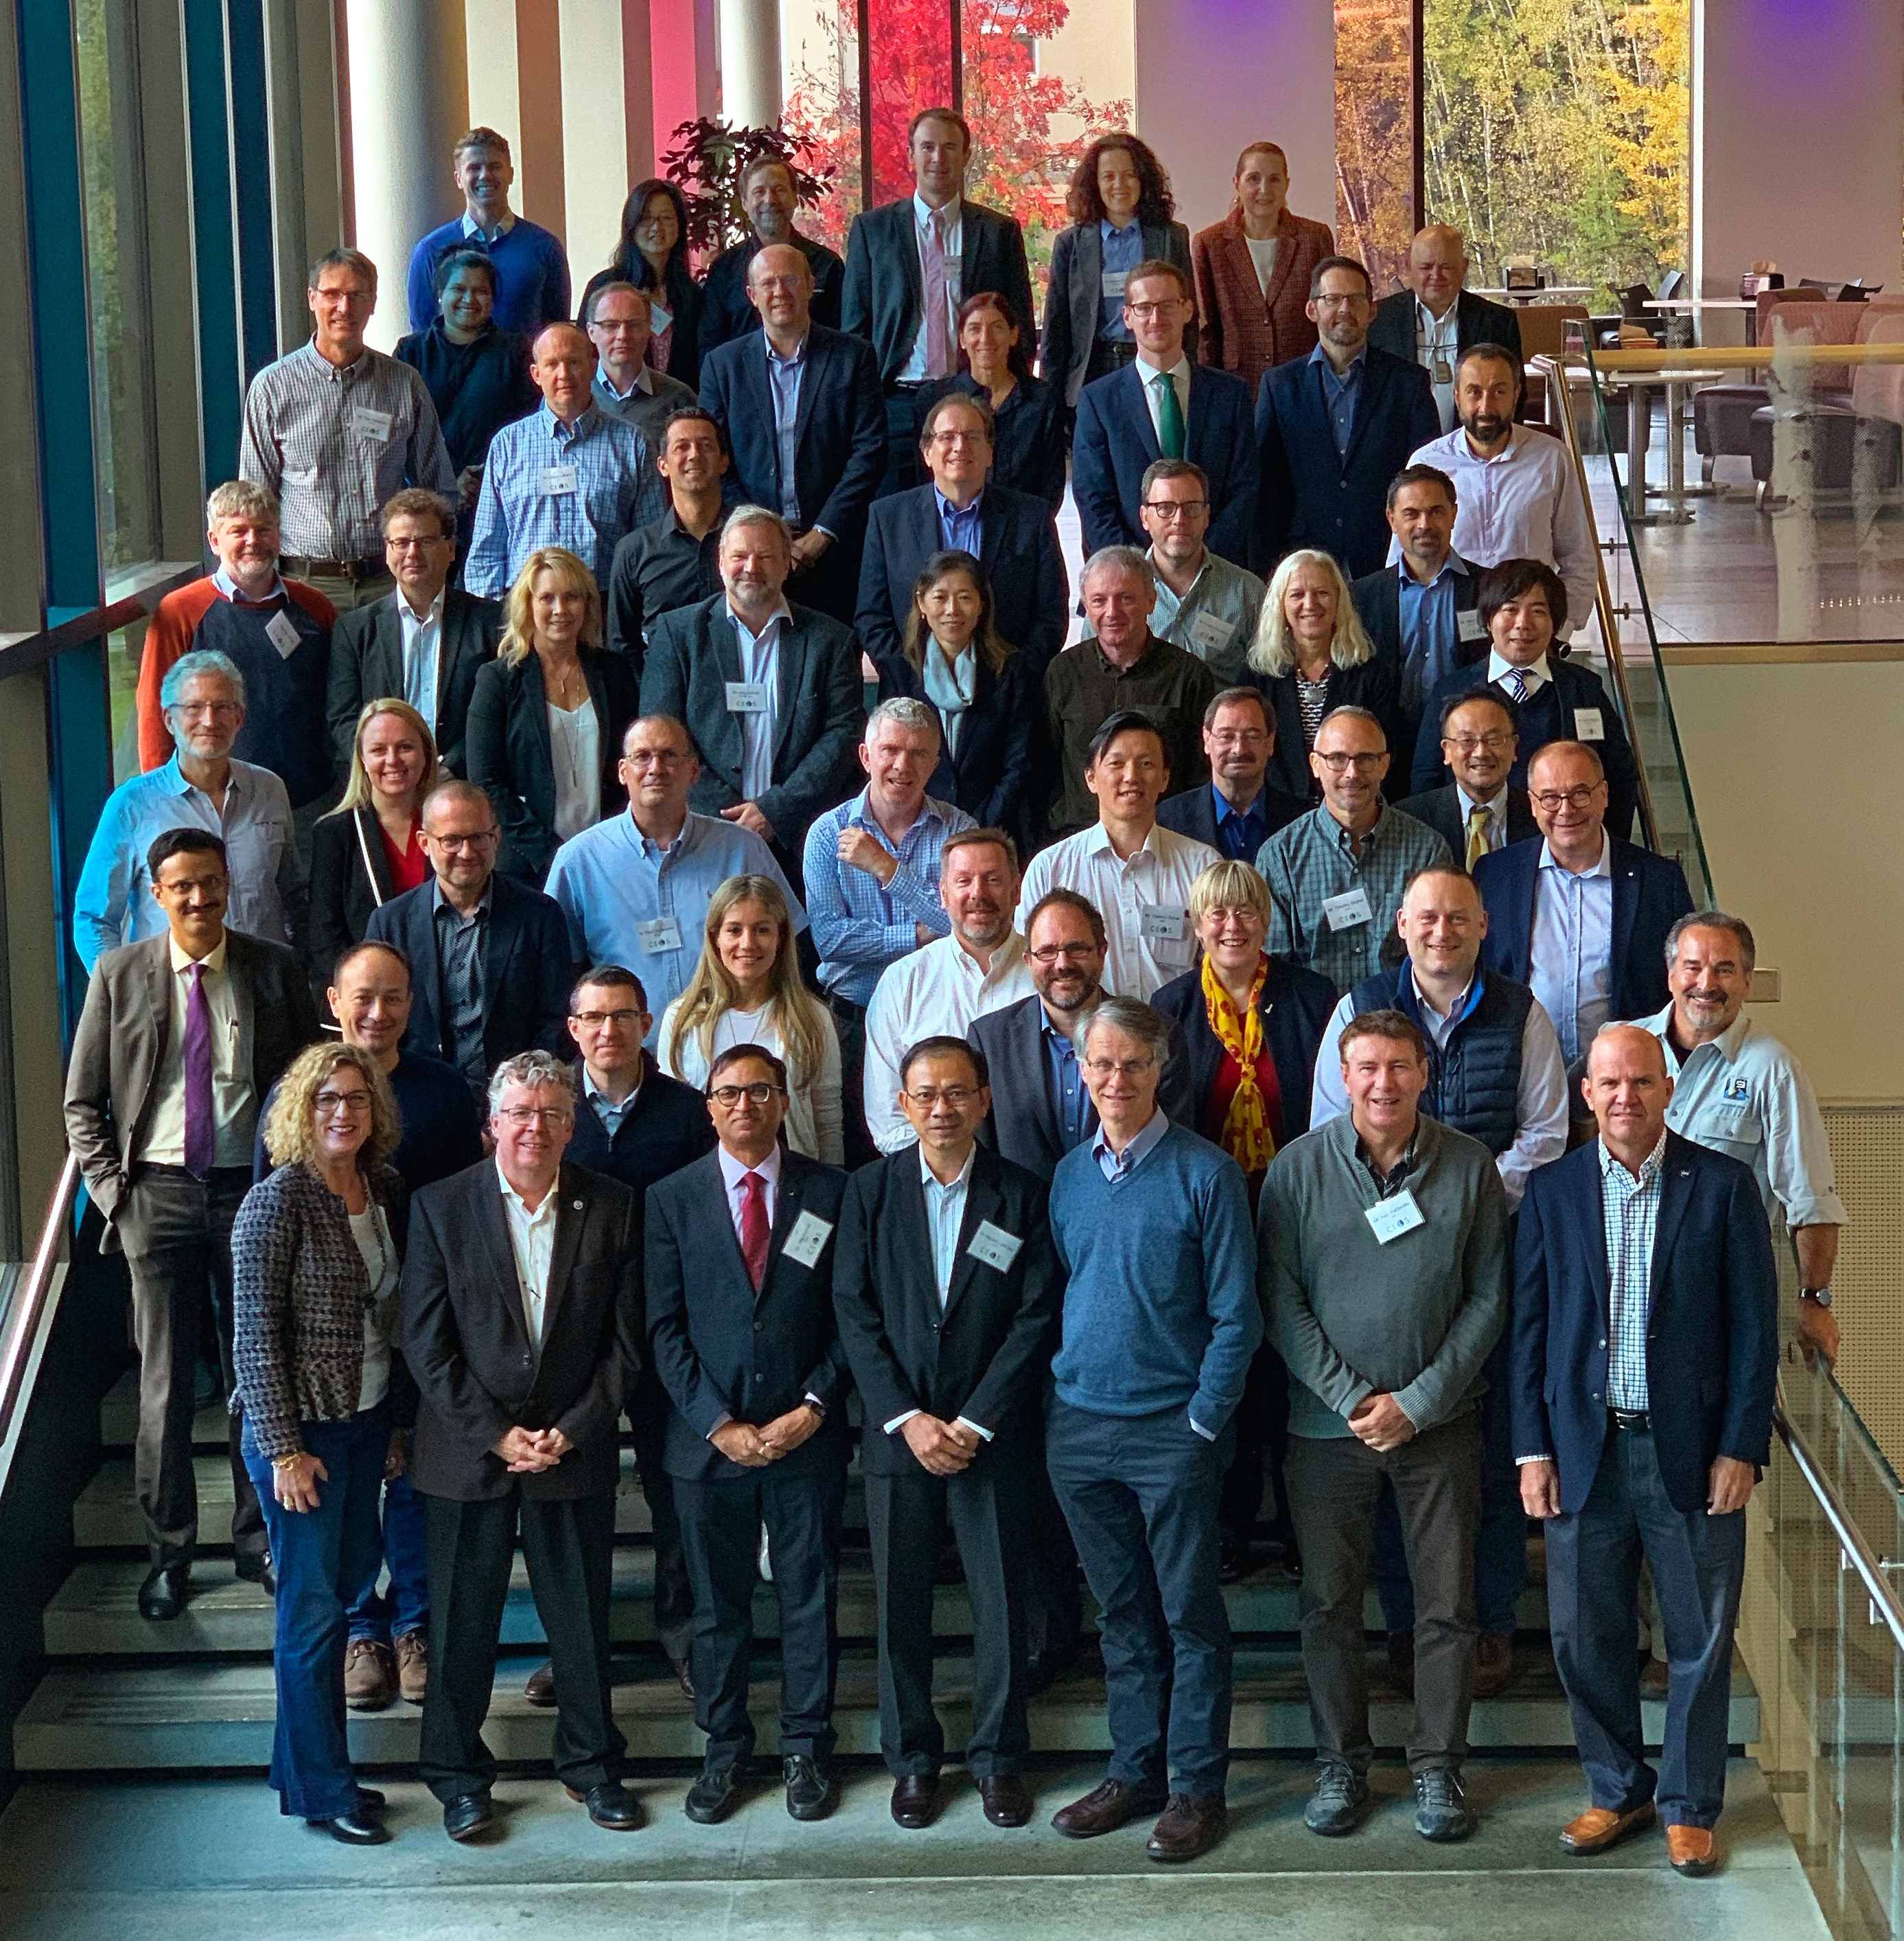
2019 CEOS SIT Technical Workshop, Fairbanks (USA) 9-12 September 2019
http://ceos.org/meetings/2019-sit-technical-workshop/

Slide 6
2019 CEOS SIT Technical Workshop, Fairbanks (Alaska, USA) VC-WG-AHT Working Day, 9 September 2019
WG Study Team: address additional user communities needs (e.g. from GEO) through the set-up of as new working group:
Recommendation to use existing CEOS organization without a new WG;
WG study team to prepare a final proposal for CEOS plenary endorsement.
Ocean Virtual Constellations Merger Study Team: merge four Ocean VCs to increase engagement and improve delivery of cross-domain, integrated products:
Recommendation not to merge the four OVCs (3 pros, 8 cons);
Need to implement a more rigorous tasking and feedback process between CEOS Agency Principals and individual VCs, and to identify a CEOS mechanism to develop requirements for integrated/cross-domain products to be delivered in a coordinated way by individual VCs.
Minor Language update in the VC Process Paper for VC Leadership Succession.

Slide 7
2019 CEOS SIT Technical Workshop, Fairbanks (Alaska, USA) VC-WG-AHT Working Day, 9 September 2019
Data Exploitation/Use Session (chaired by WGISS/WGCV):
Interplay between WGCV and WGISS on calibration may be a fruitful work area for future;
Outreach to Agencies for compliance with guidelines is slow, suggest we work through VCs in addition;
If end-user motivated data formats or approaches are developed within VCs, they should coordinate with WGISS.
Actions
AI.WGDAY.01A WGISS SLT to review VC data collection inventories (EXCEL) and confirm if/what information is missing to generate DIF-10 metadata for the datasets therein included;
AI.WGDAY.01B WGISS SLT to prepare a template for VC Leads to gather information for IDN registration. Ask for specific needs (e.g. One-stop-shop data discovery and access for relevant data sets and tools? Community portals?);
AI.WGDAY.02 WGISS SLT to continue work with SDG AHT Lead for discovery/access to SDG indicators relevant datasets.

Slide 8
2019 CEOS SIT Technical Workshop, Fairbanks (Alaska, USA) VC-WG-AHT Working Day, 9 September 2019
CEOS ARD Strategy (August → October 2019): good initial progress for the land imaging elements of ARD (CARD4L) but more general ARD applicability for CEOS needs to be demonstrated with non-land imaging examples.
Strategy built around four pillars with actions:
CEOS ARD User needs/specs → 1.4 CEOS Interoperability Terminology Report (Q2 2020, WGISS/Others);
Assured Production & Access → 2.2 Facilitate Discovery of and Access to CEOS agencies ARD (Q1 2020 onwards, WGISS);
→ 2.4 CEOS paper on interplay of industry and CEOS ARD (Q2 2020, Others/WGISS)
Pilots and Feedback → 3.1 Production of ARD and supply of data aggregators and platforms (Q3 2019 onwards, Others/WGISS)
Communication/Promotion → 4.3 CEOS ARD stocktake and outlook (Q3 2019 onwards, Others/WGISS).
WGISS Chair provided comments to ARD strategy
Actions
WGISS Contribution to ARD Strategy to be addressed in more detail and possibly translated in relevant actions for the CEOS Work Plan 2020-22 (process to be clarified with CEO)
ARD products tools. Explore possibility to organize a dedicated session at WGISS#49.

Slide 9
2019 CEOS SIT Technical Workshop, Fairbanks (Alaska, USA) VC-WG-AHT Working Day, 9 September 2019
GHG and Carbon
No current need for update to the Carbon Strategy;
GHG Roadmap: CEOS group roles identified, need to work more with CGMS.
Actions
Update WGISS Glossary of Terms to add ECV definitions and other interoperability related terms to help in communicating with external entities: cooperation with WGClimate/LSI-VC/WGCV.
Coastal Observations: Suggestion to form a Study Team to initiate the discussion on Coastal observations; include multi-sensor observations through value chain to extract information for users.
SST-VC preliminarily expressed the need of a Data Cube for coastal activities: could be a potential WGISS project (Pilot contribution to ARD strategy). To be further investigated.

Slide 10
2019 CEOS SIT Technical Workshop, Fairbanks (Alaska, USA) VC-WG-AHT Working Day, 9 September 2019
GFOI
AHT will contact WGISS to share what works and what does not work with CEOS agencies in terms of data access and see if/how we can help.
GFOI registered 34 tools and services which could be potentially added to the WGISS SW/Tools inventory. To be further investigated.
Others
Knowledge Hub implementation at CEOS level?
→ We should continue our work with DOIs to ensure that Metadata at collection level in the IDN contain a DOI pointing to relevant information in landing pages.
Should WGISS address AI on-board satellites (e.g. on-board processing)?
AI could help in the CAL/VAL domain; Training systems datasets; Support traceability issues in the public policy context.
→ How can we use Artificial Intelligence to support WGCV activities? Any improvement/evolution of ongoing activities with Data Cubes?

Slide 11
2019 CEOS SIT Technical Workshop, Fairbanks (Alaska, USA)
11-12 September 2019 – WGISS Actions/Activities
WGISS report on status/progress of activities/deliverables
Several white papers produced on Data Stewardship Best Practices.
WGISS Connected Data Assets (includes IDN/CWIC/FedEO) are now classified as a CEOS Service, with GEO one of the main users.
FDA activities in WGISS are addressing: services/tools/elements discoverability; interoperability; showcasing support to CEOS/GEO Initiatives; and, outreach.
Cooperation with WGCV: ESA PDGS Data Cube (https://preops.eodatacube.eu/) provides services to RadCalNet, and ACIX (In-situ and S-2/L-8) data, including Jupyter notebooks to reproduce ACIX use cases: http://calvalportal.ceos.org/results.
Exploring topics related to Artificial Intelligence and Machine Learning.
A number of activities with other CEOS Teams (e.g., Carbon/WGClimate, WGDisasters, WGCV, VCs, WGCapD, SEO, and SDG AHT), as well as a number of contributions to GEO.
Robert Woodcock (CSIRO) will take over as WGISS Chair from Plenary, with Makoto Natsuisaka (JAXA) as Vice Chair.
CEO position after CEOS 2019 Plenary currently vacant → impact on CEO activities like CEOS Work Plan 2020-22 preparation
Notes:
QUI AGGIUNGERE OUTCOMES

Slide 12
WGISS Cooperation

Slide 13
Synergies Among CEOS Teams
CEOS Carbon Team/WGClimate - Carbon Portal development and possible use for next phase of carbon strategy, ECV/CDRs registration in IDN, ECV inventory update automation.
WGDisasters - possible cooperation on generic recovery observatory.
WGCV - Data cube prototypes (ESA and GA/CSIRO) supporting CAL/VAL activities through providing access to ACIX (16 sites), RadCalNet (4 sites) and LPV (3 sites) cal/val data; CEOS Data Maturity matrix.
Virtual Constellations - inventory of VC data to be updated to review discoverability/accessibility through WGISS CDA infrastructure.
WGCapD - joint organization of technology webinars and FDA events.
SEO - COVE tool harvesting WGISS metadata, data cubes coordination, implementation of web pages for tools/SW discovery.
SDG AHT - discovery of SDG indicators relevant data via WGISS CDA.

Slide 14
WGISS contribution to GEO
Past/Current
GEOSS Platform accessing CEOS data via WGISS CDA
WGISS contribution to GEOSS-EVOLVE initiative, GEO Expert Advisory Group (EAG) and GEO Technology Workshops
WGISS represented in NextGEOSS Advisory Board and working on federated authentication technology
GEO Sec reporting during WGISS meetings; Joint Workshops on GEOSS-WGISS interoperability and FDA at WGISIS-43/46, GEO Knowledge Hub side event at SIT-34
Future
Contribution to GEOSS Data, Information and Knowledge Resources and GEOSS Infrastructure Development Tasks
Advance Data Management Principles through Data Sharing and Mgm Working Group → M.Albani (ESA), R.Moreno (CNES)
Facilitate CEOS agencies data access via WGISS CDA, contribute technologies and solutions for GEOSS Infrastructure Evolution
GEOSS Infrastructure Development Task Team → R.Woodcock (CSIRO)
GEOSS Infrastructure Evolution Working Group → M.Albani (ESA), A.Mitchell (NASA, TBC)
Coordinate with GEO Sec for joint workshops
Input provided to GEO Secretariat

Slide 15
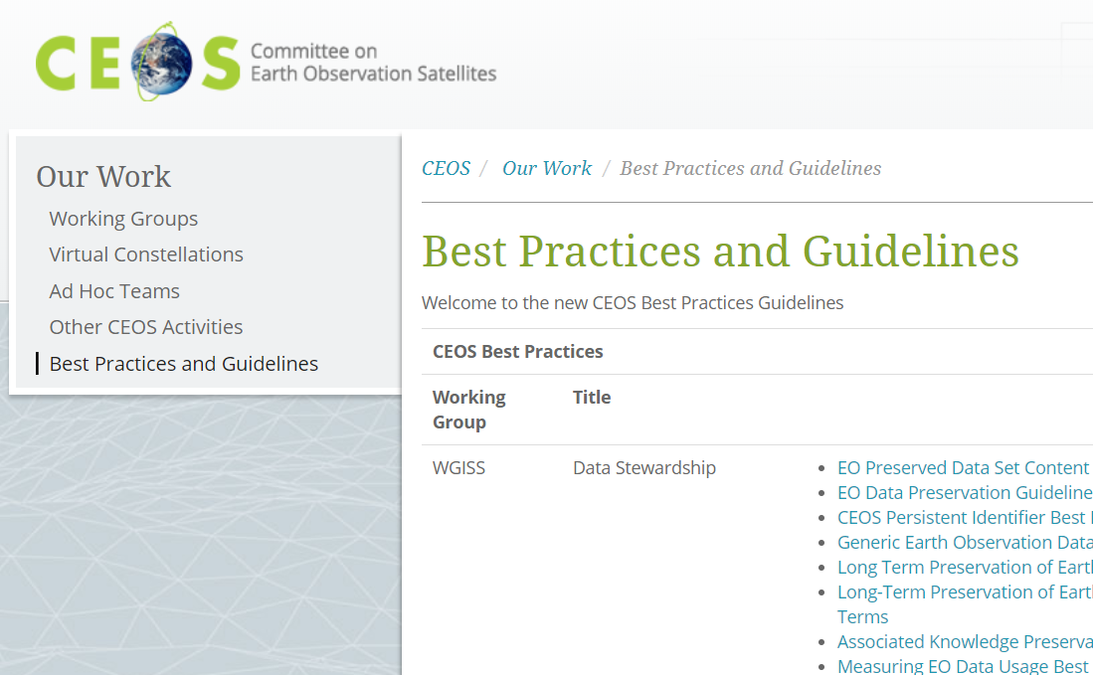
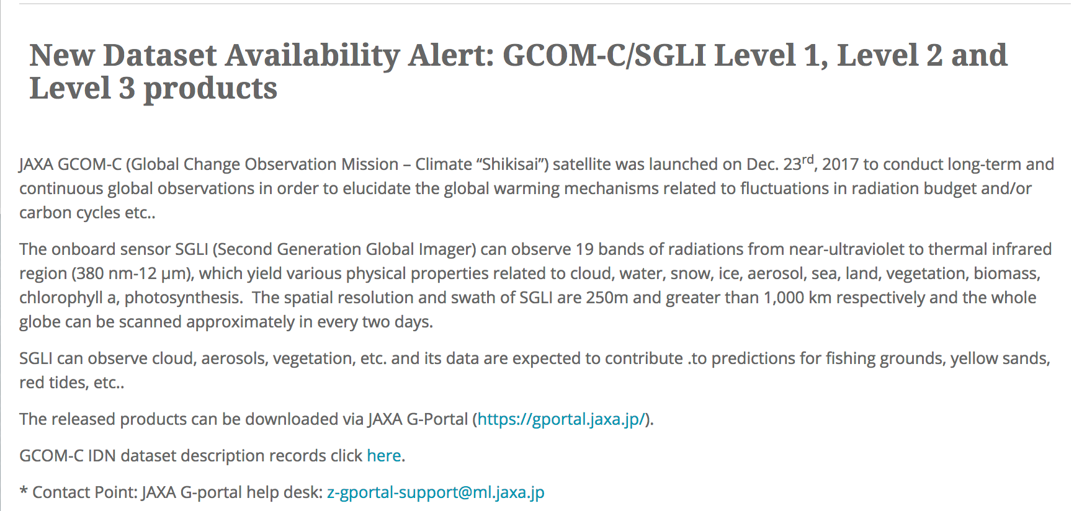
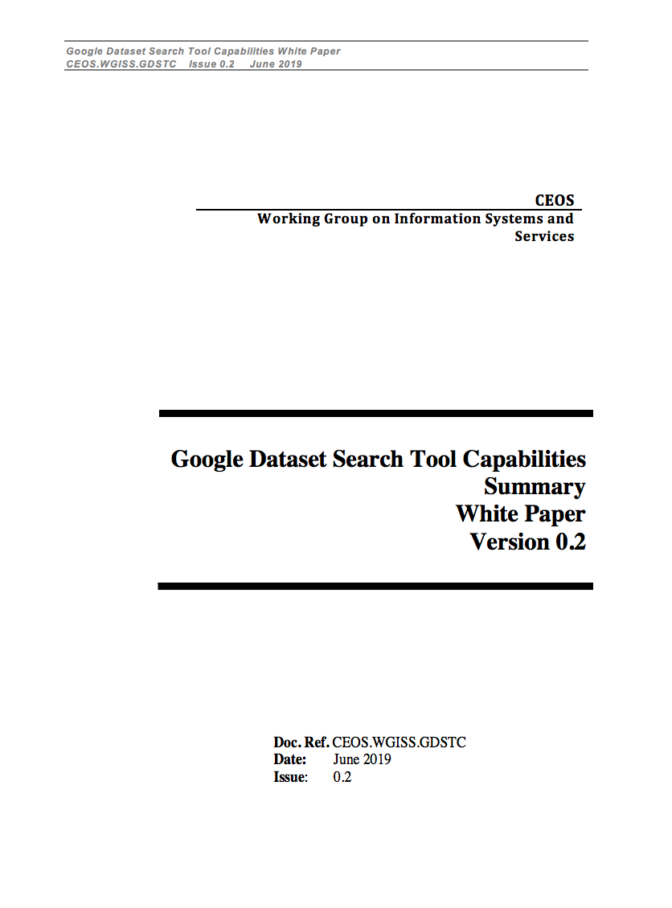
Additional Achievements
Web-page initiated and maintained on the CEOS website under "Our Work” to facilitate discovery and access to Best Practices and Guidelines developed by CEOS WGs; WGISS coordinating population in cooperation with SEO team.
New Data Set Availability Alert Procedure defined and implemented with SEO team to publicize new available data.
Google Data Search Tool report compiled with inputs from NASA, DLR, NOAA, ESA. It describes how the tool allows discovery of CEOS agencies data.
→ Under review by WGISS, will be circulated by end September.

Slide 16
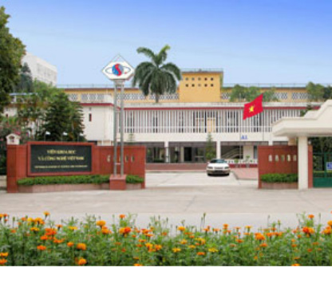
33rd CEOS Plenary
14-16 October 2019 – Hanoi, Vietnam
VIETNAM ACADEMY OF SCIENCE AND TECHNOLOGY
http://www.vast.ac.vn/en/about-vast
Notes:
NON HO CONOSCENZA

Slide 17
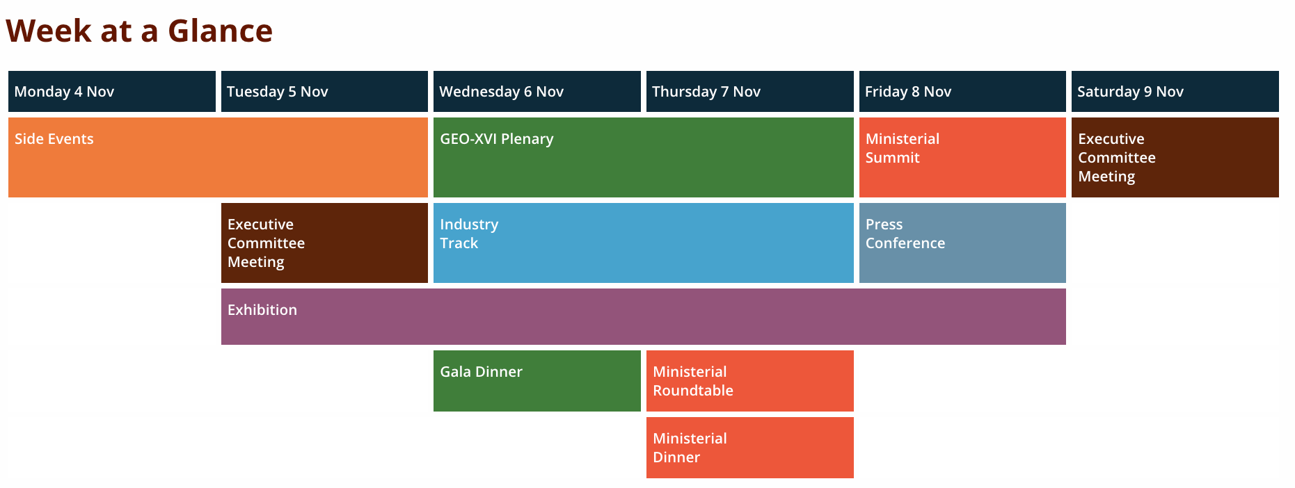
GEO Events
GEO Data Providers Workshop and GEO Data Technology Workshop in a new format as a single event hosted by the ChinaGEO Secretariat.
Focus on open data and ways to ensure that available EO data and knowledge can support international policy frameworks. It will include a full programme of workshops, training sessions, EO site tours, and more.
Notes:
NON HO CONOSCENZA

Slide 18
Contact:
Mirko.Albani@esa.int

