Slide 1

WGISS Infrastructure Project (WISP) Report
Committee on Earth Observation Satellites
Michelle Piepgrass
WGISS-48
Hanoi, Vietnam
October 8, 2019

Slide 2
WGISS WISP Responsibilities
The purpose of the WGISS Infrastructure Services Project (WISP) is to make technology an asset for WGISS needs by offering technological support during WGISS meetings and providing solutions for the needs of other Interest Groups and Projects. The primary activities are:
Creating and maintaining the WGISS webpages found on the CEOS website. This includes, but is not limited to, the meeting pages for each WGISS meeting.
Creating and maintaining 9 mailing lists which are used by WGISS and its interest groups and project groups.
Providing teleconference support in the form of GotoMeeting for WGISS teleconferences.
Providing meeting logistics coordination during the semi-annual in-person WGISS meetings including GotoMeeting for the remote attendees.

Slide 3

Support Team
Lead
  TBD
Team
  Michelle Piepgrass (mvpiepgrass@gmail.com)
  For any technical CEOS server requests, contact: it@ama-inc.com

Slide 4

WISP Request
The WISP’s success depends on YOU to:
Keep us informed of any new or departing members from your organization so we can keep the mailing lists up-to-date
Let us know of any changes needed to the
WGISS webpages
Support our outreach activities

Slide 5


WGISS-47 Presentations
Presentation Format:
  YYYYMMDDTHHMM_Title (ie. 20190429T1020_WISPREPORT)
  ***Please use two digit format for month, day, hour, and minutes (example: October=10) and use underscores ***
  Delivery Method
  Send email with presentation to
  Michelle at mvpiepgrass@gmail.com

Slide 6
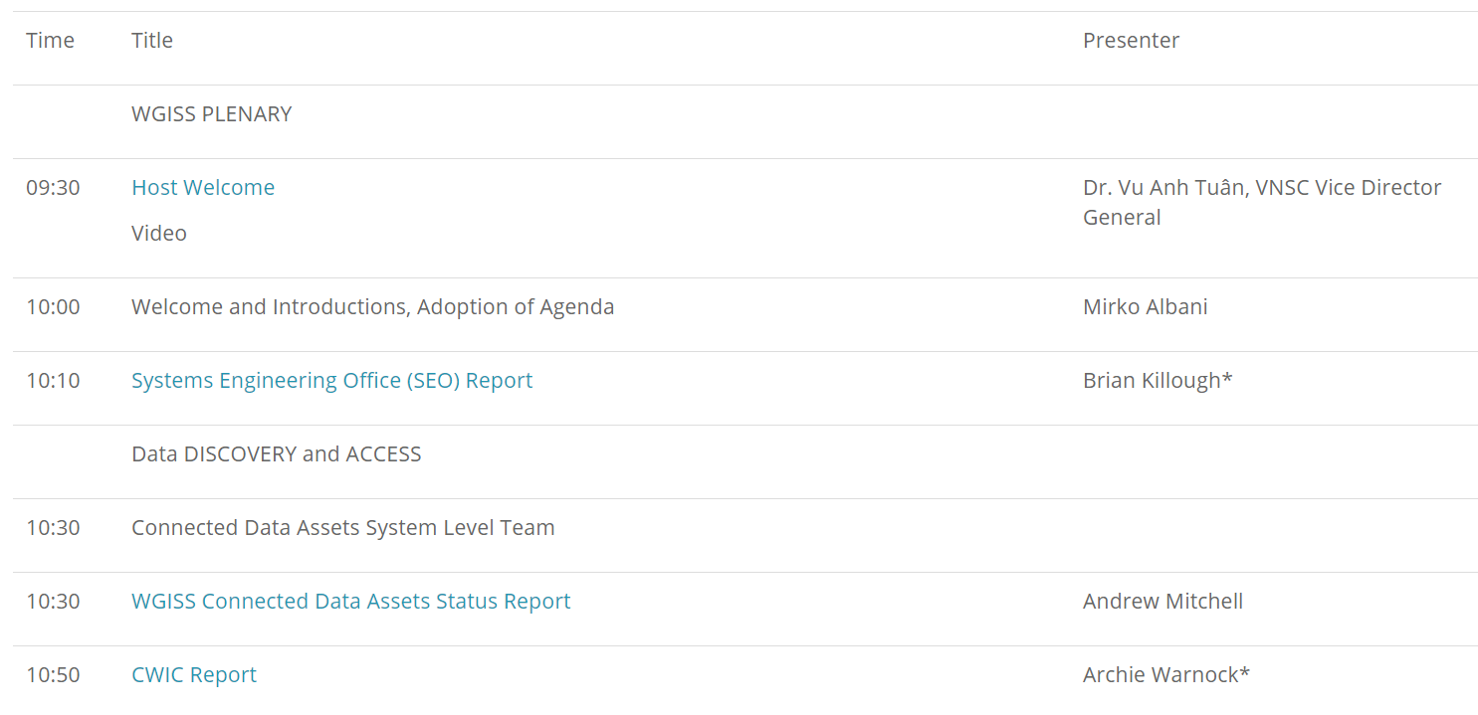
WGISS-47 Presentations
Presentations will be directly linked to the online agenda
Your cooperation is critical to ensure a
smooth time management!!

Slide 7
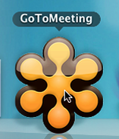
Please join my meeting from your computer, tablet or smartphone: https://global.gotomeeting.com/join/916841477
You can also dial in using your phone.
(For supported devices, tap a one-touch number below to join instantly.)
United States: +1 (786) 535-3211
Access Code: 916-841-477
New to GoToMeeting? Get the app now and be ready when your first meeting starts: https://global.gotomeeting.com/install/916841477
Web Conferencing
WGISS-47 Meeting Remote Participation
1. Please join my meeting.
https://global.gotomeeting.com/join/
2. Use your microphone and speakers (VoIP) - a headset is recommended. Or, call in using your telephone.
Access Code: 916-841-477
Audio PIN: Shown after joining the meeting
Meeting ID: 916-841-477

Slide 8
Thank you!

