Slide 1
OGC Happenings:
OGC19-020: Testbed-15 Service Discovery
Yves Coene (Spacebel), Andrea Della Vecchia (Randstad),
Damiano Guerrucci (ESA), Mirko Albani (ESA)
CEOS WGISS#48
8th October 2019

Slide 2
Outline
Introduction
Service discovery model
Implementations
Conclusion

Slide 3
Introduction
OGC 13-026r9, OGC 17-047, OGC 17-003 have been approved by OGC.
  Benefited from thorough review comments by WGISS SLT members.
  Covered EO OpenSearch and EO Granule metadata (GeoJSON)
OGC Testbed-13 (2017) and Testbed-14 (2018):
  "Application Package" to package and deploy (processing) applications on a cloud environment (i.e. Dockerized components)
  ADES and EMS services, based on WPS-T model.
Emerging next generation of OGC services model (RESTful)
  OpenAPI
  OGC API Common
  OGC API – Features - Part 1: Core (OGC 17-069r2)

Slide 4
Introduction
OGC 13-026r9, OGC 17-047, OGC 17-003 have been approved by OGC.
  Benefited from thorough review by WGISS SLT members.
  Covered EO OpenSearch and EO Granule metadata (GeoJSON)
OGC Testbed-13 (2017) and Testbed-14 (2018):
  "Application Package" to package and deploy (processing) applications on a cloud environment (i.e. Dockerized components)
  ADES and EMS services, based on WPS-T model.
Emerging next generation of OGC services model (RESTful)
  OpenAPI
  OGC API Common
  OGC API – Features - Part 1: Core (OGC 17-069r2)

Slide 5
Introduction
OGC Testbed-14 – multi-platform workflows

Slide 6
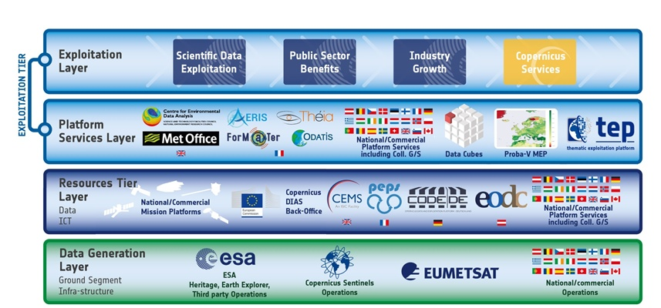
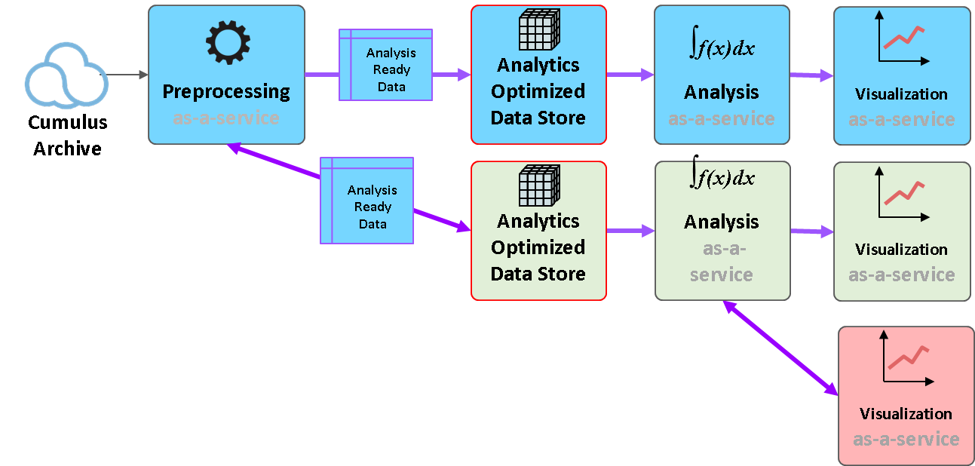
Introduction
Testbed-15 proposes common (standards-based) approach to …
    (1) discovery of EO data processing applications and services
    (2) deploy them (if not yet deployed) behind standardised OGC interfaces
    (3) execute them
Enhance discoverability of scattered EO Processes and Applications (e.g. ESA Common Architecture, NASA multi-agency analytics)

Slide 7
Outline
Introduction
Service discovery model
Implementations
Conclusion

Slide 8
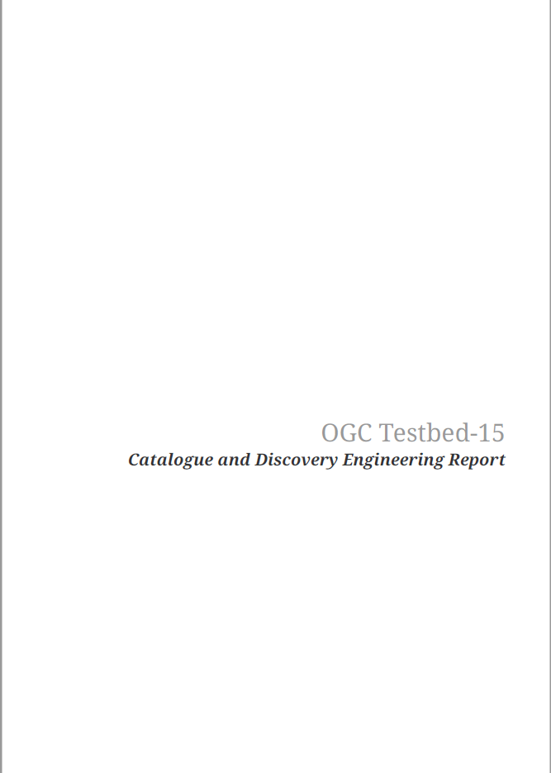
Service Discovery Model
Objectives
  Developer friendly solution consistent across environments to discover, deploy, invoke “building blocks”
  Developer friendly technology choices: JSON, OpenSearch, OpenAPI, …
  Binding agnostic data model
Deliverables
  Engineering Report OGC 19-020

Slide 9
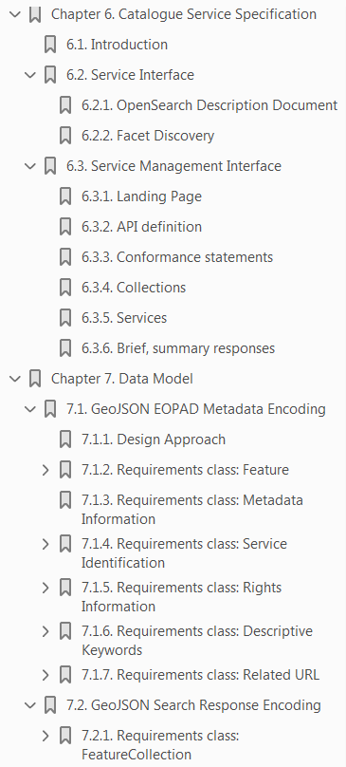
Service Discovery Model
OGC 19-020: EO process and application
discovery model (Engineering Report)
  §6.2 - Service interface
  §6.3 - Service management interface
  §7 - Metadata model
  §8 - Implementations & lessons learned

Slide 10
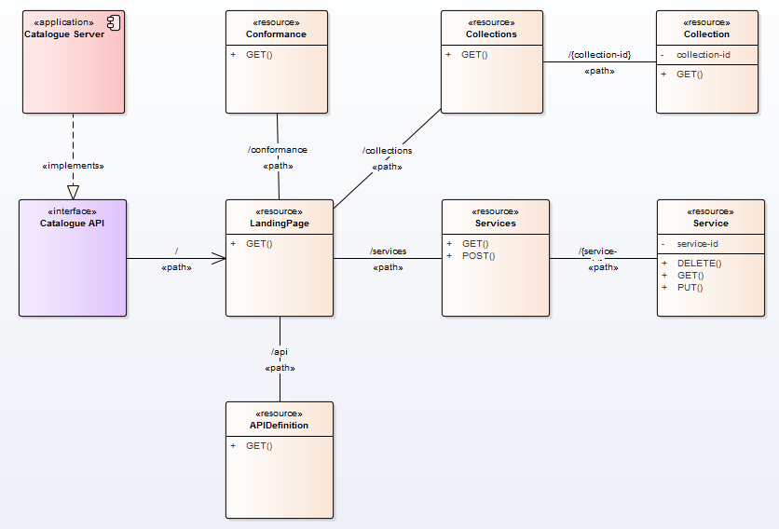
Service and Service Mgt Interface
Application resources
  Shaped by OGC API Common
Proposed by Testbed-15 (rest is OpenAPI Common)

Slide 11
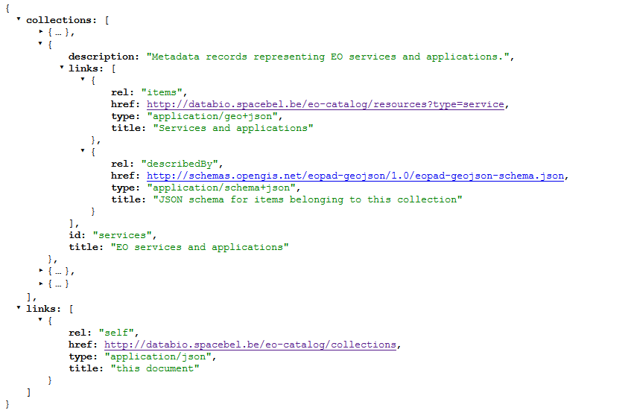
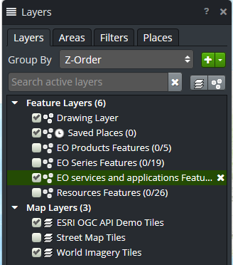

Collections - GeoJSON
/collections Collections Resource (JSON response)

Slide 12



OGC API Common - APIDefinition
/api APIDefinition Resource
  Simple (OpenSearch) or advanced (OpenAPI)
  Content negotiation

Slide 13
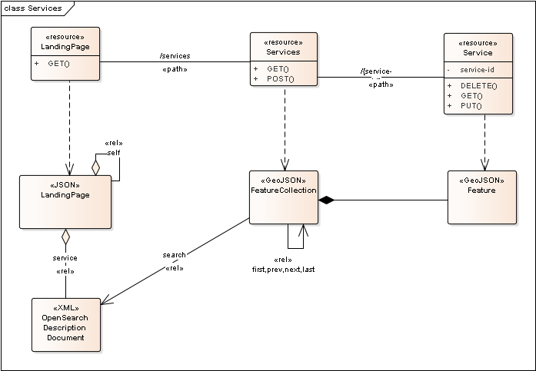
Services - GeoJSON
/services Services Resource

Slide 14
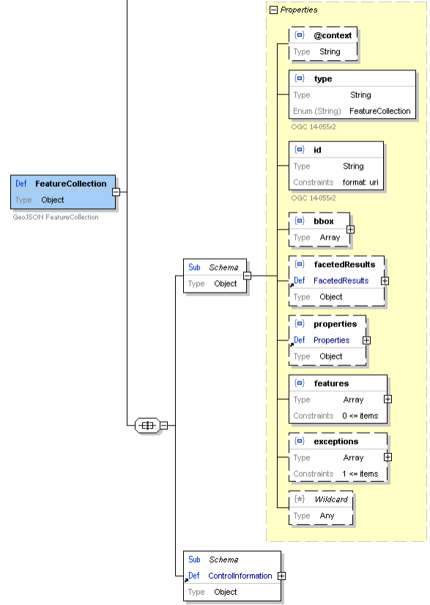
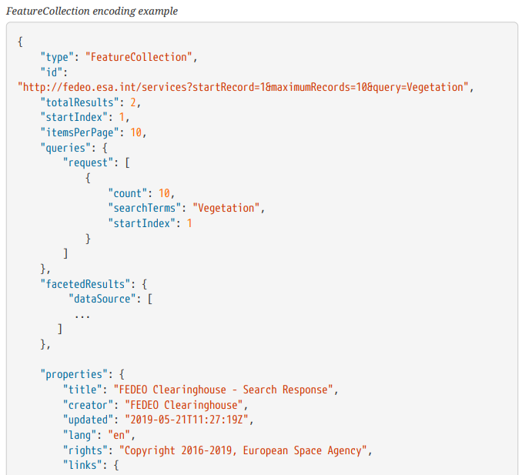
Services - FeatureCollection
/services OpenSearch Response (OGC 17-047)

Slide 15
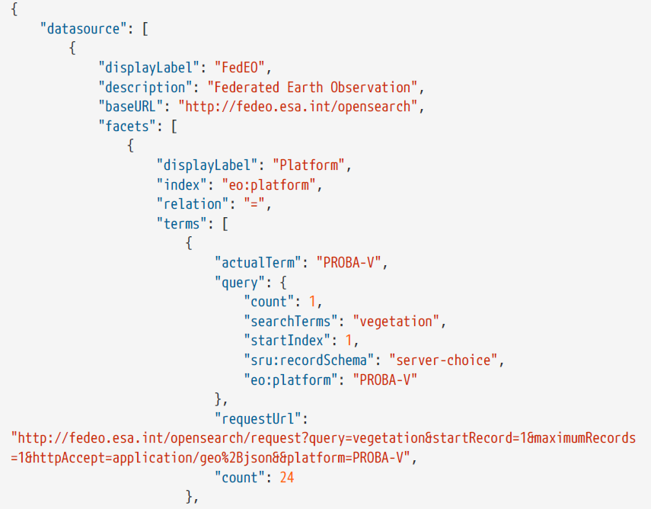
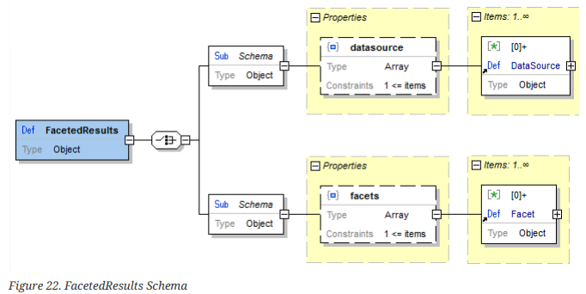
Services - Faceted Results
- Borrowed from OASIS
searchRetrieve standard*.
(*) http://docs.oasis-open.org/searchws/searchRetrieve/v1.0/os/schemas/facetedResults.xsd

Slide 16
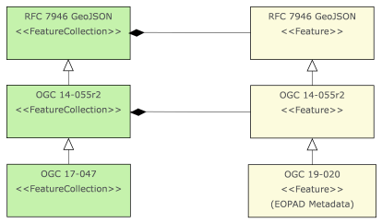
Service - Feature
GeoJSON and JSON-LD
OWS Context (OGC 14-055r2)
Aligned with DCAT (W3C) and GeoDCAT-AP (EC)
Testbed-15
OGC 19-020
EO Process & Application Metadata Testbed-15 Catalog & Discovery ER
GeoJSON Metadata
JSON-LD Metadata

Slide 17
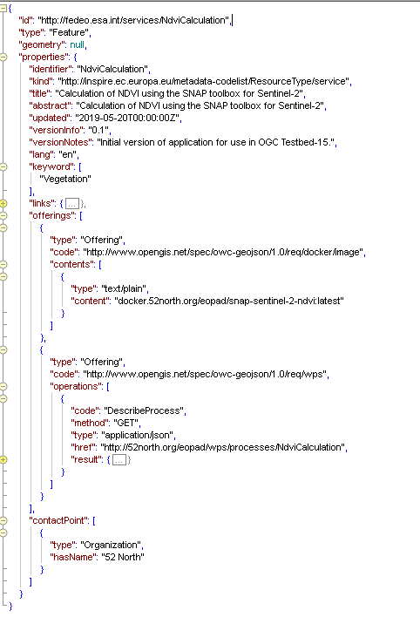
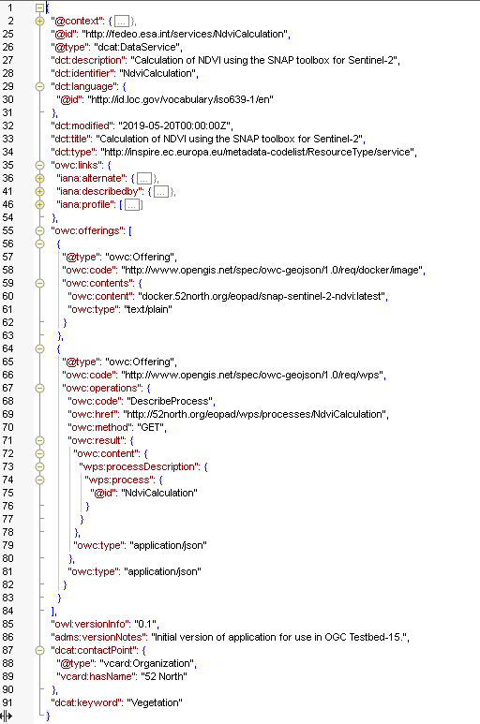
GeoJSON Feature [OGC14-055r2]
dcat:
DataService [DCAT Version 2]

Slide 18
Outline
Introduction
Service discovery model
Implementations
Conclusion

Slide 19
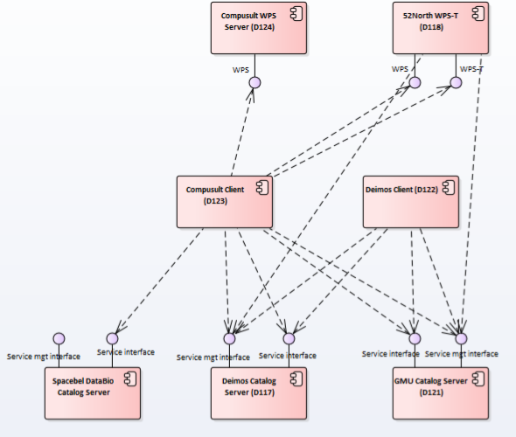
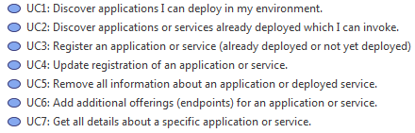
Implementations
Multiple implementations
Covering different use cases
Testing underway
ER submission (End Oct. 2019)
Presentation at TC Toulouse

Slide 20
Outline
Introduction
Service discovery model
Implementations
Conclusion

Slide 21
Conclusion
Modular discovery interface
  Simple client: "OpenSearch " (R)
  Advanced client: "OGC API Common" and OpenAPI (CRUD).
Maximum reuse of existing specifications
  OGC 14-055r2 (OWS Context)
  -> + (additional) Offerings for container, application package, etc..
  DCAT (V2), DCAT-AP, GeoDCAT-AP metadata specifications
  OGC 13-026r8, OGC 10-032r8 OpenSearch
  OGC 17-047 OpenSearch GeoJSON(-LD) Response
  OGC API Common, OASIS searchRetrieve Explain
Service-binding agnostic data-model also applicable in JSON-LD, RDF (SPARQL), Linked Data, OGC API Features...

Slide 22
Thank you.

Slide 23

References
http://databio.spacebel.be/eo-catalog/readme.html
OpenAPI Specification, Version 3.0.2 [https://github.com/OAI/OpenAPI-Specification/blob/master/versions/3.0.2.md]
OGC API (OAPI) Common Specification [https://github.com/opengeospatial/oapi_common]
JSON Schema [https://tools.ietf.org/html/draft-zyp-json-schema-04]
Data Catalog Vocabulary (DCAT) - Revised edition, W3C Editor’s Draft 05 May 2019 [https://w3c.github.io/dxwg/dcat/]
Data Catalog Vocabulary (DCAT) - Revised edition W3C Working Draft 16 October 2018 [https://www.w3.org/TR/vocab-dcat-2/]
DCAT-AP Version 1.2, European Commission [https://joinup.ec.europa.eu/solution/dcat-applicationprofile-data-portals-europe/releases]
GeoDCAT-AP Version 1.0.1, European Commission [https://joinup.ec.europa.eu/solution/geodcatapplication-profile-data-portals-europe/distribution/geodcat-ap-101-pdf]

Slide 24
References
OGC 10-032r8, OGC OpenSearch Geo and Time Extensions [https://portal.opengeospatial.org/files/?artifact_id=56866]
OGC 13-026r9, OGC OpenSearch Extension for Earth Observation (OpenSearch-EO) [http://docs.opengeospatial.org/is/13-026r8/13-026r8.html]
OGC 17-047, OGC OpenSearch-EO GeoJSON(-LD) Response Encoding Standard [https://portal.opengeospatial.org/files/?artifact_id=83328]
OASIS OpenSearch -searchRetrieve: Part 7. Explain Version 1.0, OASIS Standard, 30 January 2013 [http://docs.oasis-open.org/search-ws/searchRetrieve/v1.0/searchRetrieve-v1.0-part7-explain.html]

