Slide 1
OGC Happenings:
OGC17-084: EO Collection Metadata
Yves Coene (Spacebel), Andrea Della Vecchia (Randstad),
Damiano Guerrucci (ESA), Mirko Albani (ESA)
CEOS WGISS#48
8th October 2019

Slide 2
Outline
Introduction
Collection Metadata overview
Conclusion

Slide 3
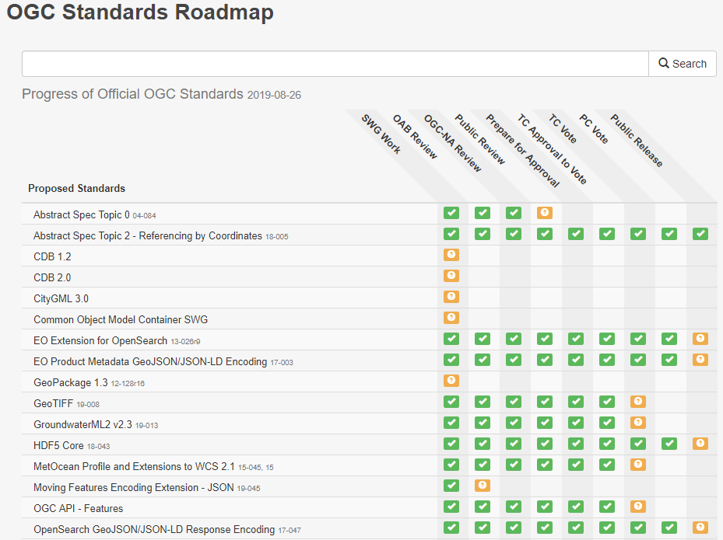
Introduction
OGC 13-026r9, OGC 17-047, OGC 17-003 have been approved by OGC.
  Cover EO OpenSearch and EO Granule metadata (GeoJSON)
  Benefited from thorough review by WGISS SLT members.

Slide 4
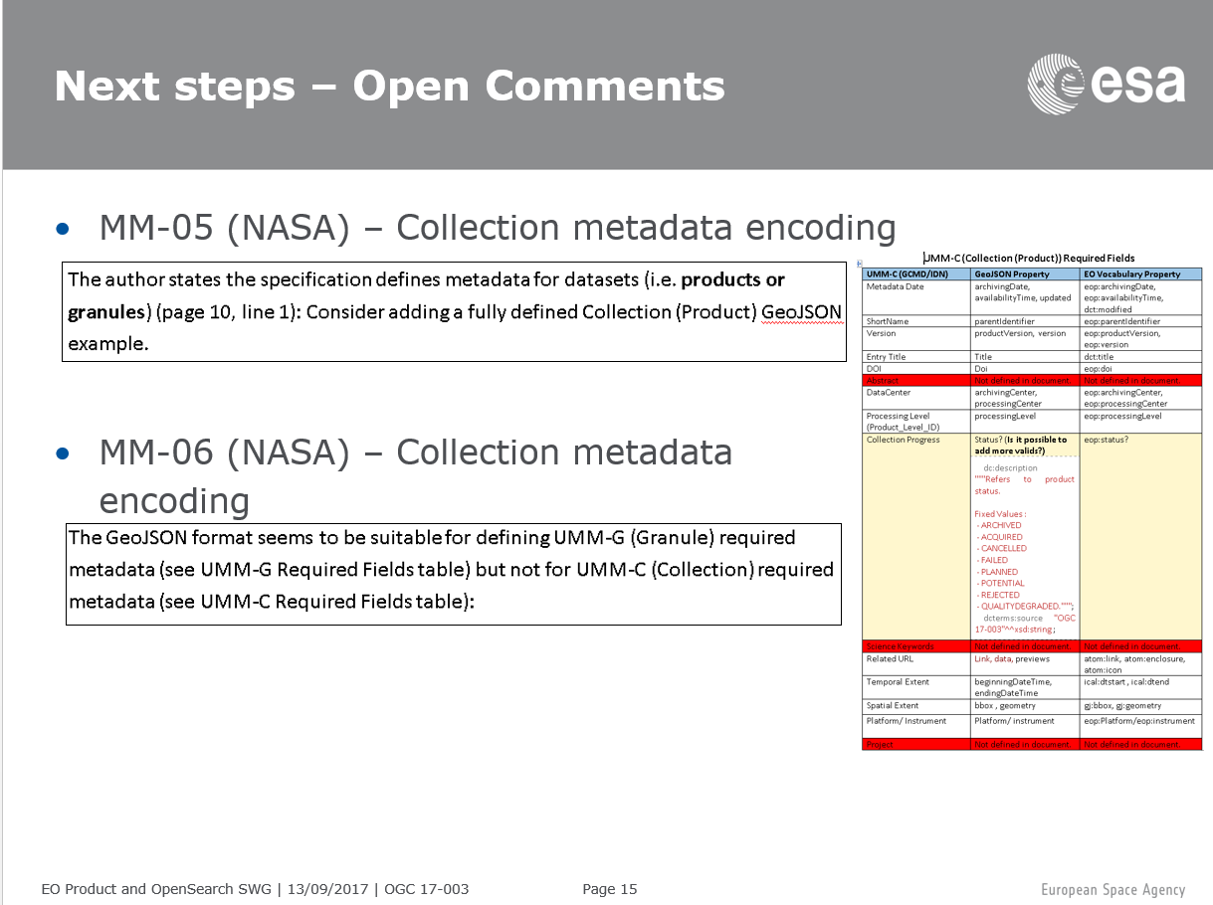
Introduction
WGISS SLT review process of OGC 17-003
raised comments related to Collection
metadata.
EOPMOS SWG at OGC TC Portsmouth 09/2017
agreed to prepare dedicated document for
EO Collection metadata since then identified
as OGC 17-084.
Prepared as background task as priority
given to OGC 17-003, 17-047 and 13-026r9.
All intermediate versions available on OGC SWG Portal pages.
Mature draft provided to WGISS SLT team for comments (11 sept 2019).

Slide 5
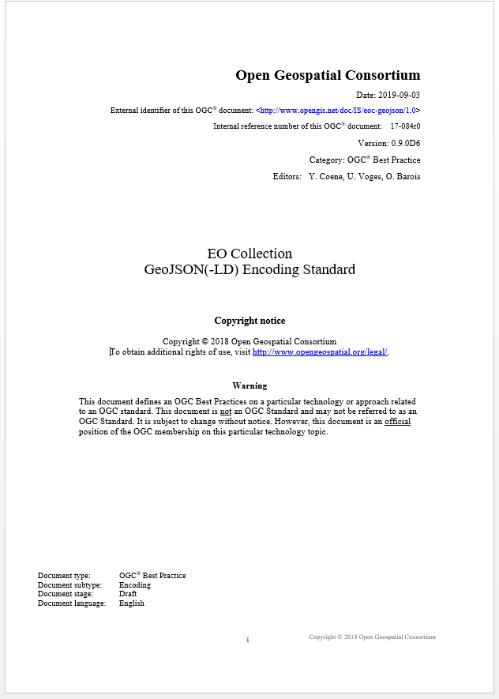

OGC 17-084 - Overview
Encoding for conceptual models:
  NASA UMM-C
  OGC 11-035r1 chapter 6
  ISO19139(-2), INSPIRE
Standards-based:
  GeoJSON (RFC 7946) Feature
  OWS Context (OGC 14-055r2)
  GeoDCAT-AP
  DCAT
GeoJSON to JSON-LD

Slide 6
OGC 17-084 - Overview
Similar approach and presentation as OGC 17-003 (Granule Metadata)
OGC 19-020
EO Process & Application Metadata Testbed-15 Catalog & Discovery ER
GeoJSON Metadata
JSON-LD Metadata

Slide 7
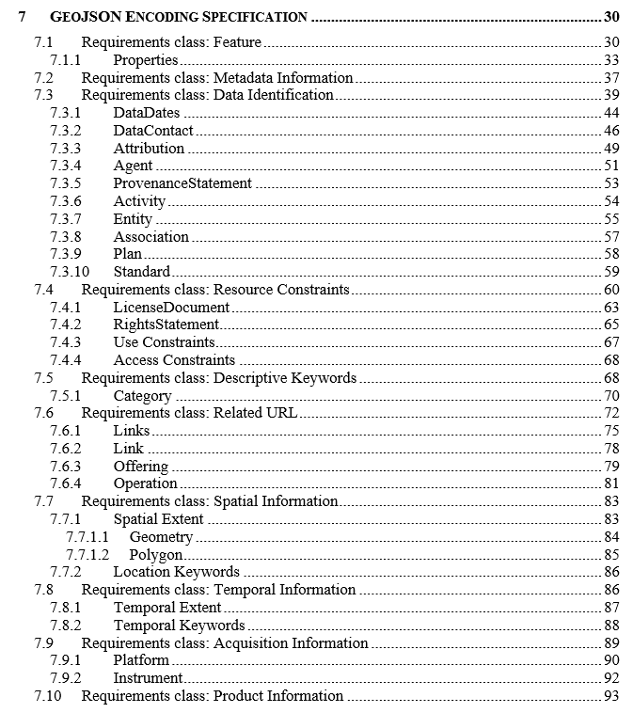
OGC 17-084 – Table of Content
Mapping between document subsections and UMM-C top-level structure.

Slide 8
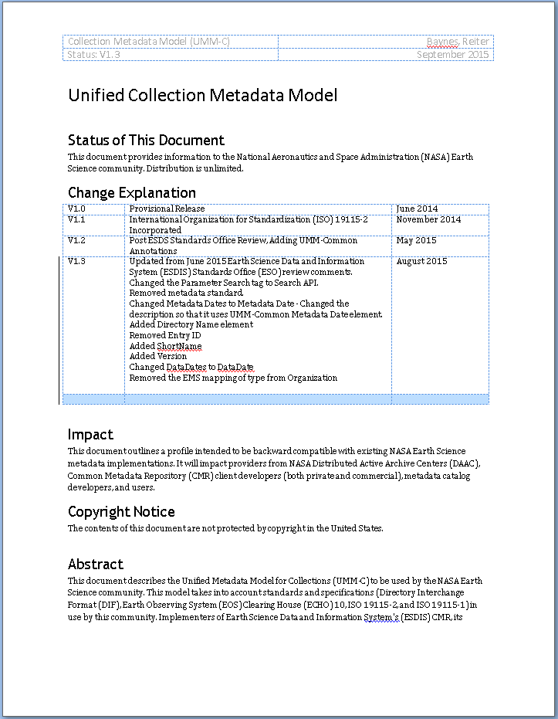
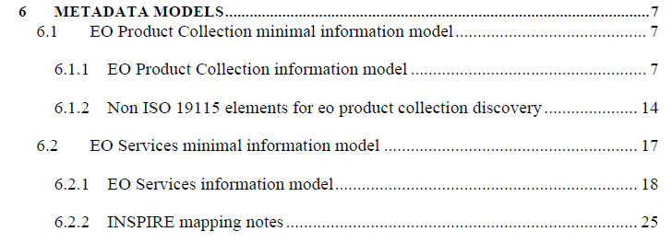
OGC 17-084 – Conceptual models
Traceability to:
  NASA UMM-C Model
  OGC 11-035r1 Chapter 6
  (ISO19115, INSPIRE)

Slide 9
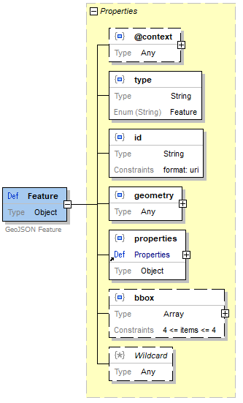
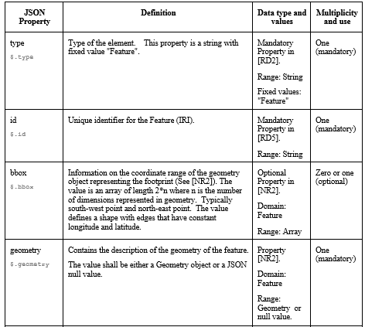
Chapter 7: GeoJSON Encoding
Top-down presentation
  JSON schema (draft 4) graphical representation
  Property tables
  GeoJSON example

Slide 10
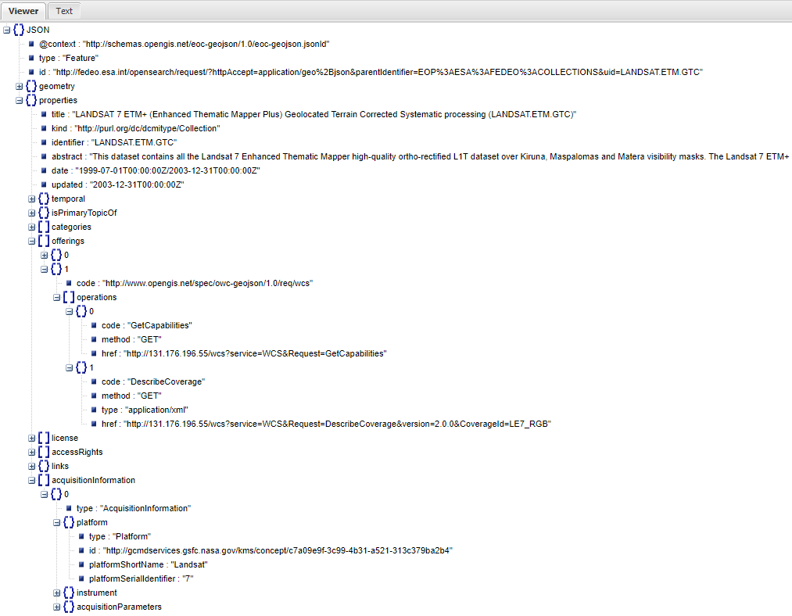
GeoJSON Encoding - Feature
Collection encoded as GeoJSON Feature, with "geometry" and "properties"
Related service "offerings" , e.g. WCS (DataCube)
acquisitionInformation and productInformation defined in
OGC 17-003
(*) Visualised with http://jsonviewer.stack.hu/

Slide 11
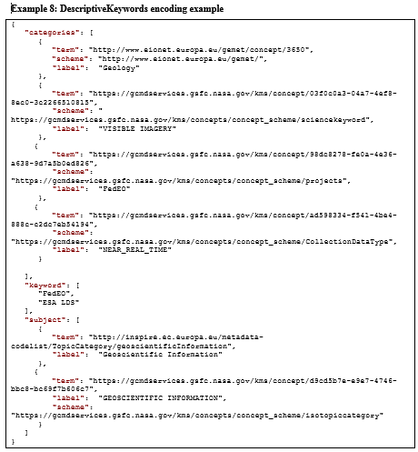
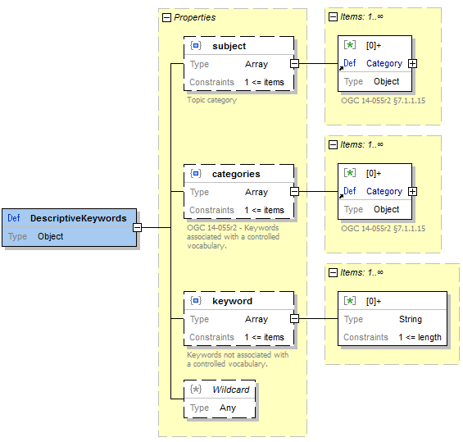
GeoJSON Encoding - DescriptiveKeywords
Example:

Slide 12
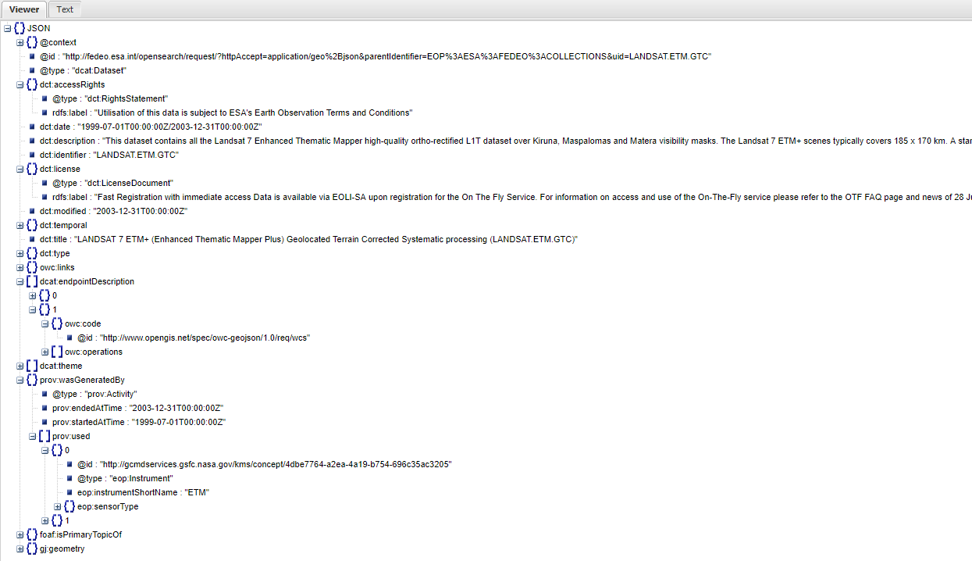
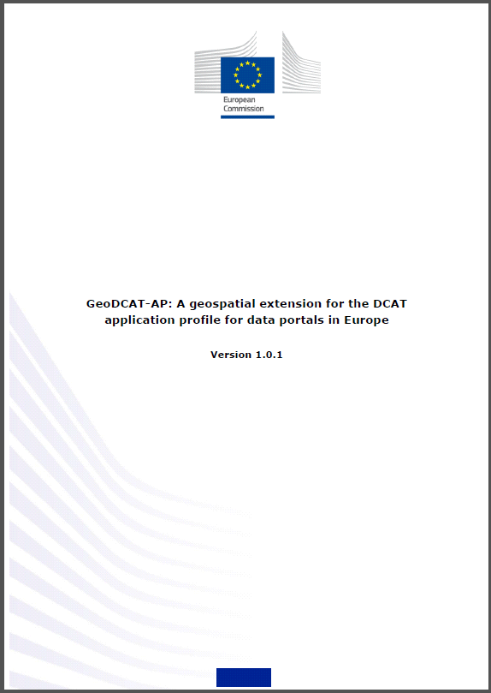
Annex B: Normative JSON-LD @context
Collection encoded as JSON-LD dcat:Dataset via normative @context

Slide 13
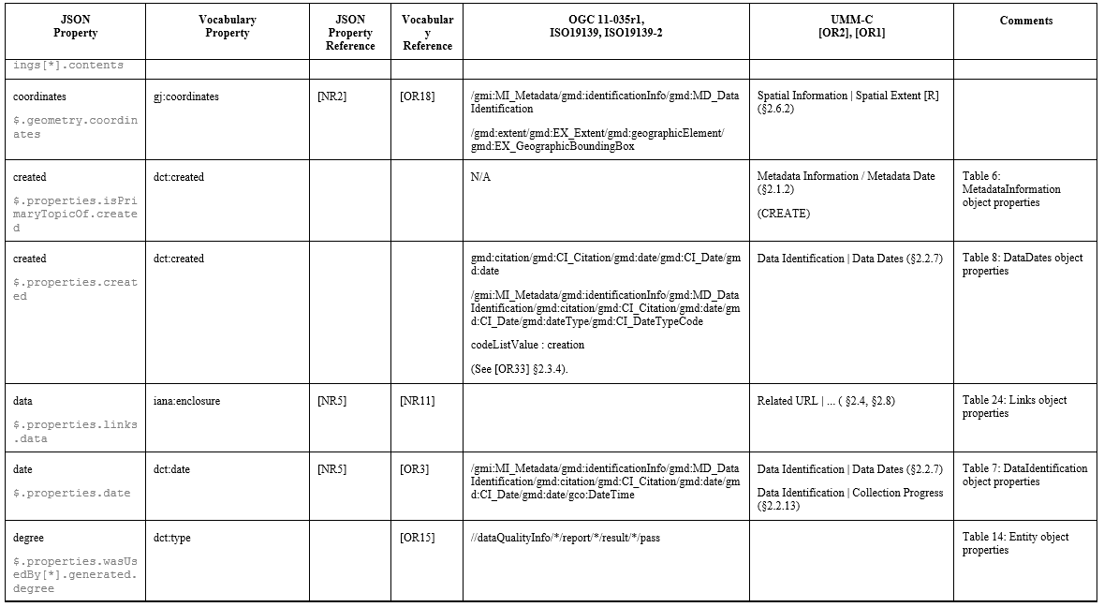
Annex C: EO Vocabulary Mapping
Annex with mappings, GeoJSON as entry-point

Slide 14
Conclusion
Data model defined as
  GeoJSON
  JSON(-LD), thus applicable for linked data (RDF).
Formal definition using JSON schema (OpenAPI compatible)
Maximum reuse of existing specifications and vocabularies
  OGC 14-055r2 (OWS Context)
  DCAT (V2), DCAT-AP, GeoDCAT-AP
  OGC 17-003 (EO Vocabulary)
Consistent with similar specifications for:
  OpenSearch GeoJSON(-LD) Responses (OGC 17-047)
  EO Granule Metadata (OGC 17-003)
  Application and Service Metadata (OGC 19-020)

Slide 15
Conclusion
Traceability covers main elements from
  UMM-C
  ISO19139(-2)
Implementations:
  http://geo.spacebel.be/opensearch/readme.html
  http://databio.spacebel.be/eo-catalog/readme.html
Next steps:
  Address WGISS SLT review comments
  Move specification forward in EOPMOS SWG

Slide 16
Thank you.

