Slide 1
Federated Earth Observation (FedEO)
Andrea Della Vecchia (Randstad), Yves Coene (Spacebel),
Damiano Guerrucci (ESA), Mirko Albani (ESA)
CEOS WGISS#48
8th October 2019

Slide 2
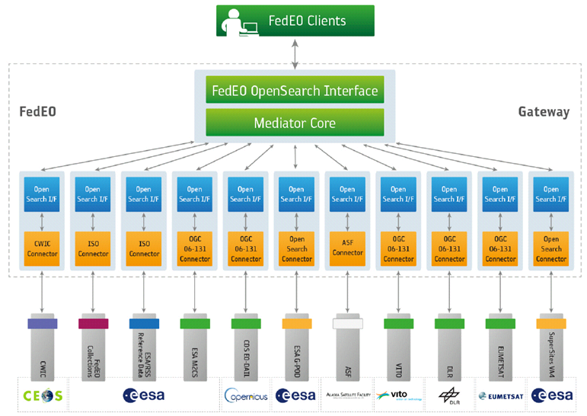
FedEO: Federated Earth Observation Gateway System
FedEO = Federated Earth Observation missions access
The FedEO system provides a unique entry point to a growing number of scientific catalogues and services.

Slide 3
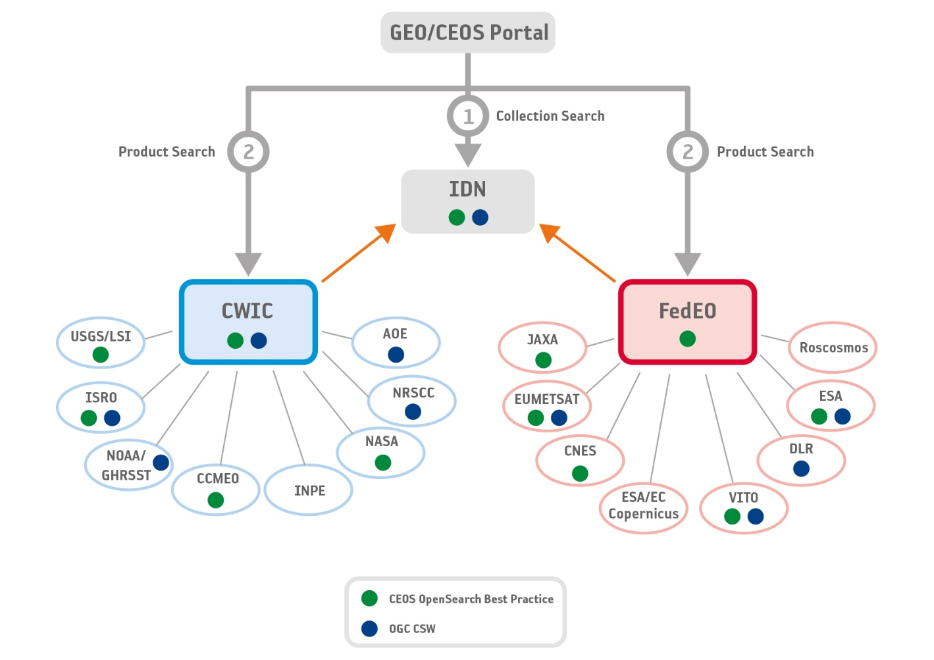
WGISS Connected Data Assets

Slide 4
FedEO Metadata Mediator
Automatic Procedure – Available on FedEO reference environment, on Operational environment at ESA by Oct 2019
Partner Metadata repository
Metadata Import
Harvester tool
Metadata Preparation
Metadata Mediator
IDN
Complementary
Information
gcmd keyword
Metadata Preparation
IDN guideline for Information Content completeness and consistency (HERE)
ESA Thesauri Service
FedEO Collection Catalogue
FedEO Gateway
ISO to DIF-10
DIF-10 Validator
(HERE)
DIF-10 Validation
Metadata Export
DIF-10 Encoding
IDN
repository

Slide 5
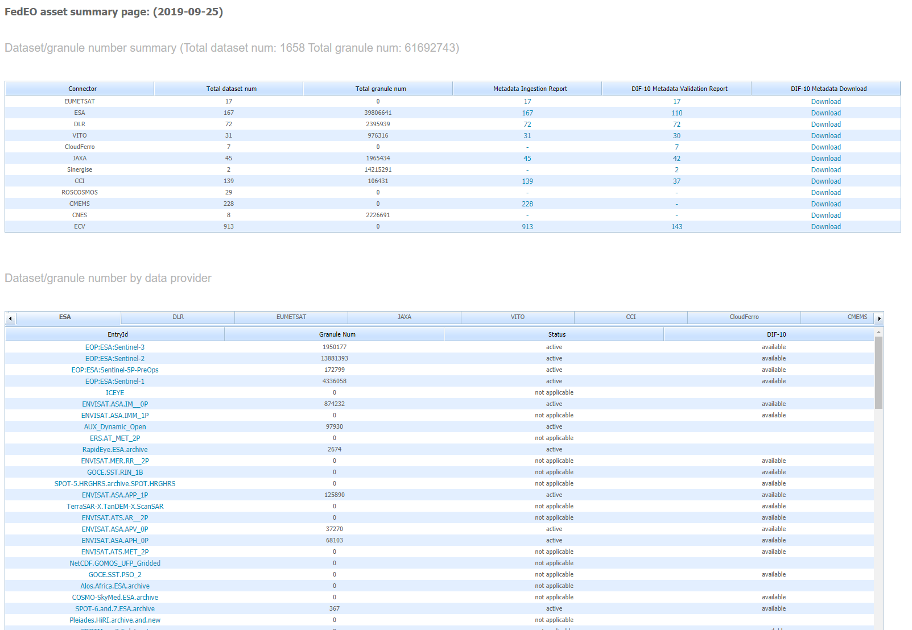
DIF-10 Metadata Export
http://geo.spacebel.be/opensearch/asset/index.html
Most of harvested collections are ready for being ingested into IDN, e.g.
EUMETSAT 17/17
ESA 110/167
DLR 72/72
VITO 30/31
JAXA 42/45
Some effort still required on ECV (143/913), CCI (37/139), CMEMS (0/228)
Once closed the FedEO TTO, the DIF-10 collections will be ready for being ingested in to IDN, from http://fedeo.esa.int/opensearch/asset/index.html
Notes:
To updated with ECV metadata

Slide 6
ESA PDGS Collaborative Environment
To provide the ESA PDGS with a set of interoperable and federated services permitting the users to:
Access to missions/platforms information supported by a common ontology
Discovery and, if possible, direct access to EO and in-situ data:
  Copernicus Missions (e.g. Sentinels)
  Third Party Missions - TPMs (e.g. SPOT, Landsat, …)
  Heritage Missions - HMs (e.g. ERS-1/2, ENVISAT, …)
  Earth Explorer – EEs (e.g. SMOS, Cryosat, SWARM, …)
  International repositories (e.g., NASA CMR, CEOS IDN)
Discovery and access to exploitation services (e.g. datacube):
  Browse/visualization tools for time series analysis
  EO data extraction, resampling and reprojection
Hosted Processing for authorised users/communities (e.g. CAL/VAL)

Slide 7


Operational interface
ESA
Query and service requests
External
Conceptual Model
Data access interface
Operational Data Access
Web User Interfaces
Web User Interface for pixel-based access, analysis and processing
Web User Interface for granule-based discovery and/or retrieval
……….
International EO Information Page:
- CEOS IDN
Mission oriented GUI
  - SWARM
  - SMOS
  - Cryosat
  - External
External catalogue application
……….
ESA PDGS Data Cube GUI, VIRES GUI, etc…
ESA EO Information Page:
- ESA EO Gateway
Multi Mission GUI:
– ESA EOCAT
ESA EO Catalogue
OpenSearch
(collections and granules)
Knowledge-Base Facility
Centralised Knowledge-Base Facility
Standard services request Interfaces (e.g., restful API)
OpenSearch
(collections
and granules)
Standardised Interoperable Interfaces
Thesauri Repository
Metadata management
Protocol for data access
(e.g., OGC, Open Datacube)
EO Data & Service Metadata Repository
Products Access Interface
Data Repositories
Data Repositories
Copernicus Data Repositories
ESA Missions Data Repositories
External Web Interface
Hosted Processing
External Web Interfaces
Standardised Interoperable Services Interfaces
IT Resources provided as services (IaaS, PaaS, SaaS)
TPMs
HMs
EEs
S-1
S-2
S-3
S-5
User Applications
ESA User Applications
Temporary
VM – Processors
Storage
VM – Browse Images Generation
VM – DataCube Engine/API

Slide 8


Operational interface
ESA
User Community
Query and service requests
External
Current Instantiation
Data access interface
Operational Data Access
Web User Interface for pixel-based access, analysis and processing
Web User Interface for granule-based discovery and/or retrieval
……….
International EO Information Page:
- CEOS IDN
Mission oriented GUI
  - SWARM
  - SMOS
  - Cryosat
  - External
External catalogue application
……….
ESA PDGS Data Cube GUI, VIRES GUI, etc…
ESA EO Information Page:
- ESA EO Gateway
Multi Mission GUI:
– ESA EOCAT
https://datacube.pdgs.eo.esa.int/
https://earth.esa.int/eogateway
https://eocat.esa.int/sec/#data-services-area
OpenSearch
(collections and granules)
Knowledge-Base Facility
Standard services request Interfaces (e.g., restful API)
OpenSearch
(collections
and granules)
Standardised Interoperable Interfaces
https://thesauri.eo.esa.int/thesaurus/en/
Thesauri Repository
Metadata management
ESA Operational Service
Protocol for data access
(e.g., OGC, Open Datacube)
EO Data & Service Metadata Repository
https://eocat.esa.int/opensearch/description.xml
Products Access Interface
https://esar-ds.eo.esa.int/oads/meta/ASA_IMP_1P/index/
https://smos-diss.eo.esa.int/oads/meta/SMOS_Open/index/
……
……
Data Repositories
https://scihub.esa.int/dhus/
Copernicus Data Repositories
ESA Missions Data Repositories
External Web Interface
Standardised Interoperable Services Interfaces
External Web Interfaces
Data management
IT Resources provided as services (IaaS, PaaS, SaaS)
TPMs
HMs
EEs
S-1
S-2
S-3
S-5
User Applications
ESA User Applications
Temporary
VM – Processors
Storage
VM – Browse Images Generation
https://datacube.pdgs.eo.esa.int/wcs?service=WCS&request=GetCapabilities
VM – DataCube Engine/API

Slide 9

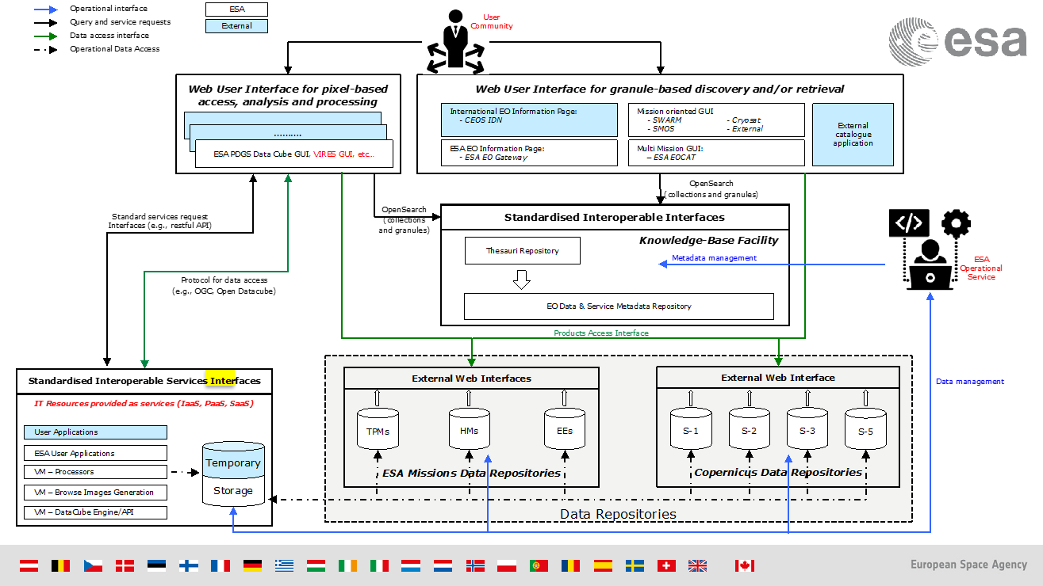
ESA Catalogue TTO
ESA Catalogue:
is the centralised metadata repository of ESA Collaborative Environment
reuses same FedEO SW
manages collections Digital Object Identifiers (DOIs)
is part of CEOS WGISS Data Asset via FedEO

Slide 10
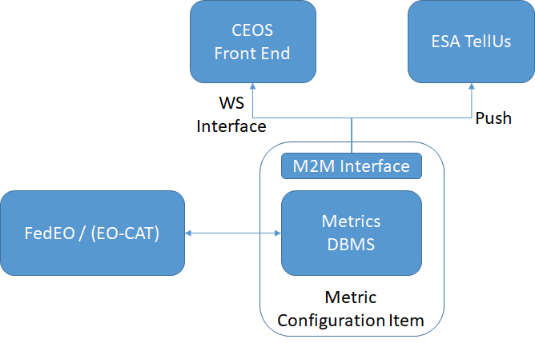
Web interface FedEO Metrics
CEOS Data Access metrics

Slide 11
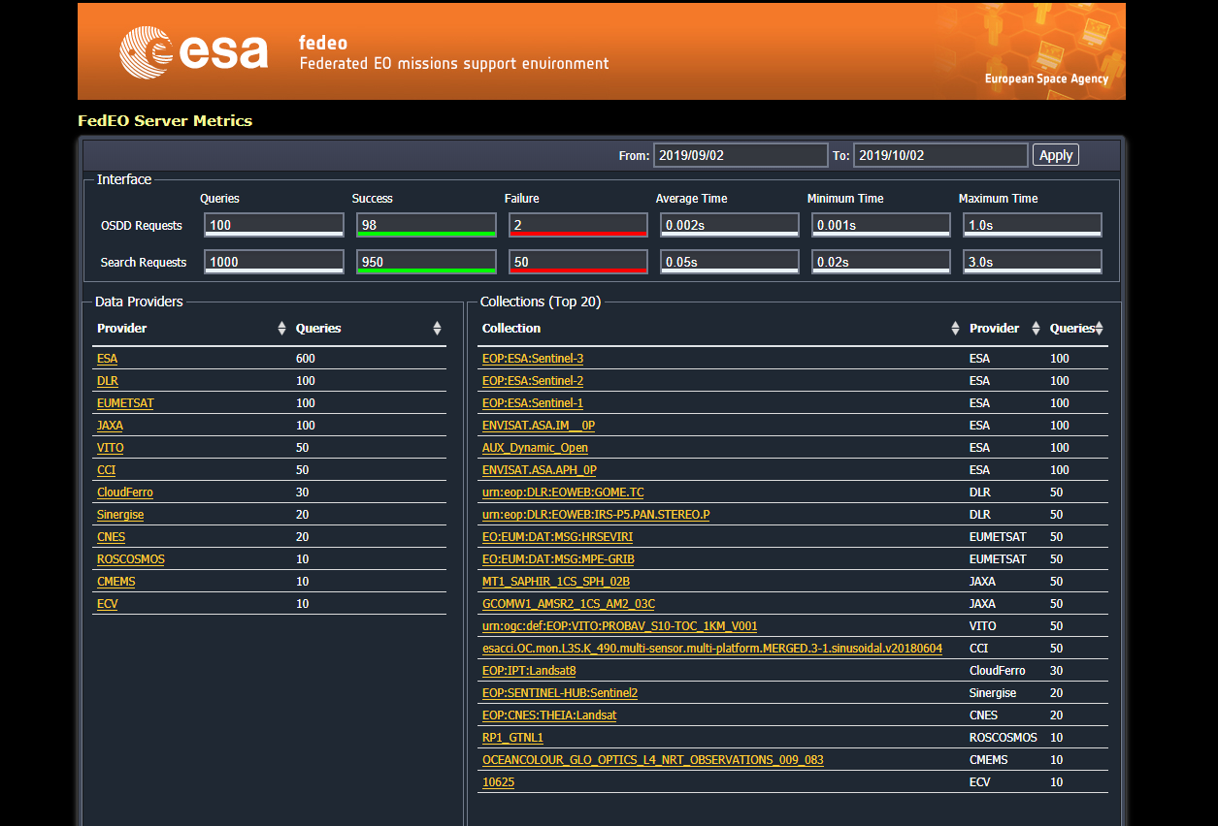

Slide 12
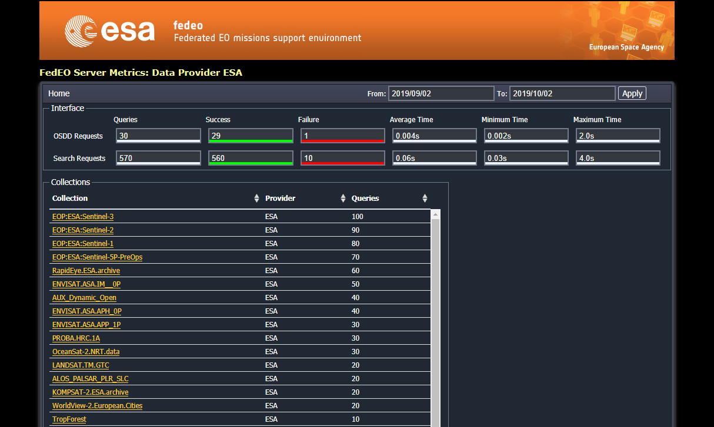

Slide 13
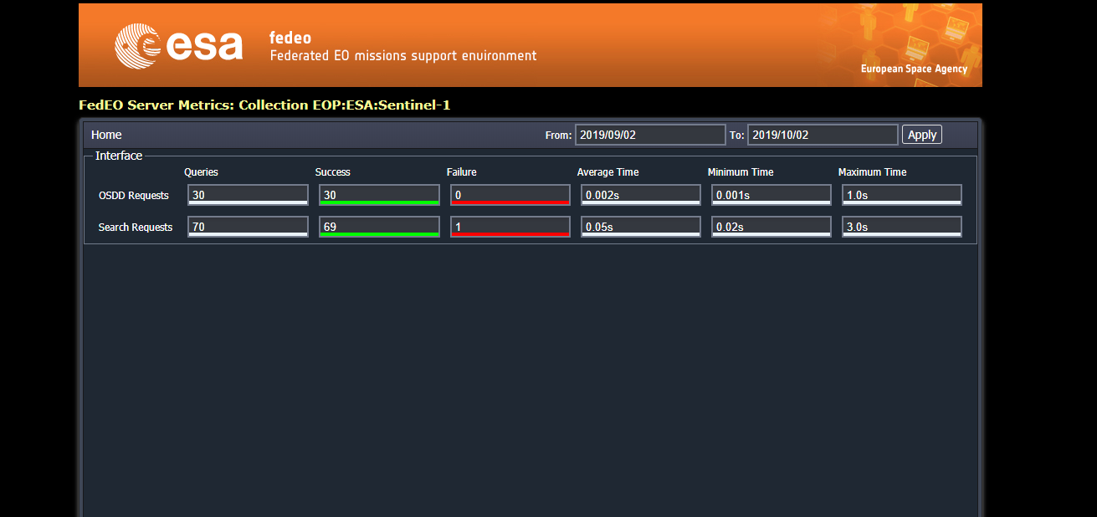

Slide 14
FedEO Evolution
ESA GSTP Project “ESE-ERGO” (Oct ‘19 – Apr ‘21) aims to:
Adoption of OpenAPI, also encouraged by OGC, as standard interface for its services, in combination with JSON and JSON-LD
Analyse and adopt new international guidelines and standards to improve gateway/catalogue functionalities, performance and interoperability. This includes:
  Emerging GeoDCAT-AP specification to publish EO metadata
  OGC 13-026r9 to introduce enhanced functionalities (e.g., flexible string search, results ranking, links to EO external services)
  OGC 17-047 to provide a JSON based encoding response from OpenSearch interface (e.g., quicker catalogue response, ease User interface development)
Transition to an internal metadata model of which other metadata models are views, to allow more flexibility and to align to similar approaches applied by NASA (e.g., Unified Metadata Model – UMM/-C/-G/-S/-JSON). This includes:
  Recent OGC guidelines, in cooperation with CEOS/NASA, about collection and product metadata model based on GEO-JSON(-LD) encoding (e.g., OGC 17-084, OGC 17-003)
  Generalization of the concept of catalogue entry in order to consider granules (/products), collections (aggregation of granules/products) and services related to both of them (e.g., remote processing, datacube, etc…) seamlessly (e.g., GeoDCAT-AP, ISO 19115-1 & ISO 19115-3, etc…)
Web-based metadata management tool to allow authorised users to add/modify collection catalogue entries

