Slide 1
SEO Report to WGISS-48
Brian Killough
NASA Langley Research Center CEOS Systems Engineering Office (SEO)
WGISS-48 Meeting
October 8, 2019

Slide 2
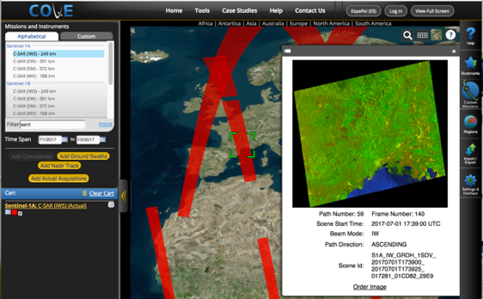
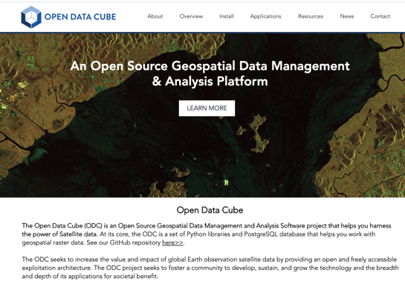
SEO Tool Summary
COVE Tool ... add a new coverage/revisit performance feature and a new coincident observation tool for single or multiple missions over a given location and time window.
Open Data Cube (ODC) ... working with the ODC team on several tasks ... add the ODC to the Open Source Geospatial Foundation (OSGeo), advance country prototypes, advance tools (on-demand Jupyter notebooks), advance algorithms
ODC GitHub: https://github.com/opendatacube
Data Cube User Interface Demo: http://tinyurl.com/datacubeui
ceos-cove.org
opendatacube.org

Slide 3
Data Flow Summary #1
GOAL: Global Landsat, Sentinel-1, Sentinel-2, and ALOS level-2 analysis-ready data (ARD) in cloud-optimized COG (Cloud GeoTIFF) format on the cloud. This will support a number of global data cube projects and provide an efficient cloud-based solution.
Landsat ... Level-2 surface reflectance data (Collection 2) on AWS-USA-West by the Feb 2020 !!! Preparing ODC tools to connect to this archive as soon as it is available.
Question ... We are often asked about BRDF and sun angle corrections. Is there an issue with doing this globally due to accuracy in all locations around the globe?
Question ... Are plans to use a consistent DEM for both Landsat and Sentinel-2 in the future? If so, when might this happen and would it mean a reprocessing of the archive?
Sentinel-1 ... Sinergise currently copies global GRD (level-1) to AWS-Frankfurt and converts to COG format since 1.1.2017. We would like to get older GRD data (pre 2017) into AWS.
Question ... We know the Alaska Science Facility (ASF) holds all of the S1 archive. Could Sinergise have access to this data for COG format production and addition to the current archive in AWS-Frankfurt?
Question ... We heard that ASF is testing HDF formats to be compatible with NISAR. How does HDF work in a cloud environment? Why choose HDF? Is it just to optimize storage and metadata? Is this similar to netCDF? Does this format contain one or more low resolution overview layers?

Slide 4
Data Flow Summary #2
Sentinel-2 status ... We now have global Level-2A on AWS-Frankfurt since Dec 2018. There is a desire to get older global data (Dec 2016 to Dec 2018) processed and added to this archive.
Recent news ... Joe Flasher (AWS) confirmed that they are working with Sinergise to process older S2 data to bring the L2A global archive (on AWS-Frankfurt) up to date by the end of 2019.
More news ... Further discussions between Sinergise and Amazon are considering converting this data to COG format and hosting on AWS-US-West, along with Landsat. This would happen in 2020. The AWS-Frankfurt data will remain in place and the COG format data would be a separate holding.

Slide 5
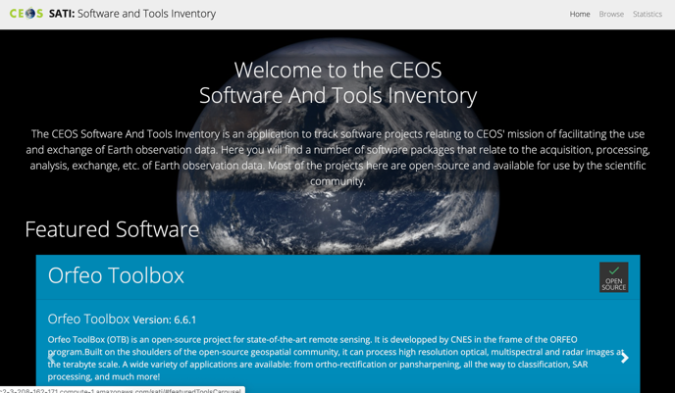
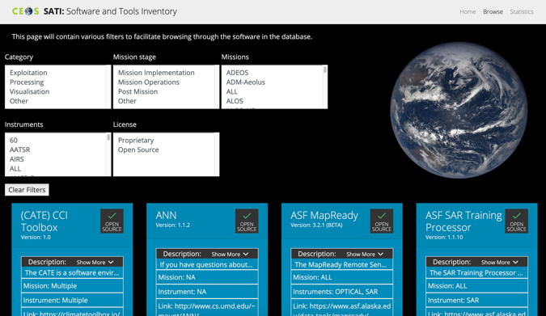
OSS Inventory
The SEO team is working with Lolanda Maggio (ESA) to develop a CEOS Software and Tools Inventory (SATI) to manage open source software and tools (CEOS Action FDA-10).
Lolanda will report on the details of this task later in the WGISS agenda (Wednesday).
There are currently 81 items listed on the SATI site. This data includes name, description, POC, mission, instrument, company, release date, operating system and web location.

Slide 6
More SEO Plans
Analysis Ready Data (ARD) ... develop specifications and promote and demonstrate value thru ODC prototypes, improve production and access
Support to SDGs ... development, testing and sharing of open source algorithms within the ODC framework
Transition the Africa Regional Data Cube to Digital Earth Africa
CEOS Mission Database (database.eohandbook.com) ... work with ESA to add new data and analysis tools
Explore data cubes for new and diverse datasets (e.g. RCM, NISAR, Lidar)
Continue CEOS outreach at major meetings ... GEO, IGARSS

