Slide 1
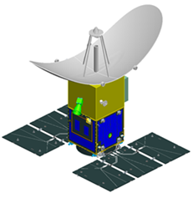
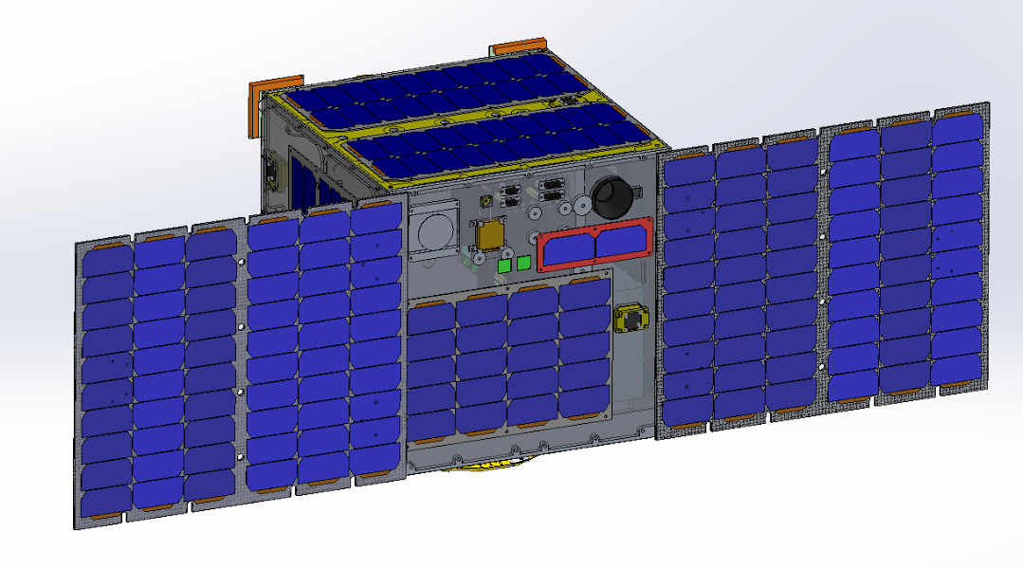
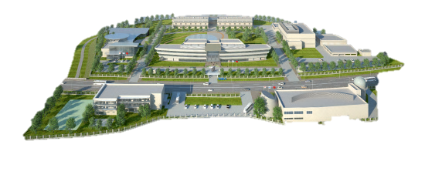
Vietnam Academy of Science and Technology
VIETNAM NATIONAL SPACE CENTER
INTRODUCTION TO
Vietnam National Space Center
Hanoi – Sep. 2019

Slide 2
Contents
Overview of VNSC
Vietnam Space Center Project

Slide 3
Overview of VNSC

Slide 4
Functions and tasks
On Sep. 16, 2011, Vietnam National Satellite Center was established under Vietnam Academy of Science and Technology (VAST) by the Vietnamese PM’s decision
Based on Decree No. 60/2017/NĐ-CP, from July 17, 2017, the Vietnam National Satellite Center is officially changed to:
Vietnam National Space Center
VNSC
Space Science and Education
Space Technology
Vietnam Space Center project
Space Utilization

Slide 5
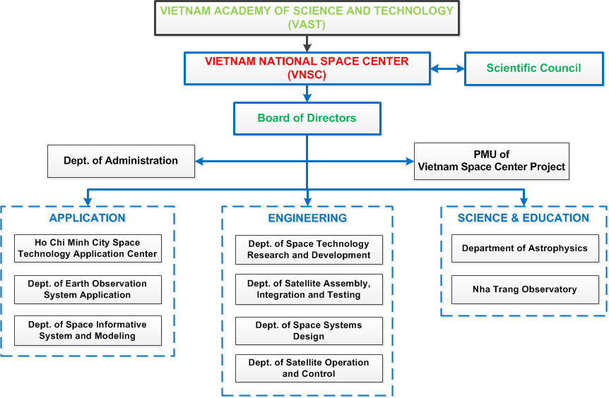
Organization Chart

Slide 6
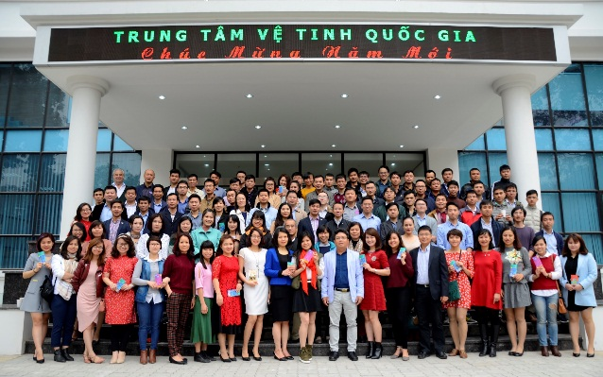
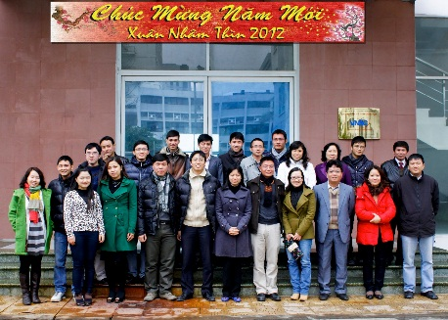
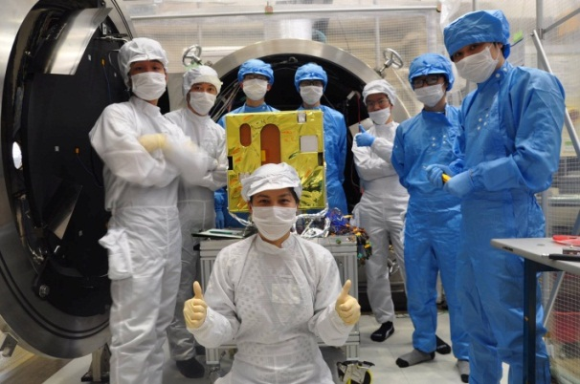
Capacity development
31
77
126
200
250
2023
2020
2018
2013
2012
Doctoral: 16
Master: 67
84% under 40 year olds
2011

Slide 7
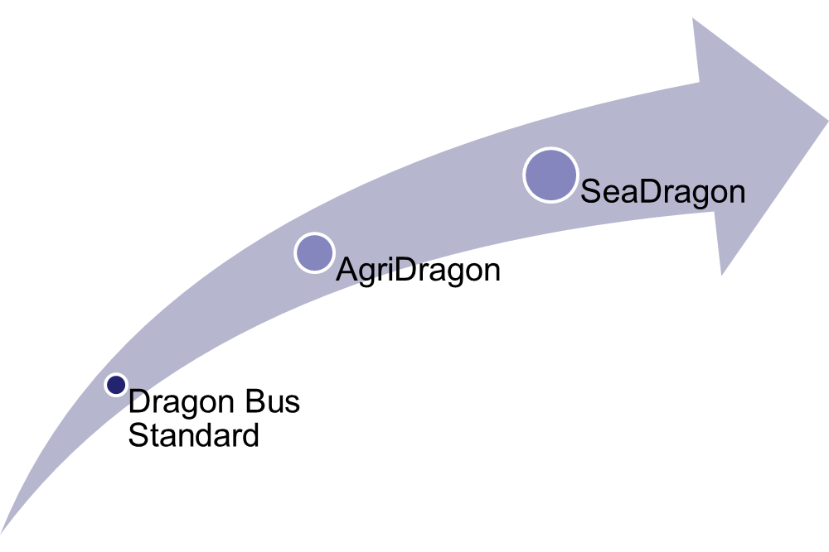
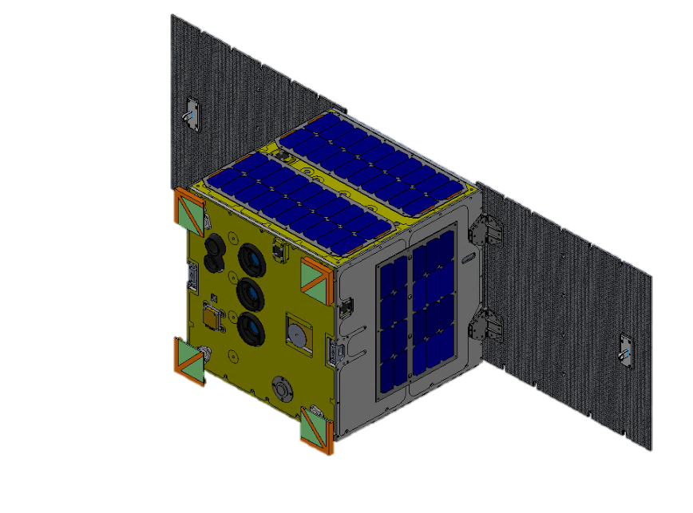
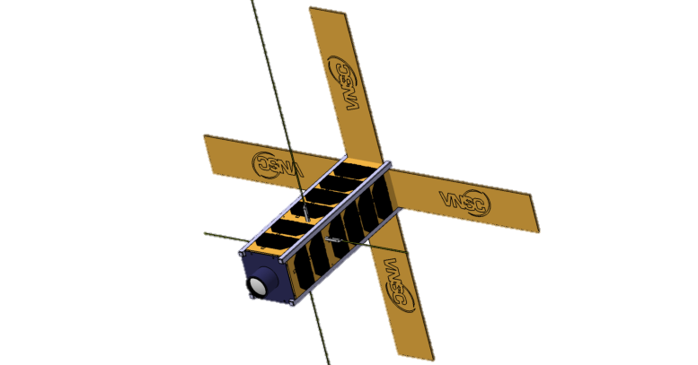
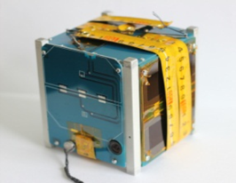
“Made in Vietnam” satellites
Aim to develop national product for small satellites bus concept
2011 Start
2013 (1 kg)
2017-2020 (4-6 kg)
2013-2018 (50 kg)
2019-2023 (600 kg)
LOTUSat-1
MicroDragon
NanoDragon
PicoDragon

Slide 8
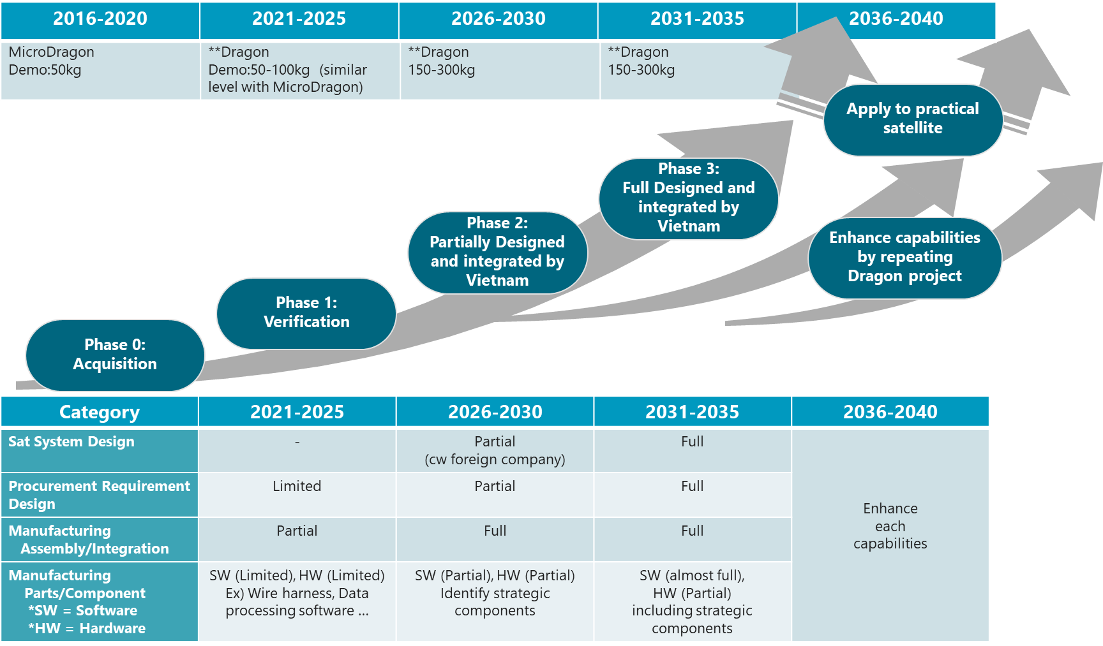
“Made in Vietnam” satellites

Slide 9
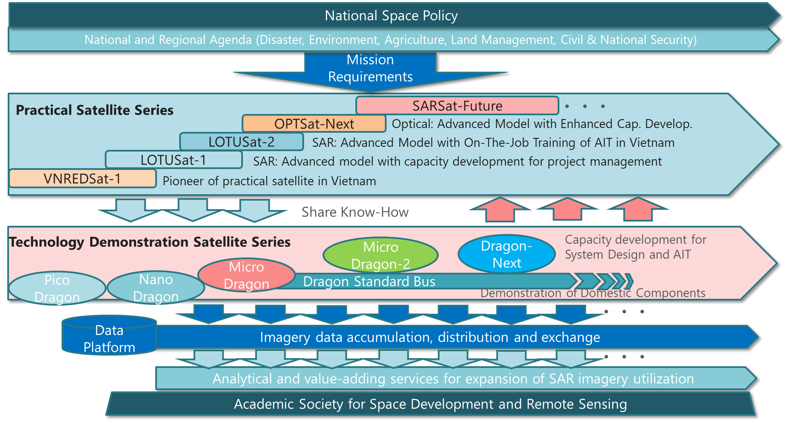
Roadmap for VN EO Satellites

Slide 10
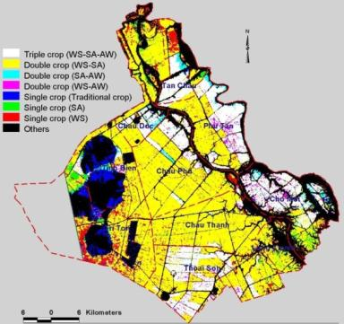
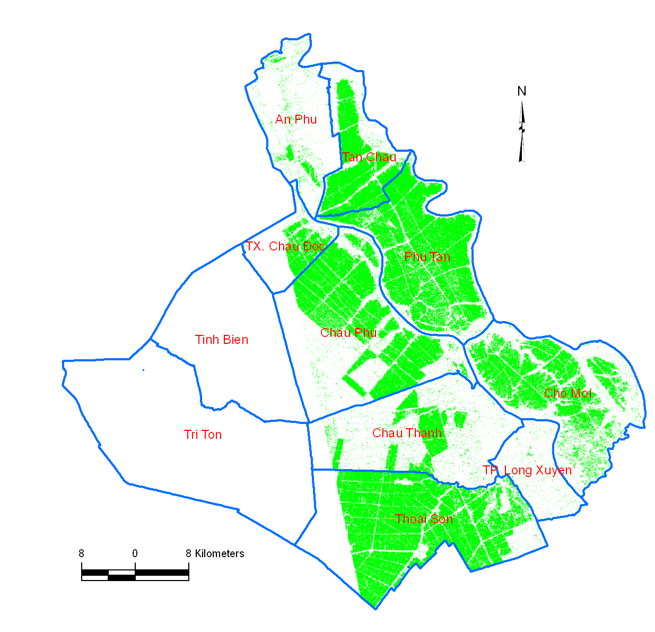
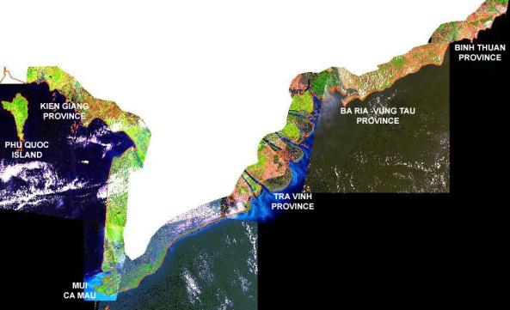
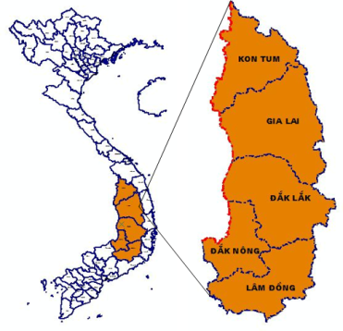
Space technology applications
Rice crop monitoring in An Giang
Coastal zone erosion management
Forest mapping and monitoring in Tay Nguyen
Flood monitoring at the Red River Delta

Slide 11
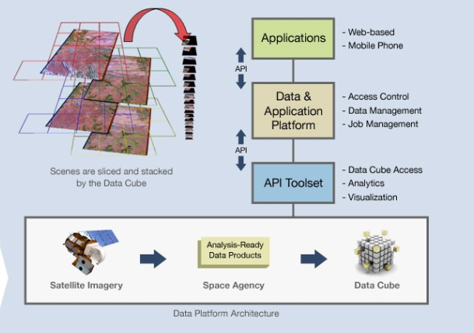
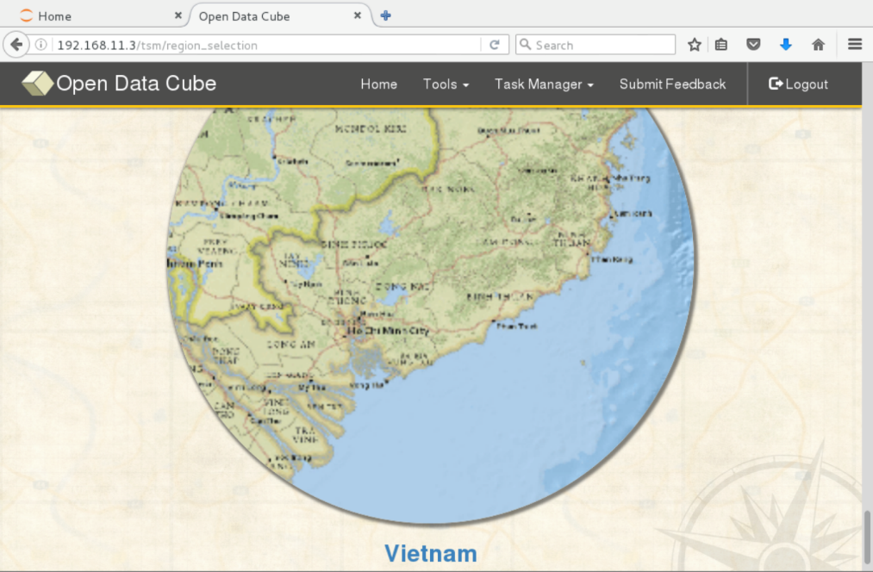
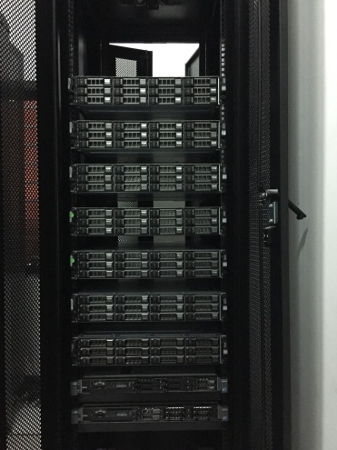
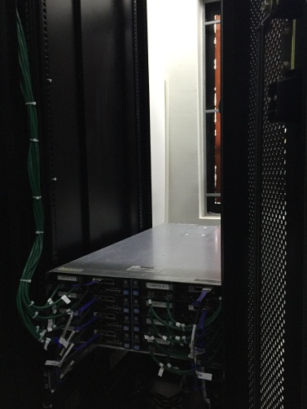
Vietnam Data Cube
Under CEOS activities (http://ceos-cube.org/)
Under developing with the technical support from CSIRO (Australia) and IMSG (USA)
Application:
Forest monitoring
Rice crop monitoring
Water quality

Slide 12
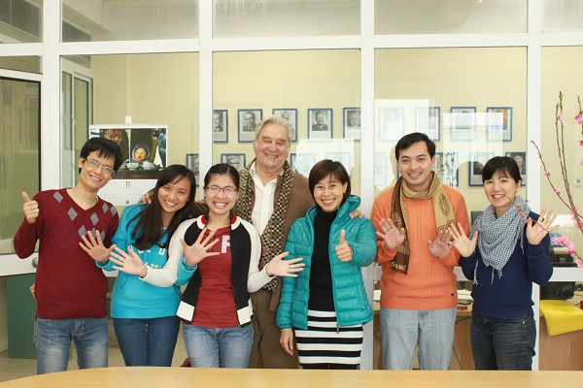
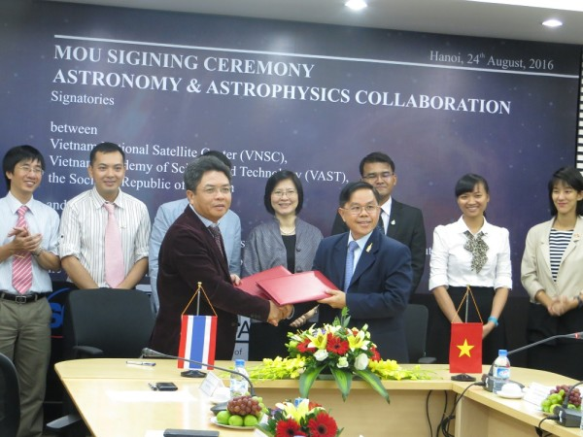
Space Science
Department of AstroPhysics
Membership: 1 professor, 5 PhDs and 1 PhD student.
Published 15 articles in ISI journals.
Data from major international installations (ALMA, NOEMA).
Training experience: 7 PhD (1 underway), 16 master theses, 13 graduation dissertations
International Collaborations with institutions from France, Southeast Asia and East Asia.

Slide 13
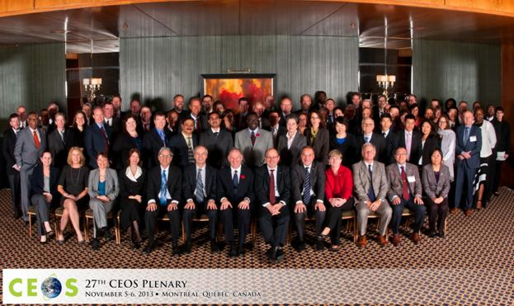
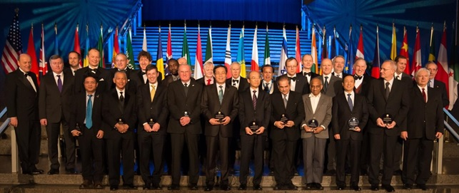
International cooperation
VAST/VNSC is an official member of:
Group on Earth Observations (GEO): 96th member since 2014
Committee on Earth Observation Satellites (CEOS): since 2012
International Astronautical Federation (IAF): from 2012
International Academy of Astronautics (IAA): from 2012
Asia-Pacific Regional Space Agency Forum (APRSAF)
Sentinel Asia

Slide 14
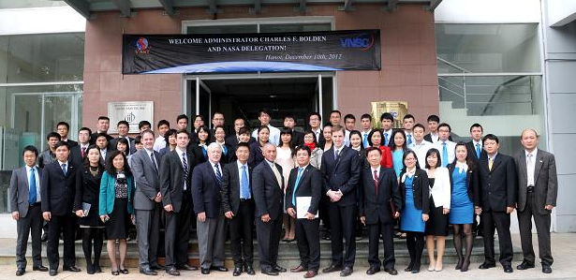
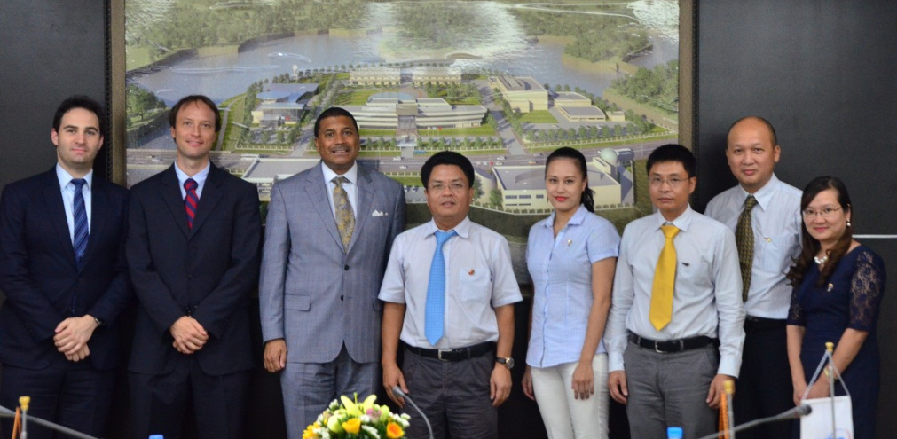
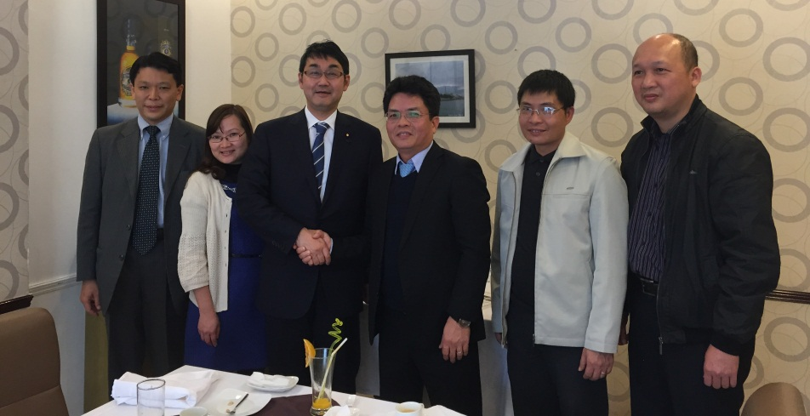
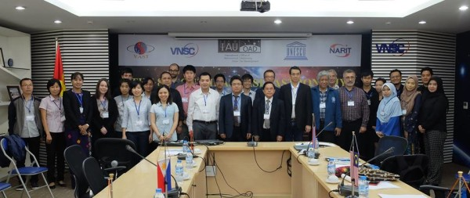
International cooperation
NASA Administrator visited VNSC in Dec. 2012
Assistant US Secretary of State visited VNSC in Mar. 2014 & Jul. 2015
Meeting with Mr. K. Kawai - Japan's House of Representatives (Dec.2015)
Southeast Asia Astronomical Network in VNSC (Dec. 2016)

Slide 15
International cooperation
VNSC signed MOUs with:
Japan (JAXA, METI/HIDA; JAMSS, Universities, Asian Microsatellite Consortium)
USA (IMSG, University of Maryland)
Australia (CSIRO)
France (IRD, CNES)
Netherland (Netherlands Space Office)
Thailand (NARIT)
Korea (KARI)
Israel (IAI, DRD)

Slide 16
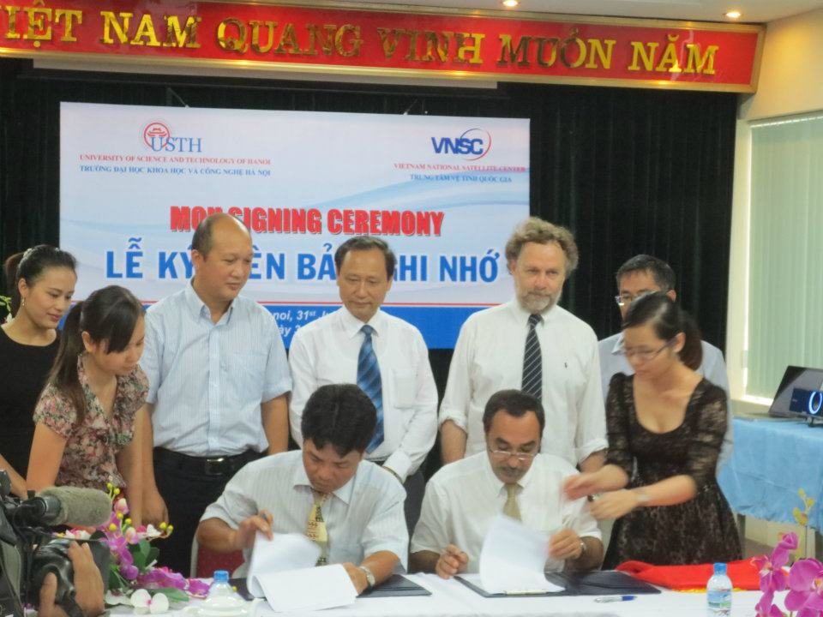
Education
Space Science and Technology Education:
Undergraduate in Aerospace Engineering at Vietnam National University, Hanoi - VNU
Undergraduate and Graduate Course in Space & Application at University of Science and Technology of Ha Noi – USTH
Undergraduate Course in Space Engineering at International University, Vietnam National University in Ho Chi Minh city
The University of Tokyo, Tohoku University, Hokkaido University, Keio University and Kyushu Institute of Technology

Slide 17
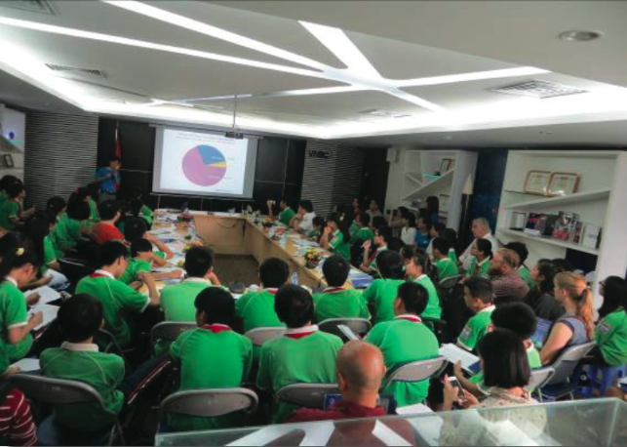
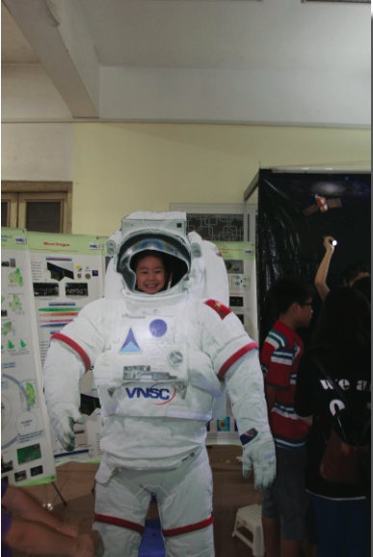
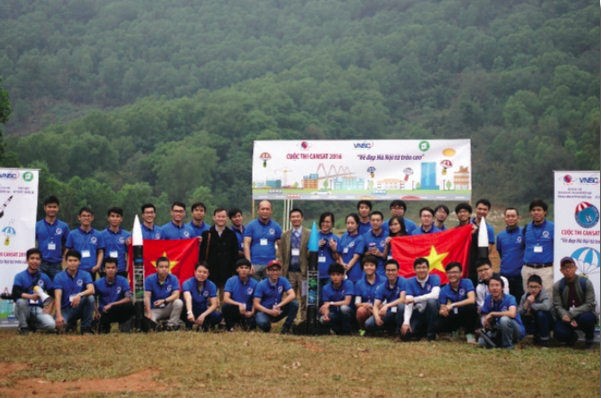
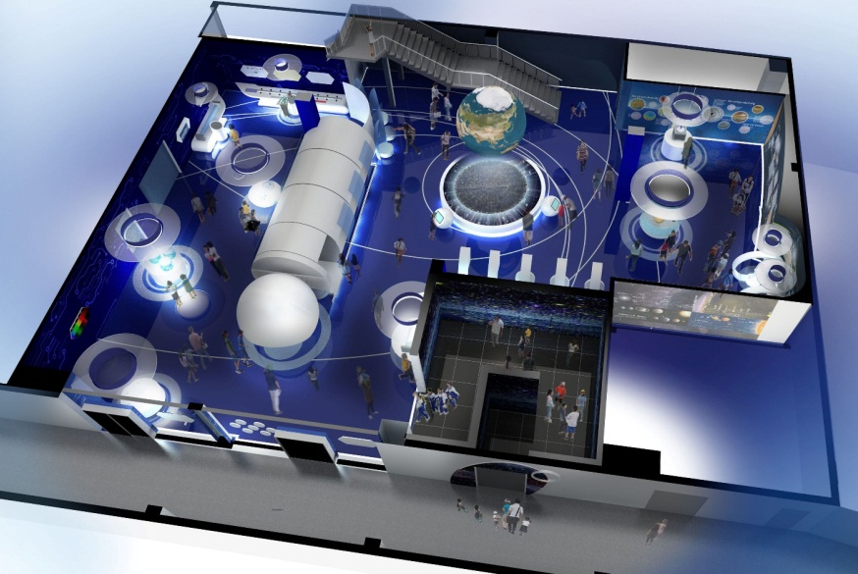
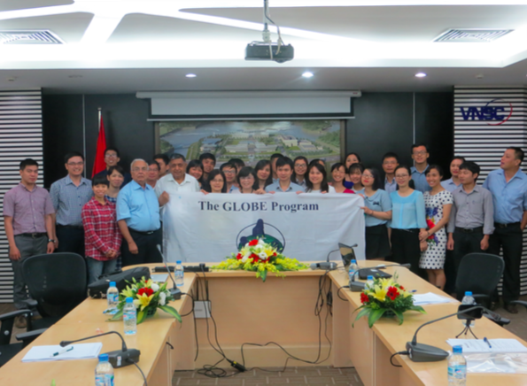
Space Public Education
Space Day
STEM Day
Space Museum
CanSat Competition
GLOBE Program

Slide 18
Vietnam Space Center Project

Slide 19
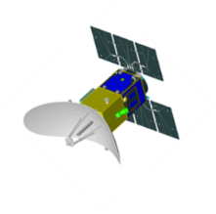
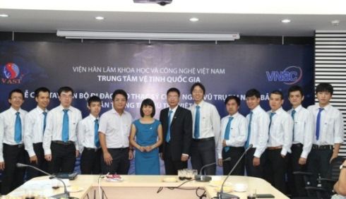
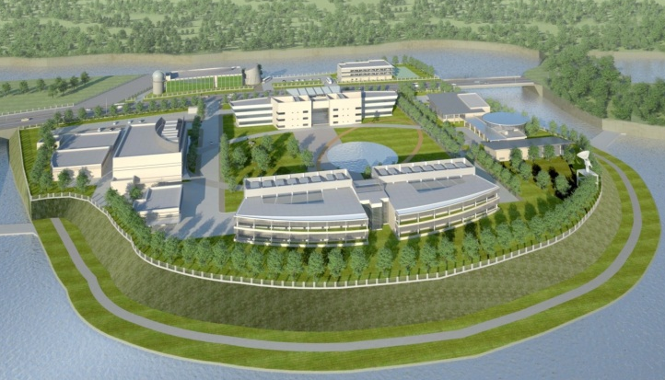
Vietnam Space Center Project
Total Investment: 310 mil. USD (ODA & Counterpart fund)
Implementation timeline: 2012 to 2023
Satellite Technology
LOTUSat-1 (570 kg)
Human Resource
Infrastru-cture/ Facilities
Capacity Building for
Satellite Development
R&D equipment and AIT facilities for small satellites up to 180 kg
Notes:
- Đổi màu chữ trong hình (Infrastructure…) - 600 or 1000 kg?

Slide 20
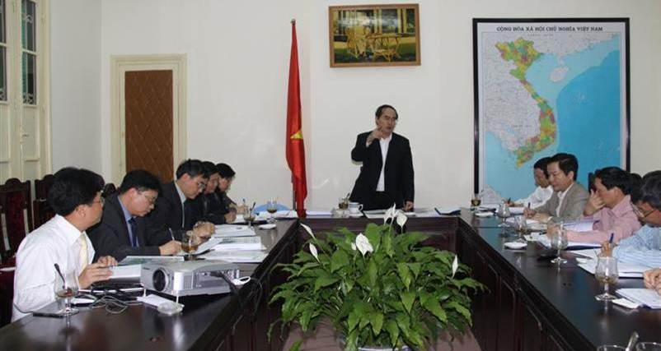
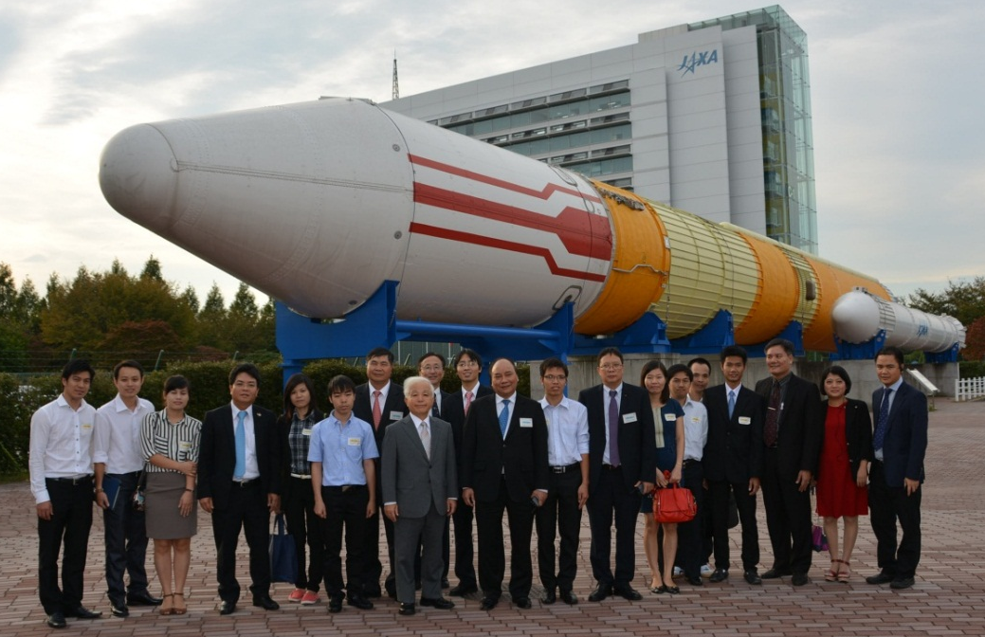
Vietnam Space Center Project
In 2009, the Prime Minister of Vietnam concluded: “This is a key investment project and play an important role for The strategy of research and applications of Space technology of Vietnam until 2020”
In 2017, the Prime Minister of Vietnam continues to conclude that outcomes of project will “assist the social – economic development via the building and integration of the facilities and equipment of National Space Center and developing Earth observation satellite technology”
Vietnam PM Nguyen Xuan Phuc met VNSC’s trainee in Tskuba Space Center (JAXA – Japan)

Slide 21
LOTUSat-1
Mass: ~570kg
Life: >5 years
Size: Approx. 1.5m x 1.5m x 3m
<Mission>
X-band SAR sensor
Resolution: ~ 1.0m -16m
(3 modes)
LOTUSat-1
LOTUSat-1 launching (tentative): 2023

Slide 22
LOTUSat-1 system

Slide 23
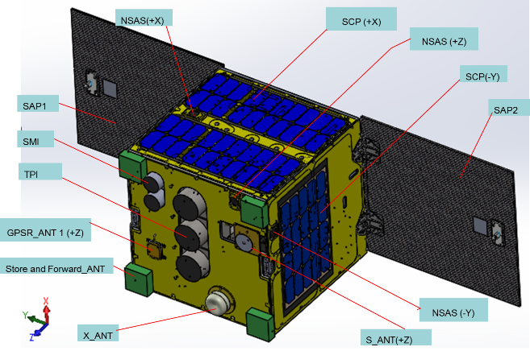
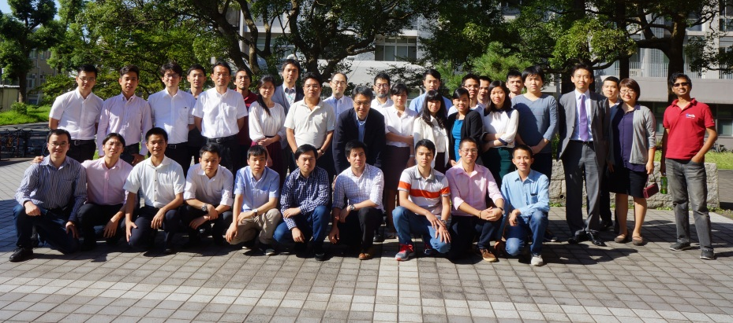
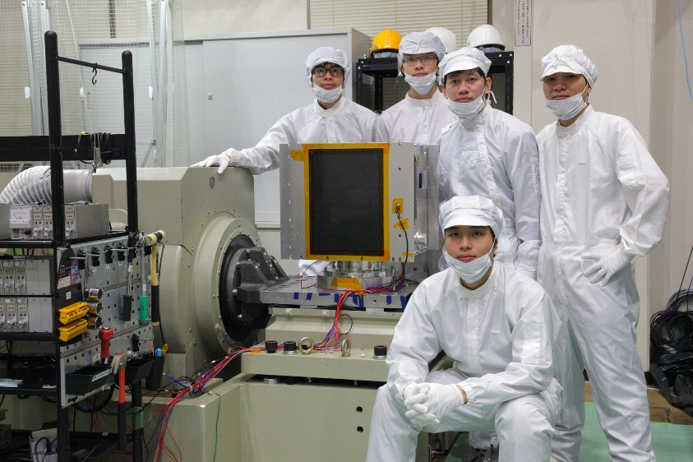
Capacity Building
Training contents:
Basic Training (36 masters in Japan)
Advanced training in Japan
Data utilization training in Japan
On-job training in Hoa Lac

Slide 24
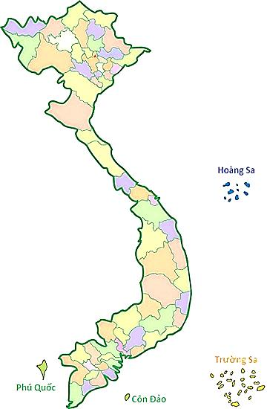
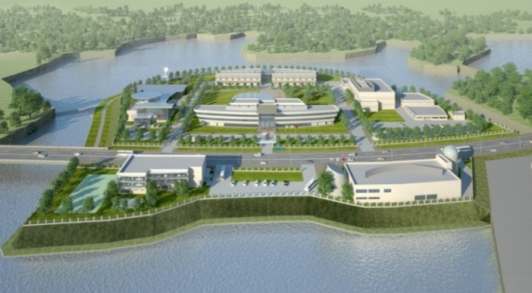
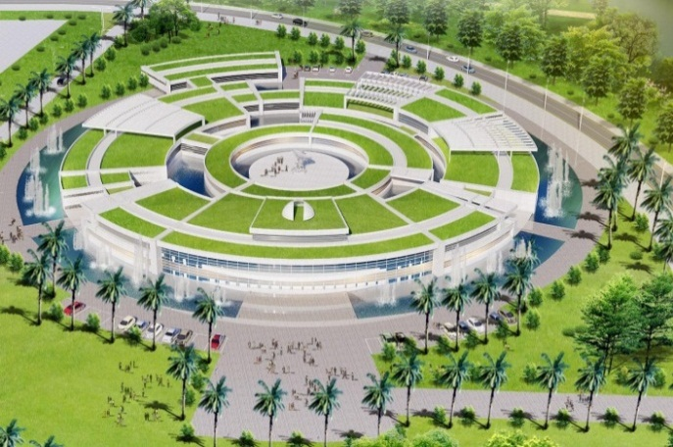
Infrastructures
Hà Nội
Hanoi
(2017)
Hoa Lac
(2021)
Nha Trang
TP. Hồ Chí Minh
Nha Trang
(2017)
Hochiminh City
(TBD)

Slide 25
R&D Center at Hoa Lac
3D measuring equipment
Tensile testing machine
Small space chamber
Temperature chamber
Facilities and equipment for R&D of small satellite up to 180 kg

Slide 26
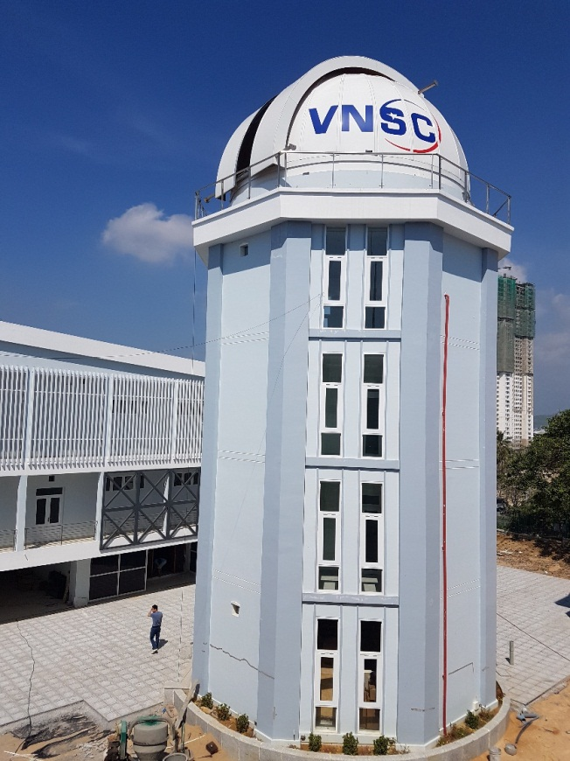
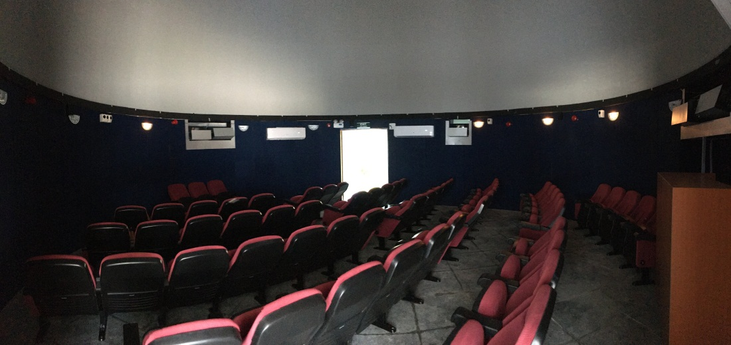
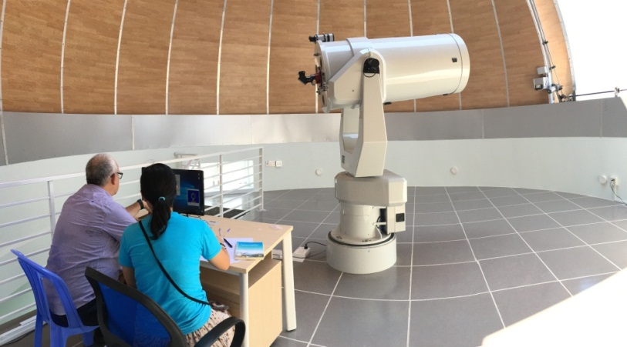
Nha Trang Observatory
Location: Hon Chong, Nha Trang
Project duration: 2014 - 2017
Facilities:
9 m planetarium with 60 seats
50 cm optical telescopes with CCD camera and spectrograph

Slide 27
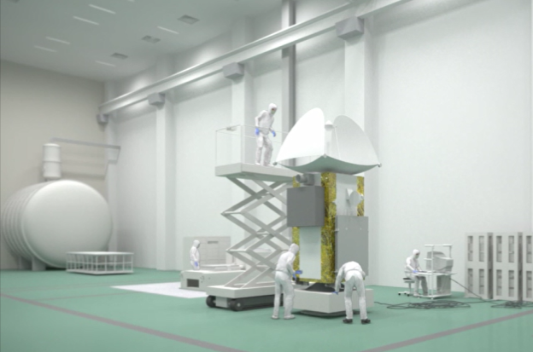
Missions
Focusing on R&D on space science and technlogy to product realization by development of Vietnam National Space Center with 4 main majors:
Space technology
Space application
Space science and astronomy
Education and public outreach in space

Slide 28
Thank you for your attention!

