Slide 1
WGISS - 47
Hosted by
National Oceanic Atmospheric Administration (NOAA)
Silver Spring, Maryland USA
April 29 - May 2, 2018

Slide 2
Workshop Location:
Silver Spring Civic Building
One Veterans Plaza, Silver Spring, Maryland 20910
Silver Spring, Maryland is the largest inner suburb of Washington, D.C. on the Maryland side, and is located just north of Washington, D.C. in Montgomery County. Minutes away from our nation’s capital, Silver Spring combines a vibrant, laid-back atmosphere with an eclectic mix of dining, shopping, and entertainment, for community. The Silver Spring Civic Building at Veterans Plaza is a premier event facility that provides an elegant setting for all types of events. Veterans Plaza, located outside of the Civic Building, includes a memorial commemorating the service of veterans of Silver Spring and Montgomery County, Maryland.

Slide 3
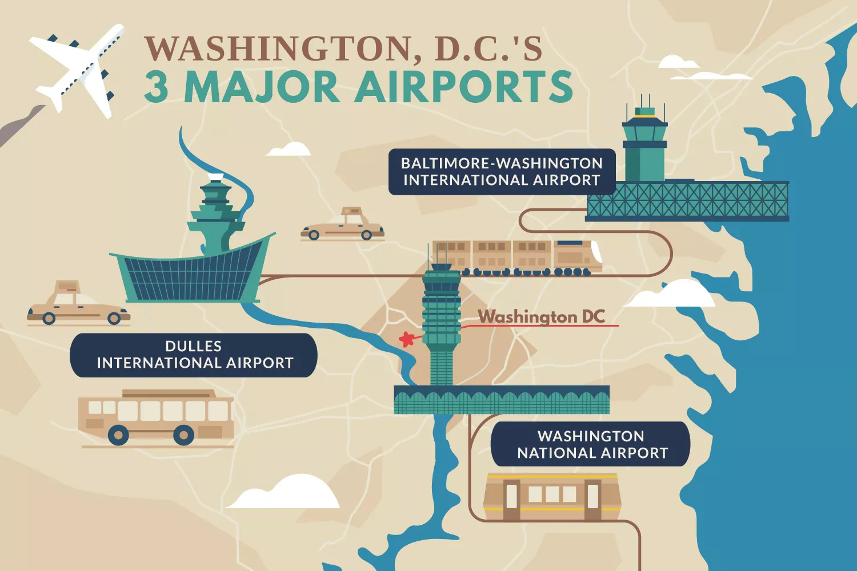
Closest Airports to Silver Spring
Silver Spring, Maryland is conveniently located within close proximity to three major airports.
Each web link below provides airport information, including car rental, shuttle service, maps and flight details
The closest major airport is :
Ronald Reagan Washington National Airport (DCA), which has international and domestic flights from Washington, District of Columbia and is 13 miles from Silver Spring, MD
The second closest is :
Washington Dulles International Airport (IAD), which has international and domestic flights from Dulles, Virginia and is 30 miles from Silver Spring, MD
Also within a reasonable distance is :
Baltimore/Washington International Thurgood Marshall Airport (BWI), This airport has international and domestic flights from Baltimore, Maryland and is 31 miles from the center of Silver Spring, MD

Slide 4
Airport Transfer: DCA to Silver Spring
Silver Spring, Maryland is conveniently located within close proximity to three major airports.
Each web link below provides airport information, including car rental, shuttle service, maps and flight details
Via Car: It’s best to use in-car GPS or built-in directions on cell phone for the most up-to-date directions based on current traffic and road closures, but turn-by-turn directions can be found here
Via Taxi: Taxis are easily accessible upon departure from National Airport. The estimated fare is $50 each way, but please consult your taxi cab operator for exact fare amounts
Via Metro Rail:
Washington, DC Metrorail system has an elevated Metrorail station connected to the concourse level of Terminals B and C at Reagan National Airport. The Metrorail system provides easy and affordable access to locations throughout Washington, Virginia, and Maryland. Metrorail farecards may be purchased at machines located at all entrances to the
Airport Metrorail station. The station is also fully accessible via elevators.
Getting to the Metrorail station from the Terminals:
Terminal B and C Use either of two enclosed pedestrian bridges on the concourse level which connect directly to the station.
Terminal A Exit the terminal to the streetside curb, and board any “Airport Shuttle” bus. At the stops for Terminal B/C you can access an enclosed bridge which connects to the Metrorail station.
Getting to Silver Spring from the Metro Rail:
Take the Yellow line train towards Fort Totten. Get off at Gallery Place. Transfer to the Red line train towards Glenmont and get off at Silver Spring

Slide 5
Airport Transfer: IAD to Silver Spring
Silver Spring, Maryland is conveniently located within close proximity to three major airports.
Each web link below provides airport information, including car rental, shuttle service, maps and flight details
Via Car: It’s best to use in-car GPS or built-in directions on cell phone for the most up-to-date directions based on current traffic and road closures, but turn-by-turn directions can be found here
Via Taxi: Washington Flyer Taxicabs serve Washington Dulles International Airport (IAD) exclusively with 24-hour service to and from the Airport. No reservations are necessary for taxi service. Simply follow the signs for Ground Transportation or Taxi to the lower level of the Terminal, DOWN the ramp to Door 2 or Door 6. A customer service representative is available 24-hours a day. Please visit the link above for additional information
Via Metro Rail: With direct service from Dulles Airport to Metro’s Silver Line, the Silver Line Express Bus provides a convenient, economical connection between Dulles’ Terminal and the Wiehle-Reston East Metro Rail Station on the Silver Line. The trip from the airport to the metro station is about 20 minutes.
Getting to Silver Spring from the Metro Rail:
Take the Silver Line Train towards Largo. Get off at Metro Center and transfer to the Red Line train towards Glenmont. Get off at Silver Spring

Slide 6
Airport Transfer: BWI to Silver Spring
*Please note there is no Metro Rail service from BWI Airport
Via Car: It’s best to use in-car GPS or built-in directions on cell phone for the most up-to-date directions based on current traffic and road closures, but turn-by-turn directions can be found here
Via Taxi: The taxi stands are located just outside of the baggage claim area on the Lower Level of BWI terminal near doors 5 and 13. Please note that this service is available from BWI Airport only. For cab service to BWI, please consult your local cab company
Via App-Based Ride Services (Uber/Lyft): App-based ride services provide pre-arranged transportation between BWI Marshall Airport and passenger-specified locations. Passengers arrange service online, typically using a smartphone app. Drivers use their personal, non-commercial vehicles to transport passengers. App-based ride services pick up and drop off passengers at the terminal curbs on the Departures/Ticketing Level between doors 9 and 11
Via Transit: Please visit the BWI Transit page to view a listing of the available bus/rail options to surrounding areas. Please be sure to check with each company to confirm specific routes and availability, as not all options provide direct service to Silver Spring.

Slide 7
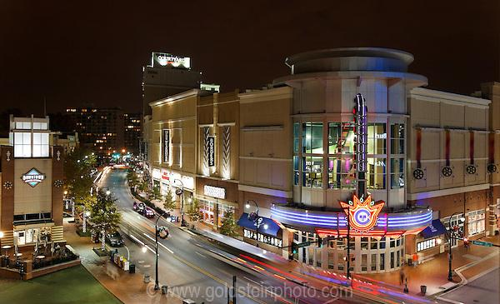
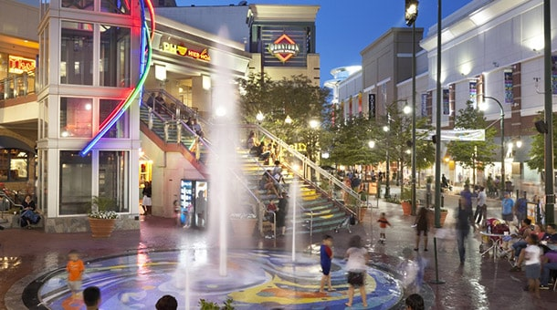
Getting Around Downtown Silver Spring
Silver Spring, Maryland is conveniently located within close proximity to three major airports.
Each web link below provides airport information, including car rental, shuttle service, maps and flight details
On Foot:
Downtown Silver Spring is pedestrian-friendly, as there are many shops, restaurants, and entertainment options within minutes of the Civic Building and local hotels.
Click here to discover all the town has to offer!
Driving and Parking:
Downtown Silver Spring offers plenty of parking in public parking garages lots throughout downtown. The public garages offer free parking on evenings and weekends and County holidays. For parking information and locations, Click here.
Local Transit:
There are several transit options available for moving about the city with ease.
Click here for more information.

Slide 8
Accommodation Options
Courtyard by Marriott Silver Spring
8506 Fenton Street, Silver Spring, MD 20910
Phone: 301-589-4899
Website: https://www.marriott.com/hotels/travel/wassv-courtyard-silver-spring-downtown/
Book by 19th April 2019 : $215.00 USD per night / Single King / Breakfast is included in the room rate
Doubletree by Hilton Washington, DC/Silver Spring
8727 Colesville Road, Silver Spring, MD 20910
Phone: 301-589-5200
Website: http://silverspring.doubletree.com
Book by 29th March 2019 : $226.00 USD per night
Sheraton Silver Spring Hotel
8777 Georgia Avenue, Silver Spring, MD 20910
Phone: 301-589-0800
Website: www.sheraton.com/silverspring
Book by 28th March 2019 $199.00 USD per night, Single/Double

Slide 9
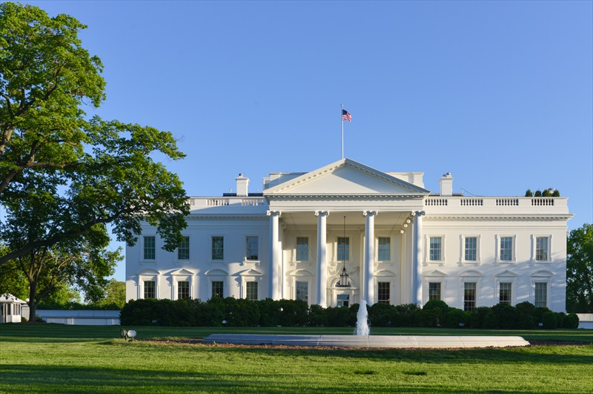
Exploring Our Nation’s Capital
Things to Do and See in Washington, D.C.
Commuting from Silver Spring to Washington, D.C. is a breeze. The ease of transportation around Washington makes it easy to explore all that the nation’s capital has to offer. Whether it’s museums, sporting events, or sightseeing tours you’re after, there is something for everyone to enjoy in this history-rich city. Please peruse the site of our official tourism board, Destination DC for all things Washington, D.C.
The Paul S. Sarbanes Transit Center, otherwise known as The Silver Spring Transit Center, located at Wayne Avenue and Colesville Road, is a one-stop location for transportation in and out of Silver Spring. There you will find local bus stops, Metro Rail, Silver Spring Vango Free Shuttle, Greyhound Bus, bike rentals, and the Marc train.
For helpful information on traversing around the nation’s capital, click here to learn about local train, shuttle, bus and bike options.

Slide 10
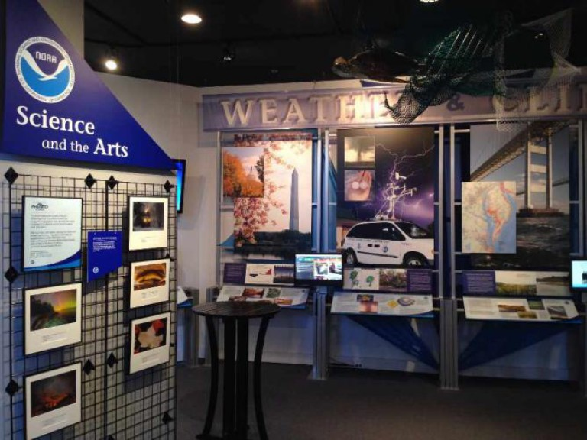
Gateway to NOAA Tour
Gateway to NOAA is a permanent exhibit in NOAA’s Silver Spring, MD campus highlighting the ways in which NOAA takes the pulse of the planet everyday and protects and manages ocean and coastal resources.
The exhibit features a number of engaging displays:
NOAA Heritage
Earth Observations
Weather and Climate
Water
NOAA in the News

Slide 11
Tentative WGISS-47 Agenda
 | Sunday 28 Apr | Monday 29 Apr | Tuesday 30 Apr | Wednesday 1 May | Thursday 2 May
09:00-12:00 |  | WGISS Discussions | WGISS Discussions | WGISS Discussions | WGISS Discussions
12:00-13:30 |  | Lunch | Lunch | Lunch | Lunch
13:30-15:30 |  | WGISS Discussions | WGISS Discussions | WGISS Discussions | WGISS Discussions
15:30-17:30 |  | WGISS Discussions | NOAA Gateway Tour & Presentation CEOS-WGISS Reception | WGISS Discussions | WGISS Discussions Adjourn
18:00 | WGISS Exec Meeting |  | No-Host Dinner

Slide 12
martin.yapur@noaa.gov
301 713-7167
1335 East West Highway
SSMC1 - 5226
Silver Spring , MD 20910

Slide 13
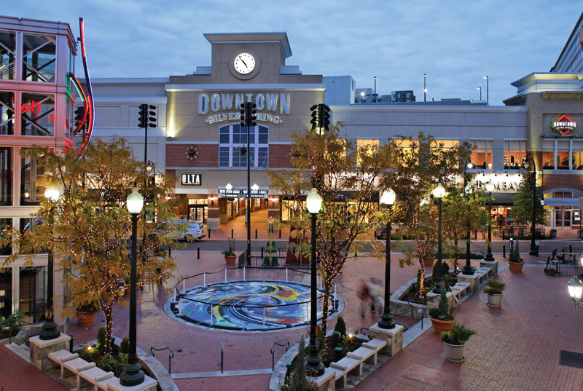
See you all at WGISS-47 in Silver Spring!

