Slide 1

WGISS Working Group on Information Systems & Services
CHAIR
SUMMARY
Committee on Earth Observation Satellites
Mirko Albani, ESA, WGISS Chair
WGISS-47 Meeting
NOAA – Silver Spring, USA
2nd May 2019

Slide 2
Plenary Session
Committee on Earth Observation Satellites

Slide 3
CEOS and WGISS
Applaud the achievements of the WGISS Connected Data Assets (CDA) Infrastructure (next slide)
  Single entry point for external clients to discover/access CEOS Agencies data
Applaud the achievement of the GEOSS Platform Discoverable Products (next slide)
  CWIC and FedEO harmonization
Applaud WGISS contributions to the GEO Data Technology Workshop, Expert Advisory Group for Results-Oriented GEOSS, GEOSS EVOLVE, and many more GEO activities
VCs and WG Coordination
  Updated inventory of VC data to ensure discoverability/accessibility through WGISS Infrastructure
Future Data Architectures
  Welcomed the transition of the FDA actions from ad hoc team into permanent WG structure – successful example of progression
WGISS successfully promotes
collaboration in the development of
systems and services that manage and
supply Earth observation data.
THANK YOU!
Borrowed from Steven Volz’s WGISS Presentation

Slide 4


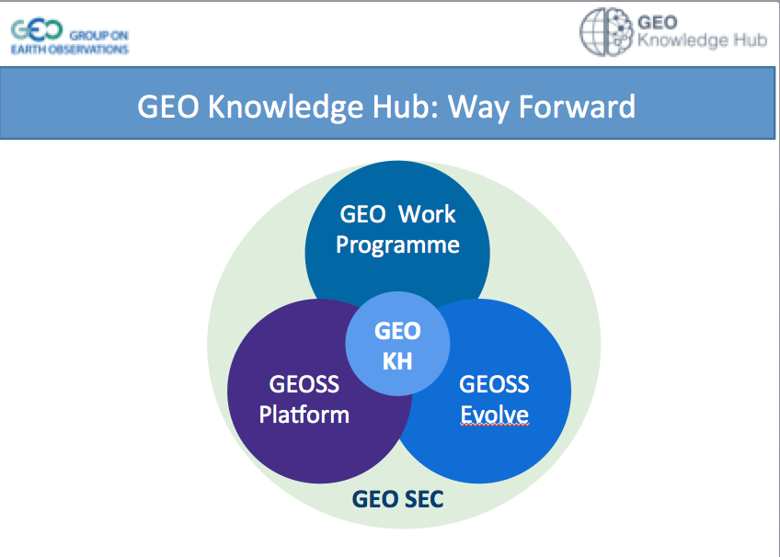


WGISS PLENARY SESSION
Working Group on Information Provision to cover these and future efforts
WGISS
WGISS to support “Study Team”
WGCalVal
WGCapD
Notes:
QUI AGGIUNGERE OUTCOMES

Slide 5
WGISS Structure
WGISS
Chair, Mirko Albani, ESA
Vice-Chair, Robert Woodcock, CSIRO
WGISS Principals
  CAS/AOE: Guangyu Liu
  CAS/RADI: Lizhe Wang
  CNES: Richard Moreno
  CONAE: Homero Lozza
  CSA: Paul Briand
  CSIRO: Robert Woodcock
  DLR: Katrin Molch
  EC: Astrid Koch
  ESA: Mirko Albani
  EUMETSAT: Michael Schick
  GA: Simon Oliver
  INPE: Lubia Vinhas
  ISRO: Nitant Dube
  JAXA: Yousuke Ikehata
  MFA/HSO: Gabor Remetey
  NASA: Andrew Mitchell
  NOAA: Kenneth Casey
  NRSCC: Chuang Liu
  ROSCOSMOS: Aleksandr Chunosov
  UKSA: Esther Conway
  USGS: Kristi Kline
WGISS Secretariat
Michelle Piepgrass, ESA
WGISS Infrastructure Services Project
NOAA – until end April 2019
Data Preservation and Stewardship Interest Group
(Mirko Albani, ESA)
Discovery and Access - WGISS Connected Data Assets System Level Team (Yonsook Enloe, NASA)
- IDN (Michael Morahan, NASA)
- FedEO (Andrea Della Vecchia, ESA ; Yves Coene, ESA)
- CWIC (Yonsook Enloe, NASA)
- OpenSearch II (Andrea Della Vecchia, ESA; Olivier Barois, ESA)
Interoperability and Use Interest Group
(Robert Woodcock, CSIRO; Richard Moreno, CNES)
- Future Data Architectures (Robert Woodcock, CSIRO; Richard Moreno, CNES; Kristi Kline, USGS)
- Carbon Portal (Kenneth Casey, NOAA; Liping Di, NOAA)
- Data Analytics Software and Tools (Iolanda Maggio, ESA)
Technology Exploration Interest Group
(Chris Lynnes, NASA; Yousuke Ikehata, JAXA)

Slide 6
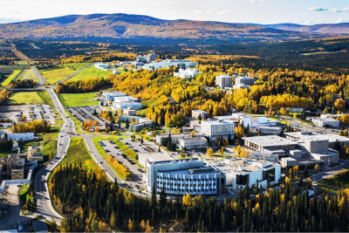

2019
SIT Technical Workshop
Host: NOAA, SIT Chair Team
Location: Woods Student Center
University of Alaska,
Fairbanks Alaska, USA
Dates: September 9-12, 2019
Monday 9th | Tuesday 10th | Wednesday 11th | Thursday 12th
9:00am – 5:00pm Virtual Constellation and Working Group Day | 9:00am – 5:00pm Side Meetings | 9:00am – 5:00pm SIT Technical Workshop Day 1 | 9:00am – 4:30pm SIT Technical Workshop Day 2
Evening Free | Technical Tour | Social | Evening Free

Slide 7


Next Meetings
WGISS-48 meeting, 8-11 October 2019
33rd CEOS Plenary, 14-16 October 2019
Ha Noi, Vietnam
VIETNAM ACADEMY OF SCIENCE AND TECHNOLOGY
Notes:
NON HO CONOSCENZA

Slide 8

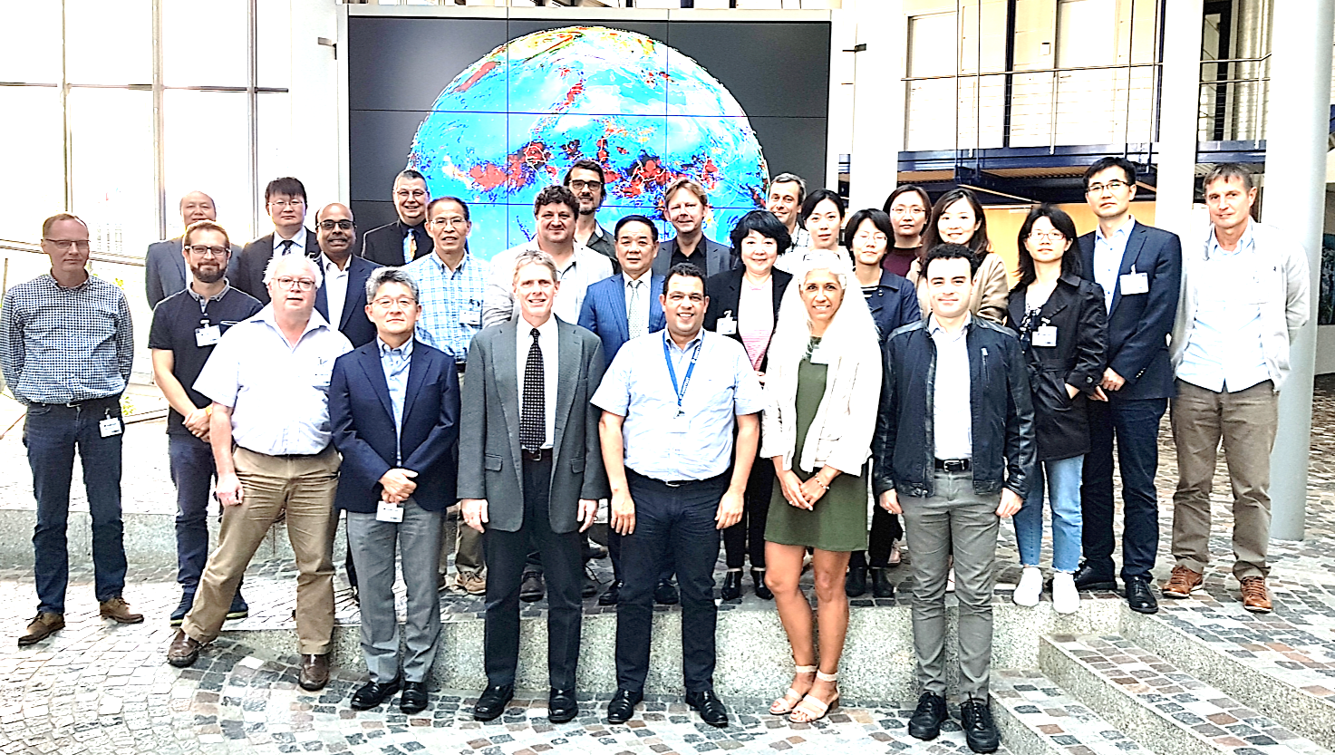
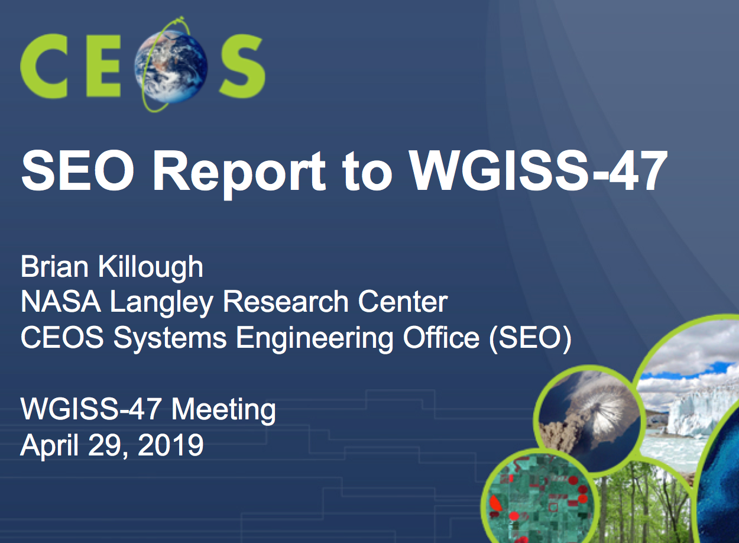
WGISS PLENARY SESSION
WGCV
Notes:
QUI AGGIUNGERE OUTCOMES

Slide 9
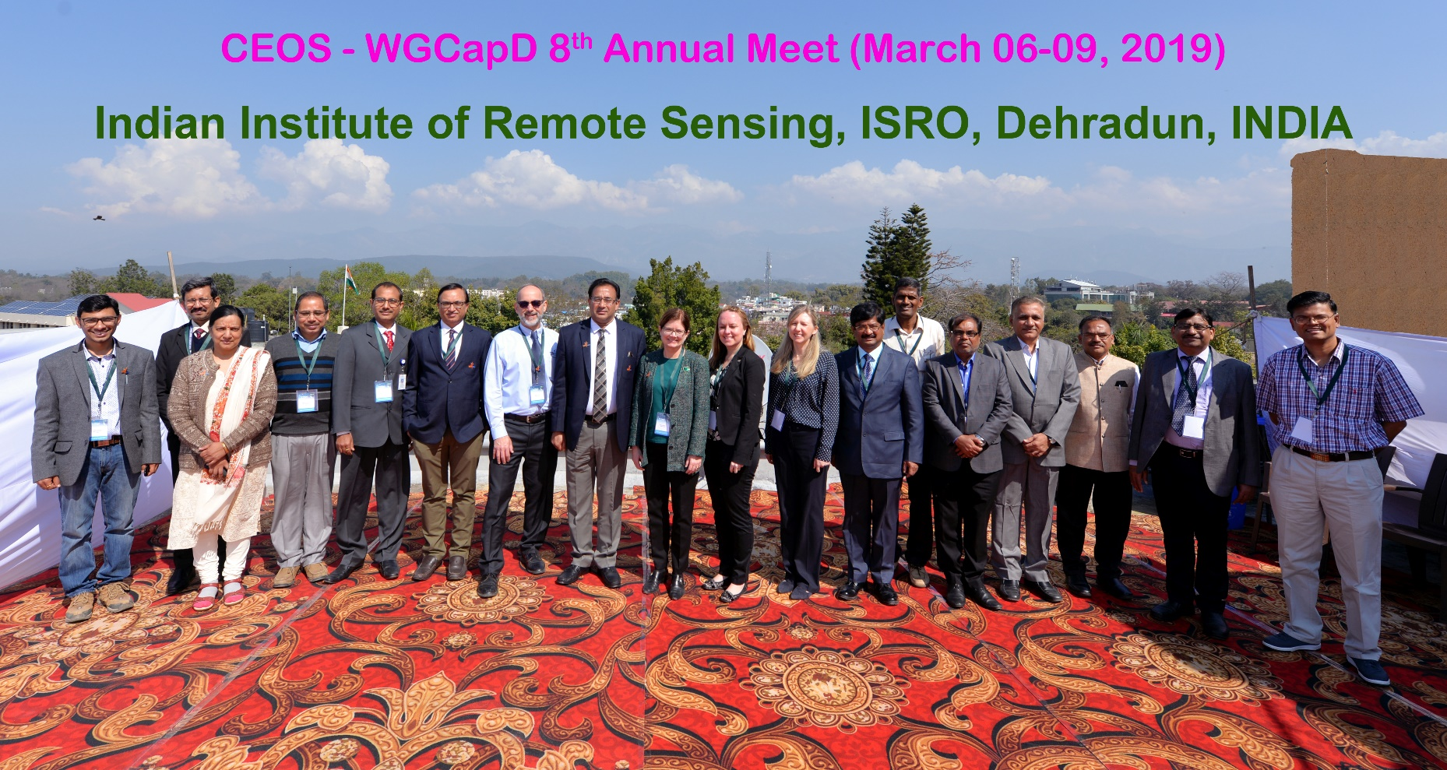
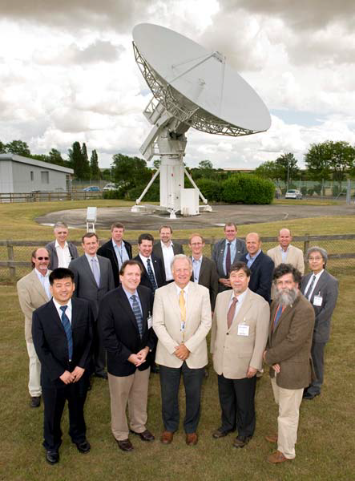
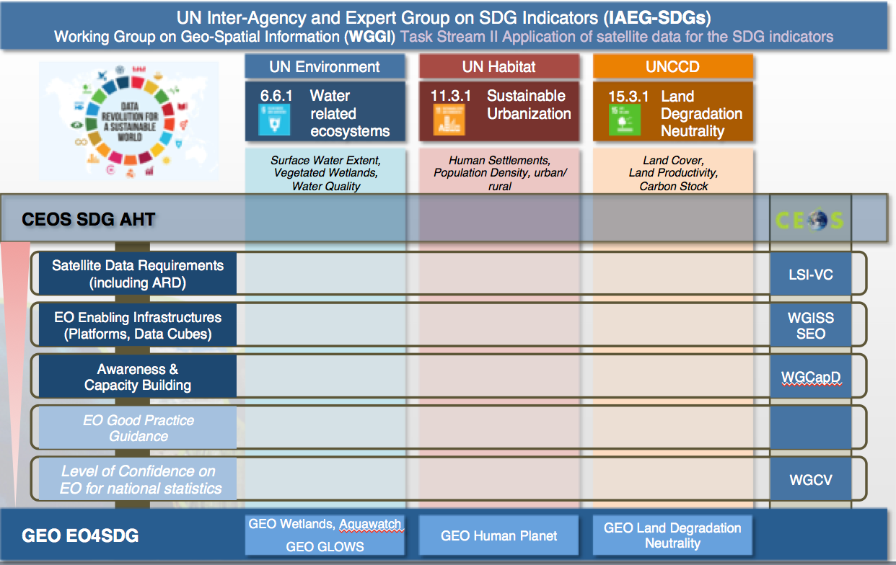
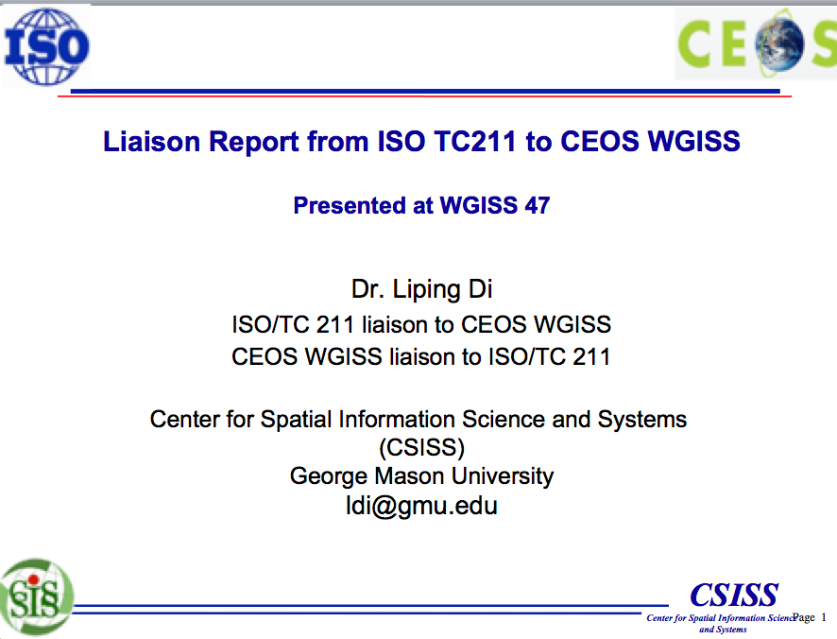
WGISS PLENARY SESSION
WGCapD
WGClimate
Notes:
QUI AGGIUNGERE OUTCOMES

Slide 10

WGISS 47 FDA Elements Demonstration Workshop

Slide 11
FDA Elements Demonstration Workshop
11 FDA elements presentations and demonstrations, FDA-08 and FDA-09 actions addressed
GEO AquaWatch
CEOS SEO Client Interfaces and Open Data Cube
USGS Architecture for Services in the Cloud
ESA PDGS Data Cube
European Data Cube Service
GEOhazard Thematic Exploitation Platform
Copernicus Data & Exploitation Platform – Deutschland (CODE-DE)
Food Security Thematic Exploitation Platform with Demo
Plateforme d’Exploitation des Produits Sentinel (PEPS)
JASMIN Super Data Cluster
Big Data Approaches Supporting Market Growth in EO at the Satellite Applications Catapult

Slide 12
FDA activities in WGISS proceeding along three lines
Making FDA services/tools/elements discoverable/accessible through WGISS CDA (FDA-9, FDA-10, FDA-14) – and agency services catalogue harvesting/registration.
Pursuing interoperability between FDA elements through a manageable number of possibly standardized interfaces (FDA-8)
  Data Cubes interoperability (ODC / HMDC / DCFS)
  Follow-up standardization activities in OGC
Showcases of FDA Elements supporting CEOS/GEO Initiatives:
  Data Cubes for WGCV – two versions, ESA and ODC DEA
  GEOhazards TEP in support to WGDisasters
  WGISS to support AquaWatch and CEOS SEO ODC with data pipelines from existing FDA sources
  SDGs? Urban indicators…??

Slide 13
Data Discovery and Access Session
Committee on Earth Observation Satellites

Slide 14
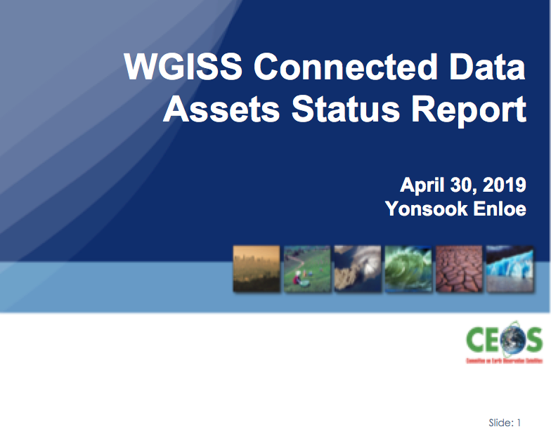

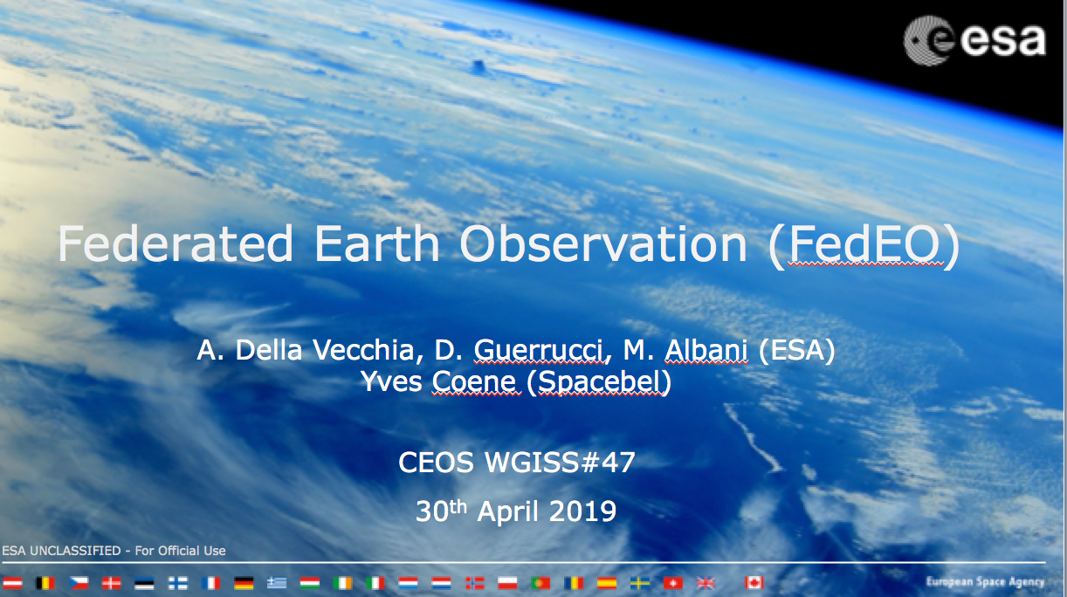
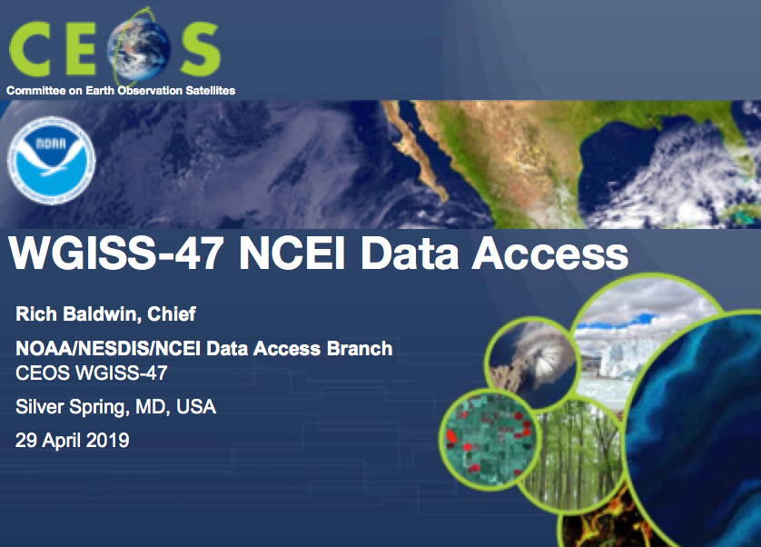
WGISS Connected Data Assets
Elements

Slide 15
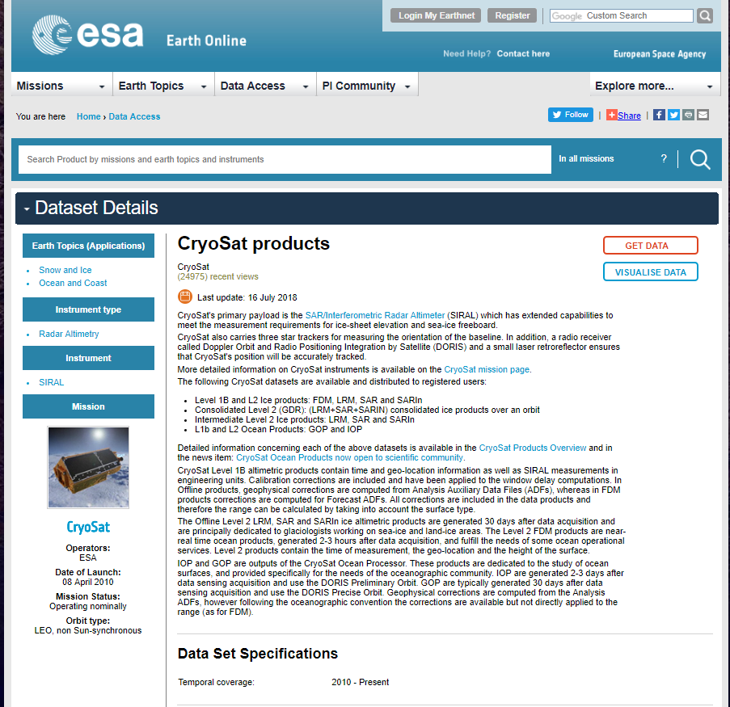
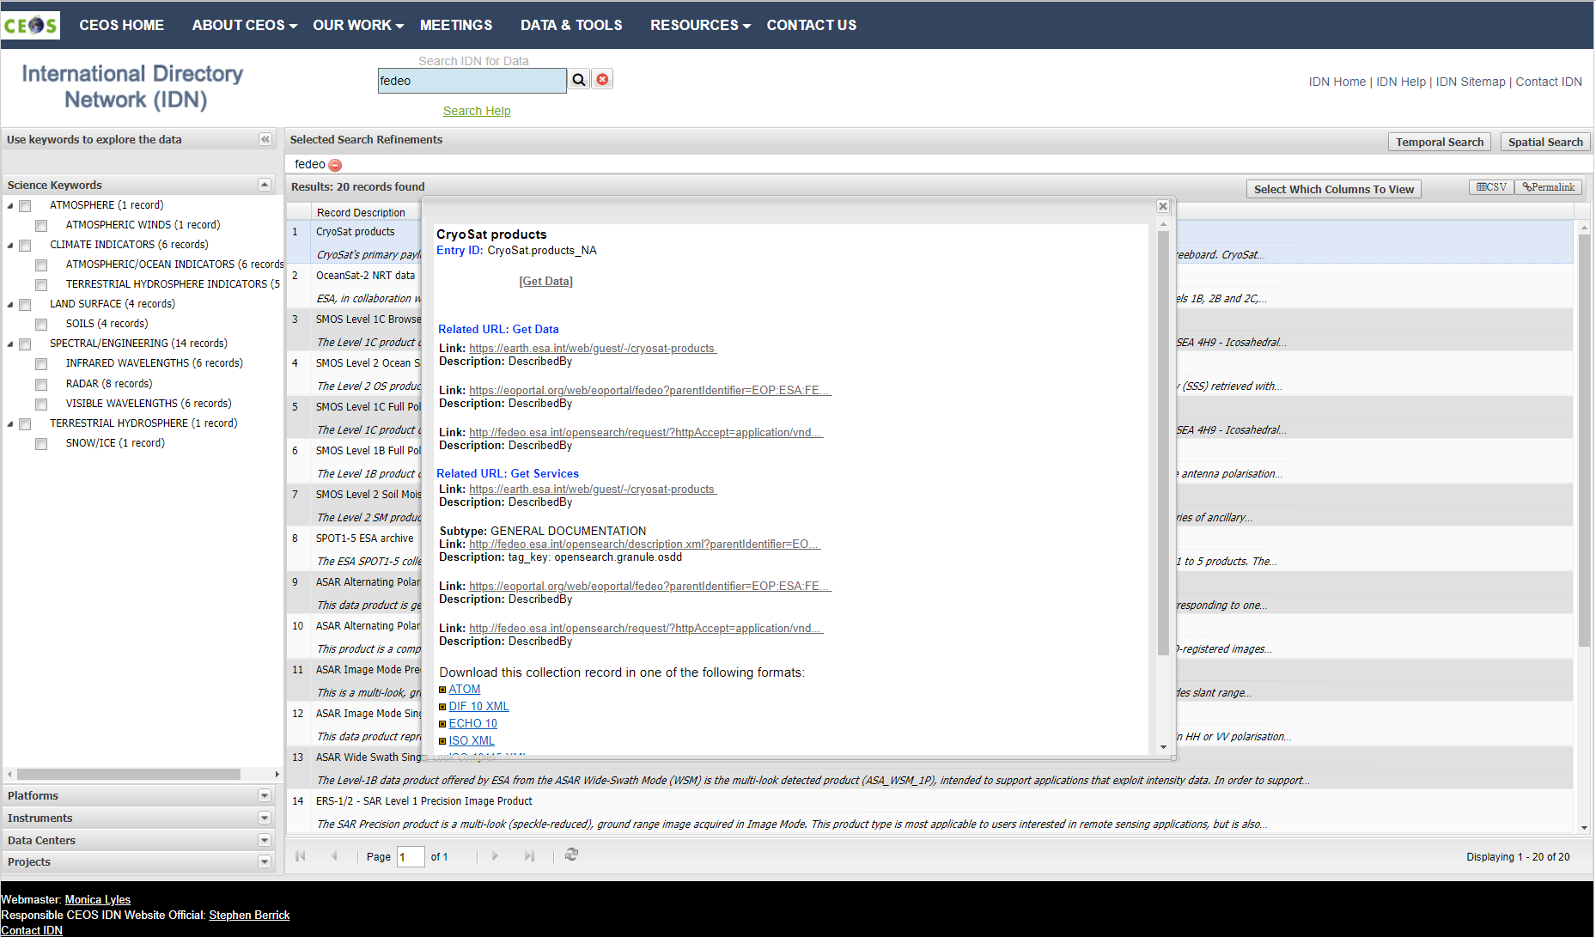
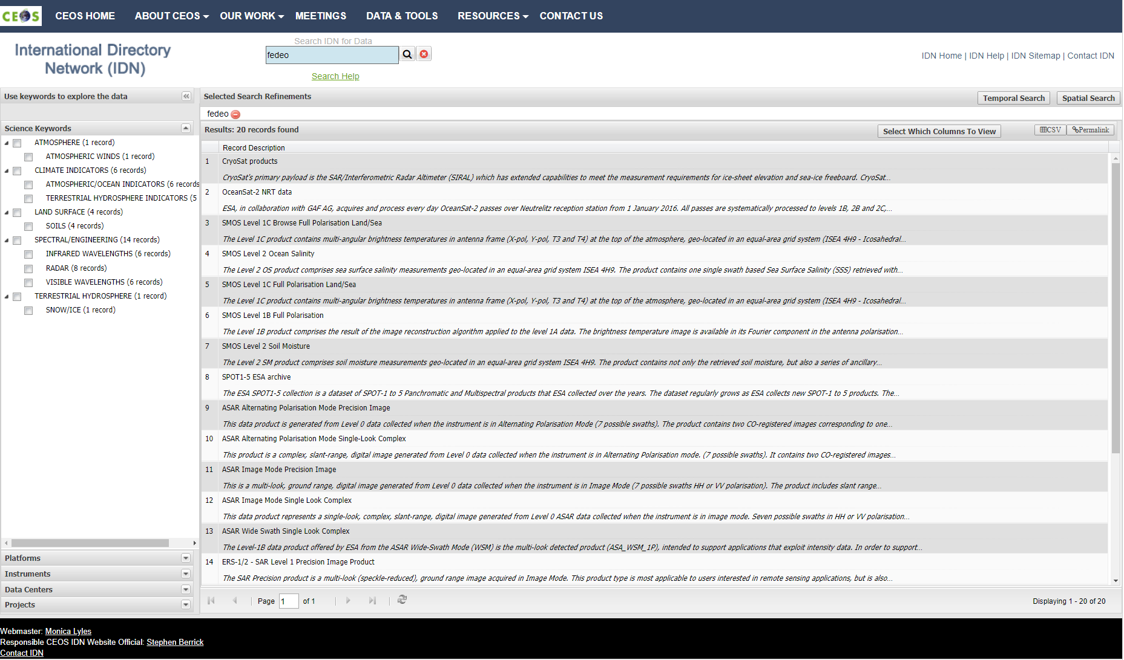
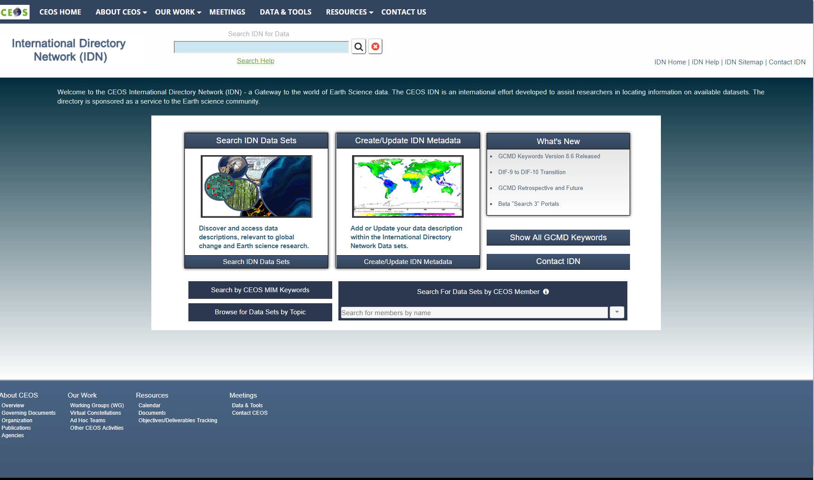
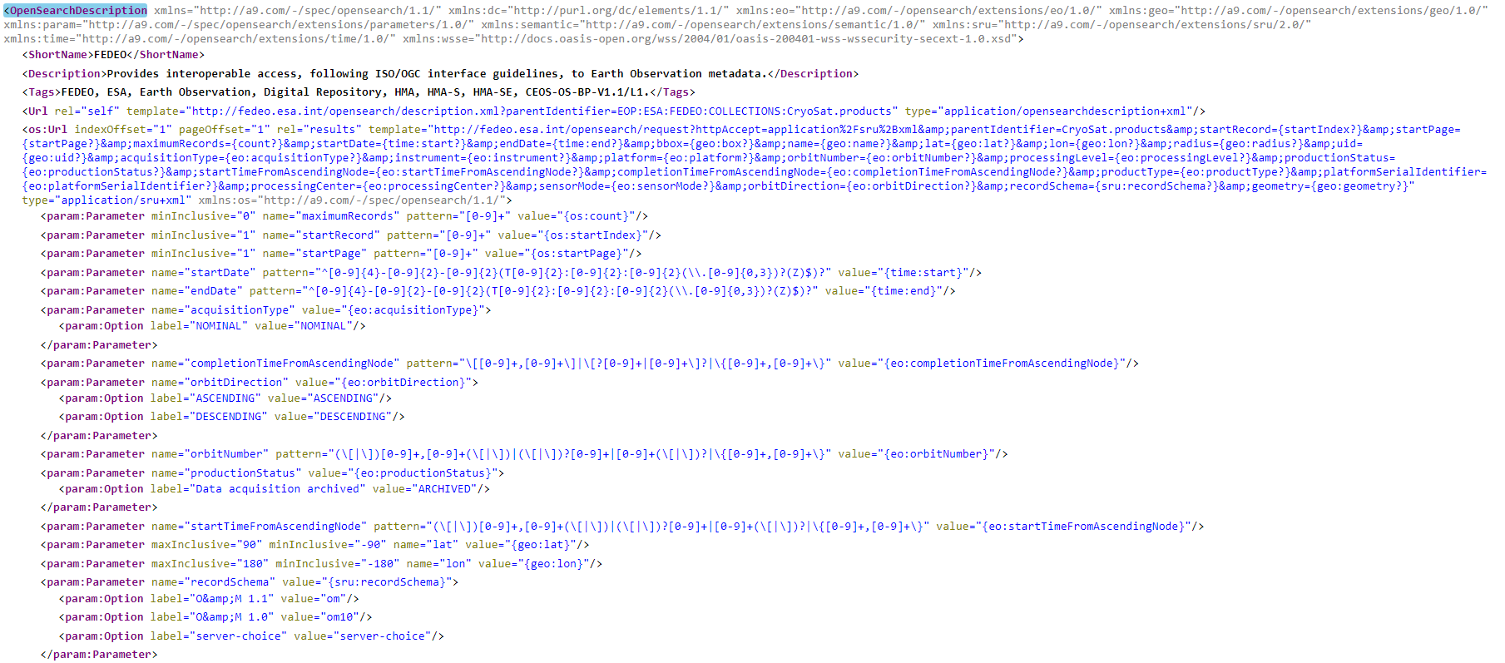
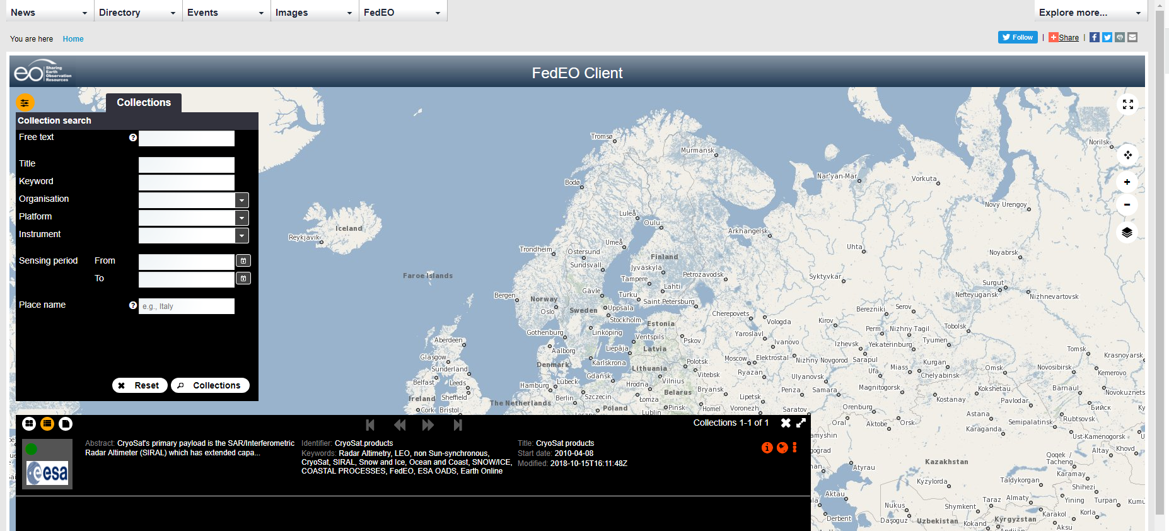
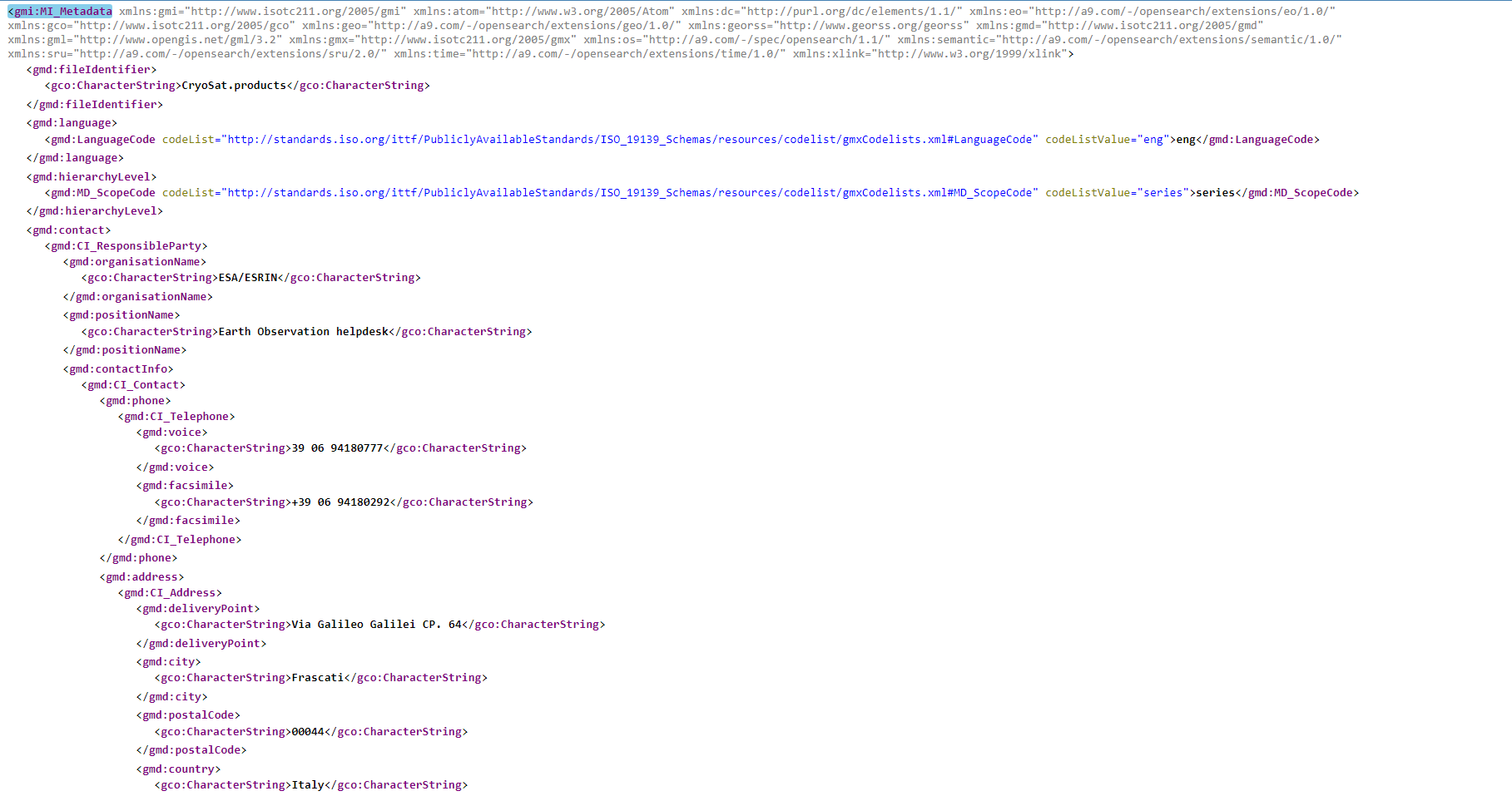
WGISS CDA GUI Interface and Metrics Discussion
ESA Collection Landing Page
Second Step OSDD
FedEO Client
ISO 19139-2 Metadata

Slide 16
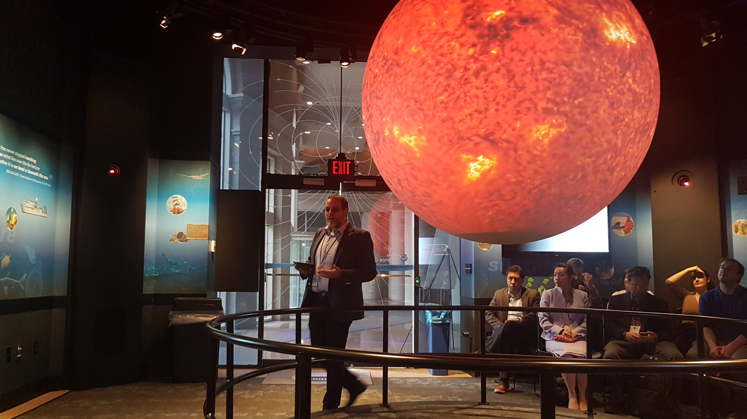

Slide 17
Data Interoperability and Use
Committee on Earth Observation Satellites

Slide 18
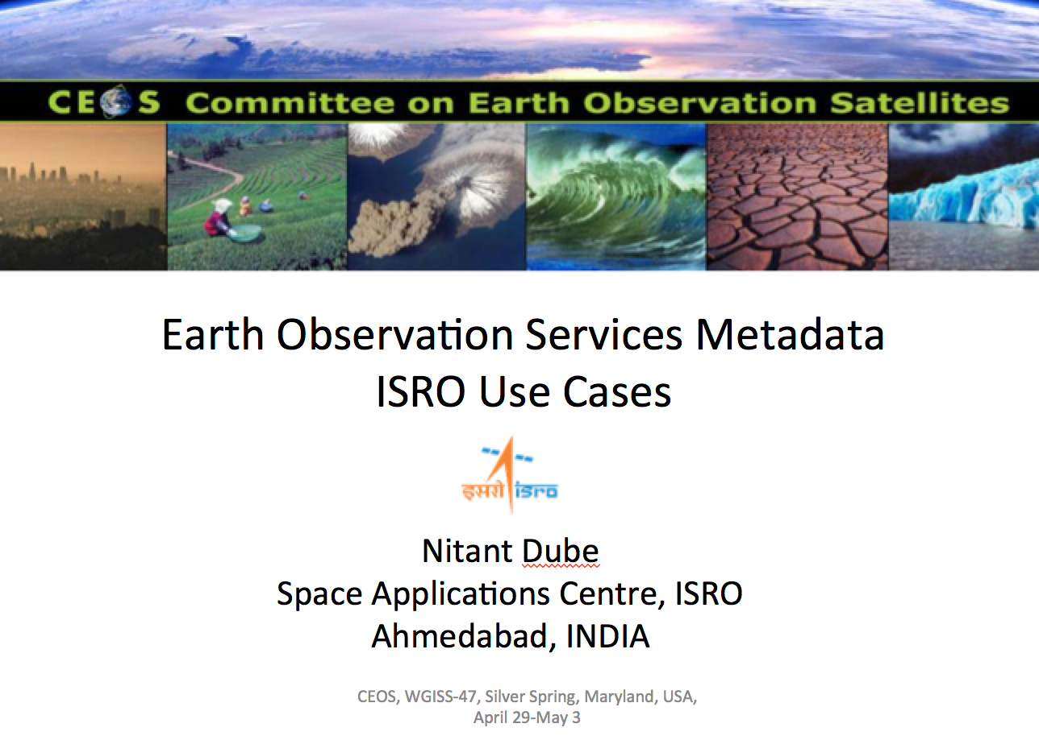
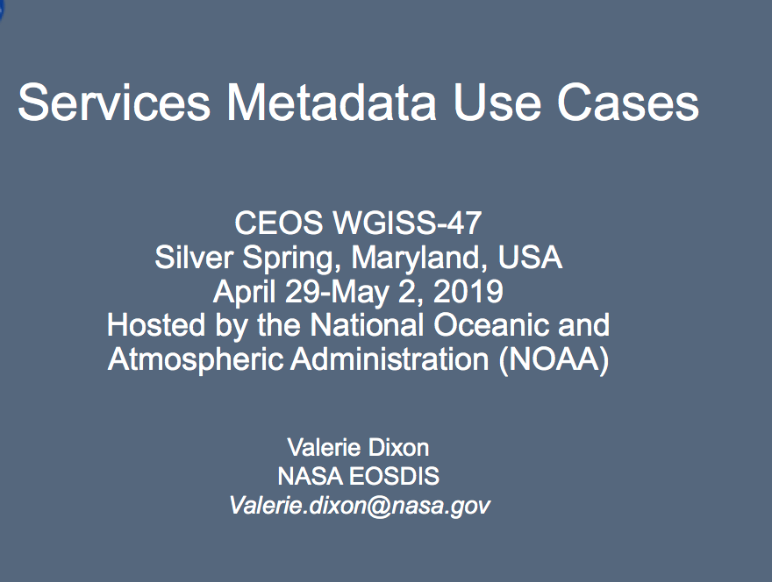
EO Services Metadata Use Cases
Different Steps:
Define services metadata model for an initial set of use cases
Register services in IDN
Linking services to data?

Slide 19
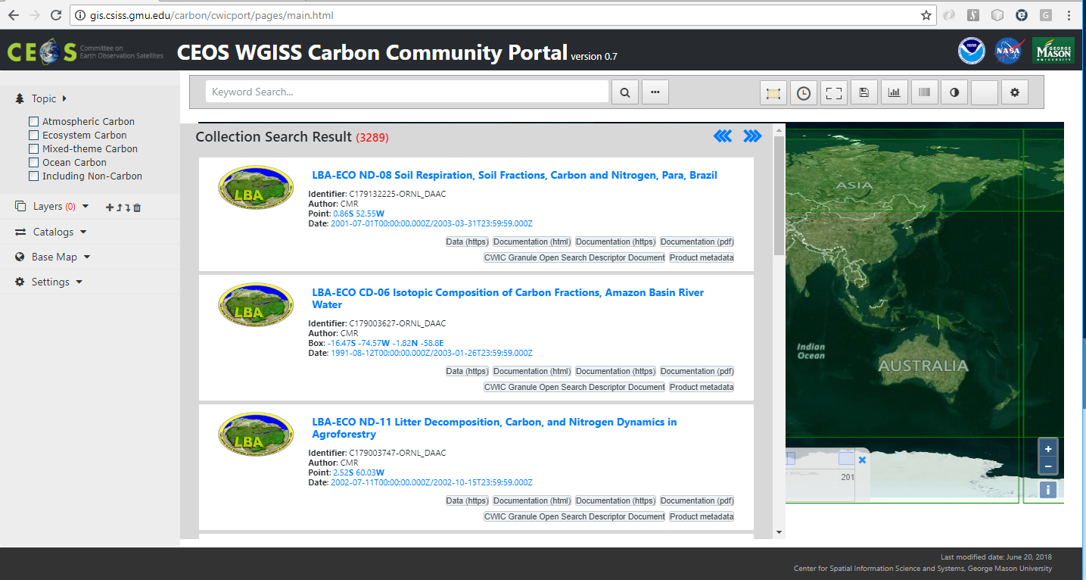
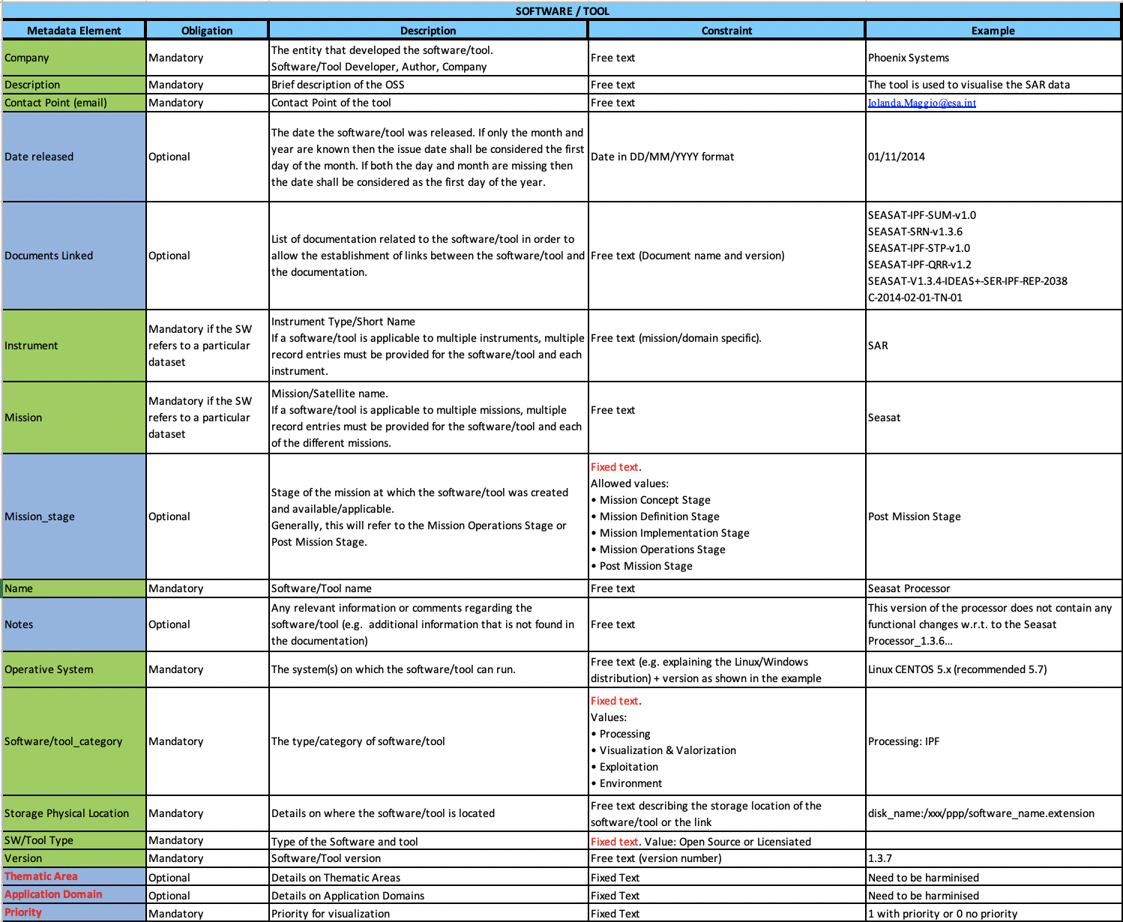
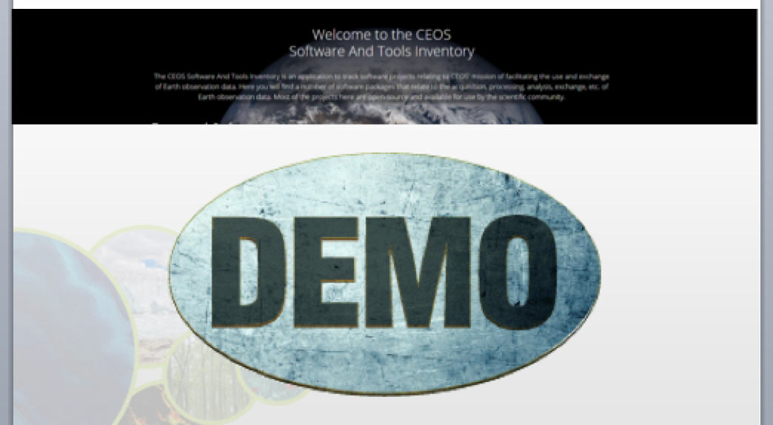
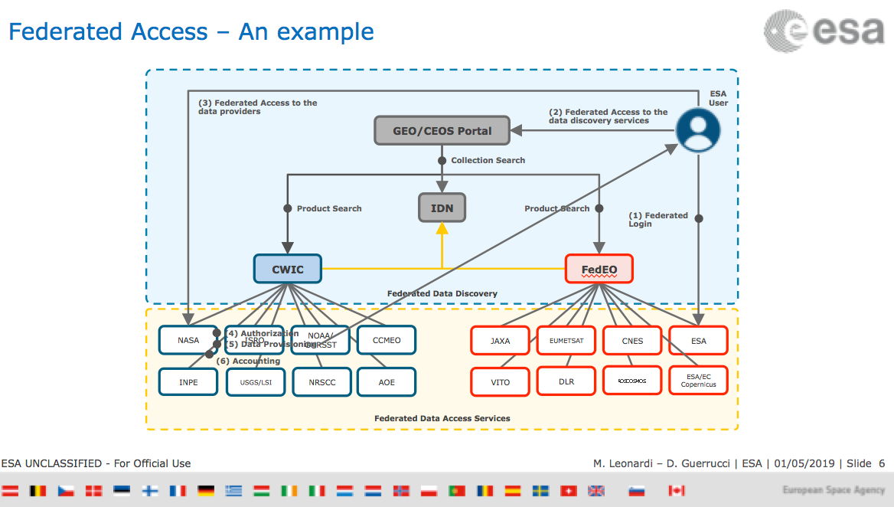
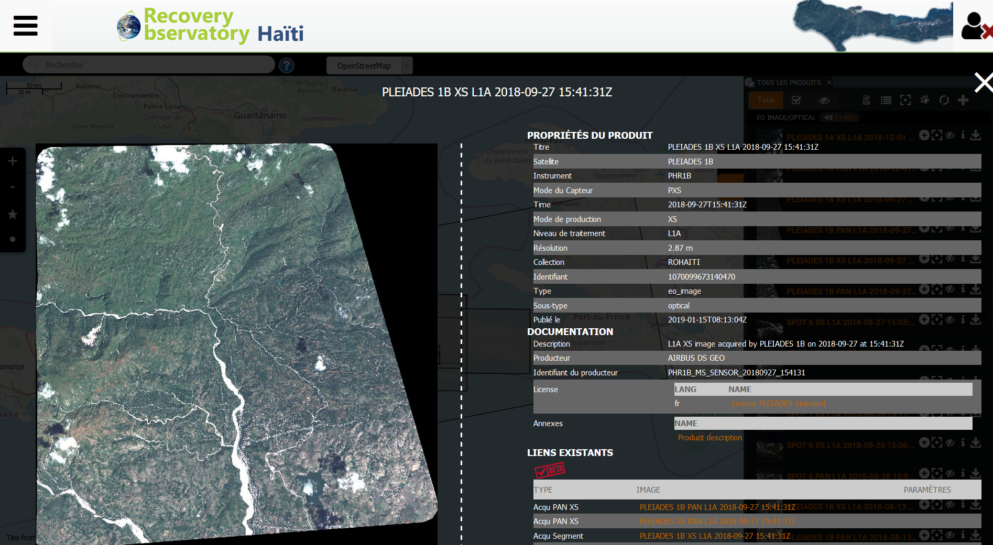
Interoperability and Use Session
https://gis.csiss.gmu.edu/carbon/cwicport

Slide 20
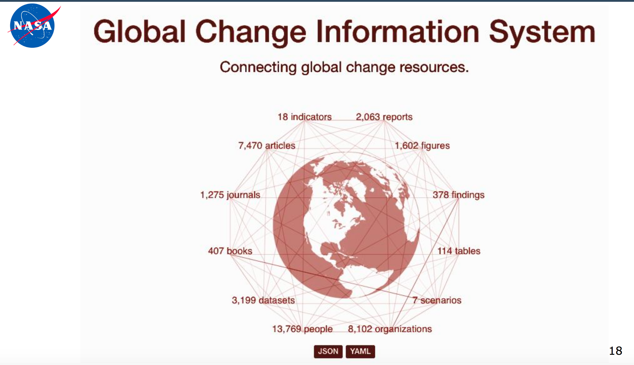
Interoperability and Use Session

Slide 21
Data Preservation and Stewardship Session
Committee on Earth Observation Satellites

Slide 22
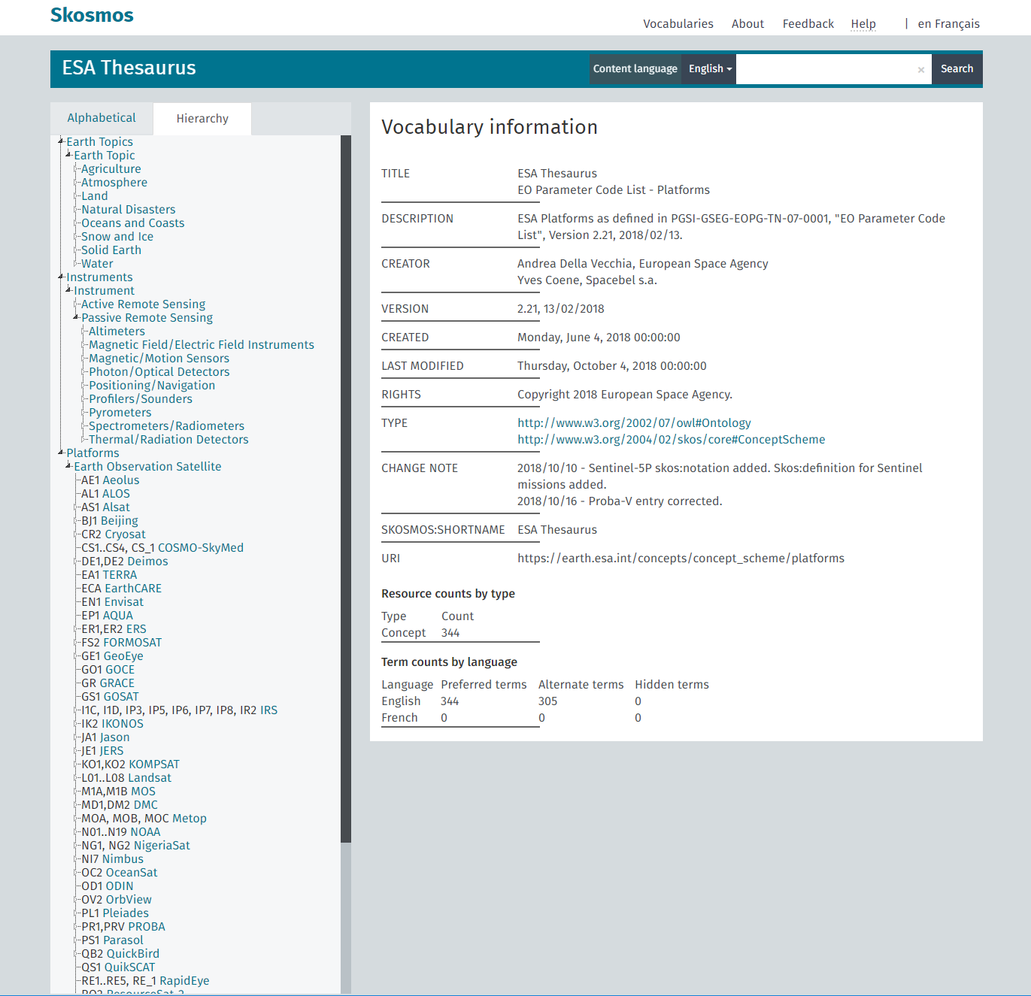

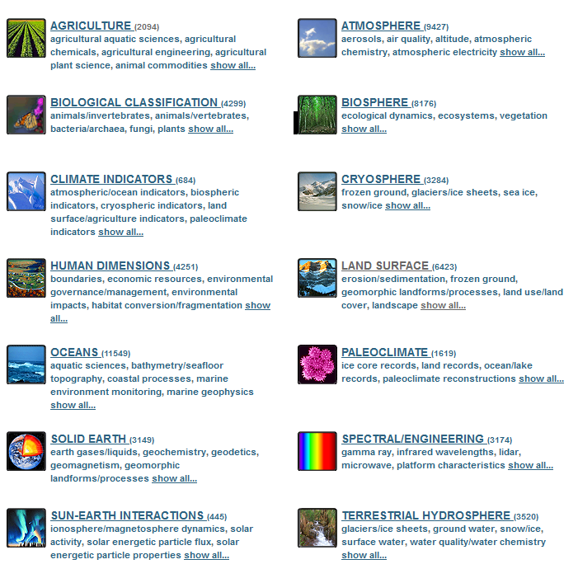
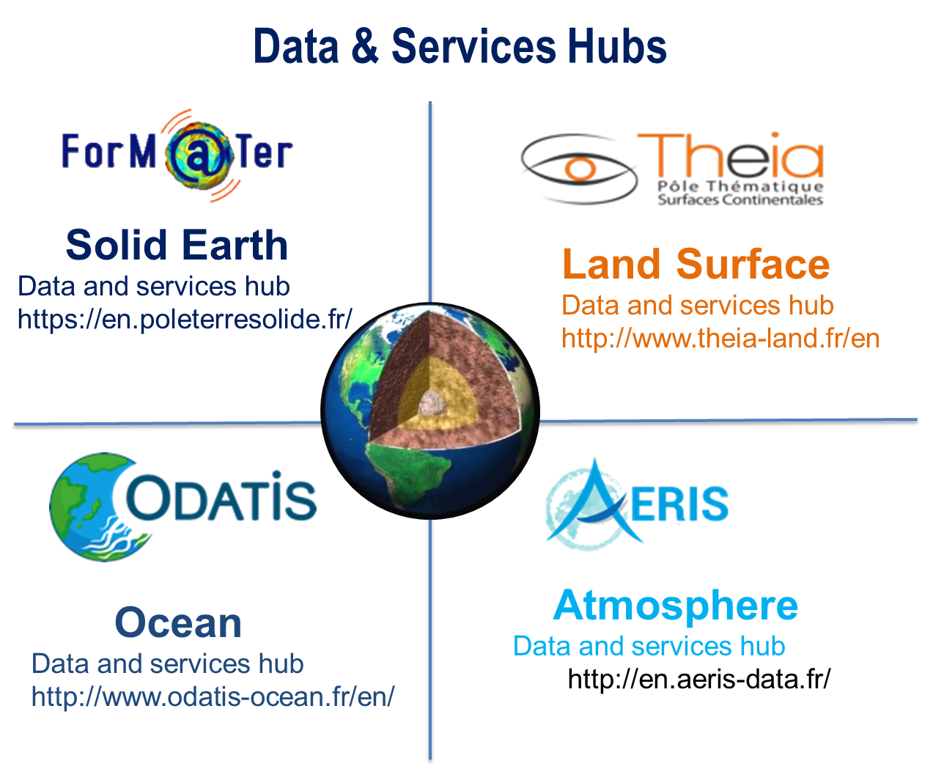
EO Ontologies
GCMD Earth Science Keywords
https://gcmd.nasa.gov/

Slide 23
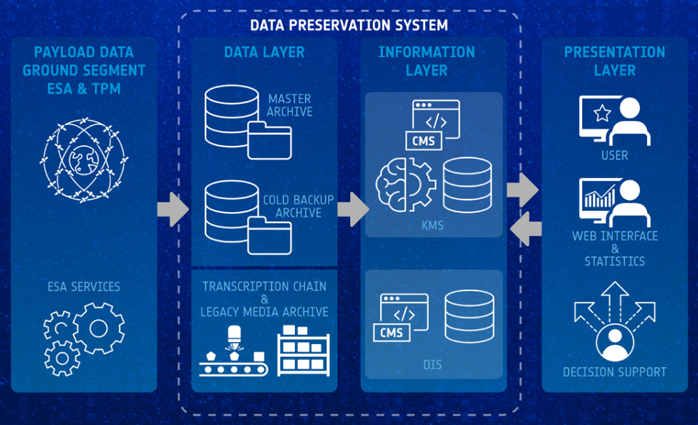
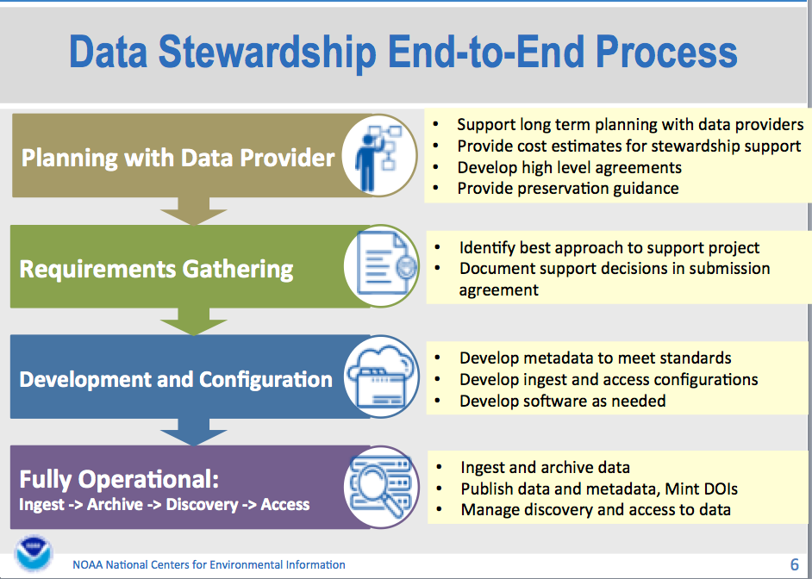
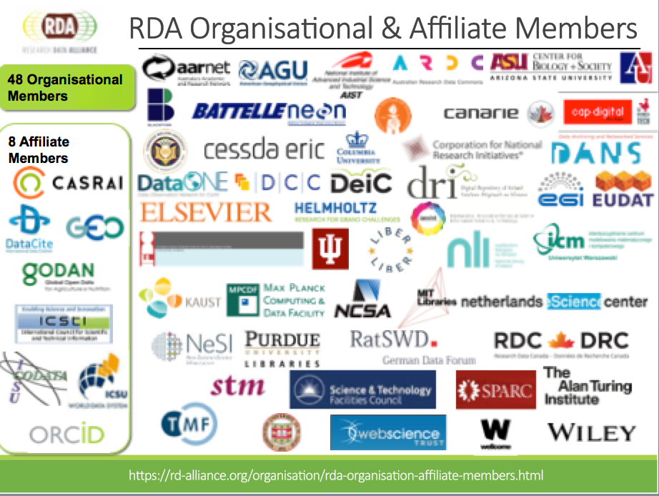

WGISS Data Stewardship

Slide 24
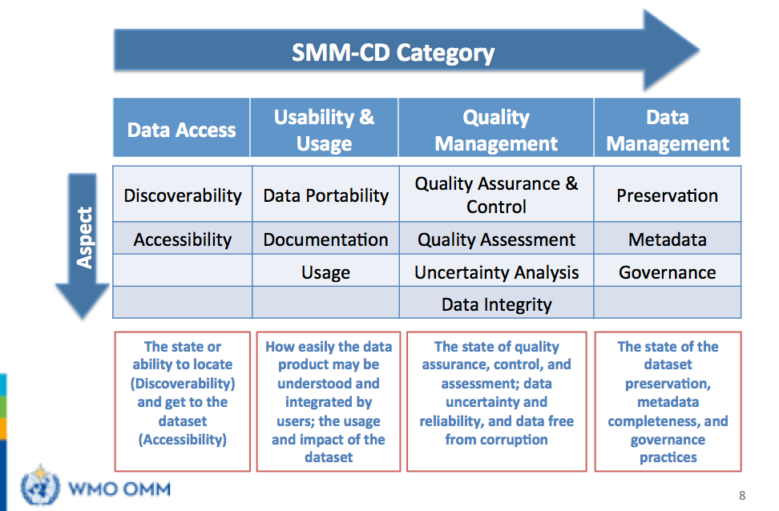
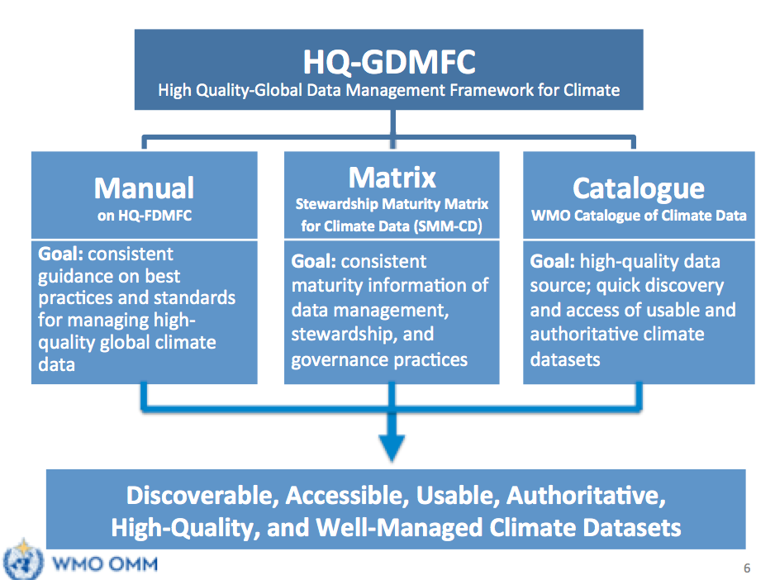

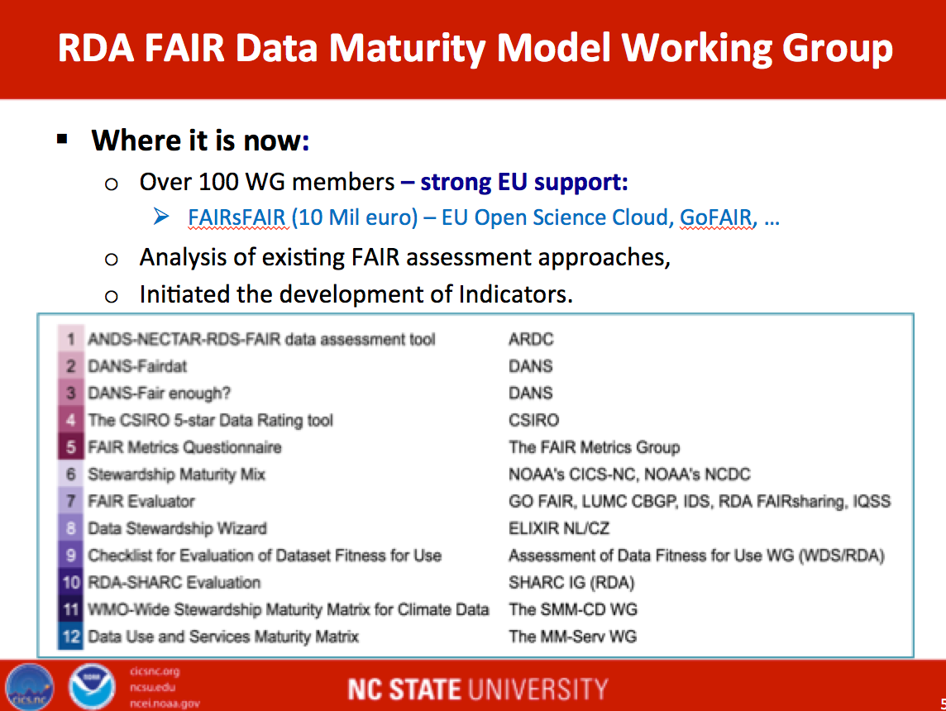
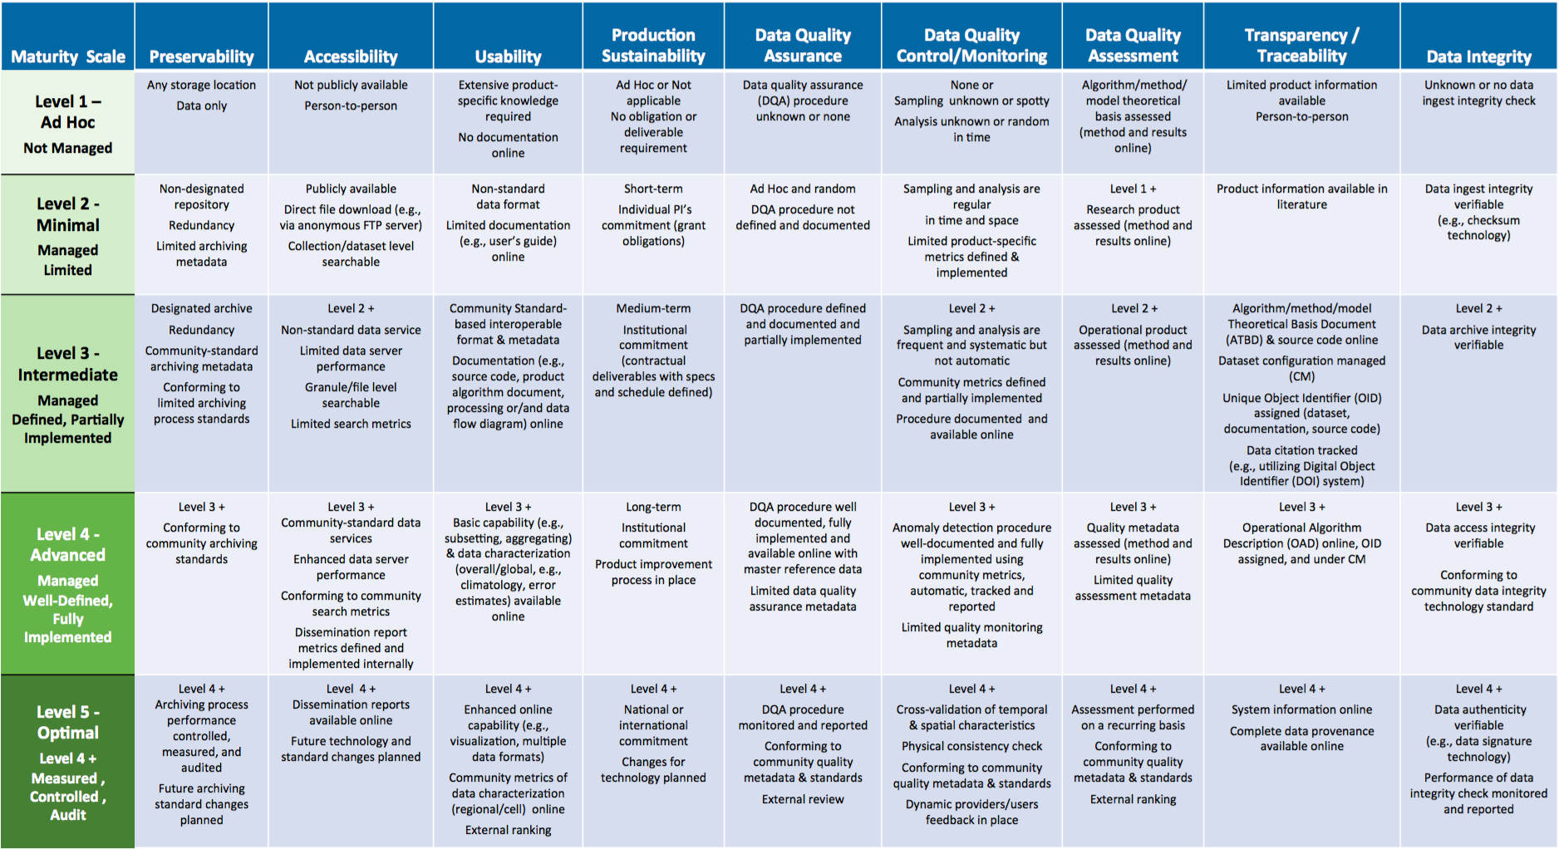
Stewardship Matrices

Slide 25
Technology Exploration Session
Committee on Earth Observation Satellites

Slide 26

Services in the Cloud

Slide 27

Artificial Intelligence and Machine Learning

Slide 28




Agency Reports

Slide 29
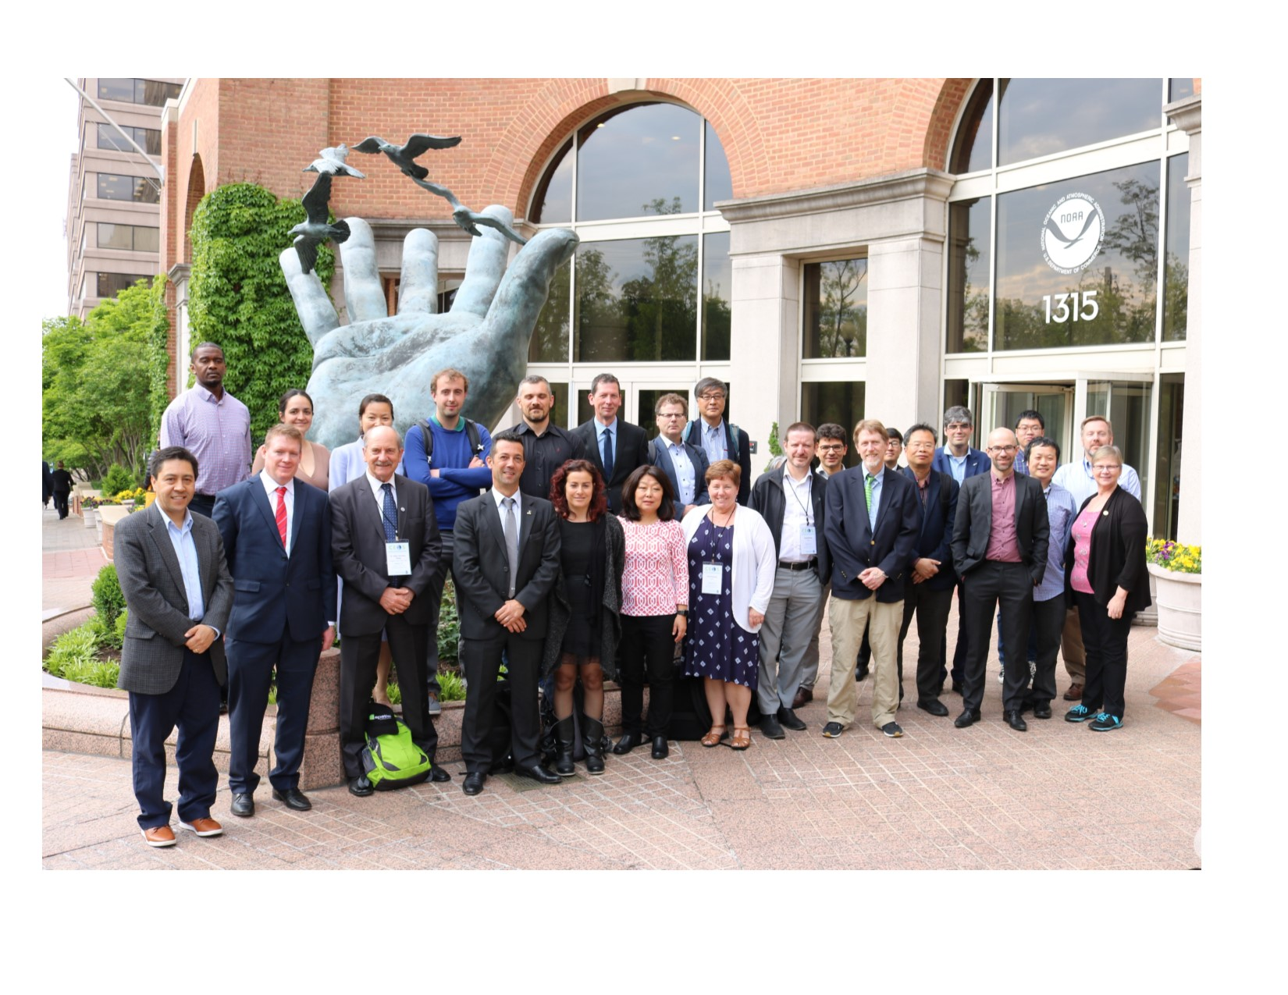

WGISS-47, NOAA – Silver Spring,
29 April – 2 May 2019

Slide 30

See you all at WGISS-48 in Hanoi!

