Slide 1




A New Large-Scale Sentinel-2 Benchmark Archive to Drive Deep Learning Studies
in Remote Sensing
Gencer Sumbul¹, Marcela Charfuelan³, Begüm Demir¹, Volker Markl^{2,3}
¹Remote Sensing Image Analysis (RSiM) Group, TU Berlin
²Database Systems and Information Management (DIMA) Group, TU Berlin
³Intelligent Analytics for Massive Data Research Group, DFKI GmbH

Slide 2



Outline
1
Introduction
2
Existing Benchmark Archives in Remote Sensing
BigEarthNet: Large-Scale Sentinel-2 Benchmark Archive
3
4
Three-Branch CNN
5
Experimental Results
6
Conclusion and Future Developments

Slide 3
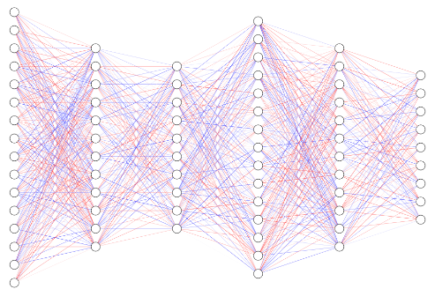
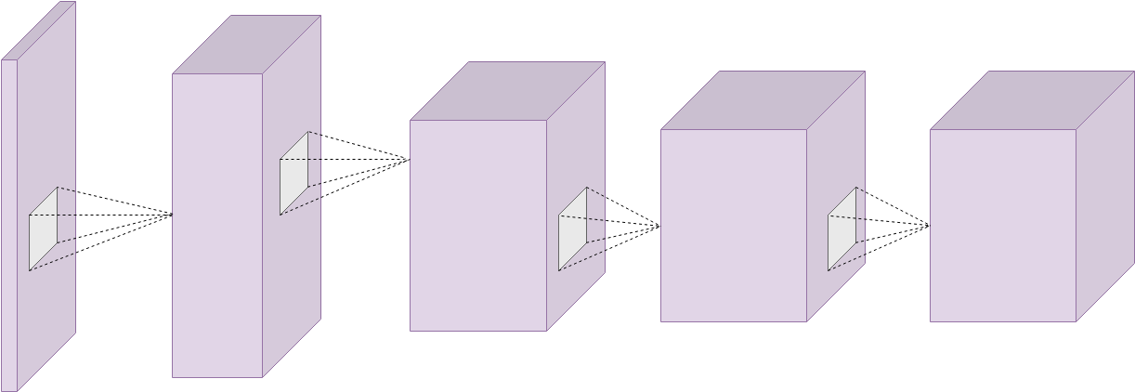
Introduction
One of the most challenging and emerging applications in remote sensing (RS) is related to the accurate description of RS images present in the archives.
Recent advances in deep learning have attracted great attention RS due to high capability of deep networks, e.g.,
  Convolutional Neural Network;
  Recurrent Neural Networks;
  Generative Adversarial Networks.
To train such networks, very large training sets are needed with a high number of annotated images.
G. Sumbul, M. Charfuelan, B. Demir, V. Markl
2

Slide 4
Existing Benchmark Archives in RS
Archive Name | Image Type | Annotation Type | Number of Images
UC Merced | Aerial RGB | Single Label | 2100
 |  | Multi-Label | 2100
WHU-RS19 | Aerial RGB | Single Label | 1,005
RSSCN7 | Aerial RGB | Single Label | 2,800
SIRI-WHU | Aerial RGB | Single Label | 2,400
AID | Aerial RGB | Single Label | 10,000
NWPU-RESISC45 | Aerial RGB | Single Label | 31,500
RSI-CB | Aerial RGB | Single Label | 36,707
EuroSat | Satellite Multispectral | Single Label | 27,000
PatternNet | Aerial RGB | Single Label | 30,400
Problem: Publicly available RS image archives contain only a small number of annotated images and a large-scale benchmark archive does not yet exist.
G. Sumbul, M. Charfuelan, B. Demir, V. Markl
3

Slide 5
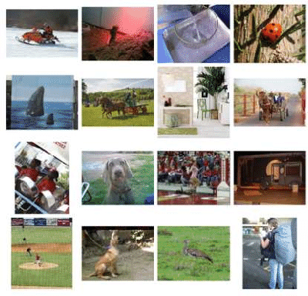
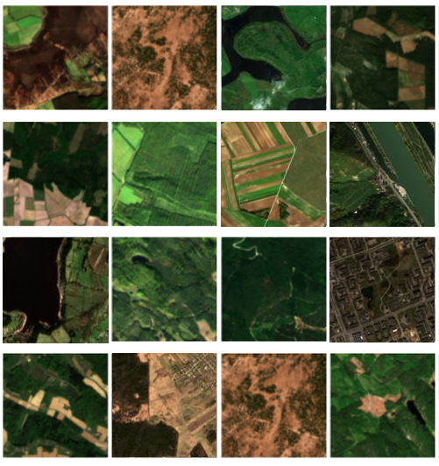
State of the Art Solutions
Use of deep learning models pre-trained on large scale computer vision archives (e.g., ImageNet)
Problem: Differences on the characteristics of images between computer vision and RS.
G. Sumbul, M. Charfuelan, B. Demir, V. Markl
4

Slide 6
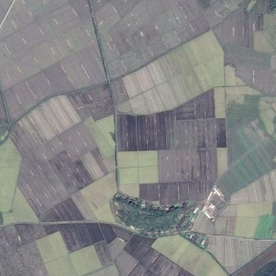
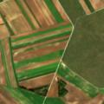
Limitations on Existing Archives in RS
Existing RS archives contain images annotated by single high-level category labels.
Most of the benchmark archives contain Aerial images that include only RGB image bands.
non-irrigated arable land, vineyards, pastures, land principally occupied by
agriculture
farmland
Problem: RS images generally contain multiple classes associated to different land-cover class labels (i.e., multi-labels).
G. Sumbul, M. Charfuelan, B. Demir, V. Markl
5

Slide 7
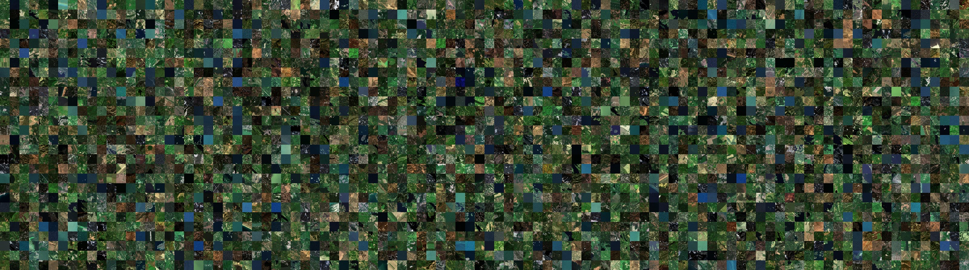
BigEarthNet: A Large-Scale Benchmark
Archive
The BigEarthNet is a new large-scale Sentinel-2 benchmark archive, consisting of 590,326 Sentinel-2 image patches.
G. Sumbul, M. Charfuelan, B. Demir, V. Markl
6

Slide 8
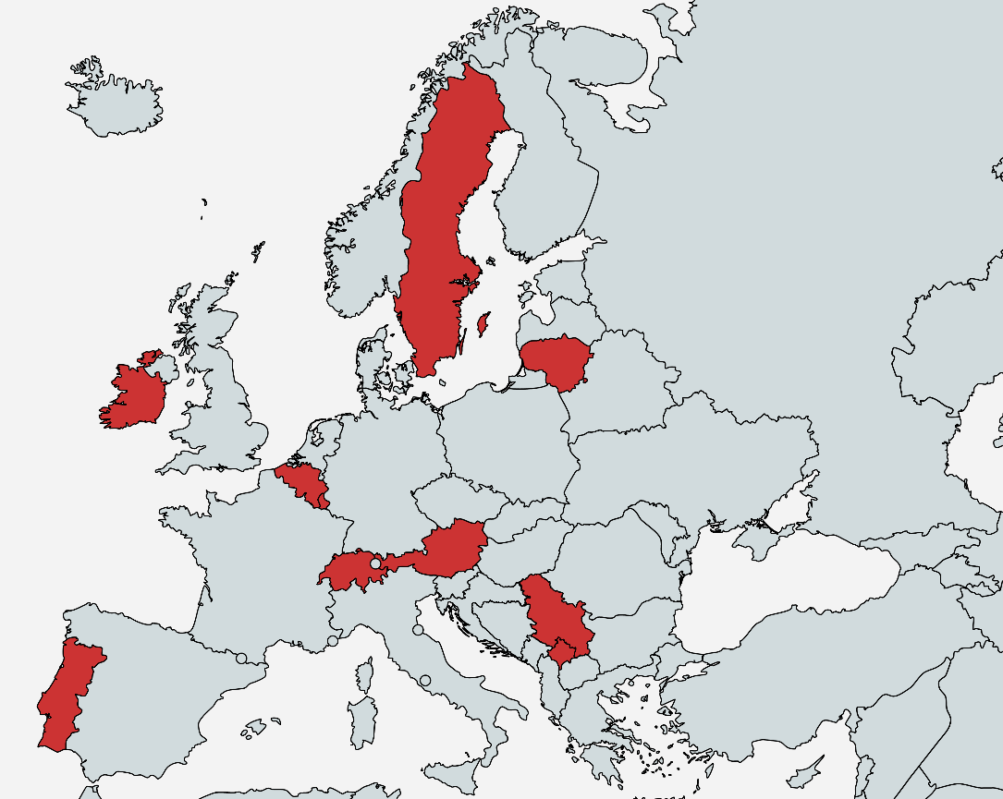
BigEarthNet: A Large-Scale Benchmark
Archive
To construct the BigEarthNet, 125 Sentinel-2 tiles (associated to cloud cover percentage less than 1%) acquired between June 2017 and May 2018 were selected.
Considered tiles are distributed over the 10 countries of Europe:
  Austria
  Belgium
  Finland
  Ireland
  Kosovo
  Lithuania
  Luxembourg
  Portugal
  Serbia
  Switzerland
All the tiles were atmospherically corrected.
G. Sumbul, M. Charfuelan, B. Demir, V. Markl
7

Slide 9
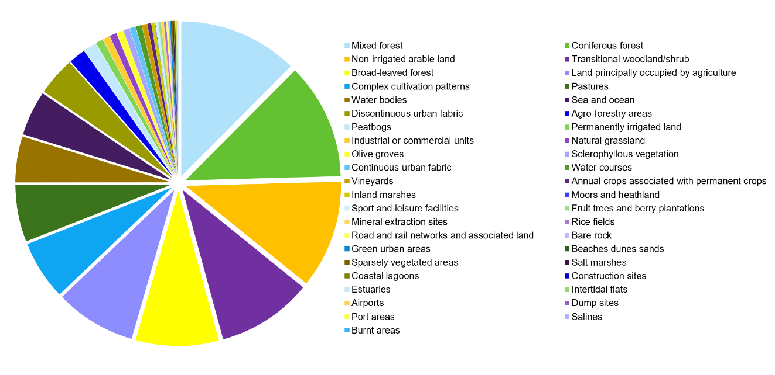
BigEarthNet: A Large-Scale Benchmark
Archive
Selected tiles were divided into 590,326 non-overlapping image patches, each of which has size of 120x120 pixels in 10 meter resolution.
Each image patch is associated with one or more land-cover class labels provided from the CORINE Land Cover (CLC) database of the year 2018 (CLC 2018).
It is produced with assistance from the European Environment Agency's Eionet network.
G. Sumbul, M. Charfuelan, B. Demir, V. Markl
8

Slide 10
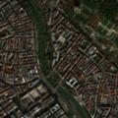
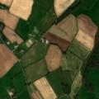
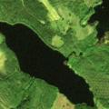
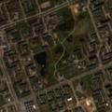
BigEarthNet: A Large-Scale Benchmark
Archive
The number of labels associated with each image patch varies between 1 and 12, whereas 95% of patches have at most 5 multi-labels.
Images acquired in different seasons are considered.
By visual inspection, we have identiﬁed that 70,987 images are fully covered by seasonal snow, cloud/cloud shadow and not used while training/testing our system.
Continuous urban fabric,
Green urban areas
Non-irrigated arable land,
Fruit trees and berry plantations,
Pastures
Coniferous forest,
Mixed forest,
Water bodies,
Transitional woodland/shrub.
Discontinuous urban fabric,
Construction sites,
Green urban areas
Seasons | Number of Image Patches
Autumn | 154,943
Winter | 117,156
Spring | 189,276
Summer | 128,951
G. Sumbul, M. Charfuelan, B. Demir, V. Markl
9

Slide 11
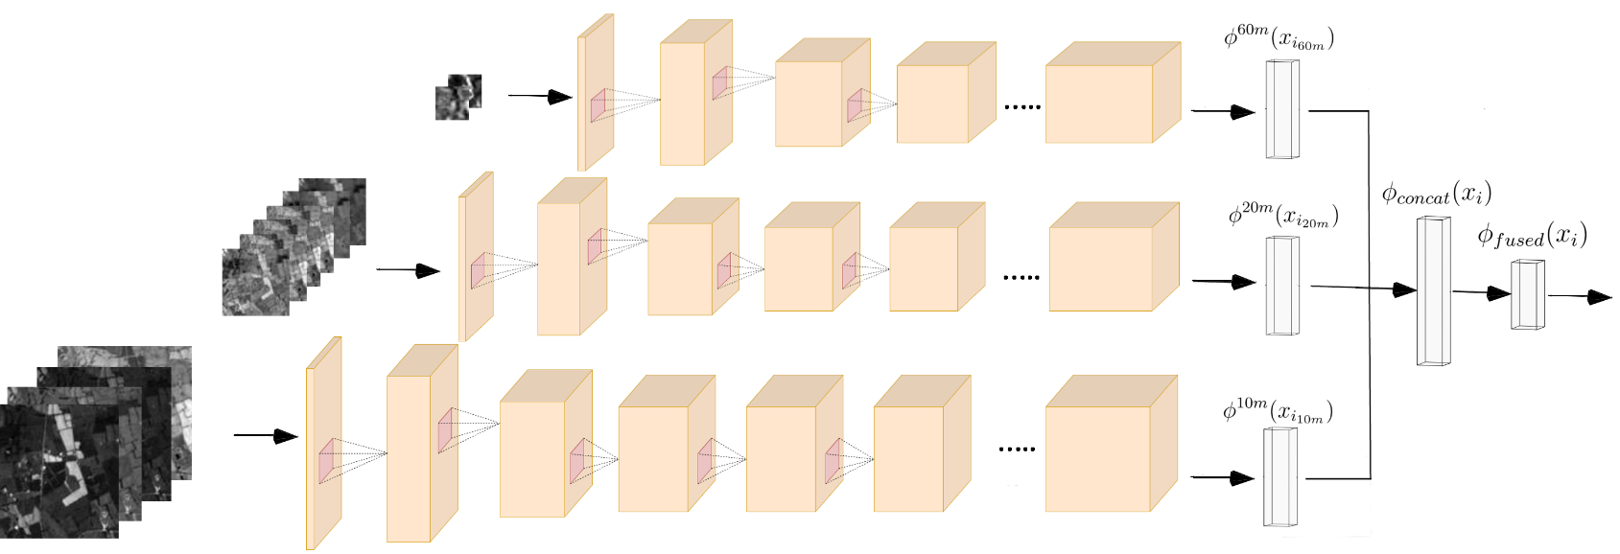
Three Branch CNN (TB-CNN)
TB-CNN includes three different convolutional branches specifically designed for different spatial resolutions of Sentinel-2 bands.
Each branch acts as a feature extractor for different resolutions
G. Sumbul, M. Charfuelan, B. Demir, V. Markl
10

Slide 12
Three Branch CNN (TB-CNN)
For the first and second branches developed for 60m and 20m resolutions, 2x2 filters and 3x3 filters are used, respectively, throughout the layers.
5x5 filters for initial layers and 3x3 filters for deeper layers are used for the last branch, which accepts 10m resolution bands.
G. Sumbul, M. Charfuelan, B. Demir, V. Markl
11

Slide 13
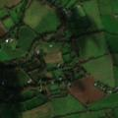
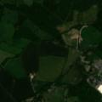
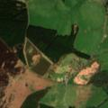
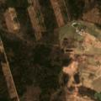
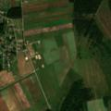
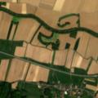
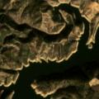
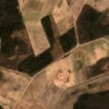
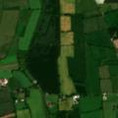
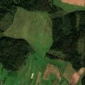
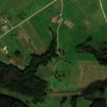
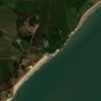
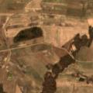
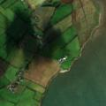
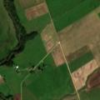
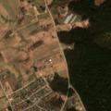
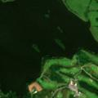
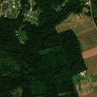
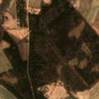
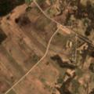
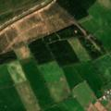

Applications on BigEarthNet
Multi-Label Scene Classification
discontinuous urban
fabric, non-irrigated arable
land, land principally
occupied by agriculture,
broad-leaved forest
Olive groves
Land principally occupied by agriculture
Broad-leaved forest
Transitional woodland/shrub
Water bodies
Archive
Image Retrieval
Query Image
Retrieved Images
G. Sumbul, M. Charfuelan, B. Demir, V. Markl
13

Slide 14
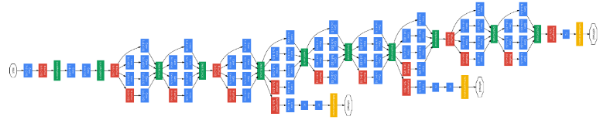
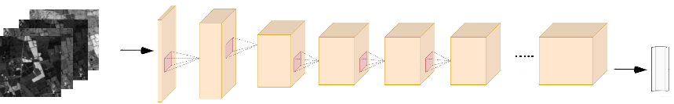

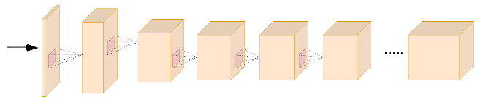
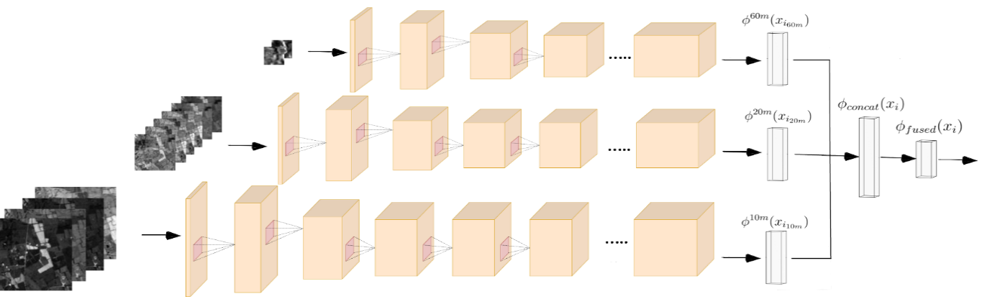
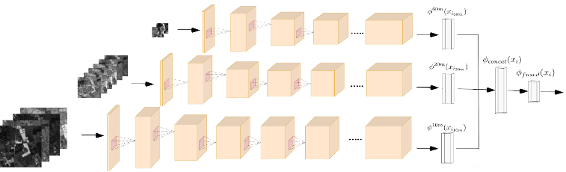
Design of Experiments
We have compared the results with those obtained by:
  Fine-tuning the last layer of Inception-v2 pre-trained on ImageNet.
  Standard CNN architecture trained on only RGB bands
  Standard CNN architecture trained on all spectral bands
G. Sumbul, M. Charfuelan, B. Demir, V. Markl
13

Slide 15
Results of Scene Classification
Methods | Recall | F₁ Score | F₂ Score
Pre-trained CNN on ImageNet* | 40.75 % | 0.4171 | 0.4085
RGB Bands in Standard CNN | 54.72 % | 0.5543 | 0.5451
All Bands in Standard CNN | 57.20 % | 0.6083 | 0.5812
All Bands in Three Branch CNN | 70.62 % | 0.6519 | 0.6763
* We apply fine-tuning to the pre-trained Inception-v2 architecture.
G. Sumbul, M. Charfuelan, B. Demir, V. Markl
15

Slide 16
Results of Content Based Image Retrieval
1st | 3rd | 7th | 13th
Pre-trained CNN
on ImageNet
RGB Bands in
Standard CNN
Query Image
All Bands in
Standard CNN
All Bands in
Three Branch
CNN
G. Sumbul, M. Charfuelan, B. Demir, V. Markl
15

Slide 17
Results of Content Based Image Retrieval
Query Image
Pre-trained CNN
on ImageNet
RGB Bands in
Standard CNN
All Bands in
Standard CNN
All Bands in
Three Branch
CNN
Non-irrigated
arable land
Industrial or commercial units,
Non-irrigated arable land
Non-irrigated arable land, Pastures, Water bodies
Discontinuos urban fabric,
Non-irrigated arable land
Non-irrigated
arable land
G. Sumbul, M. Charfuelan, B. Demir, V. Markl
15

Slide 18
Conclusion and Future Developments
We have introduced a large-scale benchmark archive that consists of 590,326 Sentinel-2 image patches annotated by multi-labels, for RS image understanding.
BigEarthNet will make a significant advancement for the use of deep learning in RS by overcoming current limitations of the existing archives.
We plan to regularly enrich the BigEarthNet by increasing the number of annotated Sentinel-2 images.
We are currently working on designing and implementing a scalable architecture for massive processing and analysis of images in the BigEarthNet.
G. Sumbul, M. Charfuelan, B. Demir, V. Markl
17

Slide 19



http://bigearth.net/
G. Sumbul, M. Charfuelan, B. Demir, V. Markl
18

