Slide 1
Machine Intelligence towards Tomorrow’s Earth Science Data Systems
Manil Maskey
Program Officer - Earth Science Data Systems, NASA HQ

Slide 2
Why ML for Earth Science Data Systems
Applying ML is critical to fully exploiting the large archives of Earth Science data
Novel machine learning models show promise across disciplines by outperforming established benchmarks in prediction, forecasting, classification, and recommendations.
Open and large datasets from multiple measurement systems now provide a unique opportunity to innovate new ways of analysis and obtain valuable insights.
Mature ML systems can be applied to augment data systems operations, search/discovery, access, and use.
Cloud platform now enables scaling ML applications with collocated data

Slide 3
Challenges in applying ML for Earth Science
Issues with training dataset
  Scarcity
  Ensuring data access at a granular level
  Inconsistency
  Requires SMEs
  Disparate systems/sensors
Integration of heterogeneous data sources
Use of suitable ML architectures and algorithms for a problem
High barriers to entry (requires team science)
Requires expertise in problem-specific optimization
Lack of human-understandable solutions for interpreting ML model

Slide 4
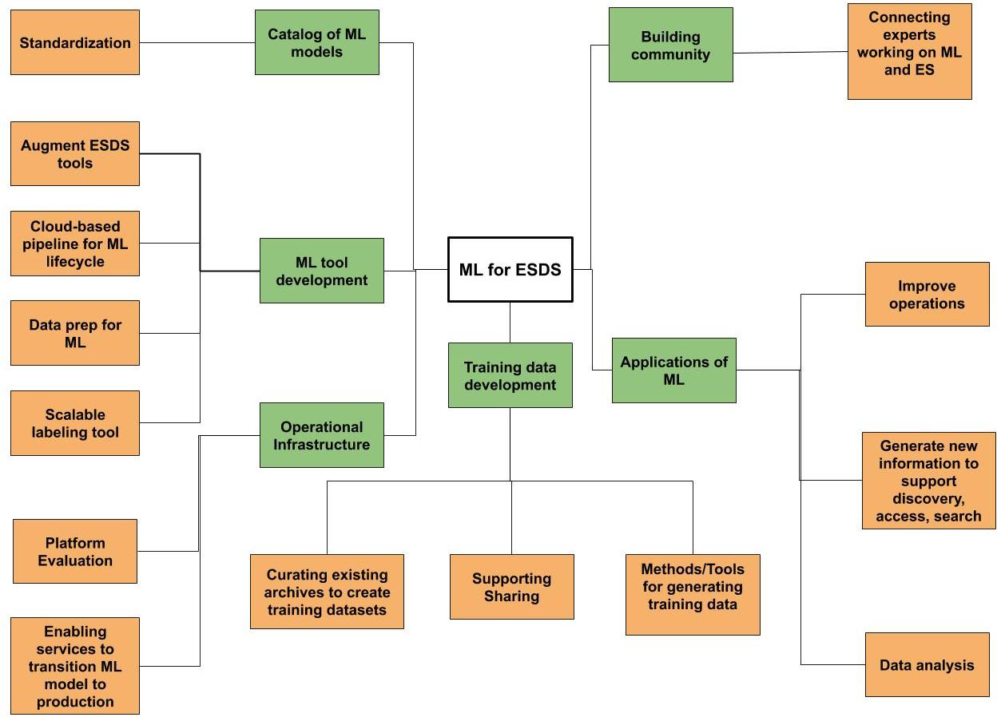
ESDS Vision for ML

Slide 5
Near term priorities
Training data generation/standardization/metadata
  Workshop
  Citizen science
New Competed Solicitation
  ML tool development
  Training datasets
  ML Applications
  ML for selected mission datasets
Building community
  Workshop
  Strategic Partnership

Slide 6
Ongoing efforts
Applied science
Improving operations
Improving data discovery
Transitioning research model to production
Scalable labeling tool

Slide 7
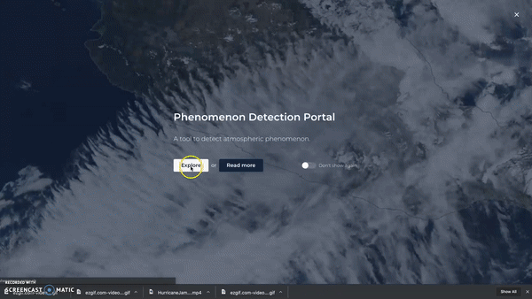
Phenomena Detection Portal
Objective:
Discover interesting events
Use event space/time parameters to search for relevant datasets
Approach:
Train DL algorithm with manually labeled dataset
Run trained model daily on GIBS tiles
Output identified events on portal
Analyze events over space and time
Leverages Cumulus and GIBS
http://phenomena.surge.sh/

Slide 8
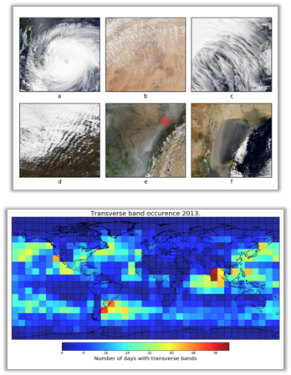
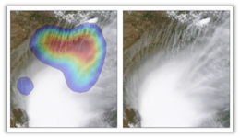
Transverse Cirrus Bands Detection
Objective:
Identify and study transverse cirrus bands which are associated with aviation turbulence yet very little is known about them
Approach:
Use deep learning to identify bands in satellite imagery
Analyze regions where these bands occur most often using GIBS imagery
~95% accuracy

Slide 9
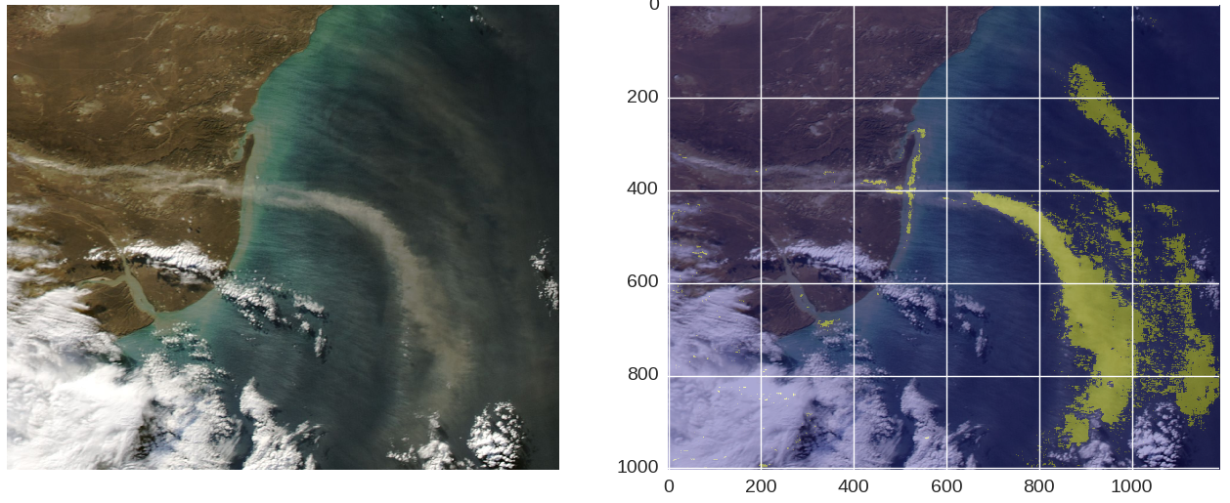
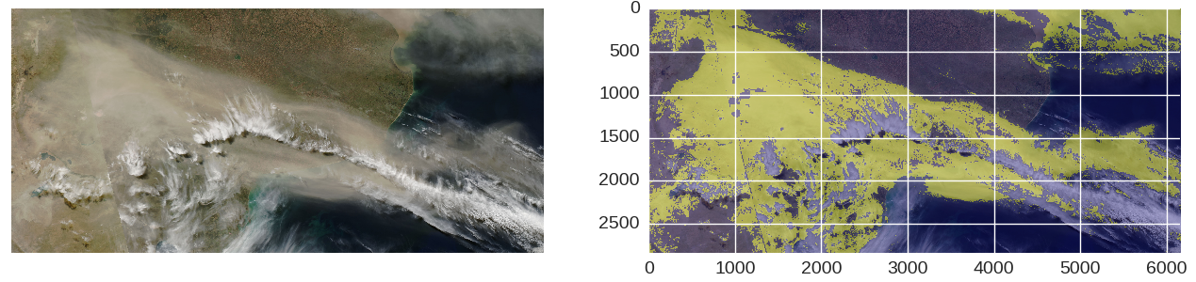
High Latitude Dust Detection
Objective:
Develop a pixel-based High Latitude Dust detection
Approach:
Train a DL-based pixel classifier
Apply the classifier across GIBS
Display results in phenomena portal
Leverages GIBS

Slide 10

Tropical Cyclone Intensity Estimation Portal
Objective:
Use a Deep Learning (DL) method to objectively estimate tropical cyclone intensity
Create a situational awareness tool to display estimation and other information in real-time
Approach:
Train DL algorithm using heterogeneous datasets to estimate tropical cyclone intensity
Use cloud infrastructure to build a real-time system triggered by event notification
Leverages Cumulus
http://hurricane.dsig.net/

Slide 11
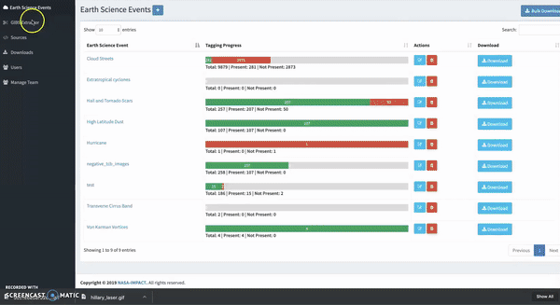
Image Labeler
Objective:
Develop a scalable image labeling tool for Earth science events
Approach:
Build a multi-user image labeler
Integrate directly with GIBS
Maintain a database of images for Earth science events
Output data in ML ready structure
Leverages GIBS
https://labeler.nasa-impact.net

Slide 12
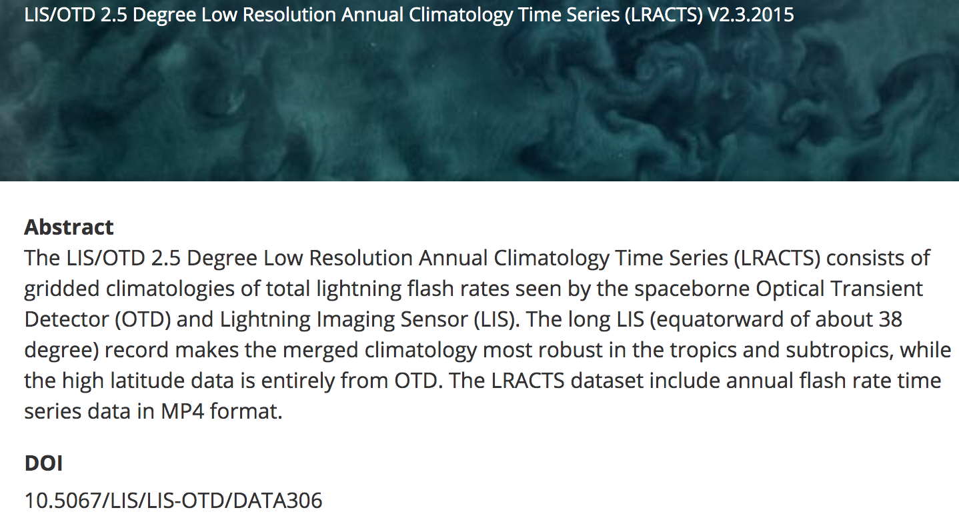
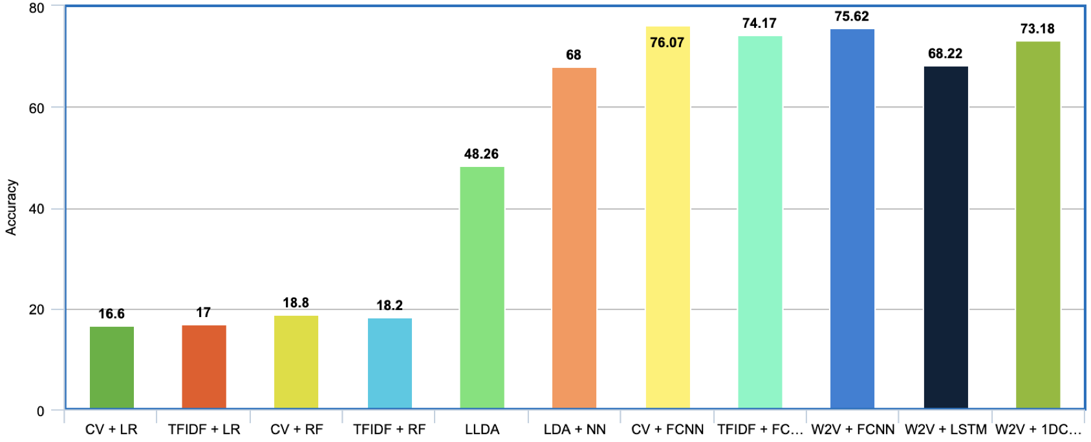
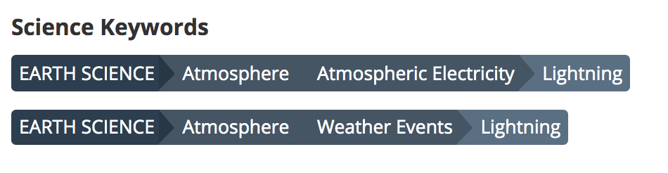
Automated science keyword assignment
Objective:
Automatically tag metadata with science keyword.
Approach:
Use CMR metadata to to train a classifier to select GCMD science keyword
CMR Dataset Title and Description
~76% accuracy

Slide 13
Building on existing portfolio
Data/Metadata Archives
  27 PB of archived data
  CMR: Rich curated content
Cloud Infrastructure
  Turn key ML stack
  Pipeline for transitioning to production
Tools
  GIBS, Worldview, EONET,Cumulus
Private industry partnership

Slide 14
Contact
Manil Maskey
manil.maskey@nasa.gov

