Slide 1
AI4EO4AI
… and what we learned from Climate Informatics
A presentation to CEOS WGISS #47
2 May 2019
Sveinung Loekken
Φ-Lab, Future Systems Department, Directorate of Earth Observation Programmes

Slide 2
Where were we?
the perfect storm …
=> The 4th paradigm applied to EO (and related) is still a promise. Enter AI …
Notes:
<Content as above>

Slide 3
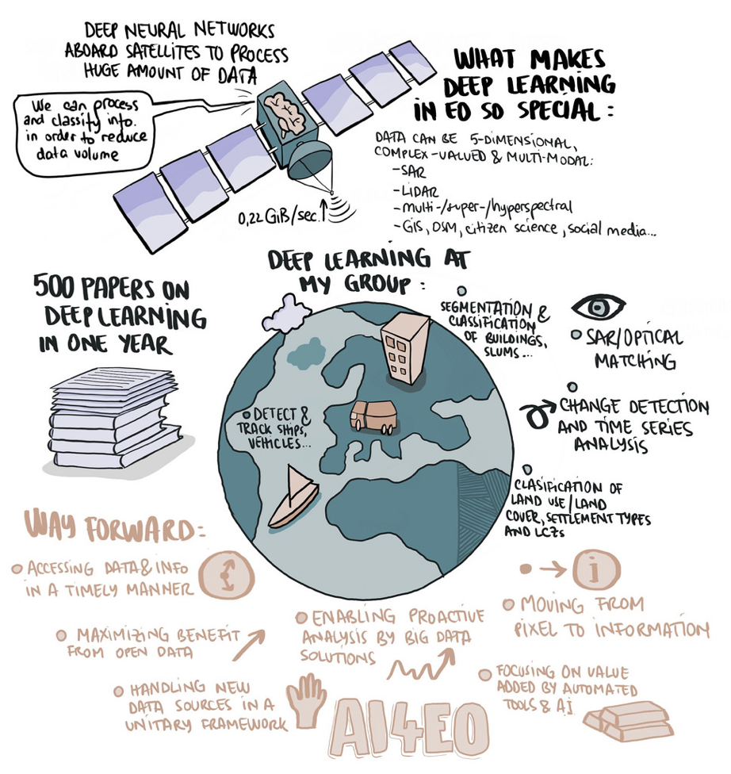
=> AI is the enabler to increase uptake and impact of EO data: AI4EO

Slide 4
What we want to achieve
AI lets us to do things we can already do, but 100-1000 times faster.
AI lets us to do previously impossible things, e.g. using computer vision.
AI can create pathways to new Earth observation, Earth system and space science and solutions to the societal problems these represent.
Challenging AI researchers with Earth & space problems and data can create pathways to new AI science.
We can already count swimming pools from space and speed up chemistry models using AI. This stuff is very useful, but not new science.
This is real new science – and the big goal

Slide 5
The AI4EO4AI Opportunity
So, to spell it out, here’s the theory:
By developing collaboration among European AI and EO we can maximize the socioeconomic benefits of EO
By applying our unique EO assets we can accelerate the development of AI
=> AI4EO4AI synergy

Slide 6
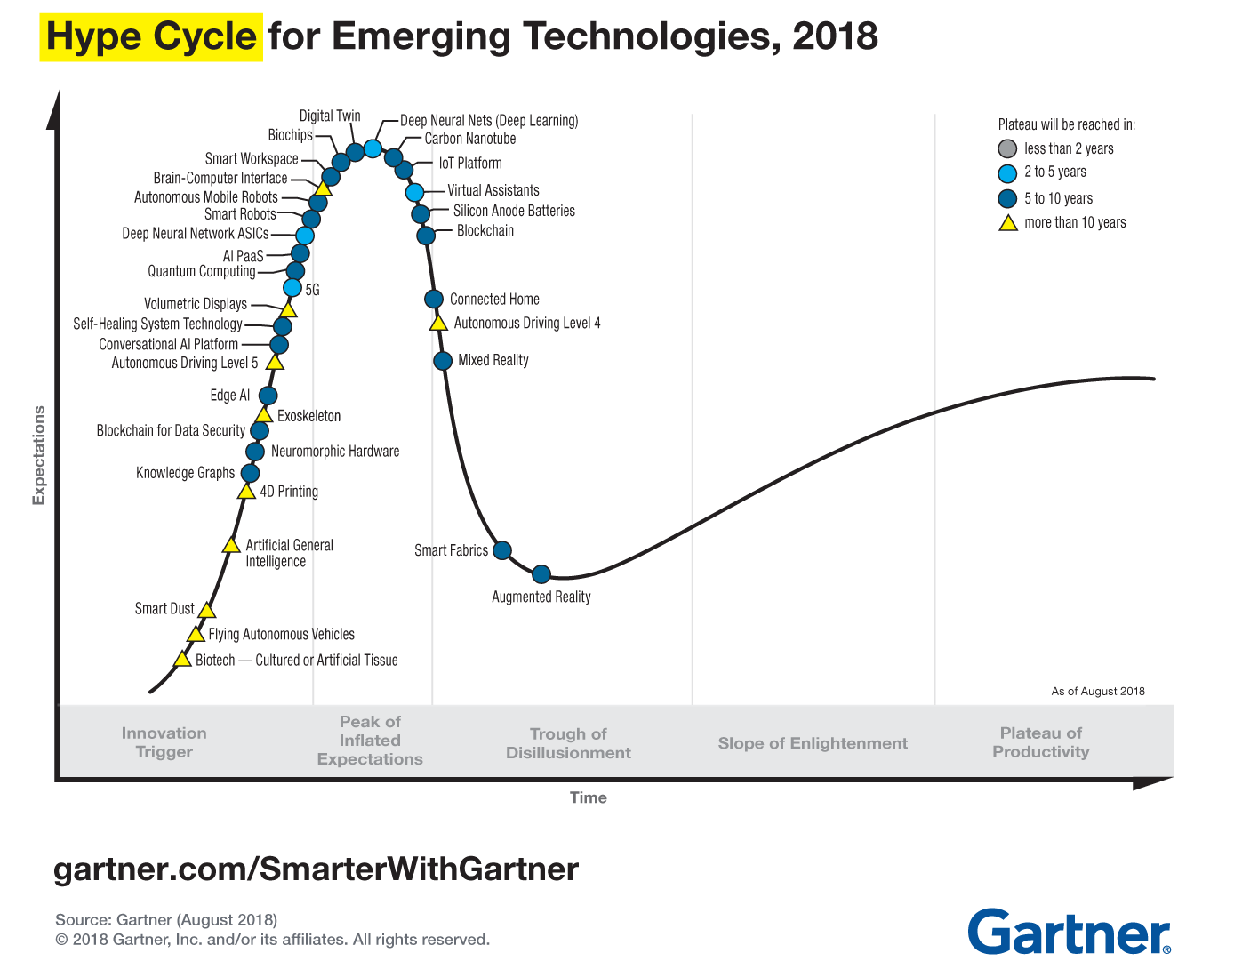
Gartner™:
Deep Learning at ‘Peak of Inflated expectations’, a 2-5 year horizon to reach ‘plateau of productivity’.
“5 Trends Emerge in the Gartner Hype Cycle for Emerging Technologies”, August 16, 2018
https://www.gartner.com/smarterwithgartner/5-trends-emerge-in-gartner-hype-cycle-for-emerging-technologies-2018/
=> So, what are we betting on ?

Slide 7
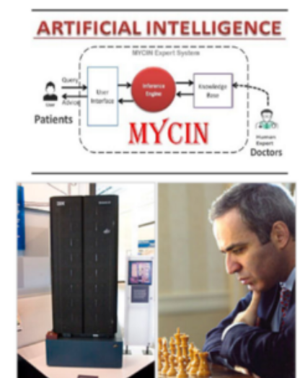
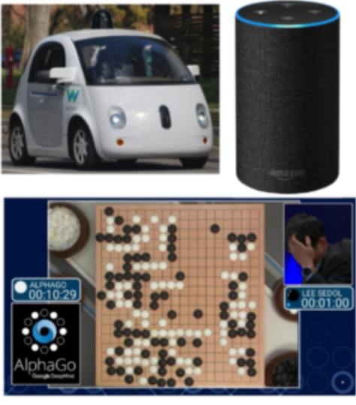
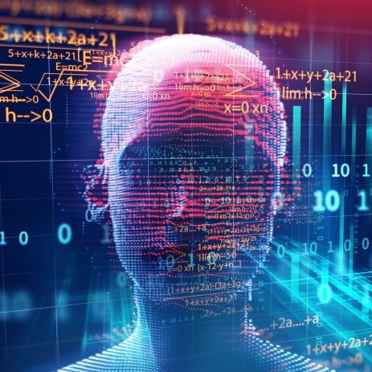
A (DARPA) time perspective: three waves of AI
A DARPA perspective on AI
https://www.darpa.mil/attachments/AIFull.pdf
First wave
Second wave
Third wave
Describe
1970s - 1990s
Handcrafted knowledge
GOFAI
Categorize
2000s - present
Explain
2020s – 2030s
Statistical learning
ML, CNNs, …
Contextual adaptation
Causal and explanative
*AI4EO*
Data availability a major enabler for 2nd wave AI; AI4EO and X-AI potential in 3rd Wave AI

Slide 8
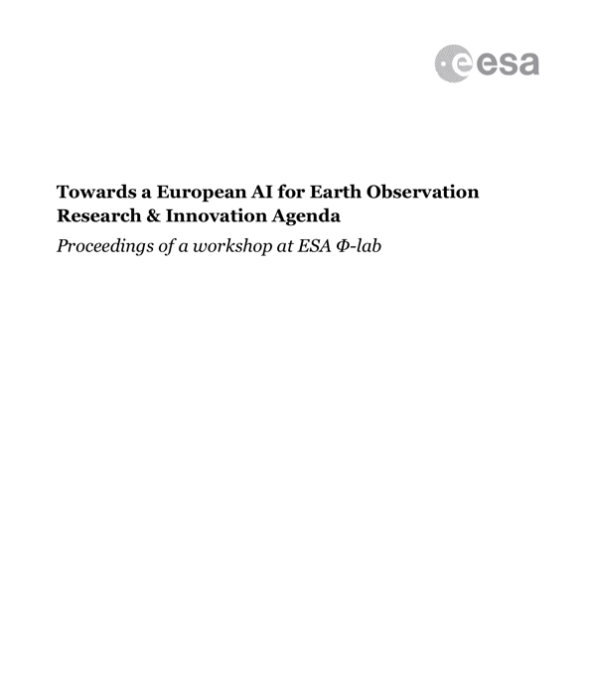
“With AI becoming a transformative technology and European EO capability delivering a unique and comprehensive dataset on the planet that could be analysed by AI, we are at a cross roads.
Addressing some of these challenges … would help accelerate our AI industries and realise the full potential of EO.
Not doing so would miss huge opportunities. Making the most of this window of opportunity is an urgent challenge.”
=> Earth Observation is AI’s next big data source – EO4AI

Slide 9
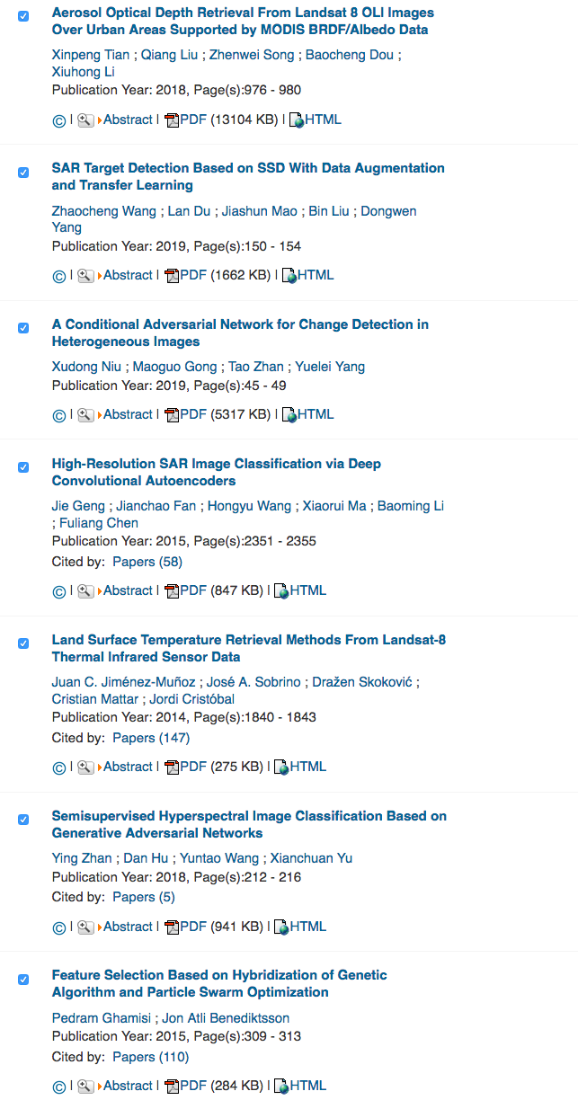
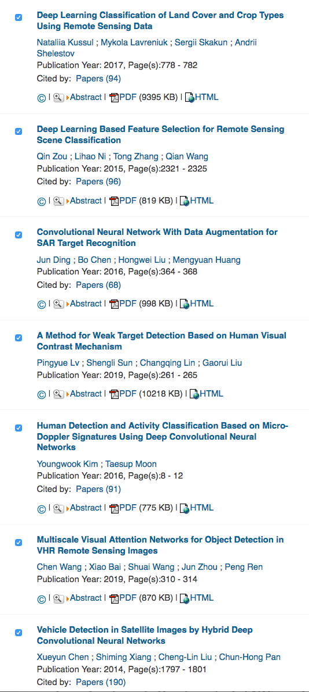
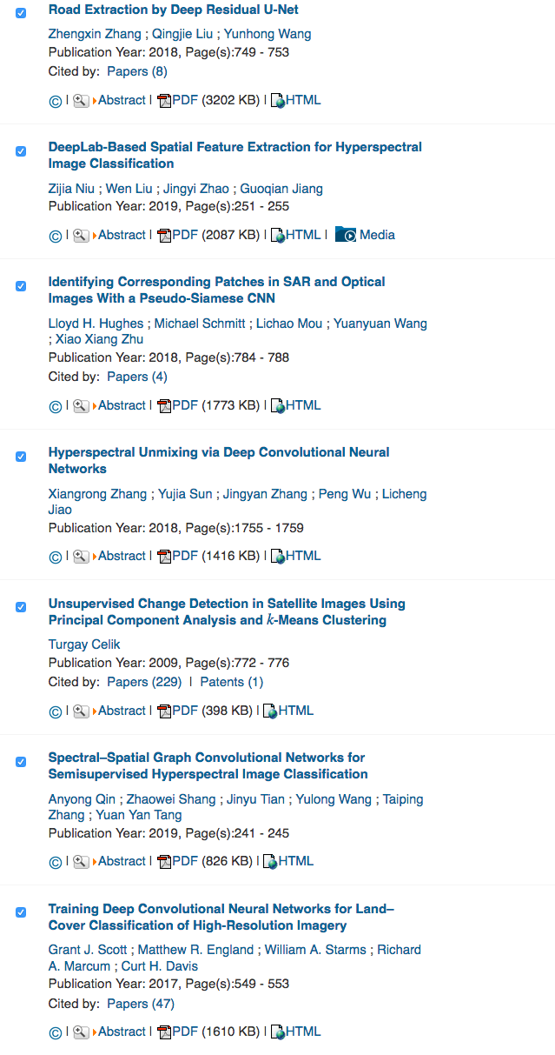
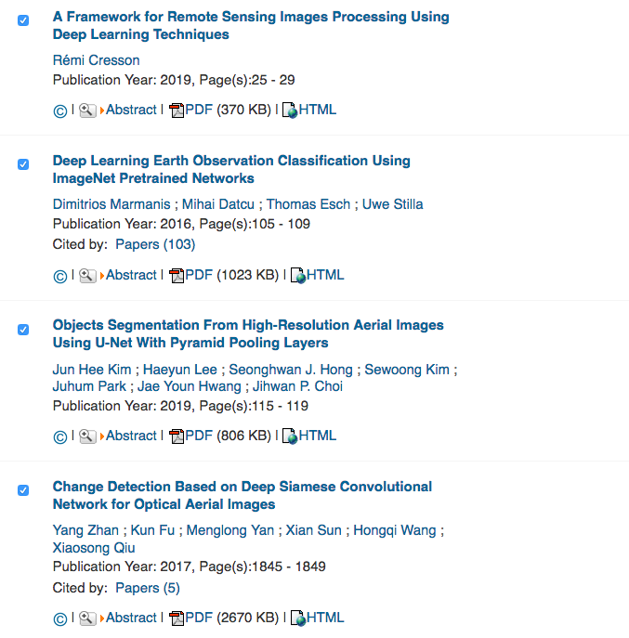
Inspired by: Artificial Intelligence and Deep Learning in Earth Observation, Xiaoxiang Zhu et al. 2017
X
Status: AI4EO
X
X
X
The EO/RS community has definitely picked up on AI

Slide 10
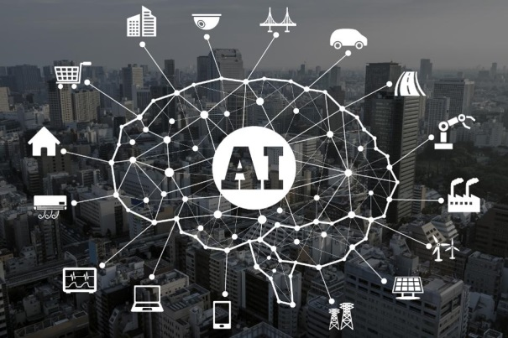
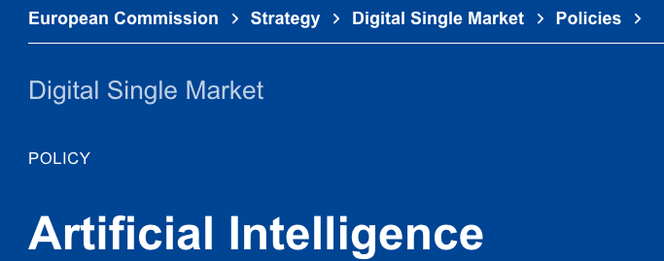
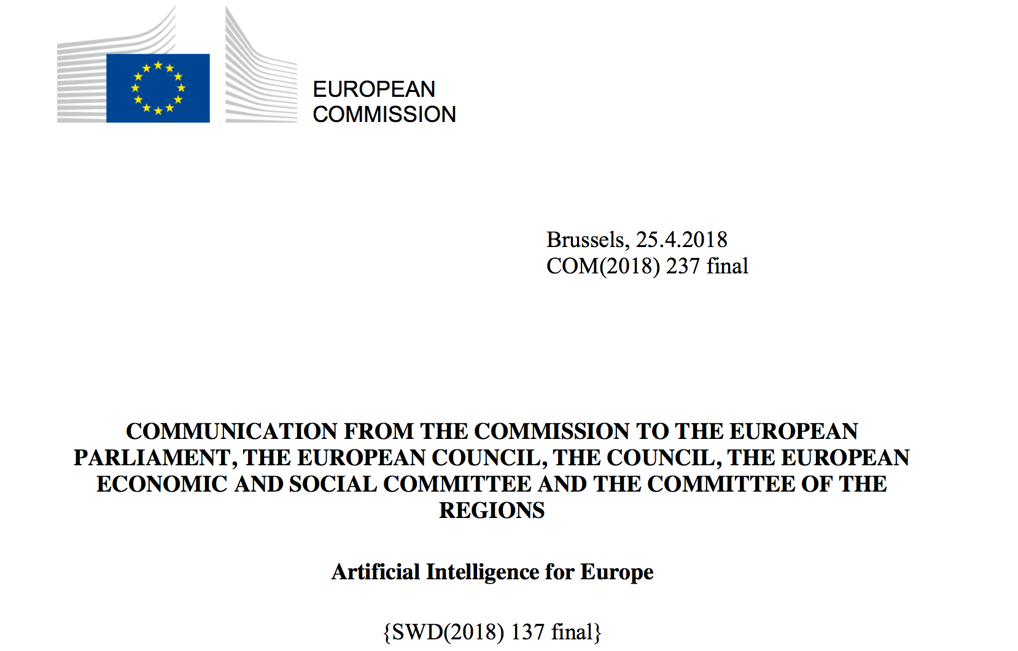
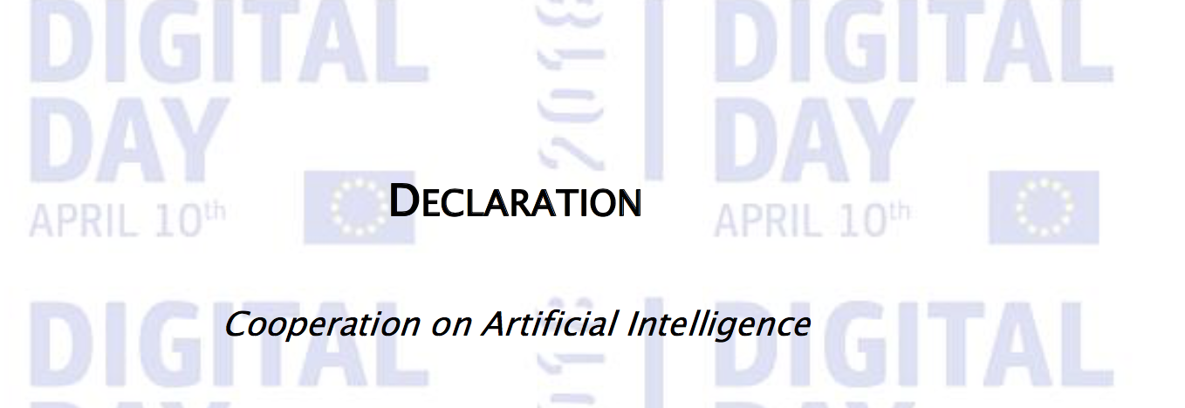
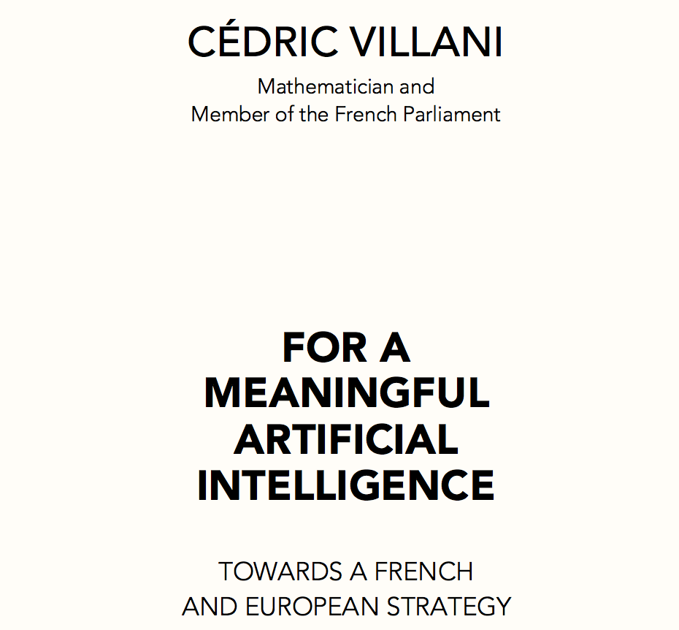
Status 2: EO4AI
World economic forum: AI is “The new ‘electricity’ fuelling the 4th Industrial revolution”
ML technology: AI-winters to everyday use: 2010 + and imagenet …
A policy area of great societal and economic importance
AI dependents on the availability of data
- http://reports.weforum.org/digital-transformation/artificial-intelligence-improving-man-with-machine
=> EO data not yet driving research in AI

Slide 11
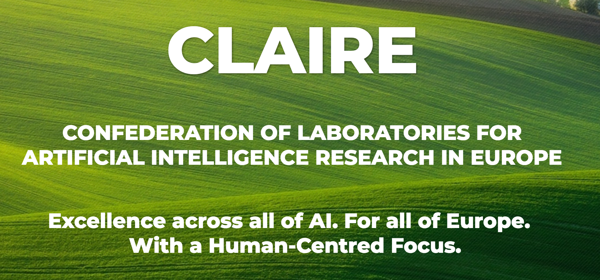
Do: engage the AI community

Slide 12
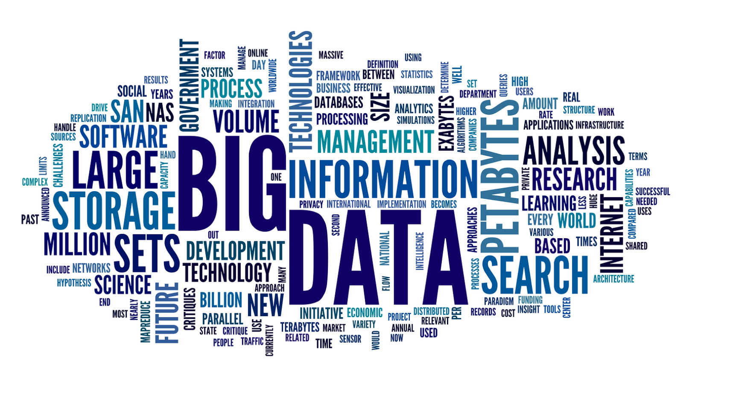
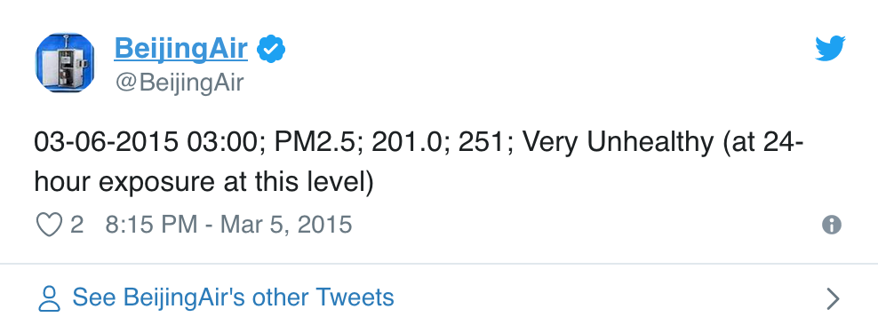
Do: go for impact
Big data vs. ‘a few good numbers’
“What we’re often looking for is a few good numbers”
- Paul Romer, FutureEO conference 2017: https://bit.ly/2CBM3Td, @1:49:30 (approximately)
Liability
Asset
Notes:
If information is a difference that makes a difference, then there is a correlation between the variety found in big data and the information it contains. There is however no necessary correlation between big data and the impact it has.
The Internet of Things, Social media, One Good Number, and Paul Romer
Paul Romer, Chief economist and vice president of the world bank, was co-recipient of the 2018 Nobel Memorial Prize in Economic Sciences.
At the FutureEO conference in ESA in 2017 he sapproximatelyaid: “What we’re often looking for is a few good numbers.”
- https://bit.ly/2CBM3Td, @1:49:30 ()
As an example he used the automatic tweeting of the air pollution readings in Beijing, the PM 2.5 readings in 2008 by the US embassy, which transformed the debate about air pollution and the policy response to air pollution.
Incidentally this had nothing to do with AI, and with a sensor on top of the embassy that cost as much as a nice car.

Slide 13
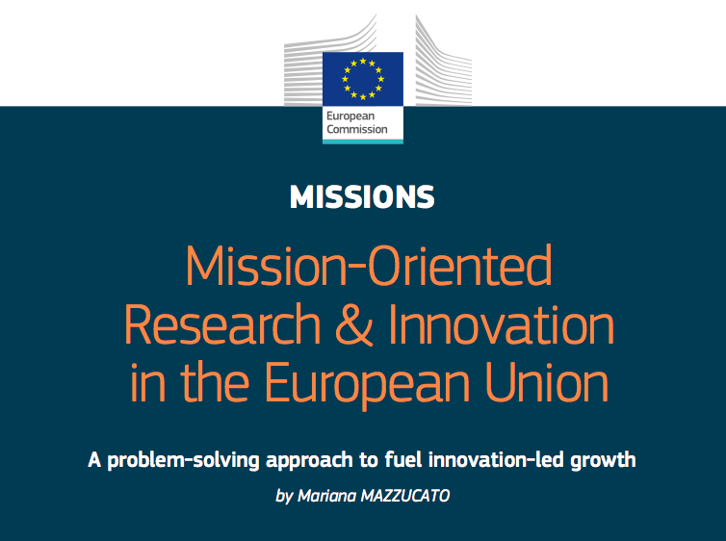
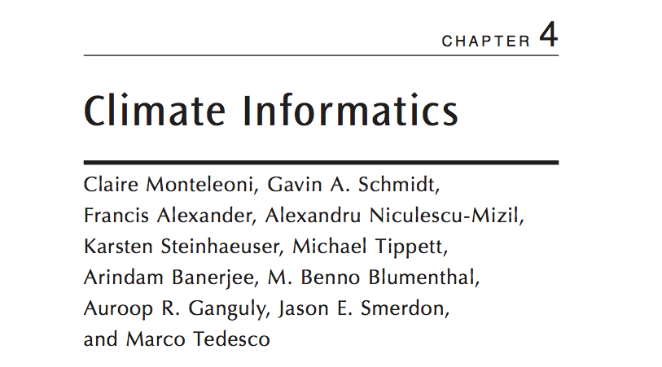
Do: grand challenges
=> Impactful but not necessarily fast
Notes:
We take inspiration in the ideas of Mariana Mazzucato (mission driven innovation), and Claire Monteleoni (climate informatics).
Mariana Mazzucato, of the Institute for Innovation and Public Purpose at University College London, makes a convincing case that radical innovation cannot be pushed by research alone, but rather should be pulled by the government’s determination to fulfil missions such as curbing climate change, making healthcare more affordable or solving the urban housing crisis.
Mission oriented policies - Mariana Mazzucato:
Mission-oriented policies can be defined as systemic public policies that draw on frontier knowledge to attain specific goals or “big science deployed to meet big problems”. Missions provide a solution, an opportunity, and an approach to address the numerous challenges that people face in their daily lives. Whether that be to have clean air to breathe in congested cities, to live a healthy and independent life at all ages, to have access to digital technologies that improve public services, or to have better and cheaper treatment of diseases like cancer or obesity that continue to affect billions of people across the globe. To engage research and innovation in meeting such challenges, a clear direction must be given, while also enabling bottom-up solutions.
From “Mission-Oriented Research & Innovation in the European Union, A problem-solving approach to fuel innovation-led growth”, EC 2018
And Climate Informatics – Claire Monteleoni (probably in the audience!) – addressing one of the grand challenges of our time:
The amount of [satellite based] observational and model-simulated data within the climate sciences has grown at an accelerating rate since the early 1990s. The increasing amount of available data creates many opportunities for researchers in machine learning and statistics to partner with climate [earth] scientists [and downstream value adders] in the development of new methods for interdisciplinary knowledge discovery.
From the web page of Climate informatics 2013, https://www2.cisl.ucar.edu/event/ci2013
Its not necessarily fast, it wont revolutionize a complex field over night. But its probably not just another hammer either.

Slide 14
The long way to uptake and impact
Engage the AI community
Look for impact
Less Big Data, more ‘good numbers’
Be mission driven, address Grand Challenges
Prepare for 3rd wave AI
And for another time …
Invent, discover, do moonshots, bridge earth sciences and social sciences
Don’t forget the basics …
Notes:
By developing collaboration among European AI and EO we can maximize the socioeconomic benefits of EO
By applying our unique EO assets we can accelerate AI in Europe
By addressing AI4EO we can retain (or regain) leadership in industry and research, and shape the future of EO
The objective is a ‘veritable revolution’ in the Uptake and Impact of EO data.
(Voice) Or as a minimum - at least not pass the ball on to somebody else. .. And this is what it is about, to no little extent – the possibility to shape the future of EO, and to some measure also that of AI, to get return on the investment on the observing system, and ensure European competitively and autonomy
.

