Slide 1
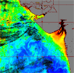
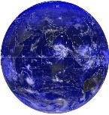
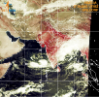
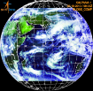
WGISS-47
Advanced Geospatial Techniques: Aiding Earth Observation Applications
Nitant Dube
Space Applications Centre, ISRO
Ahmedabad, INDIA

Slide 2
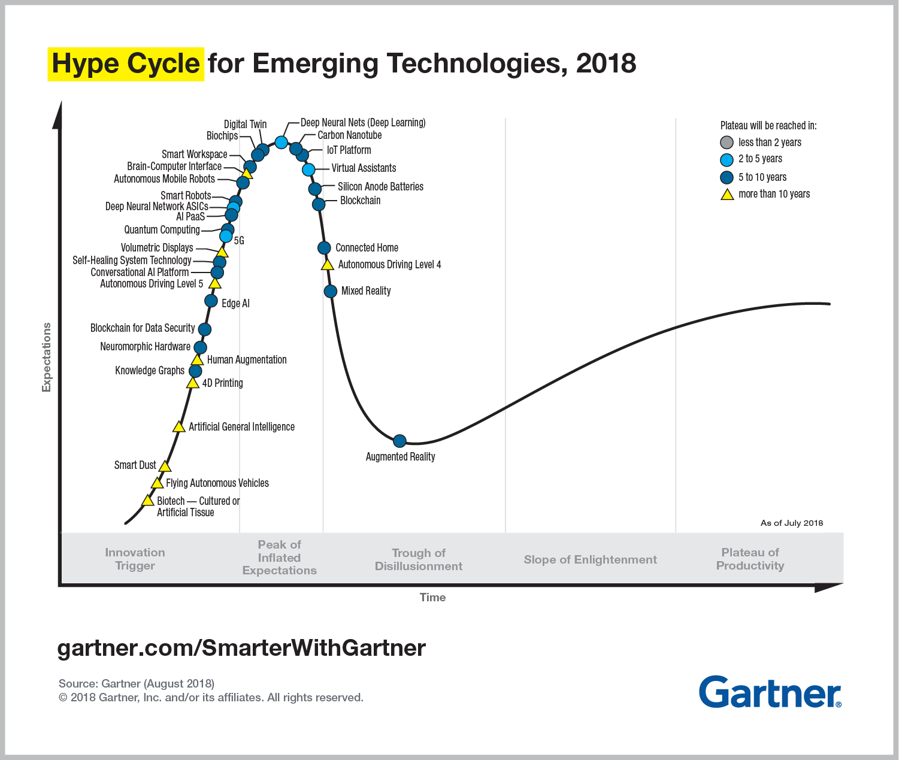

Slide 3
Geospatial Data Challenges
More and More Geospatial Data are becoming unstructured
Exponential growth in data volume
Requirements of Data availability/access on demand
Data Security
Interoperability to support new technologies/applications

Slide 4
Geospatial Databases
Geo-relational Databases
Relational Databases + Geo-spatial attributes in separate file
Spatially Enabled Databases
Geo-spatial attributes are also part of relational database
Supports advanced geo-spatial SQL queries
NoSQL
Does not require fixed schema and usually avoid join operations, Good in Horizontal scaling
Geo-spatial support: MongoDB, BigTable, Cassandra, CouchDB
In-memory Database
Database management system, which primarily uses main memory or hybrid approach for data storage as compared to conventional disk based storage (Apache Ignite)
Cloud Database
Database runs typically on cloud and provide access to database as service (DBaaS)

Slide 5
Geospatial Data Processing
Big Data (In mature stage)
Addresses issues of processing data that is too large for conventional data processing architectures
Cloud Computing (Operational)
Resource and data on demand as service
Real time Data Processing (Future)
Customized chips or FPGA for processing on real time data stream
Real time maps for Autonomous vehicle navigation
Location Based services
Real time Information services

Slide 6
Augmented Data Analytics
Next generation data and analytics paradigm
Emphasis is on automation of data discovery, preparation and insight discovery using machine learning techniques.
Automatically generates actions from insights
Earth Observation Applications
Automated feature extraction using deep learning techniques (Applications in Urban management)
Automated event tracking using machine learning techniques (Oil Spill, forest fires, cyclone, Heavy rains)
Natural Resource and Crop Monitoring (Monitoring of Forest cover and Crop yield)

Slide 7
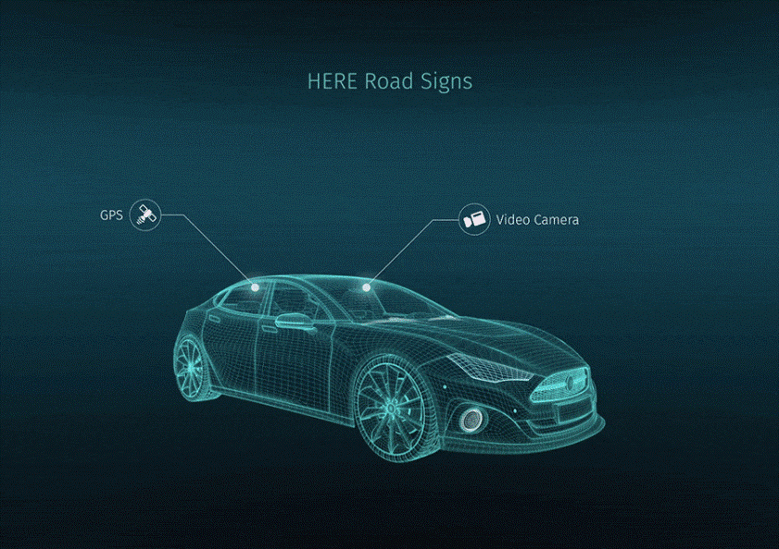
High Definition Maps: Autonomous Navigation
High Definition Maps (HD Maps)
Maps with High accuracy ( centimeter level)
Dynamic composition using sensors on multiple autonomous vehicles in the vicinity
Capability for machines to understand maps
Sharing of maps using ad-hoc network
Source: /www.geospatialworld.net

Slide 8
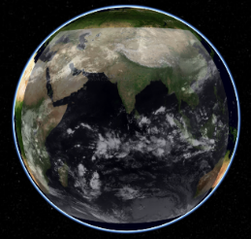
Earth-Digital Twin
Development of Digital Earth Model which updates in Near Real time using concepts of Digital Twin
Earth Observation Data which can contribute towards development of Earth Digital Twin
Satellite data
Ground Observations
Model Forecast
Applications
Real time insight into earth processes
Understanding of multiple parameter dependency

Slide 9
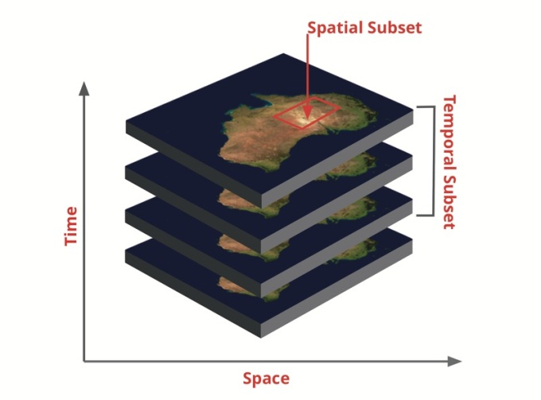
Data cubes
Data cubes are gaining importance as it is an innovative approach to organize and analyze data, which is difficult and time consuming using conventional methods.
Provides a portable environment of analysis ready products for quick analysis and interpretation by end users.
Limitations
High Dimensionality Curse : i.e. complexity of data cube (both for creation and execution of operator on the cube) increases exponentially with increase in dimension of data.
Requires High Performance computing environment for creation of Data cubes

Slide 10
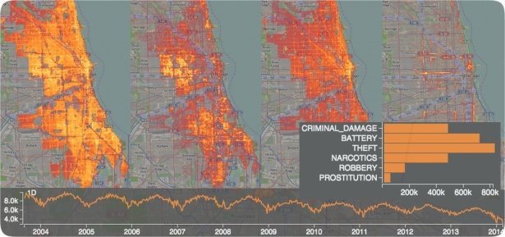
Dwarf Data cubes
http://nanocubes.net/
Dwarf is a highly compressed structure for computing ,storing and querying data cubes. Dwarf identifies prefix and suffix structural redundancies and factors them out.
Advantages
Volume reduction of huge orders, for some type of data sets 1:400000 reduction in volume is reported. (We need to explore for earth observation data what volume reductions are possible)
Dwarf data cubes can be created using standard desktops or server machines as compared to HPC requirements for Data cubes.
Dwarf cubes provide analysis ready products, with minimum latencies, even on laptops.

Slide 11
Thank you nitant@sac.isro.gov.in

