Slide 1

AHT on Sustainable Development Goals (SDG AHT)
Committee on Earth Observation Satellites
Alex Held, CSIRO, Co-lead & SIT Vice Chair
Marc Paganini, ESA, Co-lead
Flora Kerblat, CSIRO, Executive Secretary
Argyro Kavvada, NASA, GEO EO4SDG
Executive Secretary
CEOS WGISS-47
Silver Spring, Maryland, USA,
April 29-May 2, 2019

Slide 2

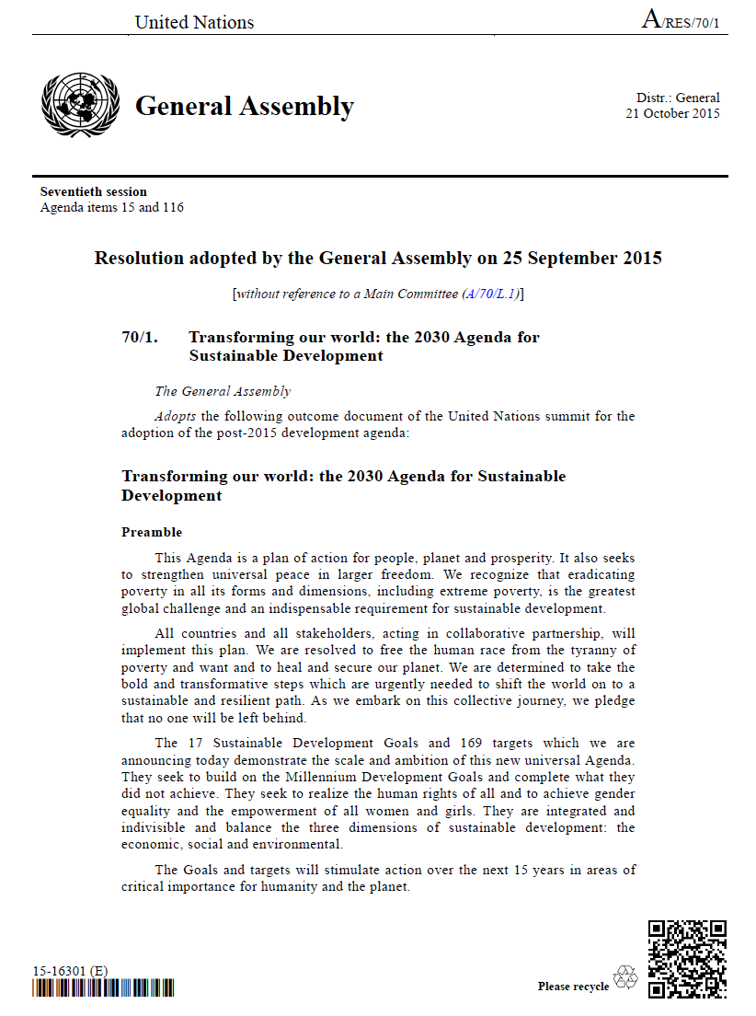

Transforming our World: The 2030 Plan for Global Action
Article 76:
… We will promote transparent and accountable scaling-up of appropriate public-private cooperation to exploit the contribution to be made by a wide range of data, including Earth observation and geo-spatial information, while ensuring national ownership in supporting and tracking progress.
Notes:
Extract of the UN Resolution 70/1 “Transforming our world: the 2030 Agenda for Sustainable Development” ratified by the UN General Assembly at the Sustainable Development Summit in New York on the 25th September 2015
The 2030 Agenda for Sustainable Development clearly stressed the importance of Earth observation to inform the SDG Targets and Indicators.

Slide 3


Mobilising the data revolution
Sustained data for sustainable development
The monitoring of the MDGs taught us that data are indispensable elements of the development agenda.
Despite improvement, critical data for informed policy making on development are still lacking.
New technology is changing the way data are collected and disseminated.
Data should be open, easily accessible and effective for decision-­‐making.
A World That Counts: Mobilising the Data Revolution for Sustainable Development, Nov. 2014
UN SG Independent Expert Advisory Group on data revolution for sustainable development
Global Action Plan for Sustainable Development Data launched at UN WDF in Jan 2017 .
modernizing NSOs is essential to achieving the 2030 SDGs.
Integrating geospatial and statistical data is a necessity.
First UN World Data Forum
on Sustainable Development
Data
15-18 January 2017
Cape Town, South Africa.
Notes:
One of the major lessons learned from the 2015 Millennium Development Goals (MDGs) has been the importance of data in the development agenda.
Despite some significant improvement, critical data for informed policy making on development policies were still largely lacking especially in the developing world.
A report requested by the UN Secretary General to analyse the data gaps and challenges, was published in November 2014 with the title “A World That Counts: Mobilising the Data Revolution for Sustainable Development”. The report stressed the importance to have a UN-led effort that would mobilise the data revolution for all. The report also recognized that new technology (including geospatial data and Earth Observations) is changing the way data are collected, analysed and disseminated.
In January 2017, The UN organized the first World Data Forum (WDF) on Sustainable Development Data.
The major outcome of the WDF is “the Cap Town Global Action Plan for Sustainable Development Data” officially adopted by the UN Statistical Commission at its 48th session in March 2017.
First of all, the Global Action Plan for Sustainable Development Data recognizes that the implementation of the UN SDGs requires the collection, processing, analysis and dissemination of an unprecedented amount of data and statistics, at multiple levels and by a large range of stakeholders.
The Global Action Plan features six strategic areas, each associated with objectives and key actions.
To be highlighted is the necessity to enhance capacity building in countries facing high data challenges, to modernize the national statistical systems, to encourage NSOs to embrace open data initiatives, to mainstream new technologies and new data sources in the activities of the NSOs, and to integrate geospatial data (and Earth Observation data) into statistical production programmes at all levels.

Slide 4



“The integration of statistics, geospatial information, Earth observations, and other sources of Big Data, combined with new emerging technologies, analytics and processes, are becoming a fundamental requirement for countries to measure and monitor local to global sustainable development policies and programs”
UN-GGIM co-chairs
http://eohandbook.com/sdg/
Notes:
3 parts:
The role of EO in support to the SDGs
Stekholders perspectives on EO for the sDGs
Example of EO contribution to the SDG targets and indicators

Slide 5


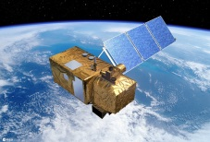

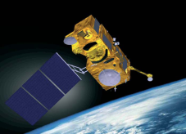



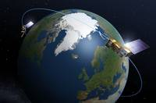
Sentinels Fleet
>15 TB per day
Advent of steady satellite data streams
High Performance Computing Infrastructures
Mobilise the data revolution
for the benefits of all
leaving no one behind
Building on ICT advances

Slide 6
Commonly stated obstacles to the scaling-up and operational use
of EO in the global sustainable development agenda
  Not enough
  “fit for purpose” products
  Needs for continuity of observations and
  long-term
  EO programs
  Restrictive data access policies
  (including cost)
  Frequency of observations insufficient to track changes at appropriate scales
  Lack of
  analysis ready data
  Capacity building and training
  Lack of standardisation of EO data processing methodologies
  Lack of
  clear and solid
  user-oriented methods and guidelines
  Difficulties to discover and access EO data
  Insufficient solid track records of successful case studies

Slide 7
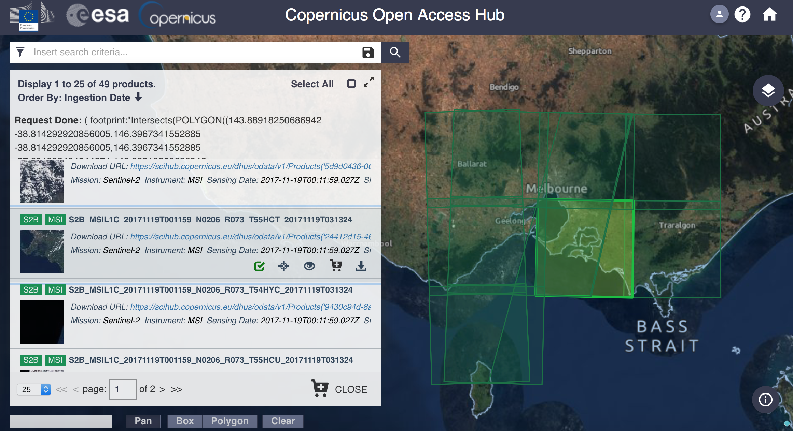
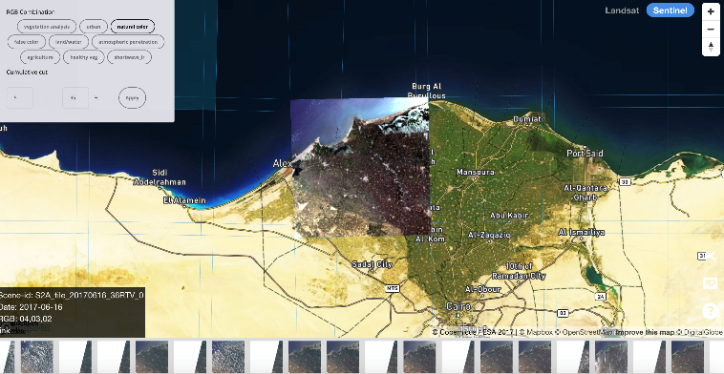
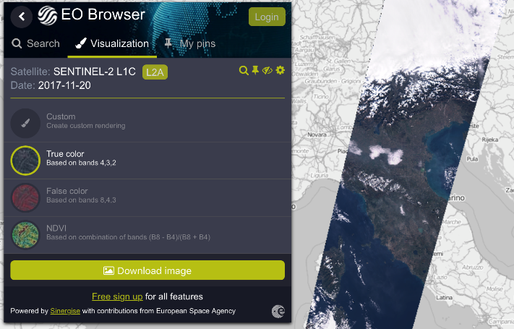

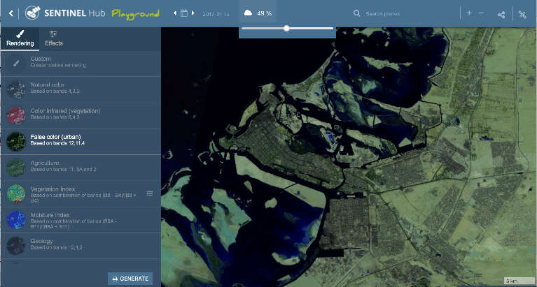
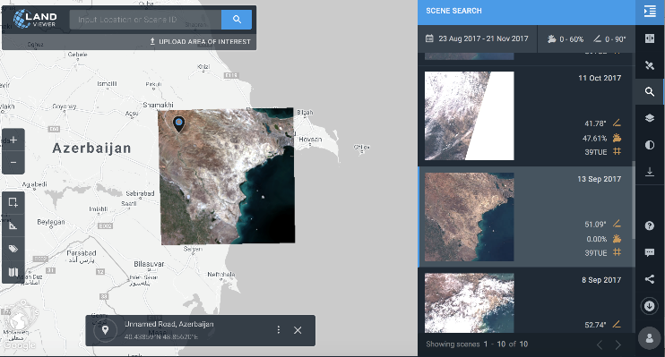
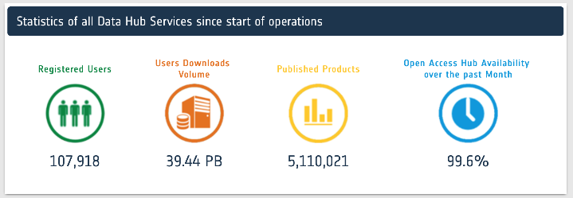
Proliferation of platforms for EO data access and visualisation
RemotePixelViewer
GEOSS Portal
EOBrowser
LandViewer
Sentinel Hub Playground
Notes:
S2 on Amazon S3 / AWS
S1 & S2 on Google Earth Engine

Slide 8











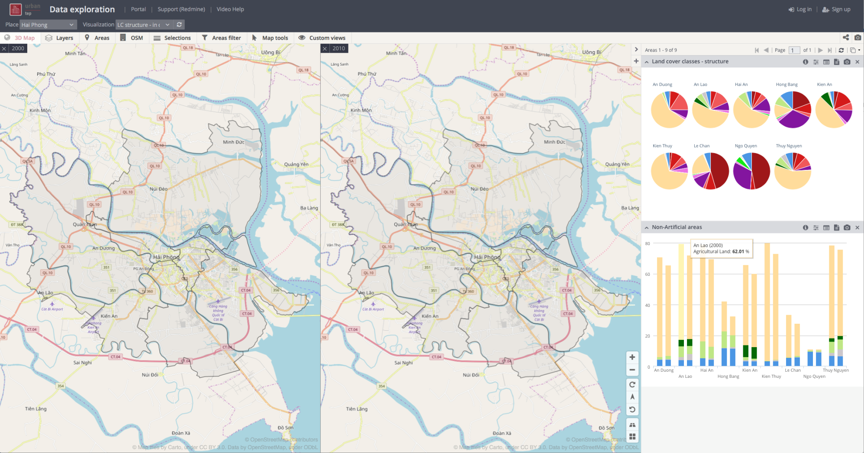
Collaborative “big data” exploitation platforms
The power of the Cloud
The power of
Partnerships
“Bringing the users to the data”
Simplify the extraction of information from EO data
Enable large scale exploitation of EO data
Stimulate innovation with EO data
Platforms as enabling technology
Service
providers
Satellite data
Remote access for expert users
{api}
Toolboxes
knowledge & algorithms
Ancillary data
(land use, DEM, soil,…)
User knowledge & algorithms
User data
Mobile data collection citizen science
tools
Data Analytics
Processing &
Storage Capacities
User generated results
Notes:
How can we as a community facilitate satellite data discovery, access, processing, analytics and extract the value of satellite for all?
How can we do it in sustained and cost effective manner?
Alone the amount of data to be managed is far too high for many countries, for many organisations.
We must act collectively.
And here comes the importance to also mobilise the ICT revolution for the benefits of all.
We must harness the power of the cloud by developing these EO data exploitation platform on cloud computing infrastructures that would faciliate the discovery of data, the access, the extraction of information. They can also enable large scale exploitation. It can also stimulate innovation and business opportunities.
This is already happening as we have seen with GEE and AWS but many other initiatives of EO platforms are also taking place both at private and public levels. In Europe we are developing the Copernicus Data and Information Access Services (DIAS) to enable easy access to Copernicus data and services
It is not only about satellite data. It is also about bringing other datasets on these platforms to be able the data anlaytics and statistics.
But it also about partnerships, about mutualising the cost of these platforms, about engaging all actors to share their data, their tools, their
It is also about connecting to the citizens, to crowd sourcing information that is such an important source of information.

Slide 9
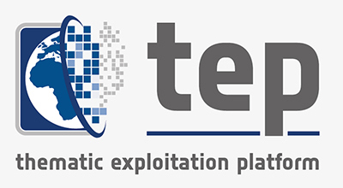
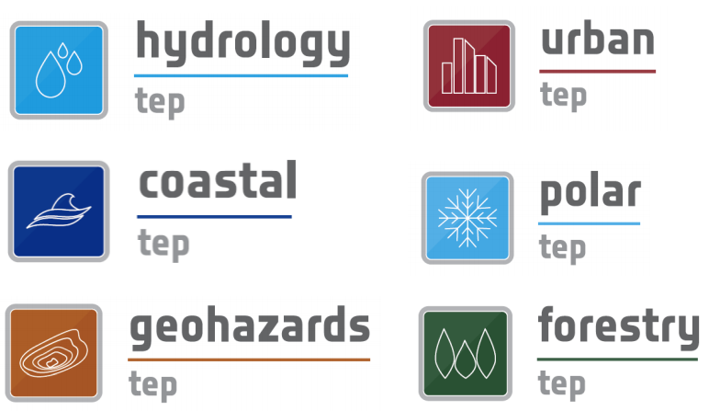

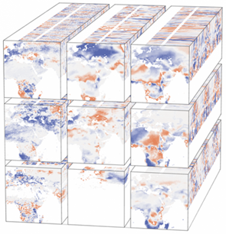
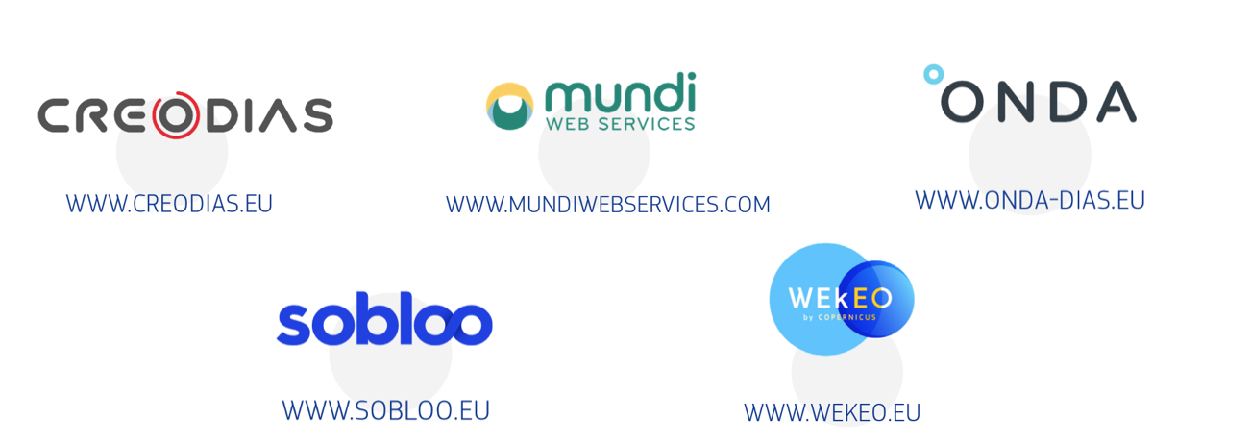
Proliferation of EO exploitation platforms

Slide 10
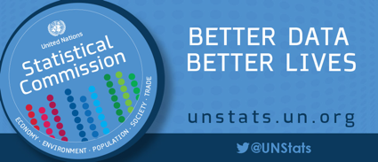

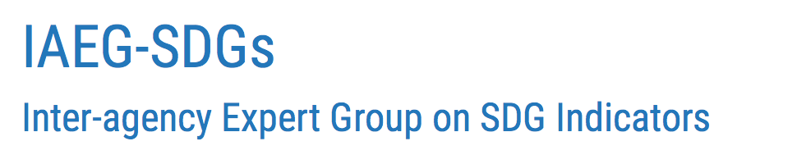
GEO Initiative on SDGs
(EO4SDG)
CEOS Ad-hoc team on SDGs (SDG AHT)
CEOS and the SDG landscape
UN Habitat
UNCCD
UNEP
WBG
GPSDD
UN Statistical Division
WG on Geo-spatial Information (WGGI)
UN Specialized Agencies
National Statistical Offices
Line Ministries
SDG Stakeholders
UN ISDR
WHO
FAO
ADB
Radiant Earth
Global Datasets
Mainstream in National Systems & Processes
EO enabling Infrastructure
Tools
& Platforms
Good Practices Guidance
Capacity Building
EO
Knowledge Sharing Hub

Slide 11
Criteria used to streamline
CEOS engagement on SDGs
Focus on CEOS unique role
and on a few SDG Indicators
(start with 6.6.1; 11.3.1; 15.3.1)
Complement rather than duplicate
the GEO community efforts on SDGs
Encourage more commitment and participation from agencies
Leverage the knowledge and expertise of CEOS bodies (VCs, WGs, SEO)
to maximise impact.
Identify the key partners with whom CEOS should primarily interface
(IAEG-SDGs WGGI, custodian agencies)
The UN has established a complex governance system on the SDG Global Indicator Framework with many stakeholders involved both at UN and national levels.
Take a decision based on an
in-depth assessment of implications
(resources, reporting, etc.)
Future of the SDG AHT is uncertain. Continue or disappear? New entity (post AHT)? WG or Strategy?
The original goals of the SDG AHT were too broad in scope and not fully aligned with the CEOS mandate.
The AHT activities were too similar to the work of the GEO EO4SDG initiative, which brought some confusion on the respective roles of CEOS and GEO.
The impact of the CEOS activities on SDGs is commensurate to the level of resources available. Number of agencies actively involved has not reached the expected level.
The SDG is a very broad and cross-cutting topic (land, marine, atmosphere) requiring different EO competences (satellite data, EO infrastructures, capacity building, accuracy assessment).
Reduce the governance burden
to focus on key contributions
Creation of a new entity includes more governance paper, reporting.

Slide 12
Streamlining of
CEOS activities on SDGs
# | Activity Title | Activity Description | Support from CEOS bodies
1 | Satellite Data Requirements (Analysis Ready Data) | Production of guidelines on how to integrate satellite data in the production of SDG indicators, including availability of satellite Analysis Ready Data, review of satellite data requirements, access to satellite data. (one guideline per indicator). | LSI-VC (and other VCs)
2 | EO Enabling Infrastructures | Review of EO-enabling infrastructures (EO processing platforms, data processing and analytics tools) to facilitate uptake of satellite observations and products by SDG stakeholders. (one review per indicator). Customisation of CEOS Data Cube for SDG indicators. Development of a CEOS SDG Community Portal for Satellite Data discovery and access. | WGISS SEO
3 | Awareness and Capacity Building | Organisation of Capacity Building on advanced satellite-based methodologies for SDG indicators. (one capacity building webinar per indicator) | WGCapD
4 | EO Good Practices | Collection of EO good practices on SDG indicators. (one set of good practices per indicator) | LSI-VC (and other VCs)
5 | Validation and Standardisation | Production of guidelines for countries on the accuracy assessment and associated level of confidence regarding the integration of EO in national statistics. (one guideline per indicator). | WGCV

Slide 13
Streamlining of
CEOS activities on SDGs
As a demonstration of the effectiveness of the streamlining measures,
the SDG AHT proposes
to start with the 3 SDG indicators
that are most ready to integrate EO in their processes.
These 3 indicators are also the
3 primary indicators selected by the IAEG-SDGs WGGI
for the Task Stream on satellite Earth Observation data for the SDG indicators
SDG 6.6.1
Water related
Ecosystems
SDG 11.3.1
Sustainable
Urbanization
SDG 15.3.1
Land Degradation Neutrality

Slide 14

CEOS Engagement on SDGs
Streamlined approach
UN Inter-Agency and Expert Group on SDG Indicators (IAEG-SDGs)
Working Group on Geo-Spatial Information (WGGI) Task Stream II Application of satellite data for the SDG indicators
UN Environment
UN Habitat
UNCCD
6.6.1 Water
related ecosystems
11.3.1 Sustainable Urbanization
15.3.1 Land Degradation Neutrality
Surface Water Extent, Vegetated Wetlands,
Water Quality
Human Settlements,
Population Density, urban/rural
Land Cover,
Land Productivity,
Carbon Stock
CEOS SDG AHT
Satellite Data Requirements
(including ARD)
LSI-VC
EO Enabling Infrastructures
(Platforms, Data Cubes)
WGISS
SEO
Awareness &
Capacity Building
WGCapD
EO Good Practice
Guidance
Level of Confidence on
EO for national statistics
WGCV
GEO EO4SDG
GEO Wetlands, Aquawatch GEO GLOWS
GEO Human Planet
GEO Land Degradation Neutrality

Slide 15
SDG 6.6.1: Water Related Ecosystems
Custodian | UN Environment, Ramsar
Indicators | Change in extent of water-related ecosystems over time
Sub-Indicators | Spatial extent of open water bodies Spatial extent of vegetated wetlands Lake Water Quality Others not relevant for EO
Custodian’s expert group | ESA, NASA, EC/JRC, JAXA
EO in Custodian guidelines | Level 1 includes 2 Sub-Indicators based on EO global data from which will be validated by countries against their own methodologies and datasets.
EO products | Dynamics of surface waters Vegetated Wetland inventory (with high level classification) Surface Water Quality (Chl-a /Trophic State Index, TSM / Turbidity)
Source of EO | Landsat, Sentinel 1, Sentinel 2, ALOS-2 Palsar-2 (ScanSAR) Palsar-2, Landsat-8, S1, S2 MODIS, VIIRS, S3 OLCI & S2 + L8
Global Datasets | Global Surface Water Explorer (GSWE), EC/JRC Global Mangrove Watch (GMW), JAXA Copernicus Global Land Service, Lake WQ, EC
EO good practice examples | Examples from SWOS (EC), GW Africa (ESA), EO4SD Water (ESA), other projects GPSSD project in Uganda (wetlands) NASA pilot projects
Platforms (with data analytics) | GSWE (global-surface-water.appspot.com) ESA TEP Hydro (hydrology-tep.eo.esa.int)
S/W Toolbox | Open Data Cube (free, open source) SWOS Toolbox (free) GlobWetland Africa Toolbox (free, open source)
GEO Initiative | GEO Wetlands GEO Aquawatch GEO GLOWS
Knowledge Hub | GEO Wetlands Portal www.geowetlands.org
National Experience | Colombia (with NASA) Australia (with GA/CSIRO)

Slide 16
SDG 15.3.1: Land Degradation Neutrality
Custodian | UNCCD
Indicators | Proportion of land that is degraded over total land area
Sub-Indicators | Land Cover Change Land Productivity Carbon Stock Change (above and below ground)
Custodian’s expert group | CSIRO, ESA, NASA, EC/JRC
EO in Custodian guidelines | Good Practice Guidance (GPG) has been developed by the UNCCD and its partner CSIRO which deeply integrates EO into the methodology (for Land Cover Change and for Land Productivity).
EO products | Land Cover / Land Cover change Land Productivity (based on NDVI phenology)
Source of EO | Land Cover: (300m) MODIS, PROBA-V, S3, soon (20m) Sentinel 2 + Sentinel 1 Land Productivity: (300m) MODIS, PROBA-V, S3, Soon (30m) L8+S2
Global Datasets | CCI Land Cover, ESA, 300m, 1992-2015, annual WAD / Land Productivity Dynamics, JRC, 1km, 1999-2013 AVHRR/GIMMS NDVI, NASA, 8km, 1992-2015 MOD13Q1-coll16 NDVI, 250m, 2001-2016 SoilGrids 250m
EO good practice examples | Examples from LDN-Target Setting Program (based on CCI LC & JRC LPD)
Platforms (with data analytics) | CI/NASA Trends.earth
S/W Toolbox | Trends.earth (NASA algorithm for Land Productivity)
GEO Initiative | GEO Land Degradation Neutrality (with CSIRO, ESA, NASA, JRC, SANSA)
Knowledge Hub | N/A
National Experience | Country experience from LDN-Target Setting Program (based on CCI LC & JRC LPD)

Slide 17
SDG 11.3.1: Sustainable Urbanization
Custodian | UN Habitat
Indicators | Ratio of land consumption rate to population growth rate
Sub-Indicators | Land consumption rate Population growth Urban vs rural
Custodian’s expert group | EC/JRC (GHSL), NASA/CIESIN
EO in Custodian guidelines | Extensive consideration of EO in methodology. The Global Human Settlement Layer (GHSL) open framework is proposed for global open spatial baseline data production (built-up and population grids).
EO products | Human settlements (built up) Population density (census population data disaggregated with EO)
Source of EO | Free: Landsat, Sentinel 1, Sentinel 2, Commercial: WorldView, Pleiades, GeoEye, SPOT 6/7, Planet, TerraSAR-X, Cosmo-Skymed
Global Datasets | Global Human Settlement Layer (GHSL 2015, 2000, 1990, 1975), EC/JRC World Settlement Footprint (WSF 2015, soon WSF Evolution), DLR & ESA
EO good practice examples | Examples from EO4SD Urban project (ESA), GEO Human Planet initiative (EC/JRC), NASA CIESIN
Platforms (with data analytics) | EC/JRC GHSL Portal (GHSL.jrc.ec.europa.eu) ESA/DLR Urban-TEP (https://urban-tep.eu/) CI/NASA Trends.earth Urban Mapper
S/W Toolbox | Open Data Cube (free, open source)
GEO Initiative | GEO Human Planet
Knowledge Hub | GHSL Portal (EC/JRC) PoPGrid (NASA/CIESIN)
National Experience | Colombia (wit NASA) Mexico (with GA and NASA)

