Slide 1
Working Group on Information Systems and Services (WGISS)
Committee on Earth Observation Satellites
Iolanda Maggio, ESA,
WGISS#47
WGISS Relevant Conferences
NOAA – Silver Spring, USA
01st May 2019

Slide 2
BiDS 2019 Conference
Over 600 registrations from more than 50 different countries;
Artificial intelligence and machine learning techniques focus;
https://www.bigdatafromspace2019.org./

Slide 3
EGU 2019 CONFERENCE
The EGU General Assembly 2019 was again a great success with 5.531 oral, 9.432
poster, and 1.287 PICO presentations. 683 unique scientific sessions together with 87
short courses and 338 side events created an interesting programme. At the conference
16.273 scientists from 113 countries participated, of which 53% were under the age of
35 years, keen media presence and reporting, and thousands of visits to the webstreams as well as to the EGU blog GeoLog.
https://www.egu2019.eu/

Slide 4
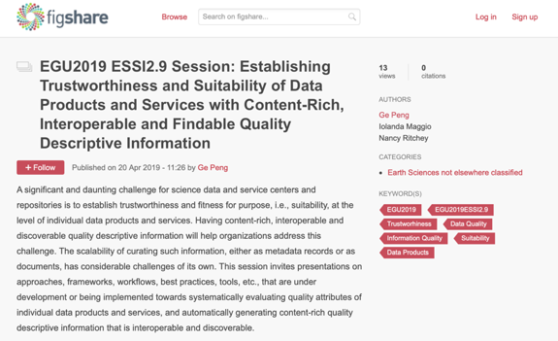
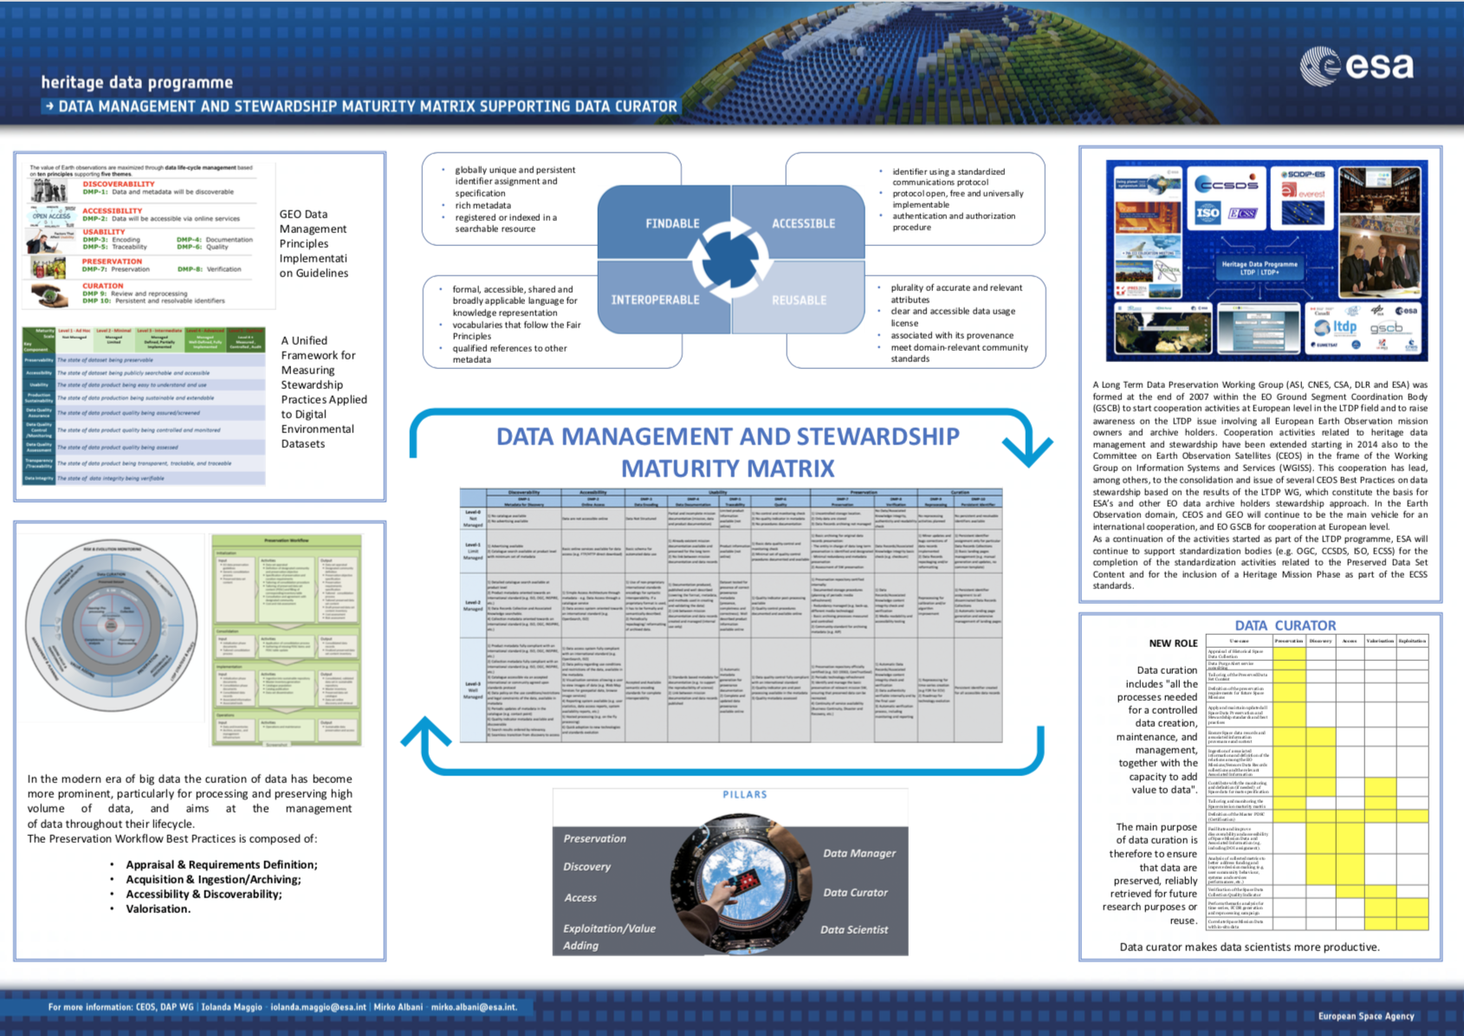
EGU2019 – ESSI2.9
https://figshare.com/collections/EGU2019_ESSI2_9_Session_Establishing_Trustworthiness_and_Suitability_of_Data_Products_and_Services_with_Content-Rich_Interoperable_and_Findable_Quality_Descriptive_Information/4467452

Slide 5
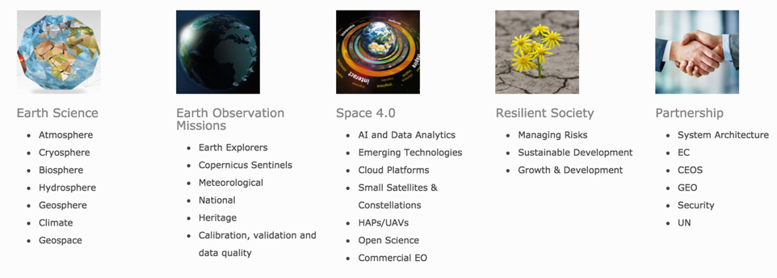
LIVING PLANET 2019 CONFERENCE

Slide 6
LIVING PLANET 2019 CONFERENCE – Mirko’s session
Long Time Data series
Fundamental Data Records

Slide 7
IAC-19 Conference
1.4 Earth Observation Data Management Systems
Focus is on Earth Observation related data systems. Emphasis is on the challenges of new IT and web technologies (e.g. Big Data, Cloud, crowd sourcing) for acquisition, communication, processing, dissemination and archiving systems and concepts needed to address large data volumes. The session also covers innovative methods for the extraction of information from these large data systems and methods for making the results available to decision makers. Presentation of International coordination and programmes - on Earth Observation data -related systems - is also encouraged.
https://iafastro.directory/iac/browse/IAC-19/catalog-technical-programme#sec.B1

Slide 8
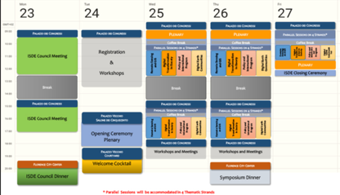
ISDE11 Symposium
http://www.digitalearth2019.eu/
Earth Observations Data Cubes (EODC)
Earth Observation Data to Knowledge Value Chains
Multi-technique and multi-platform approaches for
digital heritage
Space 4.0
…

Slide 9
IDCC 2020
Social, political and cultural implications of digital curation
Trust: assessing content and containers
Data stewardship
Preservation planning
http://www.dcc.ac.uk/events/idcc20

Slide 10
EO Phi-Week Conference
Explore the latest applications of transformative technologies affecting Science Innovation and FutureEO missions and services
Connect with innovation ecosystems and emerging EO players, including for example data scientists, deep tech innovators, large ICT corporates and startups
Gather and foster emerging EO Open Science communities
Inspire early career scientists, entrepreneurs, citizens and dreamers by showcasing the scientific and business opportunities related to Open Science and FutureEO
Partner with new players by fostering new collaboration across disciplines.
The deadline for the abstract submission is 17 May 2019
https://phiweek.esa.int/NikalWebsitePortal/esa-eo-phi-week-2019/phiweek/

