Slide 1
Working Group on Information Systems and Services (WGISS)
Committee on Earth Observation Satellites
Iolanda Maggio, ESA,
WGISS#47
GEOSS DMP IG Proposal - Discussion
NOAA – Silver Spring, USA
1st of May 2019

Slide 2
BACKGROUND: Starting Points
Scientific Data Stewardship Maturity Matrix:
A Unified Framework for Measuring Stewardship Practices Applied to Digital Environmental Datasets.
It indicates all possible activities to be performed to preserve and improve the information content, quality, accessibility, and usability of data and metadata.
Gives a technical evaluation of the level of preservation and helps with self assessment of preservation.
Data Management Principles:
These principles address the need for discovery, accessibility, usability, preservation, and curation of the resources made available through GEOSS.
The DMP provide guidelines that data providers and others can use as they seek to implement the principles.
The DMP provide a basis for assessing how well the principles are being adhered to in practice.
Notes:
Capability Maturity Model Integration (CMMI) is a process improvement training and appraisal program and service administered and marketed by Carnegie Mellon University (CMU) and required by many DoD and U.S. Government contracts, especially in software development. CMU claims CMMI can be used to guide process improvement across a project, division, or an entire organization. CMMI defines the following maturity levels for processes: Initial, Managed and Defined.
CMMI currently addresses three areas of interest:
Product and service development — CMMI for Development (CMMI-DEV),
Service establishment, management, — CMMI for Services (CMMI-SVC), and
Product and service acquisition — CMMI for Acquisition (CMMI-ACQ).
Climate Data Record Maturity Matrix (CDRMM): Bates and Privette, 2012
TECHNOLOGY READINESS LEVELS (TRLs): Standard which measures the maturity of new technologies
Scientific Readiness Levels (SRL): FOR SPACE APPLICATIONS

Slide 3
The GEOSS Data Management Principles
Implementation Guidelines
Start Date: April 2014
GEOSS Data Management Principles Document
Preliminary version reviewed by GEO-XI in November 2014
Incorporated in GEO Strategic Plan 2016-2025
Short Version on Page 12 and Long Version in Reference Document
GEOSS Data Management Principles Implementation Guidelines
Preliminary Version is GEO-XII Document 10 (40 pages)
DMPTF Members and Partners

Slide 4
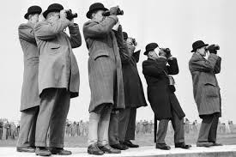
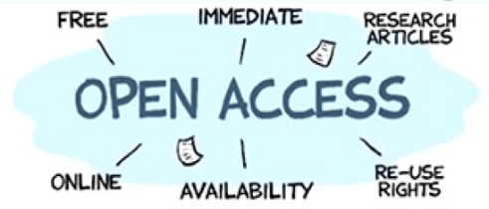
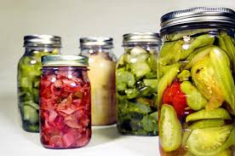
Data Management Principles
The value of Earth observations are maximized through data life-cycle management based on ten principles supporting five themes.
DISCOVERABILITY
DMP-1: Data and metadata will be discoverable
ACCESSIBILITY
DMP-2: Data will be accessible via online services
USABILITY
DMP-3: Encoding DMP-4: Documentation
DMP-5: Traceability DMP-6: Quality
PRESERVATION
DMP-7: Preservation DMP-8: Verification
CURATION
DMP 9: Review and reprocessing
DMP 10: Persistent and resolvable identifiers

Slide 5
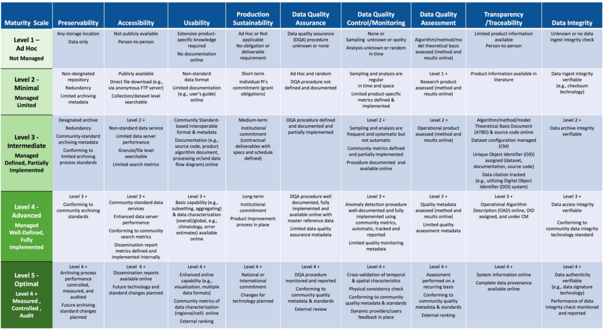
Maturity Matrix for Long-Term Scientific Data Stewardship – 2015, Ge Peng and Jeffrey L. Privette & Others
Notes:
Preservability: it focuses on assessing practices associated with data storage for resilience requirements, i.e., backup or a duplicate copy in a physically separate facility for disaster recovery, and on compliance to community-accepted archive practices and metadata standards. Preservability metadata are necessary for file storage and retrieval purposes only. They include a unique identifier for the dataset, file naming convention, file size, data volume, and, if available, a unique identifier for the collection- level metadata record associated with the dataset. The file naming convention is treated in this paper as being more relevant to preservability; however, the implication of defined file naming conventions on data usability and interoperability should also be considered when determining file naming conventions.
Accessibility: The maturity of the accessibility key component will focus on whether users can easily find and access data online. It measures whether a dataset is searchable and discoverable for collection only or to the granule level.
Usability: it deals with how easily users are able to use the data and learn whether the data are suitable for their own data requirements. It is closely tied to online documentation availability (e.g., Quick starter guide, Users’ guide, or Readme file), file format for interoperability, online data customization and visualization capability, and data characterization. It strives to alleviate the users’ burden of learning about and understanding the data.
Production Sustainability: it is addressed in terms of various degrees of commitment for and associated requirements on the product. Here, it is assumed that the commitment is backed by the necessary financial support. At maturity level 5, changes for technology in data production should be routinely incorporated into planning for continued, sustained stewardship.
Data Quality Assurance (DQA): is a set of activities or procedures focused on defect prevention to be followed in order to ensure product quality during development. Data quality screening (DQS) is a set of activities intended to ensure the source data are clean. DQS is a commonly used procedure for identifying missing or redundant records.
Data Quality Control/ Monitoring: is a set of activities taken to evaluate the product to ensure that it conforms to the required specifications. It is product-oriented and focuses on data anomaly detection. It is usually carried out after the product is created or at each major milestone of the product development and processing cycle.
Data Quality Assessment: is a set of activities designed to ensure that the products are scientifically sound (i.e., building the right thing), by carefully evaluating the product, usually by comparison with similar well-established and validated observations or data product(s).
Transparency /Traceability: The focus here is on the level of availability of information about the product and how it was created, the level of practices associated with management of documents, source code, and system information, and whether data and publication citations were tracked, such as by utilizing a Digital Object Identifier (DOI) system.
Data Integrity: Data integrity refers to the validity of data, i.e., the accuracy and consistency of data over its entire lifecycle. The Data integrity component in this version of the stewardship maturity matrix primarily assesses the practices applied to datasets to ensure the data files are free of intentional or unintentional corruption during data transfer, ingest, storage, and dissemination and to ensure data authenticity at access.

Slide 6
Three questions come to light
What is the Maturity Matrix/Model?
Who could use it?
Why it should be used?

Slide 7
Maturity Matrix/Model - WHAT
All activities needed to preserve and improve the information content, quality, accessibility, and usability of data and metadata.

Slide 8
Maturity Matrix/Model - WHO
Data providers
to evaluate and improve the quality and usability of their products
Modelers, decision-makers, and scientists
to improve their products
to make investment and use decision
Data managers/stewards of data centers and repositories
to validate their compliance or lack of stewardship practice or standards
to assess the current state
to create a roadmap forward to improve or enhance its stewardship maturity of practices applied to all its holdings

Slide 9
Maturity Matrix/Model - WHY
Provides data quality, usability information to users, stakeholders, and decision makers;
A reference model for stewardship planning and resource allocation;
Creates a roadmap for scientific data stewardship improvement;
Provides detailed guideline and recommendations for preservation;
Evaluates if the preservation follows best practices;
Gives a technical evaluation of the level of preservation and helps with self assessment of preservation;
Gives no numbers or average but a status;
Helps to break the problem down, and understand the costs associated with each;
Funding agencies can define goal levels;
Flexible and adaptable after a tailoring.
…. This is enough, isn’t it???

Slide 10
1^ EXERCISE: DMP IG content completeness measuring through the Data Stewardship Maturity Matrix

Slide 11
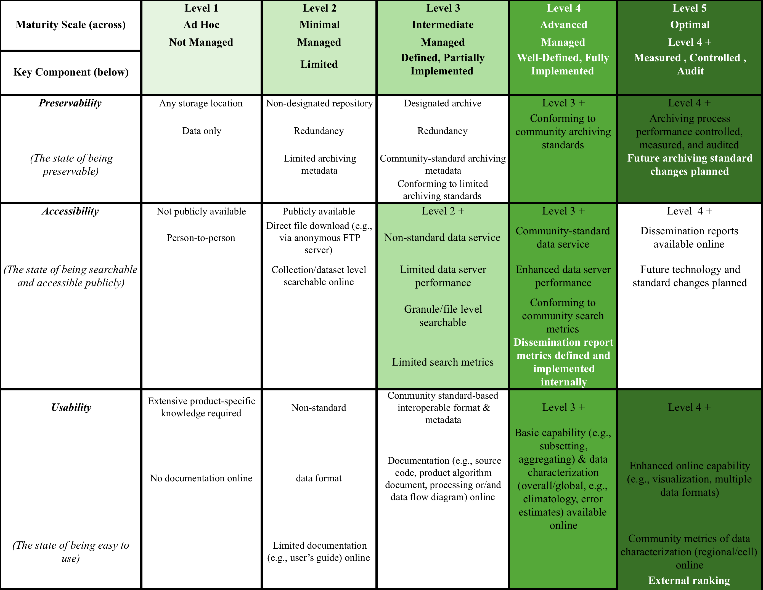
DMP Maturity Matrix Assessment

Slide 12
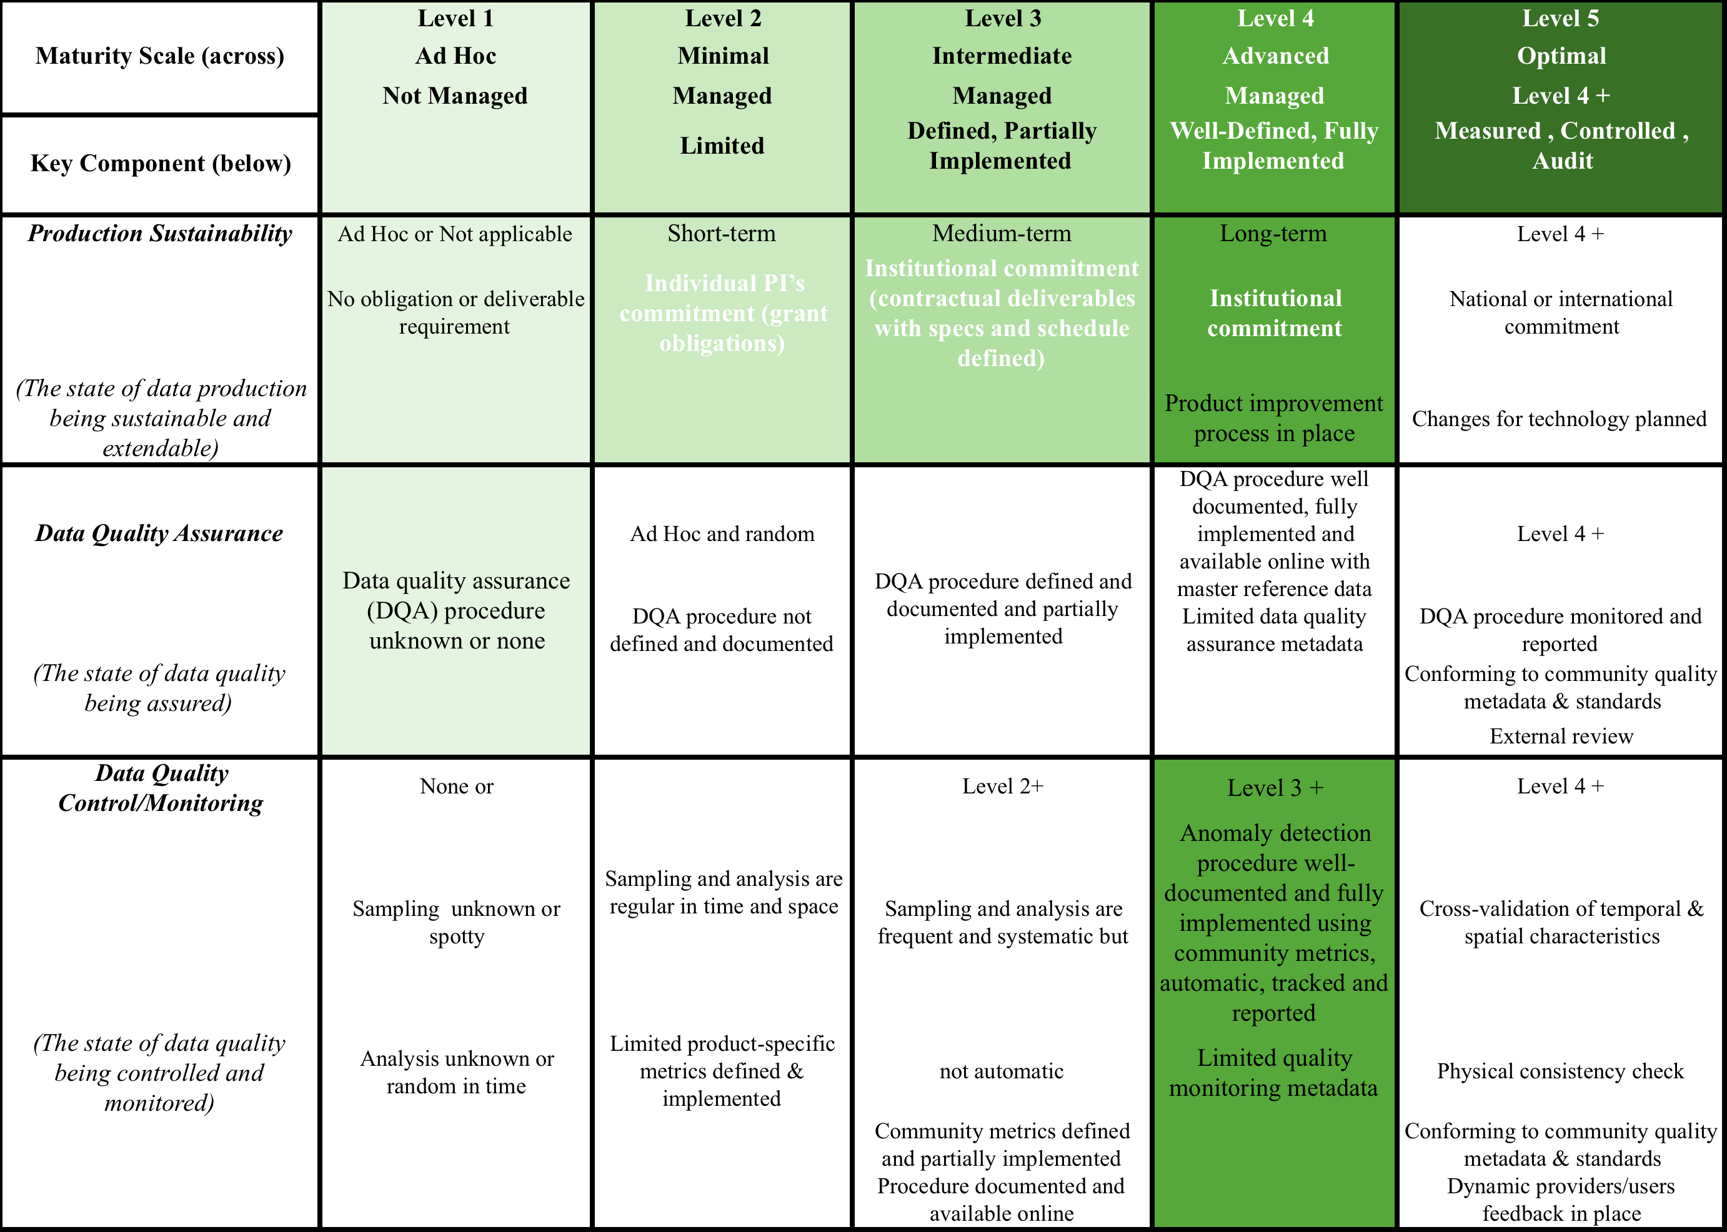
DMP Maturity Matrix Assessment

Slide 13
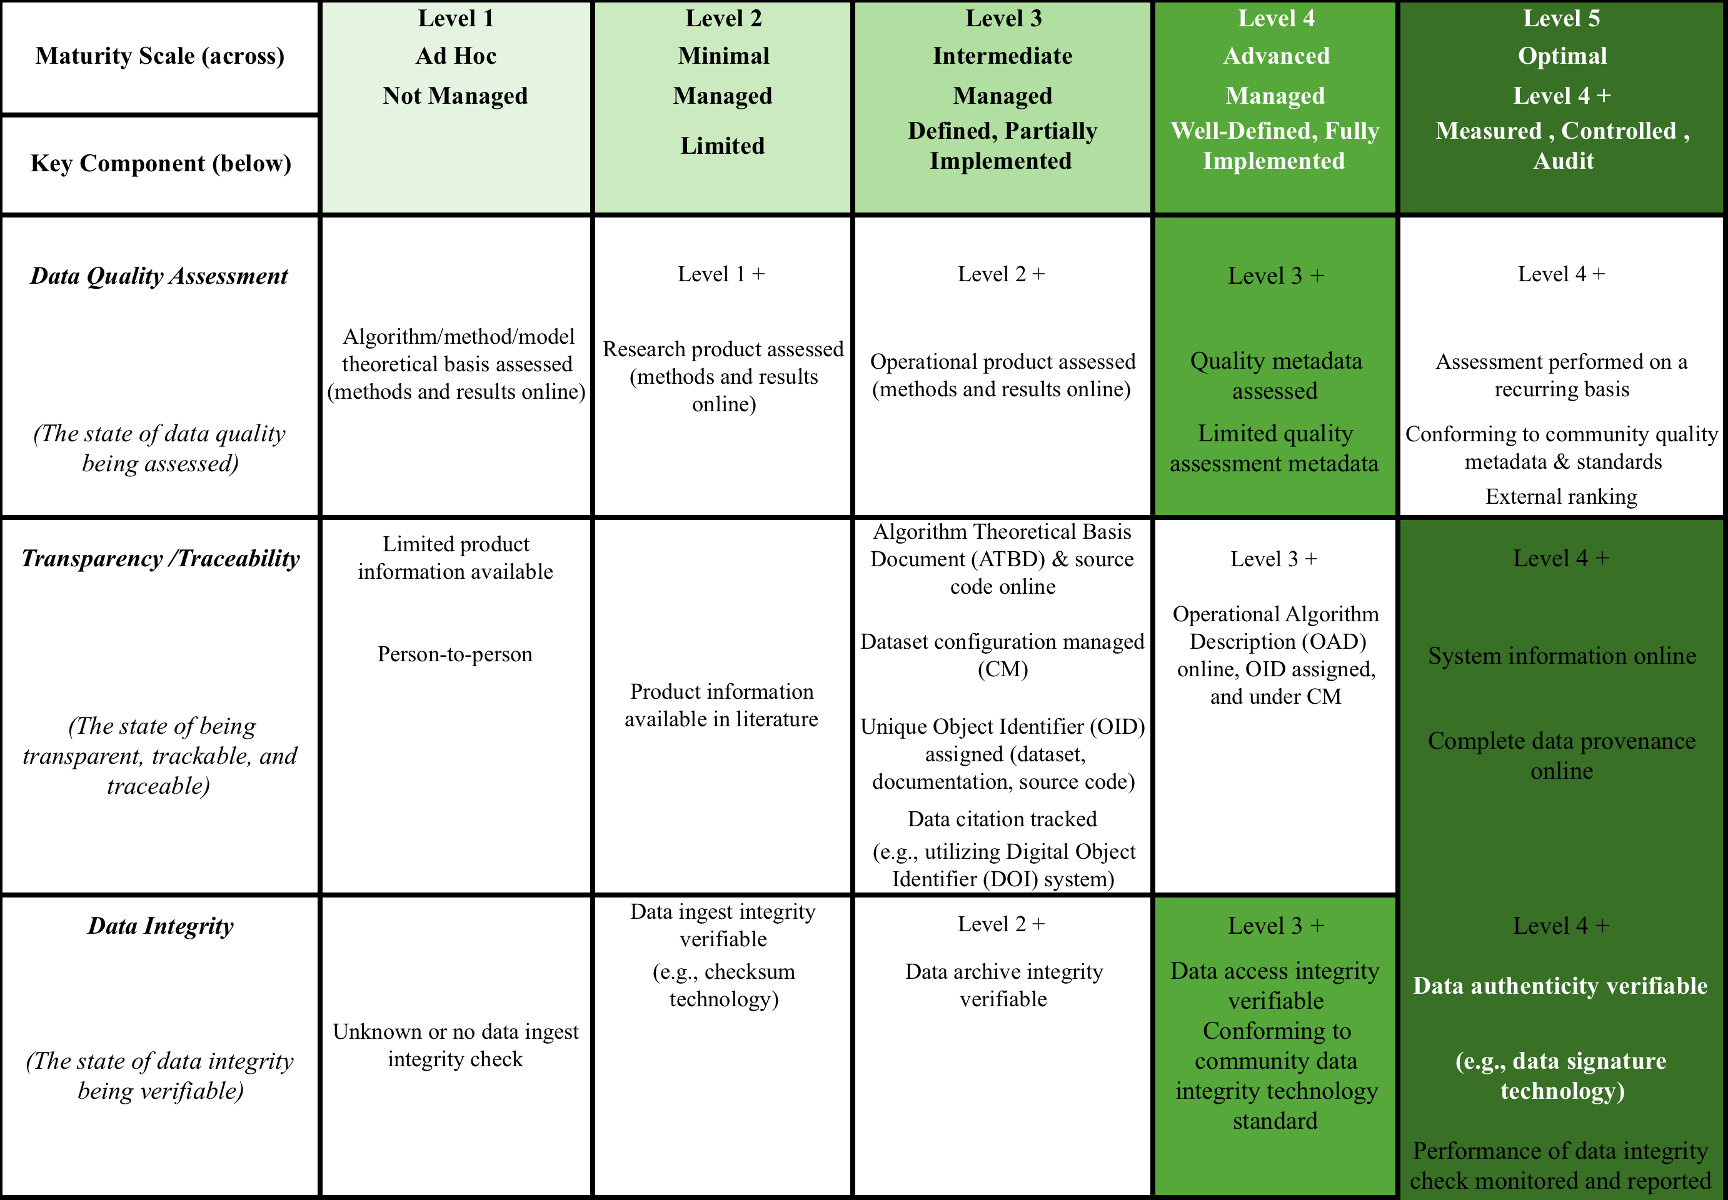
DMP Maturity Matrix Assessment

Slide 14
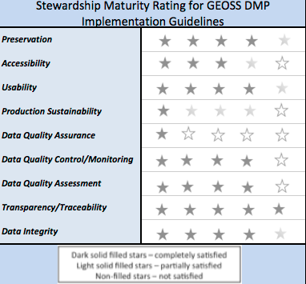
Assessment results and Rating

Slide 15
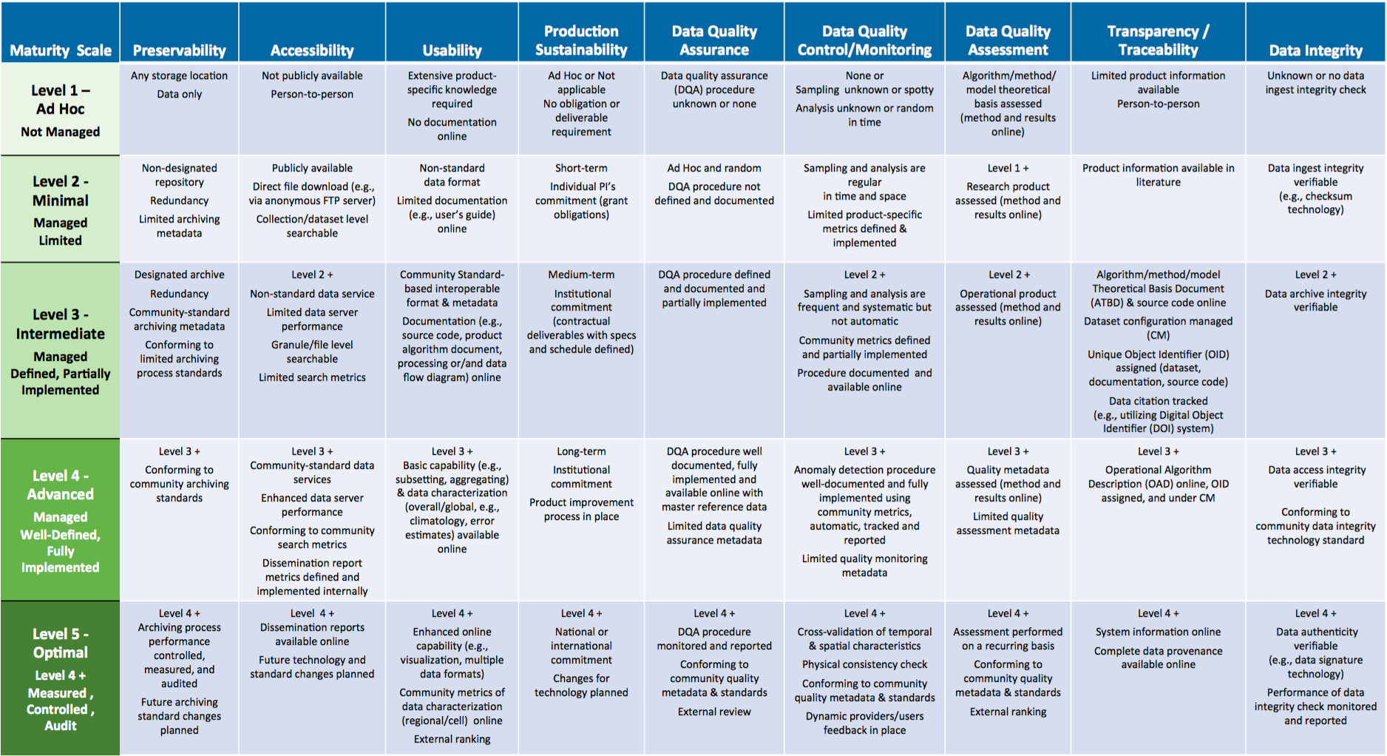
DMP Measurement Results
Notes:
Preservability: it focuses on assessing practices associated with data storage for resilience requirements, i.e., backup or a duplicate copy in a physically separate facility for disaster recovery, and on compliance to community-accepted archive practices and metadata standards. Preservability metadata are necessary for file storage and retrieval purposes only. They include a unique identifier for the dataset, file naming convention, file size, data volume, and, if available, a unique identifier for the collection- level metadata record associated with the dataset. The file naming convention is treated in this paper as being more relevant to preservability; however, the implication of defined file naming conventions on data usability and interoperability should also be considered when determining file naming conventions.
Accessibility: The maturity of the accessibility key component will focus on whether users can easily find and access data online. It measures whether a dataset is searchable and discoverable for collection only or to the granule level.
Usability: it deals with how easily users are able to use the data and learn whether the data are suitable for their own data requirements. It is closely tied to online documentation availability (e.g., Quick starter guide, Users’ guide, or Readme file), file format for interoperability, online data customization and visualization capability, and data characterization. It strives to alleviate the users’ burden of learning about and understanding the data.
Production Sustainability: it is addressed in terms of various degrees of commitment for and associated requirements on the product. Here, it is assumed that the commitment is backed by the necessary financial support. At maturity level 5, changes for technology in data production should be routinely incorporated into planning for continued, sustained stewardship.
Data Quality Assurance (DQA): is a set of activities or procedures focused on defect prevention to be followed in order to ensure product quality during development. Data quality screening (DQS) is a set of activities intended to ensure the source data are clean. DQS is a commonly used procedure for identifying missing or redundant records.
Data Quality Control/ Monitoring: is a set of activities taken to evaluate the product to ensure that it conforms to the required specifications. It is product-oriented and focuses on data anomaly detection. It is usually carried out after the product is created or at each major milestone of the product development and processing cycle.
Data Quality Assessment: is a set of activities designed to ensure that the products are scientifically sound (i.e., building the right thing), by carefully evaluating the product, usually by comparison with similar well-established and validated observations or data product(s).
Transparency /Traceability: The focus here is on the level of availability of information about the product and how it was created, the level of practices associated with management of documents, source code, and system information, and whether data and publication citations were tracked, such as by utilizing a Digital Object Identifier (DOI) system.
Data Integrity: Data integrity refers to the validity of data, i.e., the accuracy and consistency of data over its entire lifecycle. The Data integrity component in this version of the stewardship maturity matrix primarily assesses the practices applied to datasets to ensure the data files are free of intentional or unintentional corruption during data transfer, ingest, storage, and dissemination and to ensure data authenticity at access.
Level 5 is Level 4 + other things

Slide 16
2^ EXERCISE: Create a WIGISS Maturity Matrix with DMP IG simplifying the Data Stewardship Maturity Matrix

Slide 17
Approach
NEED:
Create a Maturity Matrix with DMP IG simplifying the WGISS EO Data Stewardship Maturity Matrix
Implemented Solutions:
Substituting the Key components of the Maturity Matrix with the DMP IG
Normalizing the number of maturity levels reducing them to new 4 levels
Giving a weight to every components of the principles in order to give an incremental order for the implementation of the preservation and curation activities

Slide 18
DMP Guidelines and key Components mapping
DMP Implementation Guidelines | MM Key Components
DMP-1: Discoverability | Accessibility
DMP-2: Accessibility | Accessibility
DMP-3: Encoding | Usability
DMP-4: Documentation | Usability
DMP-5: Traceability | Transparency /Traceability
DMP-6: Quality | Data Quality Control/ Monitoring Data Quality Assessment Data Quality Assurance
DMP-7: Preservation | Preservability
DMP-8: Verification | Data Integrity
DMP-9: Review and reprocessing | Production Sustainability
DMP-10: Persistent and resolvable identifiers | Transparency /Traceability
Notes:
invertire

Slide 19
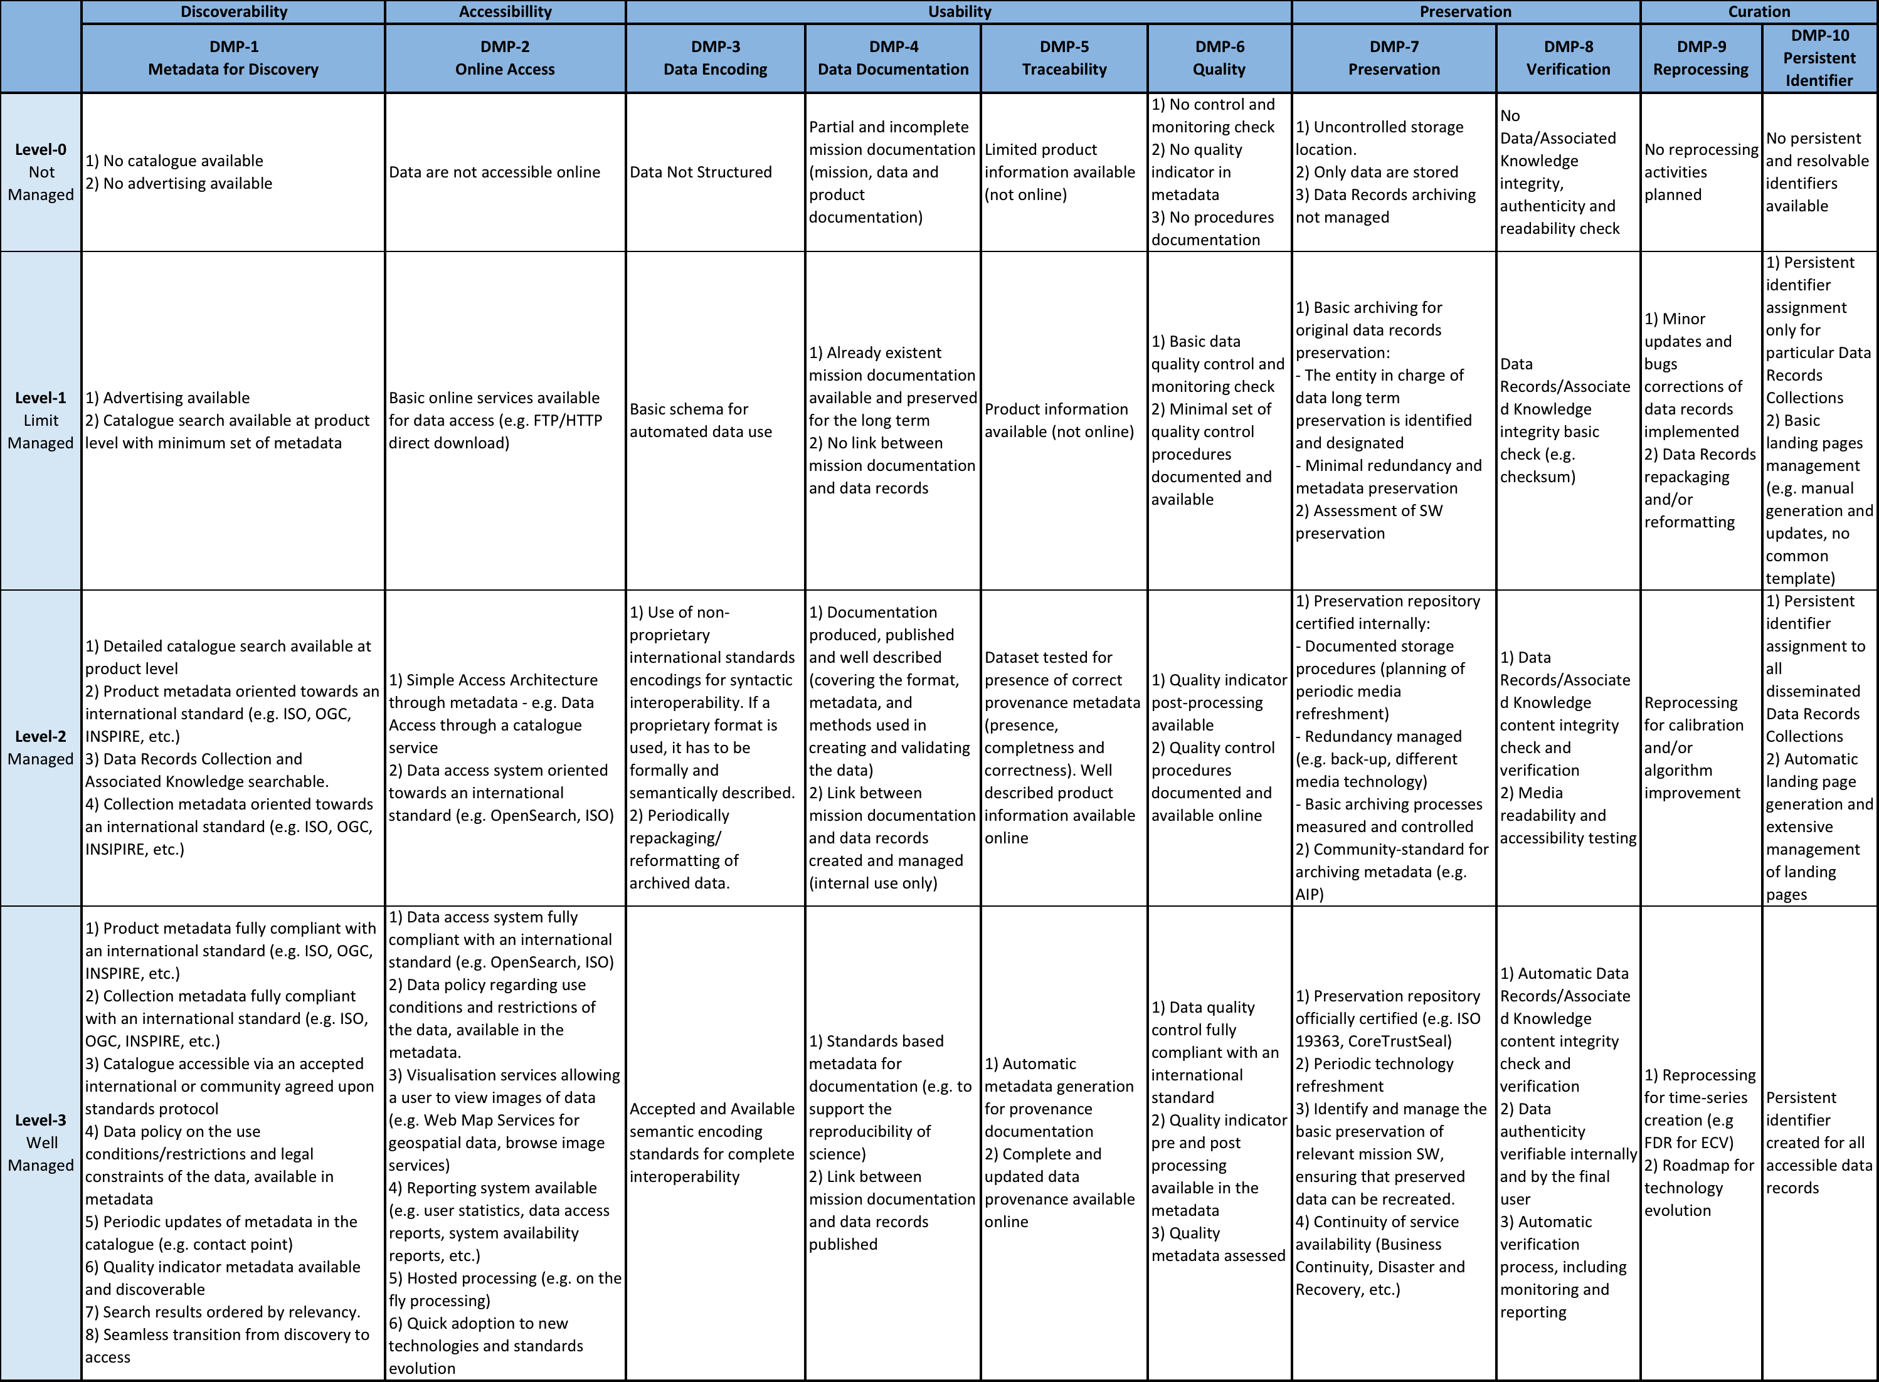
WGISS EO Data Stewardship Maturity Matrix
Notes:
Preservability: it focuses on assessing practices associated with data storage for resilience requirements, i.e., backup or a duplicate copy in a physically separate facility for disaster recovery, and on compliance to community-accepted archive practices and metadata standards. Preservability metadata are necessary for file storage and retrieval purposes only. They include a unique identifier for the dataset, file naming convention, file size, data volume, and, if available, a unique identifier for the collection- level metadata record associated with the dataset. The file naming convention is treated in this paper as being more relevant to preservability; however, the implication of defined file naming conventions on data usability and interoperability should also be considered when determining file naming conventions.
Accessibility: The maturity of the accessibility key component will focus on whether users can easily find and access data online. It measures whether a dataset is searchable and discoverable for collection only or to the granule level.
Usability: it deals with how easily users are able to use the data and learn whether the data are suitable for their own data requirements. It is closely tied to online documentation availability (e.g., Quick starter guide, Users’ guide, or Readme file), file format for interoperability, online data customization and visualization capability, and data characterization. It strives to alleviate the users’ burden of learning about and understanding the data.
Production Sustainability: it is addressed in terms of various degrees of commitment for and associated requirements on the product. Here, it is assumed that the commitment is backed by the necessary financial support. At maturity level 5, changes for technology in data production should be routinely incorporated into planning for continued, sustained stewardship.
Data Quality Assurance (DQA): is a set of activities or procedures focused on defect prevention to be followed in order to ensure product quality during development. Data quality screening (DQS) is a set of activities intended to ensure the source data are clean. DQS is a commonly used procedure for identifying missing or redundant records.
Data Quality Control/ Monitoring: is a set of activities taken to evaluate the product to ensure that it conforms to the required specifications. It is product-oriented and focuses on data anomaly detection. It is usually carried out after the product is created or at each major milestone of the product development and processing cycle.
Data Quality Assessment: is a set of activities designed to ensure that the products are scientifically sound (i.e., building the right thing), by carefully evaluating the product, usually by comparison with similar well-established and validated observations or data product(s).
Transparency /Traceability: The focus here is on the level of availability of information about the product and how it was created, the level of practices associated with management of documents, source code, and system information, and whether data and publication citations were tracked, such as by utilizing a Digital Object Identifier (DOI) system.
Data Integrity: Data integrity refers to the validity of data, i.e., the accuracy and consistency of data over its entire lifecycle. The Data integrity component in this version of the stewardship maturity matrix primarily assesses the practices applied to datasets to ensure the data files are free of intentional or unintentional corruption during data transfer, ingest, storage, and dissemination and to ensure data authenticity at access.
Level 5 is Level 4 + other things

Slide 20
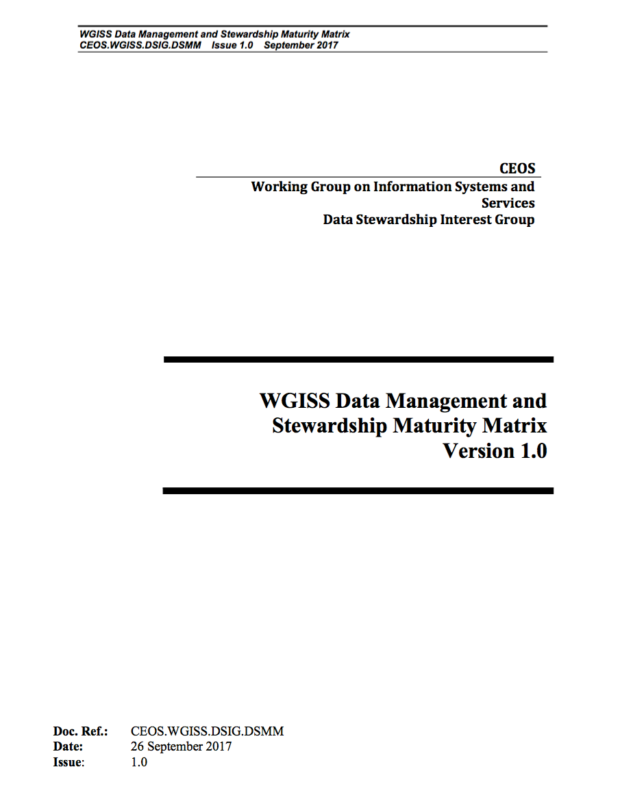
WGISS Data Management and Stewardship Maturity Matrix - White Paper
Data stewardship “encompasses all activities that preserve and improve the information content, accessibility, and usability of data and metadata” (National Research Council 2007).
Data management includes all activities for “planning, execution and oversight of policies, practices and projects that acquire, control, protect, deliver and enhance the value of data and information assets.” (Mosely et al. 2009).
In addition to data preservation, accessibility, and usability, WGISS MM also covers discoverability, use and services capabilities, program budget, data policy, etc.

Slide 21
WGISS Contribution to DMP Evolution
Notes:
Preservability: it focuses on assessing practices associated with data storage for resilience requirements, i.e., backup or a duplicate copy in a physically separate facility for disaster recovery, and on compliance to community-accepted archive practices and metadata standards. Preservability metadata are necessary for file storage and retrieval purposes only. They include a unique identifier for the dataset, file naming convention, file size, data volume, and, if available, a unique identifier for the collection- level metadata record associated with the dataset. The file naming convention is treated in this paper as being more relevant to preservability; however, the implication of defined file naming conventions on data usability and interoperability should also be considered when determining file naming conventions.
Accessibility: The maturity of the accessibility key component will focus on whether users can easily find and access data online. It measures whether a dataset is searchable and discoverable for collection only or to the granule level.
Usability: it deals with how easily users are able to use the data and learn whether the data are suitable for their own data requirements. It is closely tied to online documentation availability (e.g., Quick starter guide, Users’ guide, or Readme file), file format for interoperability, online data customization and visualization capability, and data characterization. It strives to alleviate the users’ burden of learning about and understanding the data.
Production Sustainability: it is addressed in terms of various degrees of commitment for and associated requirements on the product. Here, it is assumed that the commitment is backed by the necessary financial support. At maturity level 5, changes for technology in data production should be routinely incorporated into planning for continued, sustained stewardship.
Data Quality Assurance (DQA): is a set of activities or procedures focused on defect prevention to be followed in order to ensure product quality during development. Data quality screening (DQS) is a set of activities intended to ensure the source data are clean. DQS is a commonly used procedure for identifying missing or redundant records.
Data Quality Control/ Monitoring: is a set of activities taken to evaluate the product to ensure that it conforms to the required specifications. It is product-oriented and focuses on data anomaly detection. It is usually carried out after the product is created or at each major milestone of the product development and processing cycle.
Data Quality Assessment: is a set of activities designed to ensure that the products are scientifically sound (i.e., building the right thing), by carefully evaluating the product, usually by comparison with similar well-established and validated observations or data product(s).
Transparency /Traceability: The focus here is on the level of availability of information about the product and how it was created, the level of practices associated with management of documents, source code, and system information, and whether data and publication citations were tracked, such as by utilizing a Digital Object Identifier (DOI) system.
Data Integrity: Data integrity refers to the validity of data, i.e., the accuracy and consistency of data over its entire lifecycle. The Data integrity component in this version of the stewardship maturity matrix primarily assesses the practices applied to datasets to ensure the data files are free of intentional or unintentional corruption during data transfer, ingest, storage, and dissemination and to ensure data authenticity at access.
Level 5 is Level 4 + other things

Slide 22
Proposal for improvement of the GEOSS DMP IG using the Maturity Matrix
Not exhaustive AREAS to be supported:
DMP-1: Discoverability: e.g. Automatic Dissemination Reports
and Future Technologies and standard changes planned
DMP-6: Quality: e.g. Data uncertainty and reliability, Data Integrity
DMP-9: Review and Reprocessing: e.g. introducing and improving
the Sustainability concepts.

Slide 23
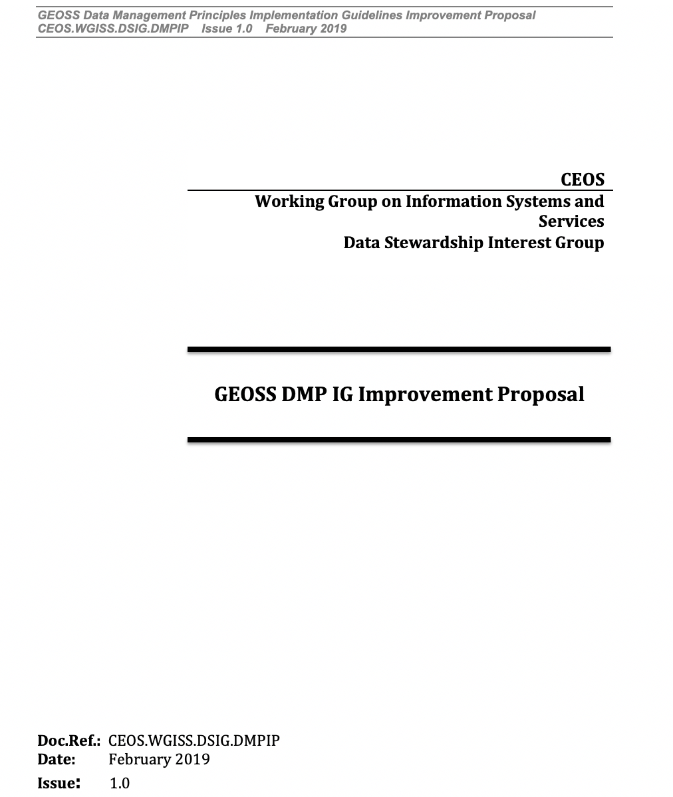
Open Points and Way Forward
Open Points:
GEOSS Evolve initiative could be not more supported BUT GEO indicated interest on FAIR DMP
RDA is fully involved on FAIR Data Maturity Model with a Working Group already fully active on this topic
Next Steps:
Verification of last version of DMP IG
Finalise and circulate the GEOSS DMP IG Improvement proposal
The relevant due date need to be defined after clarification of
the Open Points

