Slide 1
Ontology
CNES

Slide 2
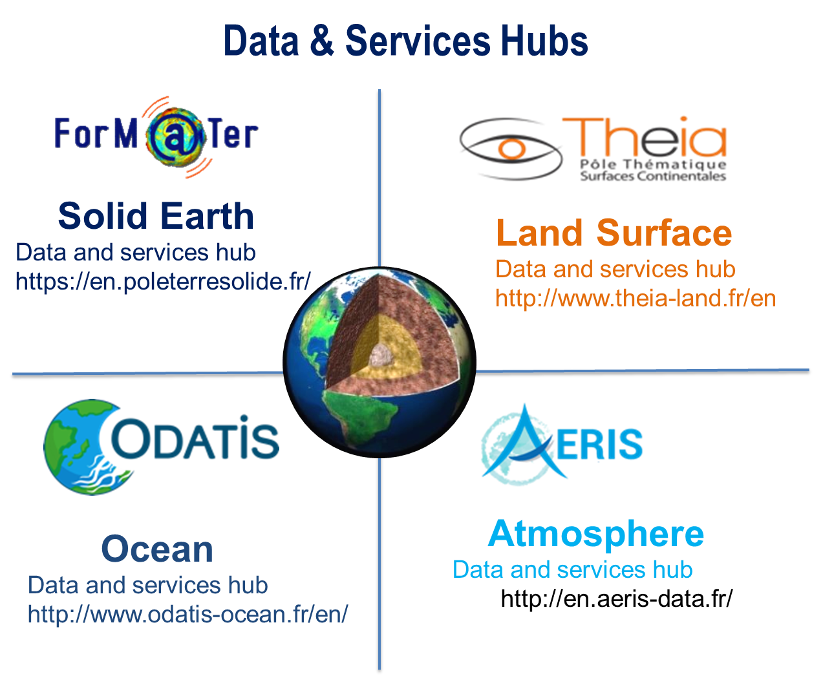
French « Earth System » Research Infrastructure
French context: data in Data Hubs/SDI
THEIA, FORM@TER, ODATIS, AERIS
Thematics research infrastructures
Each is a federation of data centers
Each are involved in ESFRI and ENVRI FAIR
‘Earth System’ Research Infrastructure
Federation of the hubs
Crosscutting applications
Space data & in-situ

Slide 3
CNES & French « Earth System » Research Infrastructure
Objective
Link / open our data to other domains
Transdisciplinary: objective of « Earth System » RI
Open to other domains: eg social and economics sciences
Allow to better describe what is targeted by our sensors
Feature of interest
Foster usage of data by machines
Allow development of evolved search engines
Be compliant to FAIR principles

Slide 4
CNES & French « Earth System » Research Infrastructure
Current situation
CNES R&D in 2012/2013
Today
Association with industry: QWANT & with laboratories IRIT, IRISA, IRD
Some developments, but not publishable yet
Principles
Thesaurus: GCMD that will be enriched to take into account the variety of in situ data
Link granules to other domains: mainly time & geography & type of sensor
And to in situ
Enrich granules description with other information (automatic ~generalization of iTag)
Land cover, weather information, population statistics, biophysical indices, …
Features that can be seen in the FoV
Accept that will be used for objective not foreseen by us

