Slide 1
NASA GCMD Keywords
CEOS WGISS-47
Silver Spring, Maryland, USA, April 29-May 2, 2019
Hosted by the National Oceanic and Atmospheric Administration (NOAA)
Michael Morahan (Presentation created by Tyler Stevens)
IDN Coordinator
Michael.P.Morahan@nasa.gov

Slide 2
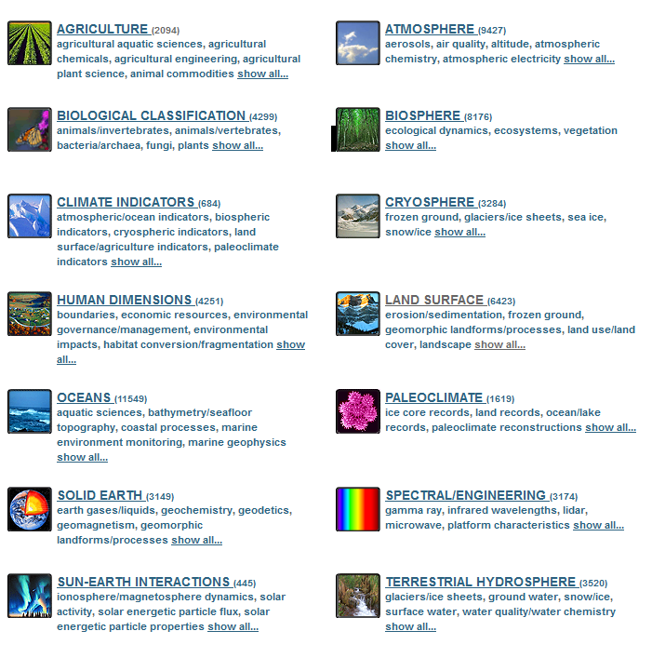
What Are The GCMD Keywords?
Hierarchical set of controlled vocabulary covering Earth science disciplines that have been evolving for over 25 years.
Contains
  12 published keyword types
  Over 11,000 unique keywords
  More than 100 defined keyword relationships
GCMD Earth Science Keywords
https://gcmd.nasa.gov/

Slide 3
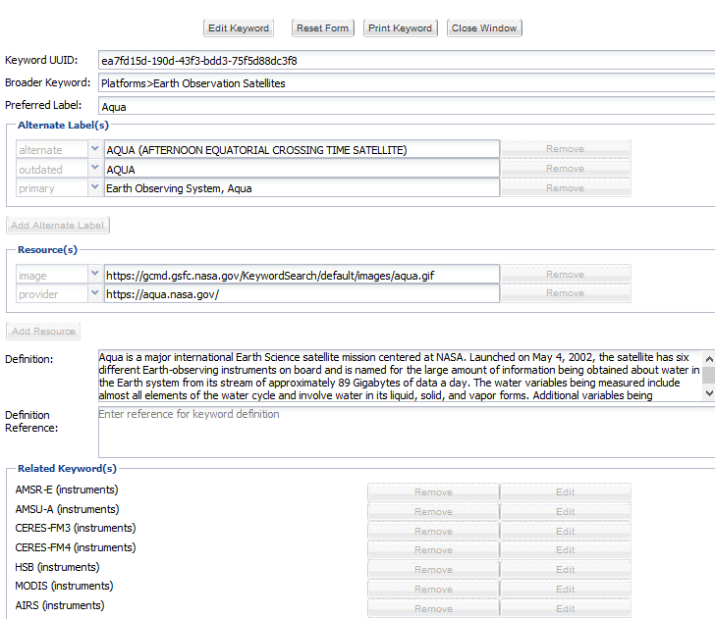
Implementing Keywords and Relationships
GCMD Keyword Editor
Add Keyword
Add Alternate Label
Add Resource
Add Definition
Add Reference
Add Related Keyword
Each keyword created has a universally unique identifier (UUID) that does not change.
Notes:
Mention that some of these steps are optional

Slide 4
A Look Behind The Scenes
Request for a list of platforms and their relationship to an instrument (AQUA has several related instruments):
https://gcmdservices.gsfc.nasa.gov/kms/concept_relation/?scheme=platforms&relation_type=has_instrument
  {"prefLabel": "AQUA",
  "scheme": "platforms",
  "uuid": "ea7fd15d-190d-43f3-bdd3-75f5d88dc3f8",
  "relatedConcepts": [
  {"prefLabel": "AMSR-E",
  "relationType": "has_instrument",
  "uuid": "736038ef-c1ae-47c7-a50e-729474eeb3b1",
  "scheme": "instruments"},
  {"prefLabel": "AMSU-A",
  "relationType": "has_instrument",
  "uuid": "2a393a42-ecf9-4137-b1ea-1c25692384b4",
  "scheme": "instruments"},

Slide 5
Visualizing Keyword Relationships
The example below shows a relationship between Platforms and Instruments. These instruments fly on the Aqua satellite.
Aqua (Platform)
AMSR-E (Instrument)
AMSU-A (Instrument)
CERES-FM3 (Instrument)
CERES-FM-4 (Instrument)
HSB (Instrument)
MODIS (Instrument)
AIRS (Instrument)

Slide 6
Keyword Relationship Use Case: GCIS
The Global Change Information System (GCIS) wanted to implement GCMD science keywords and associated relationships to describe figures, tables, chapters, etc. in the Fourth National Climate Assessment (NCA4).
https://data.globalchange.gov/report/nca4/
Background:
  The GCIS is working with NASA’s Inter Agency Implementation and Advanced Concepts (IMPACT) team to improve the discovery of global change resources.
  The MSFC IMPACT team is collaborating with the GCMD/IDN team to identify gaps in keywords based on the NCA4 review.
  The GCMD is implementing keyword changes and defined relationships based on the gap analysis.
Notes:
The Global Change Information System (GCIS) is a web-based resource for traceable, sound global change data, information, and products.
The Inter Agency Implementation and Advanced Concepts (IMPACT) team at NASA MSFC seeks to infuse NASA’s Earth Science data into other agencies and organizations application workflows. The IMPACT team monitors trends across the informatics, data science, and information technology fields to inform strategy and develop effective new solutions for Earth Science data management and dissemination.

Slide 7
GCIS Implementation Process
(1) Reviewed KMS API Documentation
(2) Wrote GCMD Keyword Update Script
(3) Ran Script To Pull In New and Updated Keywords
(4) Ran Script To Update GCIS HTML Pages
(6) Published HTML Pages
(5) Reviewed HTML Pages With Data Manager

Slide 8
GCMD Implementation Process
(1) Reviewed Proposed Keyword Changes With IMPACT Team
(2) Added Keyword and Definition To KMS
(3) Added Keyword Relationships to KMS
(4) Peer Reviewed Changes With IMPACT Team
(5) Published Keyword Changes In KMS
(6) Informed IMPACT Team of Published Keywords

Slide 9
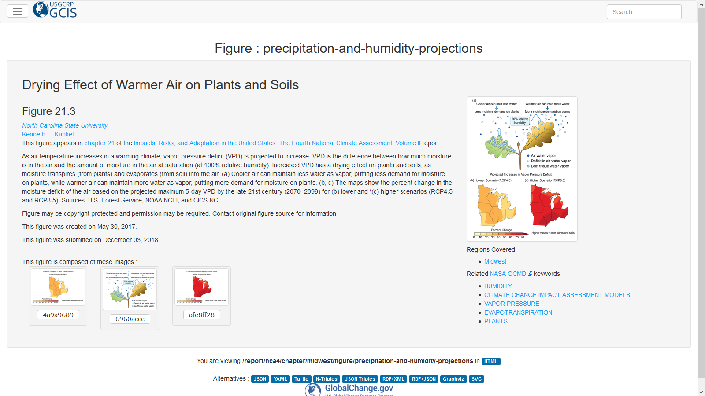
Result: GCIS Publication Page
https://data.globalchange.gov/report/nca4/chapter/midwest/figure/precipitation-and-humidity-projections

Slide 10
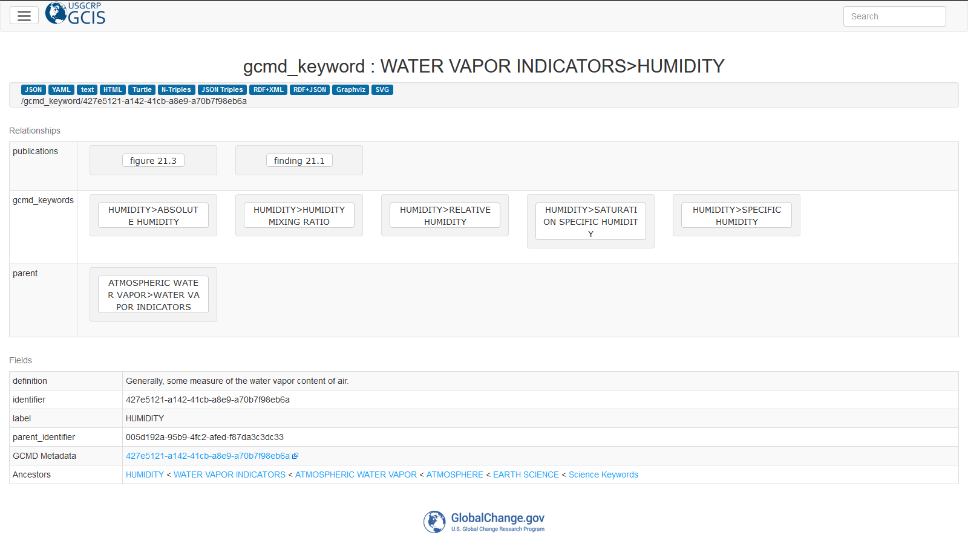
Result: GCIS Keyword Reference
https://data.globalchange.gov/gcmd_keyword/427e5121-a142-41cb-a8e9-a70b7f98eb6a

Slide 11
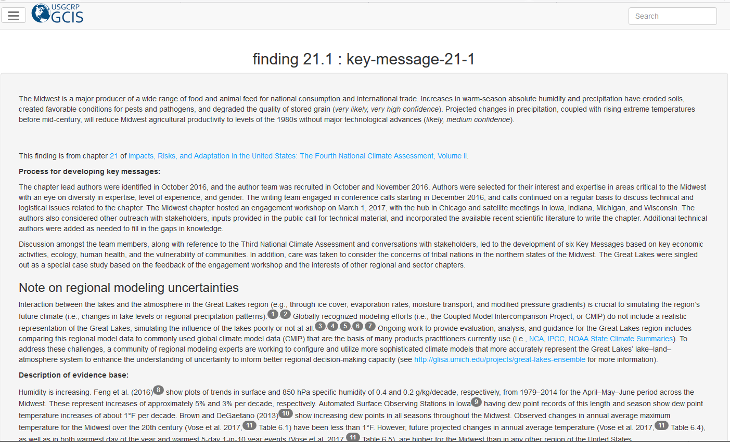
Result: Related Publications
https://data.globalchange.gov/report/nca4/chapter/midwest/finding/key-message-21-1

Slide 12
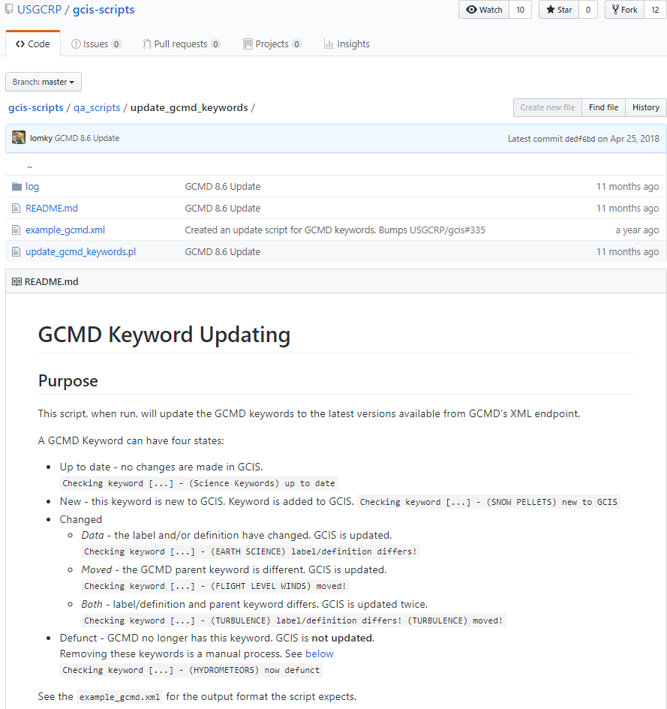
GCIS Script Details
https://github.com/USGCRP/gcis-scripts/tree/master/qa_scripts/update_gcmd_keywords

Slide 13
Conclusions
GCMD keywords continue to evolve based on feedback from U.S. and international agencies, research universities, and scientific institutions.
Implementing keyword relationships can be used to improve search and discovery of Earth science data and information.
The process defined here could be reusable for other providers who want to implement the GCMD keywords and see associated relationships.
You can contribute keywords by contacting the GCMD staff or sending an email to support@earthdata.nasa.gov.

Slide 14
Questions
  Please provide questions/comments to:
  michael.p.morahan@nasa.gov (KBR/WYLE)
  valerie.dixon@nasa.gov (NASA)
  christopher.s.lynnes@nasa.gov (NASA)

Slide 15
Background Information

Slide 16
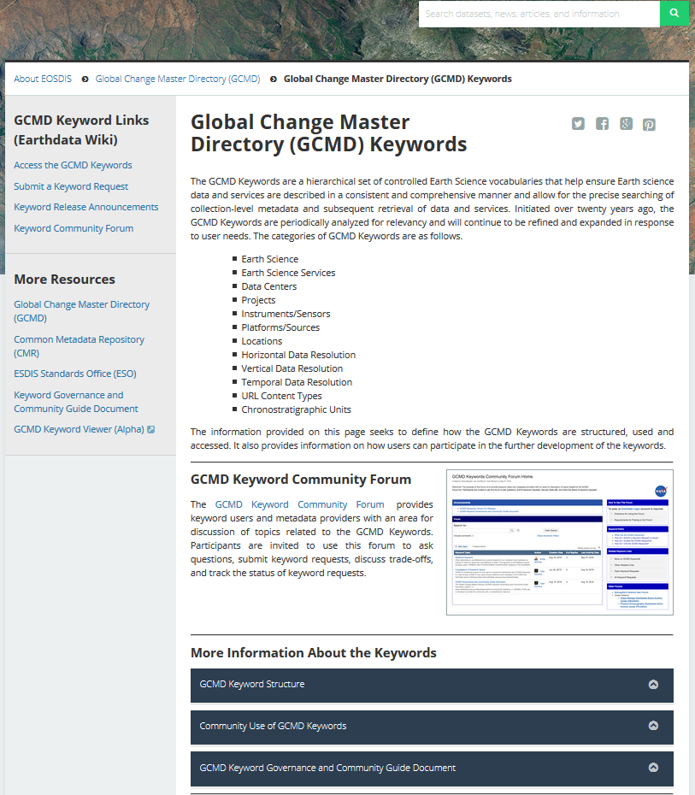
Keyword Landing Page
Learn More about the Keywords
Access the GCMD Keywords
Submit a Keyword Request
See Keyword Release Announcements
Review the Keyword Governance Document
https://earthdata.nasa.gov/about/gcmd/global-change-master-directory-gcmd-keywords

Slide 17
GCMD KMS API
The Keyword Management Service (KMS) is a RESTful web service for maintaining and accessing the keywords.
  Retrieve the keywords as SKOS Concepts (RDF, JSON, OWL), XML, and CSV
  Retrieve defined keyword relationships
  Retrieve previous versions
  Retrieve in different case (Native, Title Case, Upper Case, Lower Case)
  Search by keyword pattern (i.e. Search by ‘Terra’)
Help Documentation
  https://wiki.earthdata.nasa.gov/x/gwxNBQ

Slide 18













This work was supported by NASA/GSFC under Raytheon Co. contract number WIGSS-0419-MM2.
in partnership with

