Slide 1


Data Preservation and Stewardship
NOAA/NCEI
Nancy Ritchey
Archive Branch, Chief
NOAA National Centers for Environmental Information
01 May 2019
National Oceanic and Atmospheric Administration | National Centers for Environmental Information

Slide 2
Topics
Trusted Archive
Data Stewardship (DS) Challenges
DS End-to-End Proces
OneStop Achievements
Data Stewardship Maturity Matrix (DSMM)

Slide 3
Trusted Archive
Strengthen the trust of user communities, partners and the public by quantifiably demonstrating capabilities for ensuring data integrity and reliability over the long term.
NCEI leads four World Data Systems: Geophysics, Meteorology, Oceanography, and Paleoclimatology
Working toward Core Trustworthy Data Repository for all of NCEI
Notes:
Examine processes and capabilities which will ultimately validate the trustworthiness of the archive.
Core Trustworthy Data Repository, jointly offered by the Data Archiving and Networked Services archive in the Netherlands (creator of the Data Seal of Approval) and the International Council for Science World Data System (WDS).

Slide 4
Data Stewardship Challenges
Location-based processes and guidance
Roles and responsibilities for data preservation and stewardship varied
Uneven distribution of DSD staff across locations
Geographically dispersed NCEI staff made it difficult to communicate and to build trust
Notes:
Initiating Field Teams to support data stewardship throughout the organization

Slide 5
Data Stewardship Solutions
Initiated the NCEI Data Stewardship Council to address data preservation and stewardship topics
Recently rebooted the Data Stewardship E2E process and communication strategy
Developed staffing plan to support data stewardship throughout the organization, at all locations
Notes:
Initiating Field Teams to support data stewardship throughout the organization

Slide 6




Data Stewardship End-to-End Process
Planning with Data Provider
Support long term planning with data providers
Provide cost estimates for stewardship support
Develop high level agreements
Provide preservation guidance
Requirements Gathering
Identify best approach to support project
Document support decisions in submission agreement
Development and Configuration
Develop metadata to meet standards
Develop ingest and access configurations
Develop software as needed
Fully Operational:
Ingest -> Archive -> Discovery -> Access
Ingest and archive data
Publish data and metadata, Mint DOIs
Manage discovery and access to data

Slide 7
OneStop
To improve the discovery of, access to, and usability of NOAA’s vast and diverse collection of big data
Modern, user-friendly discovery interface
Open infrastructure, standards, and best practices

Slide 8
OneStop Data Stewardship Achievements
Developed a collection metadata standard
ISO-lite granule metadata specification developed with millions generated
Metadata and data format best practices
Tiers of OneStop readiness (Bronze-Silver-Gold) established
Developed and deployed of Common Metadata Editor Tool (CoMET)
Notes:
> 378 collections made OneStop-ready in 15 groups

Slide 9
OneStop Data Stewardship Achievements
DSMM assessed over 800 datasets
Developed report templates, guidance and workflows
DSMM results in ISO metadata
Streamlined Data Stewardship Maturity Questionnaire (DSMQ)
DSMQ is incorporated into CoMET
User’s Guide and DSMQ glossary published
Notes:
Collection Manager supporting tools are Docucomp, CEdit, Metaview, Metaserver

Slide 10
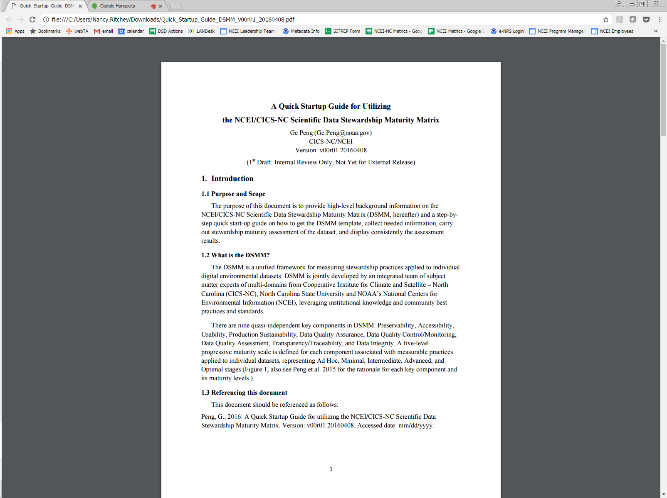
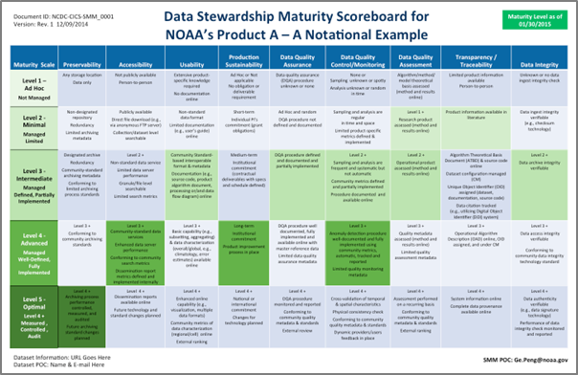
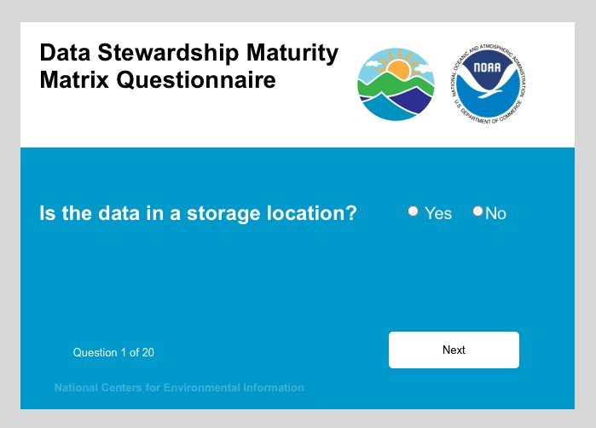
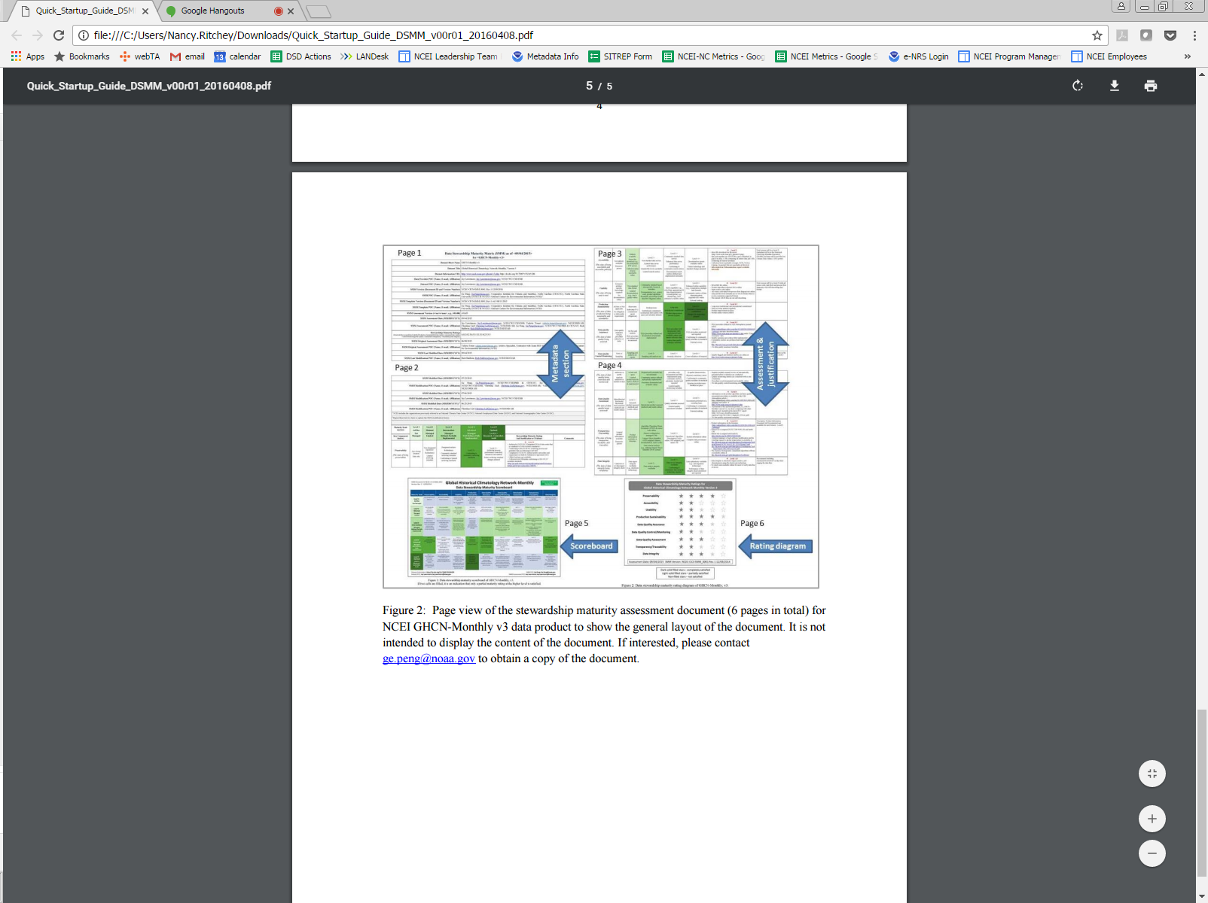
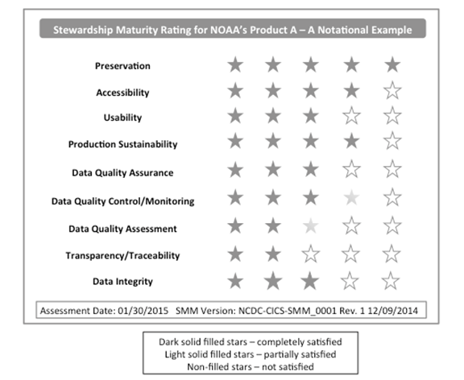
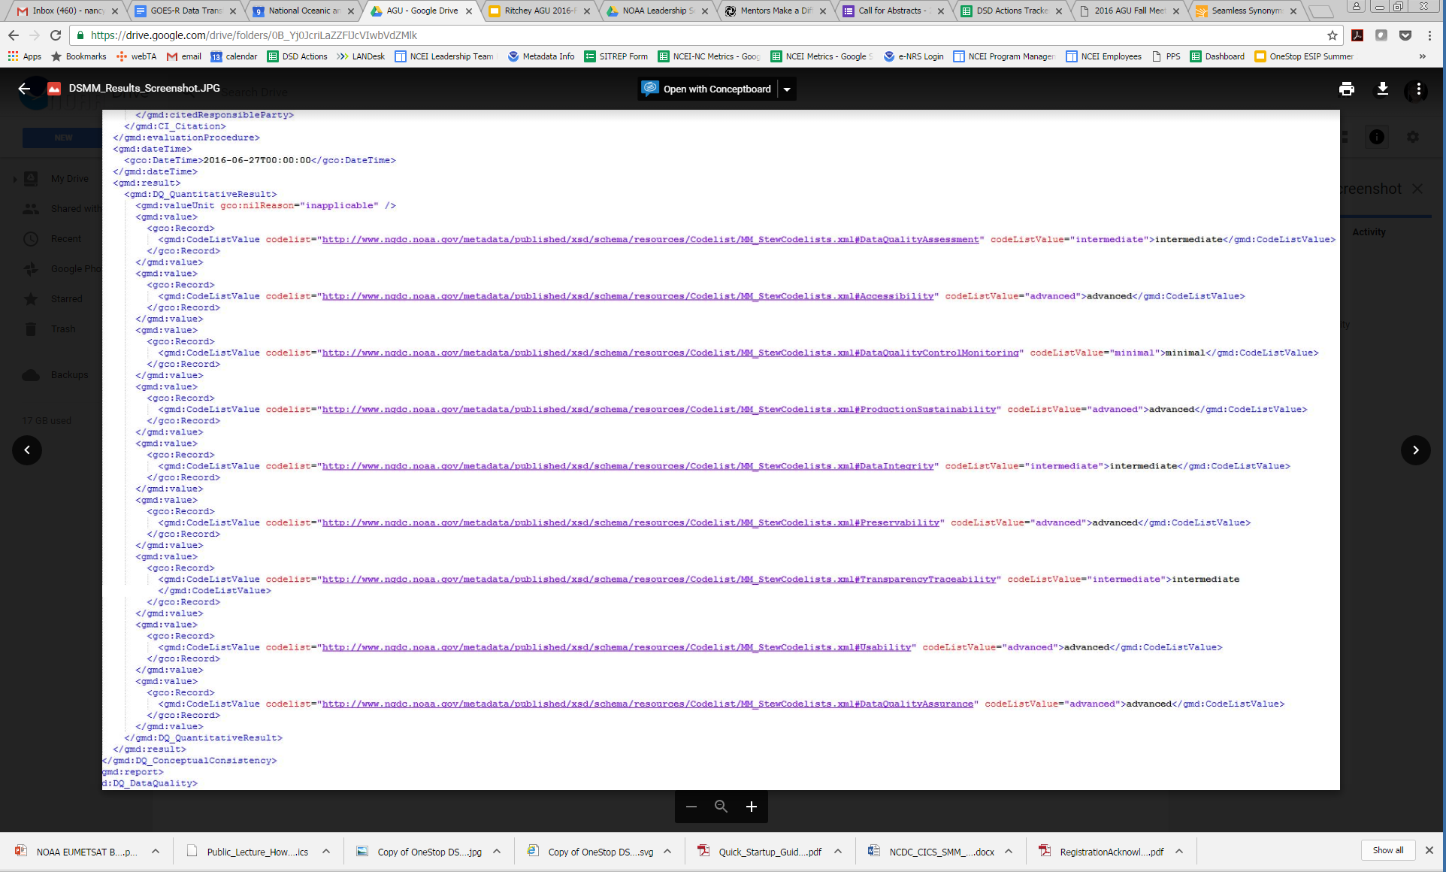
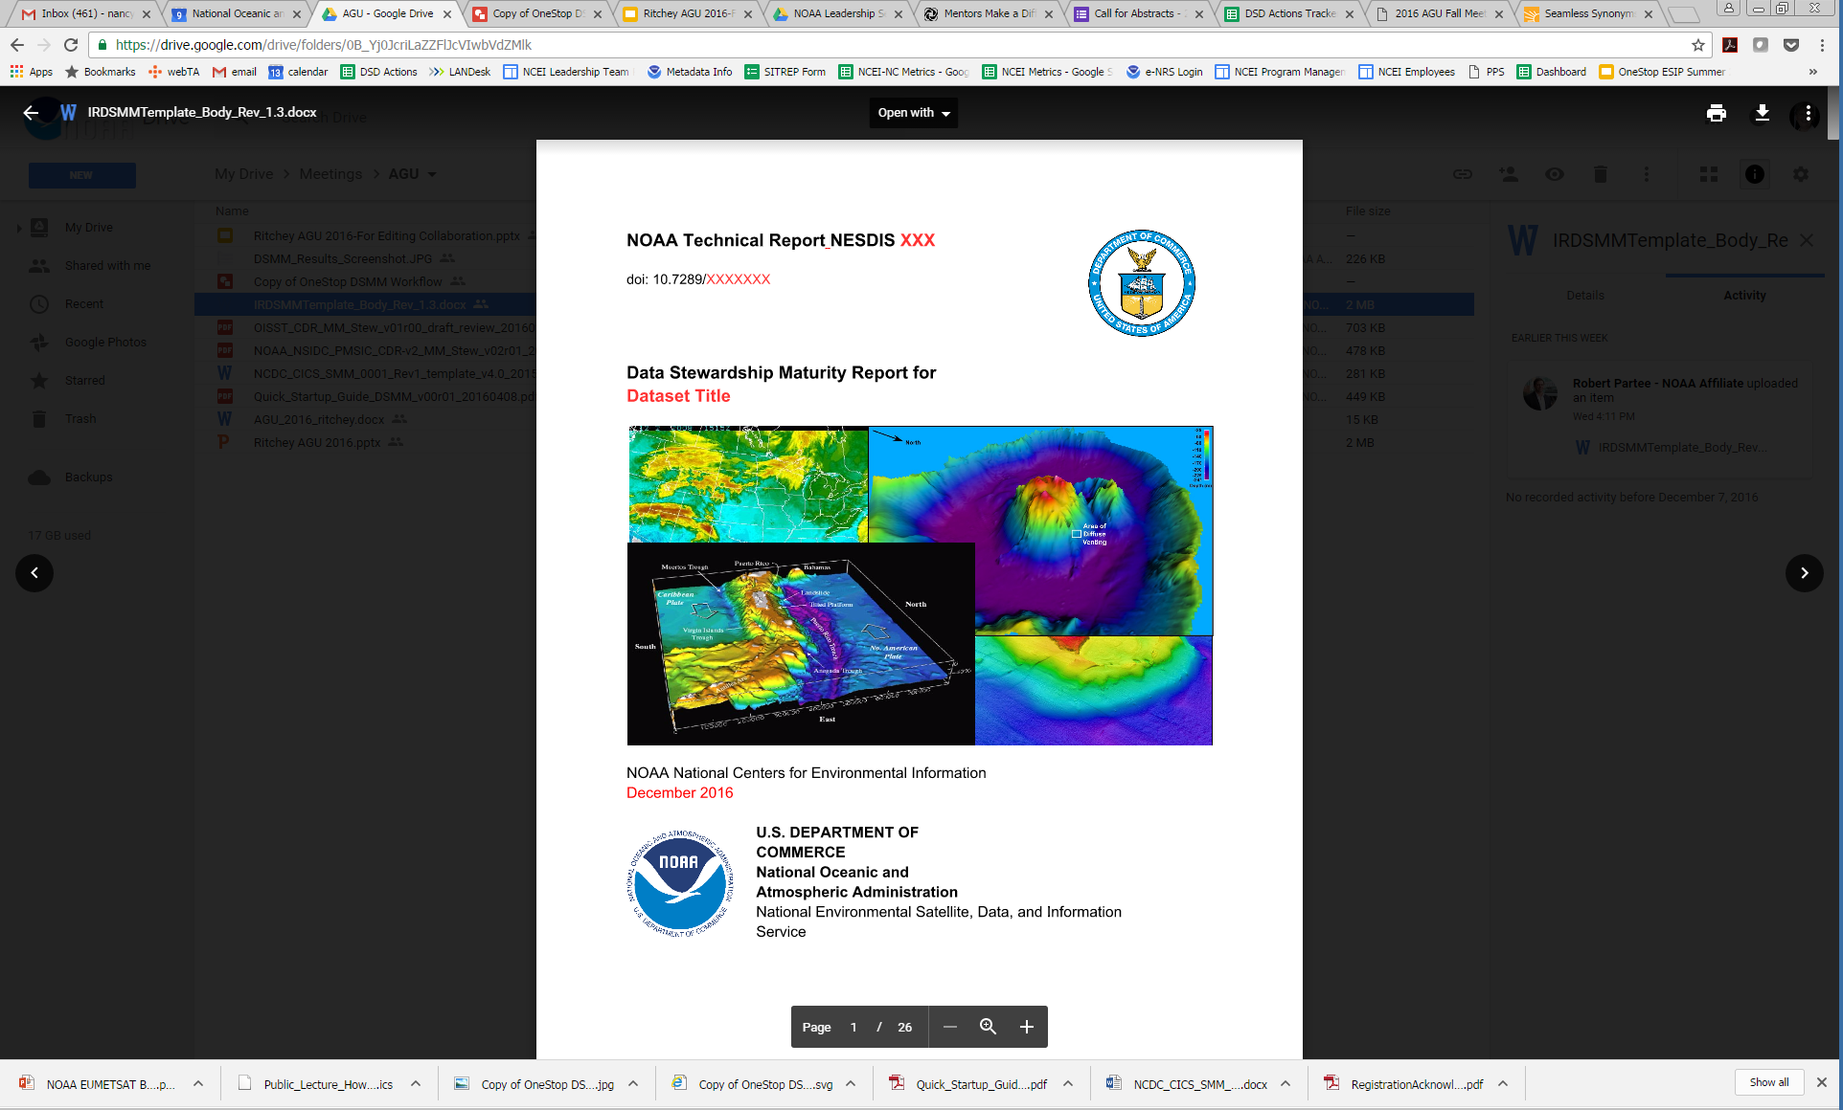
Guidance, Templates, Tools
Guidance
Scoring diagram
Workflow
Rating diagram
ISO metadata
Report
Notes:
guidance, templates, ...

Slide 11

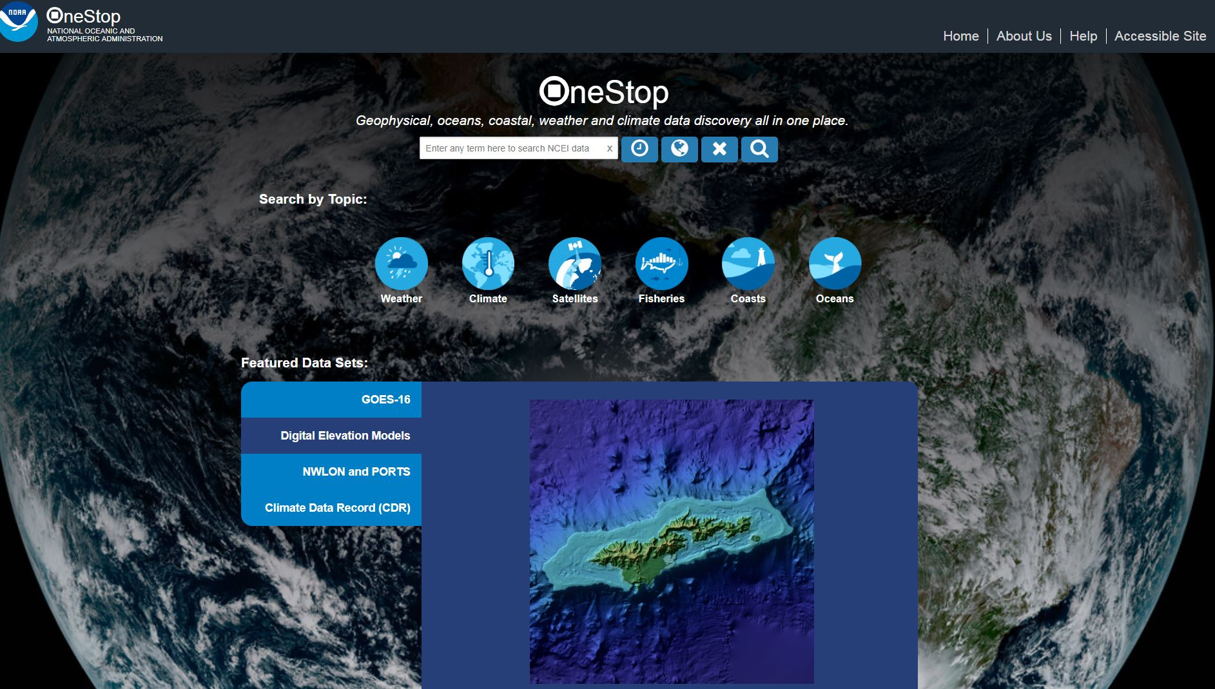
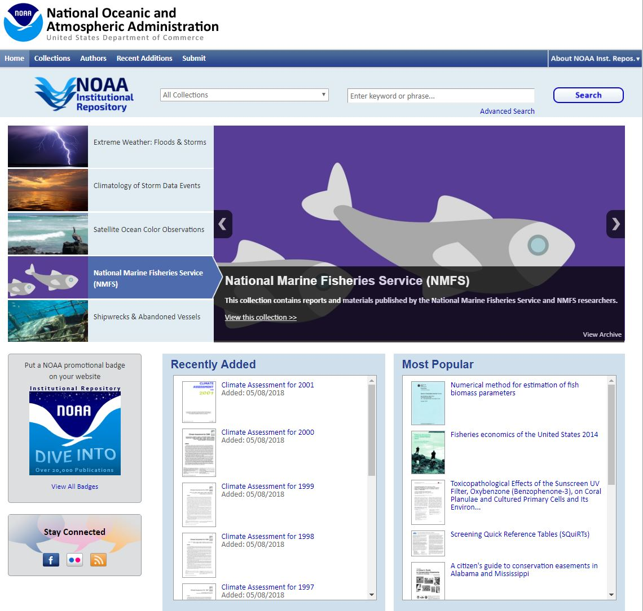

DSMQ Workflow
DSMQ
DSMM Automated Processes
Metadata
Input
Happy Users
Notes:
Automation first, then manual. Can help relieve poor metadata situations. Maybe pre-populate fields then allow the SME to confirm the selections.

Slide 12
NCEI Challenges
Ever increasing data volumes and diversity
Meeting user needs for easily consummable data
Adopting cloud technologies thoughtfully
Notes:
Examine processes and capabilities which will ultimately validate the trustworthiness of the archive.
Core Trustworthy Data Repository, jointly offered by the Data Archiving and Networked Services archive in the Netherlands (creator of the Data Seal of Approval) and the International Council for Science World Data System (WDS).

Slide 13


NOAA/NCEI
Questions?
www.ncei.noaa.gov
www.climate.gov
NCEI Climate Facebook: http://www.facebook.com/NOAANCEIclimate
NCEI Ocean & Geophysics Facebook: http://www.facebook.com/NOAANCEIoceangeo
NCEI Climate Twitter (@NOAANCEIclimate): http://www.twitter.com/NOAANCEIclimate
NCEI Ocean & Geophysics Twitter (@NOAANCEIocngeo): http://www.twitter.com/NOAANCEIocngeo

