Slide 1
Carbon Data Portal Prototype (CARB-15): status and way forward discussion Liping Di, Eugene Yu Center for Spatial Information Science and Systems George Mason University ldi@gmu.edu Reported at WGISS’47, Silver Spring, MD, USA May 1st , 2019

Slide 2
The WGISS Carbon Community Portal
Goal: To support CEOS Carbon Science Mission by providing easy discovery of and access to carbon-related data resources in CEOS member agencies
The Objectives
To enable carbon community to easily find their interested data in the CEOS agency collections brokered by both CWIC and FedEO
To allow searching and accessing data within collections using CWIC and FedEO with keywords, spatial and/or temporal constraints
To provide common discovery and access of all CWIC partner holdings targeting at the CEOS Carbon Community

Slide 3
CARB-15 Task
The portal project is undertaken as WGISS CARB-15 task
The task team consists of
Development team
WGISS member agency representatives
Carbon scientists from CEOS Climate WG and Global Carbon project (GCP), a Future Earth project
Carbon scientists provide requirements, test and evaluate the portal, and suggest improvements
Monthly telecon held
Funding from NOAA and NASA to support the development team

Slide 4
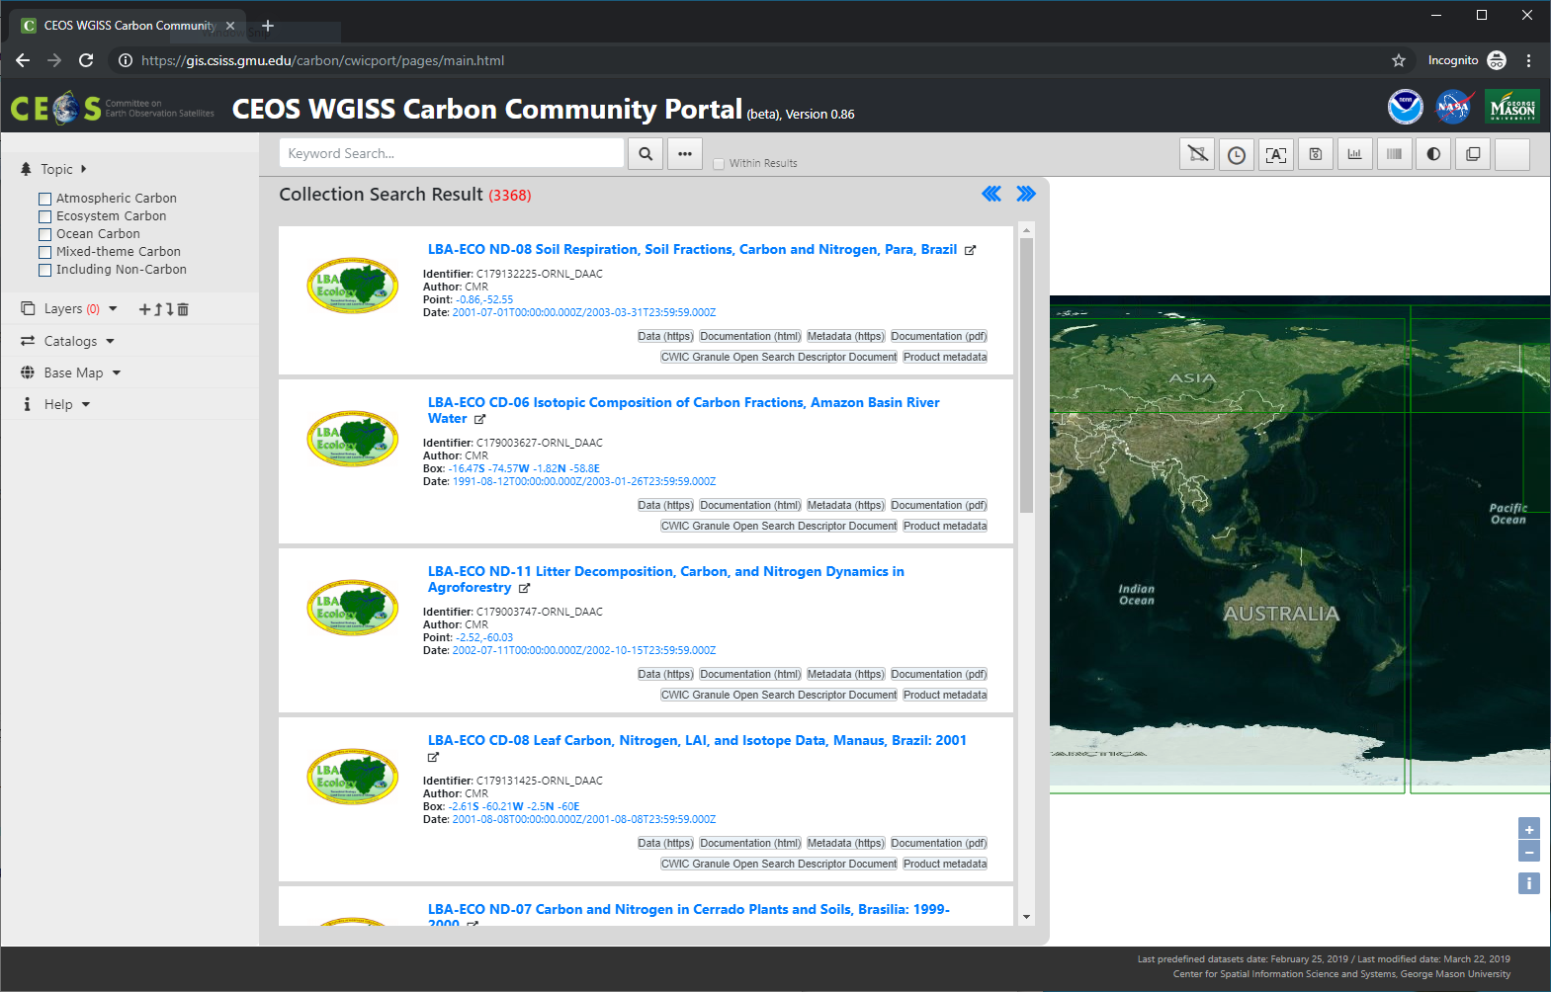
Portal Endpoints
https://gis.csiss.gmu.edu/carbon/cwicport
https://gis.csiss.gmu.edu/carbon/cwicport/pages/main.html

Slide 5
Progress since WGISS 46
After shown at WGISS 46 in October 2108, the portal was released to CEOS Climate WG and GCP for evaluation and feedbacks
Feedbacks were received, which require a set of new capabilities and improvements
Since WGISS 46, the major activity has been on implementing the new capabilities and improvements
New capabilities and improvements completed
Enhanced keyword autocomplete
Improved carbon categories
Performance improvement
Search-by-polygon (with limitation)
Geocoding
Info pages
Keyword-based search enhancements (context, multiple, priority )
Filtering (exclude global)
Clipping-by-polygon data access

Slide 6
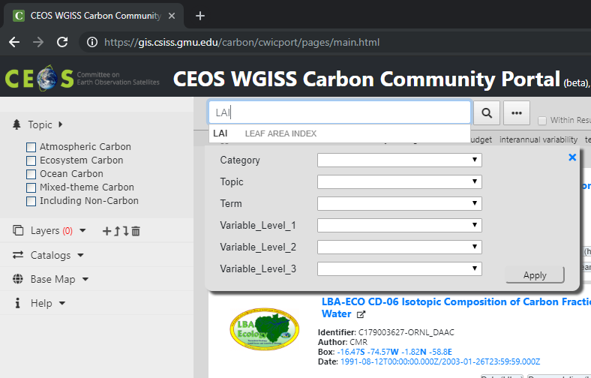
The progress – keyword autocomplete
Revised the geo-coding contextual entry interface and its function – support the expanded full text search using acronyms
Imported GCMD and related carbon project keywords and acronyms

Slide 7
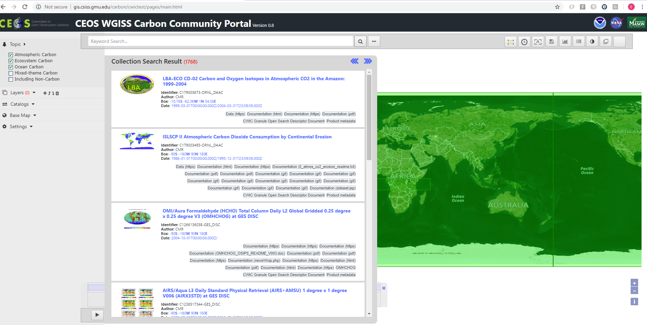
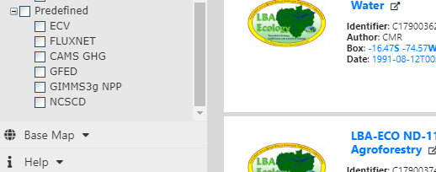
The progress – Carbon categories
Revising the search by categories to support multiple-category search
Imported and managed predefined data from carbon projects by categories, e.g. CAMS GHG, GFED, GIMMS3g NPP, NCSCD
Notes:
CAMS GHG (Copernicus Atmosphere Monitoring Service Greenhouse Gases)
GFED (Global Fire Emissions Database)
GIMMS3g NPP (Global Inventory Modeling and Mapping Studies Net Primary Productivity)
NCSCD (Northern Circumpolar Soil Carbon Database)

Slide 8
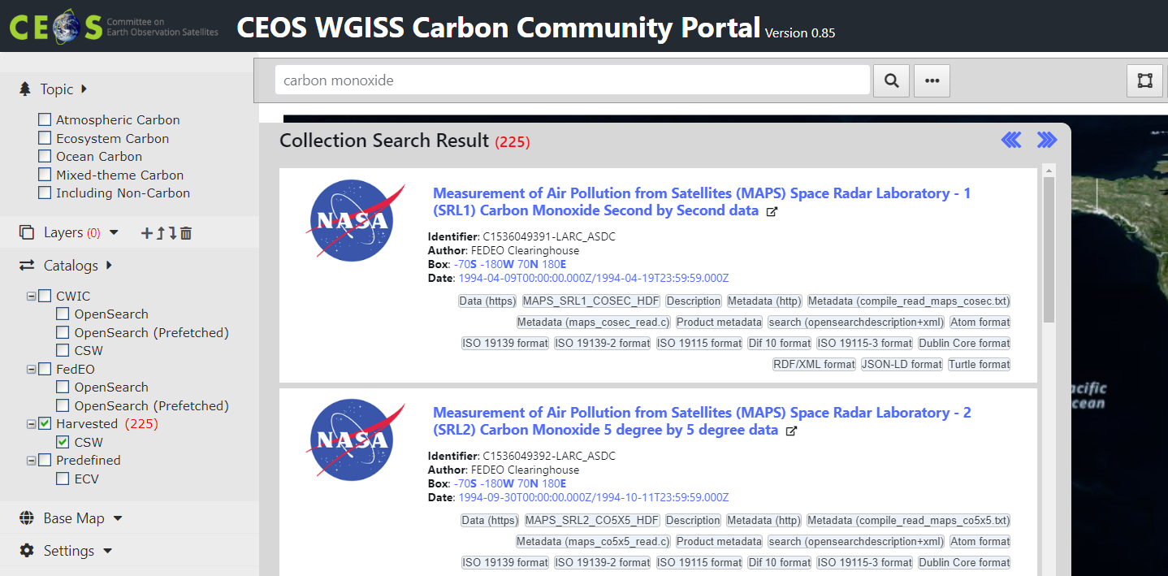
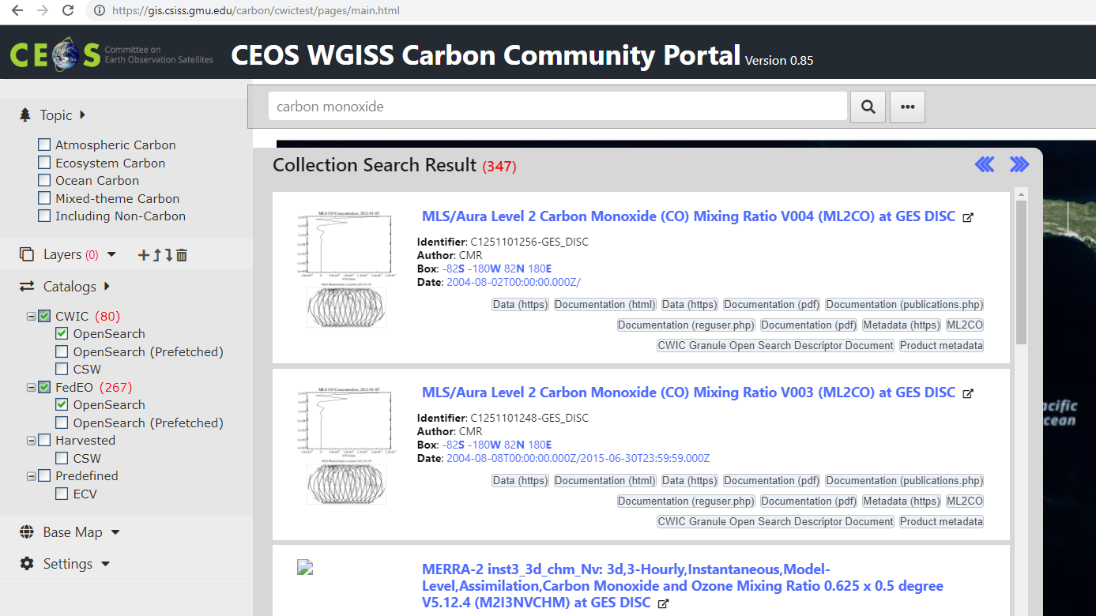
The progress – Performance improvement
To speed up the process of retrieving and merging records on the fly from two aggregated catalogs, an specialized local catalog is used to selectively cache and curate partial results at the collection level
Cached collections
Faster
Removed duplicates
Example
carbon monoxide
LAI -> (Leaf Area Index)
Integrated
CWIC+FedEO

Slide 9
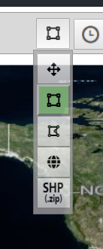
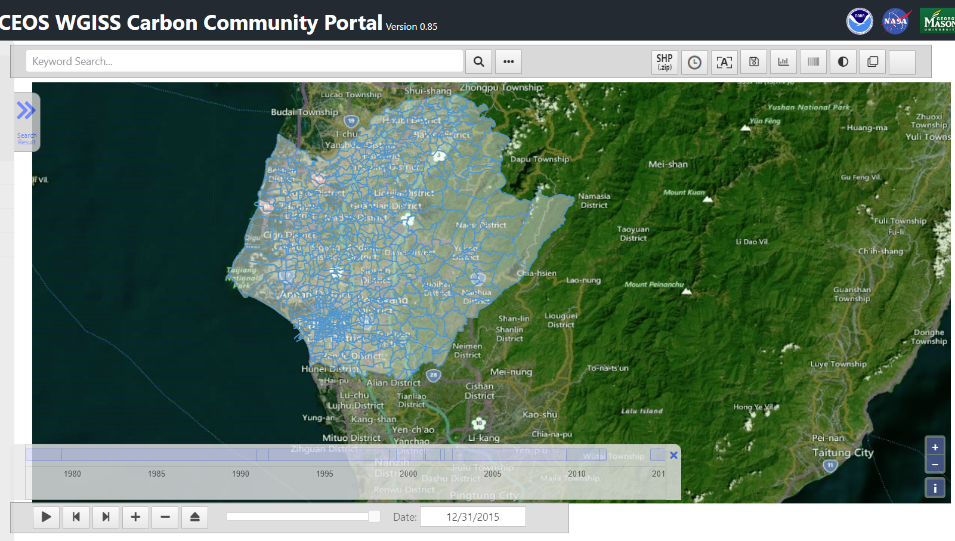
The progress – Search by polygon
Search with polygon: utilizing the CMR polygon search support and supporting free-hand-draw and uploaded polygon
Limitation: limited number of vertices
Example:
https://github.com/gipong/shp2geojson.js/blob/master/demo/10tnvillage.zip
After uploaded, select a village to search against

Slide 10
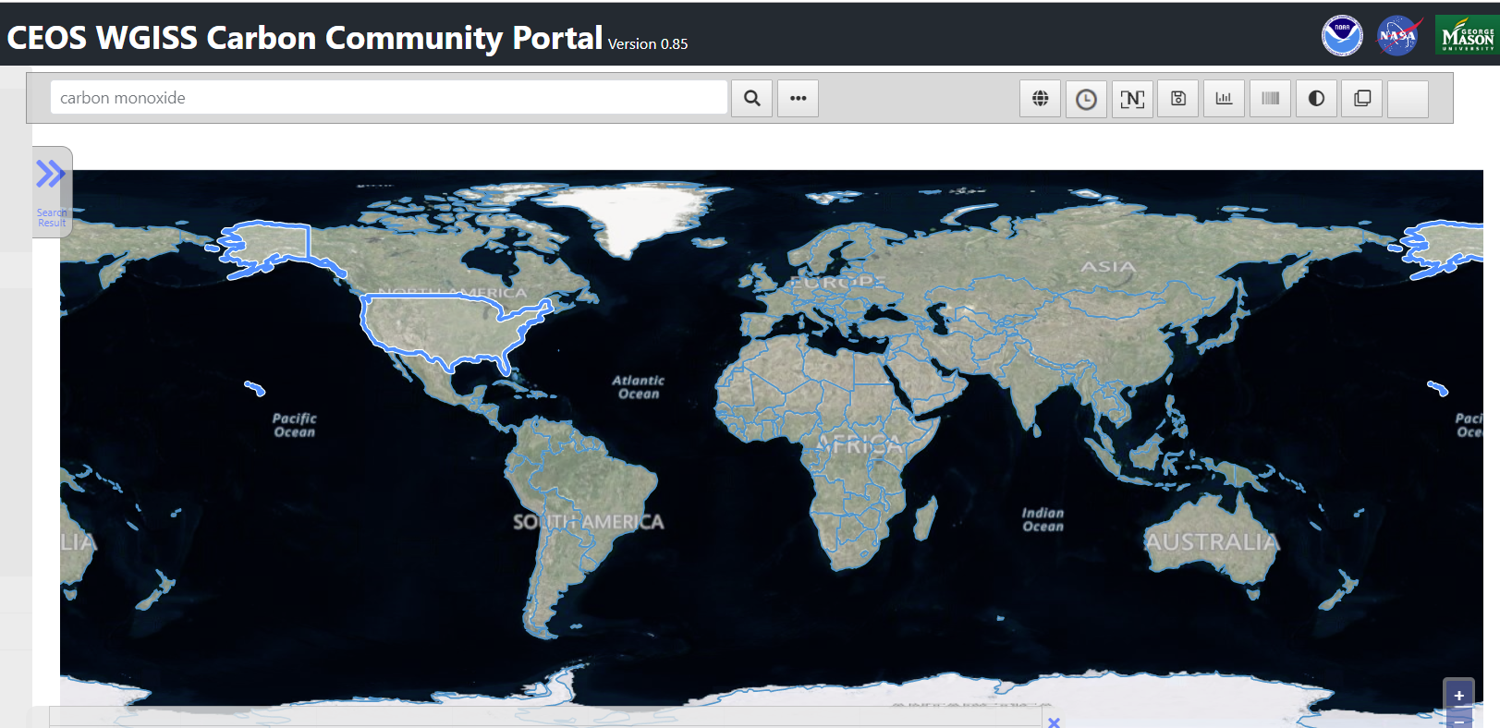
The WGISS Carbon Community Portal
The progress - Geocoding
Search with country (geocoding): Google geocoding is not used anymore due to the easily outnumbering of the free daily quota; instead, a country layer is used for selecting country and using its extent to search against.
Notes:
Free quota of commercial geocoding Web services is limited, unless paid.

Slide 11
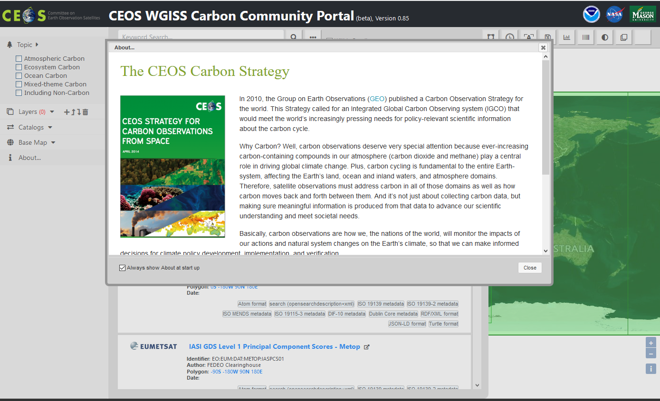
The WGISS Carbon Community Portal
Progress – Info pages
“About” page
Startup promotional popup
Content: currently used the “CEOS Carbon Strategy” as the content.
Comment?

Slide 12
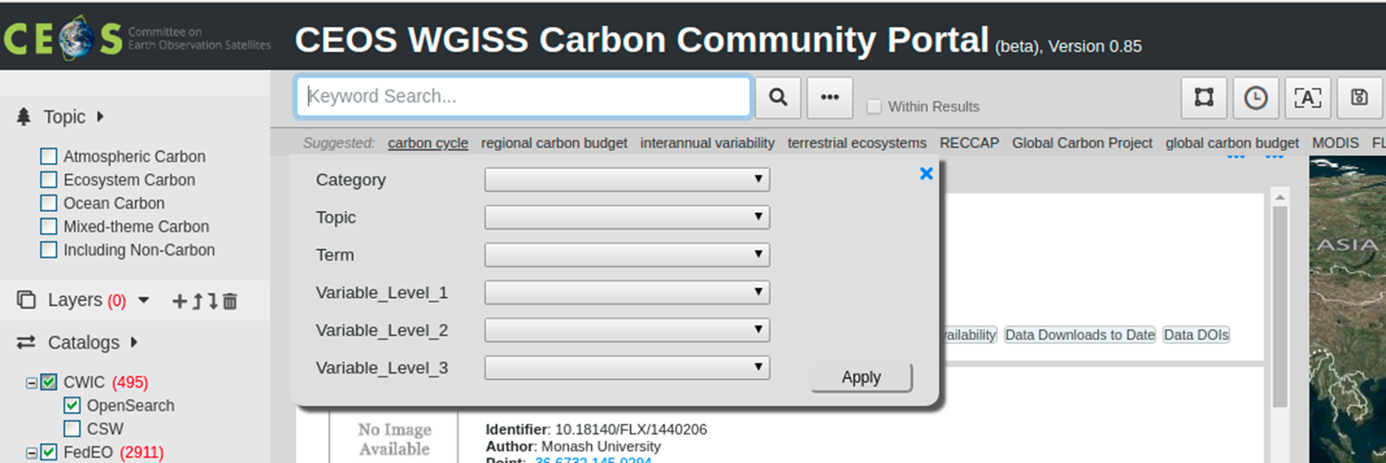
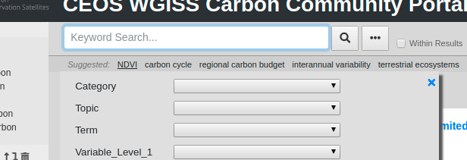
The progress: priority of dataset keywords
A list of priority keywords were added (e.g. carbon cycle)
The keywords were appeared in “Suggested” list
User’s search history is also added to the “suggested” candidate list
Examples:
If cursor is located in the keyword input area, suggested list is showing
Click a keyword in the list, the keyword is showing in the keyword input area
After searching with keyword “NDVI”, the keyword is showing at the front of the Suggested list
Suggested list is showing
After selecting a listed keyword
Keep user’s keyword

Slide 13
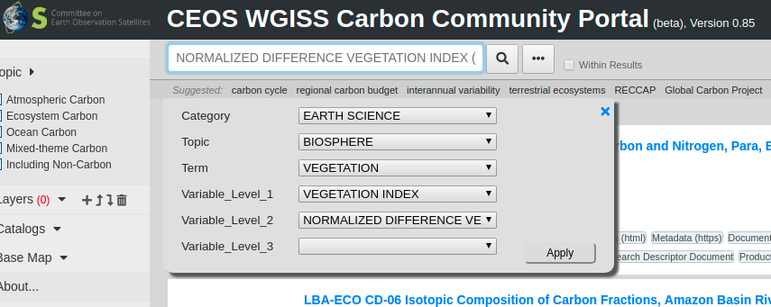
The progress – Multiple keyword combination
Combining multiple keywords on search: multiple keywords are combined by checking “within results” to add; keyword list can be edited by removing individual keyword.
Examples:
Type “NDVI”, and click by using autocomplete feature
After searching all GCMD hierarchical keywords are listed on the top of collection searching results
After clicking “x” icon of a keyword “NDVI”, a new searching result is showing
Type “LAI” with click “Within Results”, a new keyword is added
Selecting keyword “NDVI” with GCMD hierarchy
After searching, all keywords are listed
removing a keyword “NDVI”
add a keyword “LAI”

Slide 14
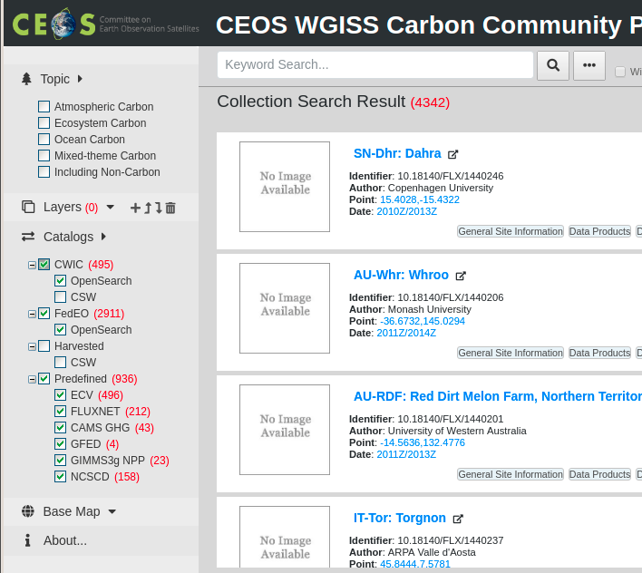
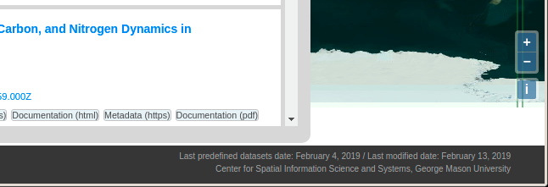
The progress – visibility of key carbon datasets
The provided list of key datasets have been added to the predefined key datasets of the portal.
Predefined datasets are used in search response with the highest priority
at the collection level
Example: total entries
ECV (496)
FLUXNET (212)
CAMS GHG (43)
GFED (4)
GIMMS3g NPP (23)
NCSCD (158)
Predefined collection datasets
The last updated date of predefined dataset

Slide 15
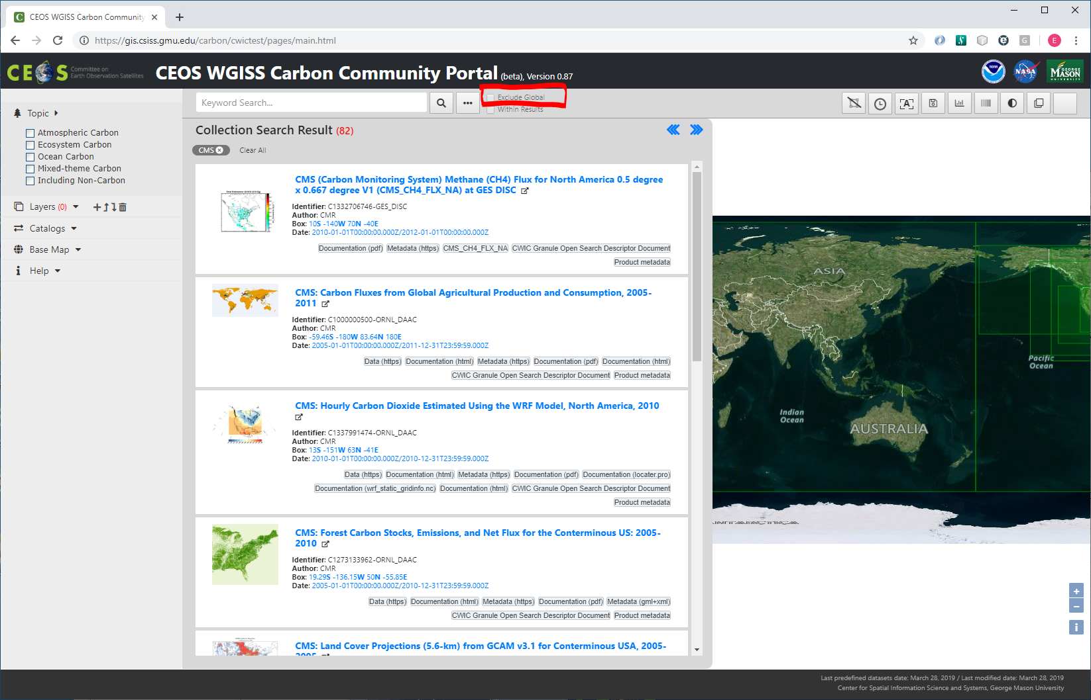
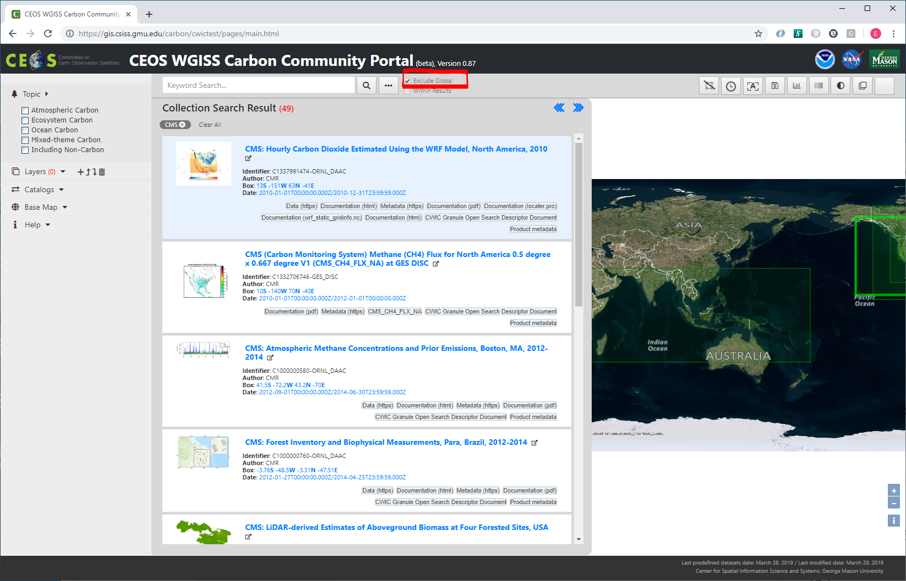
The progress- filtering results
Filtering results – exclude global option
Keyword: CMS
Unchecked & search: 82 records (the upper picture)
Checked & search: 49 records (the lower picture)
Notes:
Exclude the datasets that are global coverage:
A database is created and maintained by the Portal team to identify these are non-global datasets.
Neither CMR nor FedEO support the option to exclude global coverage. This has to be done in the locally curated catalogue.
The local database needs to be maintained periocally.

Slide 16
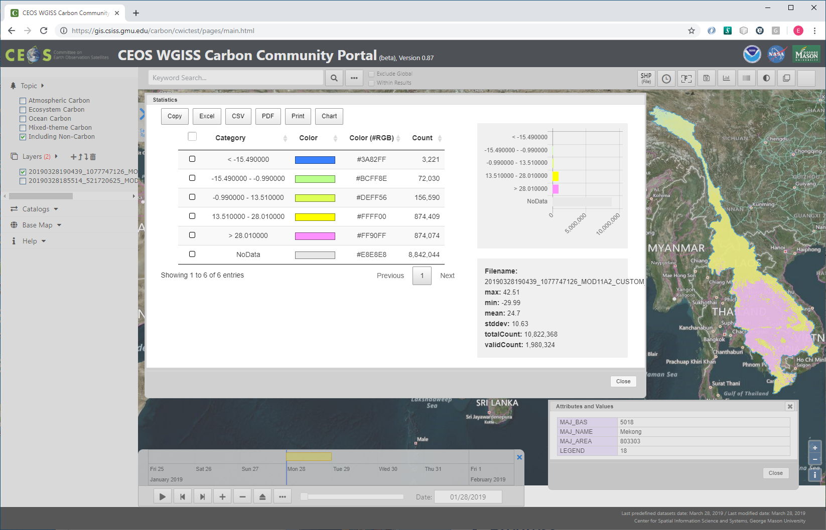
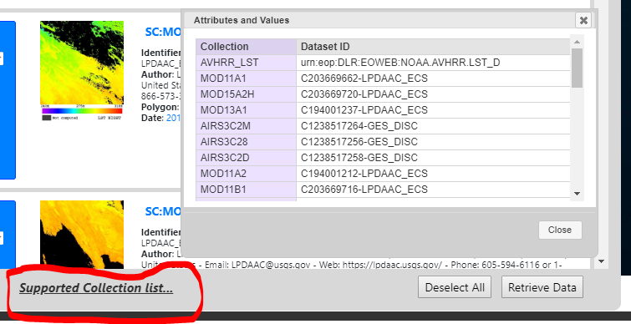
Progress – Clipping by polygon
Clipping data by polygon
Example
Product: MOD11A2 (Including Non-carbon)
Date: 01/28/2019
Spatial polygon:
Hand-draw
Country
Shapefile (the upper picture shows using Mekong basin)
Notes:
Products to be clipped are currently limited to most EO datasets, for example MODIS products MOD11A2 – land surface temperature.
Clipping polygons can be loaded from shapefile (in a zip file), or geojson in a file. Once loaded, one polygon can be selected and used for spatial constraints. Other options can be free-hand drawing or select a country from the country map layer.
The lower picture shows the complete list of currently supported products for clipping by polygons. The products may be expanded as the project progresses.

Slide 17
Work in progress
Implementing more filters: expanded to support examples mentioned in the comments - periods, acquisition types, refined subject
Clipping by polygon: extending to support more polygon data format (e.g. GML), expanding to other products.
Notes:
Acquisition types – “to identify more easily modelled only / eddy-covariance / field measurements / satellite-based / etc datasets (rather than from the names).”
Refined subject – Add other tick boxes on the left for things like “isotopic composition”, “litter”, “nitrogen”, “concentration”.
Products: we may work on adding support for products from ESA found through FedEO.

Slide 18
Way Forward Plan
Finishing the work in progress
After WGISS 47, the new version of portal will be released for further evaluation and test
CEOS Climate WG
GCP
Any other carbon community (e.g., GEO?)
Supporting CEOS Chair initiative
Customizing the portal to support the forest carbon project at Mekong river basin
Specially customized portal
Pre-populated products
Specific datasets for Mekong
Multiple telecons have been hold with VNSC

