Slide 1
Working Group on Information Systems and Services (WGISS)
Committee on Earth Observation Satellites
Iolanda Maggio, ESA / Development Team
WGISS#47 Meeting
FDA-10 Inventory of software and tools
NOAA – Silver Spring, USA
01st May 2019

Slide 2
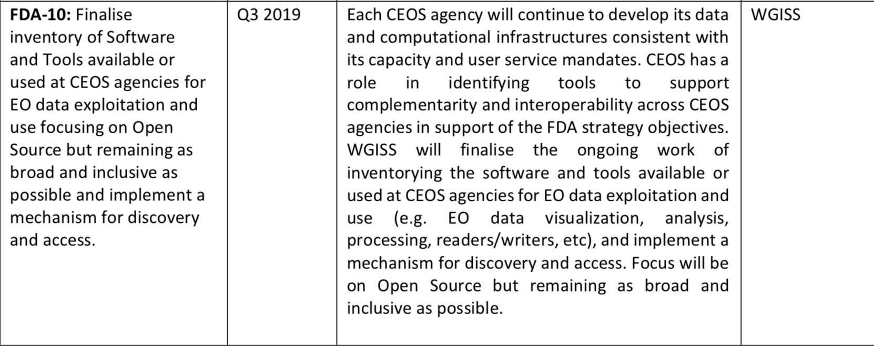
OSS Inventory triggered by CEOS and WGISS Work Plan
BACKGROUND

Slide 3
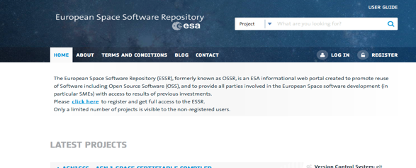
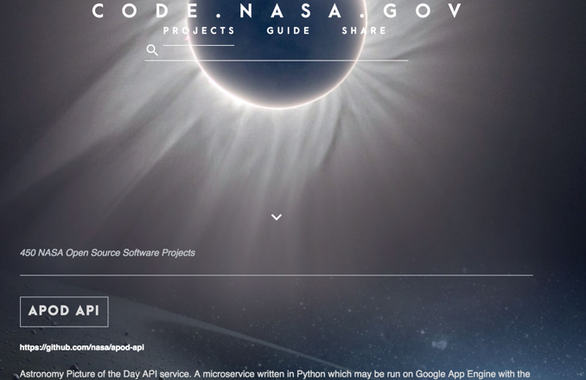
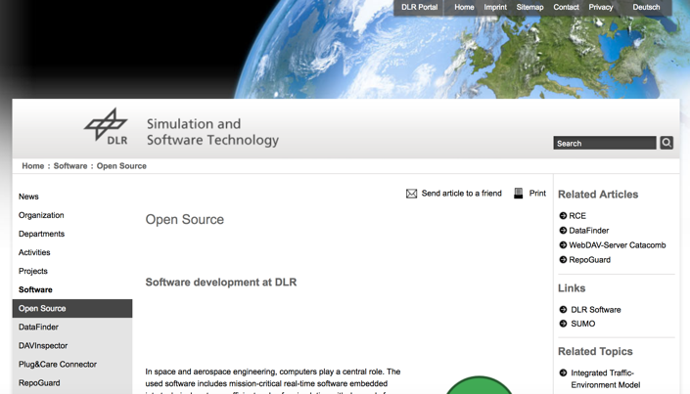
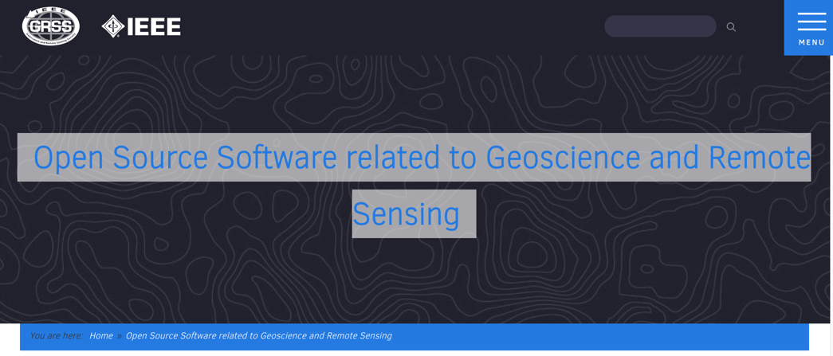
OSS in WGISS Agencies
https://www.dlr.de/sc/en/desktopdefault.aspx/tabid-5951/9688_read-19161/
https://essr.esa.int
https://code.nasa.gov/
IDN service records (SERFs) for ESA items
http://www.grss-ieee.org/open-source-software-related-to-geoscience-and-remote-sensing/

Slide 4
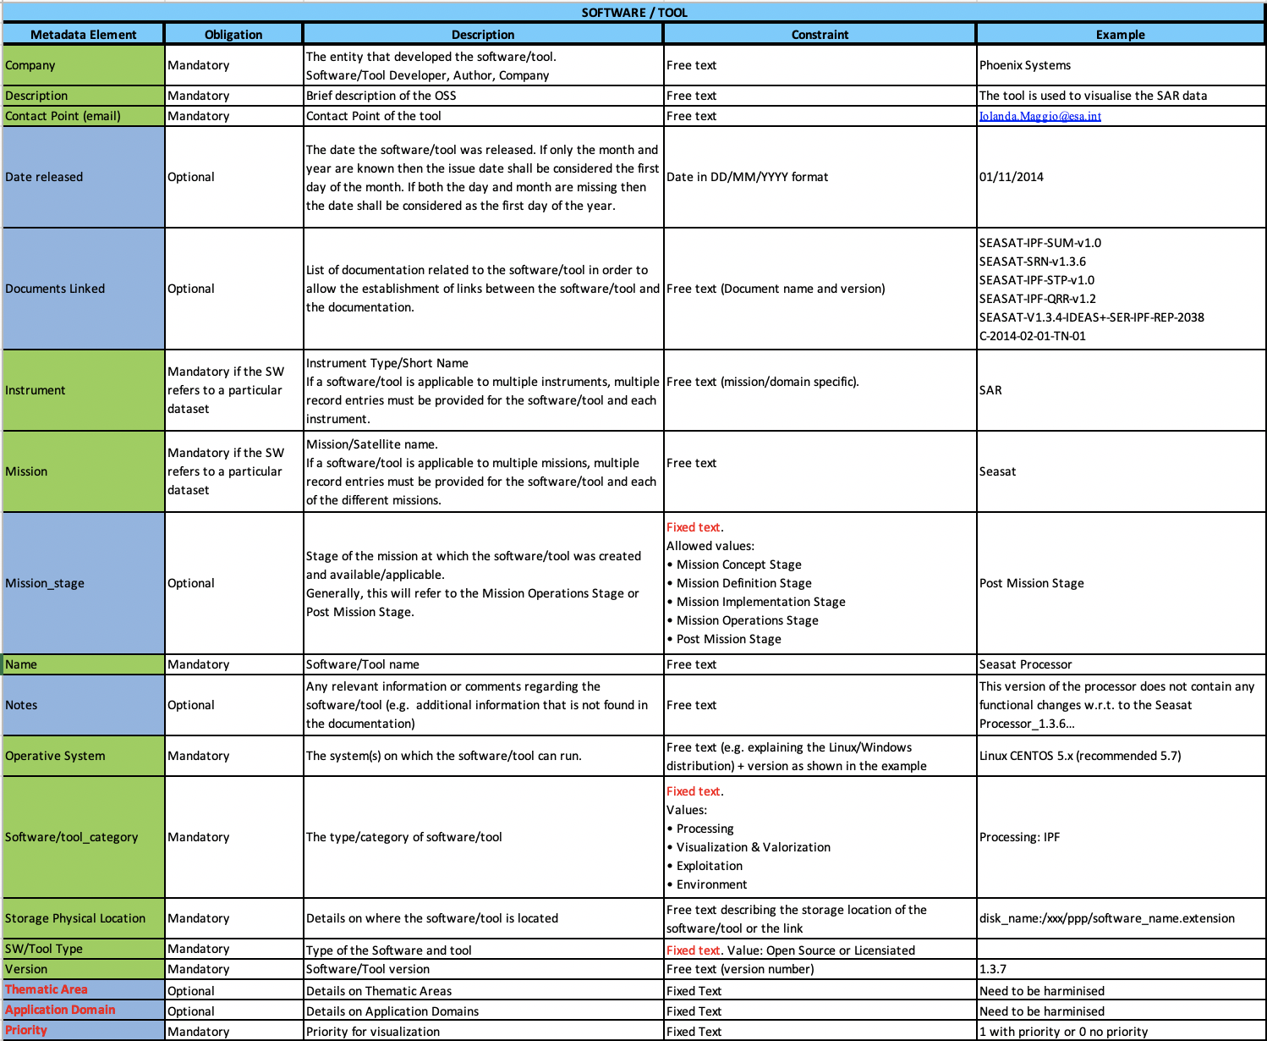
OSS Survey
OSS Survey in CEOS Agencies compiling the reports with relevant Metadata - NEW

Slide 5
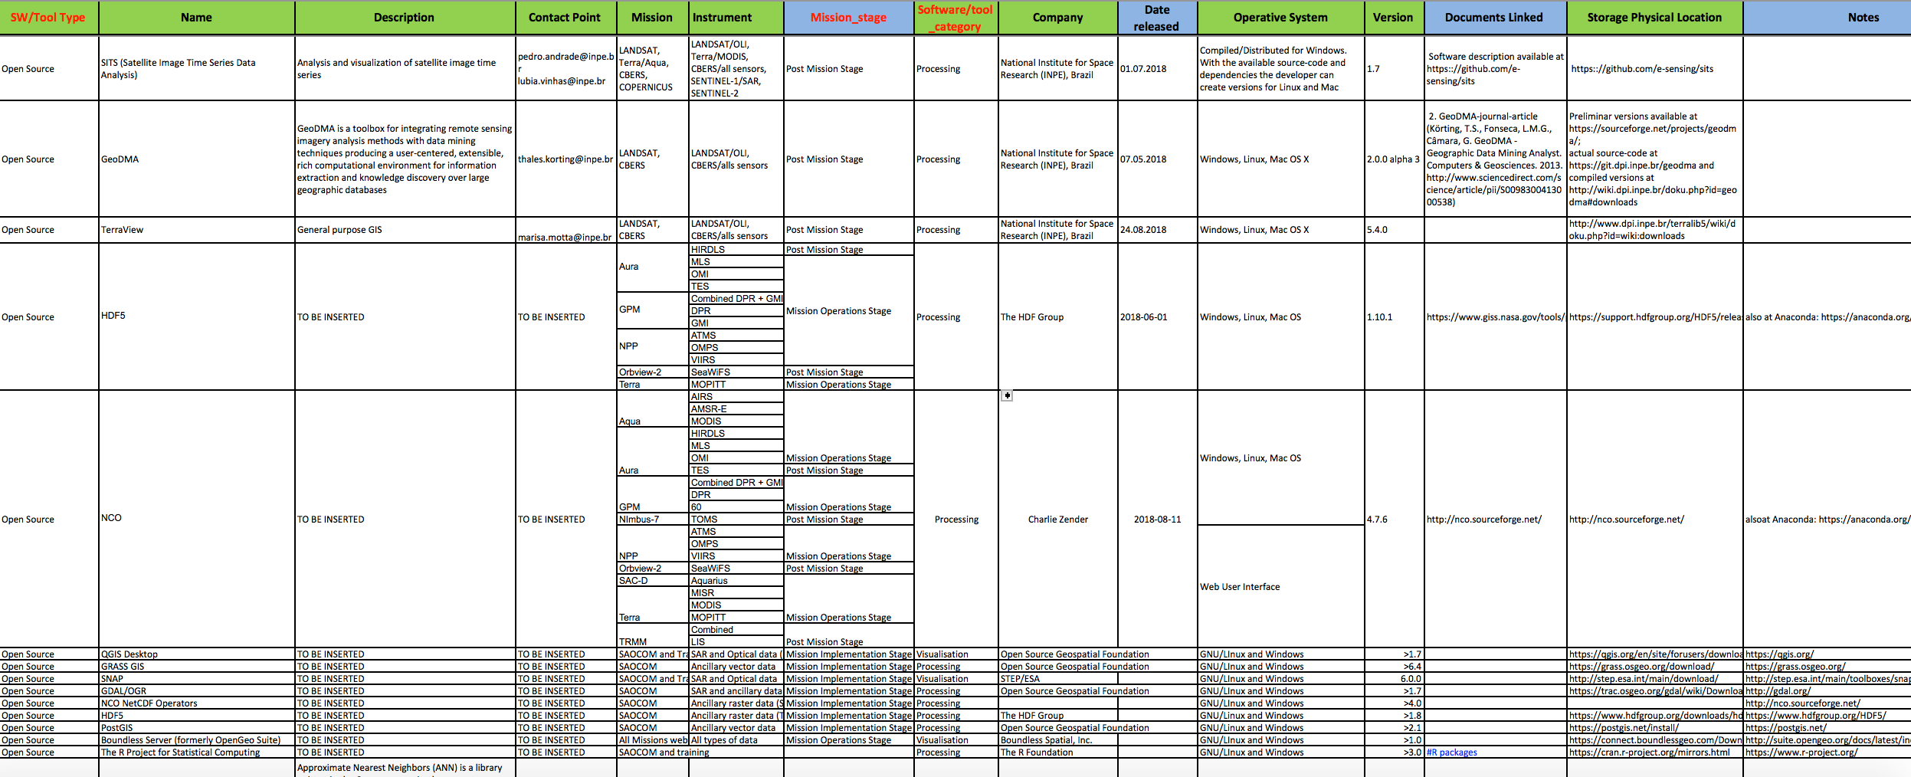
OSS Survey – First Results
The Table for the Inventory implementation is being normalised and standardised

Slide 6
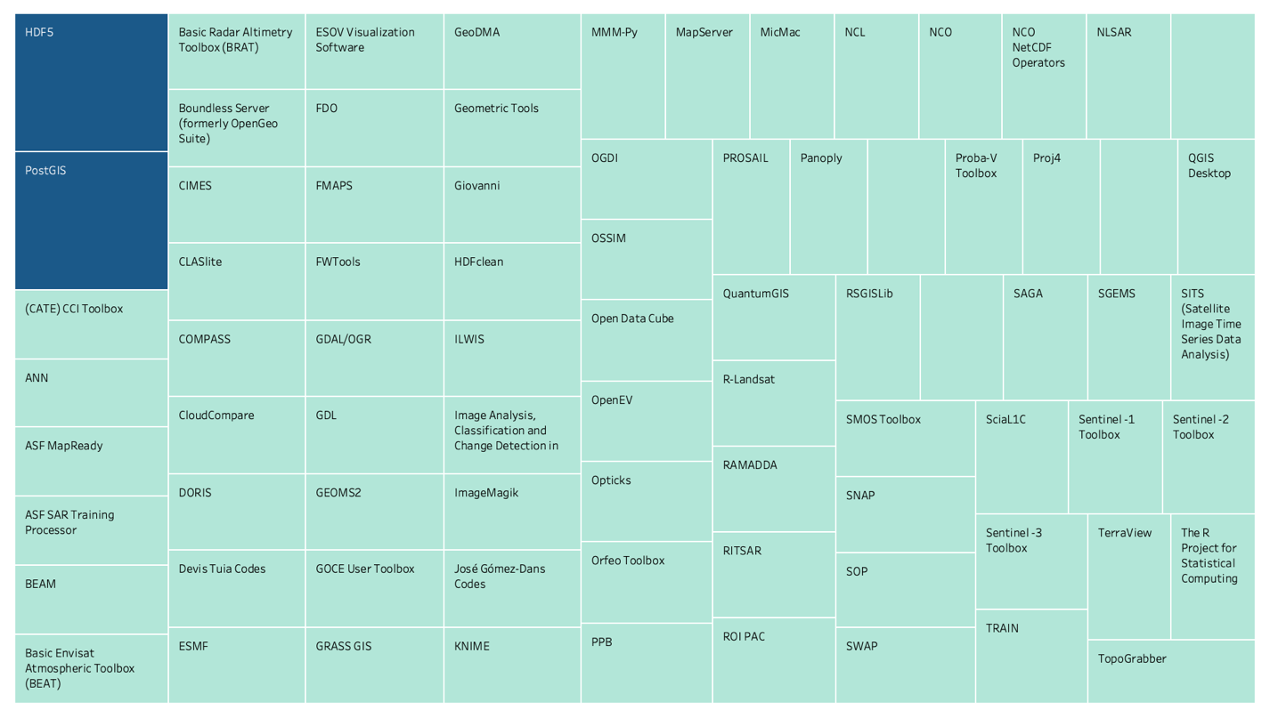
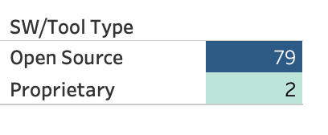
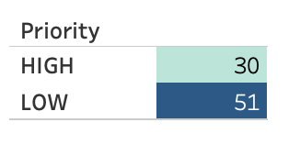
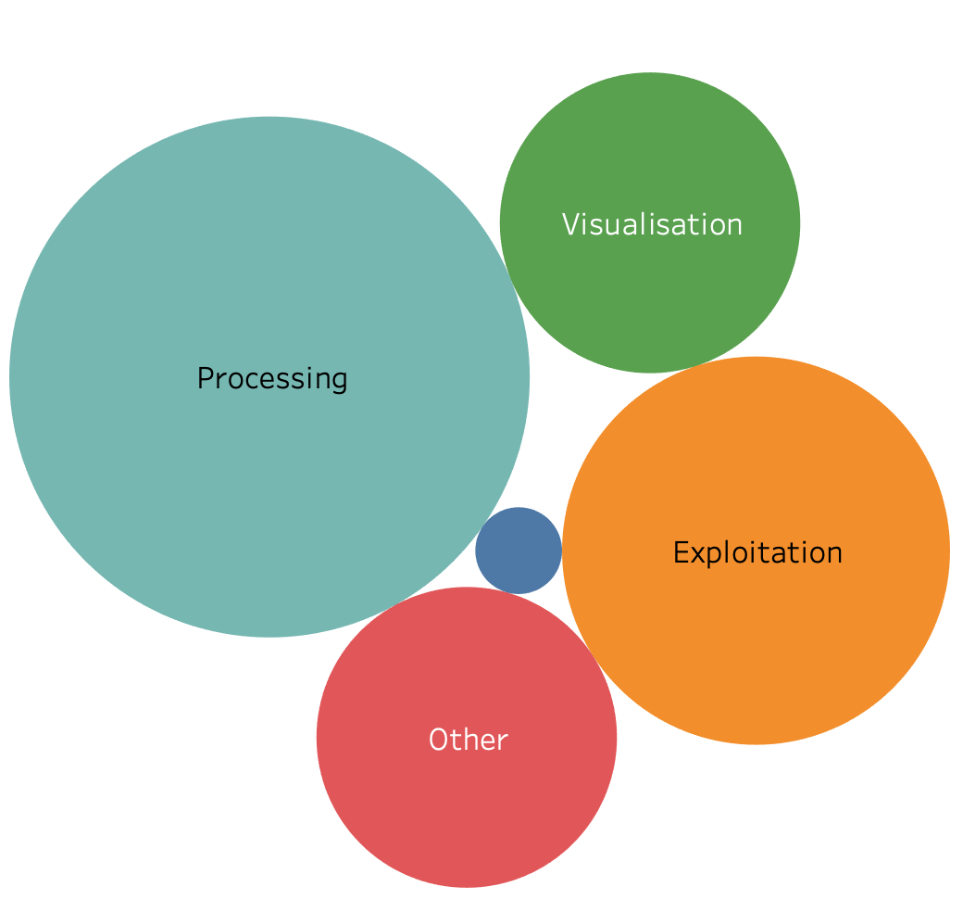
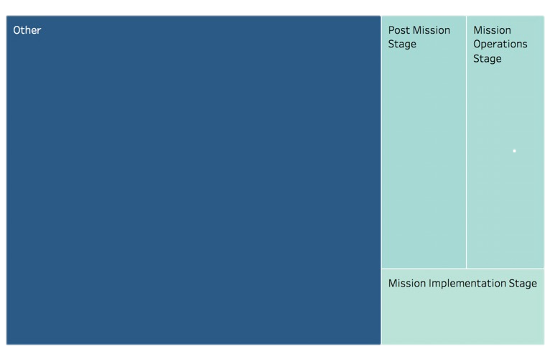
OSS Survey Statistics

Slide 7
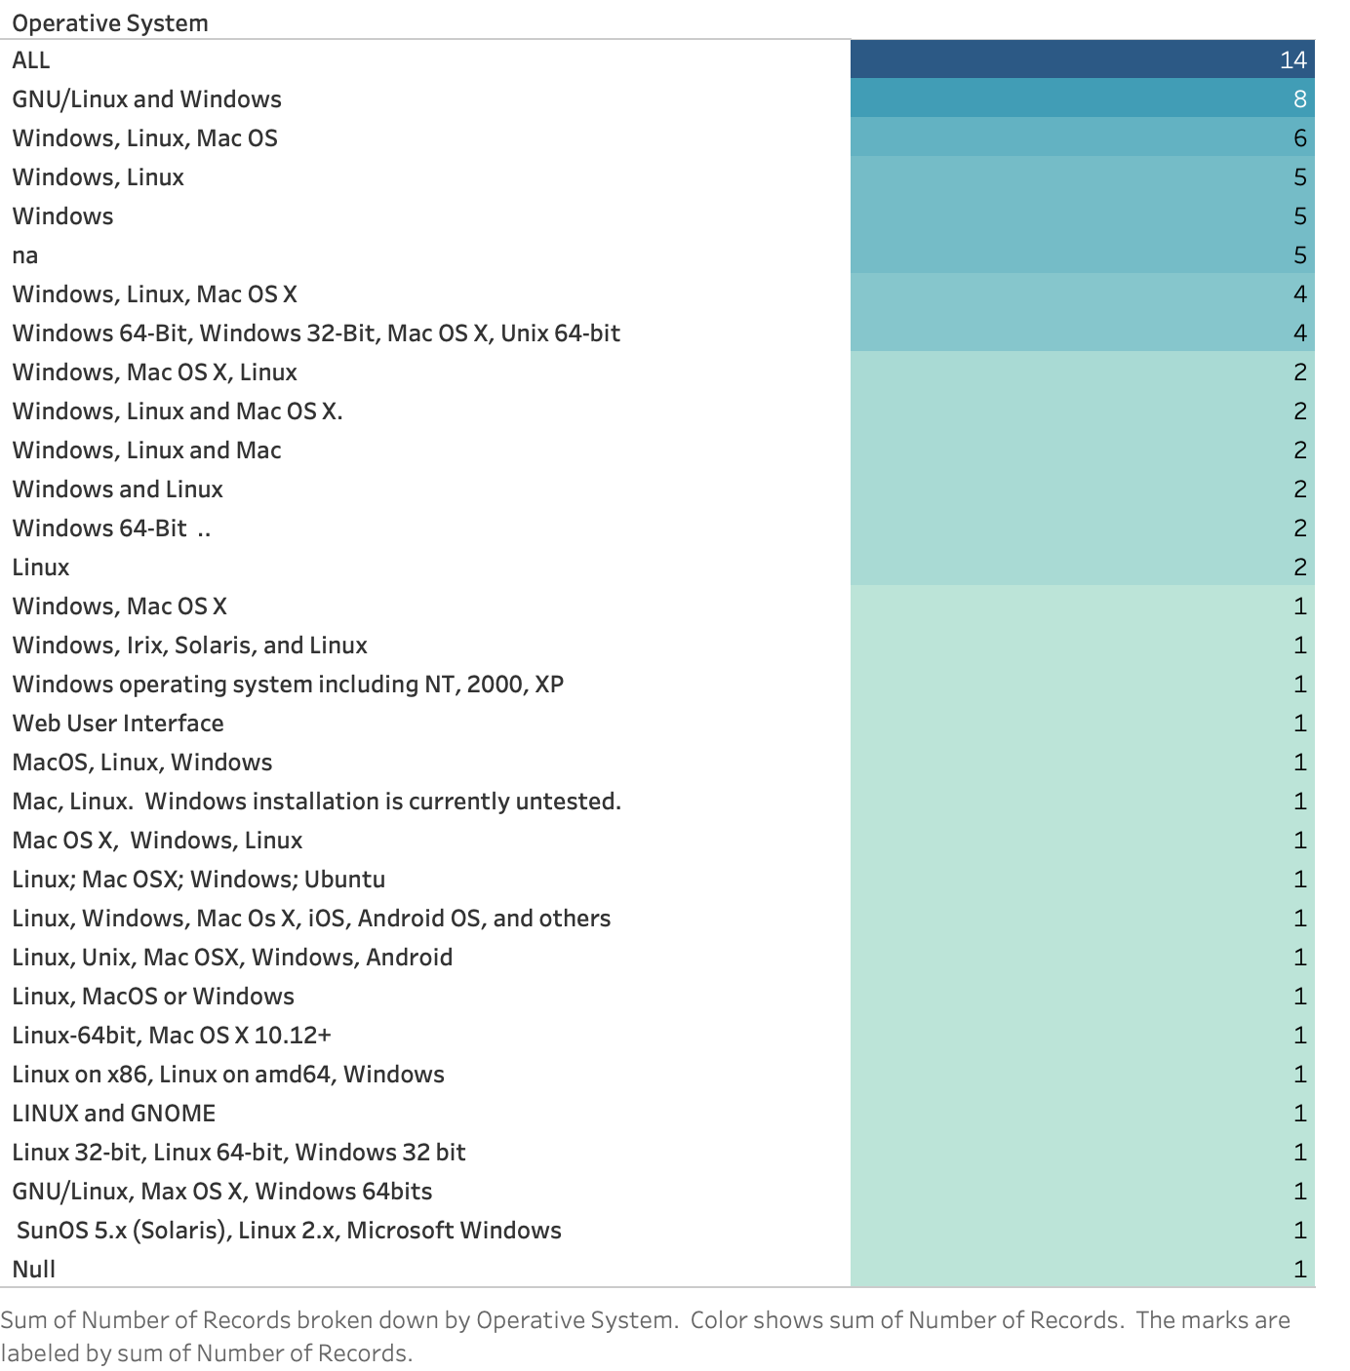
Example of Normalization

Slide 9
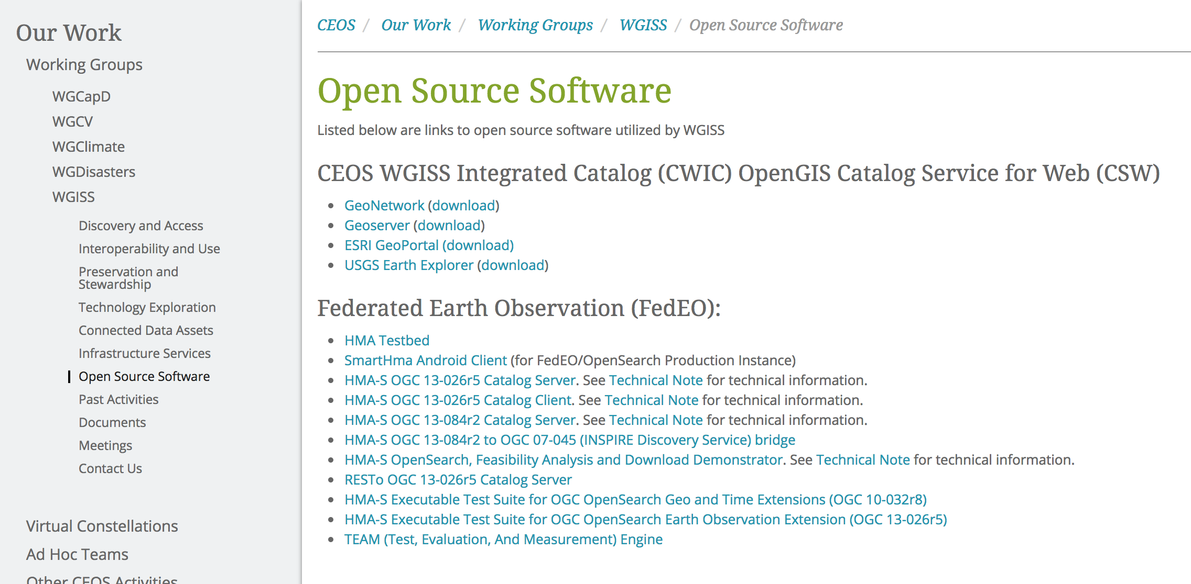
OSS in CEOS- WGISS
Open Source Software page to be moved into Interoperability and Use Area + Include the CWIC and FedEO OSS in the inventory

Slide 10
Next Steps
Finalise the normalization of the table – IM/Mid of May
Provide a statement for the OSS inventory management (e.g. similar statement for Data Purge Alert and New Dataset availability) – WGISS Exec/Mid of May
Import the new normalized table – Development Team/End of May
Implement a simple dashboard and Include new filters – Development Team/ Mid of June
Advertise the OSS inventory – WGISS Exec/End of June

Slide 12
Back-up

Slide 13
OSS Inventory USE CASE

Slide 14
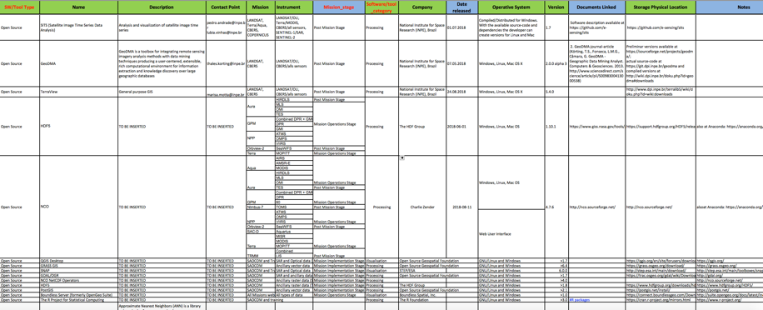
From user need to OSS Inventory utilization
WGISS OSS Inventory DB
USERS with OSS needs
The Sentinel Application Platform
(SNAP) architecture is ideal for
Earth Observation processing
and analysis

Slide 15
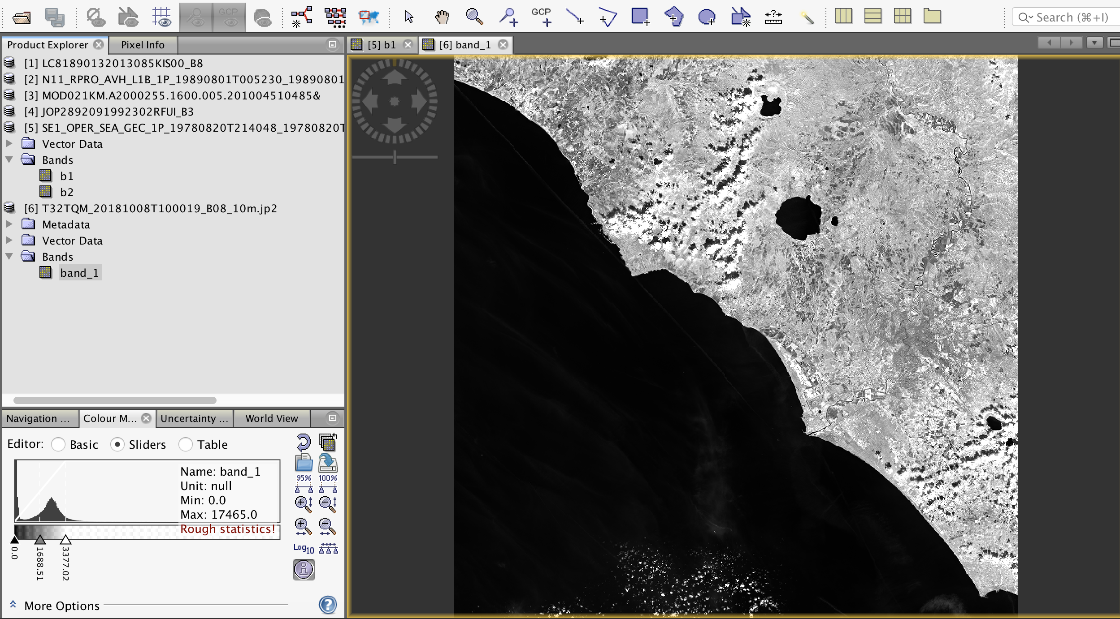
SNAP: application to other EO data

