Slide 1
CEOS WGISS-47 Silver Spring, Maryland, USA April 29-May 2, 2019 Hosted by the National Oceanic and Atmospheric Administration (NOAA)
Services Metadata Use Cases
Valerie Dixon
NASA EOSDIS
Valerie.dixon@nasa.gov

Slide 2
Problem Statement
Is it a Service or a Tool?
Many different types of tools/services
Much confusion and disagreement over what constitutes a tool or a service
How can the Service or Tool be used?
Many different ways to utilize and interface with various tools and services
How should Metadata representations be structured?
EOSDIS had a single Services Metadata model that was growing too complex
Needed to be restructured, but how?

Slide 3
Possible Solution
Break out Metadata models for each distinct use case
Never mind what it is (Tool or Service), how do you plan to use it?
Back-end automation?
Transferal of content and context?
Offline reference?
Pros:
Allows for an Agile approach:
Metadata use case models can be expanded and prioritized as needed
Adding or modifying use cases will have limited disruption to metadata models
Distinct metadata models for distinct use cases reduces ambiguity and complexity
Cons:
More to integrate and maintain
Potential for repetitious model entries:
A single Tool or Service could potentially have entries in several use-case metadata models; need to be able to link them

Slide 4
A Key Use Case to Consider:
End-to-End Services (E2E)
Enables a data transformation service to be applied to data sets behind-the-scenes:
User finds and selects a data set
User selects the desired service option
e.g. subset by [variable]
Metadata linking dataset and applicable services calls the selected service to perform upon the selected dataset
Done on the backend, transparent to user
Enabled via HTTPS API endpoint, like OPeNDAP or EGI
e.g. OGC Web Map Service
User receives transformed data set
Notes:
EGI = ESI (EOSDIS (Earth Observing System Data and Information System) Service Interface) Gateway Interface

Slide 5
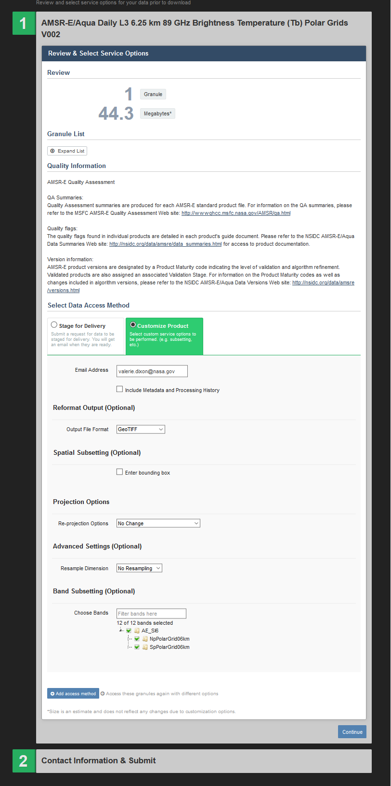
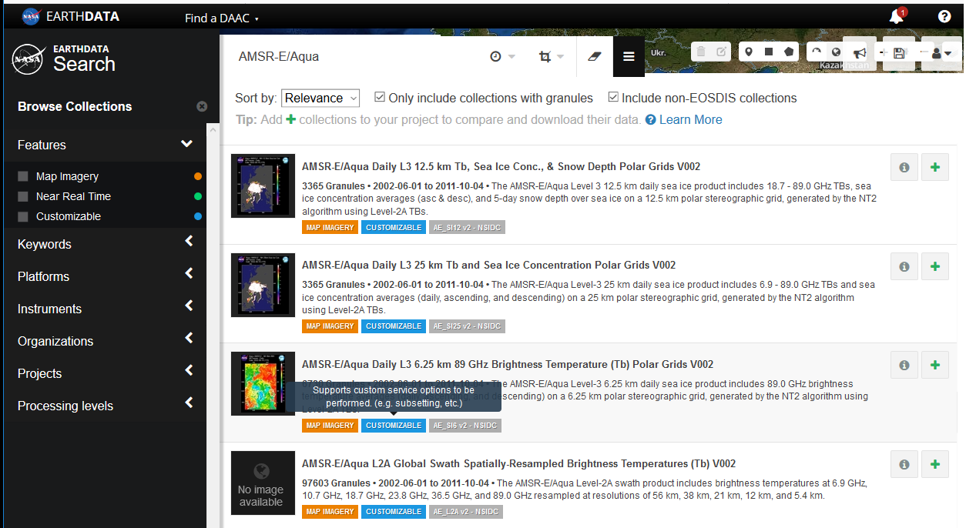
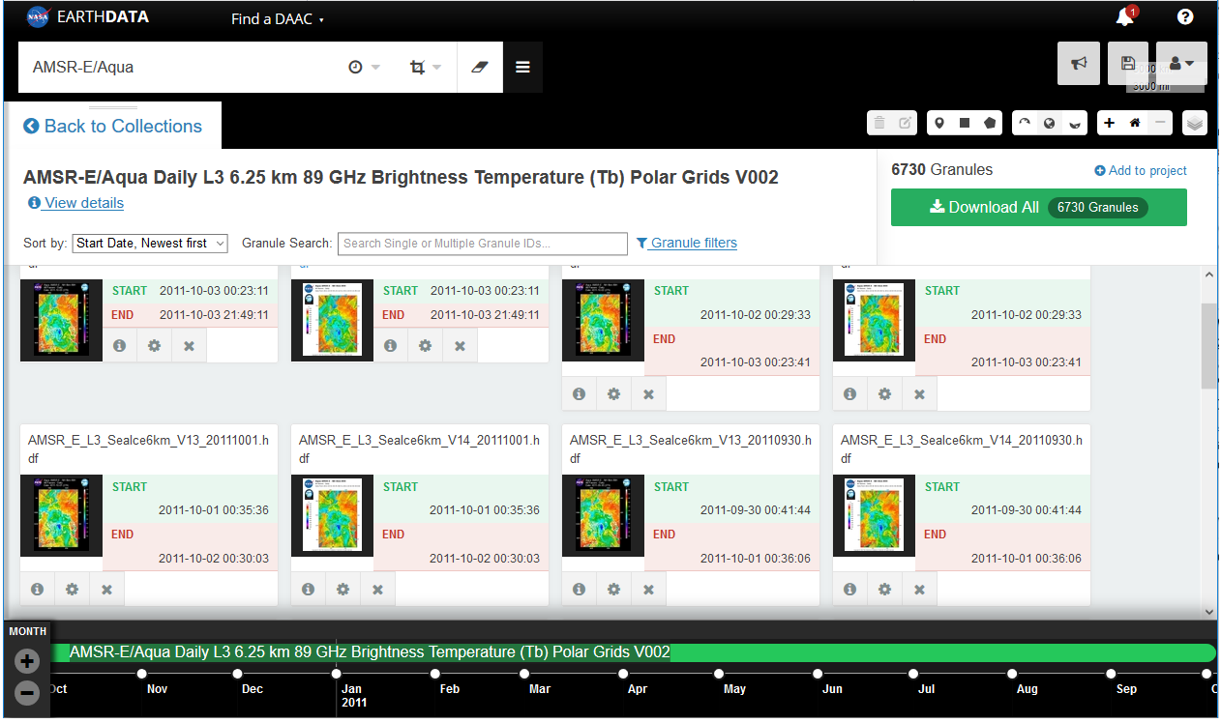
End-to-End Services (E2E):
Customizable Collection
in Earthdata Search
Configure & Download Granule
E2E Customization Options
https://search.earthdata.nasa.gov/search
Notes:
EGI = European Grid Infrastructure

Slide 6
A Key Use Case to Consider:
Smart Handoffs
Enables transferal of search results and/or context to another tool
User finds and selects a data set
User wants to view or manipulate the dataset in another tool
e.g. GIOVANNI, SOTO
User selects option to transfer search context to associated, enabled tool
e.g. dataset name, geospatial or temporal search parameters, etc.
User is redirected to the desired tool with previous search context pre-populated
via a well-defined API endpoint
via a WMS/WCS/THREDDS call
User carries on with their analysis in their desired tool
Notes:
Jupyter Notebook? API-instigated handoff (use case/methodology analysis still under development):
e.g. a script in Jupyter Notebook uses THREDDS as a server to go fetch related data/tool info from CMR

Slide 7
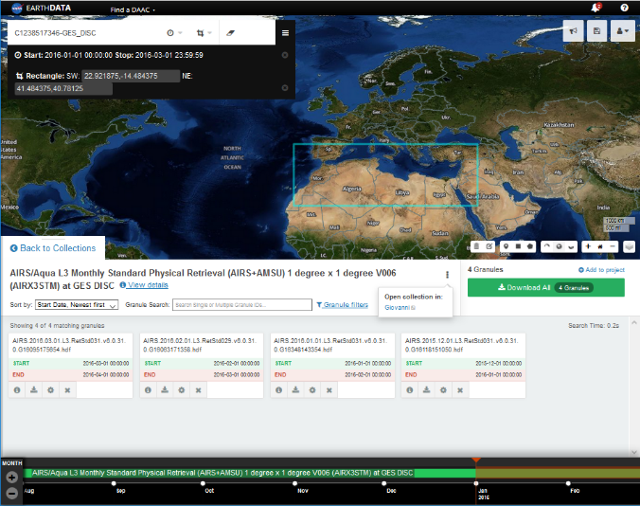
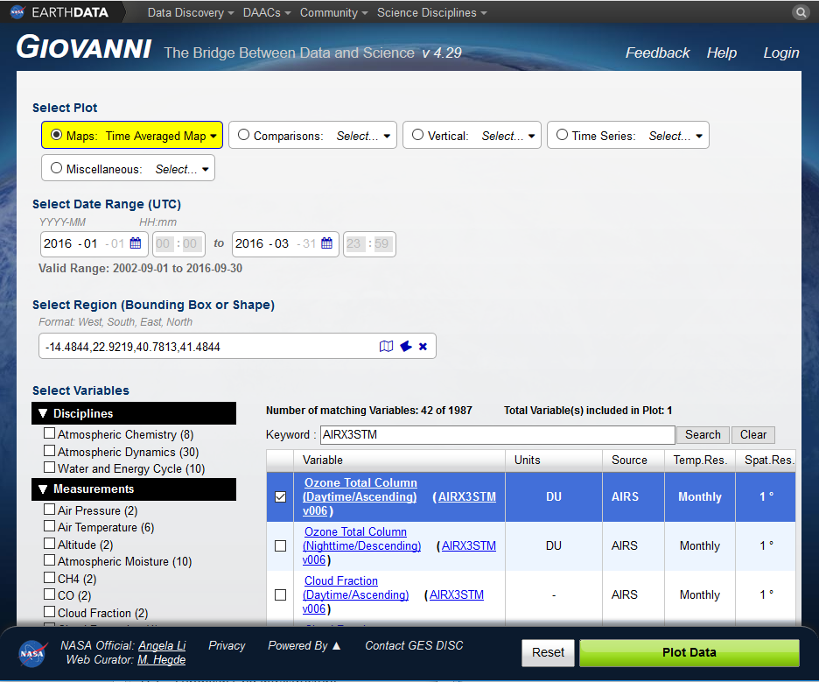
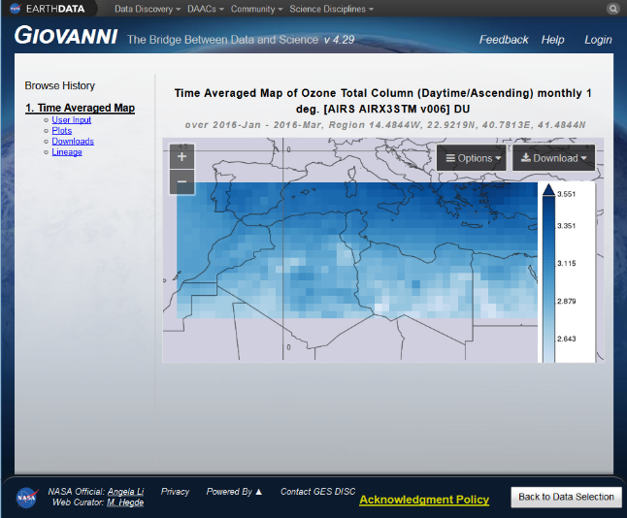
Smart Handoffs:
Collection in Earthdata Search with a Smart Handoff metadata association…
…to a more specialized data extraction tool like Giovanni:
https://search.earthdata.nasa.gov/search
https://giovanni.gsfc.nasa.gov
Notes:
Jupyter Notebook?

Slide 8
A Key Use Case to Consider:
Downloadable Tools
Associates datasets to applicable tools which must be downloaded to the user’s processing platform to use them locally
User finds and selects a data set
User wants to see what Downloadable Tools are applicable to the selected data set
e.g. Python, R libraries, Panoply
User selects desired Local Tool and is redirected to a primary splash page, containing:
Information about the tool,
How to install and use it,
A download option
User downloads the dataset to perform local processing
Notes:
Smart Handoff option for Downloadable Tools?
Open tool and populate with dataset context: Recipe, pre-configurations, etc.?

Slide 9
A Key Use Case to Consider:
Service Entry Resource Formats (SERFs)
Legacy records from the GCMD
Describe tools and services, primarily from the IDN community
Migration effort recently concluded
Identified and updated still-valid SERF records
Migrated valid SERF records to UMM-Service
Archived remaining legacy SERF records
Deprecated SERF DocBuilder tool
SERF Curation concerns
Access to Metadata Management Tool (MMT) restricted
New tool for anyone to curate UMM records is coming soon!
The Draft Metadata Management Tool (dMMT) will allow users with an Earth Data Login credential to propose new or modifications to existing collection or service metadata records
Until then, send requests to support@earthdata.nasa.gov
With Refactoring, UMM-S SERFs will need to be reallocated to applicable use-case sub-models
Notes:
dMMT anticipated to come online later this year

Slide 10
Special thanks to EED-2/GCMD team
Erich Reiter
erich.e.reiter@nasa.gov
Michael Morahan
michael.p.morahan@nasa.gov
Doug Newman
douglas.j.newman@nasa.gov
Simon Cantrell
simon.cantrell@nasa.gov
Tyler Stevens
Tyler.B.Stevens@nasa.gov
Scott Ritz
Scott.A.Ritz@nasa.gov
Thank you!
If you have any questions, please reach out:
valerie.dixon@nasa.gov

