Slide 1
IDN Update
CEOS WGISS-47
Silver Spring, Maryland, USA, April 29-May 2, 2019
Hosted by the National Oceanic and Atmospheric Administration (NOAA)
Michael Morahan
IDN Coordinator
Michael.P.Morahan@nasa.gov

Slide 2
Outline
IDN Activities (since WGISS-46)
Registration of services for the IDN
Setting up CEOS 2-Step OpenSearch in the IDN (CMR)
Update on efforts to provide consistent Quality Assurance (QA) Rule messaging.

Slide 3
I. IDN Activities
(since WGISS-46)

Slide 4
Adding FedEO Platform/Instrument relations in KMS
The relationships show the linkage of Instruments to Platforms.
Services (Web Services and APIs) used for task:
  Skosmos (ESA Thesaurus): is a web based open source ontology browser.
    URL: http://fedeo.spacebel.be/thesaurus/en/
  GCMD Keyword Manager (KMS): is a web based management system for maintaining and registering Keywords (not available externally).
  GCMD KMS API: is a RESTful web service for maintaining keywords (science keywords, platforms, instruments, data centers, locations, projects, services, resolution, etc.) in the GCMD/IDN system.
    Documentation URL: https://wiki.earthdata.nasa.gov/display/gcmdkey/Keyword+Management+Service+Application+Program+Interface

Slide 5
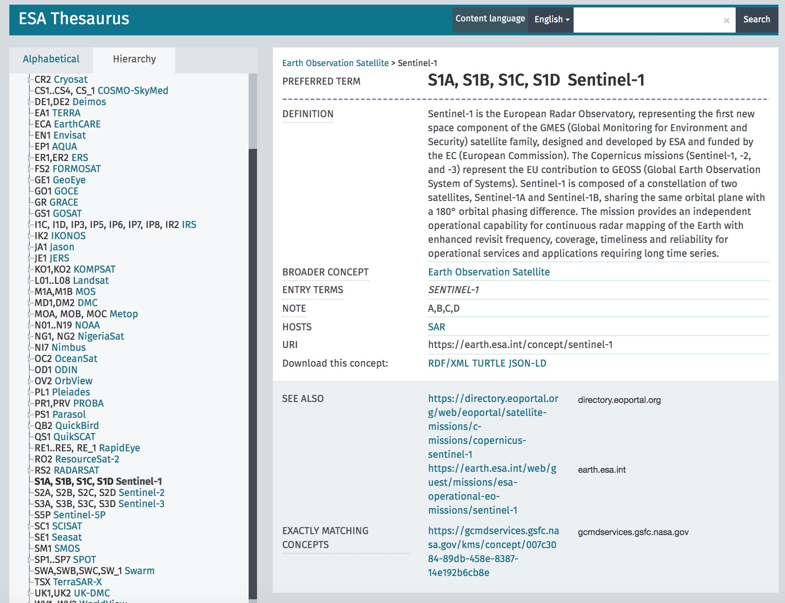
FedEO Platform/Instrument relations in KMS
ESA Thesaurus: http://fedeo.spacebel.be/thesaurus/en/

Slide 6
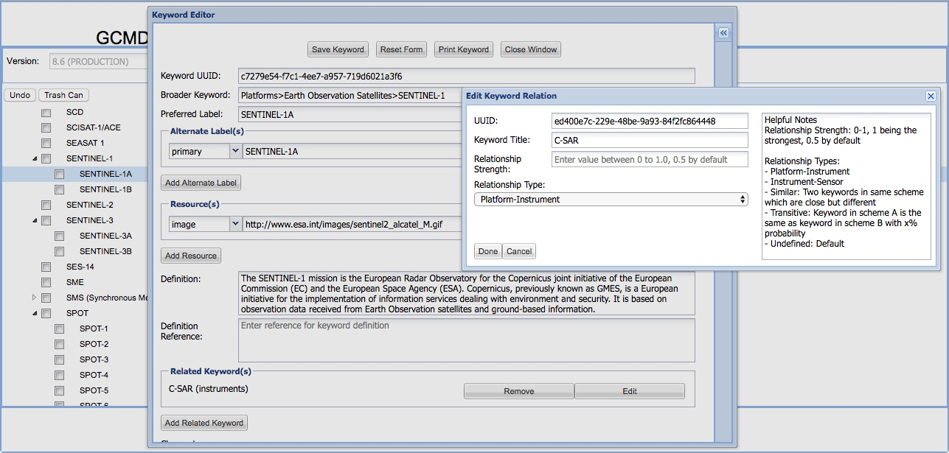
FedEO Platform/Instrument relations in KMS

Slide 7
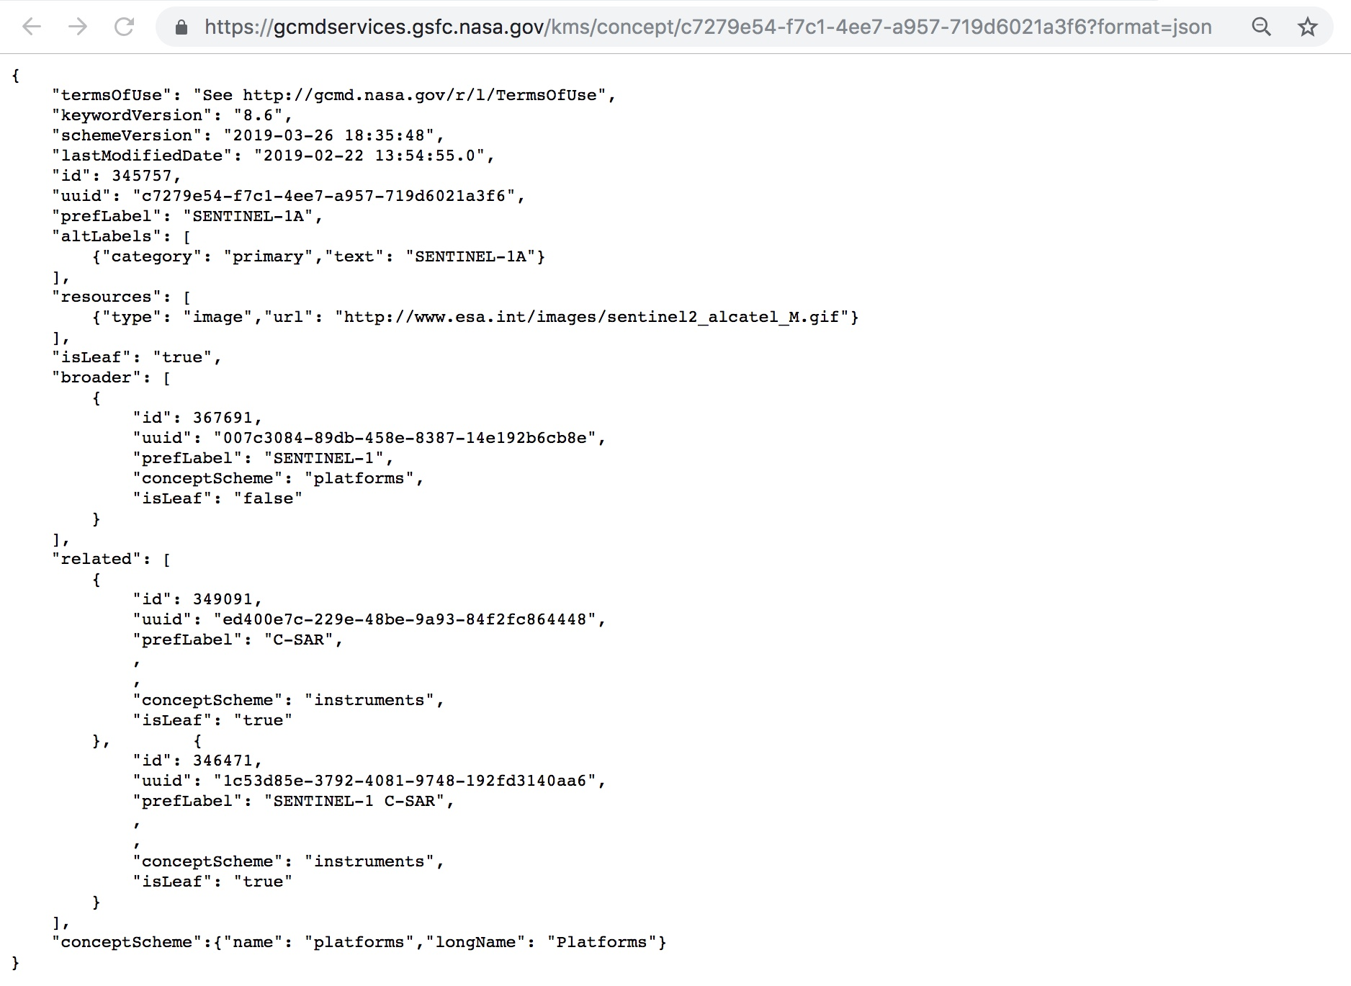
Platform/Instrument relation using KMS API (JSON)
  https://gcmdservices.gsfc.nasa.gov/kms/concept/c7279e54-f7c1-4ee7-a957-719d6021a3f6?format=json

Slide 8
Ingest of NOAA_NCEI (NOAA OneStop) Native ISO
IDN preformed a comparison between NASA MEND’s ISO metadata and NOAA OneStop ISO metadata.
4 issues were discovered that prevented the NOAA OneStop’s ISO from ingesting directly into the CMR for the IDN.
NOAA, NASA CMR, and IDN worked together to revolve these issues.
Presently, 70 NOAA_NCEI GHRSST ISO have been ingested into the CMR for the IDN.

Slide 9
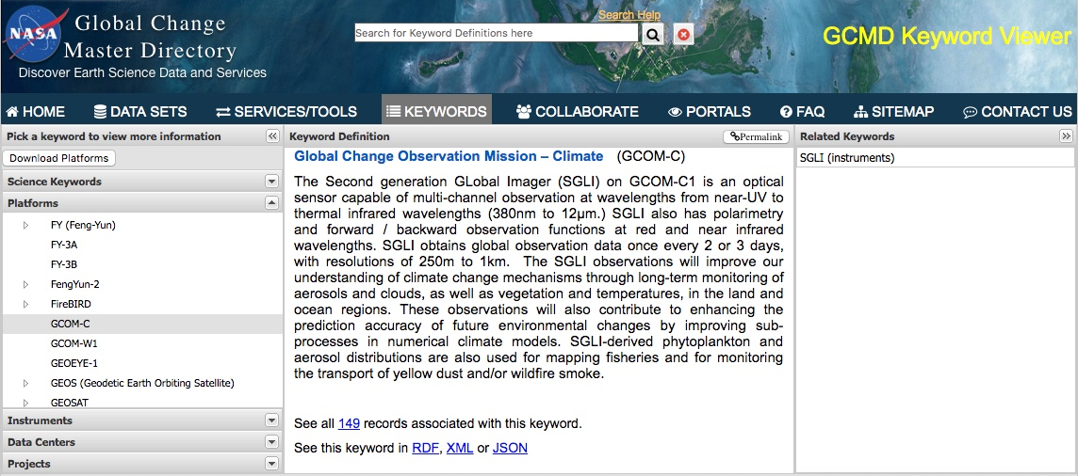
New JAXA GCOM-C collection records
149 JAXA GCOM-C collection records have been ingested for discovery in the IDN (CMR)
CEOS WGISS “Discovery and Access” page has information on GCOM-C products:
  http://ceos.org/ourwork/workinggroups/wgiss/access/
IDN access to collection metadata:
  https://idn.ceos.org/search/Titles.do?subset=idn&json={"condition":{"and":[{"keyword":"*"},{"project":"GCOM-C"}]}}
Keyword Viewer:
https://gcmd.nasa.gov/search/Keywords.do#keywords

Slide 10
Transition of DIF-9 to DIF-10
Provider | # of records | # of records transition | # of records not transition | Completion Precentage | State
SCIOPS | 15933 | 15933 |  | 100% | Completed
AU_AADC | 2819 | 0 | 2819 | 0% | Starting Q2
CNES | 20 | 20 | 0 | 100% | Completed
ESA | 112 | 20 | 92* | 18% | On-going
EUMETSAT | 37 | 37 | 0 | 100% | Completed
INPE | 43 | 43 | 0 | 100% | Completed
ISRO | 34 | 34 | 0 | 100% | Completed
JAXA | 388 | 388 | 0 | 100% | Completed
NOAA_NCEI | 5563 | 84 | 5479** | 1% | On-going
USGS_EROS | 146 | 146 | 0 | 100% | Completed
Total | 25095 | 16705 | 8390 | 67%
* New delivery of FedEO ESA records in calendar Q2 will replace existing records.
** Remove and replace NOAA/NCEI records.

Slide 11
Attended Conferences: AGU and ESIP
ESIP Winter Meeting 2019 (Presentation)
  Topic: GCMD Keyword Management Process and Life-Cycle
  Summary: Show the process for GCMD keywords - fast track and yearly reviews through the ESDIS Standards Office, and how Earth science users can influence keyword additions and modifications. Highlight how keywords faciliate the discovery of EOSDIS data and services. Upcoming keyword reviews.
  Session Abstract link:
    https://2019esipwintermeeting.sched.com/event/JORW/gcmd-keyword-management-process-and-lifecycle
AGU Winter Meeting 2018 (Poster)
  Topic: Structured Methods for Organization and Discovery of Variables within NASA’s Common Metadata Repository

Slide 13
II. Registration of services for the IDN

Slide 14
Registering Services into the CMR for IDN
(Future) CEOS Providers will be able to register services using the Draft Metadata Management Tool (MMT)
(Present) providers can send to the IDN the UMM-S Service JSON file or fill out a template of the fields’ values.

Slide 15
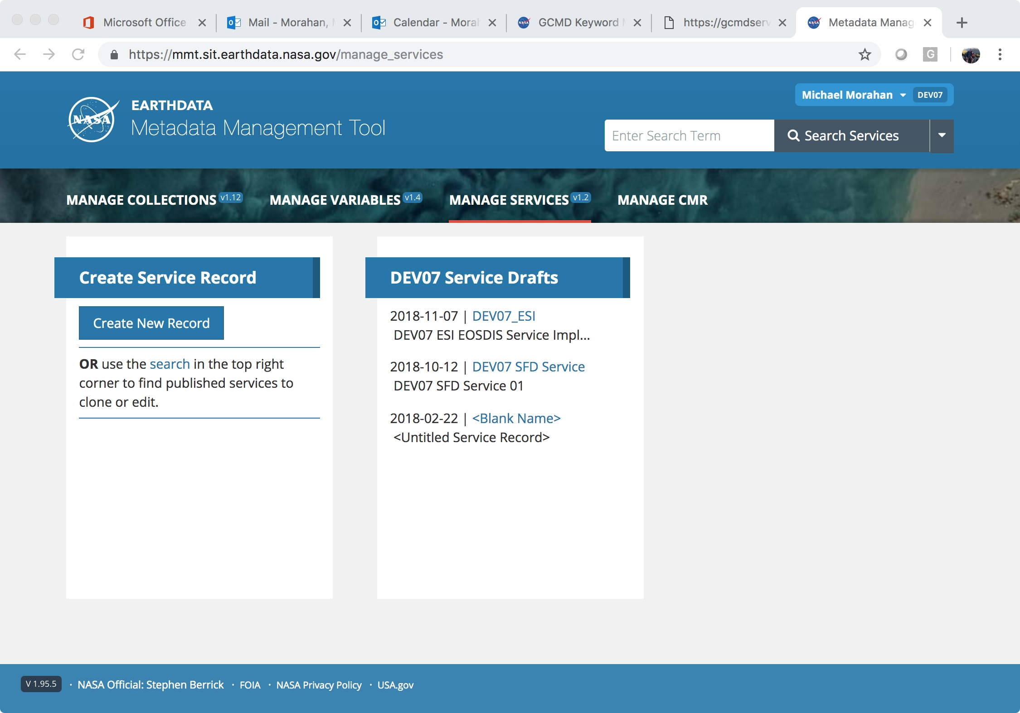

Draft Metadata Management Tool (MMT)
User and Provider
Search in CMR
Create new draft
Open drafts

Slide 16
UMM-S Required Fields
Field Name | Description
Name | The name of the service, software, or tool. (Example: "AIRS_L3_OPENDAP".)
LongName | The long name of the service, software, or tool. It provides a human readable name for the service. (Example: "OPENDAP (Hyrax) framework for AIRS Level 3 data products".)
Type | The type of the service, software, or tool. (Example: OPeNDAP)
Version | The edition or version of the service, software, or tool. The version should be defined in the form x, y, and z. where 'x.y.z' means 'major.minor.incremental' version numbers. Typically, 'x' and 'y' are numbers (0 through 9) and 'z' is a number (0 through 99). (Example: 1.1.1)
Description | A brief description of the service, software, or tool. For example, a description might contain information about what is the service, the purpose of the service, and the parameters (or variables) being invoked, and what are the sources of these data.
RelatedURLS | This element contains important information about the Uniform Resource Locator (URL) for the service.
ServiceKeywords | Allows for the specification of Earth Science Service keywords that are representative of the service, software, or tool being described. The controlled vocabulary for Service Keywords is maintained in the Keyword Management System (KMS). (Example: "ServiceCategory: Earth Science Services, ServiceTopic: Data Management/Data Handling, ServiceTerm: Data Search and Retrieval". )
ServiceOrganizations | The service provider, or organization, or institution responsible for developing, archiving, and/or distributing the service, software, or tool. (Example: "Role: SERVICE PROVIDER, ShortName: INPE, LongName: National Institute for Space Research, Brazil".)

Slide 17
CMR SEARCH API
Service records can be searched using the CMR SEARCH API:
  Search for all
  curl 'https://cmr.earthdata.nasa.gov/search/services'
  Search by Keyword
  curl 'https://cmr.earthdata.nasa.gov/search/services?keyword=OPeNDAP&pretty=true'
  Search for specific service
  curl 'https://cmr.earthdata.nasa.gov/search/services.umm_json?name=MUR-JPL-L4-GLOB-v4.1&pretty=true'
  CMR SEARCH API Documentation: https://cmr.earthdata.nasa.gov/search/site/docs/search/api.html#searching-for-services

Slide 18
III. Setting up CEOS 2-Step OpenSearch in the IDN (CMR)

Slide 19
CEOS 2-Step OpenSearch “Option 1”
Send to the IDN a populated spreadsheet with the following values:
  CMR collection record’s Concept ID (if the record exist in the IDN (CMR) (e.g.: C1532648141-ESA)
  Collection record’s Entry_ID (ShortName)
  Granule OSDD link (Example):
    "http://fedeo.esa.int/opensearch/description.xml?parentIdentifier=EOP:ESA:FEDEO:COLLECTIONS:CryoSat.products"
Concept_ID | Entry_ID (ShortName) | OpenSearch Granule OSDD
C1532648141-ESA | CryoSat products | http://fedeo.esa.int/opensearch/description.xml?parentIdentifier=EOP:ESA:FEDEO:COLLECTIONS:CryoSat.products
C1214560189-ESA | SMOS.MIRAS.MIR_OSUDP2 | http://fedeo.esa.int/opensearch/description.xml?parentIdentifier=EOP:ESA:FEDEO:COLLECTIONS:SMOS.MIRAS.MIR_OSUDP2

Slide 20
CEOS 2-Step OpenSearch “Option 2”
Populate the DIF-10 Field Related_URL with the following values:
  Type with “USE SERVICE API”
  Subtype with “OpenSearch”
  URL with the granule OSDD link
  Description with tag_key: opensearch.granule.osdd
Example of the DIF-10 text:
<Related_URL>
<URL_Content_Type>
<Type>USE SERVICE API</Type>
<Subtype>OpenSearch</Subtype>
</URL_Content_Type>
        <URL>http://fedeo.esa.int/opensearch/description.xml?parentIdentifier=EOP:ESA:FEDEO:C OLLECTIONS:CryoSat.products</URL>
<Description>tag_key: opensearch.granule.osdd</Description>
<Mime_Type>application/opensearchdescription+xml</Mime_Type>
</Related_URL>

Slide 21
Search for Tags using CMR API
IDN staff will add the opensearch.granule.osdd tag in the CMR for providers.
Providers can verify the addition of the tag using the CMR Search API:
https://cmr.earthdata.nasa.gov/search/collections.json?concept_id=C1532648141-ESA&include_tags=*&pretty=true
Example of JSON output of the query:
…
"tags" : {
"opensearch.granule.osdd" : {
    "data" : "http://fedeo.esa.int/opensearch/description.xml?parentIdentifier=EOP:ESA:FEDEO:COLLECTIONS:CryoSat.products" },
"int.esa.fedeo" : { },
"org.ceos" : { }
},
"id" : "C1532648141-ESA",
…

Slide 22
OSDD URL within OpenSearch Metadata
Discovery: The OpenSearch collection metadata URL is returned to the client user.
https://cmr.earthdata.nasa.gov/opensearch/collections.atom?uid=C1532648141-ESA
Within the collection metadata is the OSDD URL used for granule searches:
…
<link href="http://fedeo.esa.int/opensearch/description.xml?parentIdentifier=EOP:ESA:FEDEO:COLLECTIONS:CryoSat.products" hreflang="en-US" type="application/opensearchdescription+xml" rel="search" title="Non-CMR OpenSearch Provider Granule Open Search Descriptor Document"/>…

Slide 23
IV. Update on efforts to provide consistent Quality Assurance (QA) Rule messaging.

Slide 24
Registering Services into the CMR for IDN
New Task: QA Rule Set Consolidation and Implementation Strategy Across Tools
Background: CMR and IDN Metadata Validation services/tools for providers use different implementations and/or QA Rules.
Overall Goal: Give metadata providers consistent QA results when creating, publishing and updating IDN (CMR) collection metadata base on QA Rule checks.

Slide 25
Questions
  Please provide questions/comments to:
  michael.p.morahan@nasa.gov (KBR/WYLE)
  valerie.dixon@nasa.gov (NASA)
  christopher.s.lynnes@nasa.gov (NASA)

Slide 26
Background Information

Slide 27
Example: CERES EBAF Edition 4.0 TOA Cloud Effective Temperature Daynight Monthly.
{
"Name":"ceres_ebaf_e4_toa_cldtemp_total_daynight_mon",
"LongName":"Cloud Effective Temperature, Monthly Means, Daytime-and-Nighttime conditions",
"Description":"CERES EBAF Edition 4.0 TOA Cloud Effective Temperature Daynight Monthly. ",
"Type":"WEB PORTAL",
"Version":"1.6",
"RelatedURLs":
[{
"Description":"Cloud Effective Temperature, Monthly Means, Daytime-and-Nighttime conditions Image Service",
"URLContentType":"DistributionURL",
"Type":"GET SERVICE",
"URL":"https://asdc-arcgis.larc.nasa.gov/server/rest/services/CERES/ceres_ebaf_e4_toa_cldtemp_total_daynight_mon/ImageServer"
}],
"AccessConstraints":"Users must have a NASA Earthdata Login account to use the ASDC Web Portal site.",
"ServiceOrganizations":
[{
"Roles":["SERVICE PROVIDER"],
"ShortName":"NASA/LaRC/ASDC",
"LongName":"Atmospheric Sciences Data Center, Langley Research Center, NASA",
"ContactPersons":
[{
"Roles":["SERVICE PROVIDER"],
"FirstName":"Matt",
"LastName":"Tisdale"
}],
"ContactInformation":
{
"RelatedUrls":
[{
"URLContentType":"DataCenterURL",
"Type":"HOME PAGE",
"URL":"https://asdc-arcgis.larc.nasa.gov/portal/home/"
}],
"ContactMechanisms":
[{
"Type":"Email",
"Value":"matthew.s.tisdale@nasa.gov"
}],
"Addresses":
[{
"StreetAddresses":
[
"NASA Langley Research Center",
"Mail Stop 157D"
],
"City":"Hampton,",
"StateProvince":"VA",
"Country":"United States",
"PostalCode":"VA 23681-2199"
}]
}
}],
"ServiceKeywords":
[{
"ServiceCategory":"EARTH SCIENCE SERVICES",
"ServiceTopic":"DATA ANALYSIS AND VISUALIZATION"
}],
"ScienceKeywords":
[{
"Category":"EARTH SCIENCE",
"Topic":"ATMOSPHERES",
"Term":"CLOUD PROPERTIES"
},
{
"Category":"EARTH SCIENCE",
"Topic":"ATMOSPHERE",
"Term":"CLOUDS"
}],
"Platforms":
[{
"ShortName":"Terra",
"LongName":"Earth Observing System, Terra (AM-1)",
"Instruments":
[{
"ShortName":"CERES",
"LongName":"Clouds and the Earth's Radiant Energy System (CERES)"
}]
},
{
"ShortName":"Aqua",
"LongName":"Earth Observing System, Aqua",
"Instruments":
[{
"ShortName":"CERES",
"LongName":"Clouds and the Earth's Radiant Energy System (CERES)"
}]
},
{
"ShortName":"Suomi-NPP",
"LongName":"Suomi, NPOESS Preparatory Project",
"Instruments":
[{
"ShortName":"CERES",
"LongName":"Clouds and the Earth's Radiant Energy System (CERES)"
}]
}],
"OperationMetadata":
[{
"OperationName":"GetMap",
"DistributedComputingPlatform":["XML","WEBSERVICES"],
"OperationDescription":"The GET operation returns image data for a specific identifier, detailed service capabilities, bounding boxes (extent), authorities (projections), grid axes, labels, time extent and formats",
"InvocationName":"ASDC ArcGIS Image Server",
"ConnectPoint":
{
"ResourceName":"ceres_ebaf_e4_toa_cldtemp_total_daynight_mon",
"ResourceLinkage": "https://asdc-arcgis.larc.nasa.gov/server/rest/services/CERES/ceres_ebaf_e4_toa_cldtemp_total_daynight_mon/ImageServer",
"ResourceDescription":"Access the Cloud Effective Temperature, Monthly Means, Daytime-and-Nighttime conditions monthly image data through ArcGIS for Server REST Service"
},
"CoupledResource":
{
"ScopedName":"ceres_ebaf_e4_toa_cldtemp_total_daynight_mon",
"CouplingType":"TIGHT",
"DataResource":
{
"DataResourceIdentifier":"ceres_ebaf_e4_toa_cldtemp_total_daynight_mon",
"DataResourceSourceType":"Map",
"DataResourceSpatialType":"BOUNDING_BOX",
"DataResourceSpatialExtent":
{
"SpatialBoundingBox":
{
"CRSIdentifier":"4326",
"WestBoundingCoordinate":-180.0,
"SouthBoundingCoordinate":-90.0,
"EastBoundingCoordinate":180.0,
"NorthBoundingCoordinate":90.0
}
},
"SpatialResolution":36,
"SpatialResolutionUnit":"KM",
"DataResourceTemporalType":"TIME_RANGE",
"DataResourceTemporalExtent":
{
"TimePoints":
[{
"Time":"%Y%M",
"Value":"2012-01",
"Description":"Start date of the image data"
},
{
"Time":"%Y%M",
"Value":"2017-12",
"Description":"End date of the image data"
}]
},
"TemporalResolution":1,
"TemporalResolutionUnit":"MONTH"
}
}
}]
}

Slide 28













This work was supported by NASA/GSFC under Raytheon Co. contract number WIGSS-0419-MM1.
in partnership with

