Slide 1
WGISS Connected Data Assets Status Report
April 30, 2019
Yonsook Enloe

Slide 2
WGISS Connected Data Assets Session Today
Introduction
WGISS Connected Data Assets Status Report – Yonsook Enloe
IDN Update – Michael Morahan
CWIC Update – Yonsook Enloe
FedEO Evolution – Andrea Della Veccia
NOAA NCEI - Rich Baldwin
WGISS Actions for WCDA team

Slide 3
From the WGISS Workplan
Discovery and Access
The WGISS Connected Data Assets include the International Directory Network (IDN), FedEO (Federated Earth Observation Gateway), and CWIC (CEOS WGISS Integrated Catalog). WGISS- supported standards are now used to search and access data from thousands of collections and hundreds of millions of inventory records, with additional data collections and inventory records from CEOS Agencies being added daily to this integrated system.
The WGISS Connected Data Assets also provide access to CEOS Agency datasets through their integration with the GEOSS (Global Observation System of Systems) Common Infrastructure (GCI). More and more, CEOS Agencies continue to adopt the WGISS-supported standards and make their data discoverable via the WGISS Connected Data Assets.
The WGISS Connected Data Assets System Level Team provides coordination and oversight of the operations and evolution of this integrated system and also provides technical support for CEOS partners that offer access to data and to client partners that connect to the data sources

Slide 4
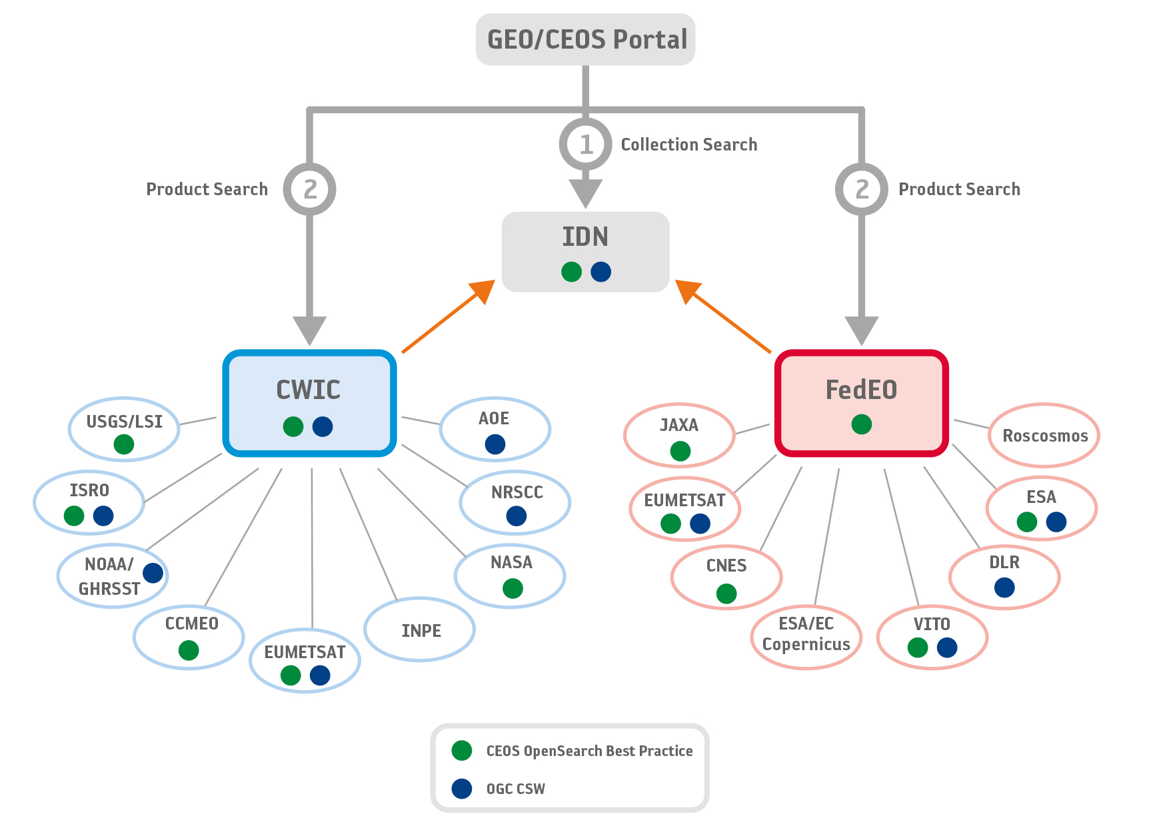
Architecture WGISS Data Assets

Slide 5
Towards a WGISS Federation
Data collection registration at the IDN using the IDN keywords; Info about how granule search is supported will be included in the data collection registration; Tag for granule access;
Data partners need to support 1 of the 2 supported WGISS standards
  CEOS OpenSearch Best Practices (v 2)
  OGC CSW 2.0.2
All searchable data must have a data access path
  Data download
  Data order (free or with cost)
  Email order (free or with cost)
Servers must have high availability (99%?)
A technical point of contact needed for each data partner

Slide 6
WGISS Federation- Where
Are We Now?
IDN Metadata Registration set of docs and tools:
http://ceos.org/ourwork/workinggroups/wgiss/access/international-directory-network/
Documents completed since October 2018:
WCDA (WGISS Connected Data Assets) Client Guide
CWIC Data Partner Guide (CSW, OpenSearch)
FedEO Data Partner Guide
CWIC Synchronization Document
WCDA Error Handling

Slide 7
More Documents
WGISS search standard documents completed:
  CEOS OpenSearch Best Practices v1.2
  CEOS OpenSearch Best Practices Conformance Test Plan
  CEOS OpenSearch Developer’s Guide

Slide 8
Current WCDA
WGISS Connected Data Assets Status Page
http://ceos.org/wgiss-connected-data-assets-status/
Automated updated (daily) metrics for WCDA searchable collections/granules
  Sharing of test scripts (CWIC Synchronization document)
Single document, WDCA Client Guide, gives details on how to search for all the data collections/granules in the WCDA
Error handling approach agreement

Slide 9
Challenges Ahead
Developing FDA capabilities to give users a specialized “chunk” of data, preprocessed to be ready to analyze.
Adding processing, analytic services/tools to WCDA
  How to describe these specialized services in a generalized way
  How to find these services and know what data these can apply to
  How to invoke these services with the special processed data

Slide 10
Working with GEOSS
IDN, FedEO and CWIC accessible from Geo Web Portal and integrated via GEO DAB
Continued participation in the GEO Data Providers-GEO Data Technology workshop
WGISS Connected Data Assets webpage on the WGISS webpage display metrics → this info given to the GEO Sec team; The completely revamped automated page has been given to CEOS CEO and GEO Sec.
Suggestion from FedEO team to share the CWIC Synchronization document with the GEO Sec.
Will share the WDCA Client Guide document with the GEO data providers

Slide 11
Outreach to Tool Developers
WDCA Client Partner Guide – new document written by the System Level Team; Details how to search for collection and granule data at IDN, CWIC, and FedEO.
  How to search for CEOS data collections in IDN
  How to search for CWIC/FedEO data granules
  How to search for GEOSS tagged collections
Outreach to potential tool developers
  One page flyer targeting tool developers
  Soft copy of the flyer will be kept on the WGISS website
  Local printing
  Advertise the url http://wgiss.ceos.org/access

Slide 12

Do you develop software tools
for the distribution and analysis of environmental data?
CEOS WGISS can help you include data collected from the vantage point of space!
30,000+ data collections that are discoverable with over 5500+ data collections that are searchable and data downloadable.
Visit http://wgiss.ceos.org/access to learn how to start accessing and using our data!
CEOS is an international organization enabling partnership and collaboration across governmental agencies that develop and operate earth-observing satellites.
The 60+ CEOS member agencies currently operate 153 satellites that produce data useful for a broad set of applications.
The Working Group for Information Systems and Standards (WGISS) brings together experts in satellite data management and services to develop common internet-based standards that facilitate discovery, search, and access to data served by the CEOS agencies.
ATMOSPHERE LAND SURFACE AGRICULTURE OCEANS BIOSPHERE CLIMATE INDICATORS CRYOSPHERE HYDROSPHERE SOLID EARTH TERRESTRIAL HYDROSPHERE

Slide 13
CWIC Update
CWIC Synchronization document completed – gives description and details (test scripts) of the daily dataset accessibility testing that is performed automatically.
  FedEO team implemented the test scripts also
CWIC Data Partner Guides (CSW, OpenSearch) updated and completed
Testing with NOAA One-Stop continues
  Ingesting updated NOAA collection metadata into IDN
  Testing for granule search
  NOAA One-Stop system will contain NOAA’s current and heritage EO data collections

Slide 14
CWIC Update
Support for China GEOSS system on hold until the China GEOSS system is ready for continuous access
Discontinued support for the prototype clients: CWIC Start (CSW) client and the CWIC Smart (OpenSearch) client
  Support will continue for the CEOS OpenSearch Validator
  Software for both clients are open source for any agency that wants to stand up and operate their own client

Slide 15
WGISS Actions for the Access Team
WGISS-46-17: WGISS CDA System Level Team (SLT) to consider access feasibility to implement defined user metrics
WGISS-46-19: To discuss way forward to implement a single front-end/portal within the IDN to access the WGISS CDA for data discovery and access
Mirko emphasized that searches should have CEOS branding at the IDN portal to motivate IDN registration by data providers, and that the portal should share a look and feel with the CEOS website, while at the same time displaying the identity of the data partner

