Slide 1
Our Vision
“To be a world-leading technology and innovation company, helping businesses of all sizes to realise the potential from space”
Rob Fletcher
Head of Geospatial Platforms & Solutions

Slide 2
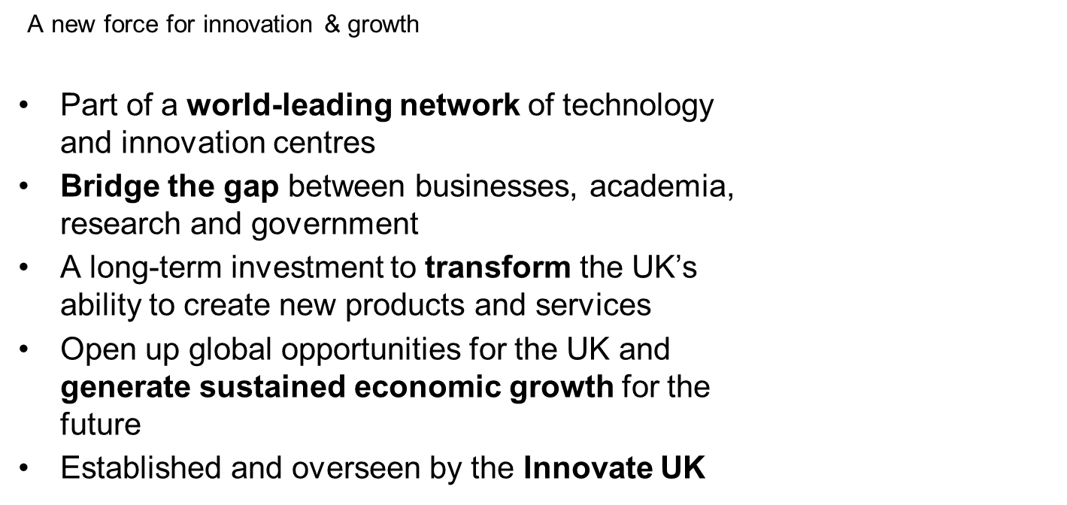
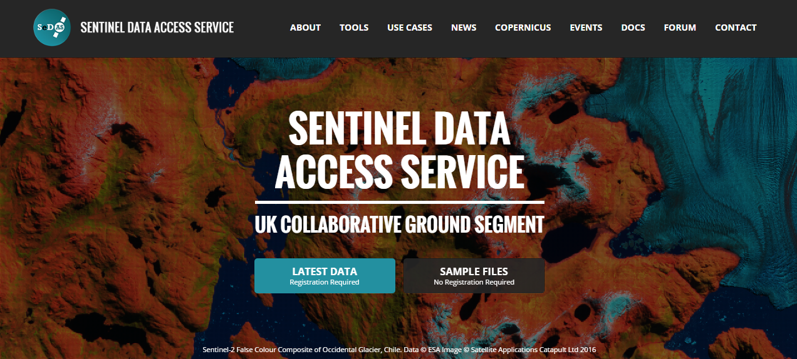
Satellite Applications Catapult
Government Services
Notes:
One of 11
Together we form a network of world leading technology and innovation centres
Drive UK economic growth through the use of downstream satellite data applications
Today – I wish to give a very quick overview of our cloud computing facility – CEMS and our Sentinel data discovery portal – SEDAS
My colleague Alan will then show a live demonstration of CEMS
These facilities are both live and production ready.
They are also being used within projects and by SMEs to help solve real world problems such as Marine pollution, illegal logging, illegal fishing and flood risk and as well as in market sectors such as mining and agriculture

Slide 3
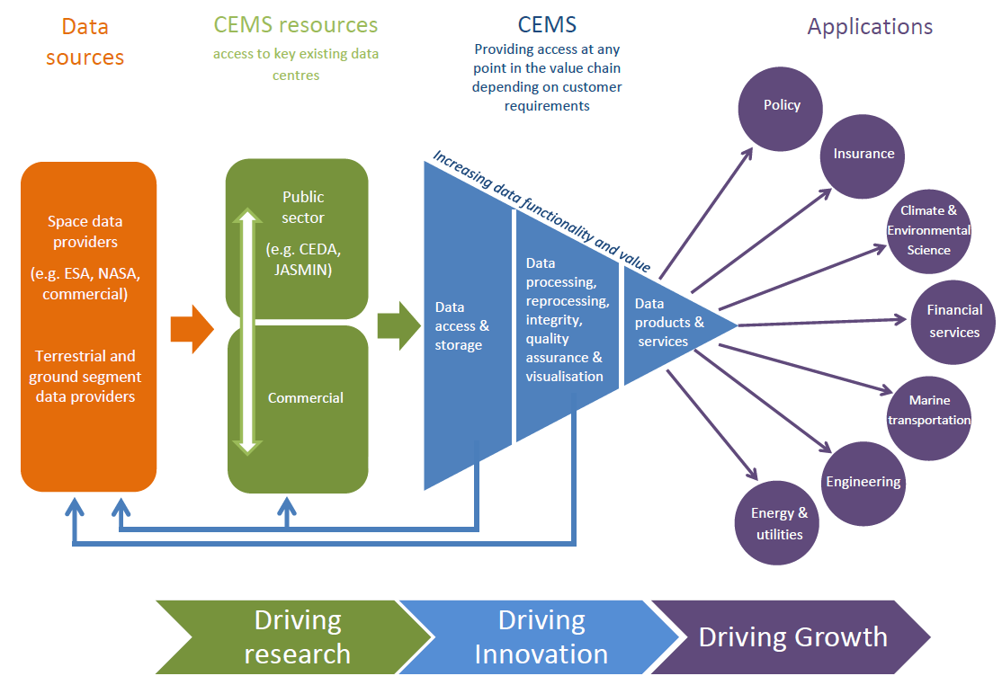
CEMS Concept
Established 2013
Current usage:
48 live environments
Projects & SMEs
450+ VMs
1100 Ghz CPU
6.2TB RAM
80% Utilised
Confidentiality Status: Catapult Open
Notes:
Original concept from ISIC aligns well with the Catapults goals
Data hub hosted and shared across two facilities/sites
Each area would also host some compute resources to process the data which inturn would drive innovation and ultimately growth of the economy

Slide 4
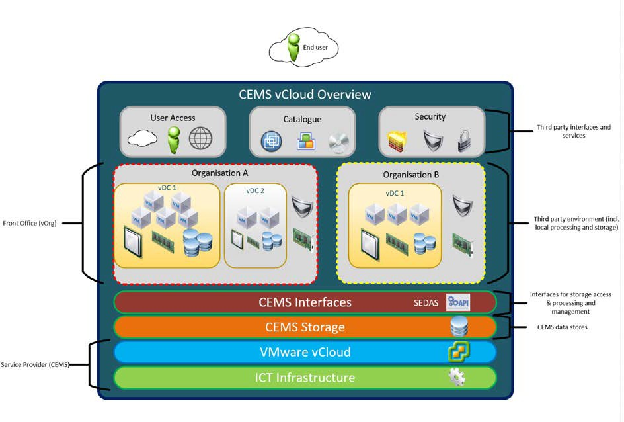
CEMS – Cloud Computing for the Space Community
Confidentiality Status: Catapult Open
Notes:
CEMS IaaS+ - managed service including data management, security, AV and DR
Each tenant is provided a private vDC providing software defined equivalents of the physical hardware found in a traditional DC
Compute resource allocation is flexible and designed to scale with a tenants business needs. Resources are allocated directly to each tenant’s virtual data centre to guarantee performance.
Each resource is priced individually and charged on a monthly basis or on demand.

Slide 5
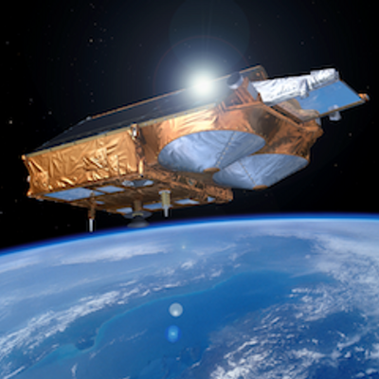
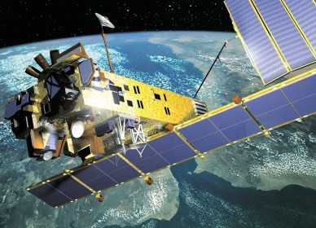
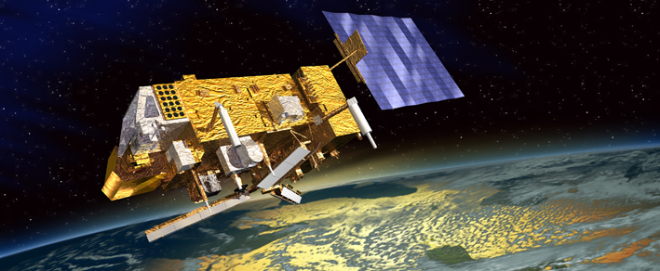
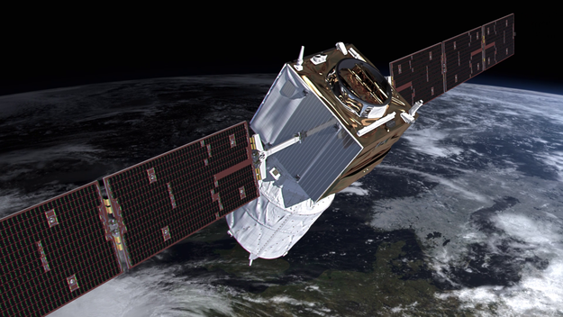
DSI - ESA Data Consolidation and Bulk Processing Service Initiative
Cryosat
Meris
ATSR
AATSR
Aeolus
Data Collection: Reception of media from ESA, uploading of the data into storage, assessment of the contents and production of an inventory
Data Consolidation: different stages covering data cleansing (removal of corrupted data and exact duplicates, merging data of same instrument from different sources into a single dataset and assessment of data completeness)
Processing system Integration: where the processing system is installed, integrated and tested in the operational environment, ready for operational processing
Reprocessing / Bulk processing / Format Conversion execution of the processing itself
Data Repatriation / delivery: Deliver data to ESA or other centres (PACs or future LTDP centres) upon request and to provide on‐line access to data for specific purposes
Confidentiality Status: Catapult Open
Notes:
This is what we do now

Slide 6
http://sedas.satapps.org/
Confidentiality Status: Catapult Open
Notes:
UK Collaborative ground segment on behalf of ESA – Consortium of Catapult, AB, and STFC
Dissemination of Sentinel data alongside discovery and processing services
SEDAS – front end web portal – collaboration on behalf of UKSA between Catapult, AB, GC and DM.
Feed from AB, data streamed as soon as available from ESA Collaborative hub
170+ registered users since launch in October of which many are actively downloading data

Slide 7
UKCGS – The Catapult’s Role
10Gbit/Sec
Launched October 2016:
Number of registered users: 800+
Countries of registration: 70+
Number of ingested products: 6.7 Million+
Totalling 5.6PB of data
UKSA High resolution UK Data
NovaSAR data coming Summer 2019
10Gbit/Sec
10Gbit/Sec
Confidentiality Status: Catapult Open
Notes:
Original concept from ISIC aligns well with the Catapults goals
Data hub hosted and shared across two facilities/sites
Each area would also host some compute resources to process the data which inturn would drive innovation and ultimately growth of the economy

Slide 8
CURRENT USEAGE AND SUCCESS STORIES
I am working on monitoring vegetation stress and vigour in Ghana using Remote Sensing data.
It is for academic research projects and teaching; the main use within this is for land-use and land-cover detection and change analysis (including time series)
We’re trying to have a go at counting traffic – specifically freight vehicles - with satellite/aerial photography and machine learning.
Satellite imagery downloaded from different sources we use for multiple work. My work is related to ecological aspects of pastures and natural ecosystems, degradation of soil and vegetation cover, etc.
We pay farmers to grow cover crops in the winter, to help reduce nutrient run off which has a detrimental effect on our water sources. At the moment we visit every farm regularly to check this crop has been grown, and I was interested to see if we could use satellite imagery to do a first pass assessment of this
The water industry is keen to reduce leakage from its network of pipes. We are looking at using satellite data to support the potential for detecting change in vegetation, patterns or colour that may indicate a leaking pipe.
I’ve downloaded some data for the Weymouth area on the south coast and I was intending to see if I could use it to look at beach change or movement of sea defences such as rock armour.
I recently used SEDAS for quick-look images of a particular area in support of a fieldwork campaign In Finland for two weeks
I am using SEDAS and snap to better understand the type of data that you get from satellites. We are creating a mass visitor immersive experience to highlight the importance of small satellites.
I'm using Sentinel-2 data for satellite-derived bathymetry. I have been using some other older portals but needed an easier option to check for and download multiple scenes using a polygon covering more than one scene, and SEADAS seems to suit that need.
My interest in your portal is related to my work. I am an expert in the use of remote sensing in agriculture.
I work for 3vGeomatics, a remote sensing company located in Vancouver that uses InSAR to detect ground movement and send reports to clients in near real time.
Notes:
Reference market size statements if possible.

Slide 9
SEDAS Portal
Confidentiality Status: Catapult Open

Slide 10
UKSA International Partnership Programme
The International Partnership Programme (IPP) is a multi million pound programme run by the UK Space Agency. IPP focuses on using the UK space sector’s research and innovation strengths to deliver a space enabled Official Development Assistance (ODA) compliant programme, that provides a measurable and sustainable economic or societal benefit to emerging and developing economies around the world.
EASOS Malaysia – Illegal deforestation, Coastal pollution & Flood prediction
CommonSensing Fiji, Vanuatu & Solomon Islands - Improve national resilience towards climate change
SEMDAC Chile - Illegal, Unregulated and Unreported (IUU) fishing
Illegal Gold Mining Colombia - Detection of illegal gold mining activity in remote forested areas
Space-based dam monitoring Peru - remotely measuring displacements of tailing dams and other mining infrastructure.
Confidentiality Status: Catapult Open
Notes:
Original concept from ISIC aligns well with the Catapults goals
Data hub hosted and shared across two facilities/sites
Each area would also host some compute resources to process the data which inturn would drive innovation and ultimately growth of the economy

Slide 11
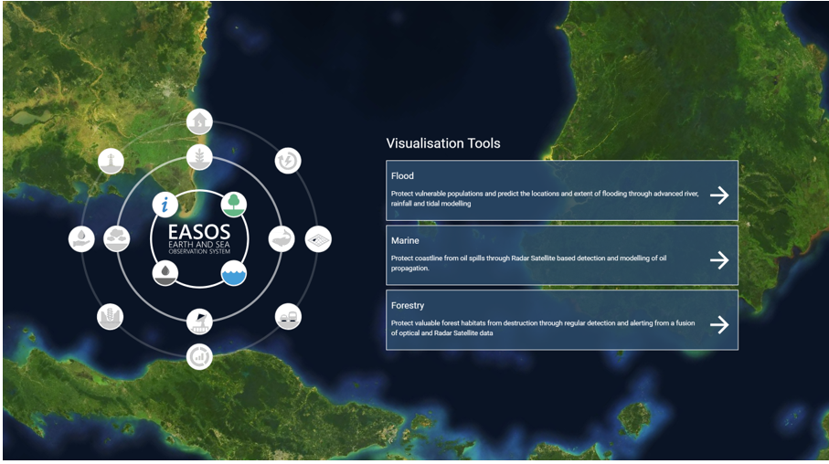
EASOS – Earth and Sea Observation System
Confidentiality Status: Catapult Open
Notes:
Original concept from ISIC aligns well with the Catapults goals
Data hub hosted and shared across two facilities/sites
Each area would also host some compute resources to process the data which inturn would drive innovation and ultimately growth of the economy

Slide 12
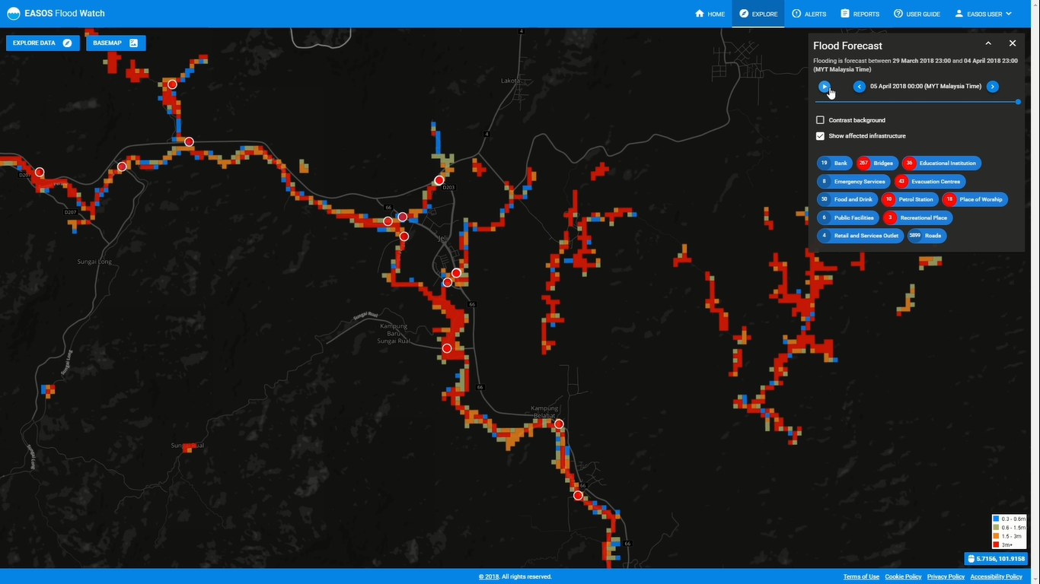
EASOS: FLOOD WATCH
Reducing the human and economic cost from flood disasters
Benefits
Provide warning of flooding up to 7 days in advance
Enable preventative action to be taken prior to a disaster event
Enable the Disaster Management committee to coordinate all agencies, and take preventative measures acting on consistent, reliable information
Achieve over 90% accuracy for flood alerts with a 12 hour lead time
Capabilities
Forecast the impact of rainfall
Continuously monitor river and rain gauge state
Locate and visualise forecasted flood impact on key infrastructure such as roads, evacuation centres, medicinal facilities
Assess human and financial impact of forecasted flooding
Flood planning for 1 in 5 to 1 in 10000 year scenarios
Notes:
4 Bn Ringits cost annually. (£800M) Aiming for 10% reduction in annual cost of flood events (RM 400M)
Increased economic growth – benefits up to 127M USD

Slide 13
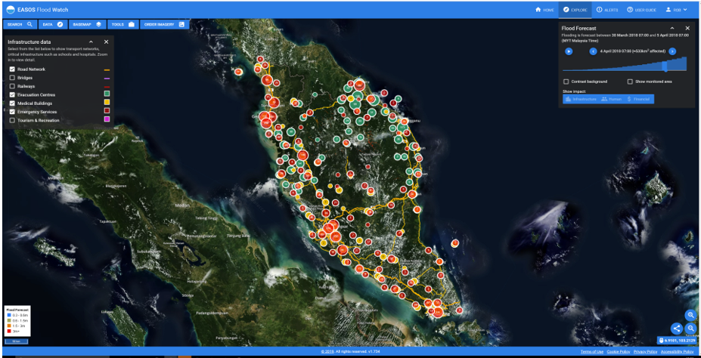
EASOS – Earth and Sea Observation System
Confidentiality Status: Catapult Open
Notes:
Original concept from ISIC aligns well with the Catapults goals
Data hub hosted and shared across two facilities/sites
Each area would also host some compute resources to process the data which inturn would drive innovation and ultimately growth of the economy

Slide 14
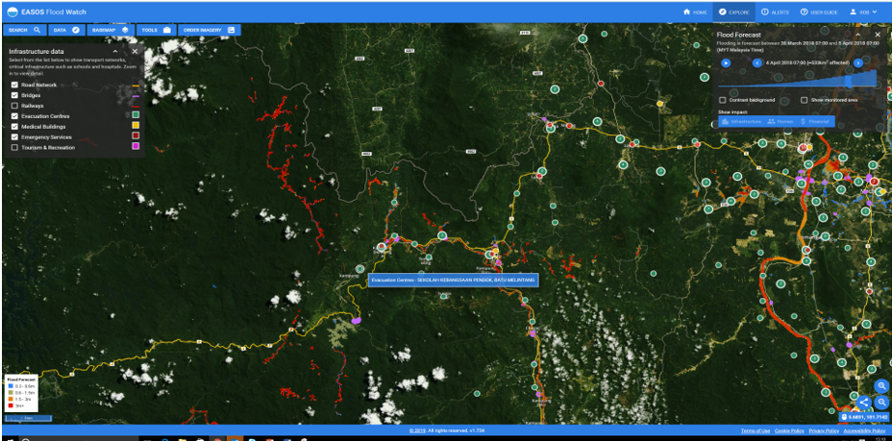
EASOS – Earth and Sea Observation System
Confidentiality Status: Catapult Open
Notes:
Original concept from ISIC aligns well with the Catapults goals
Data hub hosted and shared across two facilities/sites
Each area would also host some compute resources to process the data which inturn would drive innovation and ultimately growth of the economy

Slide 15
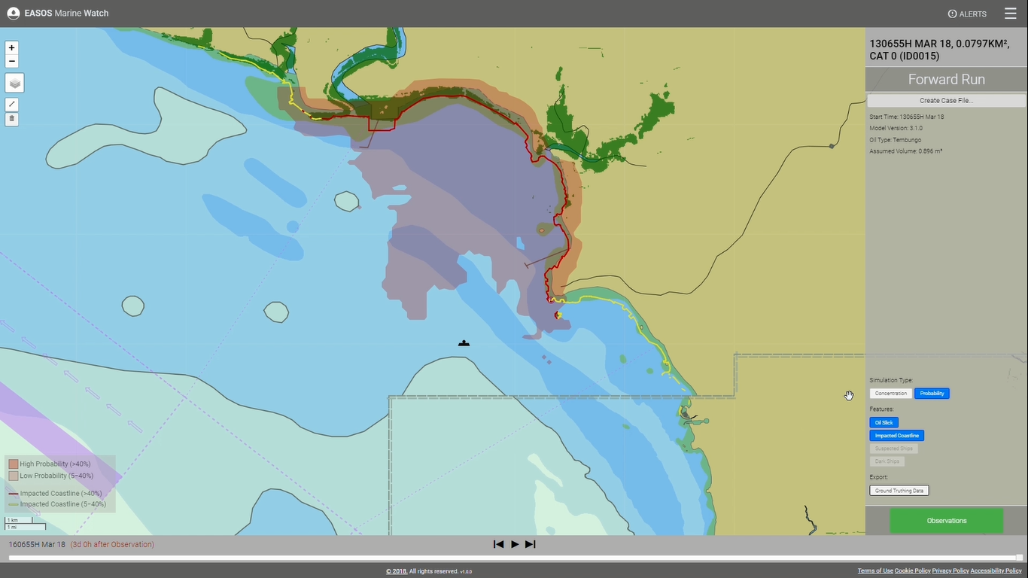
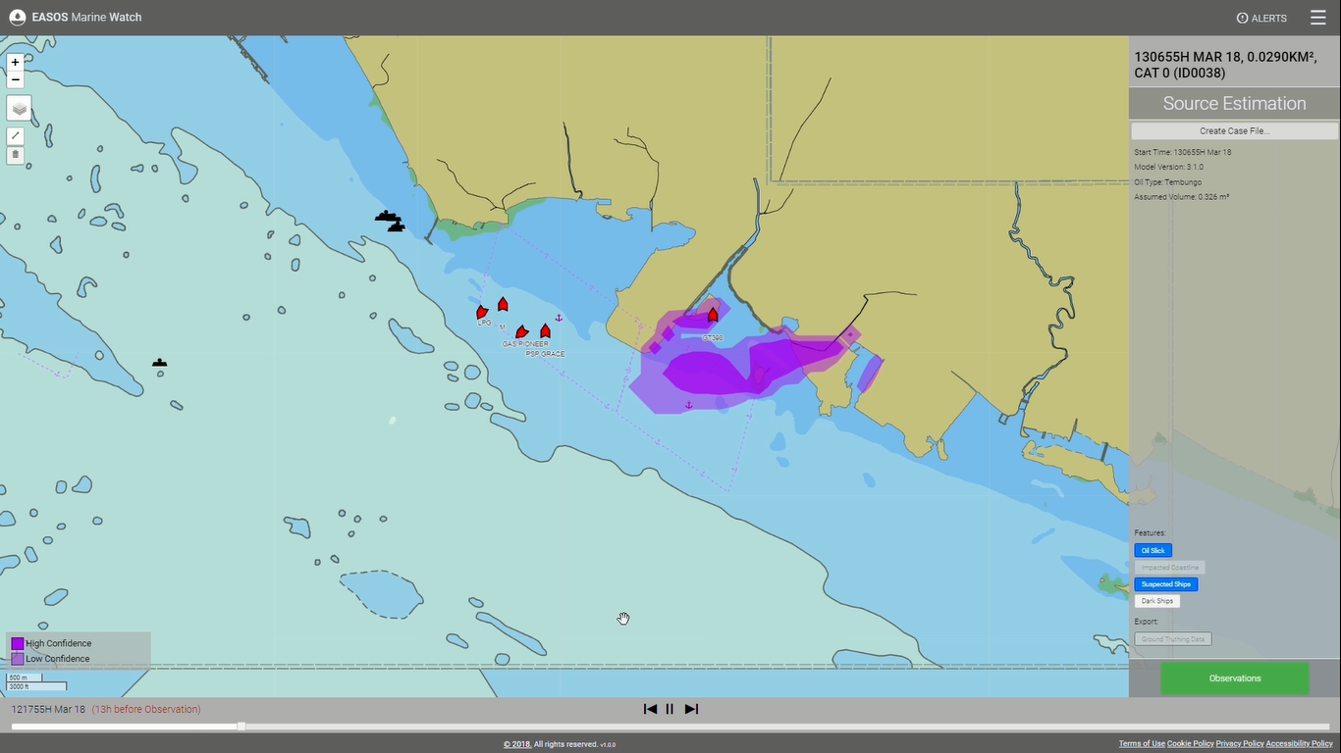
EASOS: MARINE WATCH
Reduce the financial and environmental impact of marine pollution
Benefits
Reduction in financial impact of marine pollution
Early warning of impact to environmentally sensitive coastline
Decision support for containment and cleaning efforts
Reduce loss of habitat and damage to marine life by deterring ships from pumping bilges off the coastline
Detect potential oil pollution incidents on the surface of the ocean
Forecast pollution dispersal for the next 84 hours
Automatic alerts based on areas of interest, oil detection size and forecasted coastal impact
AIS data integration to help identify vessels which could be responsible
Model what-if scenarios for oil spills and model the impact of boom deployment
Rapidly identify nearby vessels which can assist with oil slick assessment
Capabilities
Notes:
• aim for a 10% reduction in the financial impact of marine pollution (RM1 Billion)

Slide 16
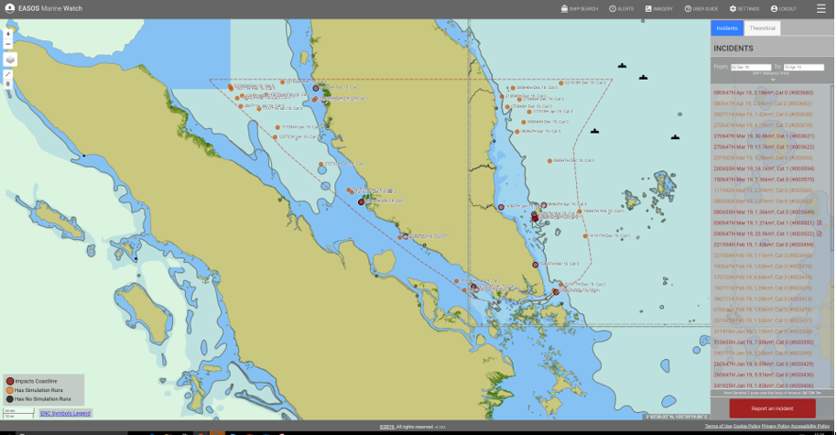
EASOS – Earth and Sea Observation System
Confidentiality Status: Catapult Open
Notes:
Original concept from ISIC aligns well with the Catapults goals
Data hub hosted and shared across two facilities/sites
Each area would also host some compute resources to process the data which inturn would drive innovation and ultimately growth of the economy

Slide 17
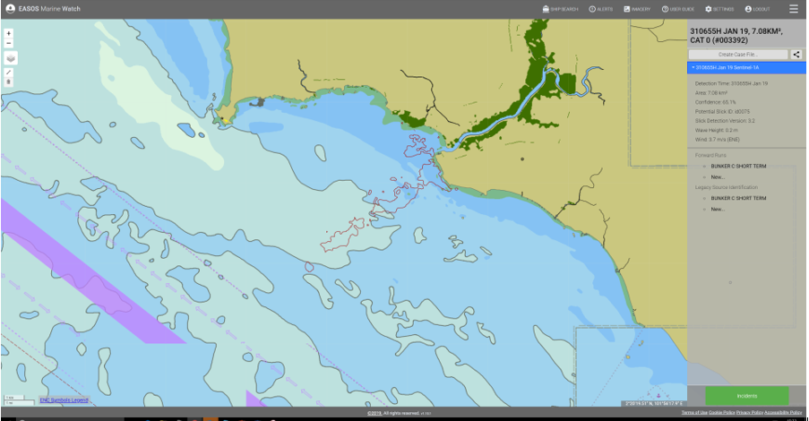
EASOS – Earth and Sea Observation System
Confidentiality Status: Catapult Open
Notes:
Original concept from ISIC aligns well with the Catapults goals
Data hub hosted and shared across two facilities/sites
Each area would also host some compute resources to process the data which inturn would drive innovation and ultimately growth of the economy

Slide 18
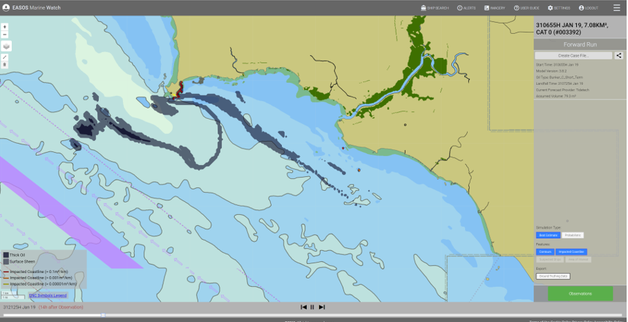
EASOS – Earth and Sea Observation System
Confidentiality Status: Catapult Open
Notes:
Original concept from ISIC aligns well with the Catapults goals
Data hub hosted and shared across two facilities/sites
Each area would also host some compute resources to process the data which inturn would drive innovation and ultimately growth of the economy

Slide 19
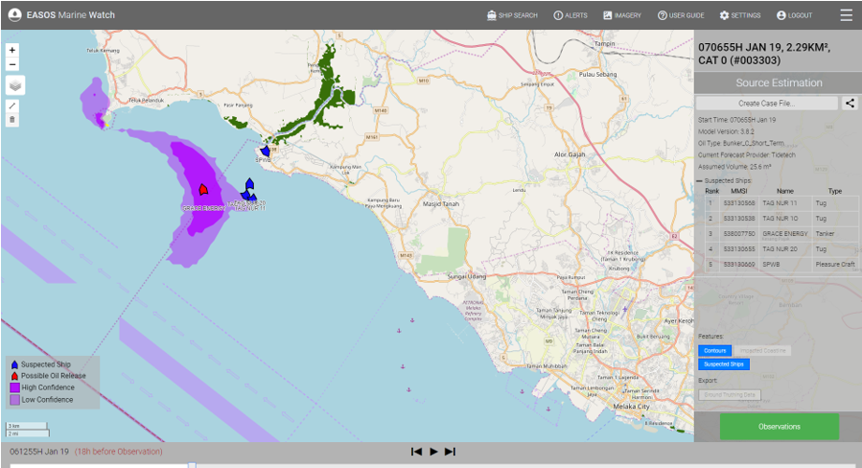
EASOS – Earth and Sea Observation System
Confidentiality Status: Catapult Open
Notes:
Original concept from ISIC aligns well with the Catapults goals
Data hub hosted and shared across two facilities/sites
Each area would also host some compute resources to process the data which inturn would drive innovation and ultimately growth of the economy

Slide 20
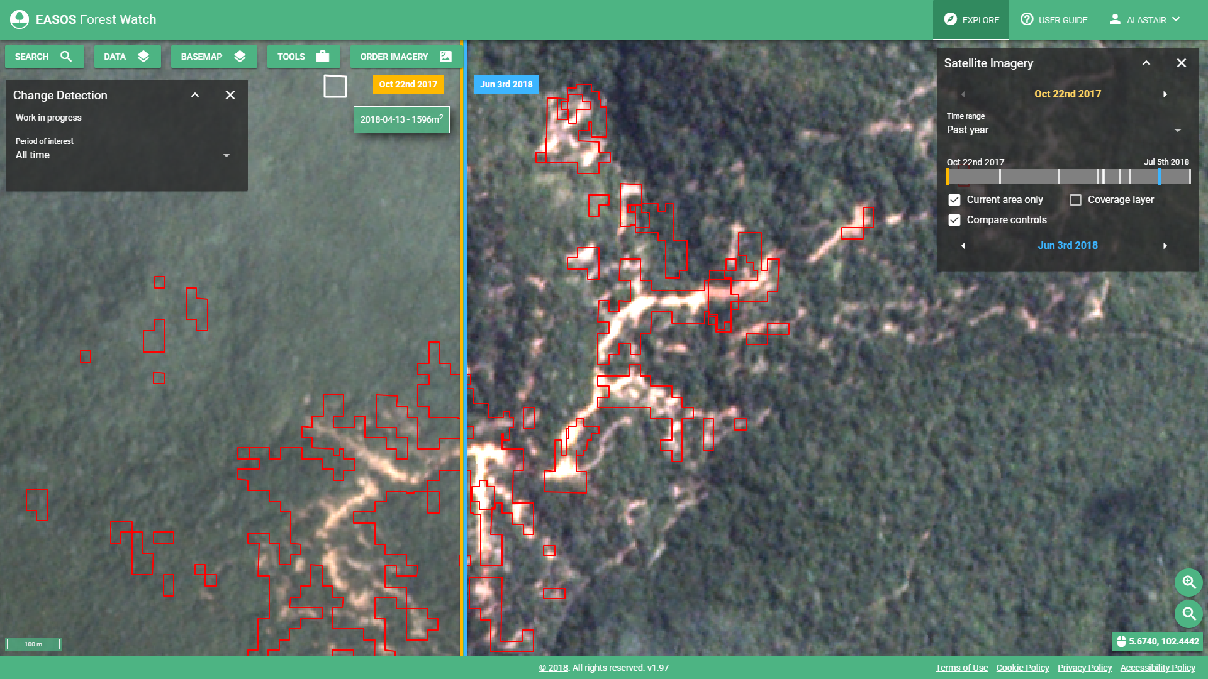
EASOS: FOREST WATCH
Reduce the social and environmental impact of illegal logging
Benefits
Regional level detection and monitoring of logging activities
Enables enforcement of forestry legislation and management practices
Help protect the endangered species threatened by their diminishing habitat
Identify change to the forest canopy in protected areas
Automatic alerts based on areas of interest, detection size and trends
Hotspot monitoring using high resolution Radar data
Capabilities
Notes:
10% decrease in illegal logging – economic benefit of RM 220M
Benefit not only through protection and rehabilitation of Malaysian wildlife but also sustaining tourism.

Slide 21
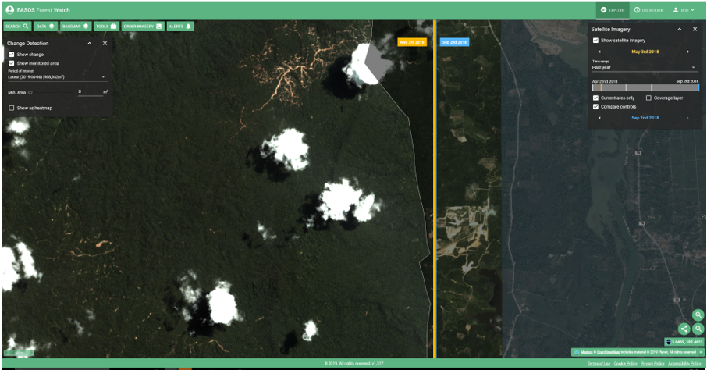
EASOS – Earth and Sea Observation System
Confidentiality Status: Catapult Open
Notes:
Original concept from ISIC aligns well with the Catapults goals
Data hub hosted and shared across two facilities/sites
Each area would also host some compute resources to process the data which inturn would drive innovation and ultimately growth of the economy

Slide 22
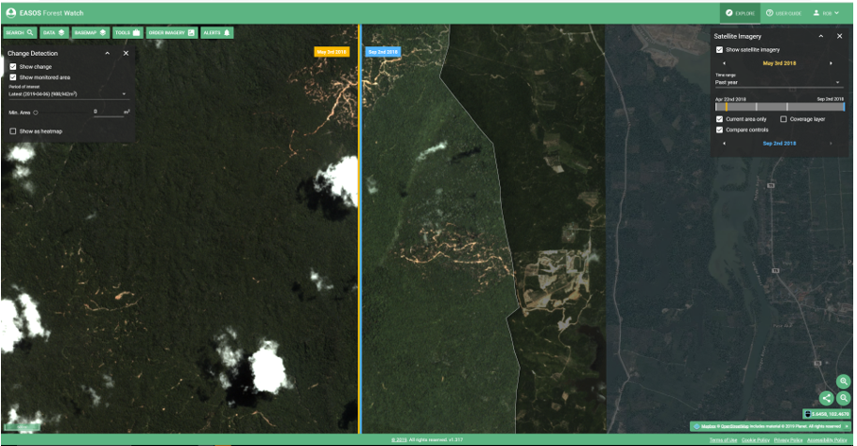
EASOS – Earth and Sea Observation System
Confidentiality Status: Catapult Open
Notes:
Original concept from ISIC aligns well with the Catapults goals
Data hub hosted and shared across two facilities/sites
Each area would also host some compute resources to process the data which inturn would drive innovation and ultimately growth of the economy

Slide 23
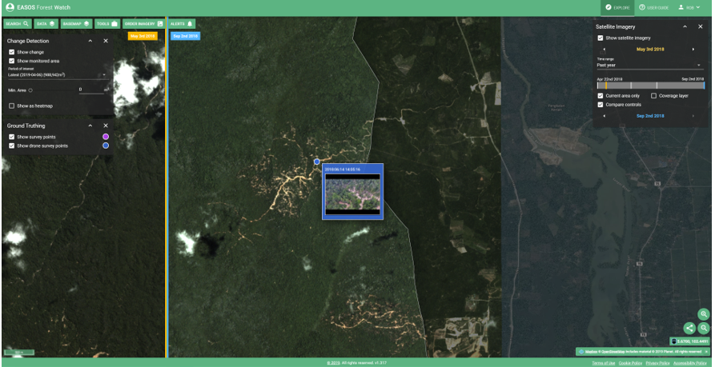
EASOS – Earth and Sea Observation System
Confidentiality Status: Catapult Open
Notes:
Original concept from ISIC aligns well with the Catapults goals
Data hub hosted and shared across two facilities/sites
Each area would also host some compute resources to process the data which inturn would drive innovation and ultimately growth of the economy

Slide 24
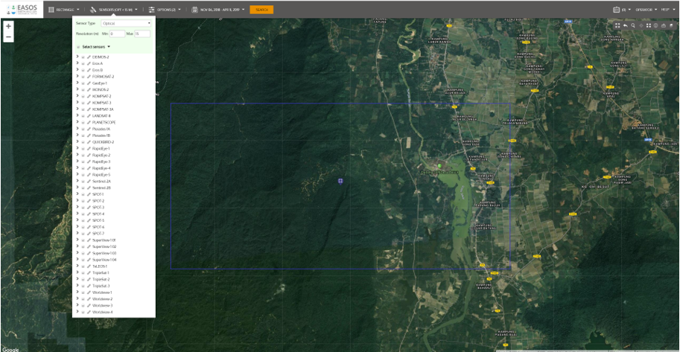
EASOS – Earth and Sea Observation System
Confidentiality Status: Catapult Open
Notes:
Original concept from ISIC aligns well with the Catapults goals
Data hub hosted and shared across two facilities/sites
Each area would also host some compute resources to process the data which inturn would drive innovation and ultimately growth of the economy

Slide 25
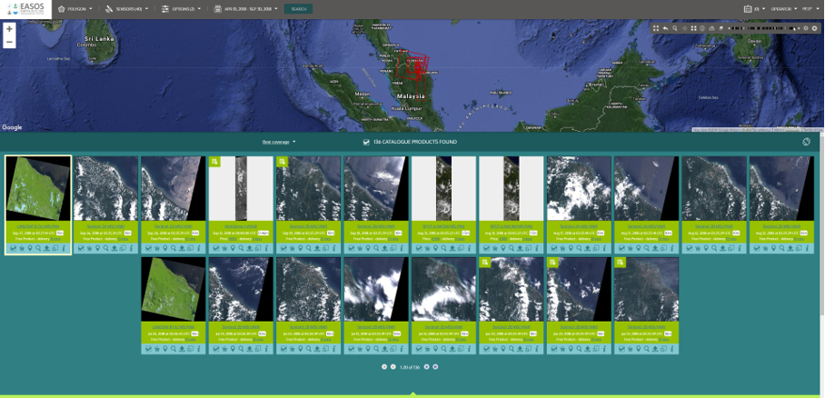
EASOS – Earth and Sea Observation System
Confidentiality Status: Catapult Open
Notes:
Original concept from ISIC aligns well with the Catapults goals
Data hub hosted and shared across two facilities/sites
Each area would also host some compute resources to process the data which inturn would drive innovation and ultimately growth of the economy

Slide 26
EASOS – Earth and Sea Observation System
Confidentiality Status: Catapult Open
Notes:
Original concept from ISIC aligns well with the Catapults goals
Data hub hosted and shared across two facilities/sites
Each area would also host some compute resources to process the data which inturn would drive innovation and ultimately growth of the economy

Slide 27
Links and Contacts
UKSA - https://www.gov.uk/government/organisations/uk-space-agency
Satellite Applications Catapult - https://sa.catapult.org.uk/
CEMS - https://sa.catapult.org.uk/facilities/cems/
SEDAS - http://sedas.satapps.org/
Me – Robert.Fletcher@SA.Catapult.org.uk
Confidentiality Status: Catapult Open
Notes:
Please check out CEMS and register for SEDAS
All feedback is gratefully received
and
Please get in touch to discuss further.
Thank you for listening

