Slide 1
PEPS
French Access to Copernicus Space Data

Slide 2
What’s PEPS today
PEPS – 04 - 12 - 2018
3 main functions:
"Mirror site" of ESA hubs providing access to Sentinel 1, 2 and 3 products
  Automatic download to multiple ESA hubs in parallel (delay <48h)
  Full archive – except S3: only up to 15th April 2019
Processing workshop allowing "first level" treatments, results visualization and products downloading
  New version released in June 2018 and progressively enriched
Incubation of relatively "mature" processing chains for "scale" validation
  5 companies hosted on the CNES computer center + 2 science laboratories
Notes:
WE HOST 4 COMPANIES ON THE CNES INFRASTRUCTURE
BY USING OUR FACILITIES THEY HAVE DEVELOPED, QUALIFIED AND IMPROVE THEIR SERVICES
FROM THIS SUCCES THE CNES WANTS TO HOST AND HELP MORE COMPANIES IN THE FUTURE
WHEN THE COMPANY REACHES A CERTAIN LEVEL OF MATURITY
THEY WILL BE TRANSFERED FROM THE CNES HOSTING TO THE ESA DIAS INFRASTRUCTURE.

Slide 3
Active treatments in PEPS
PEPS – 04 - 12 - 2018
Several standard tools: streaming visualization, NDVI, color compositions…
Dedicated treatments required by some users
Flagship treatments (based on CNES tools)
  Orthorectification of S1 products vs the S2 grid
  S2 ground reflectance using MAJA
  Unitary but also multidate processing (full Ortho and full Maja…)
  Use of WPS protocol
  In progress:
    S2 correlation
    S1 interferometry
    Soil moisture product mixing S1 and S2 data
Notes:
WE HOST 4 COMPANIES ON THE CNES INFRASTRUCTURE
BY USING OUR FACILITIES THEY HAVE DEVELOPED, QUALIFIED AND IMPROVE THEIR SERVICES
FROM THIS SUCCES THE CNES WANTS TO HOST AND HELP MORE COMPANIES IN THE FUTURE
WHEN THE COMPANY REACHES A CERTAIN LEVEL OF MATURITY
THEY WILL BE TRANSFERED FROM THE CNES HOSTING TO THE ESA DIAS INFRASTRUCTURE.

Slide 4
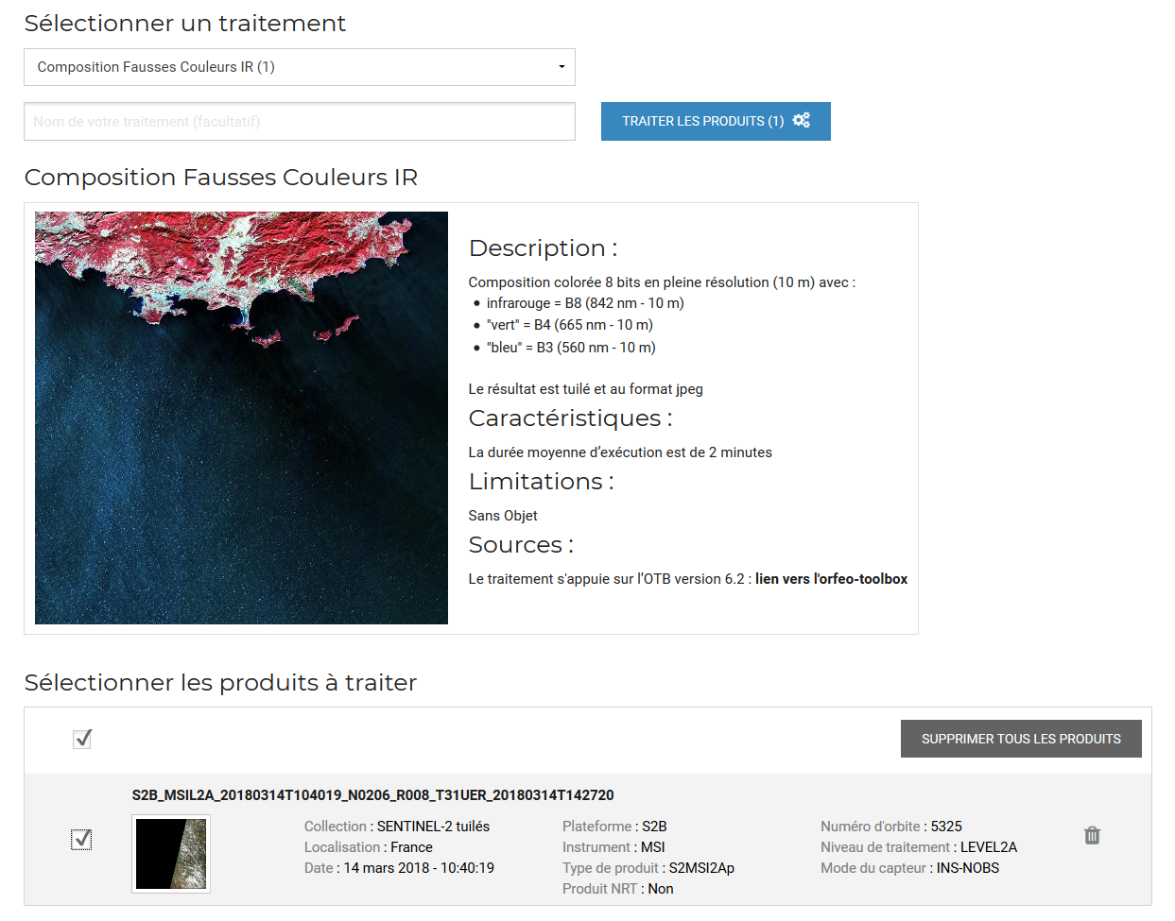
Near Data Processing
PEPS provide online processing facilities
Applications are provided by CNES or by users
This feature simplify the discovery and the use of the information in the spatial data
Notes:
NOT ONLY DOES PEPS PROVIDE THE DATA WE ALSO PROVIDE AN ONLINE PROCESSING FACILITY TO HELP THE USER OBTAIN THE NECESSARY INFORMATION FROM THE DATA
THE CNES ALSO PROVIDES APPLICATION, AND USERS CAN CONTRIBUE TOO, AND SHARED THEIR APPLICATION TO THE COMMUNITY
WITH SIMPLE PROCESSING ALGORITHM THE RESULTS ARE AVAILABLE IN LESS THAN 2 MINUTES ON THE WEBSITE

Slide 5
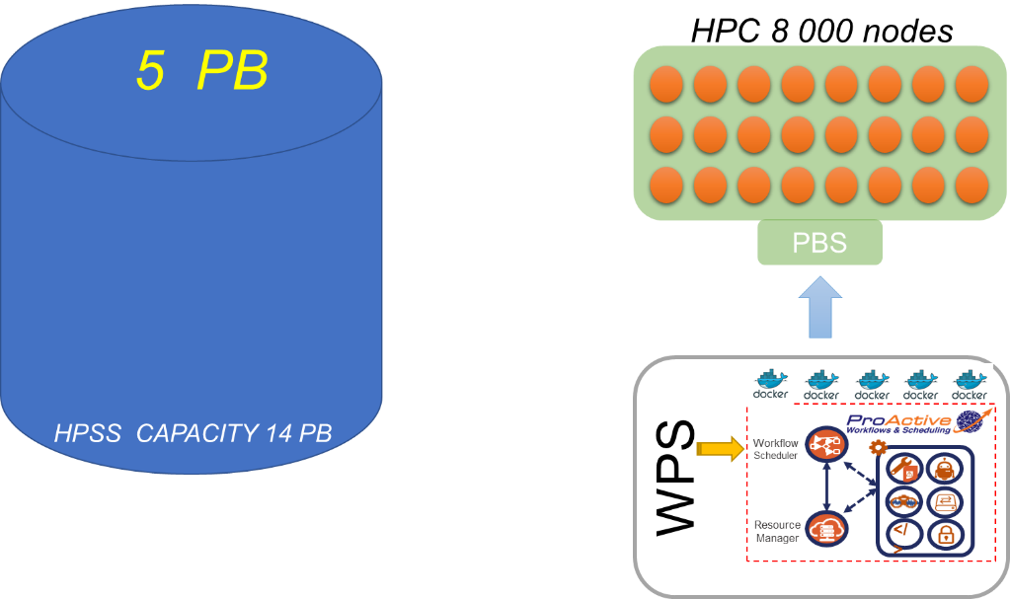
User uptake and Incubation
After agreement, PEPS host companies who want to develop and improve a spatial service
The hosting infrastructure is based on WPS, DOCKER and PROACTIVE meta scheduler
The data are stored close to the HPC/HPDA
9.5 PB
Notes:
SOMETIMES USERS/COMPANIES NEED TO PROCESS A VERY LARGE AMOUNT OF DATA
AFTER AN AGREEMENT, THE COMPANY CAN USE THE HOSTING INFRASTRUCTURE COMPOSED BY THE PEPS ARCHIVE LOCATED CLOSE TO THE HIGH PERFORMANCE COMPUTING CLUSTER
WE STANDARD SOFTWARE WPS AND DOCKER ON THE HOSTING INFRASTRUCTURE AND A META SCHEDULER NAMED PROACTIVE
PEPS GIVES THE POSSIBILITY OF SIMULTANOUSLY PROCESS A LARGE QUANTITY OF DATA
THIS THE BEST VALUABLE SERVICE PROVIDED BY PEPS, WE ALSO PROVIDE THE TECHNICAL AND THEMATICAL SUPPORT IF NECESSARY

Slide 6
PEPS link with Thematic Data Centers / hubs
PEPS – 04 - 12 - 2018
MUSCATE environment uses PEPS catalog and access directly to the products
  For Theia (Land Surface Thematic Data and Services Center)
    systematic MAJA processing over France, north Africa…
    + snow detection, monthly L3A synthesis, land cover…
    http://www.cesbio.ups-tlse.fr/multitemp/?p=14600
  For Form@ter (Solid Earth Thematic Data and Services Center)
    systematic interferometry processing over large areas
SPOT archive
  Provide access to SPOT data to complete Sentinel2 time series (SWH processing)
Notes:
WE HOST 4 COMPANIES ON THE CNES INFRASTRUCTURE
BY USING OUR FACILITIES THEY HAVE DEVELOPED, QUALIFIED AND IMPROVE THEIR SERVICES
FROM THIS SUCCES THE CNES WANTS TO HOST AND HELP MORE COMPANIES IN THE FUTURE
WHEN THE COMPANY REACHES A CERTAIN LEVEL OF MATURITY
THEY WILL BE TRANSFERED FROM THE CNES HOSTING TO THE ESA DIAS INFRASTRUCTURE.

Slide 7
Data storage
PEPS – 04 - 12 - 2018
Volume of stored data
  ≈ 9.5 PB - around 4 PB in line
  14,175,000 products
Available storage capacity: 14 PB
Logic for storage:
  Oldest data are transferred to tape storage devices (longer delay for data retrieving)
  Sentinel-3 products are systematically transferred after a few days
Easy upgrade for storage capacity if needed
Good margin in the capacities dedicated for users processing

Slide 8
PEPS
Some statistics
septembre 2018

Slide 9
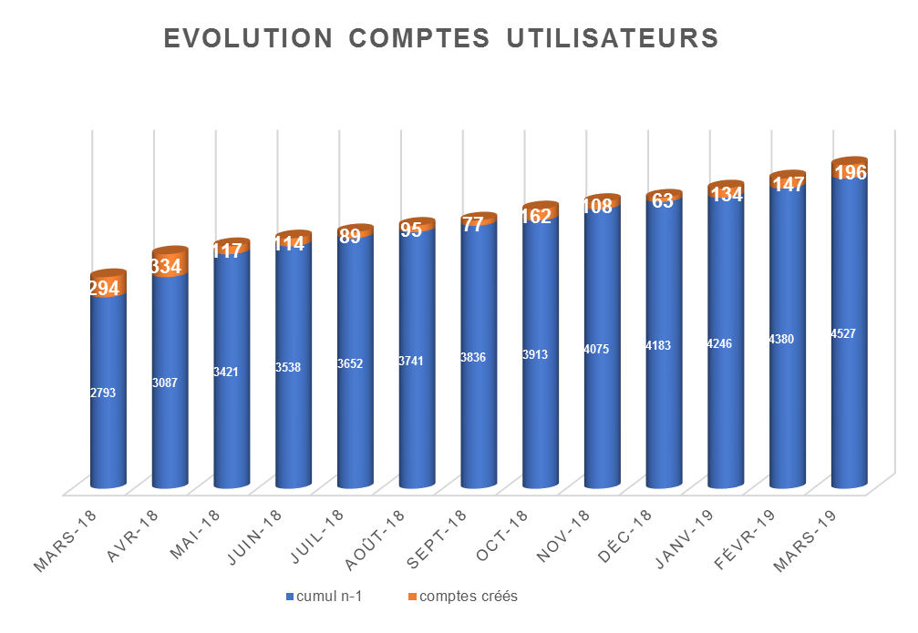
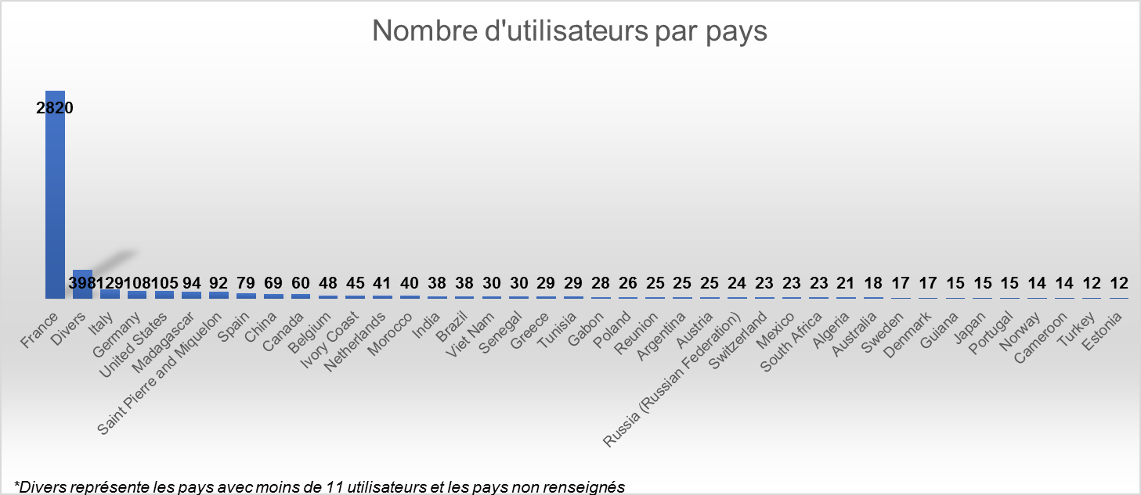
Stable increase of registered users
PEPS statistics – 04/12/2018
Users registration evolution
4713 registered users
(french users: 59.8%)
Users countries repartition

Slide 10
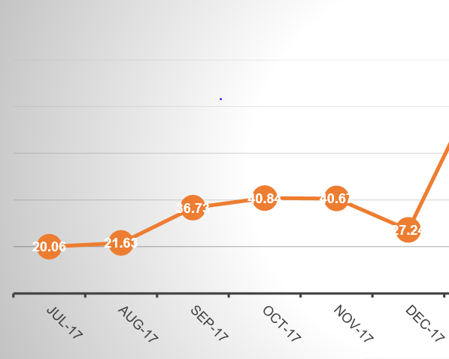
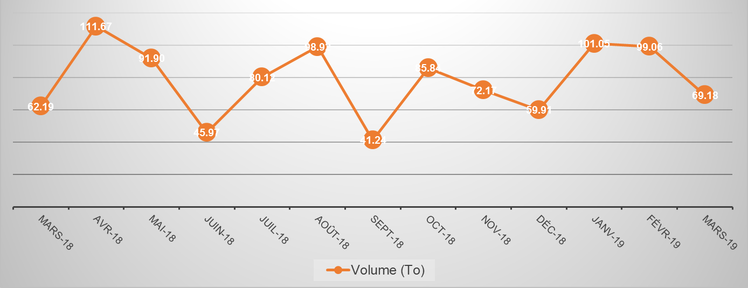
Increase of the distributed data volume (but very irregular)
PEPS statistics – 04/12/2018
- 2019 vs 2017: X2

Slide 11
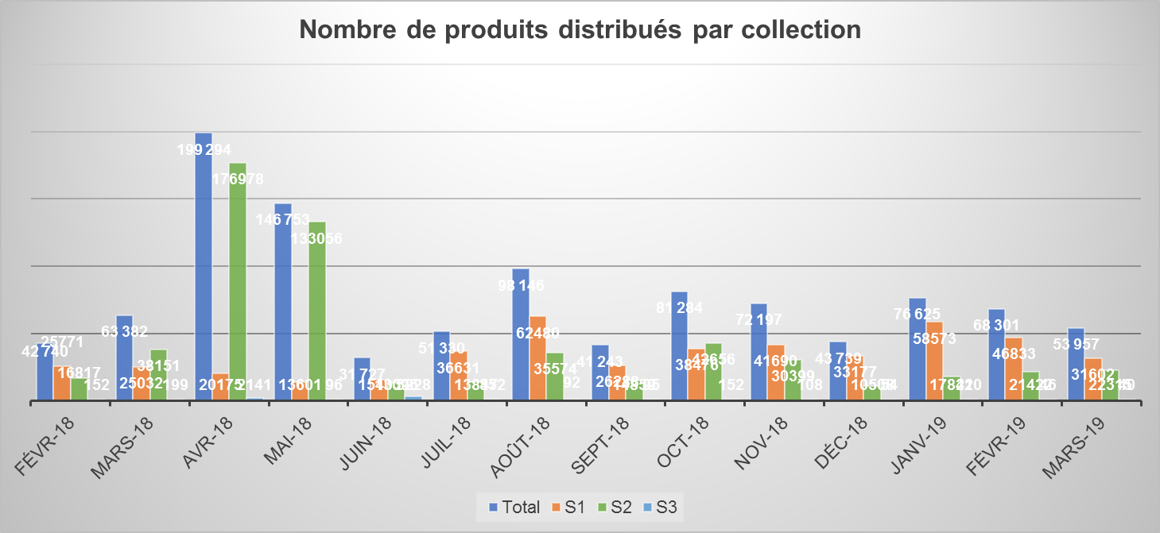
Which is the ‘top’ Sentinel?
PEPS statistics – 04/12/2018
Number of distributed products for each Sentinel
60% S1 – 40% S2 - <1% S3 (huge download of S2 products by Google in april/may 2018!!)

Slide 12
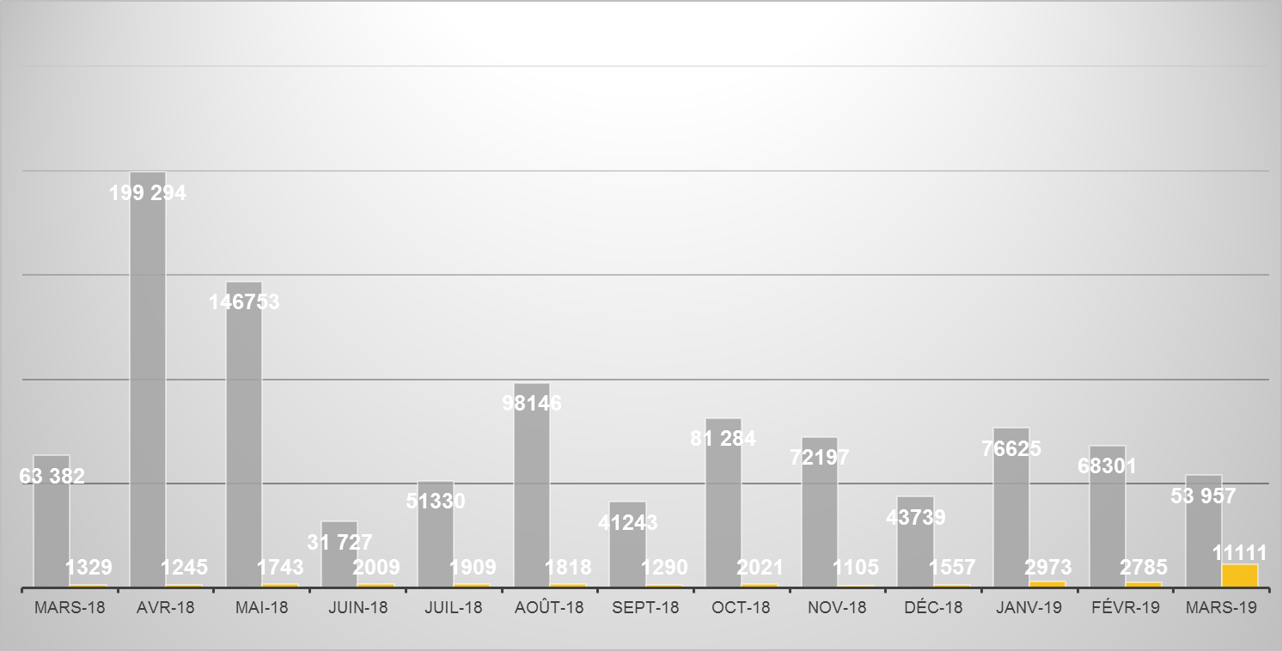
Archive products / ‘fresh’ products
PEPS statistics – 04/12/2018
≈1/5
Google archive in april/may

Slide 13
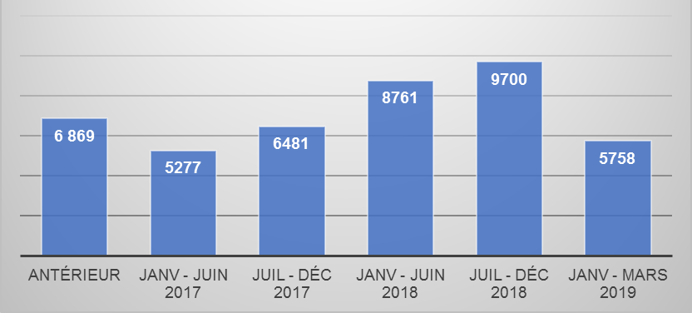
Strong interest for archive data
PEPS statistics – 04/12/2018
Number of distributed products per acquisition date

Slide 14
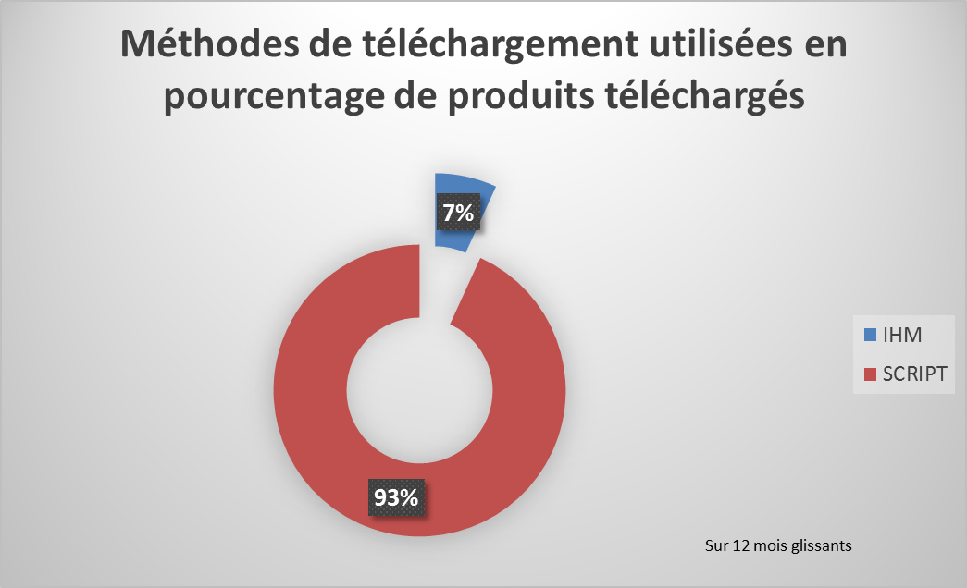
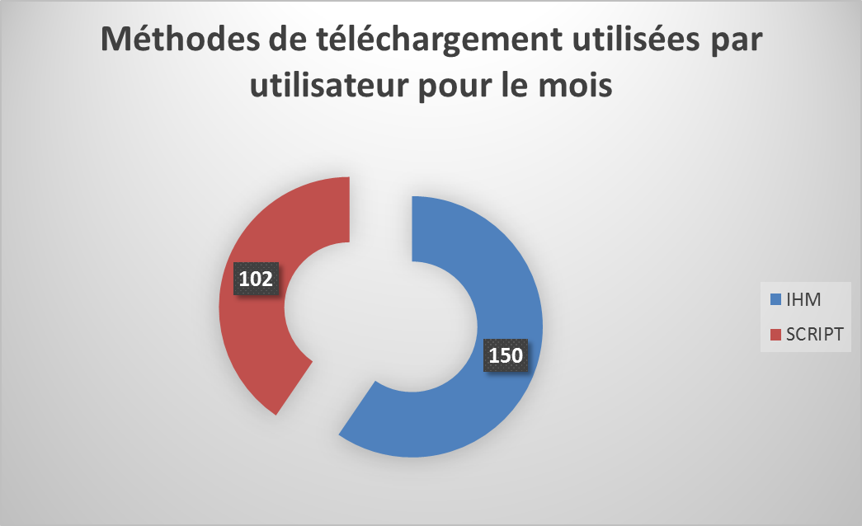
How to access the data ?
PEPS statistics – 04/12/2018
Volume of downloaded data
script vs interactive
Number of users
script vs interactive

Slide 15
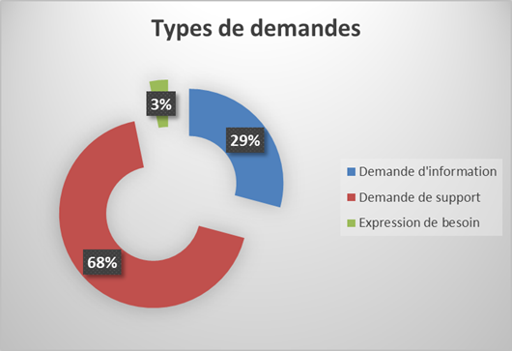
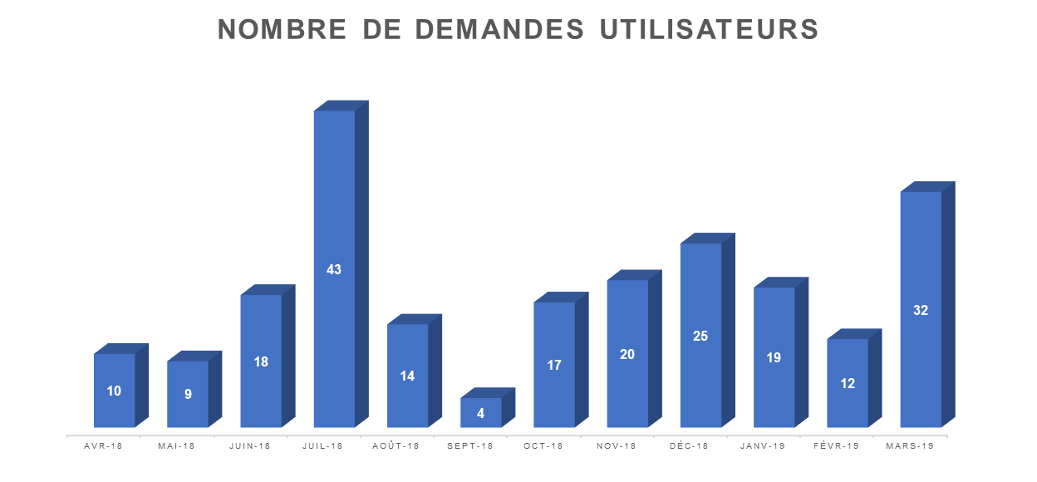
Users help desk exppeps@cnes.fr
PEPS statistics – 04/12/2018
Type of request
Number of users requests
*
Information
Help request
Request for new needs
Average delay
- 48H
*Request number increase due to deactivation of the downloading of stored products (not on line). Temporary necessity for manual operator activation.

Slide 16
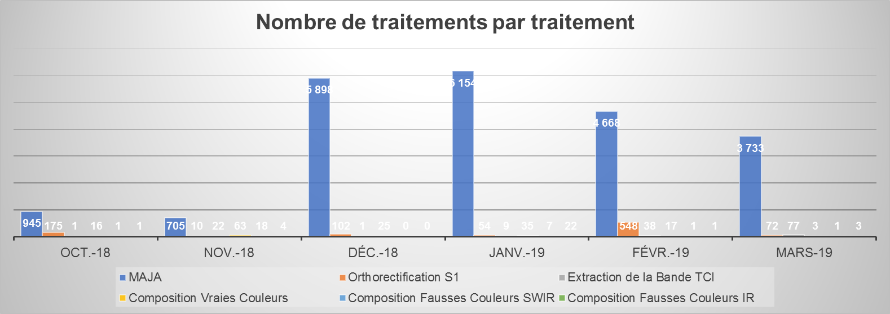
Number of treatments performed
PEPS statistics – 04/12/2018
  MAJA
  S1 ortho.

Slide 17
PEPS in 2019
PEPS – 04 - 12 - 2018
Exploitation runs smoothly
  Regular upgrades
    Optimisation of data download functions
    Users data access interface improvements
  Very low interest for Sentinel-3 data
  Some users ask for S2_L1B products
Downloading data from ESA hubs
  ESA distribution relatively mature
  Strong and efficient ESA support both for information requests and for back log retrieving in case of maintenance/crash or data gaps filling
What will be PEPS tomorrow?
Notes:
WE HOST 4 COMPANIES ON THE CNES INFRASTRUCTURE
BY USING OUR FACILITIES THEY HAVE DEVELOPED, QUALIFIED AND IMPROVE THEIR SERVICES
FROM THIS SUCCES THE CNES WANTS TO HOST AND HELP MORE COMPANIES IN THE FUTURE
WHEN THE COMPANY REACHES A CERTAIN LEVEL OF MATURITY
THEY WILL BE TRANSFERED FROM THE CNES HOSTING TO THE ESA DIAS INFRASTRUCTURE.

