Slide 1
Food Security TEP - WGISS-47
Antonio Romeo
29/04/2019

Slide 2
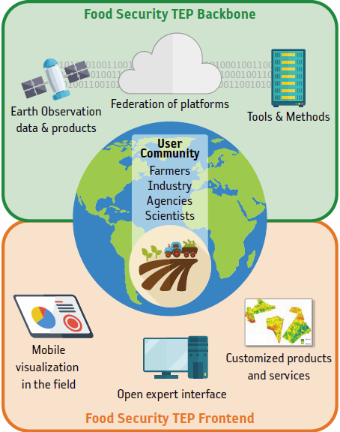
Supporting Sustainable Food Production from Space
Access to key satellite products and ancillary data, backed up by a scalable processing infrastructure
Access to tools to derive agricultural and
aquacultural products
Technical support for platform use
Interact with a range of users through a dedicated forum
Provision on request of high-accuracy, quality checked vegetation parameters (LAI, fAPAR, etc), suitable for use in operational scenarios.
Ability to easily develop new services, with the ability to share processors and outputs only with selected user groups
Access to ready-to-use products or customized services
New Business Model offer for private companies

Slide 3
Target User Community
Universities
Researchers
App developers
Service Providers
Start-ups
Public Entities
International Bodies
Agriculture and Aquaculture industry
Finance industry

Slide 4
The Project Team
Prime contractor: Vista
Platform developer: CGI, VITO (Proba-V MEP intereaction)
Thematic service providers: Vista, VITO, Hatfield

Slide 5
Project Schedule
Last (17) sprint will end in May
6 more months of pre-ops until November
Early adopter program available
Independent evolution after end of project with ESA sponsoring usage via Network of Resources

Slide 6
Portfolio 1/2
Analytical tools: SNAP, R Studio, Orfeo, QGIS, Jupyter notebooks
Access to tools for computing basic key indices (vegetation and water content indices from Sentinel-2 data, as well as chlorophyll, soil and red edge indices) on the fly
Provision of high-accuracy, quality checked biophysical parameters (Leaf Area, fAPAR, fCOVER, NDVI) generated for Pilot projects
Docker based user algorithm integration

Slide 7
Portfolio 2/2
Supplemental Dataset | Spatial res. | General information and metadata
ALOS Global Digital Surface Elevation Model (AW3D30) | 30 m | http://www.eorc.jaxa.jp/ALOS/en/aw3d30/index.htm
Copernicus Pan-European High Resolution Layers 2015 | 20 m | https://land.copernicus.eu/pan-european/high-resolution-layers
GFSAD 30m Global Cropland Extent 2015 | 30 m | https://croplands.org/
ESA Climate Change Initiative Global Landcover 2015 | 300 m | https://www.esa-landcover-cci.org
GADM Global Administrative Areas 2018 | (vector) | https://gadm.org/data.html

Slide 8
DEMO
Visit: https://foodsecurity-tep.net/

