Slide 1
The Geohazards Exploitation Platform (GEP)
WGISS-47
The 47th Meeting of the Working Group on Information Systems & Services
2019-04-30
Francesco Barchetta

Slide 2
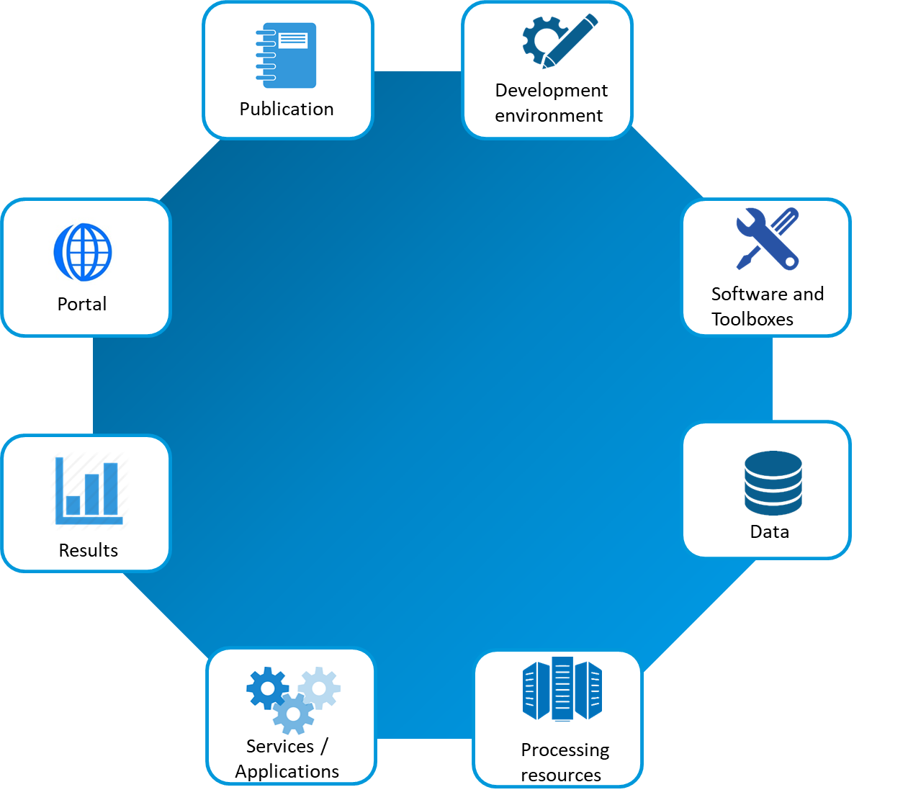
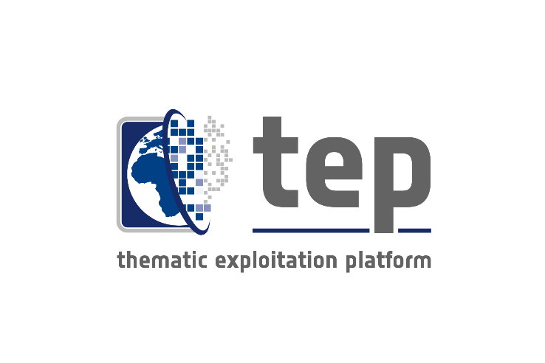
Exploitation Platforms
EXPLOITATION PLATFORM
EO software
ICT resources
EO data
In-situ data
Exploitation platform (or community platform)
=
Virtual open and collaborative environment
Notes:
bringing together:
data centre (EO and non-EO data)
computing resources and hosted processing
collaborative tools (processing tools, data mining tools, user tools etc.)
development tools and test bench functions
communication tools (social network) and documentation

Slide 3
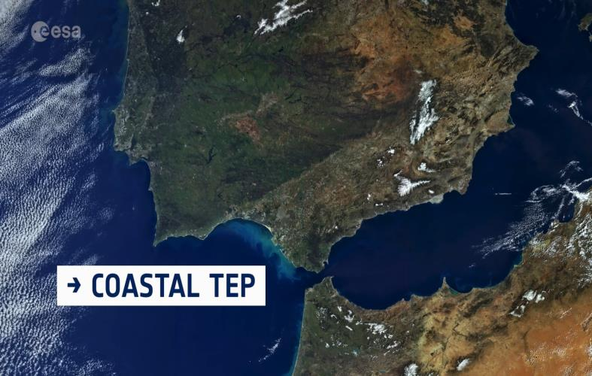
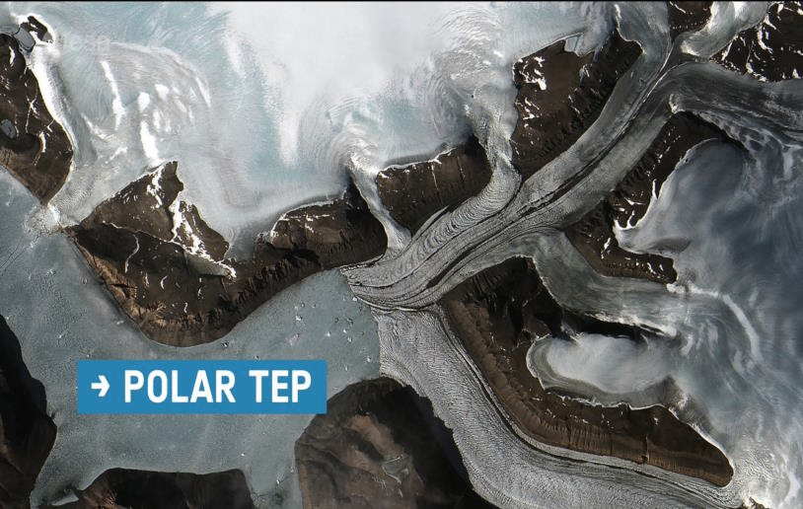
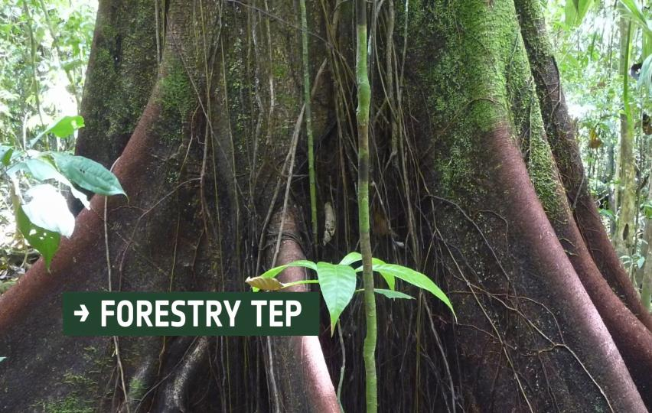
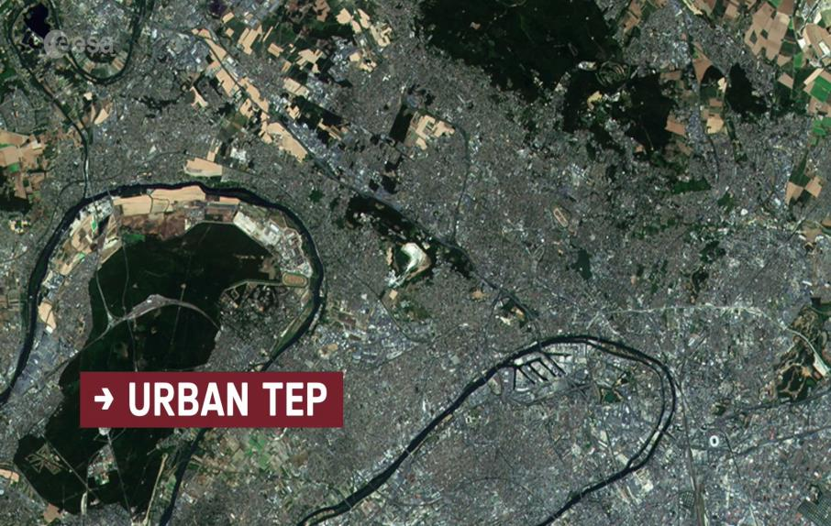
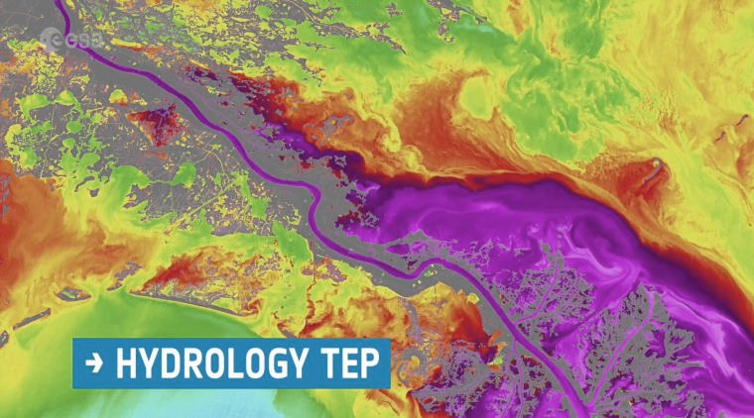
Thematic Exploitation Platforms
A unique environment to cover different aspects of coastal environment.
A unique set of tools to address the challenges of monitoring tectonic areas, earthquakes, volcanic eruptions and landslides
Supporting sustainable food production from space
The easier options for processing large volumes of EO data for the polar regions
Forestry remote sensing services for the academic and commercial sectors.
Ready-to-use data, innovative and actionable information generation supporting the realization of sustainable cities and communities.
A powerful community platform to generate and share your own water information from earth observation solutions.

Slide 4
The Geohazards Exploitation Platform (GEP)
Consortium: Terradue (IT), CNR IREA (IT), INGV (IT), DLR (DE), TRE ALTAMIRA (ES), EOST-CNRS (F), ENS-CNRS (F)
Develop an Exploitation Platform based upon virtualisation & federation of satellite EO data and methods
Provide innovative responses to the needs of the geohazards community
As a Platform, GEP:
Provides on-demand processing services for specific user needs
Runs systematic processing services to address “common information” community needs
Connects to massive compute power on multi-tenant Cloud Computing resources, to address the challenges of monitoring tectonic areas, globally
Connects to full Copernicus Sentinels-1/2/3 repositories
Connects to 70+ TB of EO data (ERS and ENVISAT archive), and specific data collections from EO missions, such as JAXA’s ALOS-2, ASI’s Cosmo-Skymed and DLR’s TerraSAR-X, provided under special arrangements in the framework of the CEOS WG Disaster and GSNL.

Slide 5
GEP v2 is there!
New features provided by the GEP:
20+ on-demand services using both Optical & SAR data grouped in Thematic Apps according to the user profile
including new advanced services available for both Optical & SAR data: (SAR based SBAS multi-baseline processing chain (CNR IREA, InSAR measurements), DSM OPT and MPIC OPT chains (CNRS EOST, Optical measurement using Sentinel-2 & VHR data)
New basic services providing full resolution Geotiff imagery (RASTER on-demand service) and change detection imagery (SNAP based COIN & SNAC tools) for rapid on-line visualization
8 systematic services including the large scale production of Sentinel-1 InSAR browse images at both 100m and 50m resolution over tectonic regions GEP V2 bringing enhanced platform capabilities:
improved processing time and system scalability allowing parallel massive data processing
multisourcing to optimise data access
integration with new Cloud based processing environments (such as the DIAS)
visualize many large images and products on the geobrowser with a low latency
display dynamic histograms of a query result over selected time span and area of interest for any data collection
directly publish the results of a processing chain for community sharing
The GEP Early Adopter programme is able to on board additional users
geohazards-tep@esa.int
Notes:
Left – Danube Delta (Romania)
Middle – Mount Etna (Sicily, Italy)
Right – South-East Greenland (glaciers)

Slide 6
Demo time…

