Slide 1
The European
Data Cube Facility Service (DCFS)
A European Data Cube service for EO
30 April 2019

Slide 2
The European Data Cube Facility Service
Agenda
DCSF the whole picture, offer and service deployment
DCFS architecture
The Interoperability layer & OGC / Standardisation contribution
Conclusion / benefits for the user

Slide 3
DCFS a Service of the EO Platform Ecosystem
DCSF implements a Platform Service for higher-level data analytics
DCSF functions become apparent to End-users as a set of services in the top Exploitation Layer
DSCF utilizes tiers in EO Networks of Resources for storage and processing
DCFS is driven by the characteristics and availability of source data which it retrieves and synchronizes with EO ground segments and with providers of auxiliary data

Slide 4
DCFS Offer - The main Services
The DCFS combines different, state-of-the art solutions:
  an on-the-fly data cube access service (Sentinel Hub),
  a mass processing Sentinel Hub services with asynchronous response,
  and the versatile pre-generated data cubes (XCUBE), based on xarray like the CEOS Open Data Cube, Pangeo, and other leading data cube initiatives
DCSF therefore offers Analysis Ready Data (ARD) from L2 to L4 including also non-EO data for a wide range of applications that can be tailored according to user specific needs
On top of EO community and GIS users the DCSF targets Algorithm/applications and data providers delivering industry-leading solution and expertise to expand the offer from 3rd party sources

Slide 5
DCFS Offer - The Use Cases
The DCFS will enable:
  Information Layer Publishing,
  On-Demand Mapping
  Cross-Mission Analysis
Users will be able to manipulate / work with
  Basic instrument data (Jupyter Notebook based template, which will have access to global coverage of all supported open missions)
  Level 3 / 4 data (combination of Data Layers and Environment Variables Data Layers according to the specification of the user)
DCSF will support Thematic use cases (Geo-rice, U-TEP, Vegetation status, Chemical weather monitoring, Inland water quality) and will become the engine of the ESA Earth System Data Lab

Slide 6
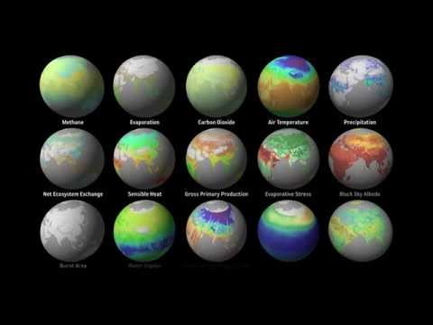

Slide 7
DCFS Offer – The Data
Data stored on various clouds, wherever the conditions are best for the data owner (CreoDIAS, Mundi, ONDA, AWS, GCP, etc.)
Access to instrument-EO data on a common, user-defined grid (as default: Sentinel, Landsat, ENVISAT, MODIS, U-TEP data set, DEMs-SRTM30)
Access to non-EO data on a common grid / mix of Instrument Data layers and Environmental Variable layers (incl. Copernicus Services and ESA’s CCI data and already available ESA’s ESDL and H2020 DCS4COP projects + API to configure additional data sources)
Further generation of Data Layers (i.e. by integration of value adder algorithms, Python, R, Jupyter notebook, thematic processing with VMs+toolboxes )
Planet Scope for VHR data

Slide 8
DCFS Offer - Services cost (user price list still under definition)
Subscription packages (monthly/annual) and Pay-per-use for basic use
Advanced options (requiring customization) at additional cost or minimum use commitment
  New (complex) algorithm/processing chain on mass processing and XCUBE
  Pre-processing and storage for XCube
  Additional modules
  Built advanced options available to all without additional costs
Notes:
The DCSF offers Monthly/Annual subscription or Pay-per-use (Sentinel Hub / mass processing / XCUBE) with associated request volume
Customization cost or minimum use commitment, to cover overhead, when a new user algorithm/processing chain is deployed (mass processing and XCUBE option). New options and “templates” available to all without additional costs.
The XCUBE foresees additional costs for processing & storage (per GB in the order of Euro cents)
Rich Geo-spatial client customization from example portal template will be charged one-off
Some Data Cube templates will be provided for free (basic instrument data and Geo-Rice), further level customisation and advanced/thematic templates will be charged

Slide 9
DCFS - Deployment time line
KO April 23rd ’19
KO + 3 M Start of (reduced/experimental) service
KO + 6 M Start of Service Operations
KO + 12M Full Service deployment
    Project total duration 36 Months (+optional 24 months extension)

Slide 10
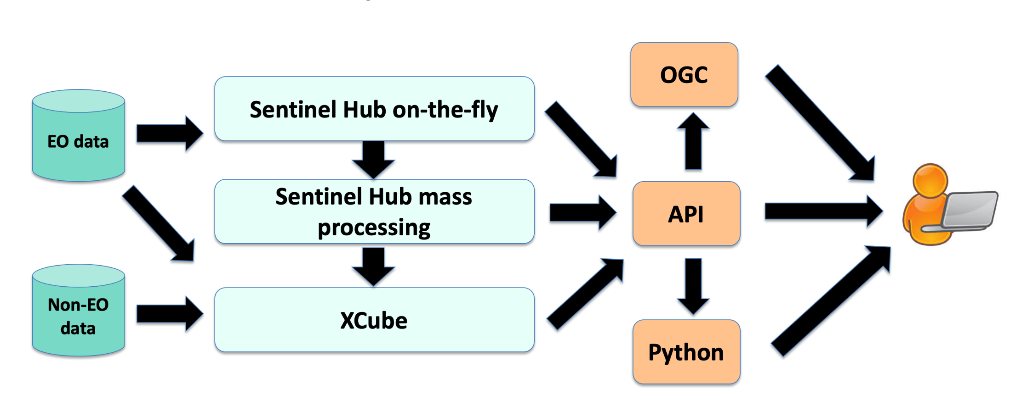
DCFS – Overall Architecture

Slide 11
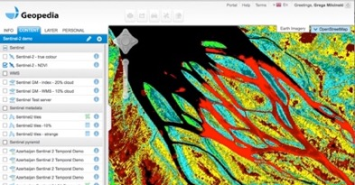
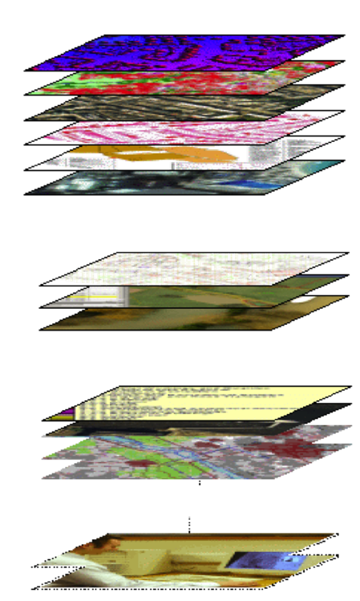

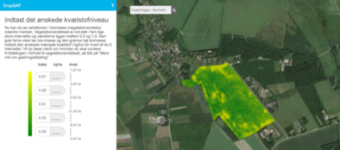

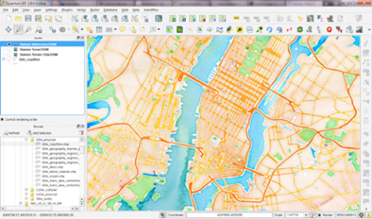
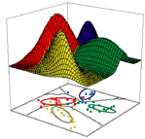
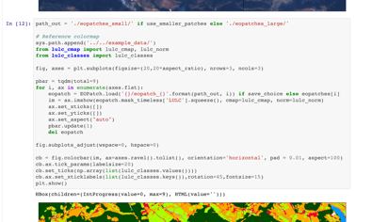
DCFS – Architecture: Sentinel Hub
Open EO data - Sentinel-1, Sentinel-2, Landsat, etc.
Cloud GIS
WMTS
Commercial EO data – Planet,...
Web / Mobile apps
WMS
WCS
Aerial imagery (drone, plane)
API
Desktop (QGIS,, ArcGIS…)
Other raster data
Machine learning
Scripting (R, Python, ENVI…)

Slide 12
DCFS – Architecture: Sentinel Hub
On-the-fly Data Access Service in combination with fast cloud-based object storage powered by the Sentinel Hub (light processing) further enhanced:
satellite imagery processing service, which is capable of on-the-fly gridding, re-projection, mosaicking, compositing and other actions required for efficient fetching of data for end- users (does not require replication or pre-processing)
handle multiple 3rd party cloud infrastructure through a micro-service approach providing efficient (orchestrated, scaled & parallelized) data access and distribution in a matter of seconds
Simple custom scripting engine, which allows user to input an algorithm defining pixel- based data processing (JavaScript, Python with additional library sentinelhub-py)
Support for data fusion, allowing using data from different data sources
Proprietary POST API and OGC (WMS/WMTS/WCS) interfaces to access the data
SH operational since 2016, currently serving up to 150 million requests per month

Slide 13
DCFS – Architecture: mass processing SH
First extension offers asynchronous mass processing capability, to apply moderately complex operations through the Custom Script functionality / user-triggered or push-based, so that some optimal level of pre-processing is achieved. Mass processing SH capability includes:
integration of 3rd party tools, e.g. Sen2Cor, SNAP, etc. –tools, which are commonly used in EO data processing and can be run in a parametrised fashion
Scheduling and Parallelization of processing and ad-hoc engagement of a fleet of virtual machines assisting the process
Caching of intermediate products so that these can be served further using basic Sentinel Hub capability
Current JRC Sentinel-2 Global Mosaic service is a precursor of the “mass processing SH” concept that will be further enhanced in the DCFS to allow custom scripts.
Note: Both SH and mass processing SH support users to configure their own algorithms

Slide 14
DCFS – Architecture: XCUBE
For more complex operations an xarray-based technology to transform and store input data into a data cube adhering to the Common Data Model
Allows access to the instrument data but also to environmental variables from non EO data (L2C data cubes further generating other L2C and L3 data cubes)
An XCUBE can be temporarily / permanently stored (cloud-optimized zarr format, Mongo Database for Vector data, In-Situ / NetCDF)
Sentinel Hub is the default source for input data and used whenever possible
Easily configurable and adjustable in terms of covered area, period, included data layers, temporal and spatial resolution, and projection
XCUBE’s are fully defined by their configuration, which can be stored and shared as a template – for re-use or to facilitate the establishment of new XCUBEs (e.g. GEORice project of ESA’s Data User Element). Data Cube templates can be re-used across users
XCUBE is based on ESDL technology (server part)

Slide 15
DCFS – Architecture: Main Data Interface (MDI)
All Data cube core functionalities are available through a single and harmonized, main interface -> MDI acting as a Central point of interaction for the DCSF components providing:
harmonized POST API access to EO / non-EO / GIS data of all data cube tools
administrative functionality like authentication (OAuth, Edugain) , security, load balancing, monitoring, transaction metering and billing
data cube orchestration (between DCSF / Cloud instances)
Support (I/Fs) to Data cube federation
On top of direct MDI API access from DCFS client: many “proxy” interfaces supported to enable easier access to data from standard GIS tools (OGC compliant services), Python, R, QGIS, machine learning tools,
DCFS catalogue service (to enable users to find the input data available for data cube generation)

Slide 16
DCFS – Architecture: Front-ends interfaces & factory/business outlets
Client Data Processing Engine (CDPE): client-side processing of COGs
Sentinel Playground and EO Browser (geospatial GUIs)
OGC-compliant Web Service APIs: “proxy” which handles OGC-compliant service transactions and translates them to the main data cube API
OGC-compliant Web client apps: software packages capable of handling the client-side of the OGC protocols (OGC WCS QGIS plug-in, re-useable GUI widgets software…)
3rd party/value adder layers registration/ingestion
Example of notebooks, web portal(s), are prepared and tuned as “showcase” examples

Slide 17
DCFS – Architecture: Market Place / DCFS Landing page
Attractively designed service catalogue to attract external providers including commercial market participants, scientific initiatives, and institutionally funded programmes
Promotional Service Portal built and maintained for presentation of DCFS native services and DCFS-empowered services provided by Customers
Social network functions
Links to showcase examples of the provided services (users are invited to clone the code of the example pages)
Legal information necessary to appear on a Web site
End-user Self-Registration and Login forms

Slide 18
DCFS – Architecture: Deployment & Federation
The Data Cube stack can be deployed on various cloud infrastructures - Mundi, Onda, CreoDIAS, AWS, CDS, Multi-mission PDGS, etc and connected to their datasets
Federation also with external Data Cubes (interoperability at API and encodings level with the OGC requirements)
DCFS that adhere to the Xarray data model could also be federated natively with CEOS Open Data Cubes as they also use the Xarray data model

Slide 19
DCFS – The Interoperability layer
Contribution to the Open Data Cube OGC Web Services (OWS) repository / WCS access support includes:
WMS 1.0/1/3, WMTS, EO-WMS
WCS 2.0 / CIS 1.0 / Trimming, Slicing Range subsetting, Scaling, CRS, Interpolation
WCS 2.1 / CIS 1.1
WCS 3.0 will be introduced
EO-WCS
WPS / WCPS

Slide 20
DCFS – OGC contribution
Active participation and co-chairing in Coverages Domain Working Group (DWG) and Web Coverage Service (WCS) Standards Working Group (SWG)
Participation in Testbeds and writing Engineering Reports as results of testing and demonstrating
Submitting suggestions for future Testbed activities based on needs arising in DCFS
Participating in the quarterly Technical Committee meetings and presenting results, demonstrations, ideas for enhancements, proposed change requests, etc.
Submitting change requests for concrete deficiencies and required extended functionalities in used services
Follow up in SWG meetings with submitted change requests
Contribute to the proposed OGC “Datacube Discussion Paper/Best Practice Paper”

Slide 21
DCFS – Open Tools Contribution
SNAP L1/L2 processing capabilities as part of the XCUBE Level-2C cube generation functionality
XCUBE data imported into SNAP via the netCDF interface of SNAP
ESA CCI Toolbox CATE…..
Interoperability Layer for Open Data Cube (ODC)

Slide 22
DCFS - Benefits for users
Combining best of both worlds: On-the-fly processing for generic data access Full-fledged data cube solution based on xarray
Minimizing pre-processing makes a flexible system
Based on already operational components (SH) dealing with millions of daily requests (available at this moment!)
Access to global archives
Interoperability with existing Data Cubes taken to foster federation
Operational service evolving over project duration from user needs
Notes:
If someone asks, Sentinel hub service is available at this moment and can be provided through Network of Resources call (contract already in place with NoR operator)

Slide 23
DCFS - Partners
Sinergise – core processing services
Brockmann Consult – XCube and various use-cases
EOX – OGC and front-end
GISAT – technical support to customers, use-cases
PLANET – access to Planet data and commercialization aspects
Sentinel Hub VAS – marketing and communication

