Slide 1
CEOS & Work Plan Status
Committee on Earth Observation Satellites
Steven Hosford
WGISS-47
30th April 2019

Slide 2
Summary
News/updates
Overview of CEOS upcoming meetings
CEOS Work Plan information

Slide 3
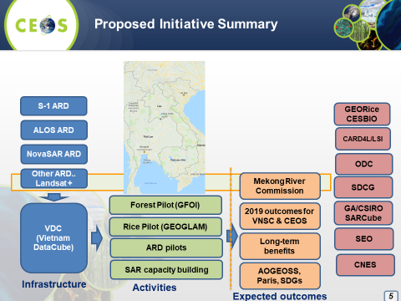
News / Updates
CEOS Chair priorities for 2019
Priority #1:
Carbon Observations (forested regions)
Priority #2:
Observations for Agriculture (rice)

Slide 4
News / Updates
CEOS Entity Leadership changes in 1 year
2019 CEOS Chair – Vietnam National Space Centre
2020 CEOS Chair – Indian Space Research Organisation (ISRO)
2019 CEOS SIT Chair – NOAA
2020 CEOS SIT Chair – CSIRO/GA
The CEO position will be vacant from October 2019.
WGClimate Chair to extend mandate for 1 year, new Vice-Chair identified (DLR)
WG CalVal Chair team renewed in Oct 2018
All other WGs looking for new Vice-Chairs in Oct 2019

Slide 5
CEOS upcoming meetings
WGCalVal Perth, 15th-19th July
AC-VC, Tokyo, 10th-12th June
July
June
Living Planet Symposium
Milan, 13^{th –} 17th May
Joint meeting LSI-VC-8, SDCG-16, GEOGLAM.
WGClimate-11,
Anchorage, 4th-6th Sep
August
May
April
SIT Technical Workshop, 2019
Fairbanks, 9th-13th Sept
September
WGDisasters-12, Rekjavik,
23rd-27th Sep
SIT-34, Miami, USA,
2nd-4th April
March
WGISS-48,
Hanoi, 8th-11th Oct
October
CEOS 33rd Plenary, Hanoi,
14th-16th Oct
November
February
GEO-XVI Plenary, Canberra, 4th-9th Nov
December
January
CEOS/GEO bilateral

Slide 6
Status of CEOS 2019-2021 WP
CEOS 2019-2021 Work Plan was submitted to principals on 14th March
Virtual endorsement completed on 22nd March
Endorsement 3 weeks earlier
than in 2018
Endorsed version now available.

Slide 7
Status of CEOS 2019-2021 WP
Some changes to the structure
Thematic: Climate, Carbon, Agriculture, Disasters, Water, SDGs, Oceans and coasts, Polar, Biodiversity
Cross-cutting: Capacity building, Data access, Data quality, VCs, Outreach
2018
2018
2019
2019

Slide 8
2018 to 2019 …
Evolutions 2018 to 2019 …
103 open deliverables
(91 in 2018, 88 in 2017)
76 deliverables to be closed in 2019 (69 in 2018)
42 newly created in 2019 (29 in 2018)
~28 open 2018 deliverables had completion data pushed back (29 in 2017)
+ 13%
+ 10%
+ 38%
+ 0.3%

Slide 9
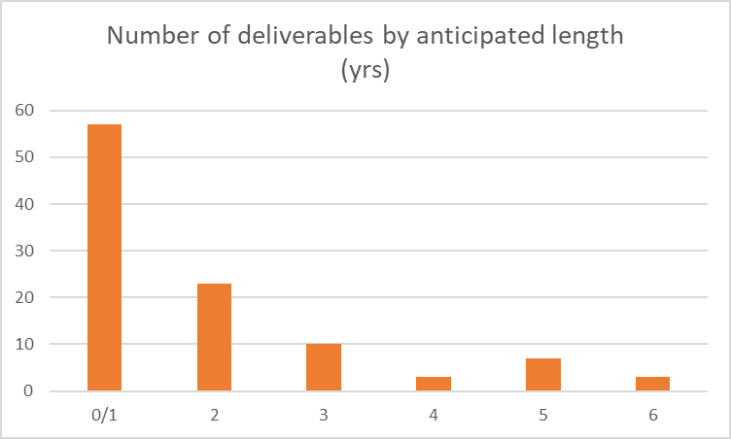
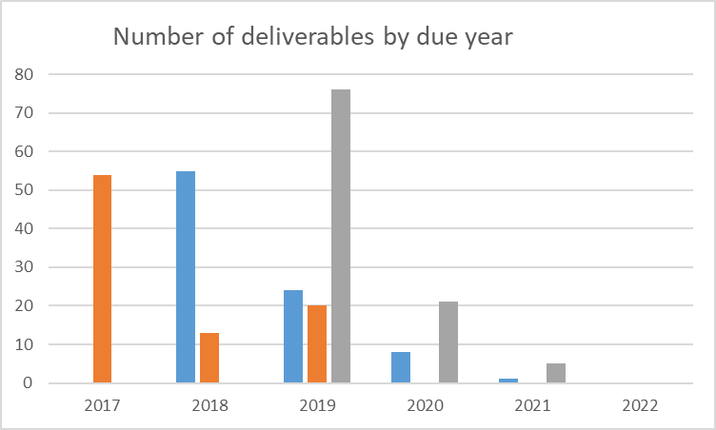
WP 2019-2021 in figures
103 open deliverables of which 42 newly created in 2019
Of these 42 new deliverables
83% scheduled to be
completed in 2019
16% in 2020
1% in 2022
WP 2017-19
WP 2018-20
WP 2019-21

Slide 10
CEOS WP Annual Cycle
July
June
August
May
SIT TW
April
Deliverable
Updates
September
SIT-34
WP Progress
Report (CEO)
March
2019-2021
CEOS Work Plan
ENDORSED 22nd
March
October
CEOS 33rd Plenary
November
February
December
January
Work Plan development

Slide 11
Work Plan Dos and Don’ts
Good practice
… distinguish Work Plan development phase (November to February) to Work plan progress reporting phase (September)
Work plan development: check relevance of current deliverables and propose new ones if required
Work plan progress: provide information on progress made on deliverables in the current work plan
… be rigorous when closing Work plan deliverables – provide a record of completion and deliverable documents
… the rest ….
Deliverables shouldn’t significantly evolve over a 12 month period
Avoid modifying substantially deliverable title or description: small changes are acceptable, but deliverables should not be rewritten thereby losing traceability

Slide 12
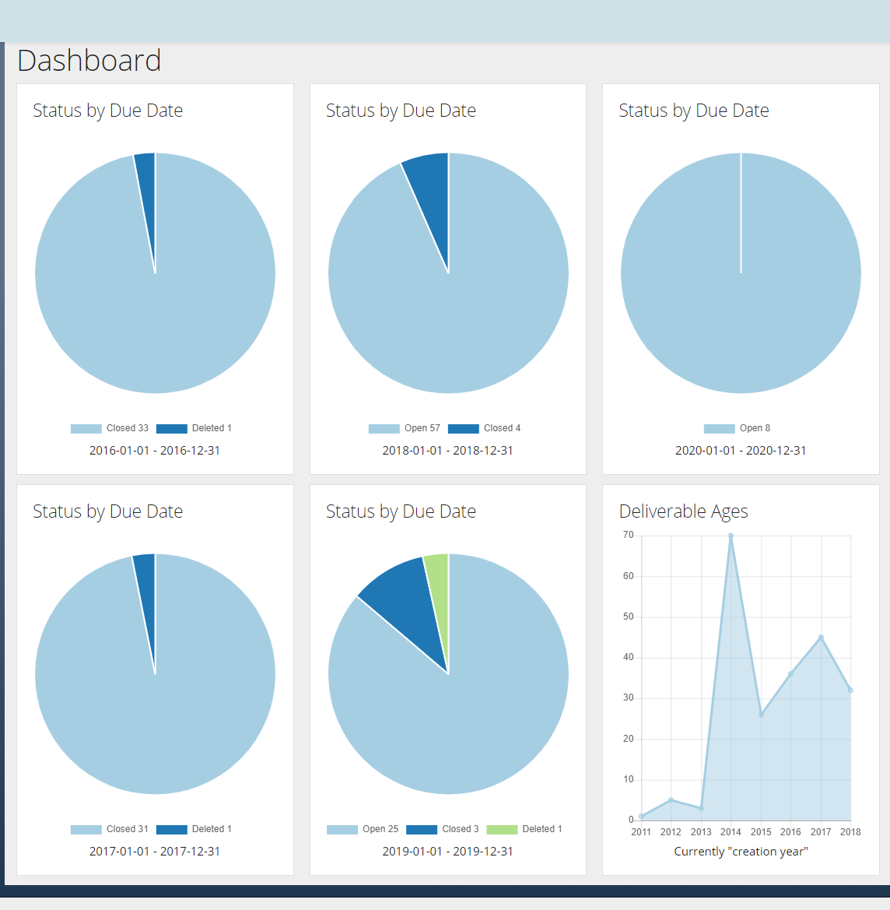
Coming soon …. to your desktop
Development of a new CEOS Deliverables database with added functionality

Slide 13
Take away messages
CEOS Leadership
CEOS Chair - VNSC, Vietnam in 2019; ISRO subsequently
CEOS SIT Chair – NOAA until October 2019; CSIRO subsequently
Candidate for CEOS Executive Officer urgently required!
CEOS Work Plan
CEOS 2019-2021 Work Plan now available online
Slight structural changes – WGISS now has its own section
CEOS “Services” concept created
Some “best practice” proposed in this presentation
Upgrade to ceos-deliverables.org – should provide new functionality and facilitate use for deliverable leads and WG Chairs!

