Slide 1
WGISS-47
Future Data Architectures
USGS Architecture for Services in the Cloud
Kristi Kline
April 29, 2019

Slide 2
Cloud First / Cloud Smart, Free & Open Data Policies
2010 – Cloud First Policy
  Provided broad guidance and authority to agencies to adopt cloud-based solutions
  Cloud technology was still very new
  Implementation plans and strategies were limited
2018 – Cloud Smart Policy
  From https://cloud.cio.gov: The 2018 Federal Cloud Computing Strategy — Cloud Smart — is a long-term, high-level strategy to drive cloud adoption in Federal agencies. This is the first cloud policy update in seven years, offering a path forward for agencies to migrate to a safe and secure cloud infrastructure. This new strategy will support agencies to achieve additional savings, security, and will deliver faster services.
Free & Open Data Policy
  Planned implementation is intended to be fully compliant with current free and open data policies

Slide 3
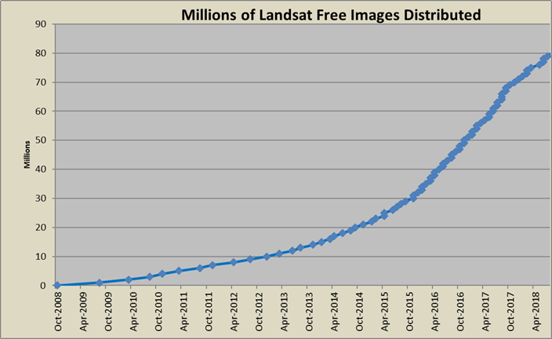
2008 Web-Enabled Landsat Data
Significant push back at the time
  Lost income to project caused concerns about viability
  Costly and difficult implementation
  The question was: "Why would we do this?"
Led to significant increase in data usage
User community greatly expanded
The question changed to:
“Why didn't we do this earlier?"
Notes:
By 2012 Landsat was considered one of the most critical earth observing systems behind only GPS and weather

Slide 4
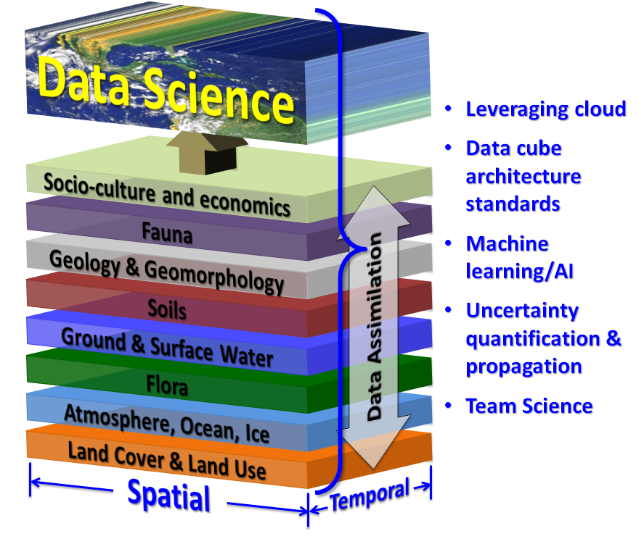
Notes:
More than compute

Slide 5
Web Enabled to Cloud Enabled
Current (Web Enabled)
  The Current implementation does not allow users to bring their algorithms to the data
  The end user currently must bring the data to their compute, made difficult due to:
    The large quantity of the data available
    The format of the data requires full scenes be transferred to their systems
  This limits the science that can be conducted depending on funding for IT infrastructure
  Requires the end user to fund and maintain IT infrastructure at their cost
Cloud Enabled
  The next revolution of Landsat data is transitioning to a Smart Cloud implementation
    Cloud first directive
    Smart Cloud
    LRS Direction
  The free and open data policy that enabled such great progress in the last shift must continue in this new environment
  This new paradigm enables opportunity for users to access the data directly allowing:
    Execution of algorithms directly on only the data they need
    Selective data usage (specify bands etc. for use)
    Reduced need for IT infrastructure
Notes:
Temporal depth

Slide 6
Overview, Purpose, Scope
Modernize Processing, Access, and Distribution of Landsat Data
  Change from a primary business model of downloads to enabling access to the full archive
  Enable users to interact with the data in an integrated environment
  Ensure provenance and data stewardship
To modernize Landsat; this project will
  Establish an enterprise cloud environment for Landsat
  Enable access to Collection 1 Level-1 and Level-2 in the cloud
    Replicate Collection 1 Level-1 and establish operational data management procedures
    Demonstrate global scale production of Landsat data in the cloud through production of Level-2 products using a cloud framework
  Establish modern access and visualization tools to access ARD
    Continue to build upon the study that the LSRD team is performing
  Establish an Environment and System to Produce and Enable Collection 2 Global ARD
    Work with Landsat 9 project to modify the DPAS to enable Global ARD production in the cloud
    Produce and Validate the Data
  Demonstrate key science use cases exploiting ARD
  Replicate the Image Assessment System database to the Cloud to enable Cal/Val querying efficiencies
Notes:
As approved at PKO
Enable the environment to allow science to move to the cloud
Communication to science

Slide 7
Operations Concept
Notes:
24 reviewers – 82 comments back – 77 completed, 5 deferred to CDR

Slide 8
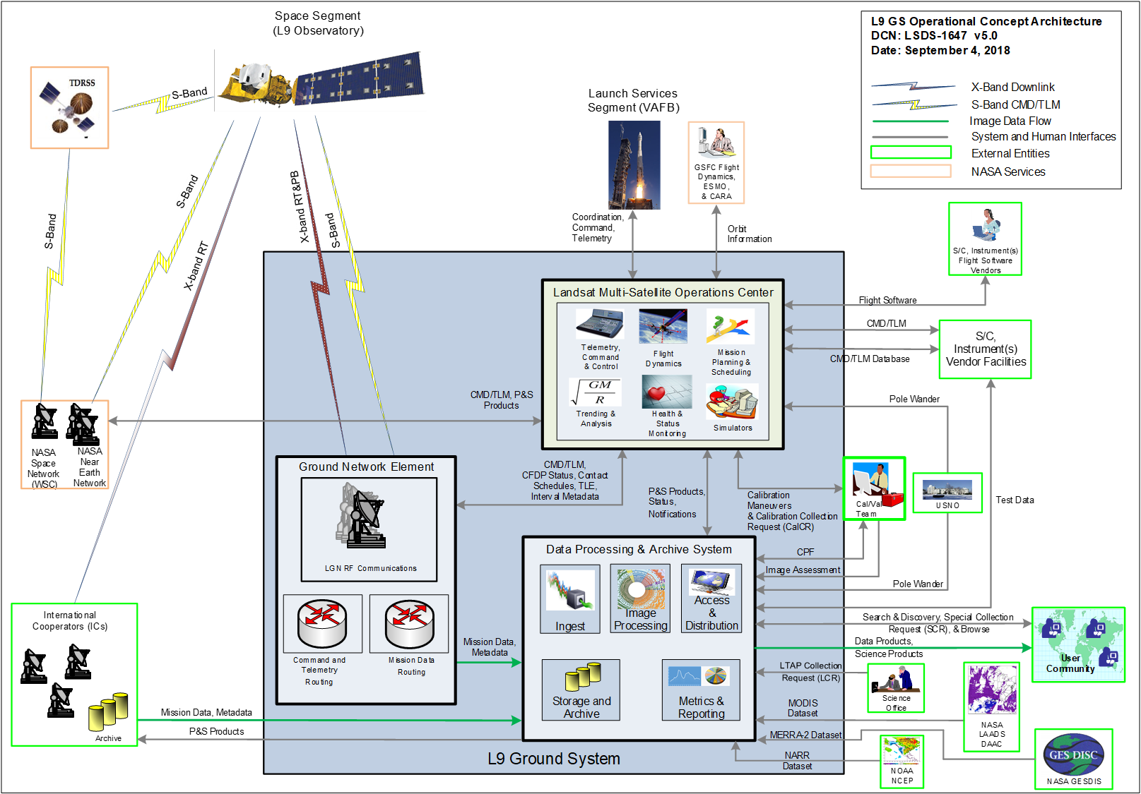
Landsat Cloud Changes
No Change for Landsat 9
Image Processing:
Cloud Collection Processing
On-premises New Data Processing
Access & Distribution:
Traditional A&D Maintained
Expanded A&D in the Cloud
Storage and Archive:
Collections in the Cloud
L0Ra, L0Rp, Auxiliary Data in the Cloud
Cloud Archiving
Metrics & Reporting:
On-premises Metrics Maintained
Cloud Metrics
Auxiliary Data:
Used for New Data
Used for Collections in the Cloud
User Community:
Traditional Search & Order
Cloud Visualization and Analytic Tools
Cloud Optimized GeoTIFF
Step to the Next Generation Architecture
Cal/Val:
Big Data Analytics

Slide 9
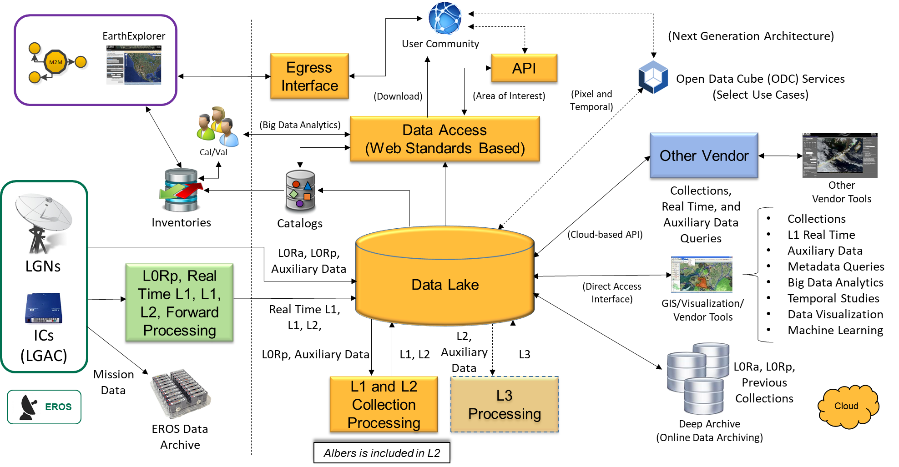
LPIP Operational View

Slide 10














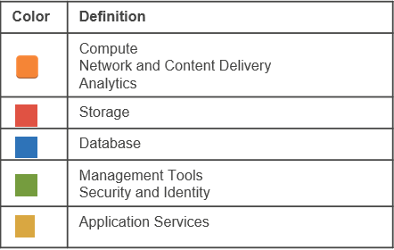
AWS Services Needed
Service | Symbol | Definition |  | Service | Symbol | Definition
Amazon Elasticsearch Service |  | Datastore that helps facilitate end user searching |  | AWS Lambda |  | Serverless function to deploy code without provisioning servers
Amazon Redshift |  | Data warehouse database |  | Amazon ElastiCache |  | In-memory data store
Amazon EC2 |  | Scalable compute |  | Amazon CloudWatch |  | Monitoring and management service
Amazon Elastic Container Registry (ECR) |  | Container management service |  | AWS CloudFormation |  | Language for codifying your infrastructure
Amazon Elastic Container Service |  | Run containerized applications in production |  | AWS CloudTrail |  | Log, monitor, and retain account activity
AWS Batch |  | Batch processing |  | Amazon API Gateway |  | Service that allows a developer to connect non-AWS applications to AWS back-end resources
Amazon S3 |  | Object storage |  | Amazon Virtual Private Cloud (VPC) |  | Logically isolated and provisioned section of the AWS Cloud

Slide 11













AWS Services Needed (cont.)
Service | Symbol | Definition |  | Service | Symbol | Definition
Amazon Aurora |  | MySQL and PostgreSQL-compatible relational database |  | Amazon Glacier |  | Long-term, durable object storage for data archiving
Amazon CloudFront |  | Fast content delivery network (CDN) |  | Amazon Elastic File System |  | Scalable, elastic file storage for Linux based workloads
AWS Step Functions |  | Coordinate multiple serverless workflows |  | Amazon Simple Notification Service |  | Fully managed pub/sub messaging service
AWS Identity and Access Management (IAM) |  | Manage access to AWS services and resources securely |  | Amazon Simple Queue Service |  | Fully managed queuing service
Amazon Elastic Block Store |  | Persistent block storage |  | AWS Key Management Service (KMS) |  | Managed service to create and control encryption keys
AWS Secrets Manager |  | Manage and rotate secrets safely without new code deployments |  | AWS Spot Fleets |  | A Spot Fleet is a collection, or fleet, of Spot Instances, and optionally On-Demand Instances.
Amazon Cognito |  | Access Control for web applications

Slide 12
Key AWS Services used for most scenarios
Service | Symbol | Definition
AWS Identity and Access Management (IAM) |  | Enables you to manage access to AWS services and resources securely
AWS CloudFormation |  | Model and provision all your cloud infrastructure resources
Amazon CloudWatch |  | Monitoring and management service built for developers, system operators, site reliability engineers , and IT managers
AWS CloudTrail |  | Service that enables governance, compliance, operational auditing, and risk auditing of your AWS account
Amazon Virtual Private Cloud (VPC) |  | Provision a logically isolated section of the AWS Cloud where you can launch AWS resources in a virtual network that you define
AWS Step Functions |  | Coordinate multiple serverless workflows
AWS Secrets Manager |  | Manage and rotate secrets safely without new code deployments
Amazon Simple Notification Service |  | Fully managed pub/sub messaging service
AWS Key Management Service (KMS) |  | Managed service to create and control encryption keys

Slide 13
Key AWS Services Required in CHS
Service | Symbol | Definition | Expected Delivery to LPIP | Impacted Scenarios
AWS Step Functions |  | Coordinate multiple serverless workflows | 5/1/19 | Collection 2 Processing and Access and Visualization
Amazon Cognito |  | Access Control for web applications | 5/1/19 | Access and Visualization
Amazon ElastiCache |  | In-memory data store | 5/1/19 | Access and Visualization

Slide 14
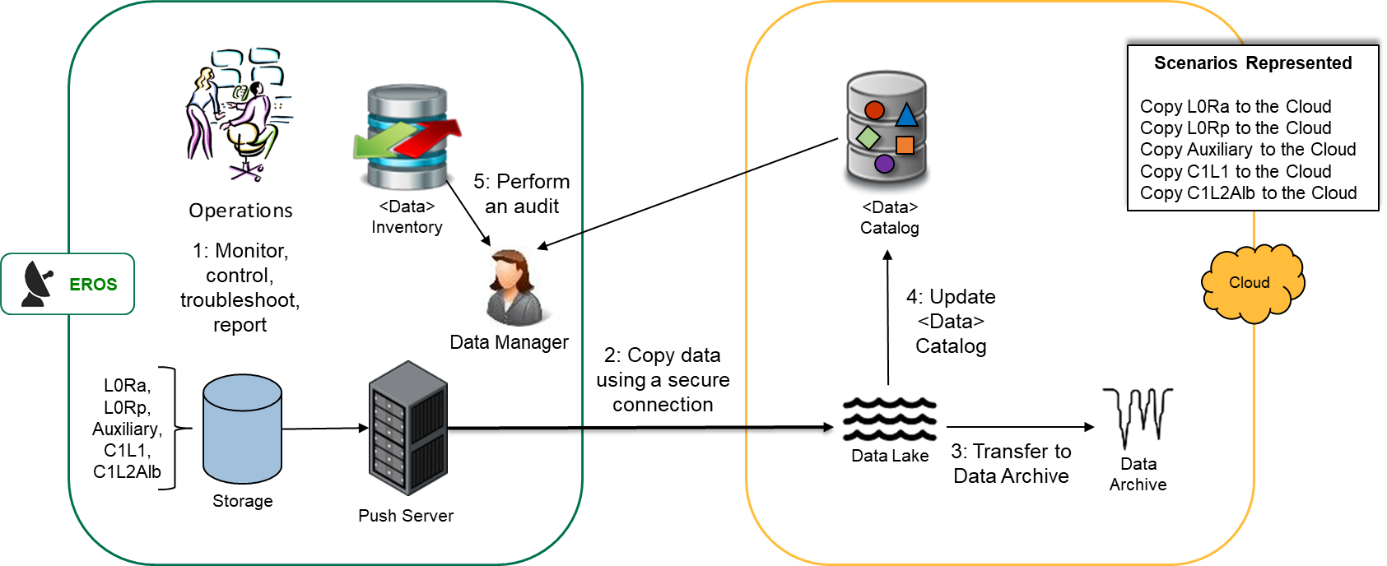




PDR - Copy Data to the Cloud
CHS
5. Life Cycle Rule

Slide 15
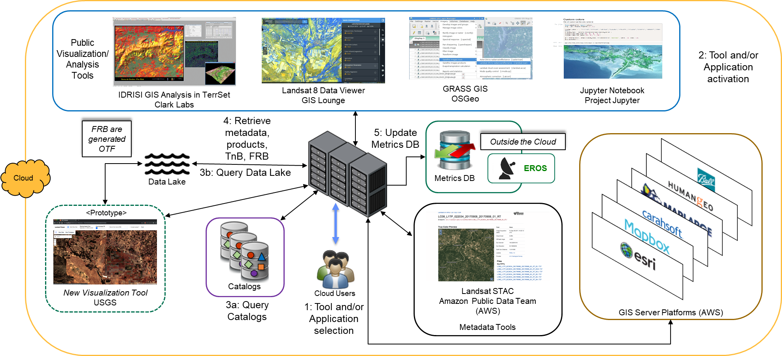


PDR - Cloud-based Visualization
CHS
ElastiCache
Elasticsearch
Cognito

Slide 16
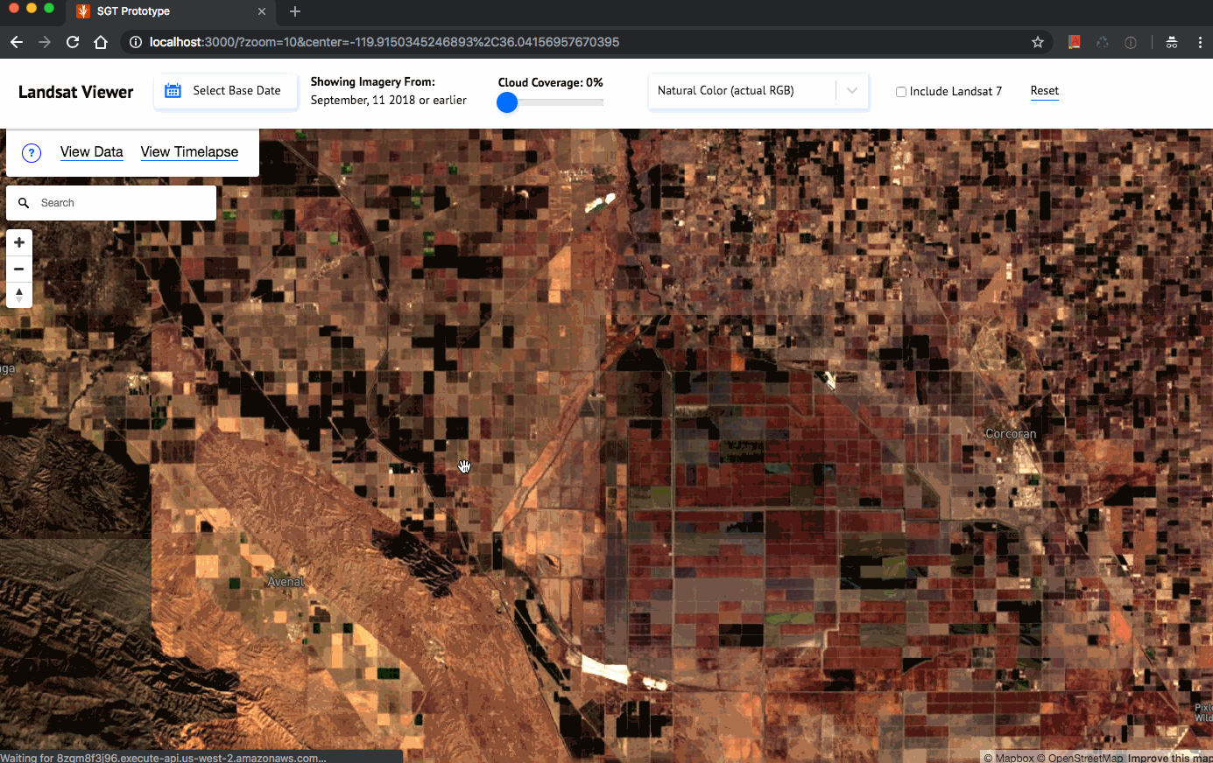
PDR - Cloud-based Visualization
Dynamic mosaicing
Filter by date range and cloud coverage
Make a connection from pixels on the screen to specific scenes
Select different band combinations
Show change time-lapse
Execute real-time processing in a few seconds

Slide 17
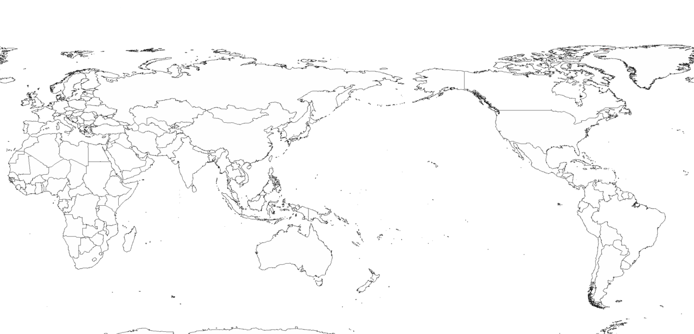


PDR - Cross-Region Replication Option
1: Master Data Lake is populate
US West (Oregon)
Data Lake
Data Sync
Data Sync
2: Perform international region data replication using a secure cloud connection
3: Provide regional use and distribution
Data Lake
Data Lake
Cape Town (TBD)
(Requestor Pays Replication Cost)
Asia Pacific (Sydney)
(Requestor Pays Replication Cost)

Slide 18
Backup

Slide 19
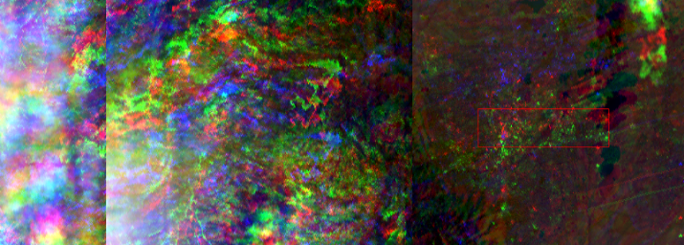
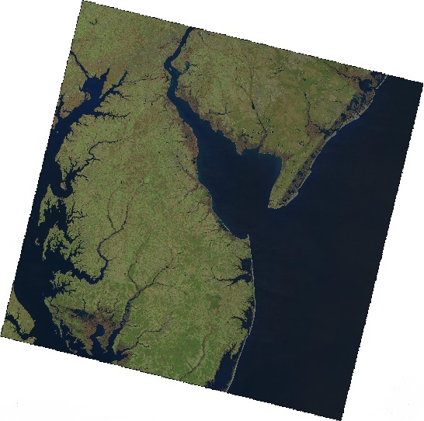
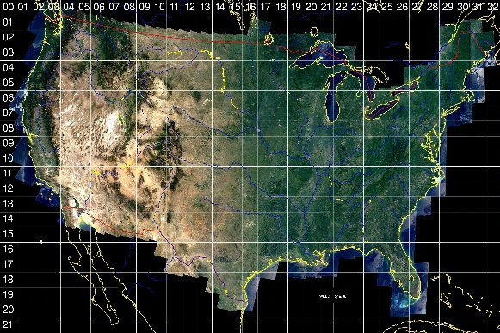
Landsat Processing Levels
Level 0 Reformatted Archive (L0Ra)
  Mission data files that the DPS has combined, corrected, and processed into a single interval for long-term storage
  Internal; not an output product from the DPS
Level 0 Reformatted Product (L0Rp)
  L0Ra data that has been spatially subsetted, nominally to Worldwide Reference System-2 (WRS-2) framing
Level 1 Terrain & Precision (L1TP)
  L0Rp data that has had radiometric and geometric corrections applied
  Digital Elevation Model (DEM) is applied to remove the effects of terrain on the corrected imagery
  A precision model is generated by registering the data to a ground control library to provide a common geodetic reference base
    If precision modeling is not possible, a Level 1 Systematic Terrain-Corrected (L1GT) product is generated instead
  Browse imagery (full- and reduced-resolution) is generated from Level 1 data
Level 2 (L2) Analysis Ready Data (ARD)
  Atmospheric corrections have been applied to provide surface reflectance and temperature; high geometric accuracy to allow stacking
  Data provided in standard tiled format to support L3+ processing
Notes:
Data provided in standard scene format and tiled is on the fly

