Slide 1

Working Group on Information Systems and Services (WGISS)
Committee on Earth Observation Satellites
Mirko Albani, ESA, WGISS Chair
WGISS#47 Meeting
FDA-09: Inventory and characterize existing FDAs
NOAA – Silver Spring, USA
29th April 2019

Slide 2
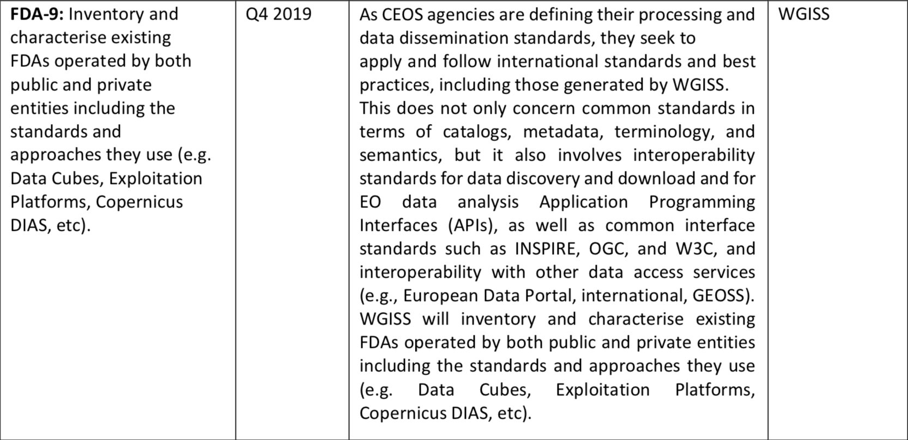
Background
Notes:
@ Mirko, con Raz stavamo rivedendo bene la descrizione dell’azione. Tutto e’ focalizzato sulla compliance degli standards piuttosto che sulle piattaforme. Secondo noi per rispondere a tale azione per ogni campo tipo discovery, processing, etc bisognerebbe mettere un campo con lo standards usato. Siamo sicuri di non essere andati fuori tema? Basta l’unica colonna per indicare la compliance sugli standards?

Slide 3
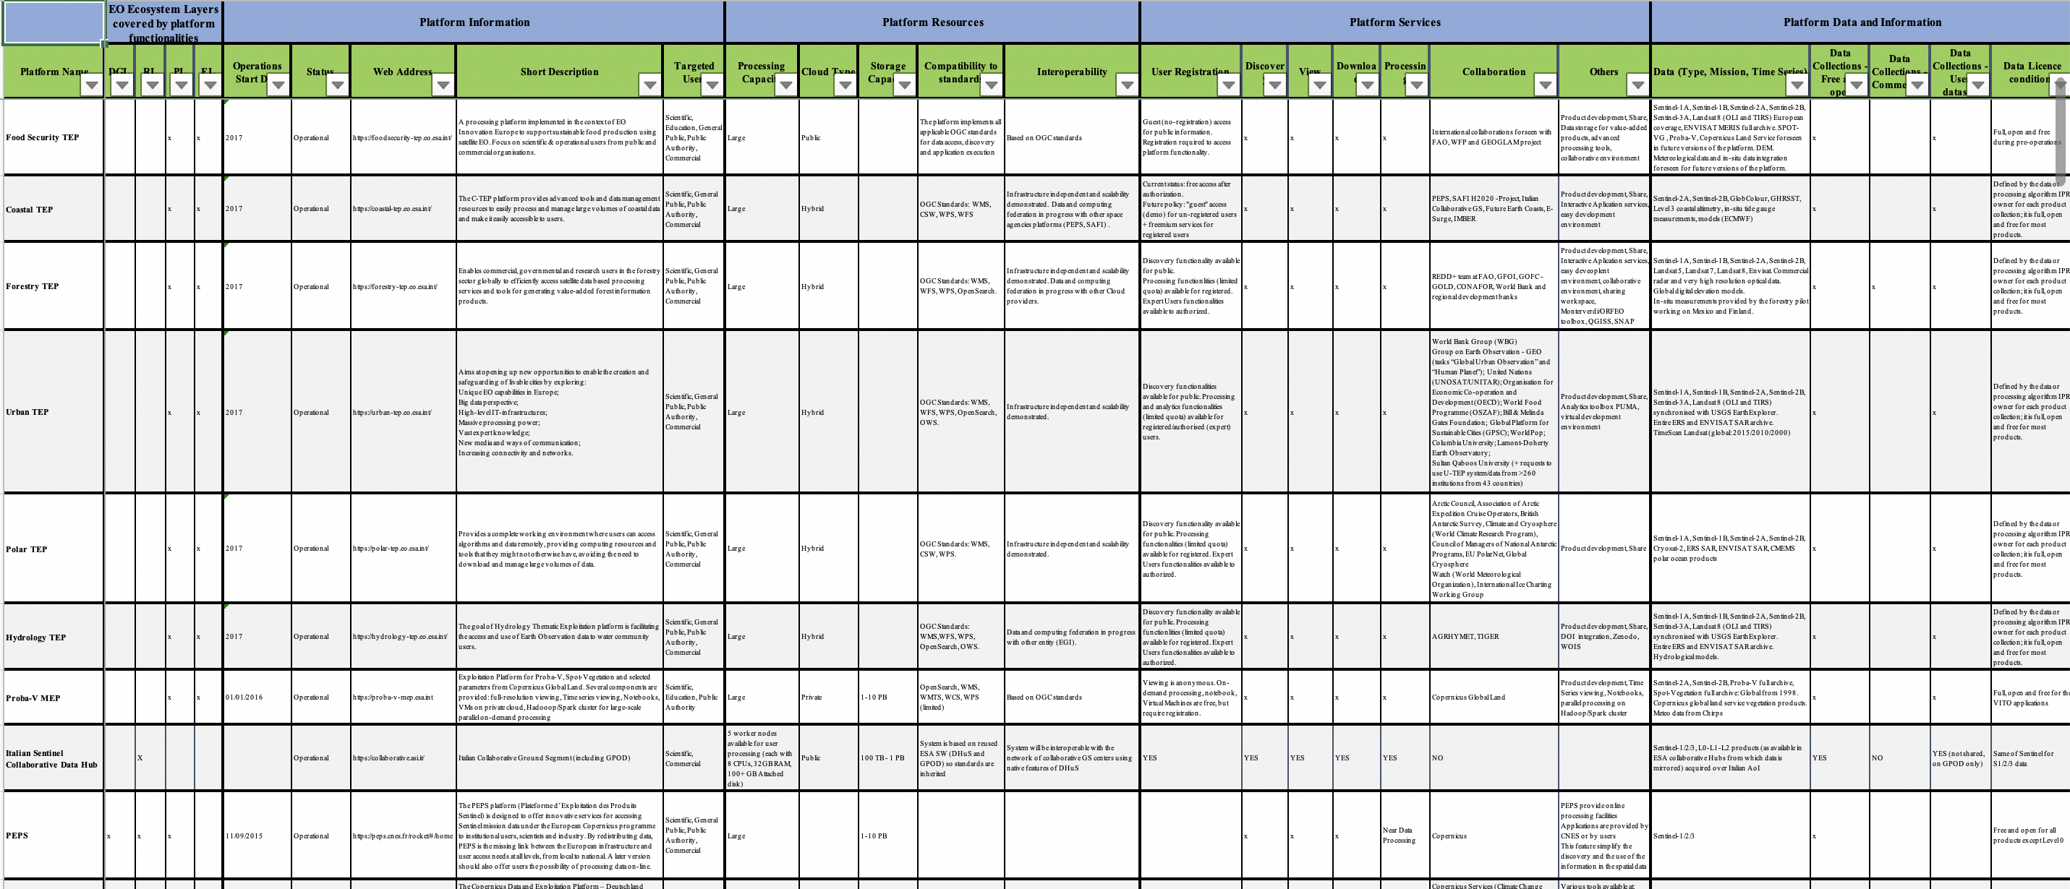

Inventory Table
44 FDA Elements currently in the table
Approximately 85% information completed
for the FDA elements included

Slide 4
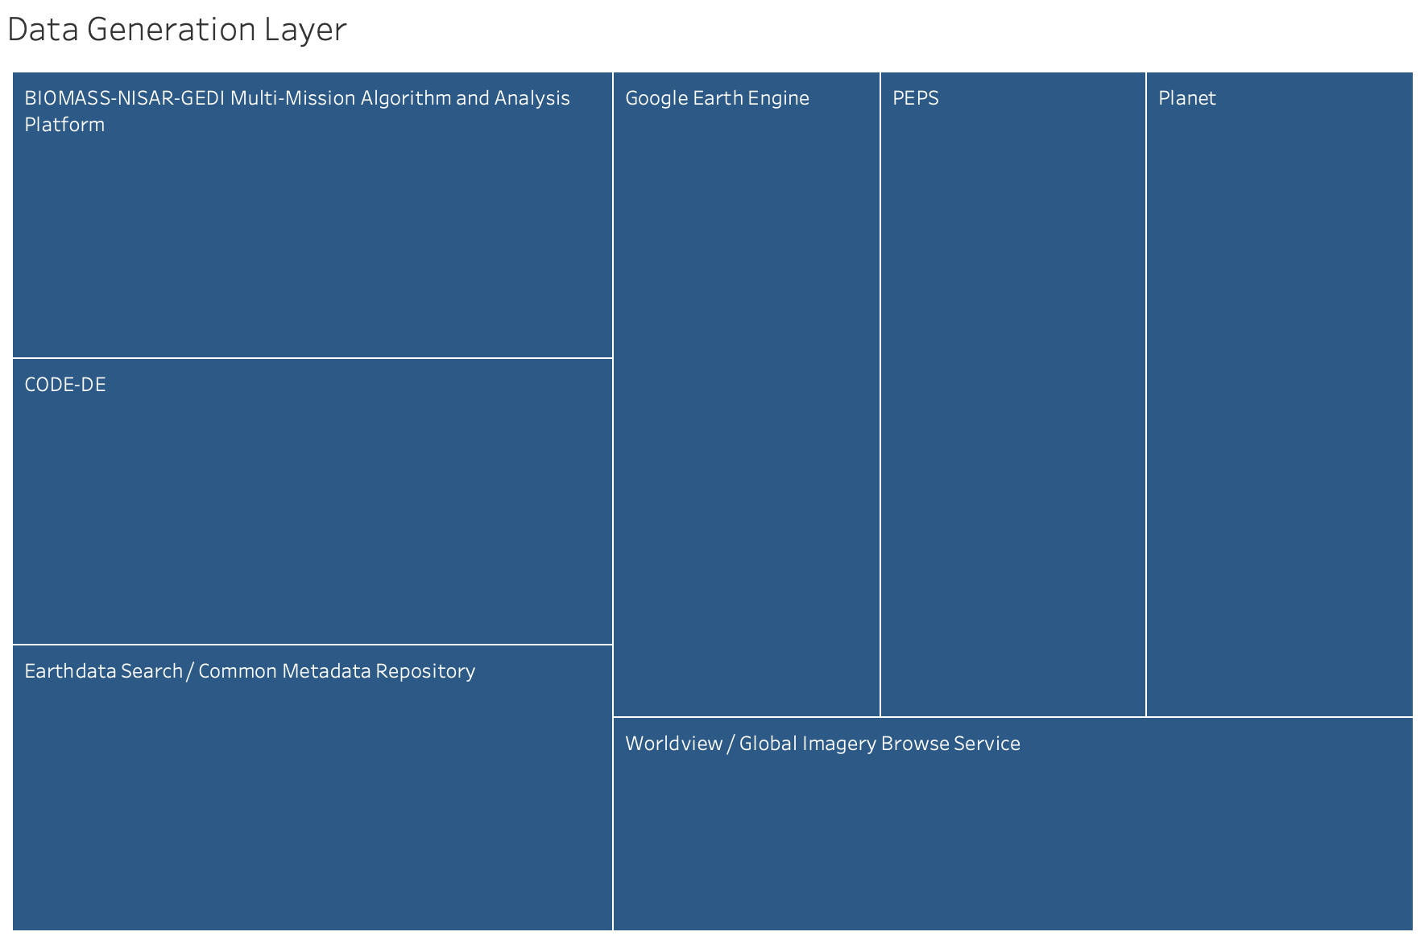
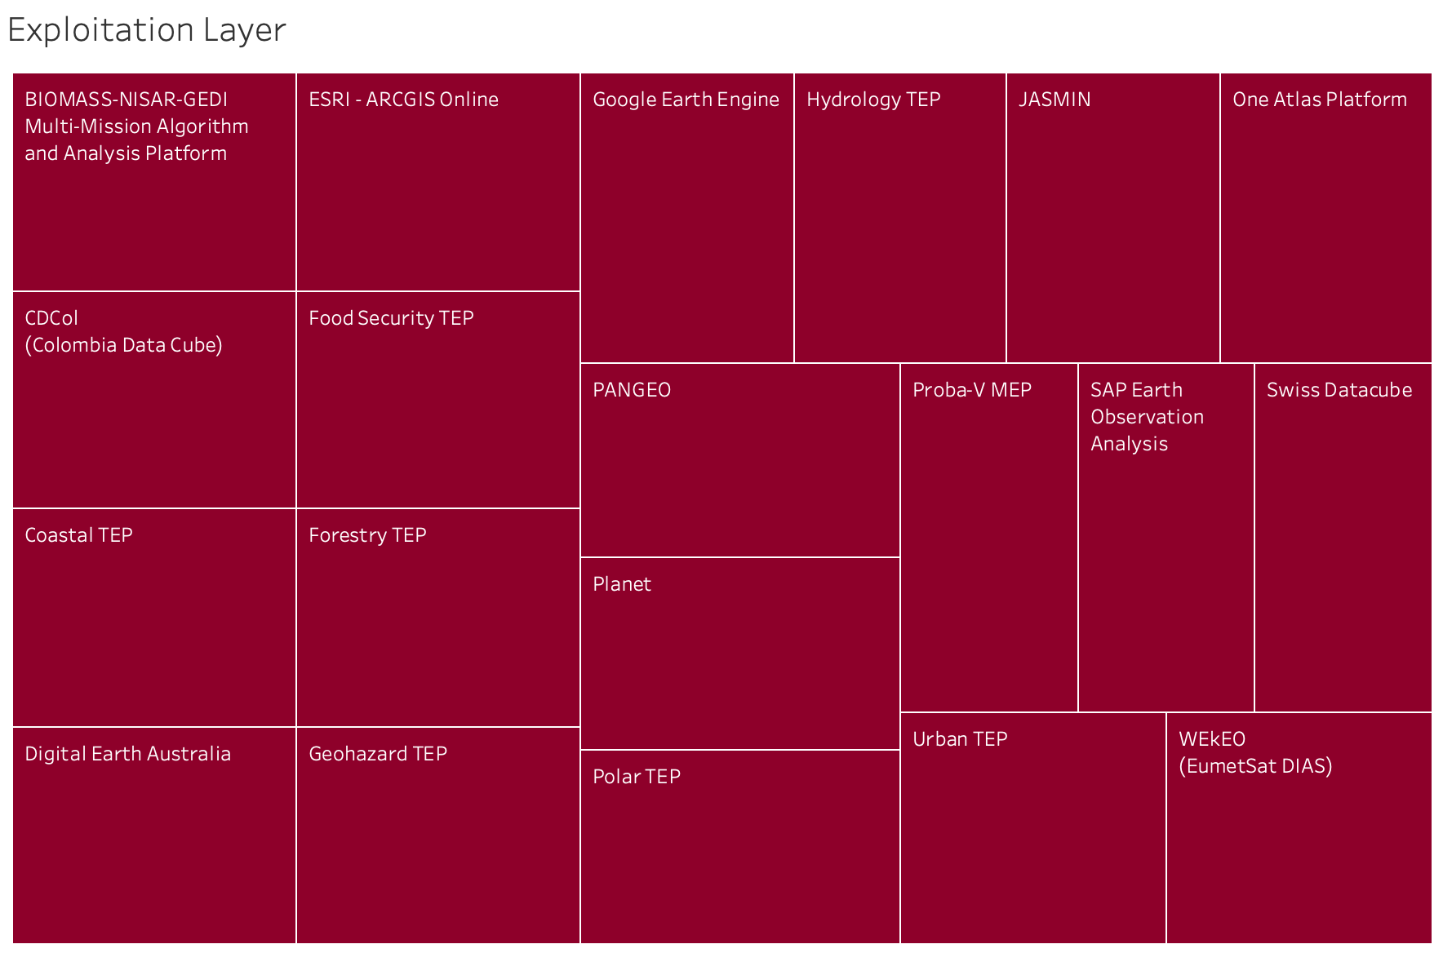
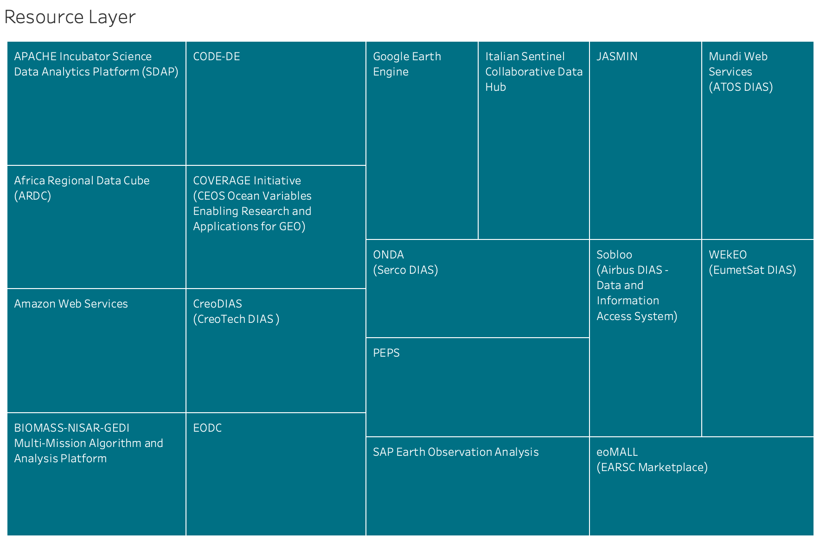
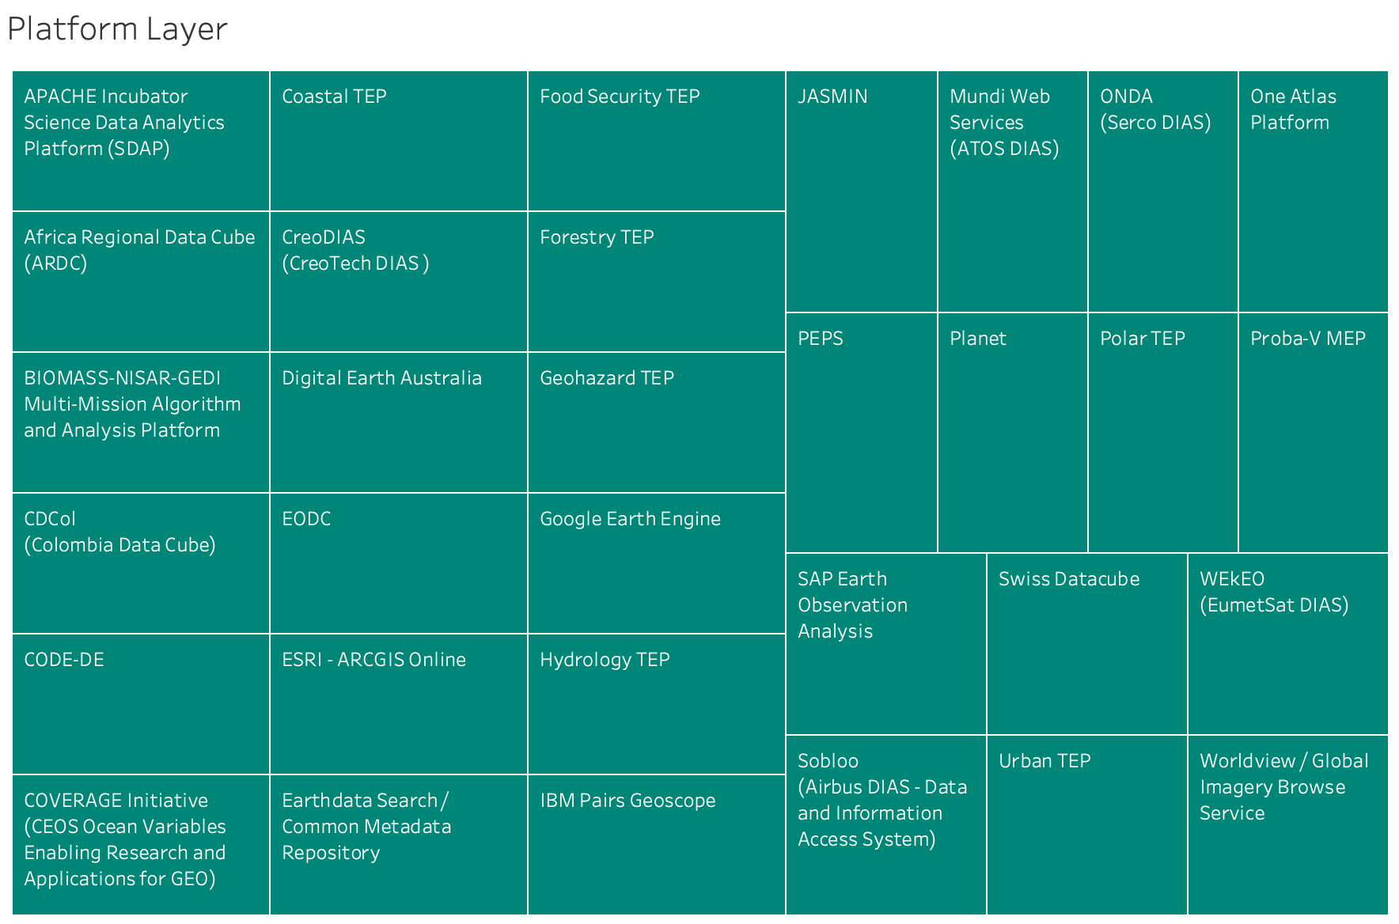
Preliminary Analysis – Ecosystem Layers Covered by FDA Elements

Slide 5
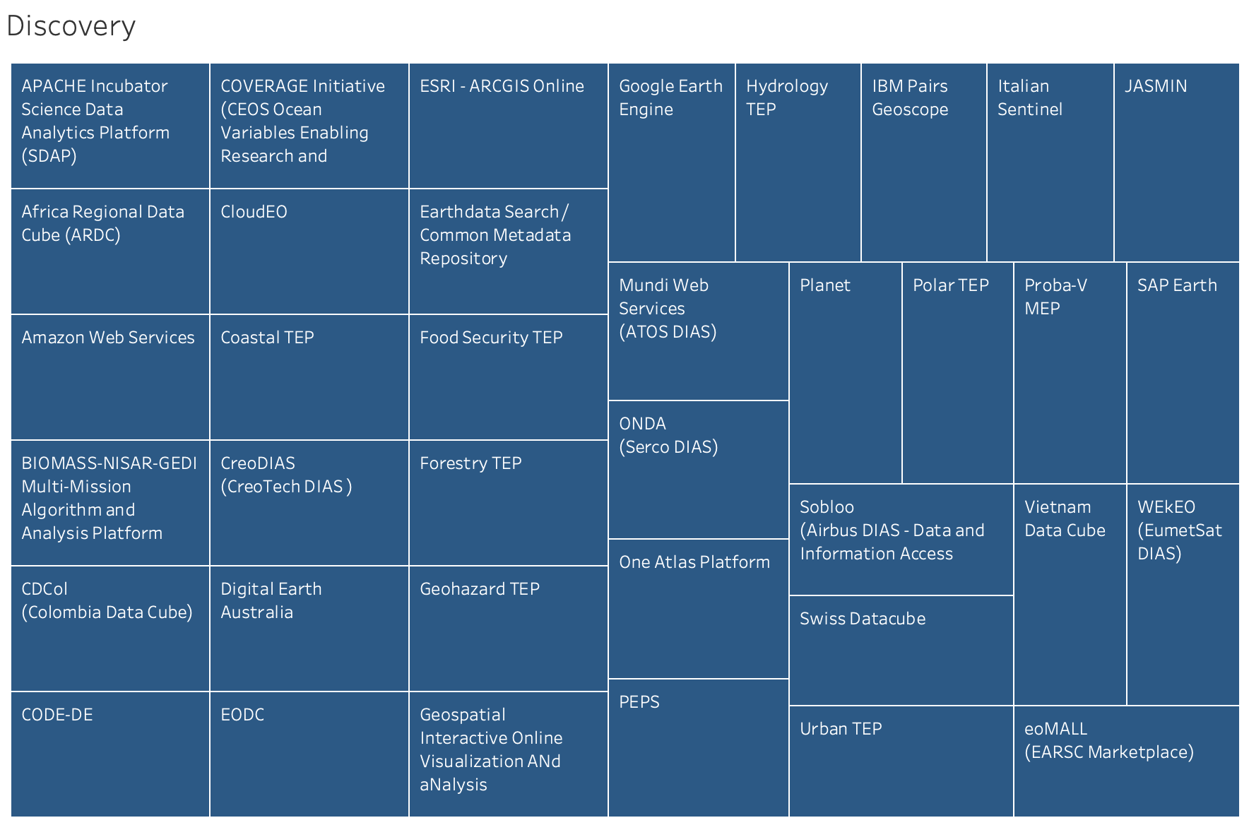
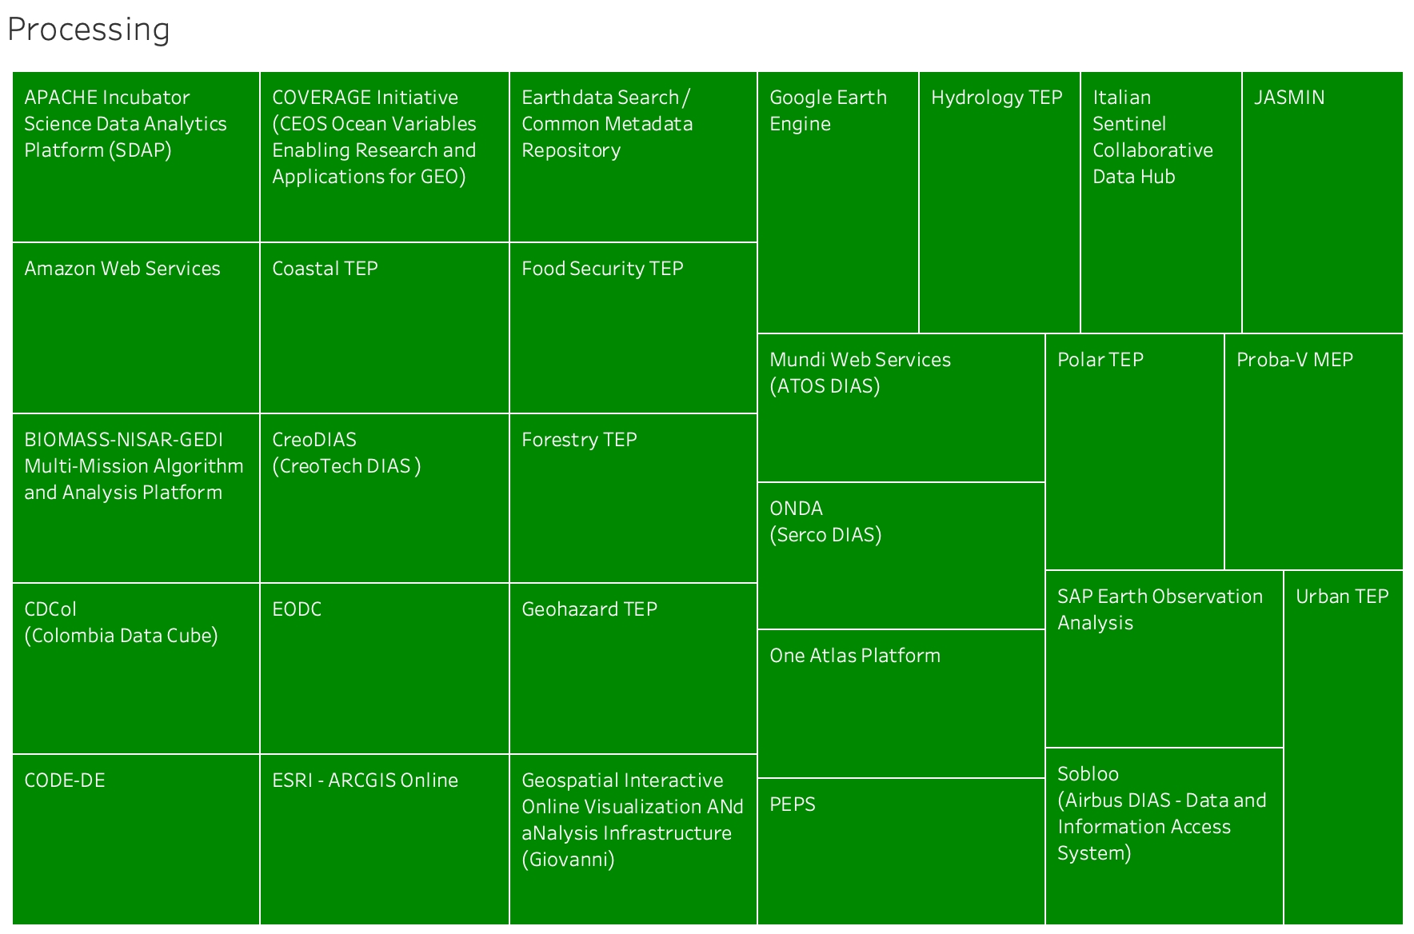
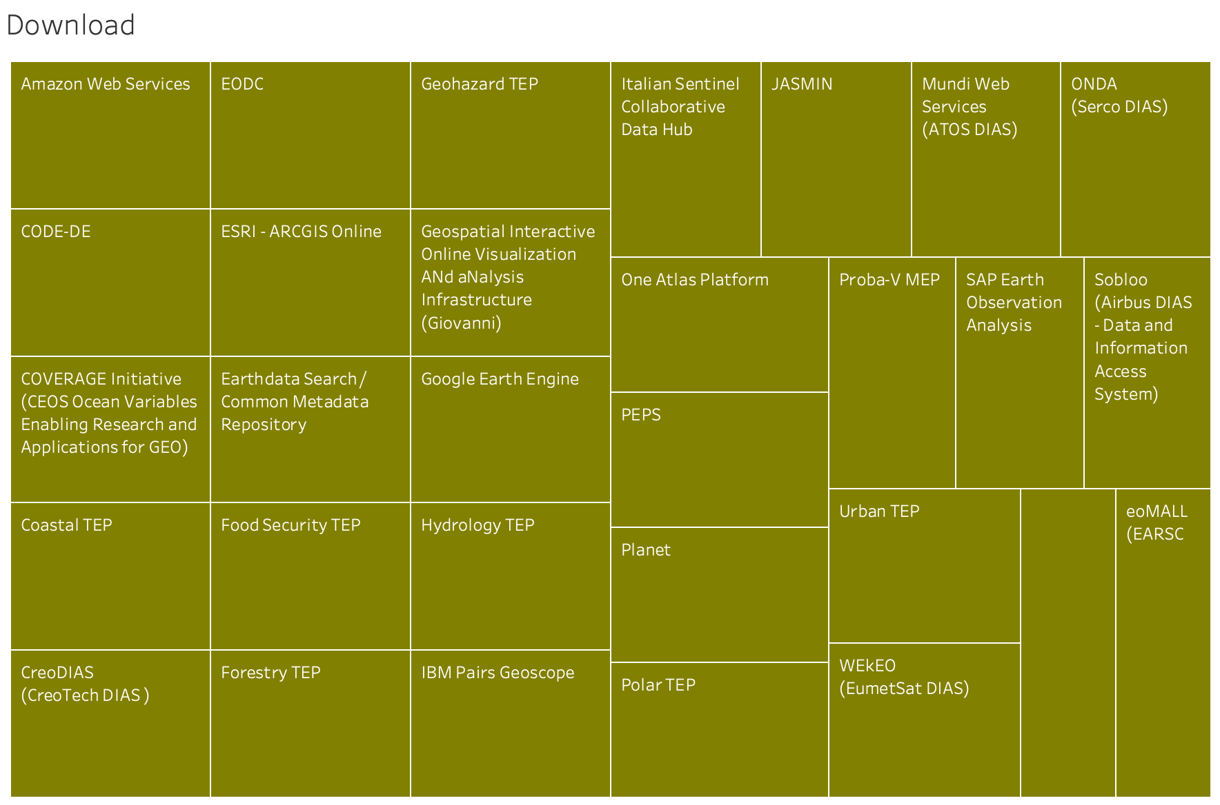
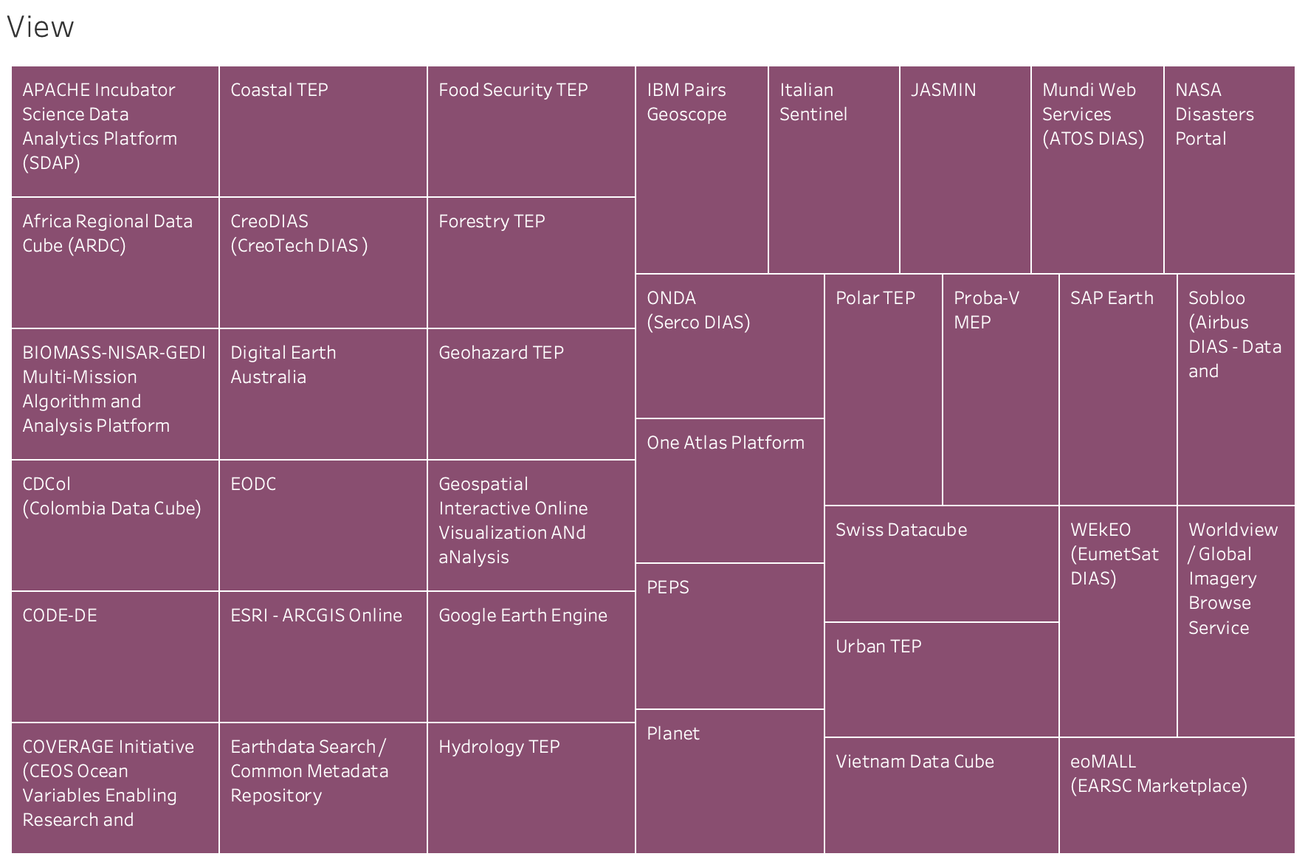
Preliminary Analysis – FDA Elements Services
BIOMASS

Slide 6
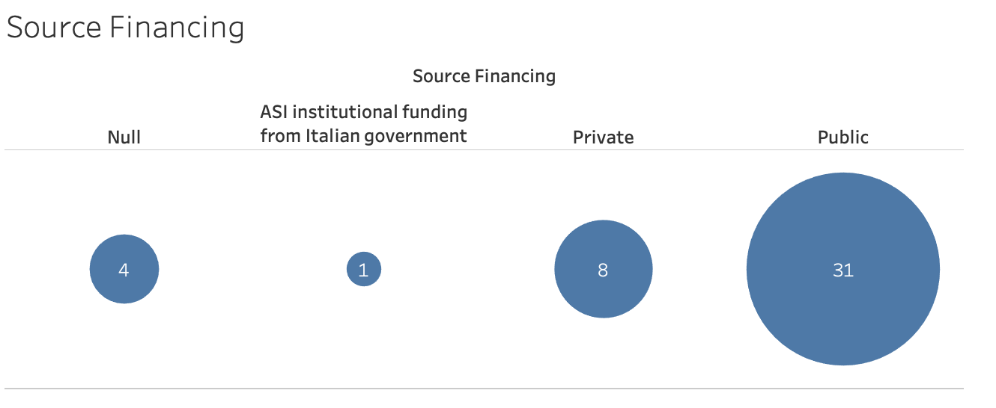
Preliminary Figures
Ecosystem Layers
Data Generation Layer
7
Resource Layer
18
Platform Services Layer
32
Exploitation Layer
20
Services and Functions
Discovery
37
Processing
28
View
37
Download
30
BIOMASS

Slide 7
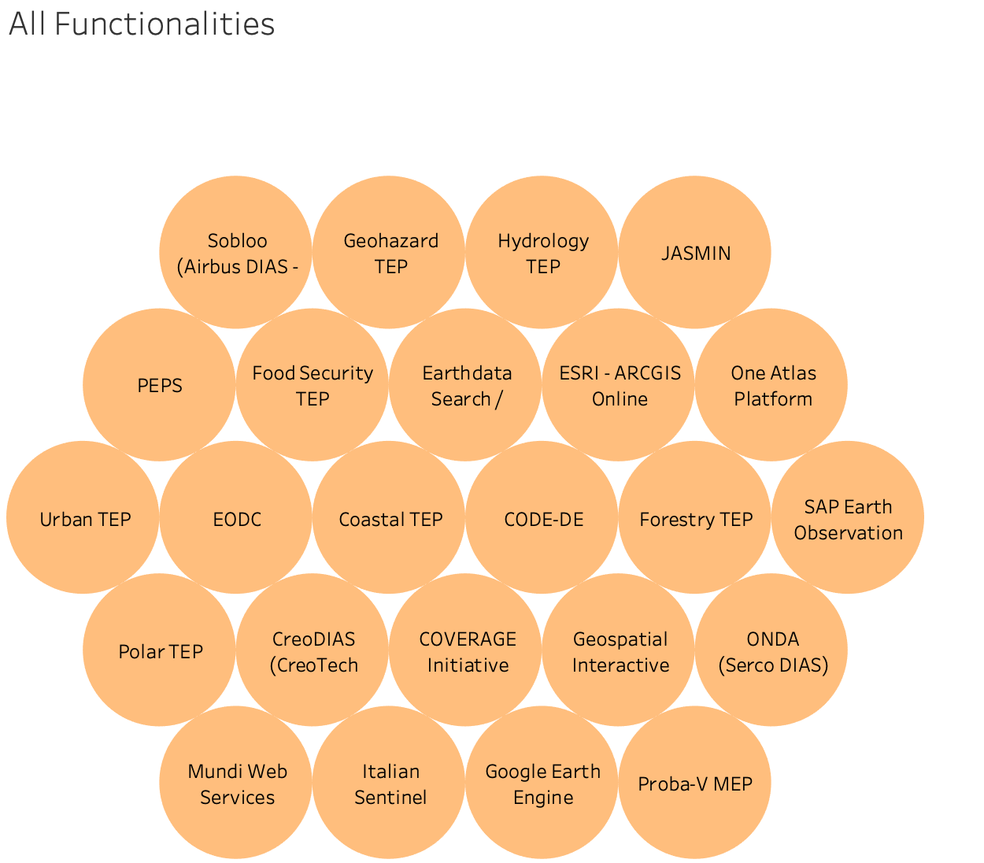
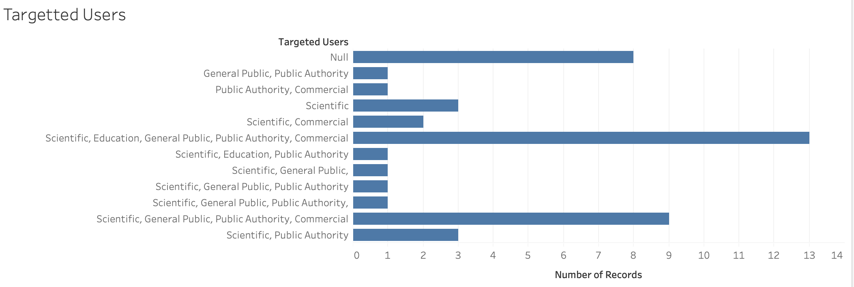
Survey Updated statistics
Targeted Users

Slide 8
Next Steps for discussion
Further (final) round of inputs/review/update by end of July
Formal closure of CEOS Work Plan action
Generation of metadata for mature services & FDA elements and discovery through WGISS Connected Data Assets Infrastructure and/or “OSS like” inventorydatabase
Pilot Interoperability project with selected FDA elements
BIOMASS

Slide 9

Contact:
Mirko.Albani@esa.int

