Slide 1

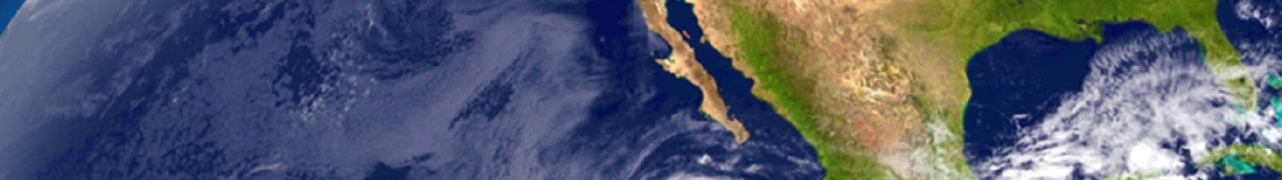

WGISS-47 Welcome
Committee on Earth Observation Satellites
Steve Volz
CEOS SIT Chair and NOAA Principal to CEOS
Assistant Administrator, NOAA Satellite and Information Service (NESDIS)
CEOS WGISS-47
Silver Spring, MD, USA
29 April 2019

Slide 2
WGISS successfully promotes
collaboration in the development of
systems and services that manage and
supply Earth observation data.
THANK YOU!

Slide 3

As CEOS Principal for NOAA…
#1
WGISS … addresses the internal management of EO data, the creation of information systems and the delivery of interoperable services. The activities and expertise of WGISS span the full range of the information life cycle from the requirements and metadata definition for the initial ingestion of satellite data into archives through to the incorporation of derived information into end-user applications.
These objectives, and the efforts of this most productive CEOS Working Group, are directly in line with multiple NESDIS objectives
  To rapidly ingest data from multiple satellites for operations
  To interconnect satellite and in situ data for ecosystem modeling and forecasting
  To enhance the value of our data archives through interconnection with the global archives

Slide 4
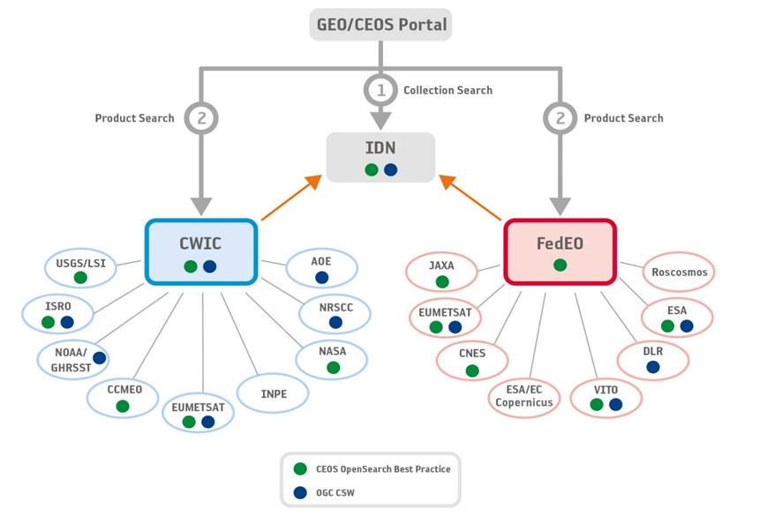
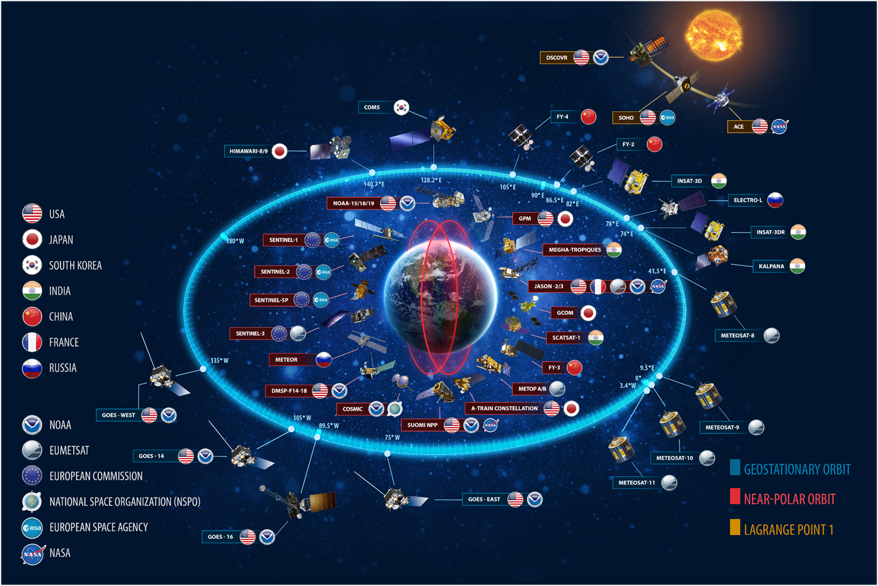
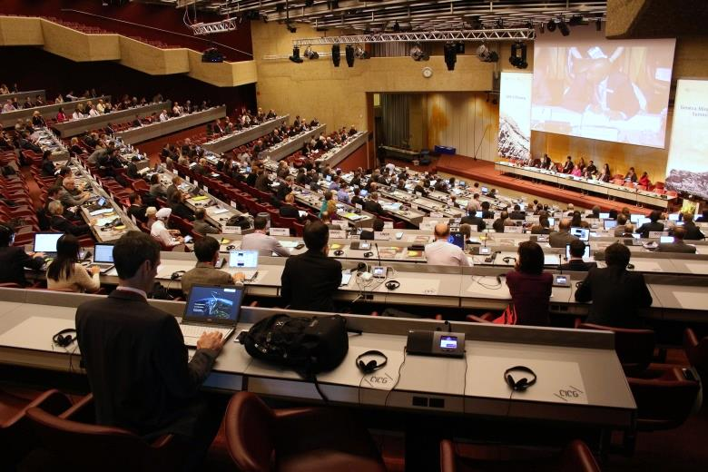
NOAA Connections to WGISS
“The Forum”
The primary benefit for NOAA is that WGISS provides a forum for space agency information system developers to exchange ideas and approaches as they implement interoperable capabilities that promote and enable the discovery, access and utilization of their Earth observation resources by the broad international community of science and applications users
With the constant evolution of data system technologies and geospatial standards the WGISS members can share their experiences and identify best practices in applying these capabilities
When and where appropriate, WGISS promotes collaboration in the development of interoperable infrastructure components such as the IDN, FedEO and CWIC.

Slide 5
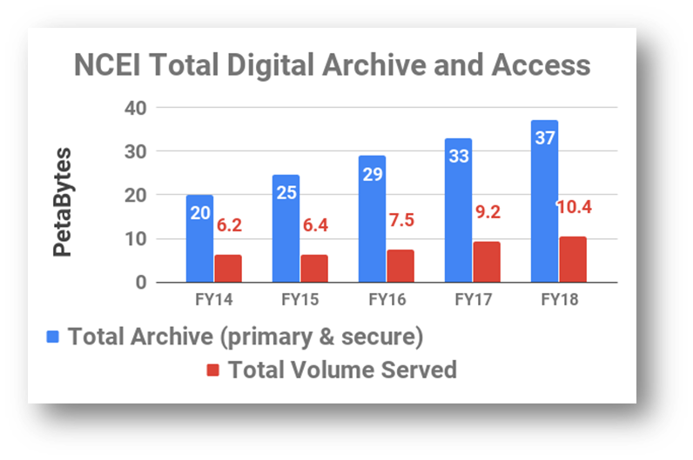
WGISS
Interoperable Infrastructure
By working together and leveraging each other's efforts and experience, WGISS members can help to ensure the maximum return on the collective investments of the CEOS agency Earth observation missions.
  In NOAA’s case, Over 65,000 collections in our catalog with billions of data granules, provided by thousands
  of organizations, spanning
  centuries and the globe...
  In the future, I expect the use
  metrics will become much more
  nuanced
  With more fully interoperable
  data sets, the products will be more customized for the users, with more products, less data volume

Slide 6
CEOS and WGISS
Applaud the achievements of the WGISS Connected Data Assets (CDA) Infrastructure (next slide)
  Single entry point for external clients to discover/access CEOS Agencies data
Applaud the achievement of the GEOSS Platform Discoverable Products (next slide)
  CWIC and FedEO harmonization
Applaud WGISS contributions to the GEO Data Technology Workshop, Expert Advisory Group for Results-Oriented GEOSS, GEOSS EVOLVE, and many more GEO activities
VCs and WG Coordination
  Updated inventory of VC data to ensure discoverability/accessibility through WGISS Infrastructure
Future Data Architectures
  Welcomed the transition of the FDA actions from ad hoc team into permanent WG structure – successful example of progression

Slide 7

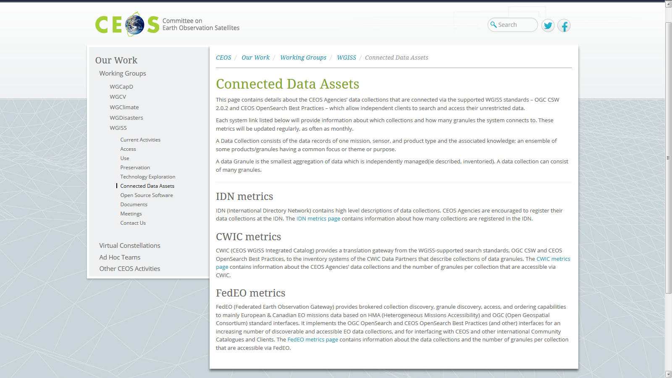

Discovery and Access
WGISS Connected Data Assets (CDA)
Single entry point for external clients to discover/access CEOS agencies data
Search over 32,000 collections in the IDN (collection search)
Access over 5000 collections with associated over 300+ million granules (granule search)
Borrowed from Mirko’s SIT-34 WGISS Presentation
CEOS Service
    DATA-2: Full representation and accessibility of CEOS Agency datasets through WGISS Standards and Connected Data Assets Infrastructure (i.e. IDN, CWIC, FEDEO).
    DATA-9: ECVs/CDRs Discovery and Access through WGISS Systems.
    FDA-14: Facilitate discovery and access for end users to data analytics and processing tools and services through the WGISS Connected Data Assets Infrastructure.

Slide 8
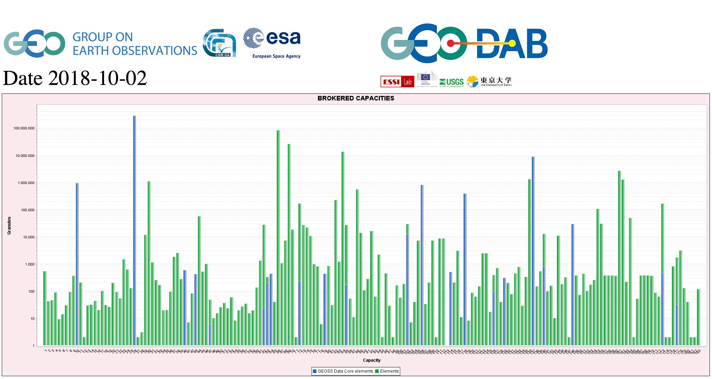
CEOS data in GEOSS
GEOSS PLATFORM DISCOVERABLE DATA PRODUCTS
CWIC
FedEO
Borrowed from Mirko’s SIT-34 WGISS Presentation
DATA-16: CEOS data holdings reported and accessible in GEO and other international relevant contexts.

Slide 9
As Chair, CEOS Strategic Implementation Team…
#2
One of our four SIT Chair Priorities for our 2018-2019 term: Enhance the efficient execution of existing SIT responsibilities as described in the SIT Terms of Reference, including addressing Working Group (WG) and Virtual Constellation (VC) continuity, sustainability, and outputs, including:
  Undertaking gap analyses for each VC, to support ongoing and likely upcoming strategic Agency observatory decisions;
  Seeking observations from VCs and WGs on best practices and possible modifications to existing practices.
Strategic Directions and Partnerships for CEOS Discussion Paper (21 March 2018)
  Ensure tangible outcomes from, and sustainable commitment to, our VCs and WGs
  Maximizing the value of VC and WG output for CEOS objectives and for individual CEOS Agency objectives
  Ensuring the necessary support for our existing thematic teams to flourish and to deliver
Concept Paper for Restructuring CEOS Virtual Constellations and Creation of a New Working Group (28 March 2019)
  Discussed later
Do VCs and other WGs see WGISS as a resource?
  Should VCs identify some technical challenges where WGISS may offer help?

Slide 10
A New Concept for VCs and WGs
Working Group on Information Provision to cover these and future efforts
WGISS
WGCalVal
WGCapD

Slide 11
New CEOS Working Group
A Proposal
Establish a new Working Group focused on Information Provision, to coordinate all activities related to user outreach and applications (e.g., forests, agriculture, freshwater, land degradation, urban, biodiversity, and more in the future).
Context:
All three existing AHTs focus on external user information and service delivery, in a class with the existing Working Groups on Disasters and Climate.
Expansion of such focused groups reflects the growing demand by the global community for specific, refined information products from CEOS and CEOS Agencies for operational decision-making.
The SDCG for GFOI and GEOGLAM activities are mature, externally focused activities relying on sustained delivery of CEOS data and information to meet user needs.

Slide 12
Concept – Presented at SIT-34
Working Group on Information Provision (TBC)
Chair and Vice Chair – 2 yrs
Secretariat
GEO Wetlands
Lead(s) – no term
GEOS4M
Lead(s) – no term
Biodiversity
Lead(s) – no term
Focus area 1 highlighted by SDG Indicators
Lead(s) – no term
Focus area 2 highlighted by SDG Indicators
Lead(s) – no term
Focus area 3 highlighted by SDG Indicators
Lead(s) – no term
…
Working Group Expertise:
Finding common best practices for User interfaces
Interpreting user needs
Generating satellite-based observation r’qmts
Coordinating with VCs on tailoring observations to better meet user needs
Forests (GFOI)
Lead(s) – no term
Agriculture (GEOGLAM)
Lead(s) – no term
“Mature Activities,” enjoying continuing support from CEOS through established data partnerships

Slide 13
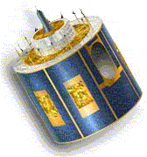
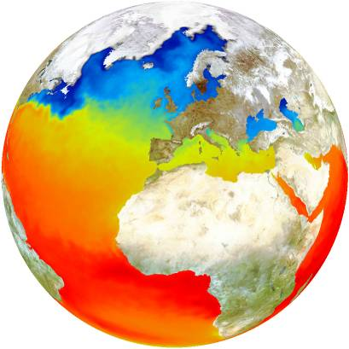
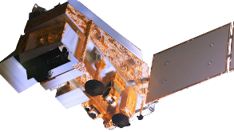
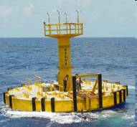
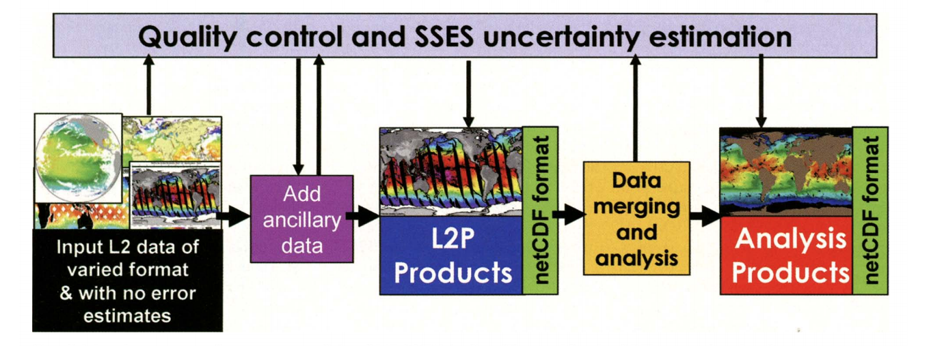
The SST-VC/GHRSST Idea
Combine satellite-derived and in situ SSTs to provide pre-processed and merged products with good estimates of uncertainty to operational users and the science community
Users drive the products and services, demanding a range of standardized individual products at Level 2 and 3, and merged products at Level 4
+
+
Notes:
SSES: Single Sensor Statistics

Slide 14
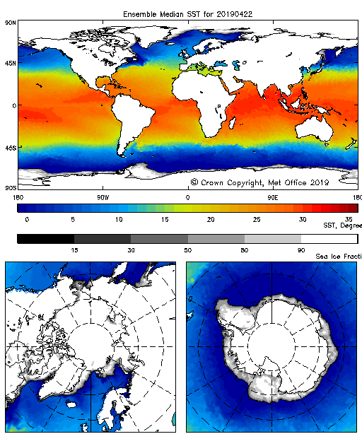
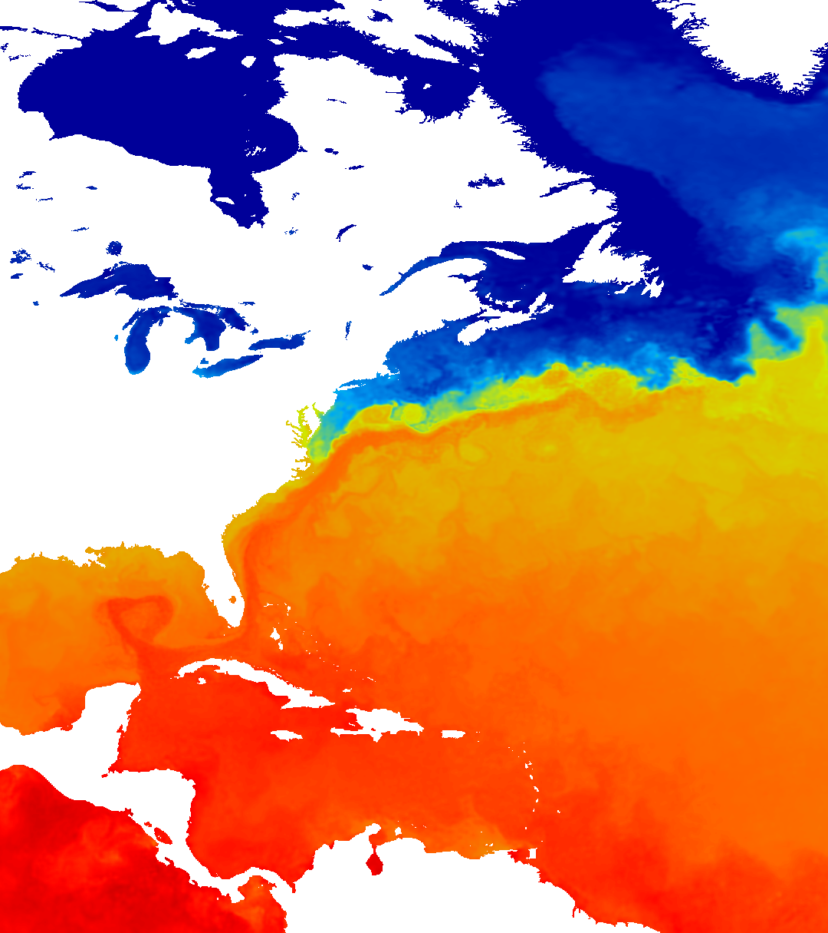
The SST-VC/GHRSST In Action
One example of this integration in action is the UK Met Office’s Operational SST and Sea Ice Analysis (OSTIA) system. OSTIA integrates SST-VC/GHRSST data from agencies around the world into a daily, blended product and uses that operationally as a boundary condition for weather forecast models at the Met Office and at ECMWF (Donlon et al., 2012)
Another example is the GHRSST Multi-Product Ensemble (GMPE, Martin et al., 2012), which takes various L4 products as inputs, transfers them onto a common grid, and produces an ensemble median and standard deviation for broad use in validation efforts, trend analysis, climate models, etc.
GMPE ensemble median SST for
22 April 2019 from > 10 input sources
Subset of OSTIA Analysis product for
23 April 2019 from multiple sources
Notes:
A great example is the OSTIA system used operationally at the UK Met Office:
The Operational Sea Surface Temperature and Sea Ice Analysis (OSTIA) system, Donlon et al., 2012 (https://doi.org/10.1016/j.rse.2010.10.017)
Abstract:
This paper describes a new Sea surface temperature (SST) analysis that is produced with global coverage on a daily basis at the Met Office called the Operational SST and Sea Ice Analysis (OSTIA) system. OSTIA uses satellite SST data provided by international agencies via the Group for High Resolution SST (GHRSST) Regional/Global Task Sharing (R/GTS) framework. GHRSST products include data from microwave and infrared satellite instruments with accompanying uncertainty estimates. The system also uses in situ SST data available over the Global Telecommunications System (GTS) and a sea-ice concentration product from the EUMETSAT Ocean and Sea Ice Satellite Applications Facility (OSI-SAF). The SST analysis is a multi-scale optimal interpolation that is designed for applications in numerical weather prediction and ocean forecasting systems. The background error covariance matrix is specified using ocean model data and the analysis uses correlation length scales of 10 km and 100 km. The OSTIA system produces a foundation SST estimate (SSTfnd, which is the SST free of diurnal variability) at an output grid resolution of 1/20° (~ 6 km) although the smallest analysis feature resolution is based on the correlation length scale of 10 km. All satellite SST data are adjusted for bias errors based on a combination of ENVISAT Advanced Along Track Scanning Radiometer (AATSR) SST data and in situ SST measurements from drifting buoys. Data are filtered (based on surface wind speed data) to remove diurnal variability and AATSR data are adjusted to represent the SST at the same depth as drifting buoy measurements (0.2–1 m) before bias adjustments are made. Global coverage outputs are provided each day in GHRSST L4 netCDF format. A variety of secondary products are also provided including weekly and monthly mean data sets. OSTIA products are continuously monitored and validation/verification activities demonstrate that SST products have zero mean bias and an accuracy of ~ 0.57 K compared to in situ measurements. OSTIA is now used operationally as a boundary condition for all weather forecast models at the Met Office and at European Centre for Medium-range Weather Forecasting (ECMWF). OSTIA is produced by the Met Office as part of the European Union Global Monitoring for Environment and Security (GMES) MyOcean project.
Another is the GHRSST Multi-Product Ensemble:
Group for High Resolution Sea Surface temperature (GHRSST) analysis fields inter-comparisons. Part 1: A GHRSST multi-product ensemble (GMPE)
Martin et al., (2012), https://doi.org/10.1016/j.dsr2.2012.04.013
Abstract:
Abstract
Many sea surface temperature (SST) gap-free gridded analysis (Level 4, or L4) fields are produced by various groups in different countries. The Group for High Resolution SST (GHRSST) is an international collaboration body which has formed the inter-comparison technical advisory group (IC-TAG), to advise SST producers and users on the relative performance of these SST fields. This two-part paper describes two of the three major systems developed under GHRSST coordination towards this goal. Part one (this paper) describes the GHRSST Multi-Product Ensemble (GMPE) system, which runs on a daily basis at the UK Met Office, taking various L4 analyses as inputs, transferring them onto a common grid, and producing an ensemble median and standard deviation. The various analysis systems contributing to the GHRSST inter-comparisons are discussed, highlighting areas of commonality between the systems as well as those parts of the systems where there is less agreement on the appropriate algorithmic or parametric choices. The characteristics of the contributing L4 analyses are demonstrated by comparing them to near-surface Argo profile temperature data, which provide an independent measurement of SST and have been shown to provide a good estimate of foundation SST (the SST free of diurnal warming). The feature resolution characteristics of the L4 analyses are demonstrated by calculating horizontal gradients of the SST fields (on their original grid). The accuracy and resolution of the GMPE median are compared with those of the input analyses using the same metrics, showing that the GMPE median is more accurate than any of the contributing analyses with a standard deviation error of 0.40 K globally with respect to near-surface Argo data. For use in climate applications such as trend analysis or assimilation into climate models, it is important to have a good measure of uncertainty, so the suitability of the GMPE standard deviation as a measure of uncertainty is explored. This assessment shows that, over large spatial and temporal scales, the spread in the ensemble does have a strong relationship with the error in the median, although it underestimates the error by about one third.

Slide 15
CEOS SIT Study Teams
Ocean Virtual Constellation Merger Study Team (OVCMST)
Determine user communities best served with a new Ocean VC, and how reorganization would maintain connections with observation-based international science teams;
Identify what CEOS wants from the VCs and determine if the VCs are currently addressing their CEOS charter;
Identify appropriate governance model(s) for the proposed merged oceans Virtual Constellation;
Prepare a report comparing the expected performance of proposed merged Ocean VC with status quo for consideration at SIT TW
Ad Hoc Working Group Study Team (WGST) Charter
Determine what user communities, current and emergent, best served with a new Working Group;
Coordinate with existing Space Data Coordination Group for Global Forest Observations Initiative and GEO Global Agricultural Monitoring (GEOGLAM) Initiative ad hoc Working Group (AHWG);
Identify organizational structure that best equips CEOS to face challenge of growing demand for tailored information products in the thematic areas of forests, agriculture, biodiversity, land degradation, freshwater, etc. for the years to come;
Prepare a report on the pros and cons of the establishment of a new Working Group for consideration at SIT TW

Slide 16
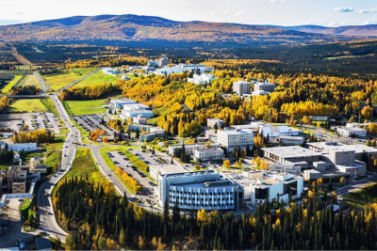

2019
SIT Technical Workshop
Host: NOAA, SIT Chair Team
Location: Woods Student Center
University of Alaska,
Fairbanks Alaska, USA
Dates: September 9-12, 2019
Monday 9th | Tuesday 10th | Wednesday 11th | Thursday 12th
9:00am – 5:00pm Virtual Constellation and Working Group Day | 9:00am – 5:00pm Side Meetings | 9:00am – 5:00pm SIT Technical Workshop Day 1 | 9:00am – 4:30pm SIT Technical Workshop Day 2
Evening Free | Technical Tour | Social | Evening Free

Slide 17
Backup Slides

Slide 18
Relevant Outcomes to WGISS from 2018 VC/WG Working Day – Data
CEOS to be aware of developments in, and stay engaged with, the commercial sector
  Emerging tools such as Google Datasets Search Tool
  Increase communication on fundamental terms and definitions i.e., “ARD,” “Interoperability,” etc.
Improved connection to “top-down” CEOS objectives and deliverables, including tracking in CEOS Work Plan to ensure continued progress and Member support
Transition of AHT FDA activities into other CEOS entities
  Tasks integrated into updated WGISS, LSI-VC, and activities
  WGISS Technology Exploration Group must continue looking “over the horizon” for emerging trends
  Include user perspective into WGISS, including collecting and communicating lessons learned
Update inventory of VC datasets and ensure discoverability/accessibility

Slide 19
Working Group Questionnaire February 2018
All WGs asked to respond to 10 questions (all responded and three former Chairs responded)
Effort to try and assemble a common information set to take stock of the current status of each WG
Gather views on the suitability of the current WG reporting and feedback structure within CEOS
Determine how to best highlight the significant contributions of the WGs to the CEOS community
Identify shortcomings, best practices, and successes across WGs.

Slide 20
Working Group Questionnaire Key Statements
“We are motivated to integrate our different Agency assets and the values of them for users so that they aren’t as confused by our many assets and can make better decisions with EO more efficiently.”
“WGXX promotes collaboration in the development of systems and services that manage and supply Earth Observation data.”
“The hope of course is that we enable the global space agency community to provide the right data for many…applications and help the …agencies in making the right plans for continued and additional measurements that may fall between the cracks in individual agency planning.”
“WGXX, as the other CEOS working groups, relies for its activities on a best effort contribution from participating agencies. Additional resources are committed by some agencies to support development and operations of key CEOS infrastructure…ensuring the availability of these resources in \the mid-long-term might be a challenge…as there is no plan or commitment ensuring this..”
“One issue is that WGXX members tend to be active within specific satellite projects in their agencies. Collaborations with other projects tends to distract from their primary efforts”
“WGXX membership is not well connected to the CEOS Plenary. Efforts to incorporate other WGs and VCs at the meeting have helped but it has still been difficult to get a broader connection between the membership and what is happening at the SIT and Plenary levels.”
“CEOS leadership could help in highlighting benefits deriving from participation to WGXX.”
Non-Attributional

Slide 21
Support to CWIC
A Critical Component of the SST-VC/GHRSST access framework is the CEOS-WGISS Integrated Catalog (CWIC)
Since WGISS/CWIC made excellent choices regarding the use of interoperable data discovery standards, and since the SST-VC and GHRSST utilized those same services, integration of the GHRSST R/GTS framework and CWIC has been a very straightforward process
GHRSST data collections are therefore fully discoverable through the CEOS International Directory Network (IDN) and data granules are fully discoverable through CWIC.
SST-VC

