Slide 1
Recent Developments in Federal and NOAA Data Activities
Ed Kearns, Chief Data Officer
National Oceanic and Atmospheric Administration
CEOS- WGISS Meeting
April 29, 2019

Slide 2
Recent US Federal Data activity
Foundations for Evidence-Based Policymaking Act (FEBPA) - Jan 2019
Geospatial Data Act (GDA) - Oct 2018
Cross-Agency-Priorities include Data Goal
Federal Data Strategy (FDS) - Ongoing
Executive Order on Maintaining Executive Leadership in Artificial Intelligence (AI) - Feb 2019

Slide 3
Some US FEBPA Data Requirements
(Jan 14, 2019) Requires US agencies to appoint Chief Data Officers and to create Data Governance Councils.
All federal data assets are to be:
Open by default (subject to legal exemptions);
Distributed under an open license (not simply as public domain, but to the same effect); and
Are to be published as machine-readable.
Each agency must:
Maintain a comprehensive data inventory;
Establish data governance structures; and
Publish an Information Resource Strategy, which includes an Open Data Plan.

Slide 4
US Geospatial Data Act
Signed into law on October 5, 2018 https://www.fgdc.gov/gda
Codifies Federal Geospatial Data Council (FGDC) roles and responsibilities & the National Geospatial Advisory Committee (NGAC)
Establishes requirements for:
National Spatial Data Infrastructure (NSDI) & Strategic Plans
National Geospatial Data Asset Data (NGDA) Themes
Geospatial Data Standards
GeoPlatform
Covered Agency planning & reporting requirements

Slide 5
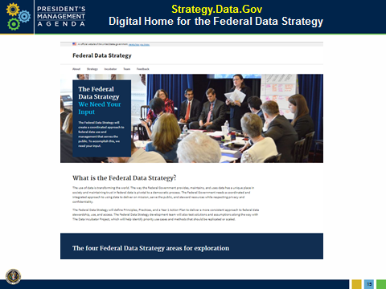
US Federal Data Strategy Development
https://Strategy.Data.Gov
Meet the team
See progress to date
Submit comments
Principles and Practices
Next updates expected in May 2019
Proof Points and Pilot Activities
The Data Incubator Project will gather and publicly share use case examples of how data can be leveraged as a strategic asset to achieve agency mission and public interest.
Notes:
The Federal Data Strategy team is requesting comments on 47 draft practices released. They’ve also released a list of use cases - real world examples of the use of data in solving important problems, advancing an agency mission, or serving the public interest. The Use Cases will help the team as it develops the Principles, Practices, and Action Steps for the Federal Data Strategy.
We have also built in mechanisms for obtaining external stakeholder feedback to make sure
that the strategy includes the insights of all types of stakeholders: businesses with experience
solving data challenges, non-profits who use the data to deliver services and improve lives,
researchers who use data or pioneer cutting-edge new data science techniques, state and local
governments, and private individuals. And our Data Fellows are actually applying big data
analytic techniques in order to get the most value from the feedback we receive.

Slide 6
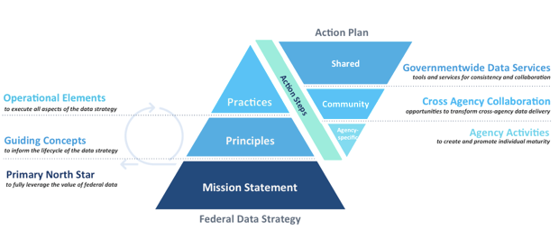
Federal Data Strategy
Annual Action Plans
Draft Year 1 Action Plan to be released May 2019

Slide 7
US Executive Order on AI
Released by US OSTP on Feb 11, 2019
Support for development of US AI capability, promote innovation
Big implications for NOAA data architectures
Promote data access to enable AI
Training Datasets
Consistent with FDS, FEBPA, GDA
https://www.whitehouse.gov/presidential-actions/executive-order-maintaining-american-leadership-artificial-intelligence/

Slide 8
NOAA’s Big Data Project
Cooperative Research and Development Agreements
5 separate but identical 4-year agreements
Experimental Phase scheduled to end in 2019
Industry provides access to NOAA’s open data to all
Data remain open, are not to be sold
Collaborators monetize services based on data
NOAA provides data and expertise
Combines 3 powerful resources based on NOAA’s open data:
NOAA’s science and subject matter expertise
Industry’s data storage and access expertise
Cloud's scalable and on-demand processing capability
Notes:
The US Department of Commerce and the National Oceanic and Atmospheric Administration (NOAA) announced the NOAA Big Data Partnership (BDP) in April 2015. Through five cooperative research and development agreements (CRADAs) between NOAA and selected commercial and academic collaborators, NOAA is learning how the value inherent in its data may be leveraged to broaden the distribution and utilization of those data. Selected datasets of interest to the BDP collaborators and their business partners are being transferred from NOAA to the collaborators’ infrastructure. The partnership has already realized a number of dataset improvements, and new and novel applications that employ NOAA’s atmospheric, geophysical, and oceanographic data, at no net cost to the US taxpayer. For example, NOAA’s National Centers for Environmental Information (NCEI) has transferred the complete NEXRAD Level II historical archive to the CRADA collaborators.

Slide 9
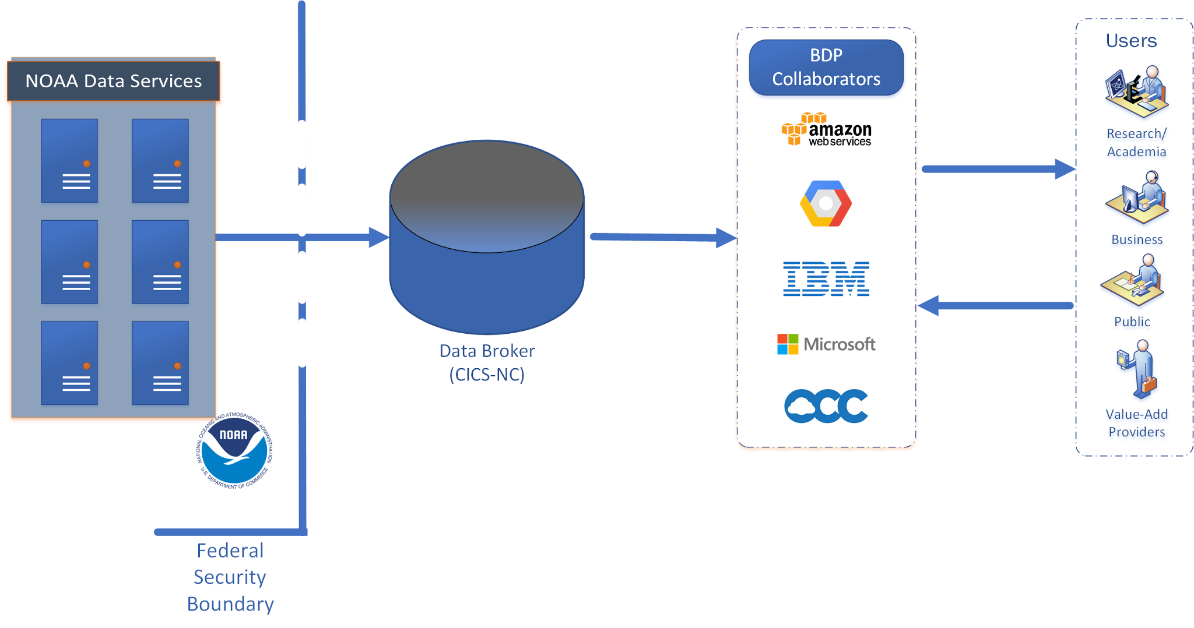
NOAA Big Data Project
Single Copy Services Many -- Use Data in Place
One-way transfer out of federal systems. Only a trusted user inside security boundary
Distributing a single copy of data can support all users.
Notes:
Improving NOAA's Cybersecurity Posture
Currently: Users access federal systems for distribution
Some mission-critical systems offer public access to data
External users have access inside federal security boundary
Potential: All data access occurs in non-federal system
Reallocate security assets and staffing to focus on mission-critical systems
Only verified trusted users granted access to federal systems

Slide 10
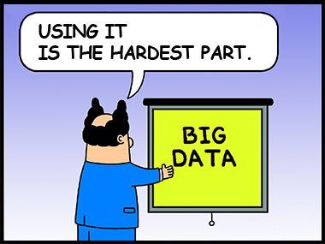
The Limiting Factor for Use of the Data
Use
Expertise
Cloud
Open Data

Slide 11
Big Data Project
Collaborators’ Data Offerings
AWS
https://aws.amazon.com/noaa-big-data/
https://registry.opendata.aws/
Google Cloud Platform
https://cloud.google.com/bigquery/public-data/
https://explorer.earthengine.google.com/#index
IBM
https://noaa-crada.mybluemix.net/
Microsoft
No public services to date
Open Commons Consortium
http://edc.occ-data.org/

Slide 12
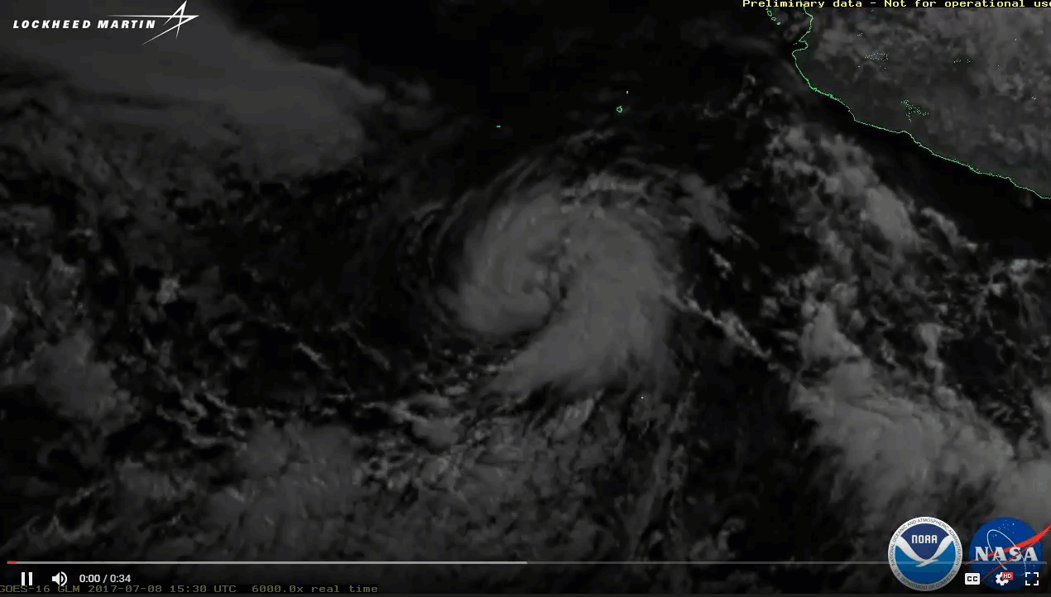
BDP and GOES-16, 17
Overview of BDP Activity
Cooperative Institute for Climate and Satellites – North Carolina
Providing GOES-16 and GOES-17 data from NOAA/NESDIS Ground System (PDA) to Collaborators.
1 source, 5 validated feeds to the CRADA Collaborators
Timing - As fast as they appear at NOAA/NESDIS distribution point
Latency - Single hop through CICS-NC systems, w/checksums
Impact - Minimal load on NOAA’s operational systems and networks
Observed additional latencies from CICS-NC transfer from NOAA Ground System to BDP Collaborator platforms
Maximum additional latency: 2 to 3 min (full disk ABI, Band 2)
Typical Range of additional latency: 4.5 to 5.5 seconds

Slide 13
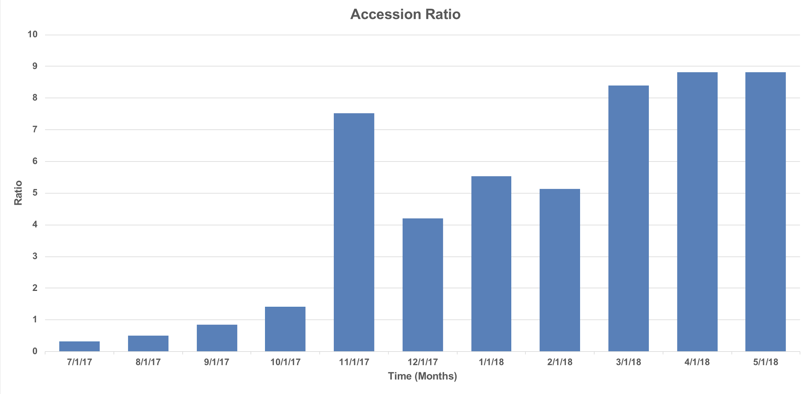
GOES 16 Data Statistics [AWS]
(courtesy of CICS-NC)

Slide 14
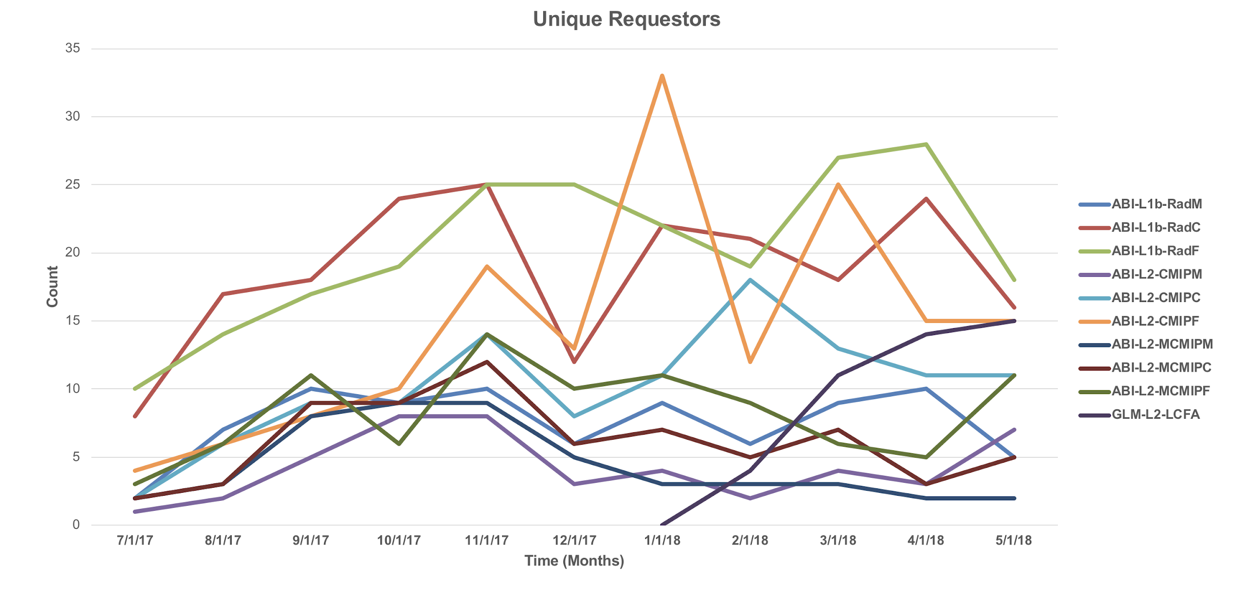
GOES 16 Data Statistics [AWS]
(courtesy of CICS-NC)

Slide 15
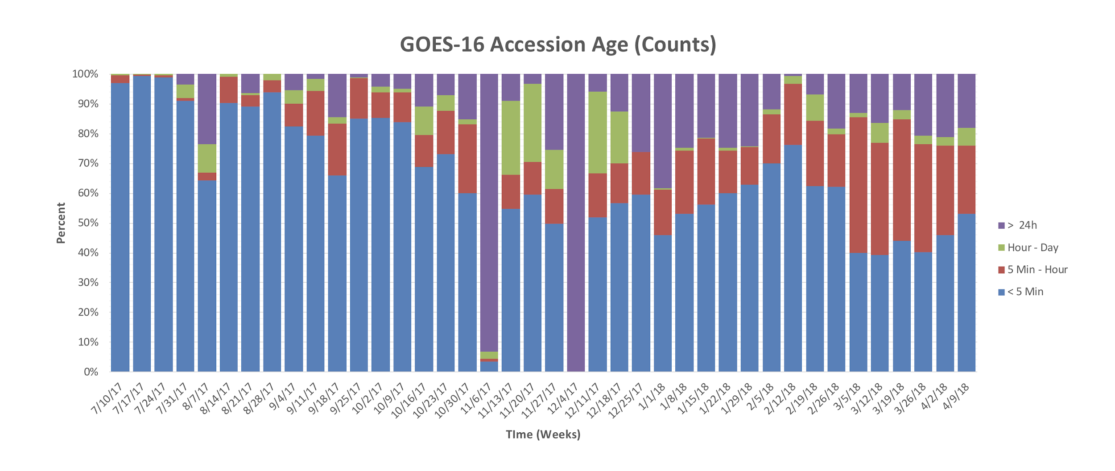
GOES 16 Data Statistics [AWS]
(courtesy of CICS-NC)

Slide 16
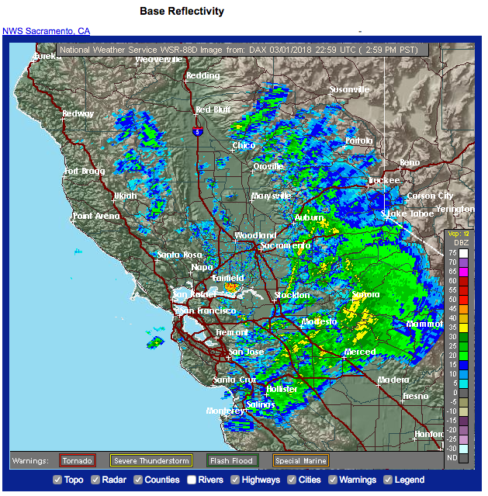
AWS and Weather Radar
Entire NEXRAD 88D Weather Radar Archive transferred to AWS, Google and OCC in Oct 2015 (~ 300TB, 20M files)
Following AWS service release:
Increased usage (2.3 times), 50% reduction on NOAA servers.
New uses – bird migration, mayfly studies
80% of NOAA NEXRAD data orders are now served by AWS.
(Ansari et al, 2017 BAMS)

Slide 17
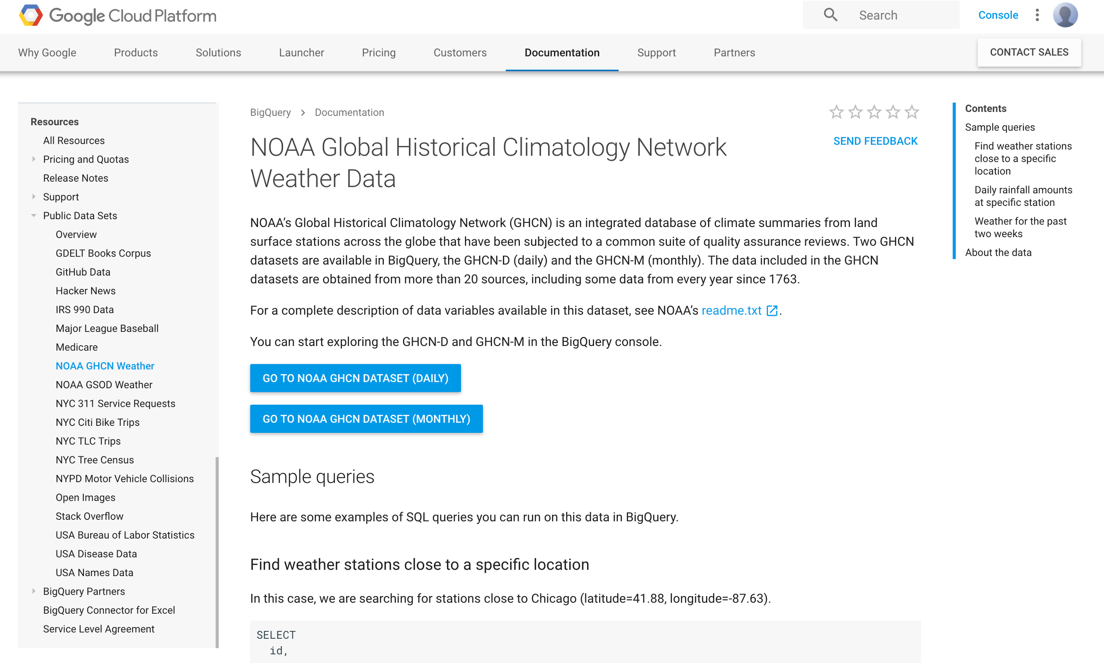
Climate Data in Google BigQuery
https://cloud.google.com/bigquery/public-data/noaa-ghcn
1.2 PBs of climate and weather data accessed through Google BigQuery, in 4 months
30-100x of NOAA deliveries in that time
Images in Google Cloud Platform
GOES-16 (began July 2017)
National Water Model data
Weather and Climate model output
Climate data records

Slide 18
OCC’s Environmental
Data Commons
http://edc.occ-data.org/

Slide 19
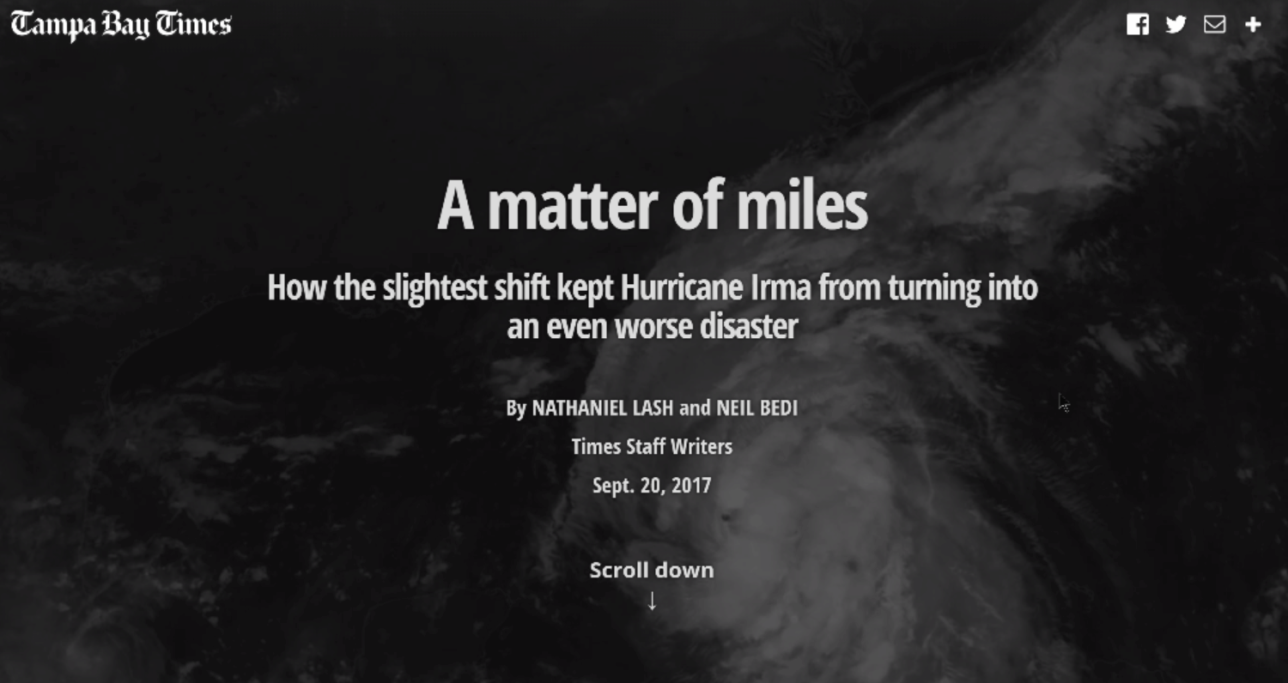

Slide 20
Google Dataset Search

Slide 21
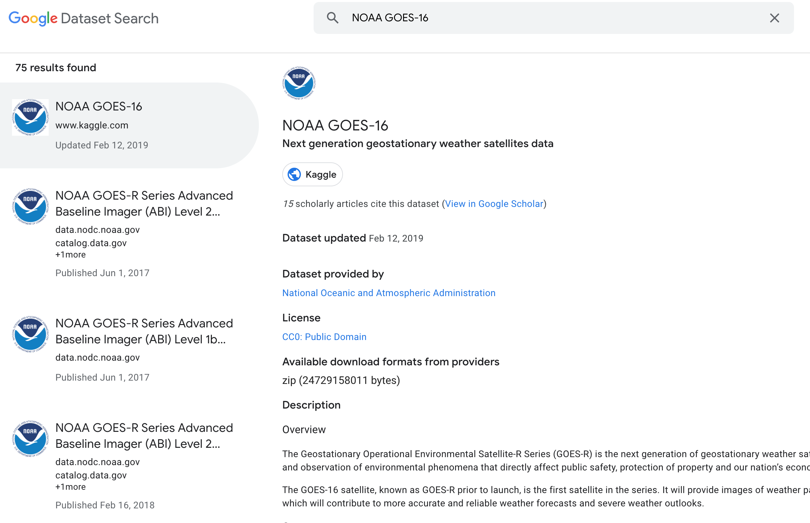
Google Dataset Search

Slide 22
BDP Data Broker Study:
Format Conversions
Pilot using AWS Lambda functions converting GHCN-D granules from .gz to .csv:
Exceptions due to limitations built into Lambda functions (exceeds memory limit), requiring cloud instance to convert for most
Datasets under discussion:
NetCDF images -> cloud optimized geotiff
GRIB/GRIB2 data matrices -> NetCDF or other formats

Slide 23
BDP Dataset Maintenance
NWC requested that we remove a parameter from the historical NWM datasets
Pilot using AWS FARGATE launching 20 Docker containers with
Python wrapper around the NCO (NCKS) tool
~26 hours to remove one parameter from ~75K objects
Notes:
Improving NOAA's Cybersecurity Posture
Currently: Users access federal systems for distribution
Some mission-critical systems offer public access to data
External users have access inside federal security boundary
Potential: All data access occurs in non-federal system
Reallocate security assets and staffing to focus on mission-critical systems
Only verified trusted users granted access to federal systems

Slide 24
Big Data Project
Interim Results
Technical Proof-of-Concept proven successful
Over 70 datasets are being served now via Collaborator services
Higher levels of service, increased volumes, new users
Lessons-learned documented; Collecting User stories
Key Points
A Partnership based on NOAA public data access can work
Expertise is the scarce, valuable commodity in the relationship
NOAA must own data security & quality to secure value & brand
Opportunities that the Partnership aspect may provide
Grow & defend NOAA budgets with new advocates for NOAA data
Cost savings in data access infrastructure
Enhanced scale and reliability of services for NOAA data consumers

Slide 25
NOAA is seeking a Sustainable Partnership
Developed a Conceptual and Functional Framework
Defining Implementation Options
Analyzing the User information available
Gathering Use Cases
Request For Information completed Fall 2018
Request for Proposals released Apr 4, 2019

Slide 26
Questions?
ed.kearns@noaa.gov
#NOAABigData

Slide 27
FEBPA Summary
Signed into law on Jan 14, 2019
www.congress.gov/bill/115th-congress/house-bill/4174/text
Takes effect by July 8, 2019 (first deliverables July ‘20)
OMB has not yet released implementation guidance (Apr ‘19)
Title I requires the 23 CFO Act* agencies to submit a plan for identifying and addressing relevant agency policy questions
Adoption of “Learning Agendas” into strategic planning
OMB shall consolidate into a Unified Evidence Building Plan
OMB shall establish:
Interagency Council on Evaluation Policy;
Advisory Committee on Data for Evidence Building; and a
Chief Data Officer Council.
Notes:
*The Chief Financial Officers Act of 1990 (Public Law 101–576), or CFO Act includes the Department of Commerce.

Slide 28
Value Driven Ecosystem
Uses
Information Consumers
Decision Support Tools
3rd Parties
Cloud Platforms
NOAA Data and Expertise

Slide 29
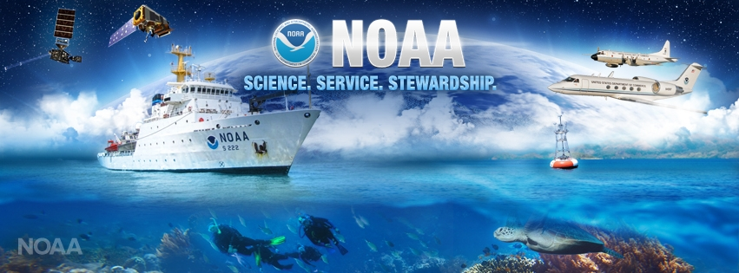
Our Mission
To understand and predict changes in climate, weather, oceans, and coasts, to share that knowledge and information with others, and to conserve and manage coastal and marine ecosystems and resources.

