Slide 1
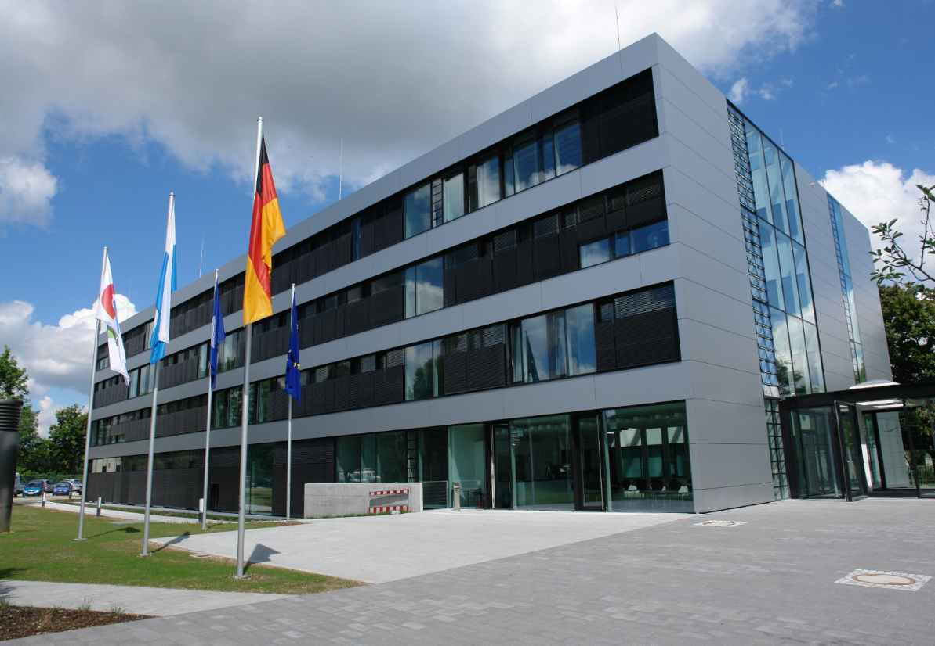
WGISS 46 - October 22nd-26th 2018
Hosted by
DLR
Oberpfaffenhofen
near Munich, Germany

Slide 2
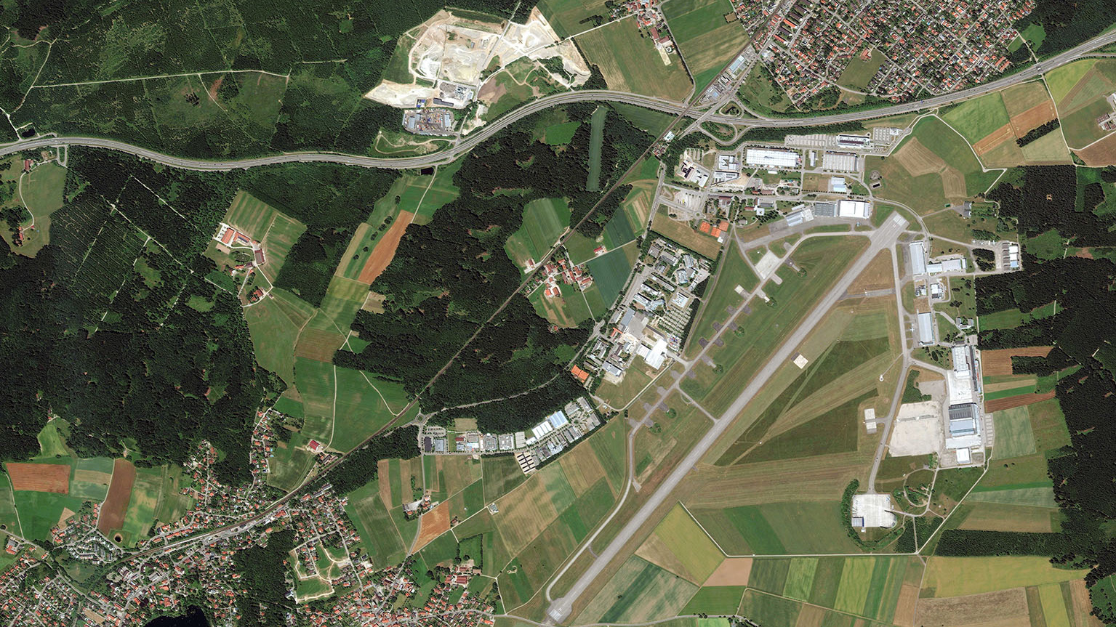

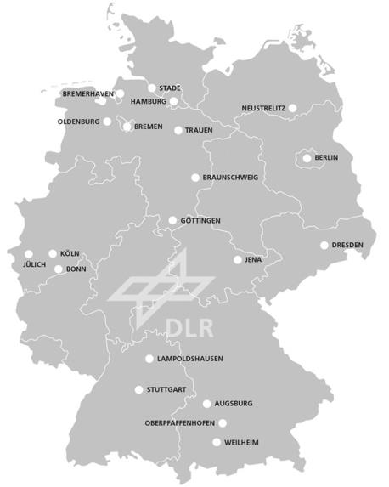

DLR-Oberpfaffenhofen
near Munich, Germany
Gilching
Munich 30 km →
← Landsberg 30 km
Wessling-Oberpfaffenhofen
DLR Earth Observation Center

Slide 3
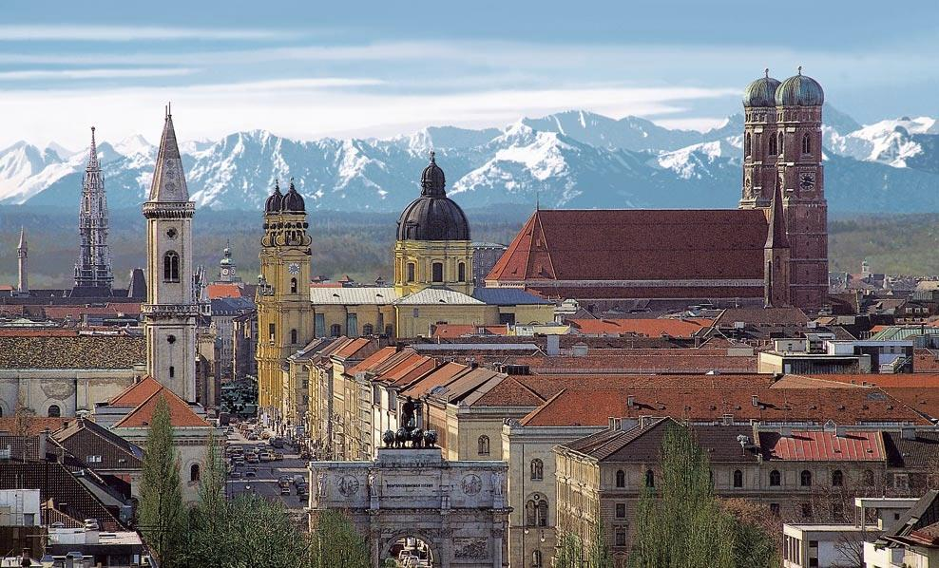
Munich

Slide 4
Additional Information
Logistics
Nearest airport: Munich Franz-Josef Strauss (MUC)
Several rooms have been blocked at a number of hotels in Herrsching am Ammersee near DLR; see separate slide for details; it is advisable to book early
The town of Herrsching can be reached from the airport via light rail (Line 8 direct); fare 11.60 EUR
DLR will provide a bus shuttle service between Herrsching and DLR in the morning and evening
Weblinks
http://www.dlr.de/dlr/en/desktopdefault.aspx/tabid-10261/320_read-214/#/gallery/701
http://www.dlr.de/dlr/en/Portaldata/1/Resources/bilder/portal/oberpfaffenhofen/DLR_OP_Standortflyer_engl2012.pdf
http://www.dlr.de/dlr/en/Portaldata/1/Resources/bilder/portal/oberpfaffenhofen/Luftbild.jpg

Slide 5

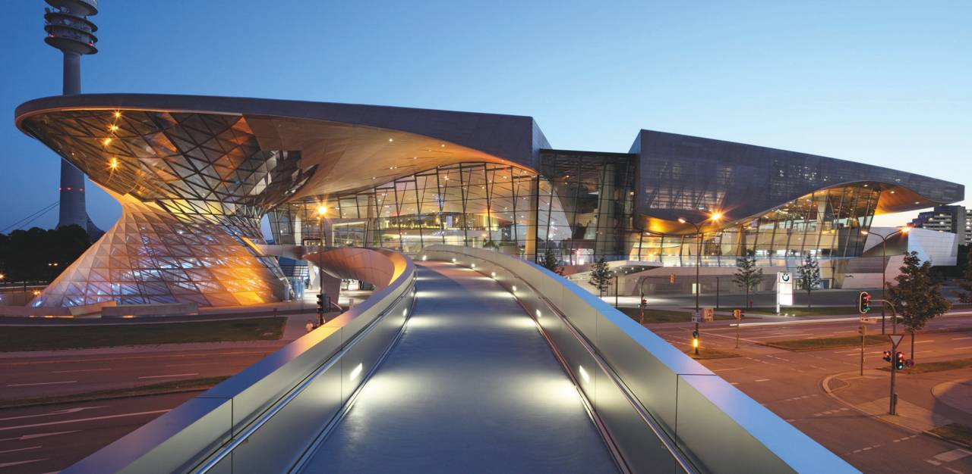
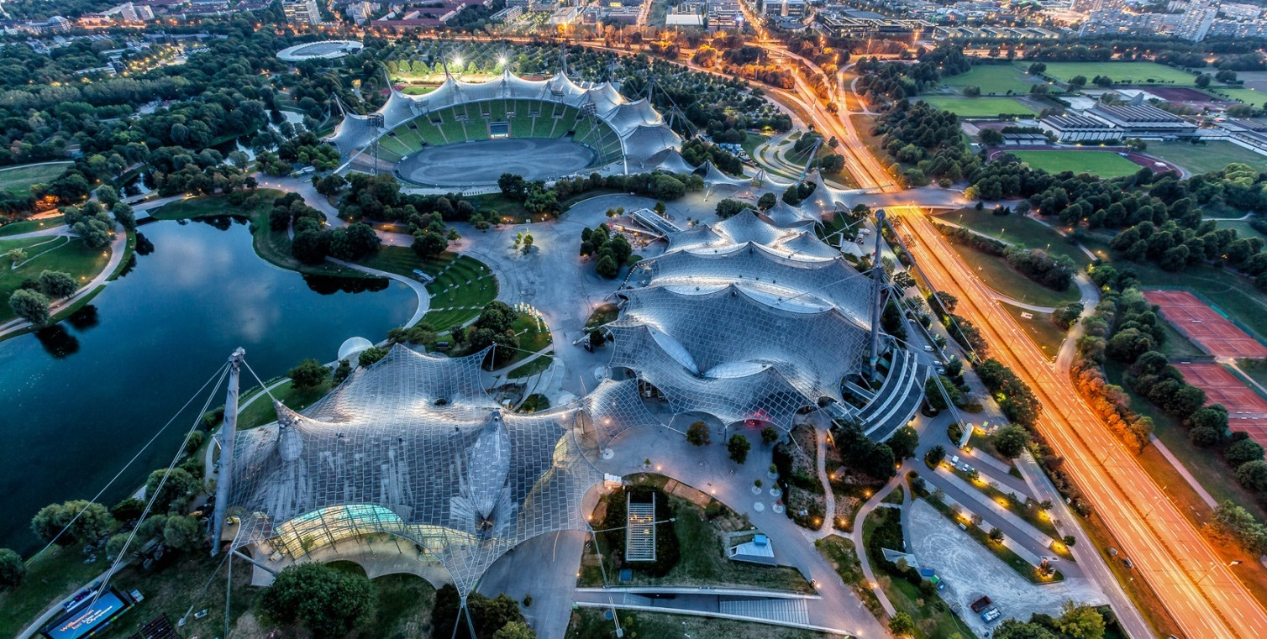
Munich
BMW-Welt & Olympic Stadium

Slide 6
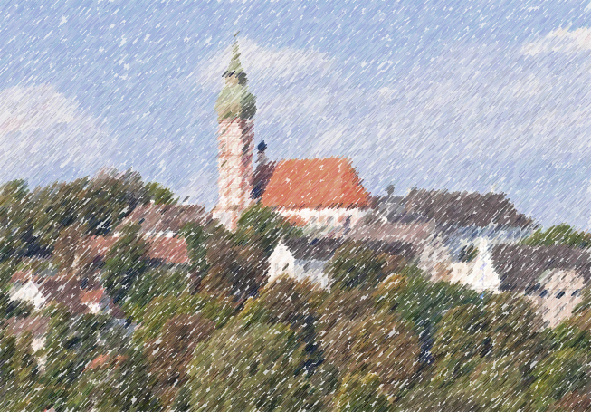

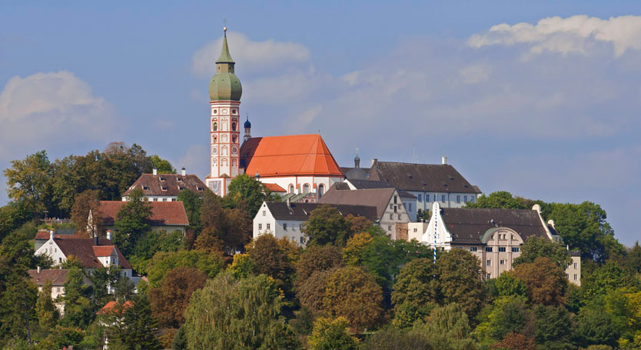
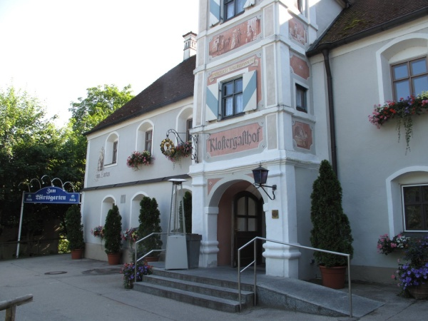
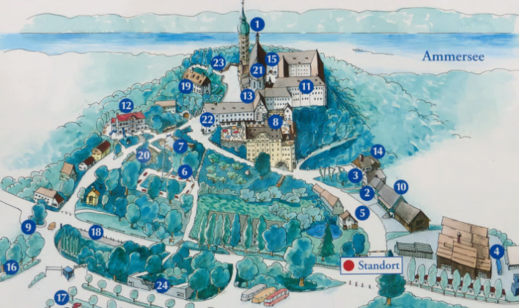
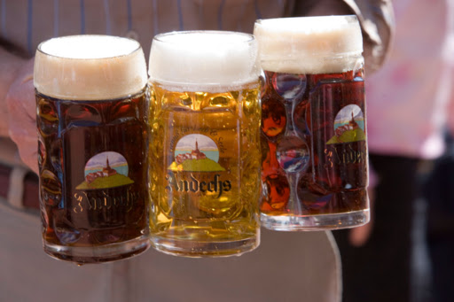
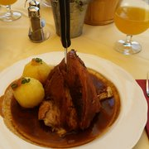
Andechs
Monastery & Brewpub

Slide 7
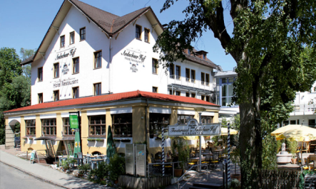
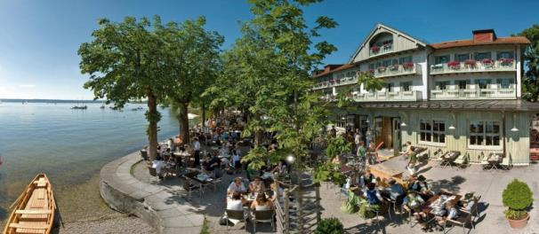
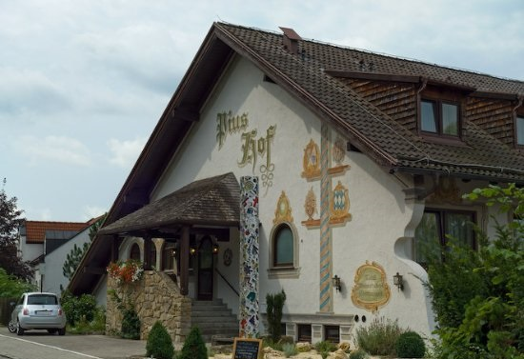
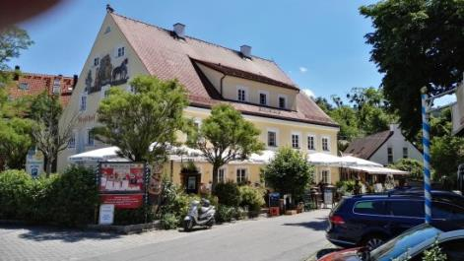
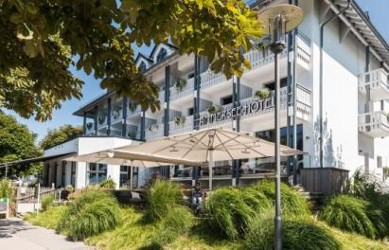
Accommodation Options
1. Hotel Courtyard Marriot Oberpfaffenhoffen
Friedrichshafener Strasse 3a, Gilching, 82205 Germany +49 89 614260
https://www.marriott.com/default.mi
  select ‘Corporate/Promo’ under ‘Special Rates’ and enter 5i0 (Five i zero)
Ask for the DLR corporate rate when making a reservation by phone
(toll-free reservation center in Germany: +49 69 945189152)
2. Hotel Andechser Hof
  Zum Landungssteg 1, 82211 Herrsching, phone +49 8152 96810
  www.andechser-hof.de
  4 rooms blocked until 31st July 2018
  110.00 EUR
  Keyword ‘CEOS-WGISS’
3. Hotel Seehof Herrsching
  Seestraße 58, 82211 Herrsching, phone: +49 8152 9350
  http://seehof-ammersee.de/en/
  15 rooms blocked until 23rd July 2018
  92.00 EUR
  Keyword ‘CEOS-WGISS
4. Hotel Piushof
  Schönbichlstraße 18, 82211 Herrsching, phone: +49 8152 96820
  http://www.piushof.de/
  22 rooms blocked until 31rd July 2018
  (4 rooms à 81.00, 18 rooms à 91.00 EUR)
  Keyword ‘CEOS-WGISS
5. Ammersee Hotel 6. Hotel Zur Post
  https://www.ammersee-hotel.de/ https://www.post-herrsching.de/

