Slide 1

WGISS Working Group on Information Systems & Services
CHAIR
SUMMARY
Committee on Earth Observation Satellites
Mirko Albani - ESA
WGISS-46
DLR – Oberpfaffenhofen, Germany
25th October 2018

Slide 2
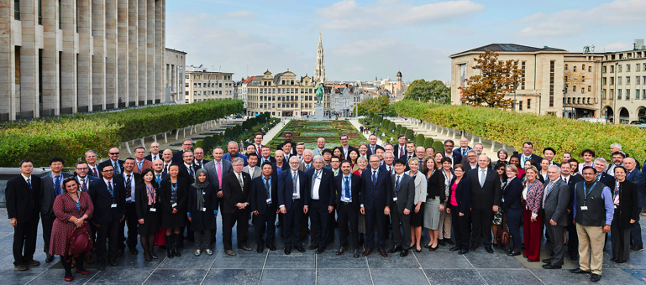


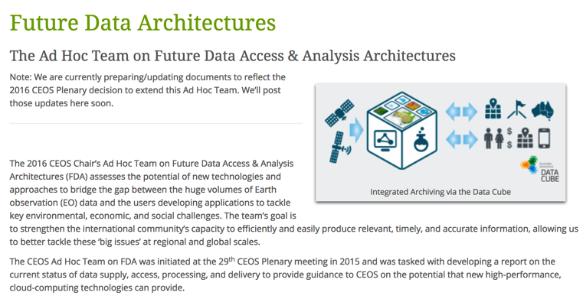
WGISS PLENARY SESSION
CEOS PLENARY,
17-18 October 2018 Brussels, Belgium
NEW CEOS Chair
VIETNAM ACADEMY OF SCIENCE AND TECHNOLOGY

Slide 3
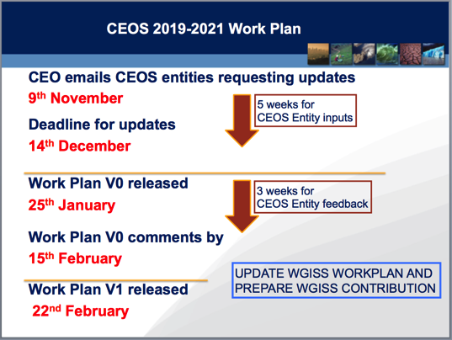
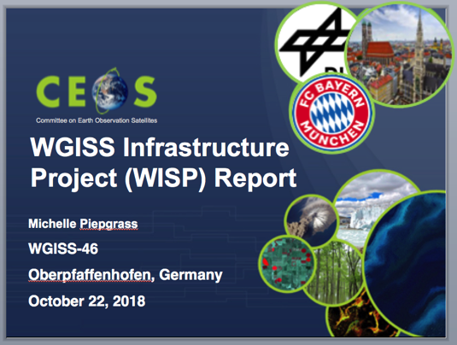
WGISS PLENARY SESSION
SEO Report
  Coverage tool, Data Cubes, Collaboration with WGISS
WGCapD Report
  Deliverables, collaborations, training calendar and resources, collaboration with WGISS
CEO Report WISP REPORT

Slide 4

WGISS Vice Chair Nomination
WGISS Vice Chair Nomination for the period October 2019 – October 21

Slide 5
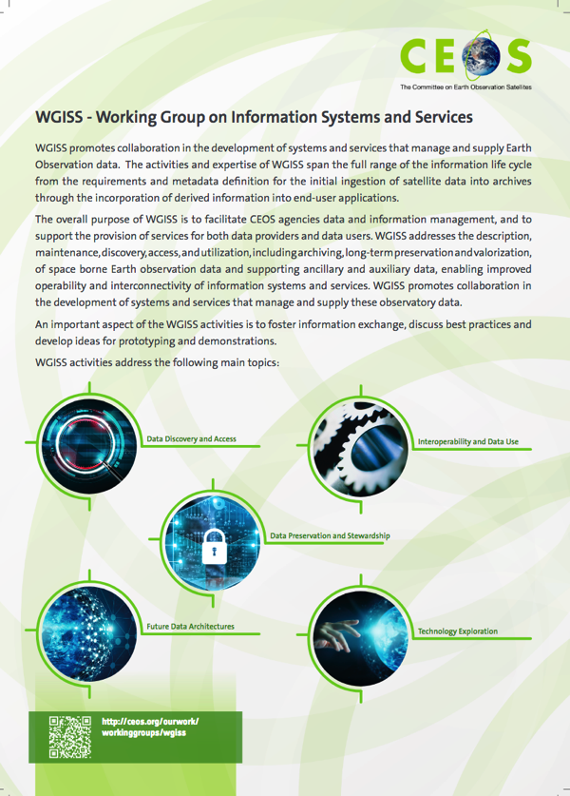
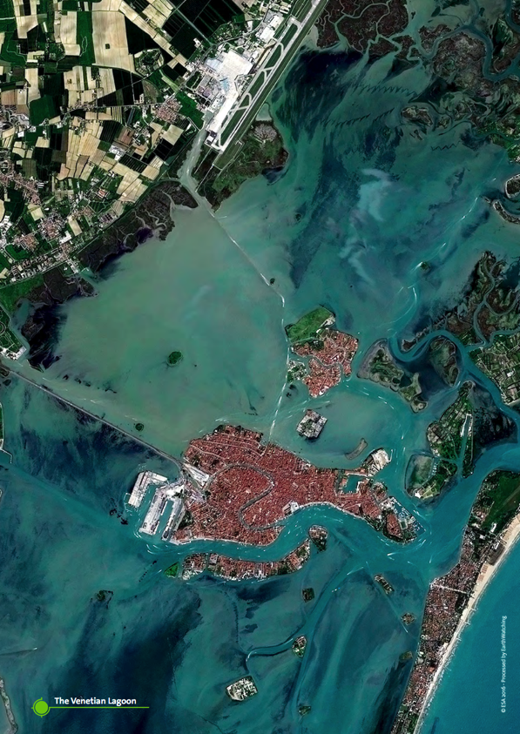
WGISS BROCHURE

Slide 6
Data Preservation and Stewardship Session
Committee on Earth Observation Satellites

Slide 7
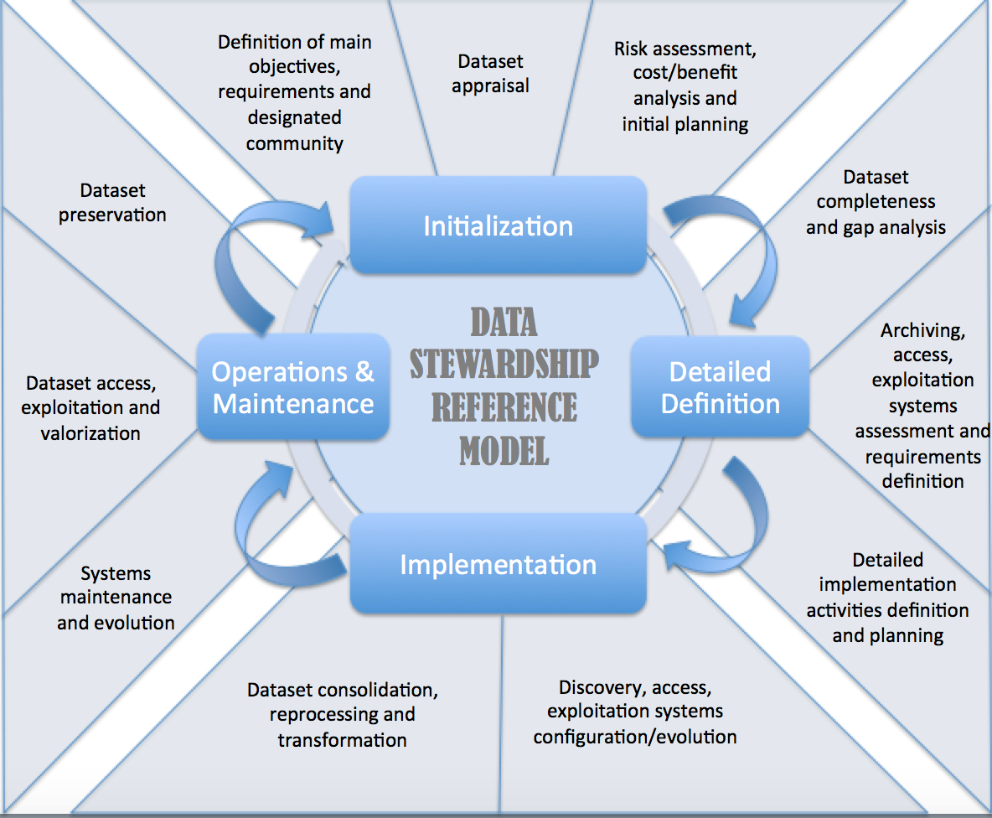
WGISS Data Stewardship Reference Model - Activities

Slide 8
The Structure of SMM-CD
SMM-CD Category
Data Access | Usability & Usage | Quality Management | Data Management
Discoverability | Data Portability | Quality Assurance & Control | Preservation
Accessibility | Documentation | Quality Assessment | Metadata
 | Usage | Uncertainty Analysis | Governance
 |  | Data Integrity
Aspect
The state or ability to locate (Discoverability) and get to the dataset (Accessibility)
How easily the data product may be understood and integrated by users; the usage and impact of the dataset
The state of quality assurance, control, and assessment; data uncertainty and reliability, and data fixation
The state of the dataset preservation, metadata completeness, and governance practices
Notes:
Four categories are agreed on by the SMM-CD Working Group and the members of the expert group.

Slide 9
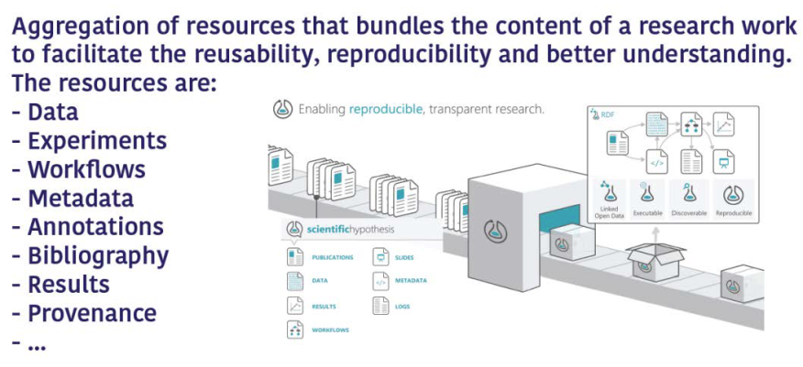

The Research Life cycle management - Research Objects

Slide 10
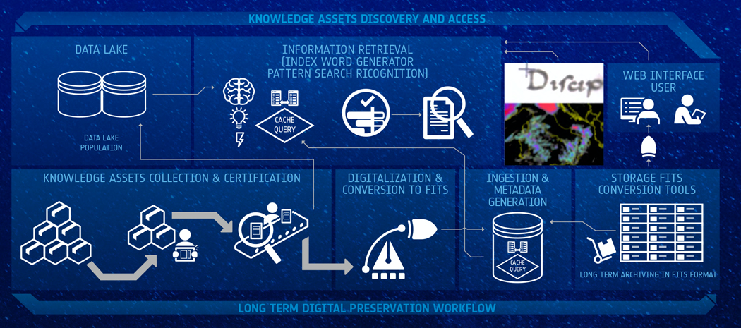

DATA ASSOCIATED KNOWLEDGE MANAGEMENT SYSTEM (KMS) CONCEPT
Notes:
Different stakeholders for who the different types of data have value e.g.
• Satellite Data for Data Users and Services;
• Technical knowledge for ESA-Projects, MS, Industry and Science;
• Management Data for ESA-Executive & MS;
LTDP has addressed with international partners the information highlighted in the slide and drafted in cooperation with them Best Practices and procedures defining the why/what/how/for how long to preserve and make accessible those items. These are being applied at ESA and other agencies.

Slide 11
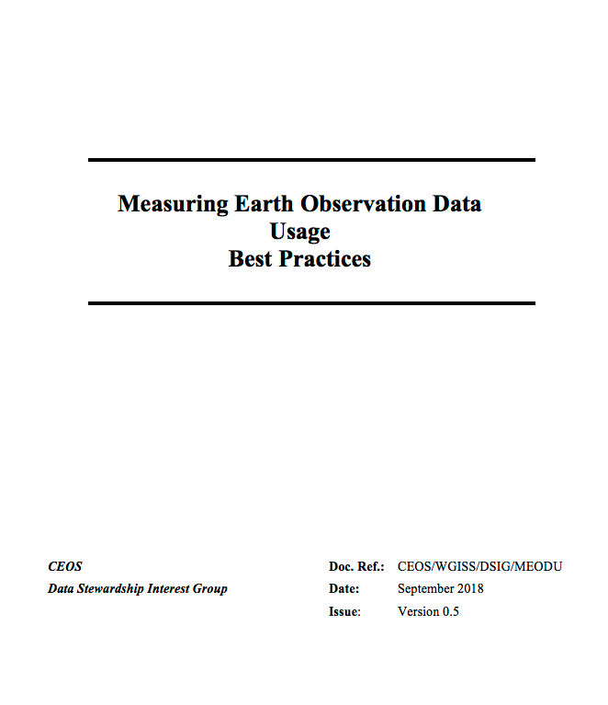
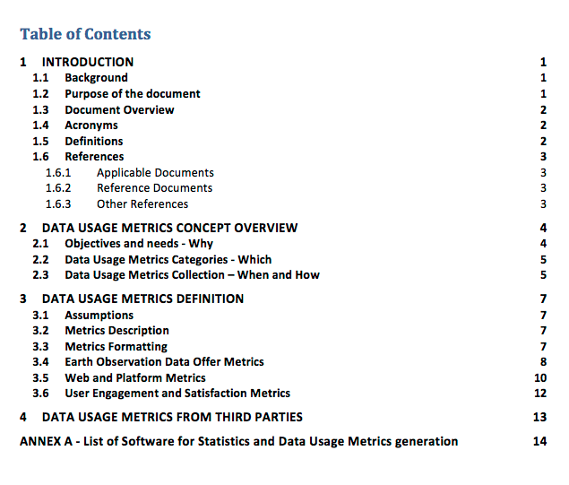
Measuring Earth Observation Data Usage - Best Practices
New title to better include all aspects around the topic

Slide 12
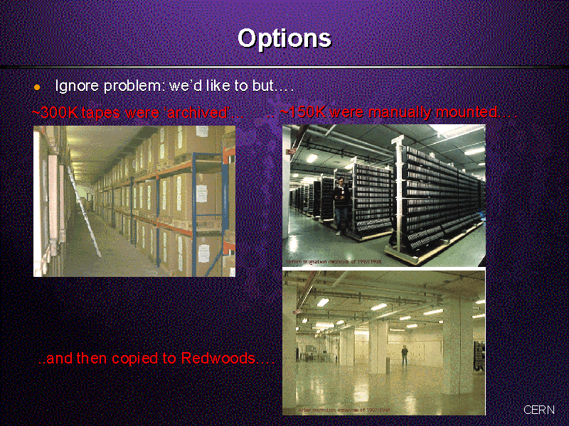
CERN - LEP Era: Tape Archive

Slide 13
ISO 19165-2 Status
Presented to the
CEOS WGISS October 22, 2018
Hampapuram (Rama) Ramapriyan
Science Systems and Applications, Inc. &
ESDIS Project, NASA/Goddard Space Flight Center

Slide 14

LIVING PLANET 2019 CONFERENCE

Slide 15


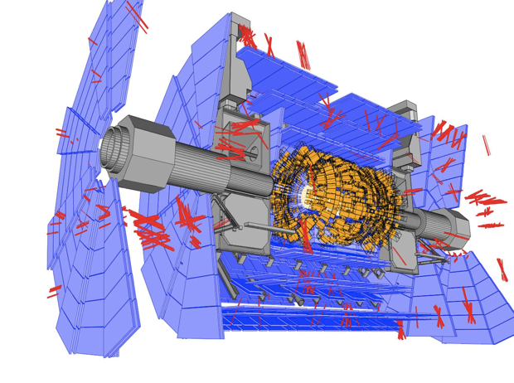
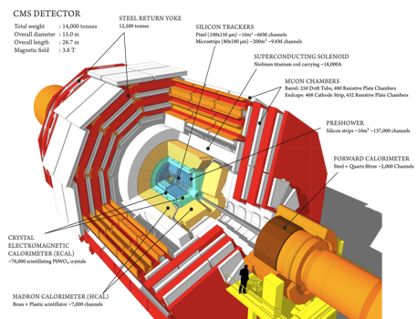
PV2020 @ CERN

Slide 16
Data Discovery and Access Session
Committee on Earth Observation Satellites

Slide 17
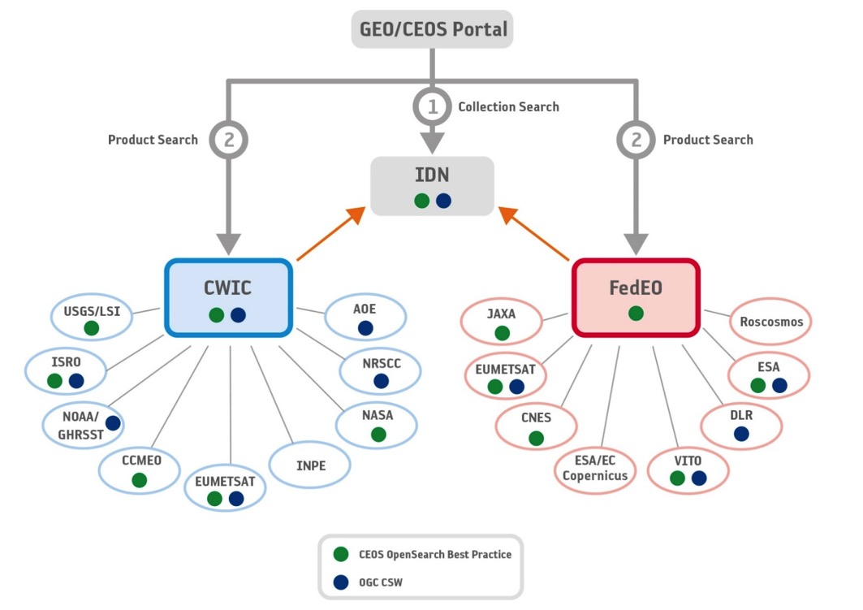
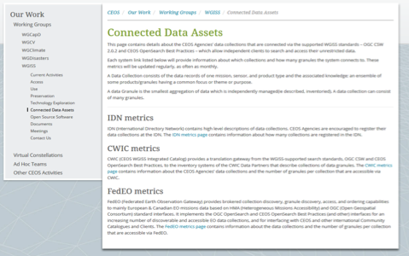
WGISS Connected Data Assets
Architecture
Relying on IDN/CWIC/FedEO components, provides a single entry point for external clients to discover and access CEOS agencies data. It is supported by the WGISS Connected Assets System Level Team (SLT)
Search over 32,000 collections in the IDN
Access over 5000 collections with associated over 300+ million granules (granule search)

Slide 18
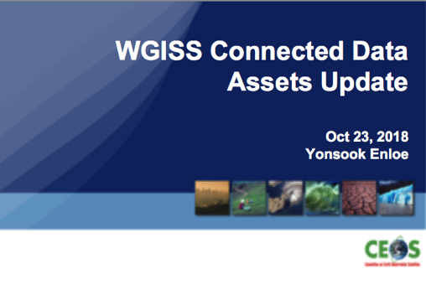
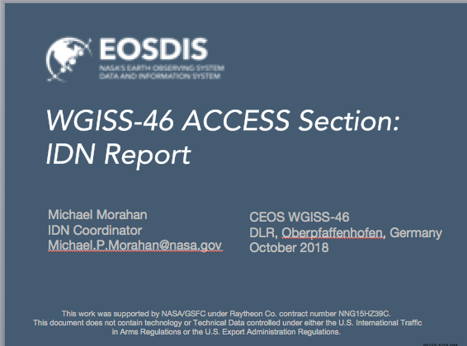
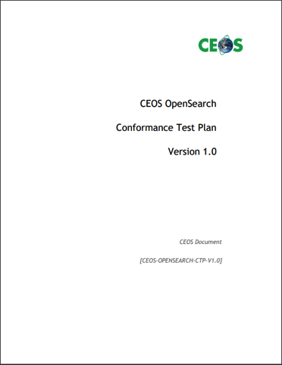
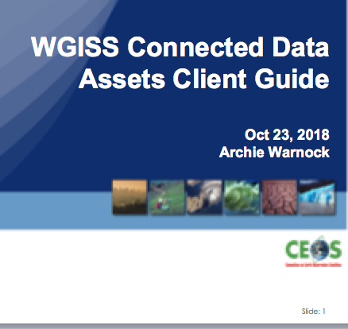
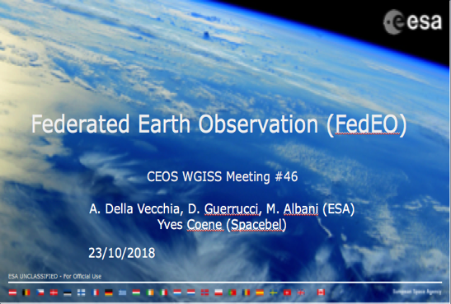
WGISS Connected Data Assets
Elements

Slide 19
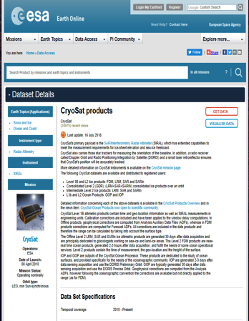
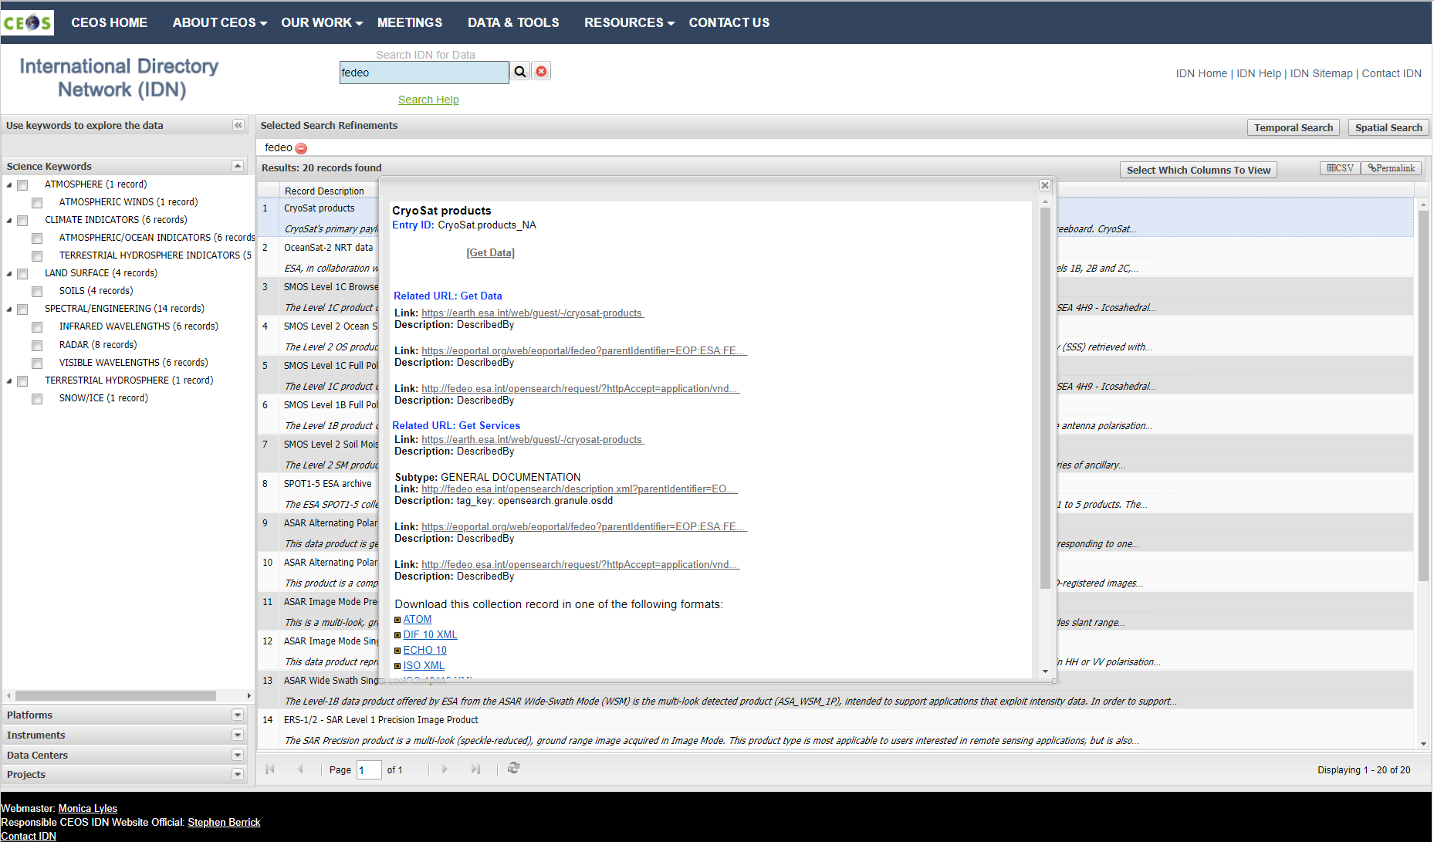
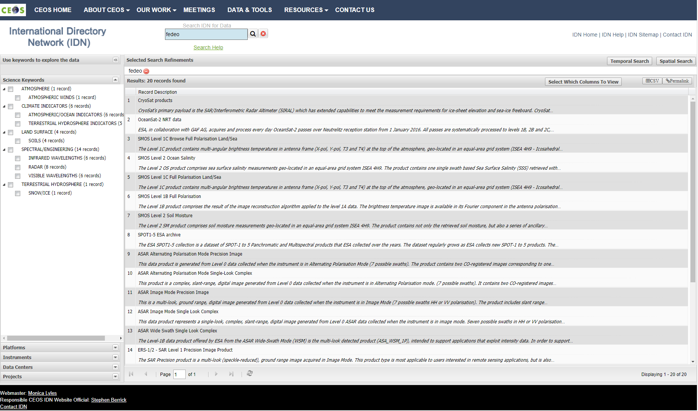
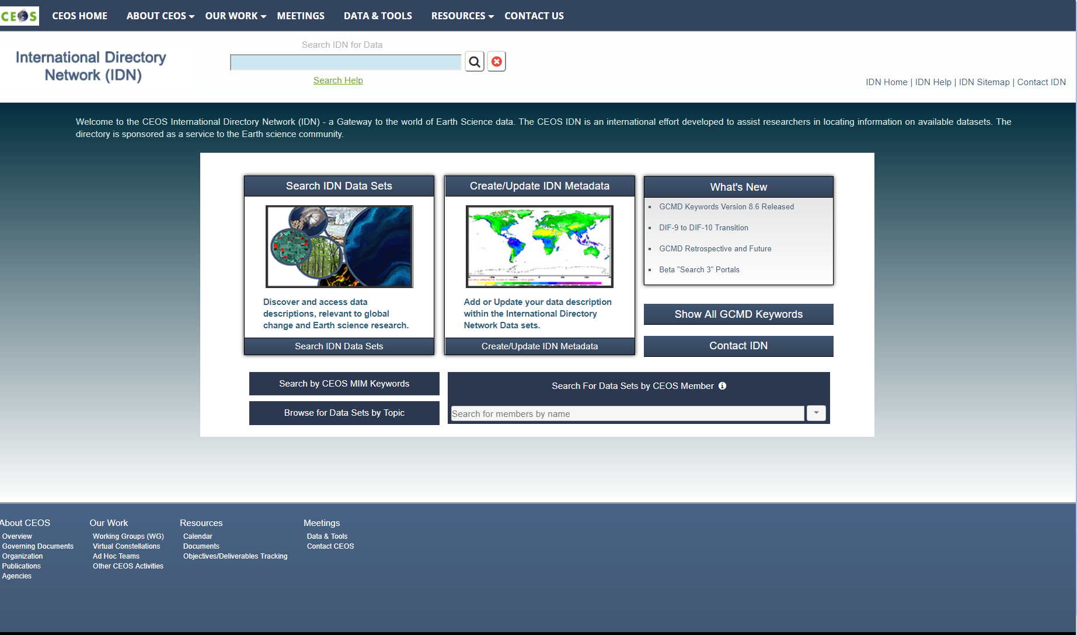
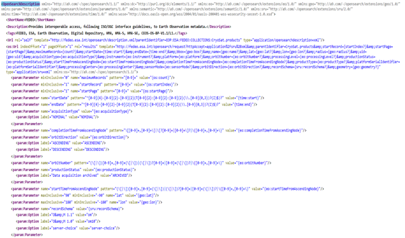
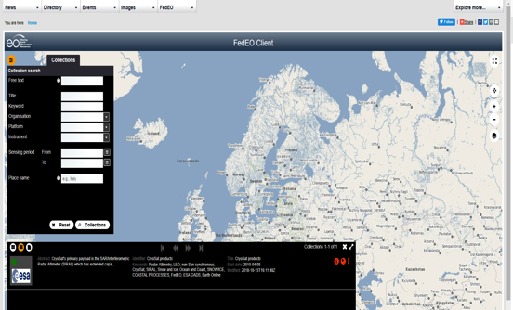
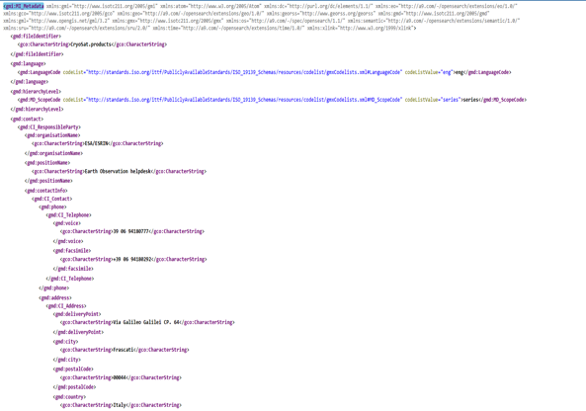
WGISS CDA GUI Interface – For discussion/action
ESA Collection Landing Page
Second Step OSDD
FedEO Client
ISO 19139-2 Metadata

Slide 20
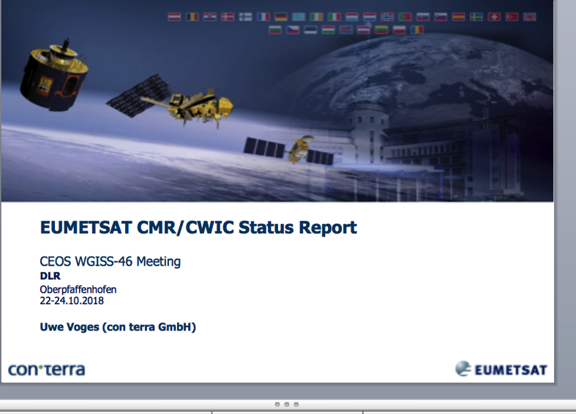
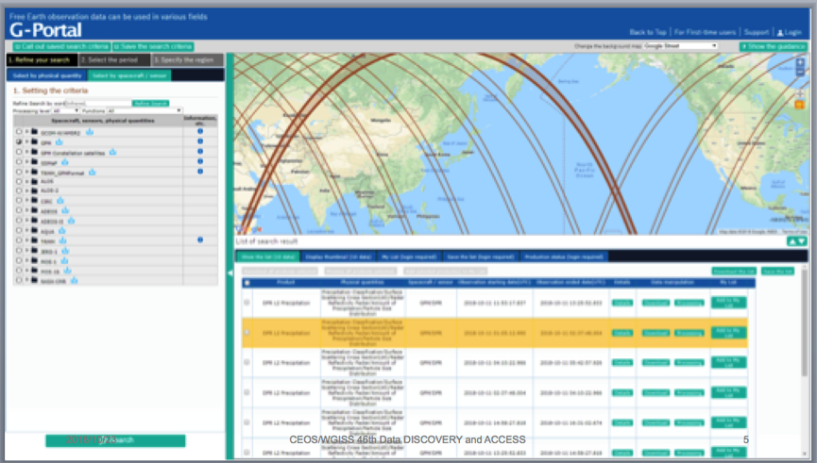

Discovery and Access

Slide 21

ESA TPM/HM Data Cube
Let’s assume we want to correlate pollution and temperature over Ferrara (Italy).
We want to use time series of Land Surface Temperature (LST) and Aerosol Optical Thickness (AOT) from MODIS.
LST timeseries 3 years
Global: ~120GB
Italy: ~245MB
Ferrara: ~17KB
Data transfer rate
500x
10⁶x
AOT timeseries 3 years
Global: ~300MB
Italy: ~1MB
Ferrara: ~17KB
Data transfer rate
300x
10⁴x
Notes:
To be replaced with time series

Slide 22
Technology Exploration Session
Committee on Earth Observation Satellites

Slide 23
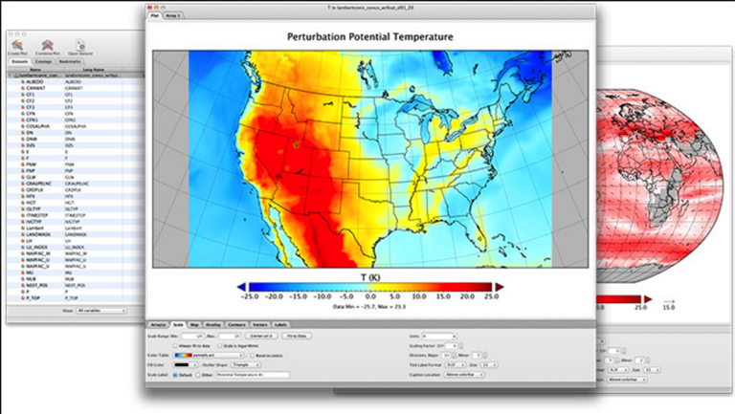
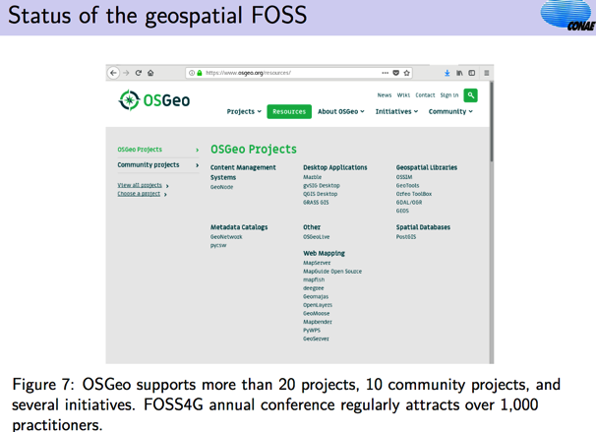

Technology Exploration

Slide 24






Evaluation – Example “path” of metadata from its origin
Indexing of schema.org
/ JSON-LD markup
Harvesting of DCAT-AP records
Data Cleaning, Replica Identification, Scholar Linking, Knowledge Graph Reconciliation
(Enriched) Metadata Index
Harvesting of ISO 19115/19139 records
Ranked Results
Catalogue

Slide 25
GEOSS – WGISS Interoperability Workshop
Committee on Earth Observation Satellites

Slide 26
Workshop Objectives
Strengthen interaction and coordination between WGISS and GEOSS at technical level.
Identify additional topics where we could work together and maximise outputs and impact.
Discuss and define CEOS WGISS contribution in shaping the evolution and future vision of GEOSS as a whole and in particular for what concerns ground segment systems and platforms (i.e. Future data Architectures).
Define a WGISS-GEOSS (Action) Plan and schedule periodic teleconferences to monitor progress in the activities.

Slide 27
Ongoing CEOS WGISS
Contribution to GEOSS
GEOSS Platform accessing WGISS CDA infrastructure for CEOS agencies data discovery and access
Participation & support to GEOSS Data Providers Workshops (e.g. “User Metrics” session, May 2018)
WGISS represented in NextGEOSS Advisory Board and Working with NextGEOSS on federated authentication technology solutions
Joint Workshop on GEOSS-WGISS interoperability and FDA at WGISIS#43 and WGISS#46
WGISS representative will be proposed as member of the GEOSS Expert Advisory Group
WGISS contributing to GEOSS-EVOLVE initiative
  WP 1: GEOSS Architecture and Evolution
  WP2: Functional Testing
  WP 3: Data Management Principles
  WP 5: Demonstrations Projects
  WP 6: Community Portals

Slide 28
WGISS Connected Data Assets
Architecture
Relying on IDN/CWIC/FedEO components, provides a single entry point for external clients to discover and access CEOS agencies data. It is supported by the WGISS Connected Assets System Level Team (SLT)
Search over 32,000 collections in the IDN
Access over 5000 collections with associated over 300+ million granules (granule search)

Slide 29
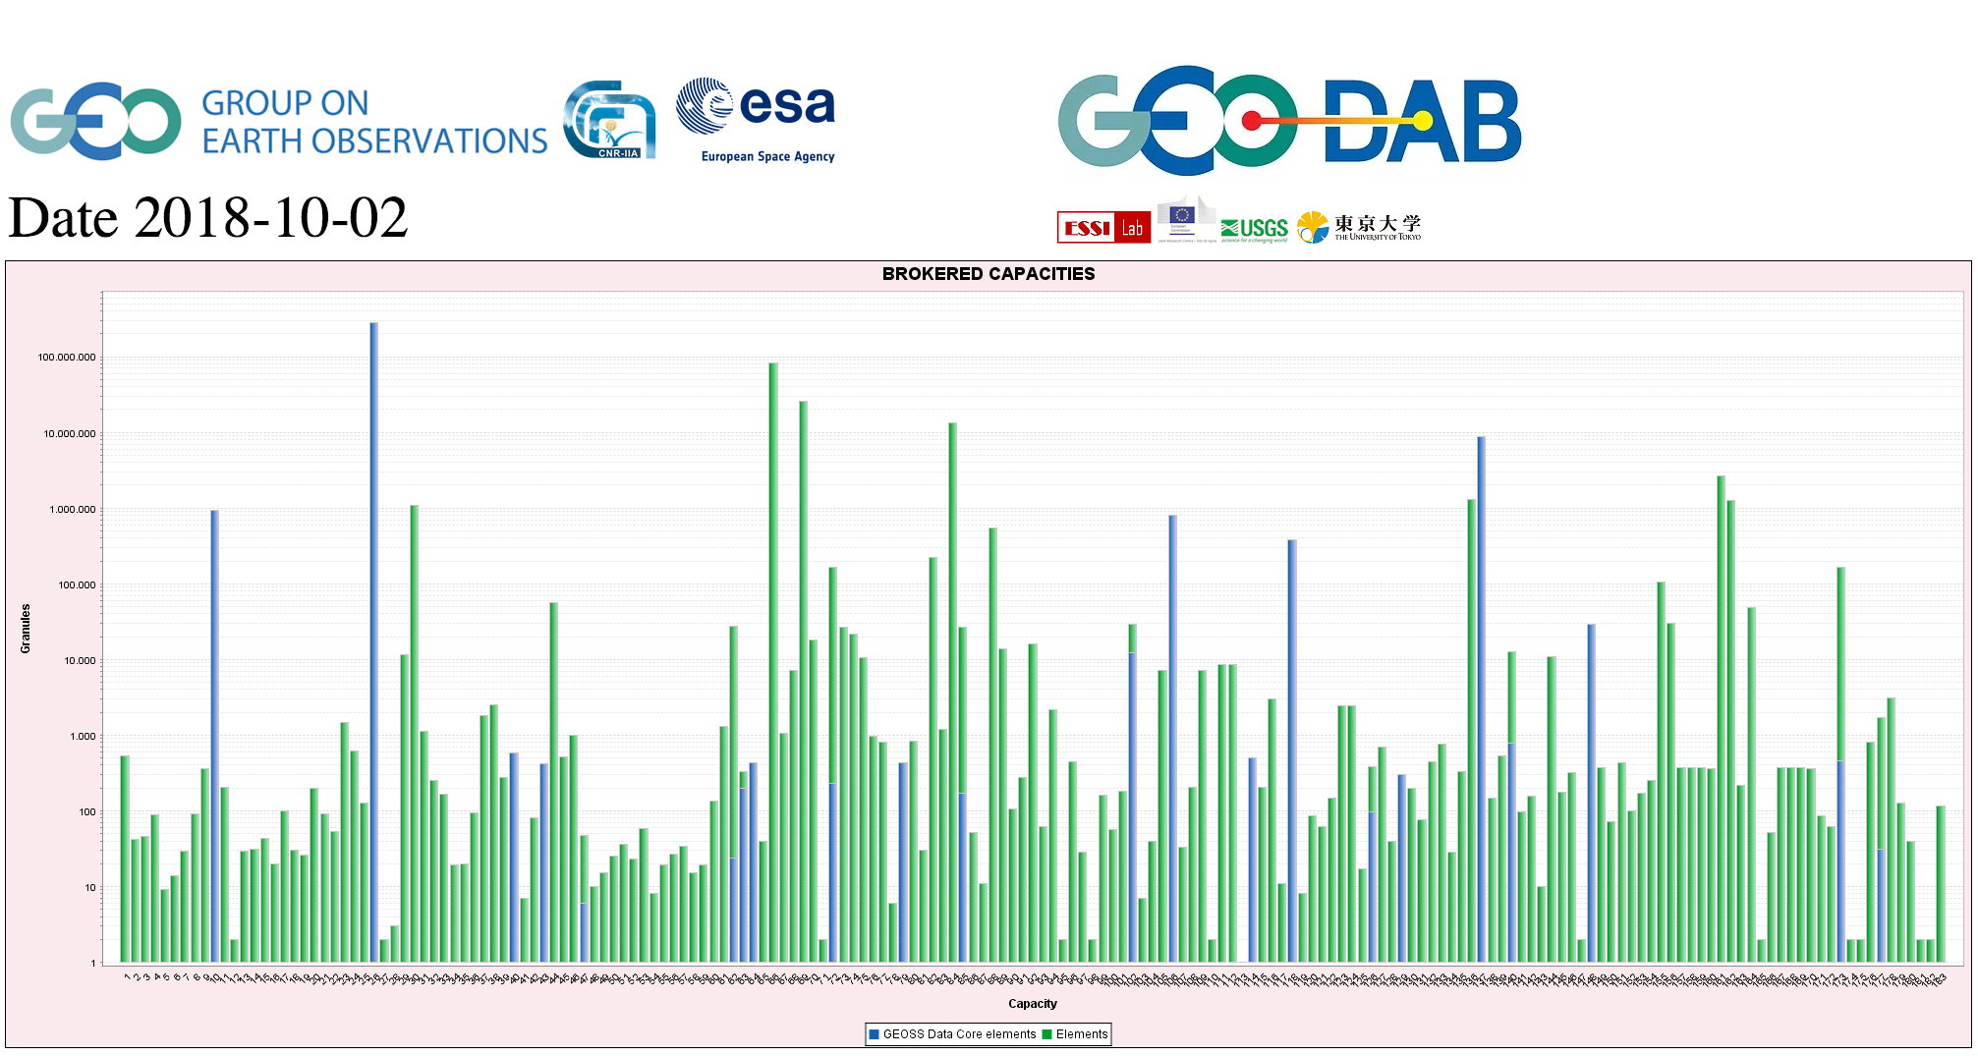
CEOS data in GEOSS
GEOSS PLATFORM DISCOVERABLE DATA PRODUCTS
CWIC
FedEO

Slide 30
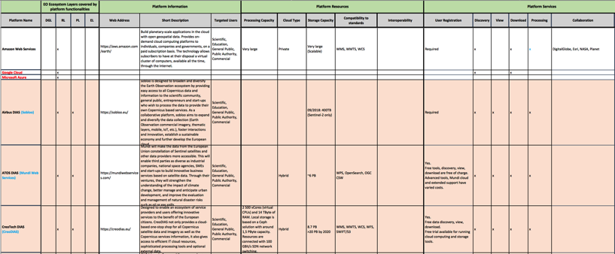

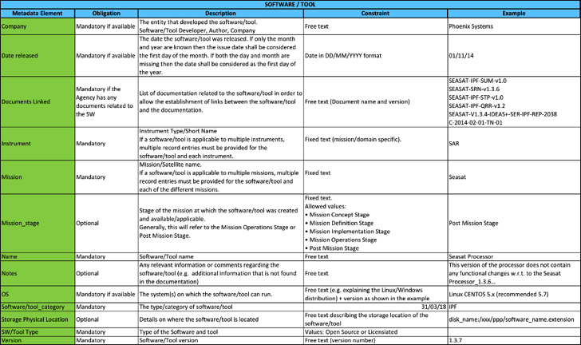
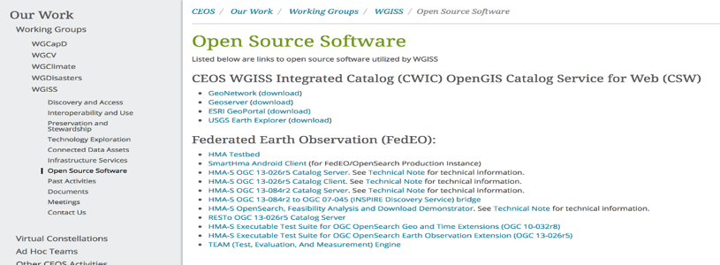
Inventories: 1) FDA Elements; 2) Open Source SW and Tools
  FDA-9: Inventory and characterize existing FDAs operated by both public and private entities
Template defined in coordination with FDA-AHT
Inventory being filled-up with information collected from different sources
  FDA-10: Inventory of CEOS agencies (Open Source) Software and Tools and implement a mechanism for discovery and access
Template defined
Inventory being filled-up with information collected from WGISS members
Notes:
Consensus that an inventory of “EO use environments” is a useful exercise that will provide insight into the EO ecosystem

Slide 31
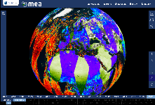






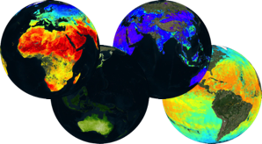
A big thing…innovation rate
Elevating Agency FDA components to WGISS CEOS Information Systems? (ESA TPM…)
Web based GUI
(including third-party applications)
Jupyter Notebook
CLI / REST API
Visualization layer
Standardised data access interfaces allow connecting a wide range of user interfaces
Datacube Engine/API VMs
The deployment of DAS in front of each data source enables effective access services
Data layer
Data remain at their own location (multiple data centers) with the original data format
Mission-specific data
Thematic data
Other geospatial data
Notes:
Rate of technology change vs rate of CEOS (WGISS) change?
Clearly, extraordinary EO analytics scales can be achieved for multiple domains and applications across multiple CEOS data sets – at what cost? Can CEOS make it cheaper and faster

Slide 32
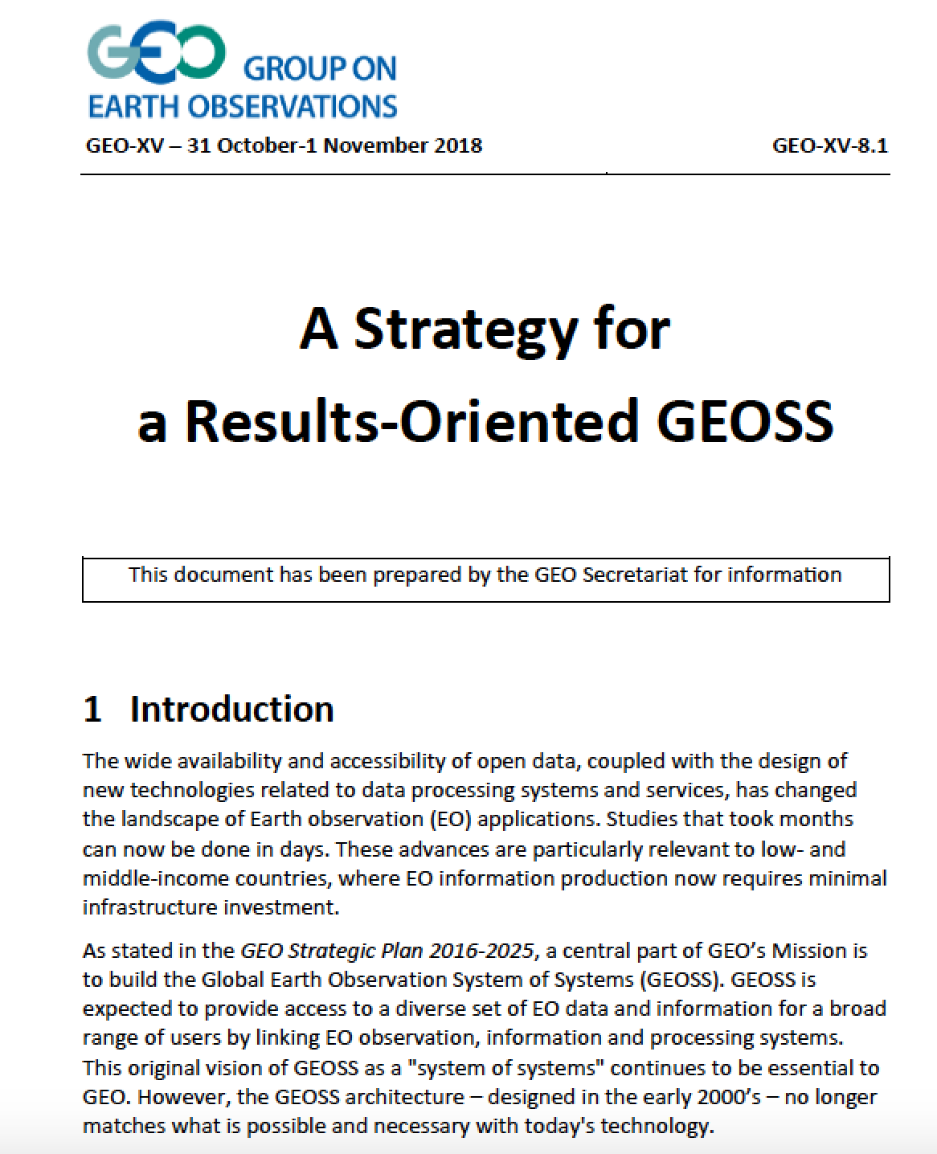
GEOSS Vision
“GEOSS needs a new design”
“We will transform the GEOSS Platform from a discovery and
access facility to a knowledge hub”
Will be presented at GEO Plenary 2018, approval at GEO Plenary 2019
Knowledge hub of reproducible documents in addition to data.
Data from CEOS essential
Importance of ARD data contribution
Importance of FDA elements and tools to facilitate and boost data use.
Fundamental contribution from CEOS to future GEOSS Vision
Official process will be started by GEOsec for new work plan in early December

Slide 33
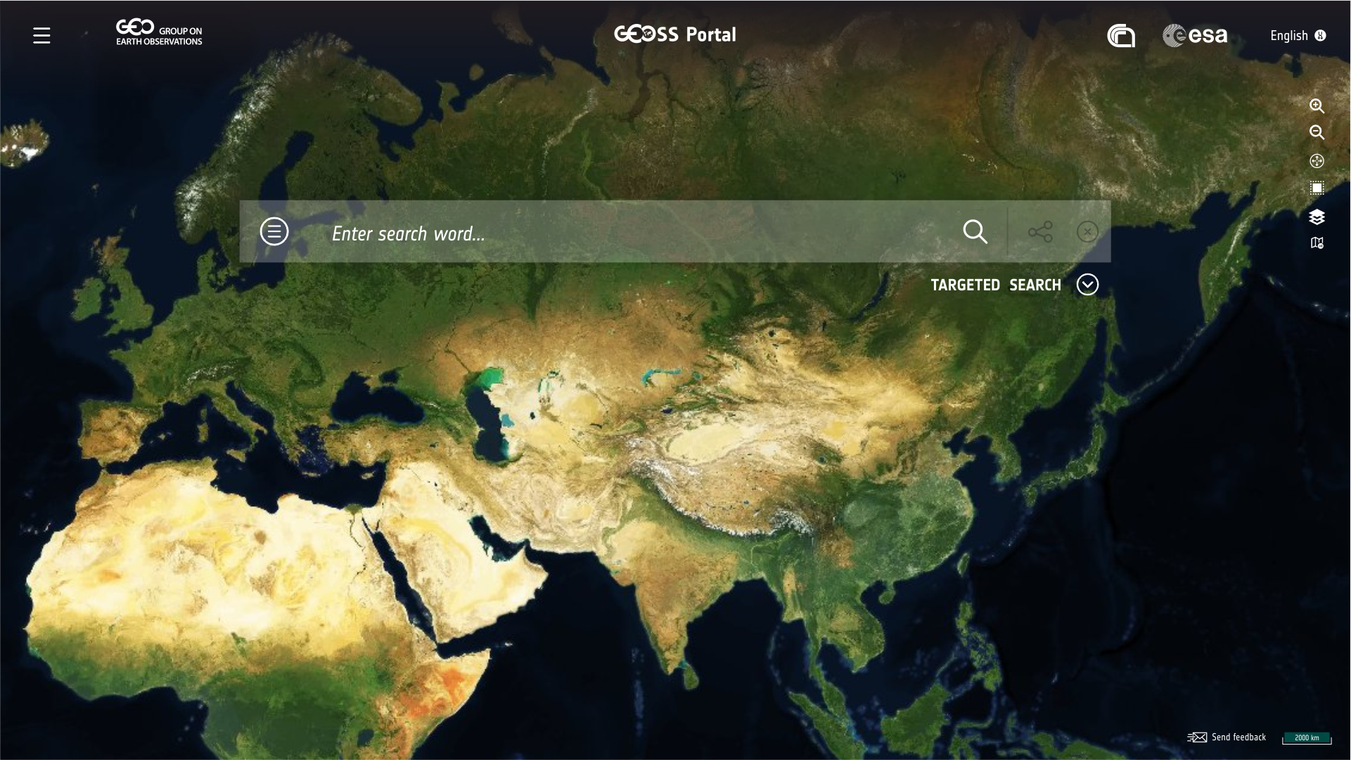


GEOSS Platform
Interface keywords ≠ Resources keywords
A user is looking for information
by using natural words
Transformation
Need to analyse the behaviour of the users to adapt both
the user interface and
the data scope
Ontologies
Role for Knowledge Providers:
Communities & Domain Experts
Web sources
Targeted search
Visualisation
Widgetization
Use Combinations
Service user
(Semi) products
Products Methods
Customised GEOSS Views
Service toolbox for visualisation
Language Support
Services

Slide 34
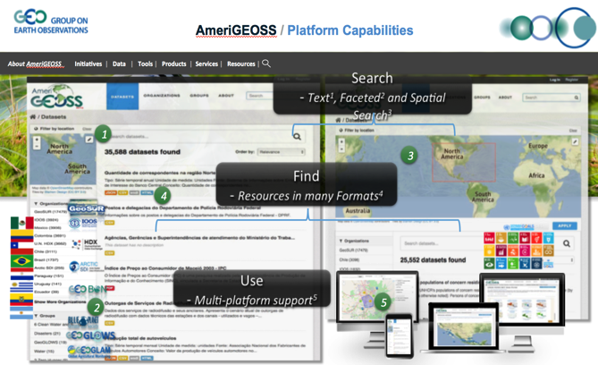
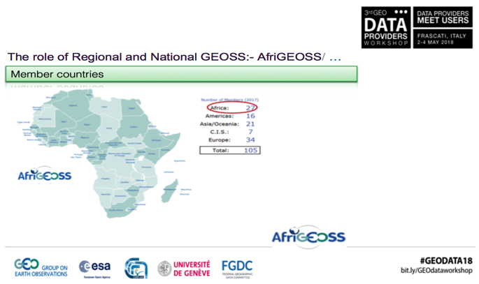
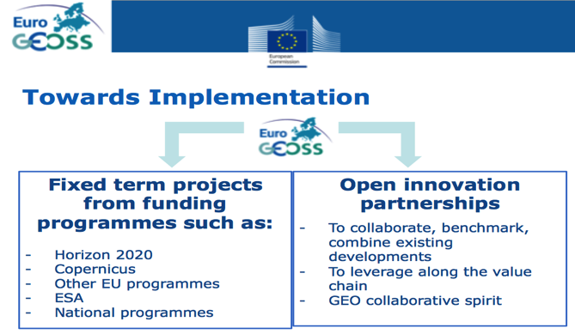
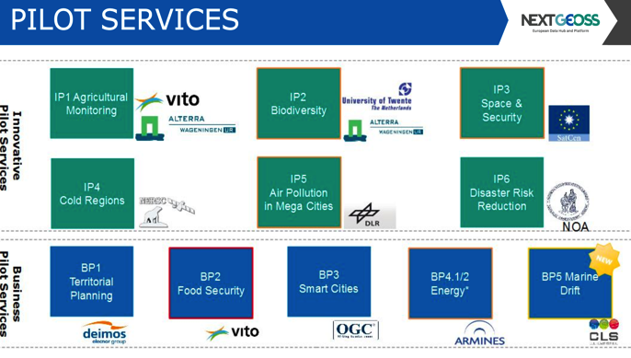
GEOSS Regional Initiatives
AmeriGEOSS
AfriGEOSS
EuroGEOSS
NEXTGEOSS

Slide 35









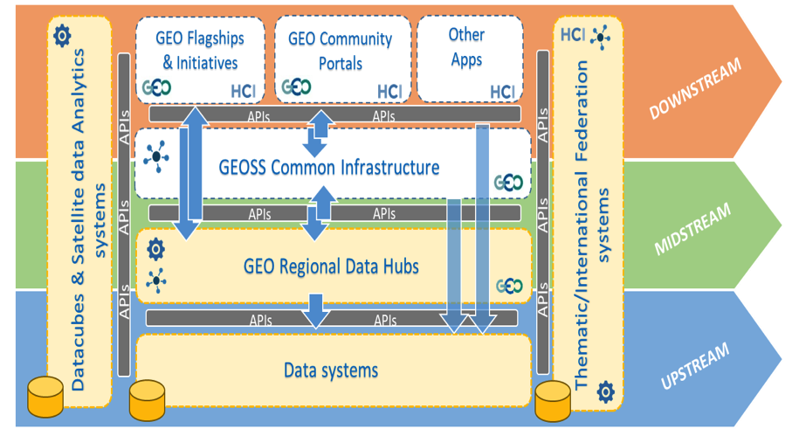










GEOSS Evolve Architecture Leveraging Systems & Emerging Technologies
Open Systems Platform
1
New Components & Functionalities
API’s
Widgets and Plugins
Views
Portals and Mirrors
More ….
GEOSS Platform
Data Cubes and Data Analytics Systems
2
Emerging Concepts &
technologies
Analysis Ready Data
Data Cubes
Artificial Intelligence
Machine Learning
Decision Ready Data/Tools
Landsat ARD
Notes:
The draft architecture recognizes the need to extend the current architecture to support the development of products and services.
The GEOSS platform concept has emerged as the conceptual architecture that can support this goal.
We will have to improve interoperability and support a variety of new user requirements.
Regional Platforms, API’s, widgets, views, portals and plugins are new components and concepts to
support interoperability,
Transformation of data into products and services.
Allow co-creation of products and services.
We recognize this new architecture is more evolved and complex we will have to address Governance/coordination challenges

Slide 36


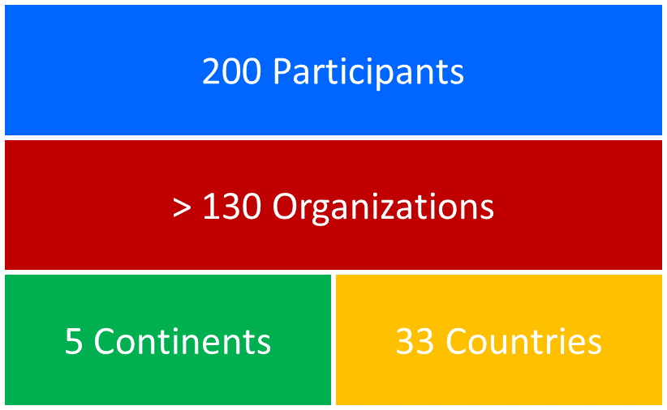

User needs have become a priority for the present GEOSS Platform and will be an essential driver for future GEOSS evolvement.
The transition from data to knowledge was a main topic raised in the workshop. This entails specific attention on interaction between GEOSS Platform and knowledge generation systems and services.

Slide 37
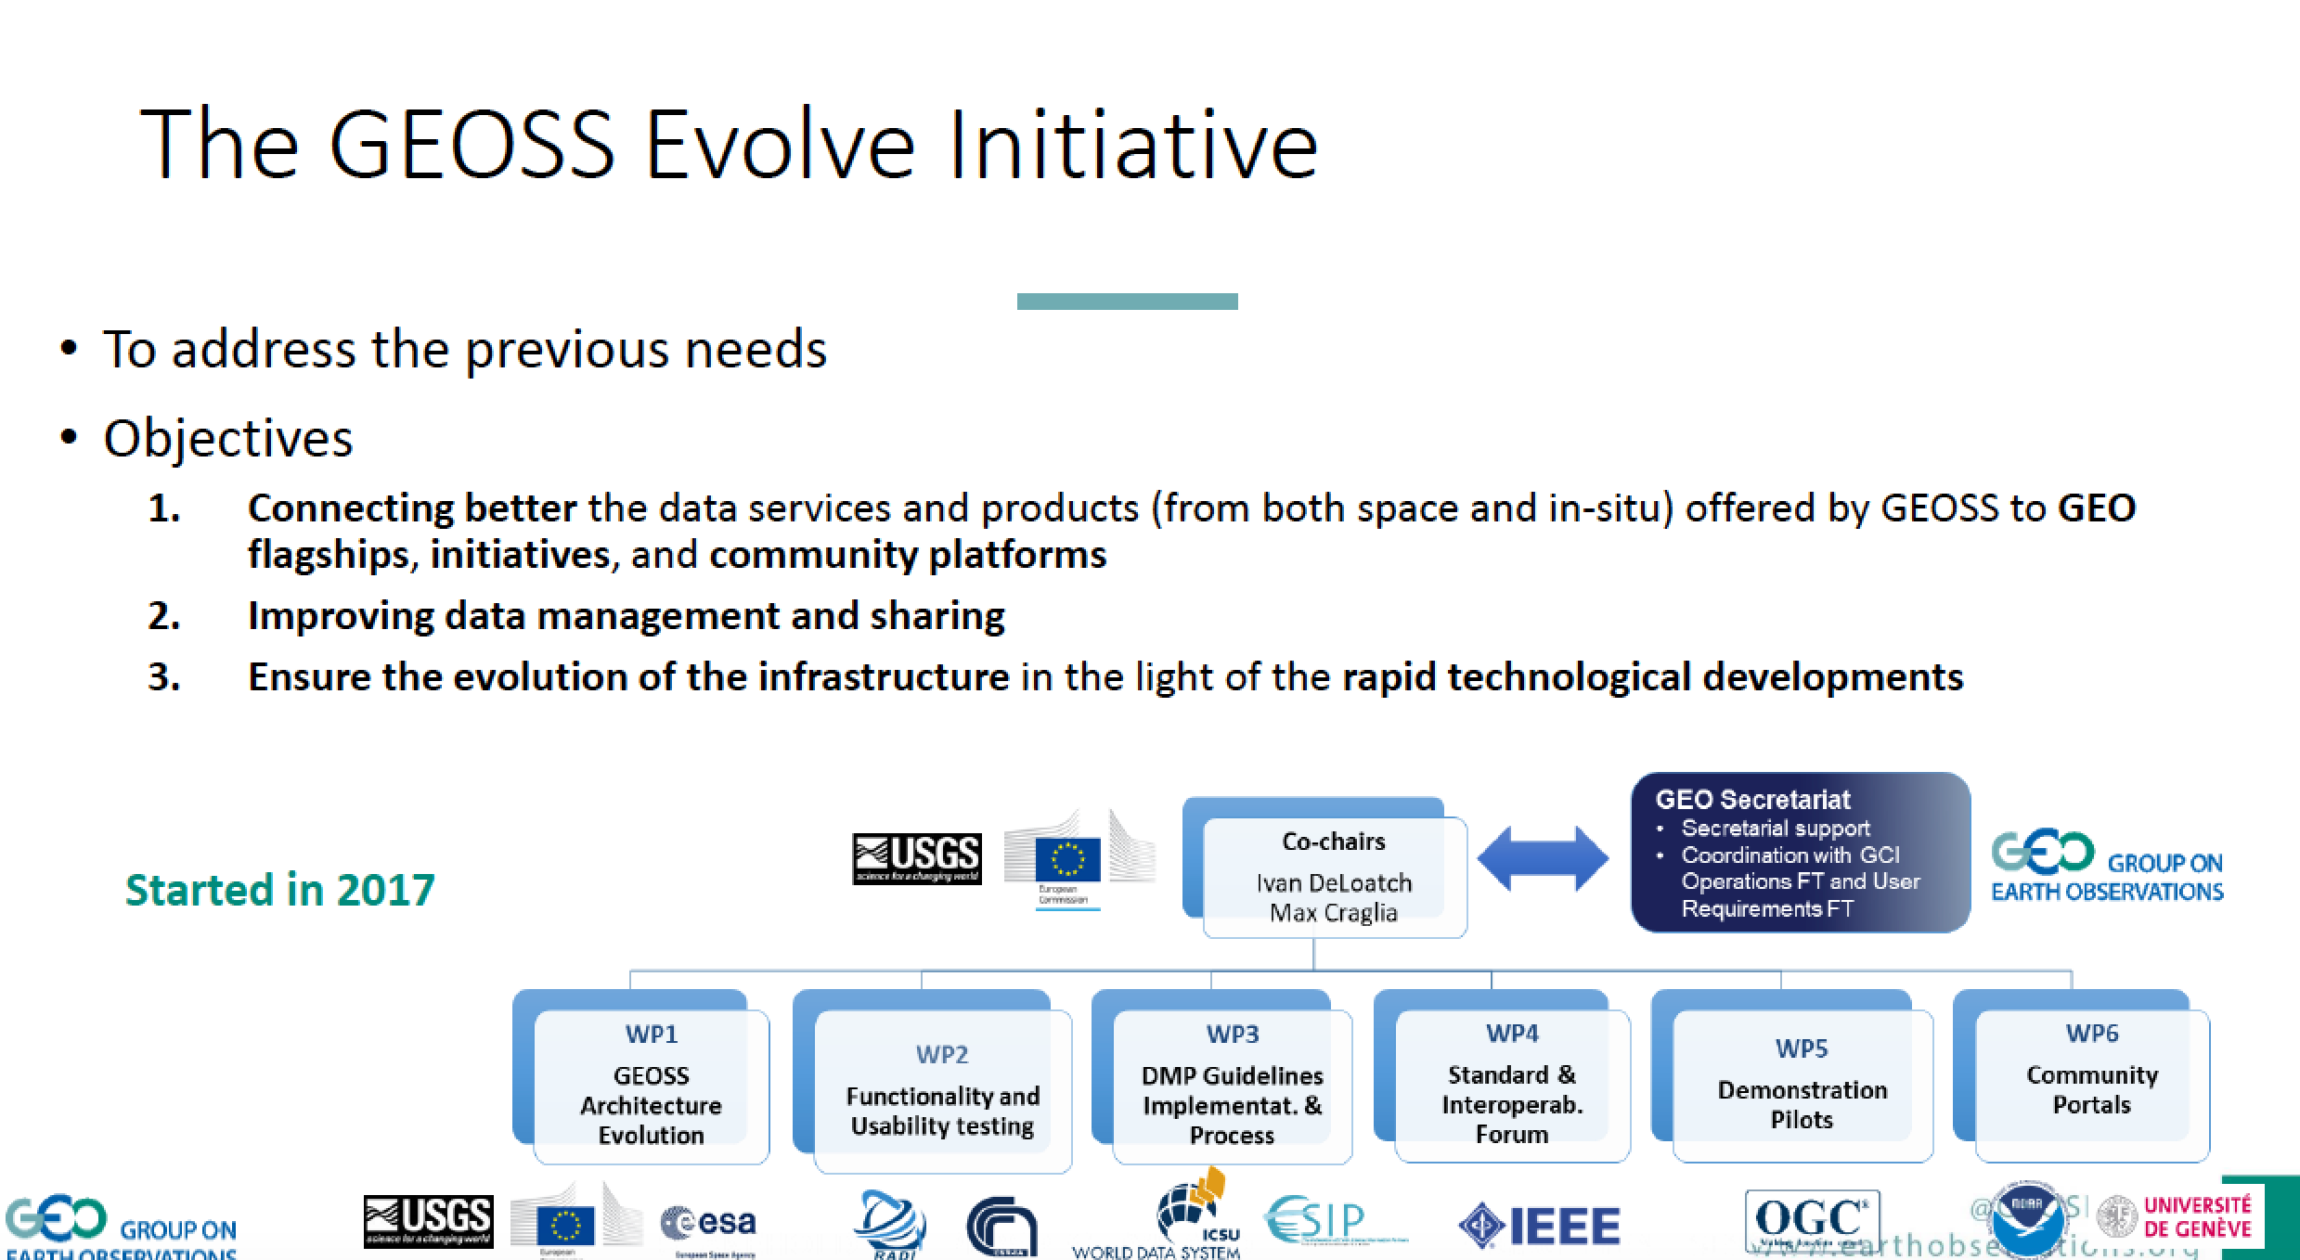
GEOSS Evolve

Slide 38
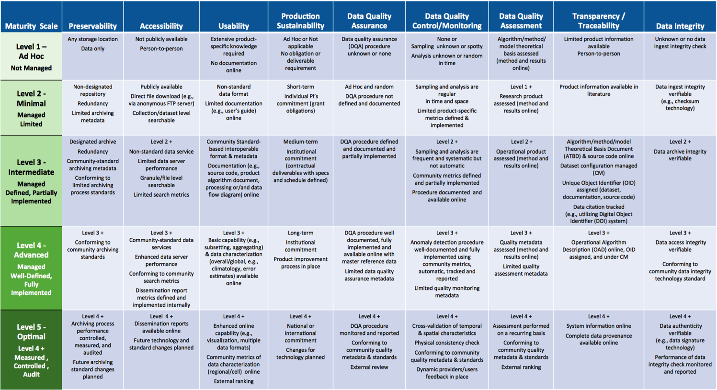
WGISS Contribution to DMP Evolution

Slide 39
Data Interoperability and Use
Committee on Earth Observation Satellites

Slide 40
WGISS Actions
FDA-08 FDA Reference Architecture
WGCV-3 CEOS Data Cubes for WGCV
WGCV-1 Data Formats and Interoperability
FDA-09 Inventory and characterize FDA
FDA-10 Inventory of tools
CARB-15 Carbon portal

Slide 41
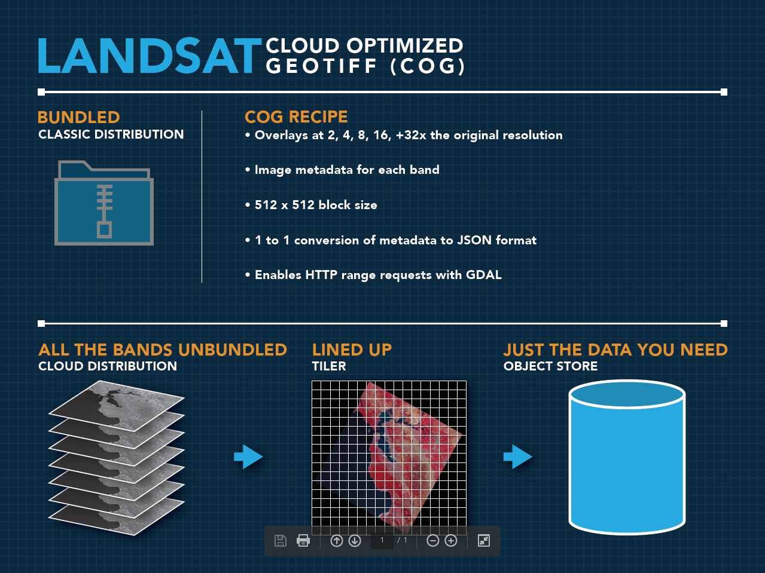
Cloud Optimized Geotiff

Slide 42
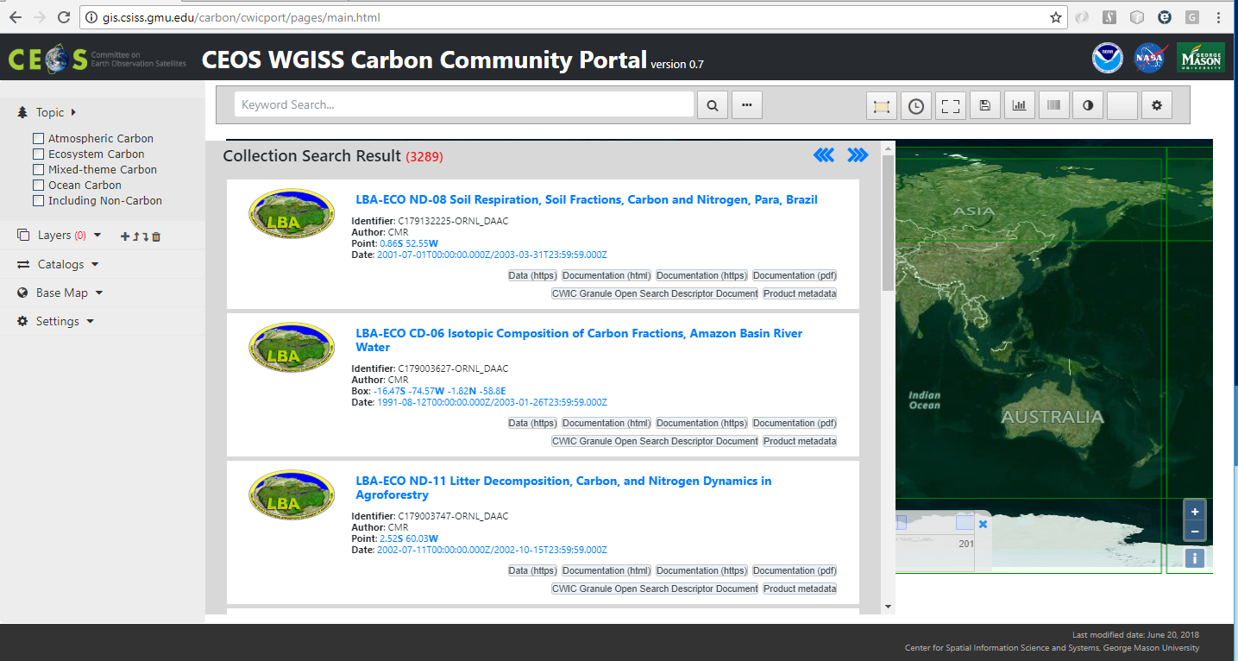
Carbon Portal Endpoints
https://gis.csiss.gmu.edu/carbon/cwicport
https://gis.csiss.gmu.edu/carbon/cwicport/pages/main.html

Slide 43
RDA – Research Data Alliance
Rapport intermédiaire de l’Expert Group de la Commission Turning FAIR data to reality

Slide 44






Agency Reports

Slide 45
CEOS upcoming meetings
July
June
Living Planet Symposium
Milan, 13^{th –} 17th May
August
May
WGISS, Silver Springs, April 29th – May 2nd
April
SIT Technical Workshop, 2019
Hawaii, 9th-13th Sept
September
SIT-34, Miami, USA,
2nd-4th April
March
WGClimate-10, Marrakech March
WGCapD-8, Dehradun &
WGDisasters-11, Athens,
4th-8th March
CEOS 33rd Plenary, Hanoi,
14th-16th Oct
October
WGISS, Munich, 22nd-25th Oct
November
February
BiDS 19 Conference
19-21 February Munich
GEO-XV Plenary, Kyoto, 31st-1st Nov
Freshwater from Space, Delft, 13th-15th November
December
January
LSI-VC-7, Hanoi, 14th-15th Feb
CEOS/GEO bilateral

Slide 46


WGISS-46
DLR – Oberpfaffenhofen,
22-25 October 2018

Slide 47

See you all at WGISS-47 in Silver Spring!

