Slide 1
CSIRO Agency Report
WGISS 46
Dr Robert Woodcock
25 October 2018
Centre for Earth Observation

Slide 2
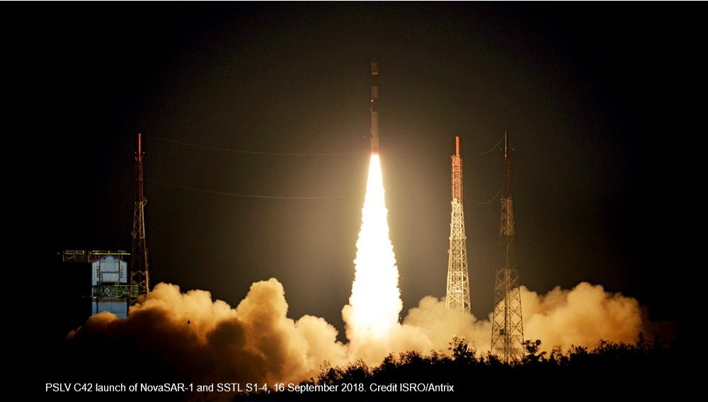
Successful launch of NovaSAR – 17/9/2018
Notes:
NovaSAR was launched in the early hours of Monday, 17 September (AEST) from the Satish Dhawan Space Centre in India, Antrix Corporation – the commercial arm of the Indian Space Research Organisation, ISRO – delivered the new NovaSAR-1 satellite into orbit.
CSIRO has secured access to NovaSAR-1, an new satellite mission developed by Surrey Satellite Technology Limited (SSTL) in the U.K.. NovaSAR will carry an S-band Synthetic Aperture Radar (SAR) and an Automatic Identification System (AIS) for maritime surveillance, and will be operated by CSIRO as a national research facility in support of Australian research. Read more here https://research.csiro.au/cceo/novasar/.

Slide 3
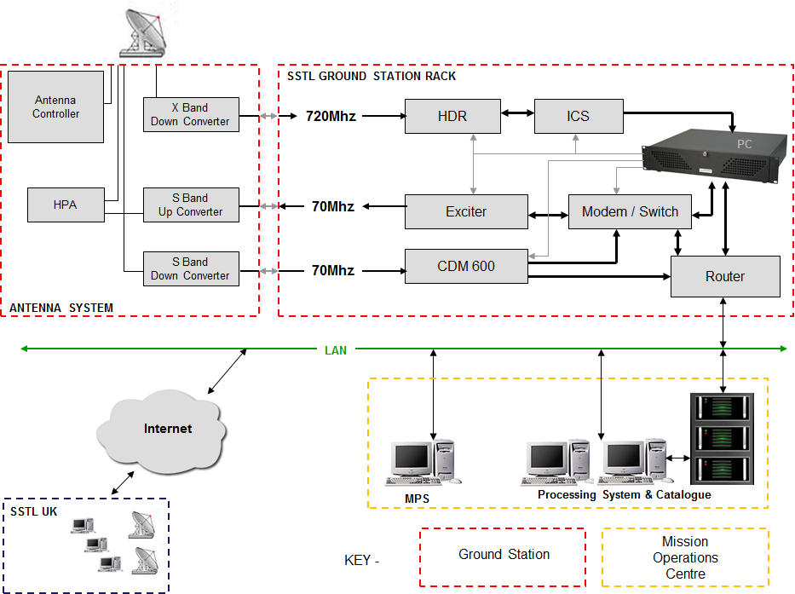
Ground Station Architecture
Customer Furnished
SSTL provided:
Client Mission Planning System
ATLAS Catalogue
SAR processor

Slide 4
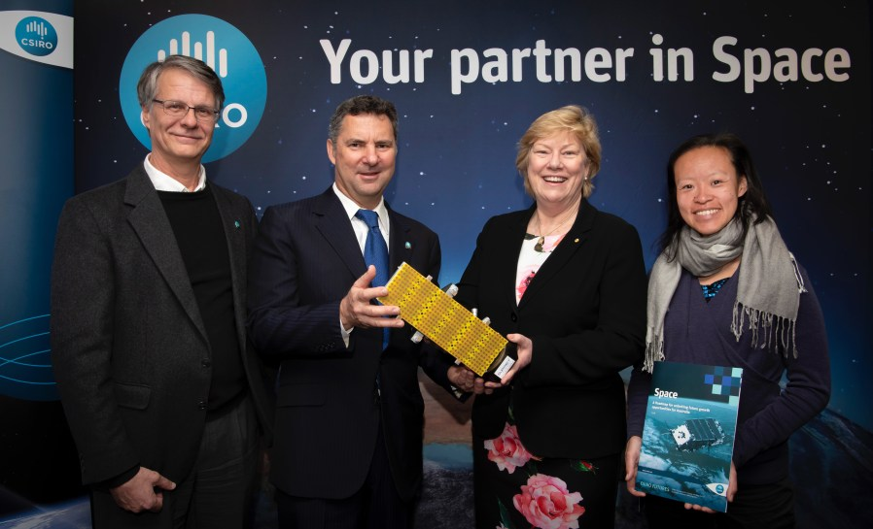
Space Roadmap
https://www.csiro.au/en/Do-business/Futures/Reports/Space-Roadmap

Slide 5
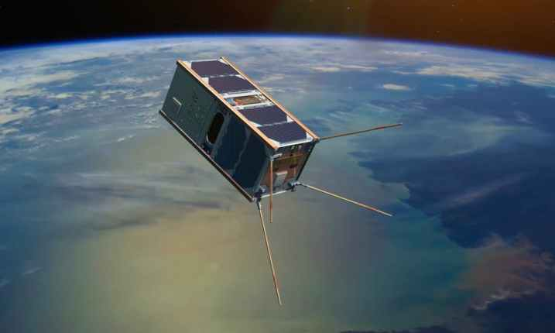
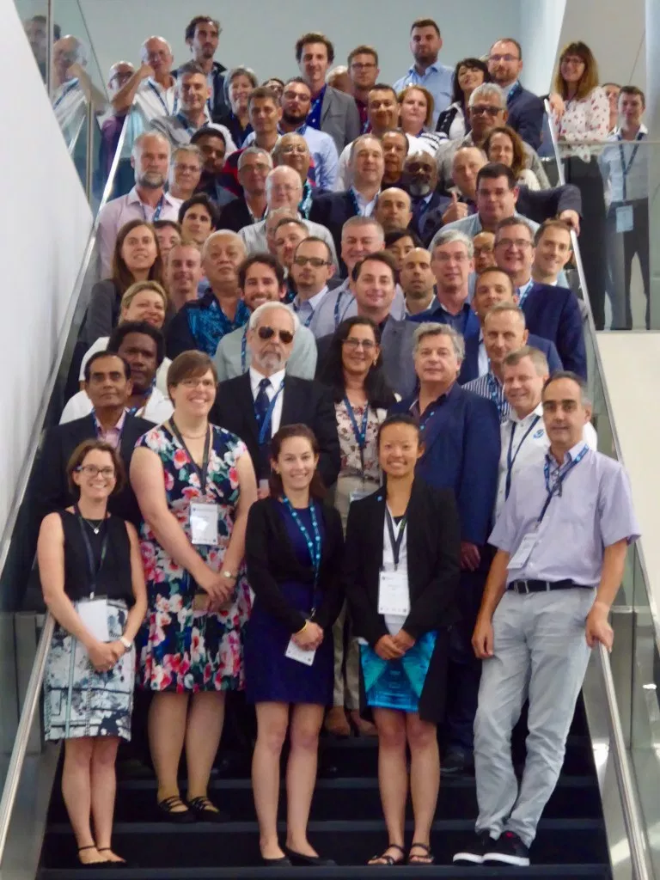
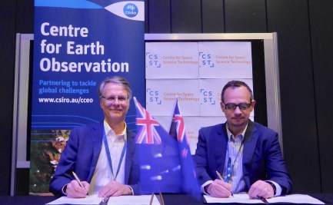
CSIRO space activities
CSIROSat-1
CubeSat
3U SWIR and on-board processing
CSIRO-Small Business engagement
And venture capital
EO for Pacific
Workshop
CSIRO Data Cube
Open Data Cube foundation
Scales on AWS for large scale multi-user processing
Automated data pipeline from CEOS providers
Cloud optimised data storage
New Zealand Centre for Space Science Technology-CSIRO

