Slide 1

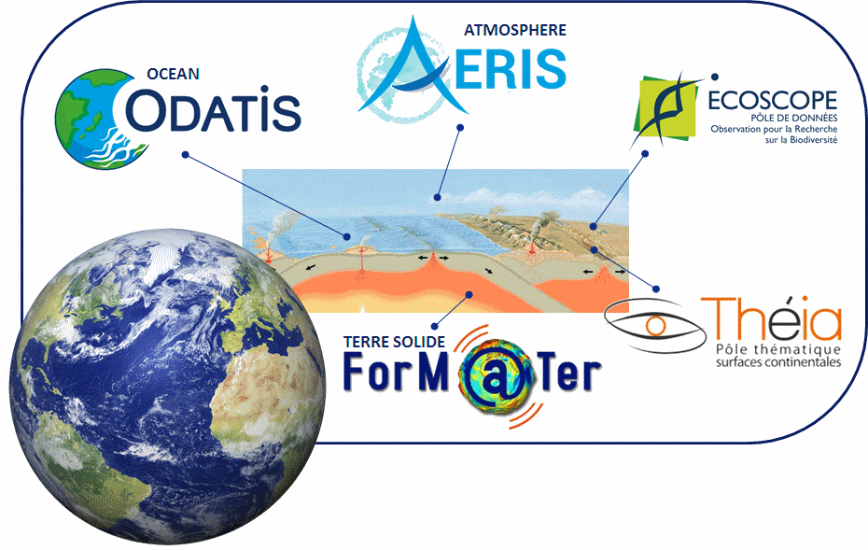
CNES agency report
WGISS meeting #46
DLR - 25 October 2018
French Research Infrastructure ‘Earth system’
Space Climate Observatory
Richard Moreno
CNES

Slide 2
French Research Infrastructure ‘Data & Services for the Earth System’

Slide 3
French Research Infrastructure ‘Data & Services for the Earth System’

Slide 4
French Research Infrastructure ‘Data & Services for the Earth System’

Slide 5
French Research Infrastructure ‘Data & Services for the Earth System’

Slide 6
French Research Infrastructure ‘Data & Services for the Earth System’

Slide 7
French Research Infrastructure ‘Data & Services for the Earth System’

Slide 8
French Research Infrastructure ‘Data & Services for the Earth System’

Slide 9
French Research Infrastructure ‘Data & Services for the Earth System’

Slide 10
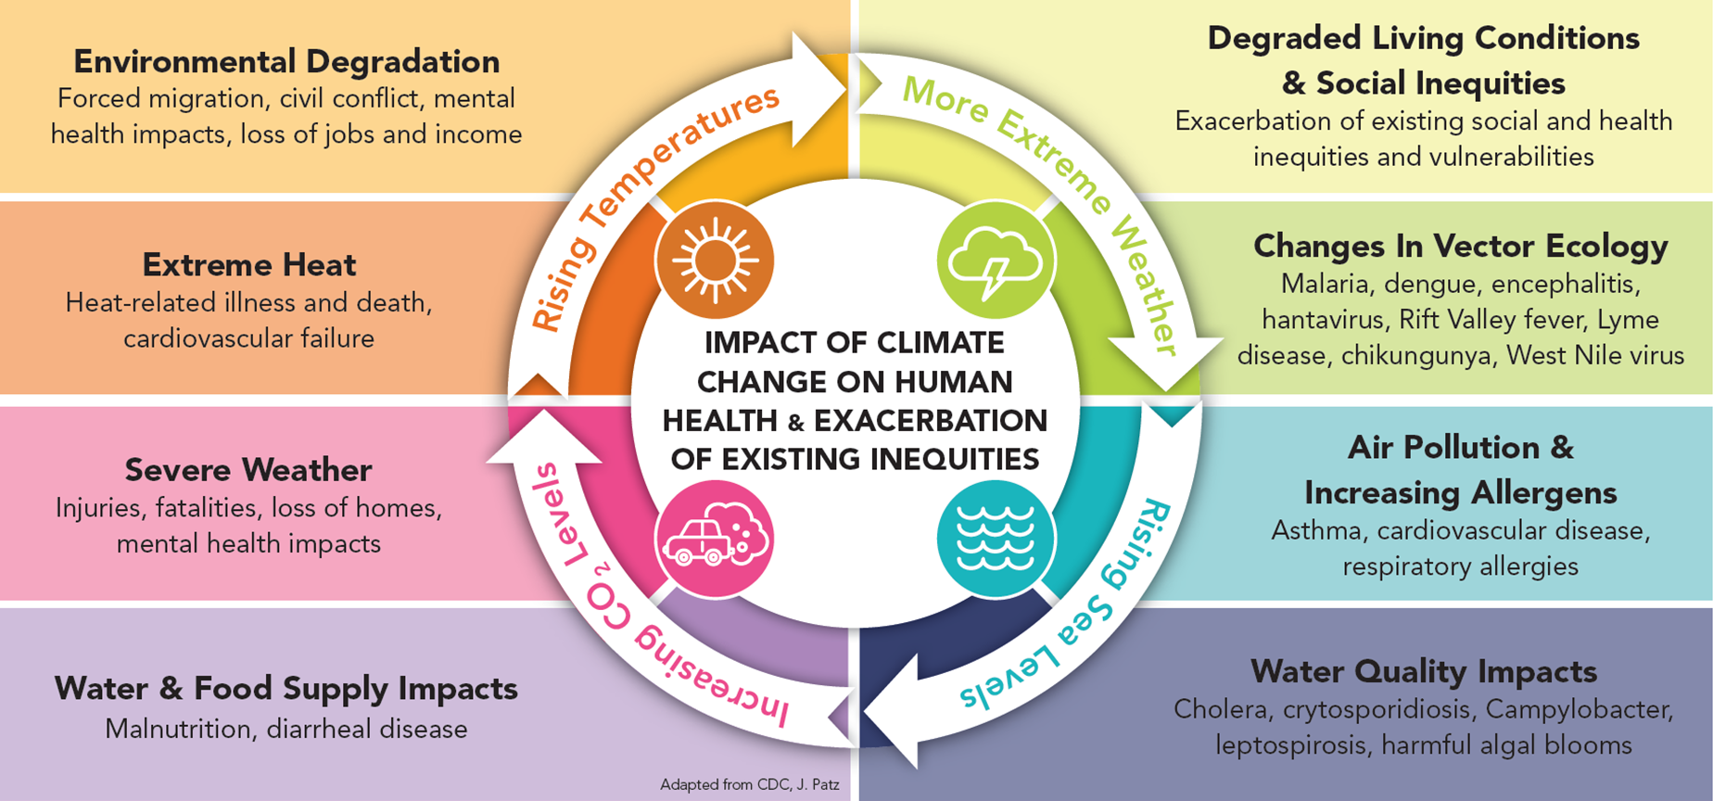
The climate change…
… and Human Impacts

Slide 11
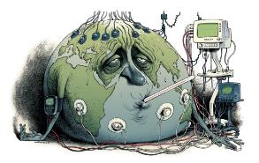
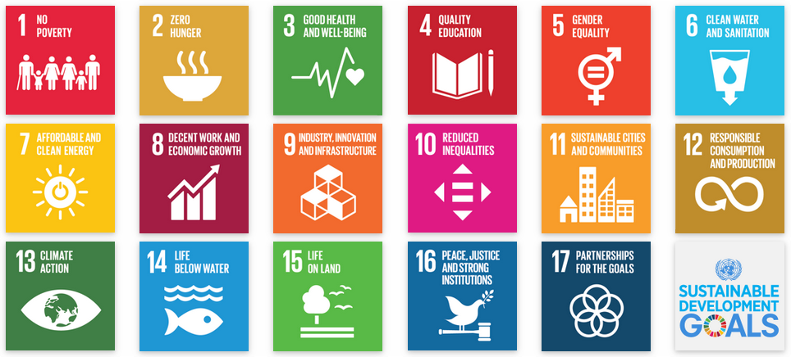
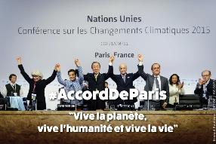
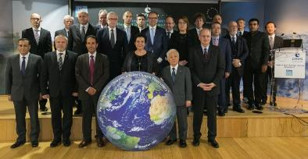
The climate change…
International framework
…
Illustration by David Parkins
Nature 514, 30–31, Oct. 2014
One Planet Summit – Paris, December 11th, 2017

Slide 12
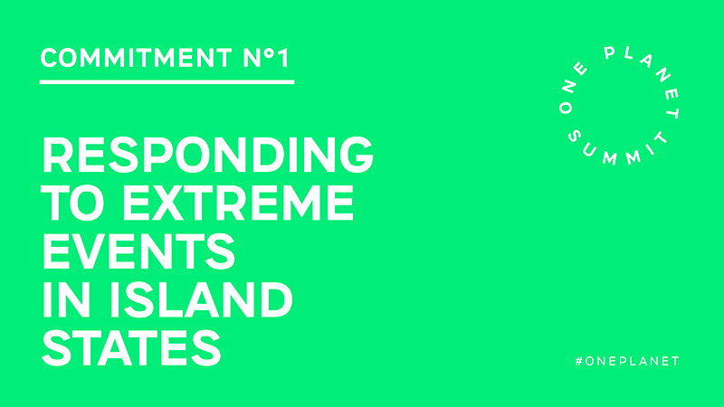
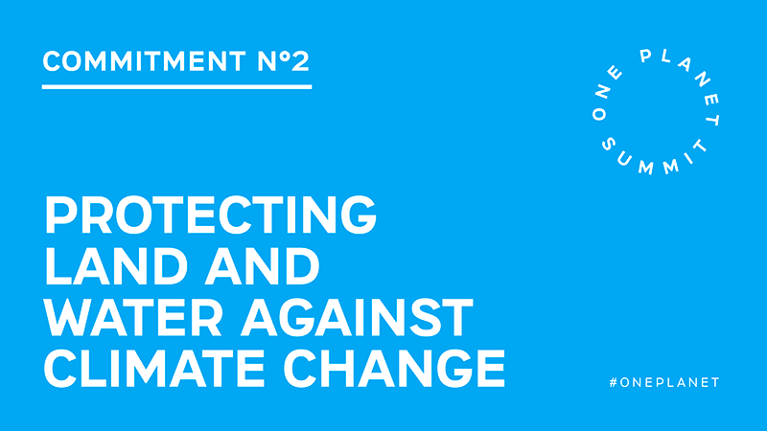
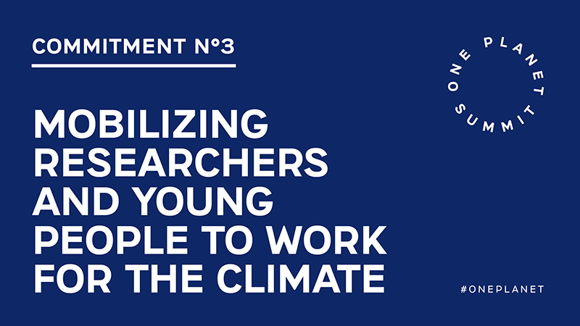
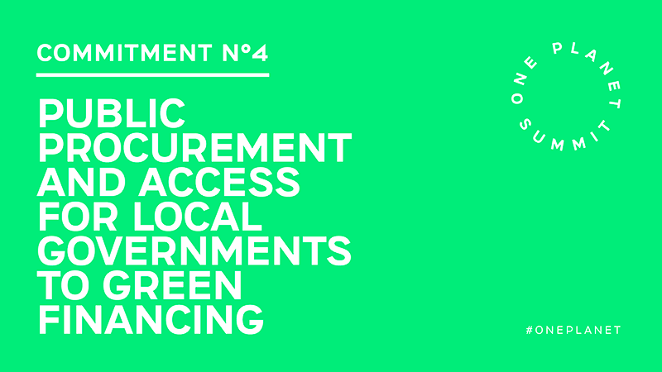
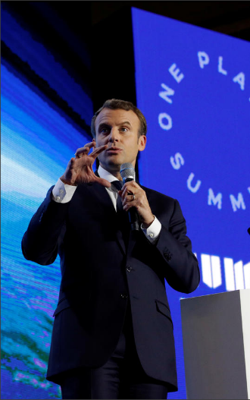
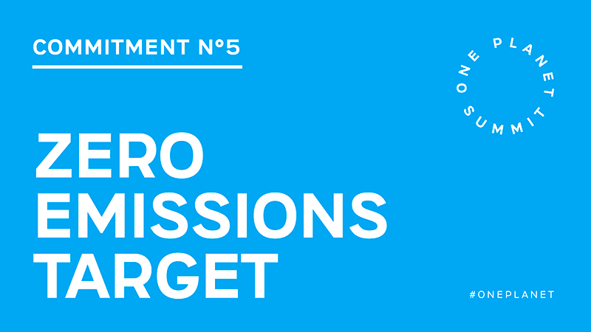
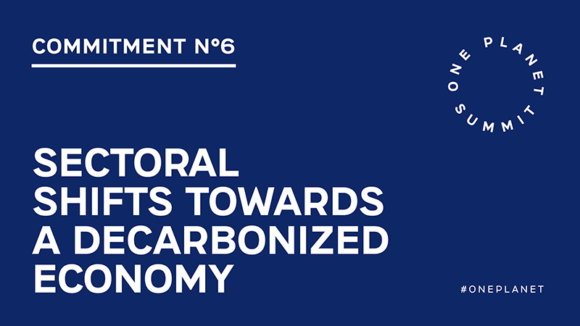
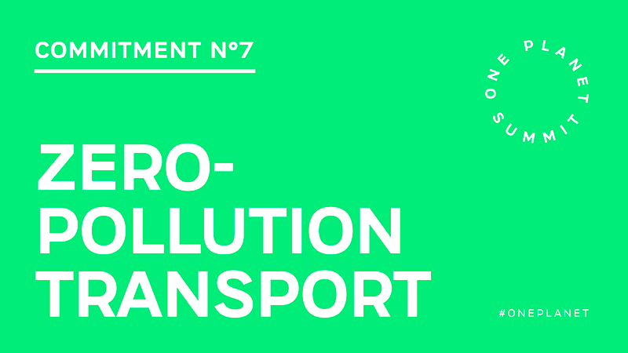
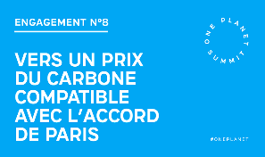

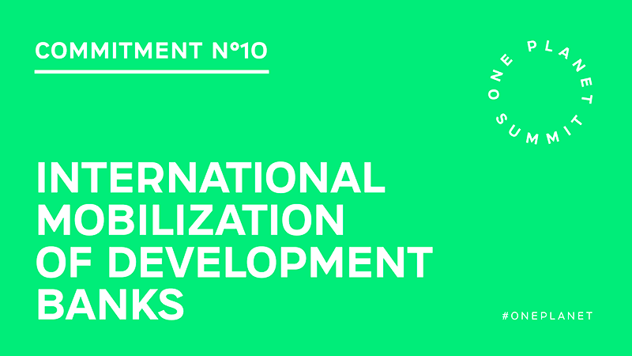
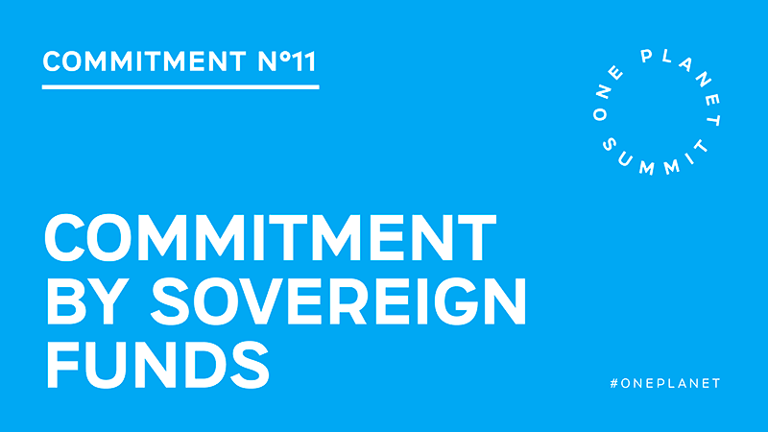
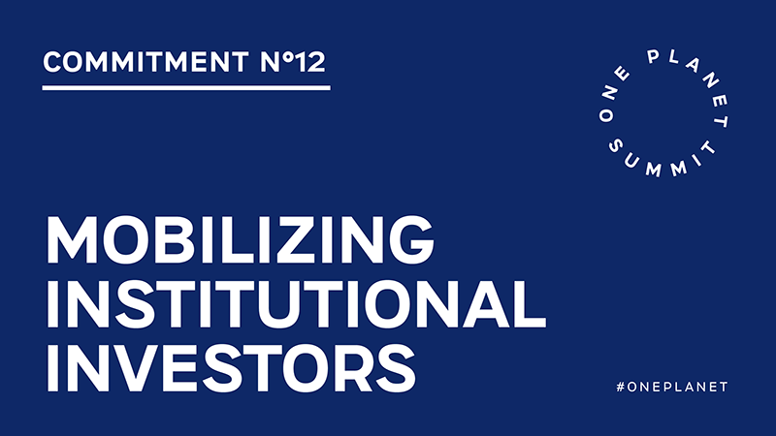
The climate change…
French Government Identifies 12 key One Planet Commitments
Creation of a Space Climate Observatory
Instigated by the French Space Agency, a Space Climate Observatory has been created in order to provide States and the scientific community with all the space data necessary for monitoring the health of our planet. This initiative is supported by all European space agencies, as well as other States including China, India, Russia, Mexico, Morocco and the United Arab Emirates. Access to interoperable space-based earth observation data will be a significant step forward in the earth monitoring system.

Slide 13
Space Climate Observatory
Scope
“Space Climate Observatory”
A world observatory of
the climate change and its impacts
from Earth Observation data
  Satellite data
      Earth observations at global, national and territories level
  Climate change and its impacts
      Humankind, both as anthropogenic causes and as the victims of their impacts (temperature increase, sea level rise and hazards…)
  a joint Observatory
      A World Heritage system
  → http://spaceclimateobservatory.org

Slide 14
Space Climate Observatory
Scope
Monitoring climate change
Tracking the impacts of climate change
Environmental impacts
Mitigating and Adapting to climate change
Resources: land use, agricultural practices, relocation, water use…
Population: Migration of people, food security…
Atmospheric CO₂ concentration,
Sea level rise, Droughts and floods…
Global temperature, Clouds and Precipitation change,
Economical costs
Social and human impacts
Biodiversity reduction
Socio-economic development paths

Slide 15


Space Climate Observatory
Two basic principles
Not alone !
  A country, an agency, an institution…
  could not make it for all the World/Planet
Co-construction
  Communities of development
  Make available to others, freely
  Exchange of use, best practice
CO DESIGN

Slide 16















Space Climate Observatory
Access
National SCO
Data Center
Space Agencies
International
Organization
National SCO
Products & Services
…
…
SCO – HUB
Data access, Information, Products & associated Services
but always
but always
End Users

Slide 17

Space Climate Observatory
Schedule
Short term | Definition of international dimension of SCO
 | Dec. 11, 2018 | Paris Declaration “Towards a space Climate Observatory”, Space Agencies
 | Dec. 12, 2018 | One Planet Summit “Creation of a Space Climate Observatory”, French Government – Commitments N°5
 | Feb. 2018 | Nomination of a Head of SCO Program and Project Manager, CNES
 | June 2018 | Toulouse Space Show (TSS) - Public demonstration, use cases [CNES-CNRS-IRD-Météo France], CNSA, CRTS
 | Sep. 26, 2018 | 2nd meeting of One Planet Summit, New York
 | Oct. 11, 12, 2018 | Workshop Australia, Brisbane
 | Oct. 18, 19, 2018 | Workshop UNEP
 | Planned
 | Jan. 2019 | First International meeting – Documentation - partnership
 | Mar. 2019 | Signature of an international charter/agreement, Nairobi
 | Nov. 2019 | GEO Ministerial in Canberra, Australia
Planned
Two Years | 2019-2020 | Use cases to validate the approach and the added value for the populations (internationally)
Five years | 2021-2023 | Sustainability of activities to respond to the 2030 agenda (SDGs)

