Slide 1

Interoperability – GO FAIR - RDA
WGISS meeting #46
DLR - 25 October 2018
Richard Moreno
CNES

Slide 2
FAIR PRINCIPLES
The FAIR Principles Explained: https://www.go-fair.org/fair-principles/
To be Findable:
F1. (meta)data are assigned a globally unique and eternally persistent identifier.
F2. data are described with rich metadata.
F3. (meta)data are registered or indexed in a searchable resource.
F4. metadata specify the data identifier.
To be Accessible:
A1 (meta)data are retrievable by their identifier using a standardized communications protocol.
A1.1 the protocol is open, free, and universally implementable.
A1.2 the protocol allows for an authentication and authorization procedure, where necessary.
A2 metadata are accessible, even when the data are no longer available.
To be Interoperable:
I1. (meta)data use a formal, accessible, shared, and broadly applicable language for knowledge representation.
I2. (meta)data use vocabularies that follow FAIR principles.
I3. (meta)data include qualified references to other (meta)data.
To be Re-usable:
R1. meta(data) have a plurality of accurate and relevant attributes.
R1.1. (meta)data are released with a clear and accessible data usage license.
R1.2. (meta)data are associated with their provenance.
R1.3. (meta)data meet domain-relevant community standards.

Slide 3
‘EOSC’
The European Cloud Initiative and its relevance for EO – DG Connect

Slide 4
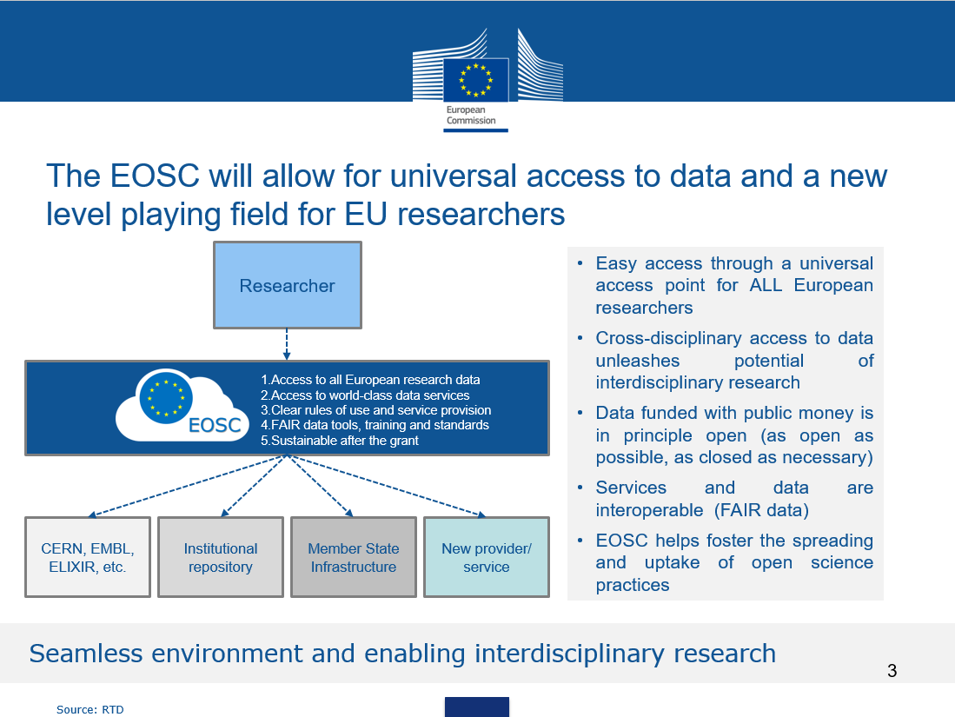
‘EOSC’
GO FAIR
RDA Europe
‘Open Science’ Clora

Slide 5
‘EOSC’
The European Open Science Cloud

Slide 6
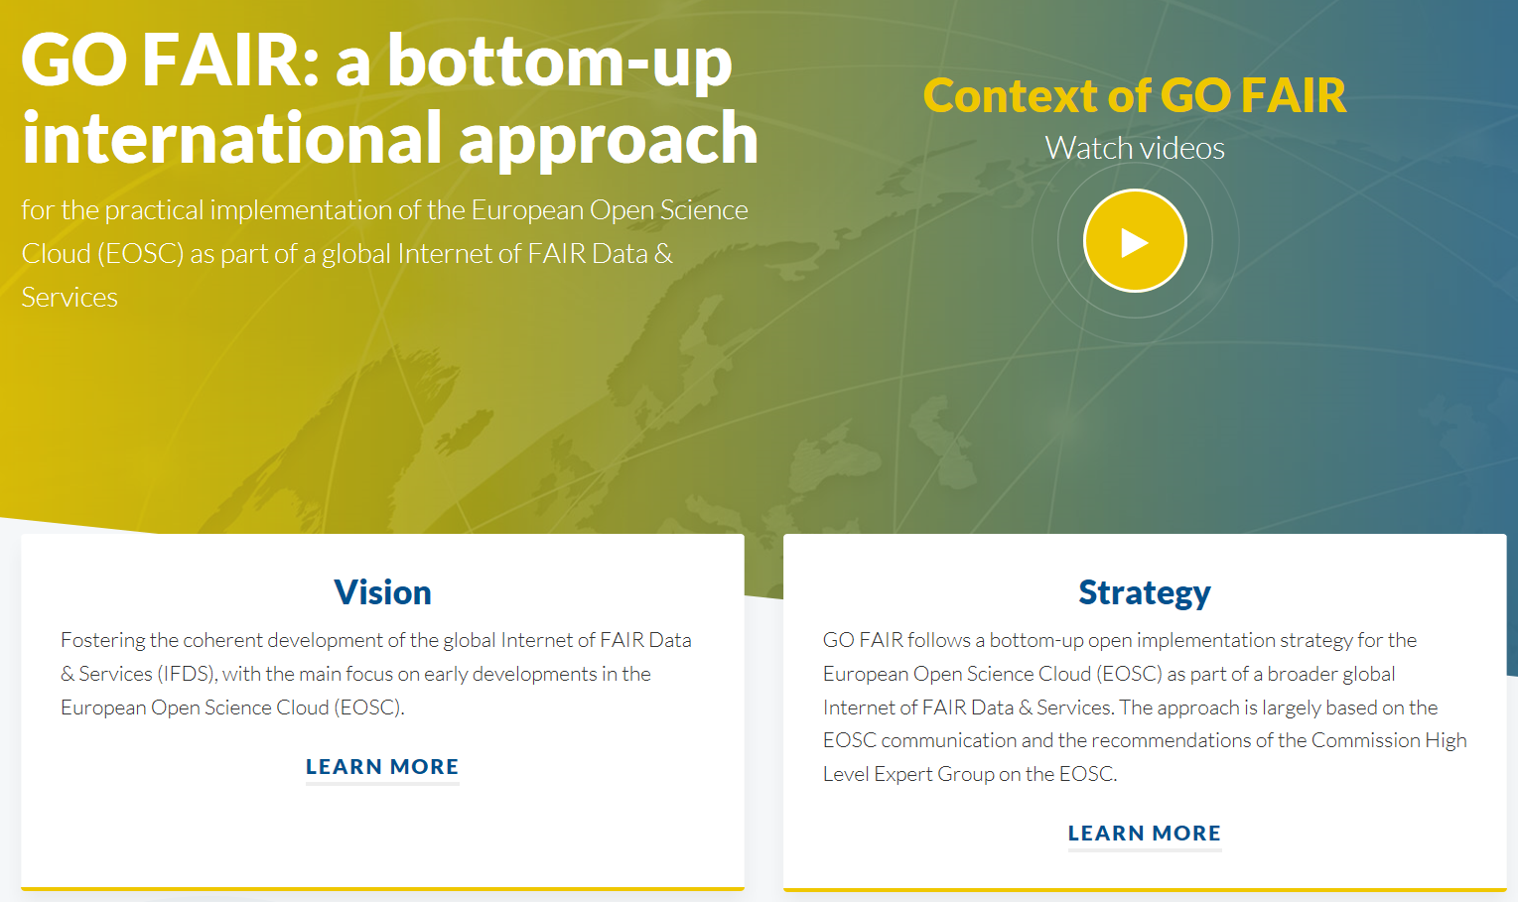
‘GO FAIR’
- The FAIR Principles Explained: https://www.go-fair.org/fair-principles/
- The FAIR Metrics Framework: https://www.nature.com/articles/sdata2018118

Slide 7
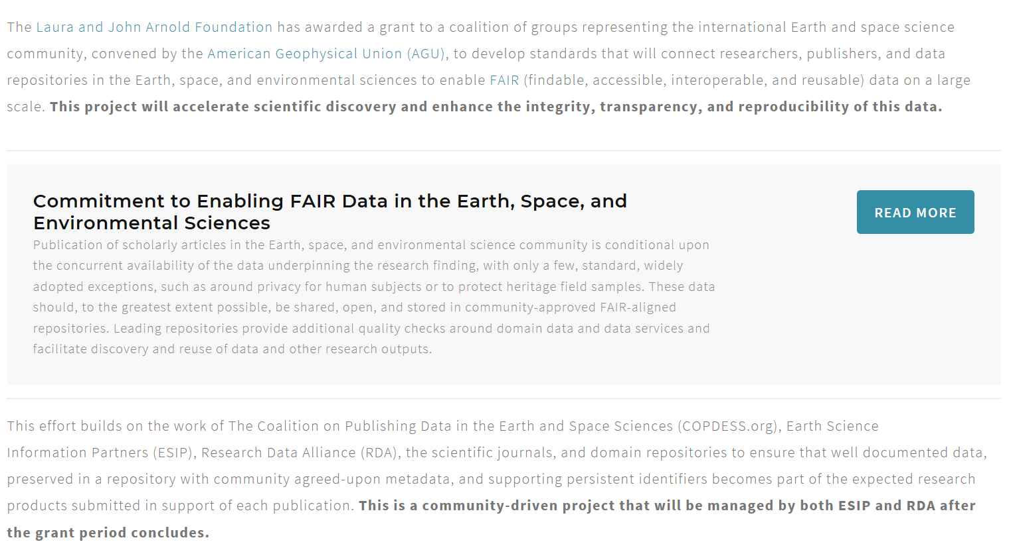
AGU Project
Arnold Foundation Sponsored AGU Project called “Enabling FAR Data”.
  http://www.copdess.org/enabling-fair-data-project/

Slide 8
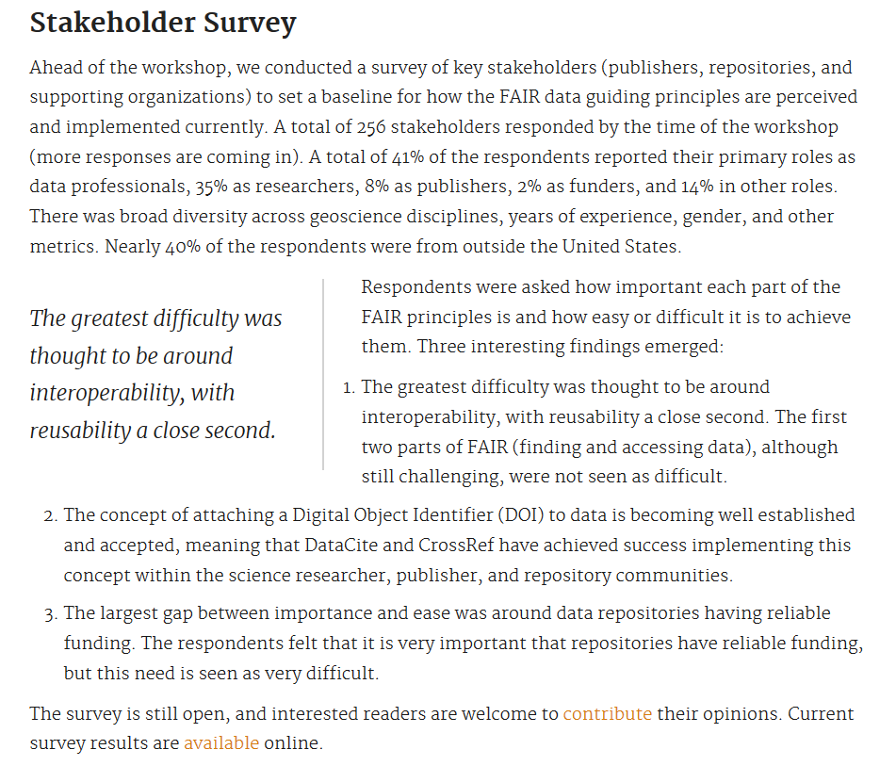
AGU Project
https://eos.org/agu-news/enabling-fair-data-across-the-earth-and-space-sciences

Slide 9
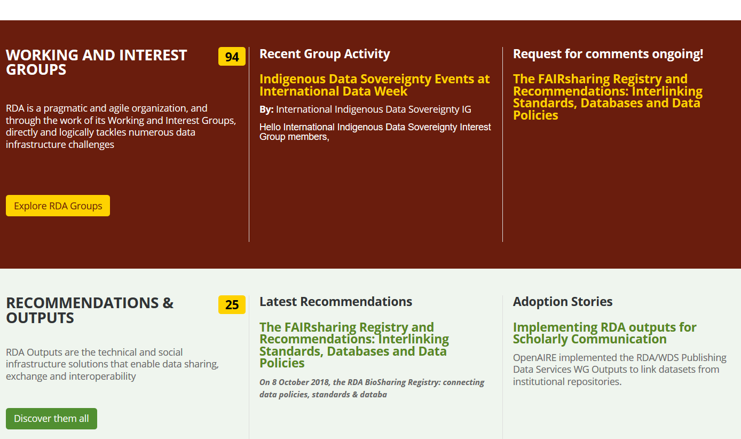
RDA – Research Data Alliance
https://www.rd-alliance.org/

Slide 10
RDA – Research Data Alliance
Rapport intermédiaire de l’Expert Group de la Commission Turning FAIR data to reality

Slide 11
RDA – Research Data Alliance
Rapport intermédiaire de l’Expert Group de la Commission Turning FAIR data to reality
Vision
Research and innovation stakeholders freely share the data, regardless of the technologies, disciplines and countries, in order to respond to major societal challenges.
Mission
The RDA builds both social and technical gateways to allow free sharing of data.

Slide 12
RDA – Research Data Alliance
Rapport intermédiaire de l’Expert Group de la Commission Turning FAIR data to reality

Slide 13
RDA – Research Data Alliance
Rapport intermédiaire de l’Expert Group de la Commission Turning FAIR data to reality

Slide 14
RDA – Research Data Alliance
Rapport intermédiaire de l’Expert Group de la Commission Turning FAIR data to reality

Slide 15
RDA – Research Data Alliance
Rapport intermédiaire de l’Expert Group de la Commission Turning FAIR data to reality

Slide 16
RDA – Research Data Alliance
Rapport intermédiaire de l’Expert Group de la Commission Turning FAIR data to reality

Slide 17
RDA – Research Data Alliance
Rapport intermédiaire de l’Expert Group de la Commission Turning FAIR data to reality

Slide 18
RDA – Research Data Alliance
Rapport intermédiaire de l’Expert Group de la Commission Turning FAIR data to reality

Slide 19
Conclusion
Should we follow what is done in the context of FAIR ?
RDA ?

