Slide 1
WGISS Carbon Community Portal Demo The WGISS Carbon Data Portal Team presented at WGISS-46

Slide 2
Outline
Introduction
Two step search
Collection
Granule
Search functions
Spatial/temporal constraints
Predefined geographical namespaces
By themes (topics)
Keywords (GCMD keywords, acronym auto-completion)
Data access
Visualization (WMS/WMTS, preview, view, animation)
Statistics/analytics

Slide 3
The WGISS Carbon Community Portal
Goal: To support CEOS Carbon Science Mission by providing easy discovery of and access to carbon-related data resources in CEOS member agencies
The Objectives
To enable carbon community to easily find their interested data in the CEOS agency collections brokered by both CWIC and FedEO
To allow searching and accessing data within collections using CWIC and FedEO with keywords, spatial and/or temporal constraints
To provide common discovery and access of all CWIC partner holdings targeting at the CEOS Carbon Community

Slide 4
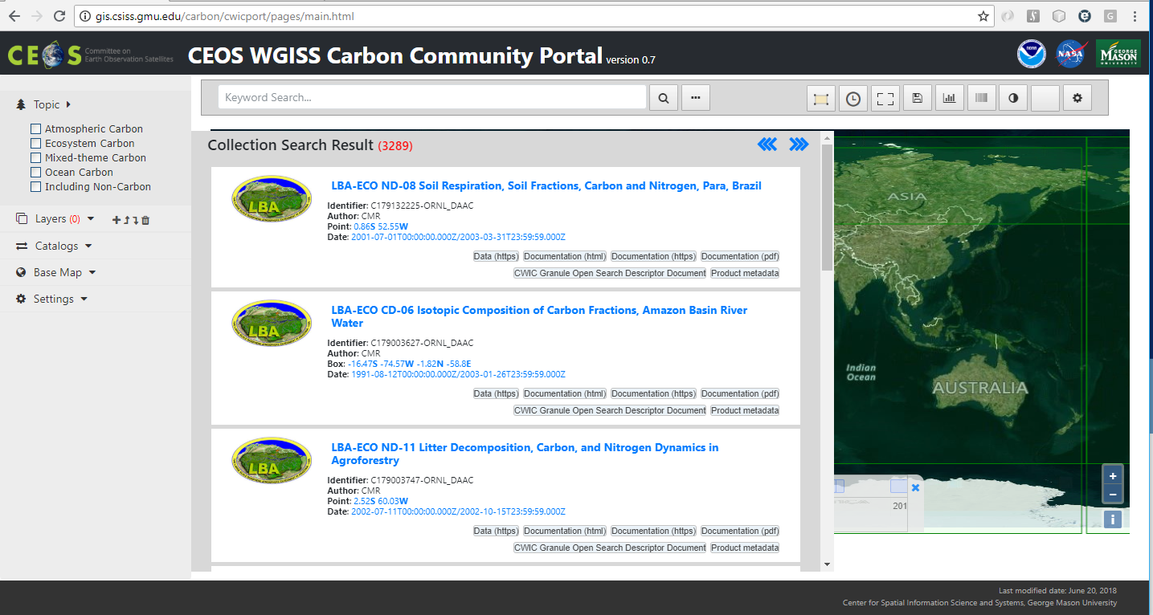
Portal Endpoints
https://gis.csiss.gmu.edu/carbon/cwicport
https://gis.csiss.gmu.edu/carbon/cwicport/pages/main.html

Slide 5
Step 1 Search
Collection Search

Slide 6
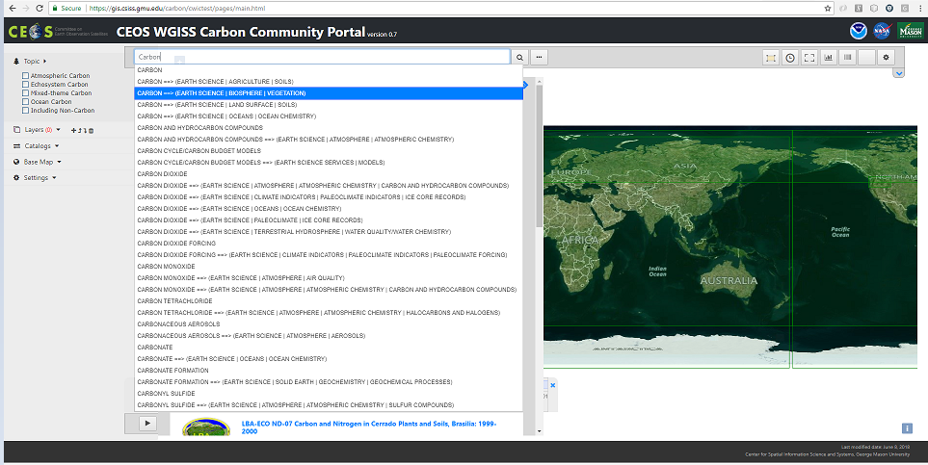
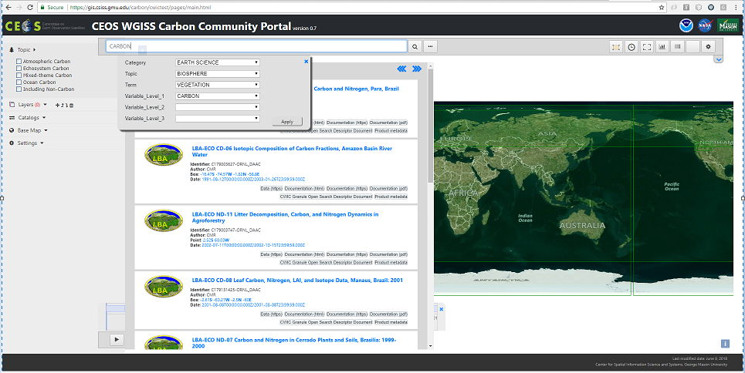
Collection Level Search (1)
Enter keywords
Keyword autocompletion
GCMD taxonomy hierarchical context

Slide 7
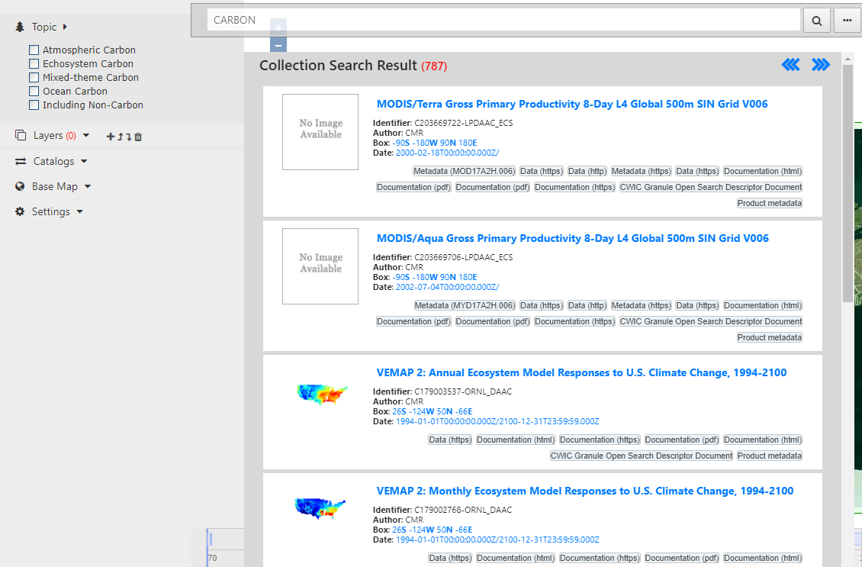
Collection Level Search (2)
Collection results matching the keywords

Slide 8
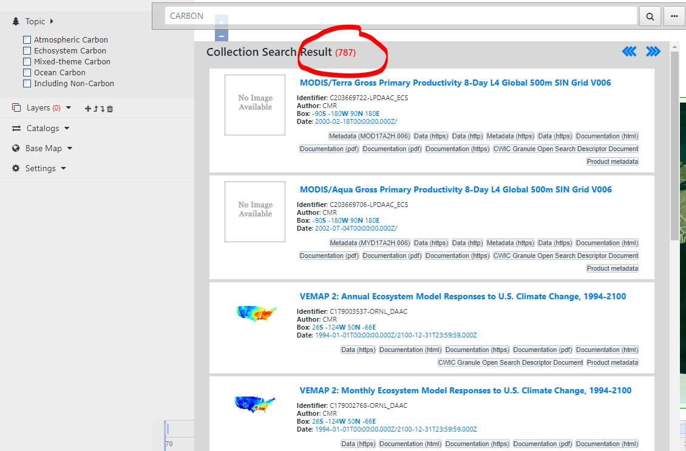
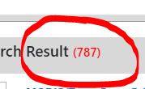
Collection Level Search (2)
Collection results matching the keywords
Total record number from both CWIC and FedEO (e.g. 787 matches that matches “
CARBON EARTH SCIENCE BIOSPHERE VEGETATION”)

Slide 9
Collection Level Search (2)
Collection results matching the keywords
Total record
First page of 10 matches shown with details (e.g. identifier, author, bounding box, date, links to data/metadata)

Slide 10
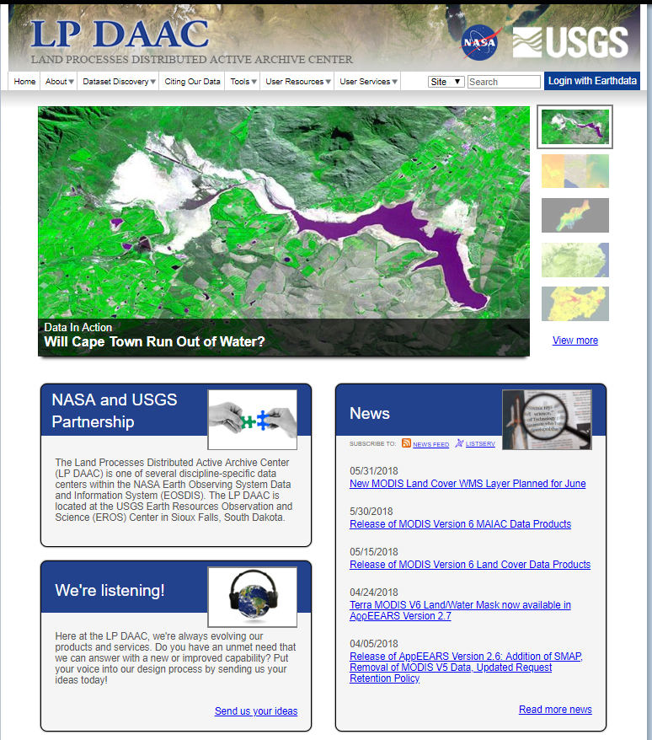
Collection Level Search (2)
Collection results matching the keywords
Total record
First page of 10
All links are active that brings up linked page /metadata/data

Slide 11
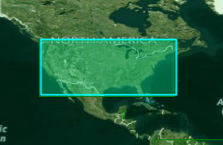
Collection Level Search (2)
Collection results matching the keywords
Total record
First page of 10
All links
Spatial coverage is highlighted on map when clicking on bounding box (e.g. the first collection is for Alaska)

Slide 12
Collection Level Search (2)
Collection results matching the keywords
Total record
First page of 10
All links
Spatial coverage
Temporal coverage is shown on timeline when clicking on date range
Toggle to show timeline

Slide 13
Collection Level Search (2)
Collection results matching the keywords
Total record
First page of 10
All links
Spatial coverage
Temporal coverage
Click on the title of collection to start the granule level search ( if applicable)
Click it to start
granule level search

Slide 14
Step 2 Search
Granule Search

Slide 15
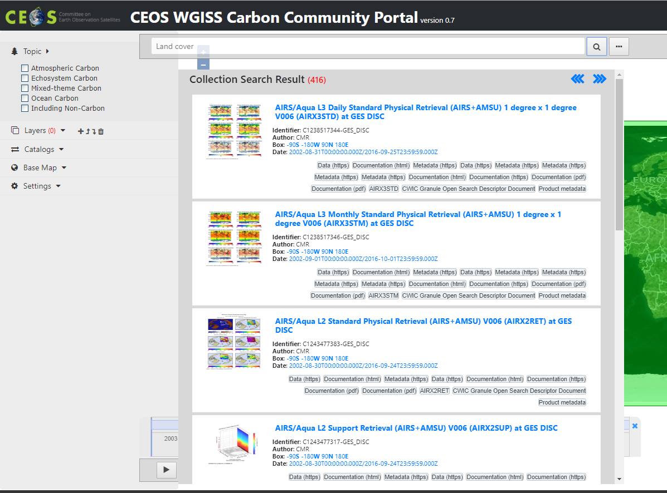
Granule Level Search (1)
Search granule within collection
Click on the title of the collection to start the granule level search (e.g. “AIRS/Aqua L3 Daily Standard Physical Retrieval (AIRS+AMSU) 1 degree x 1 degree V006 (AIRX3STD)....”)
Click it to start
granule level search

Slide 16
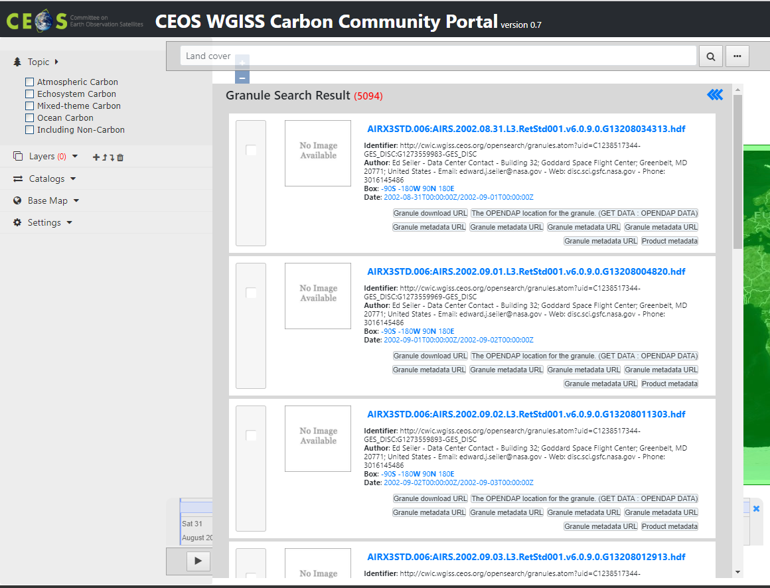
Granule Level Search (2)
Granules of the collection meeting spatial/temporal constraints
All granules
Filtered by spatial constraint
Filtered by temporal constraint

Slide 17
Granule Level Search (3)
Granules
Total number of granules
More than
5K granules found

Slide 18
Granule Level Search (3)
Granules
Total number
First page of 10 granules shown with details (e.g. identifier, author, bounding box, date, and links to data/metadata/ document)

Slide 19
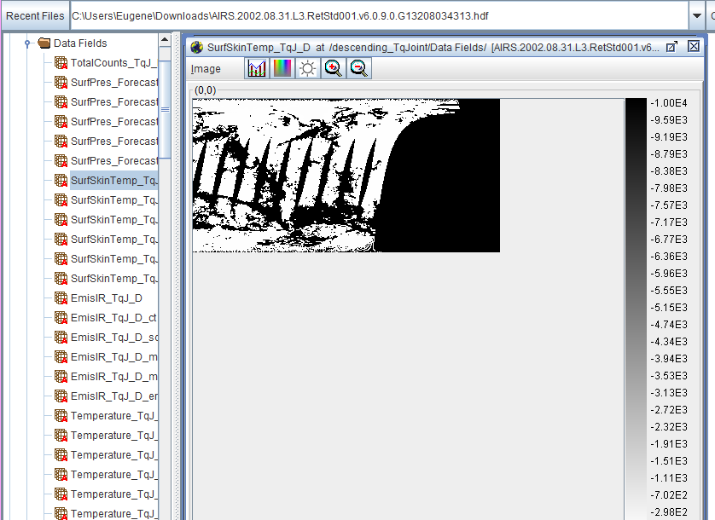
Granule Level Search (3)
Granules
Total number
First page
All links are active that allows to access description page /metadata/data (e.g. the data can be downloaded, displayed, and shown using HDFViewer)

Slide 20
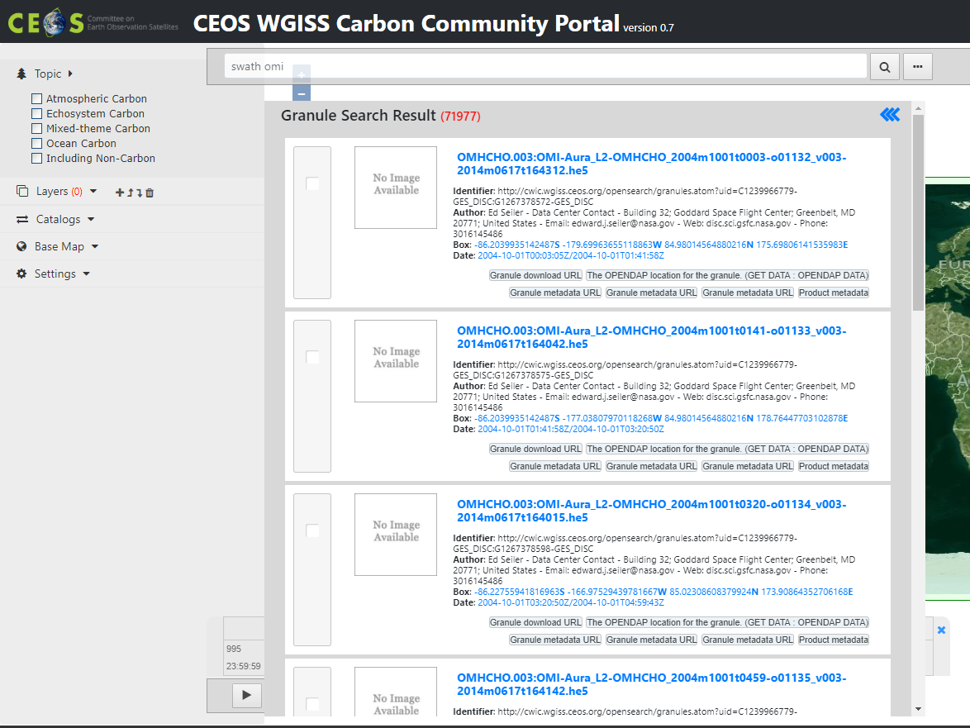
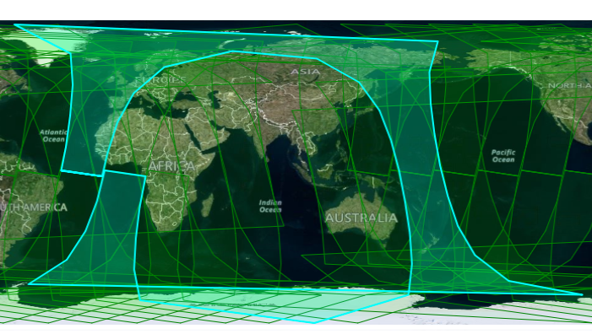
Granule Level Search (3)
Granules
Total number
First page
All links
Spatial coverage can be highlighted on map view when clicking on the bounding box (e.g. the first record is a swath covering one strip from north to south)

Slide 21
Granule Level Search (3)
Granules
Total number
First page
All links
Spatial coverage
Temporal coverage can be highlighted on the timeline when clicking on date (e.g. the first record is covering a period on Sept. 6, 2014)

Slide 22
Spatial and/or Temporal Constraint
Search and access data within space and time constraints

Slide 23
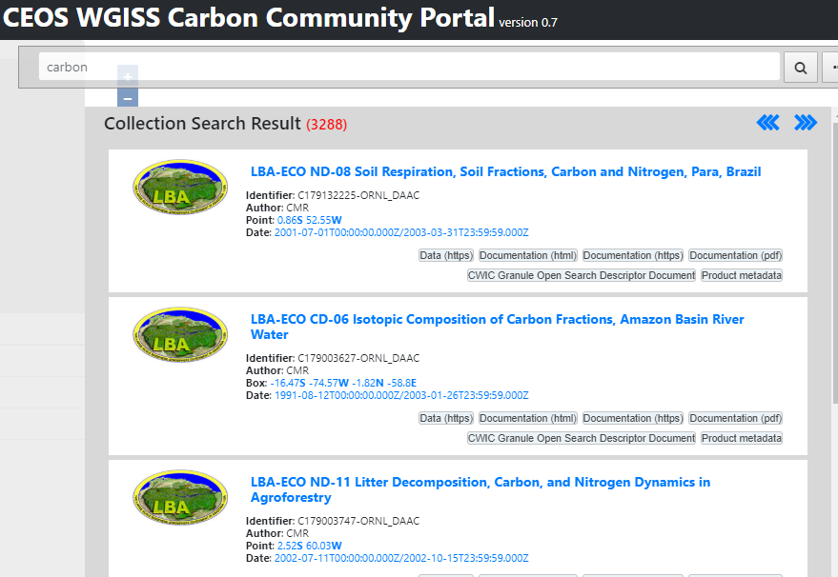
Spatial Constraint (1)
Collections
Use keyword = “carbon”
Before
CWIC: 534
FedEO: 2754

Slide 24
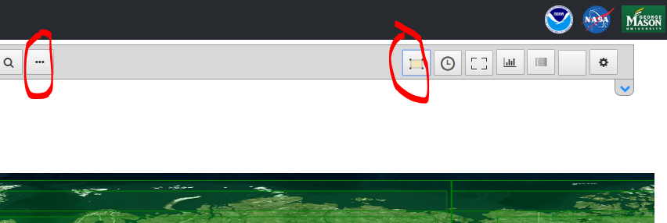
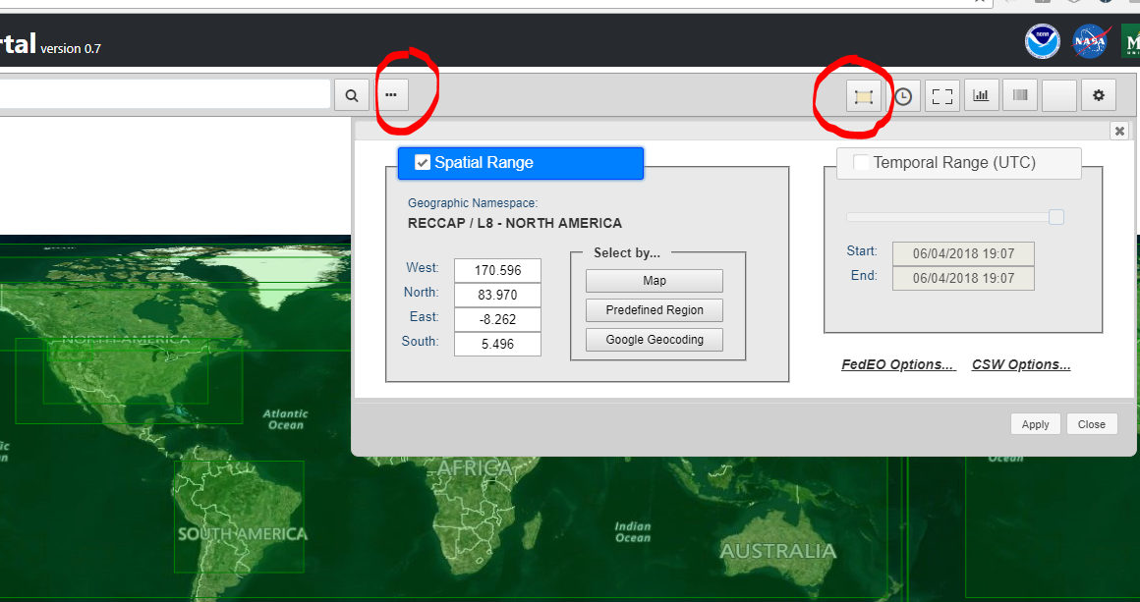
Spatial Constraint (2)
Collections
Use keyword = “carbon”
Before
CWIC: 534
FedEO: 2754
Turn on spatial Constraints
Button to on/off
Change the bounding box by dragging or editing the value in constraint form
Click to turn on or off
Spatial constraint
Click to turn on or off
The constraint form

Slide 25
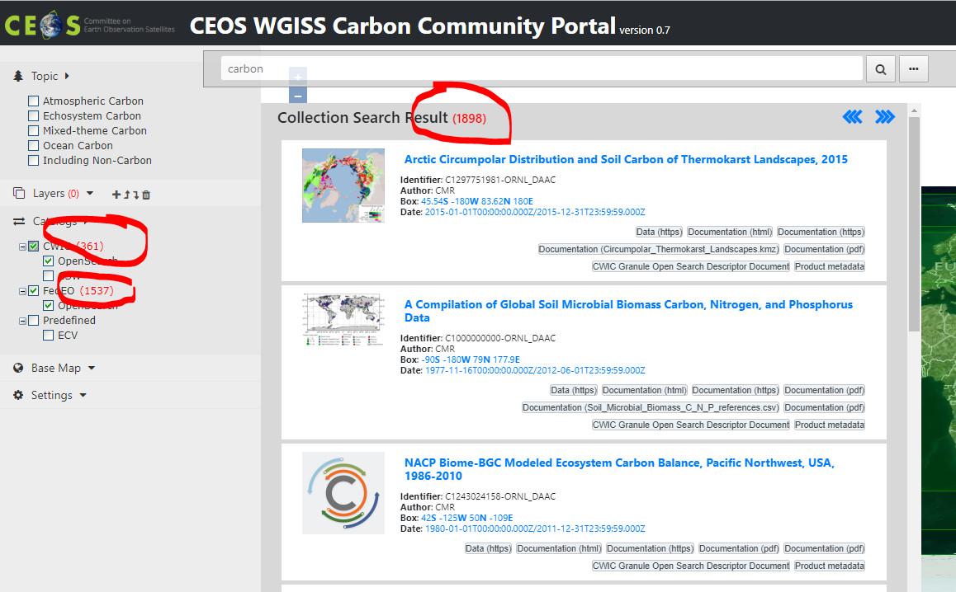
Spatial Constraint (3)
Collections
Use keyword = “carbon”
Before
Total: 3288
CWIC: 534
FedEO: 2754
Turn on spatial Constraints
[-170.596, 83.97,-8.262,5.496]
After
Total: 1898
CWIC: 361
FedEO: 1537

Slide 26
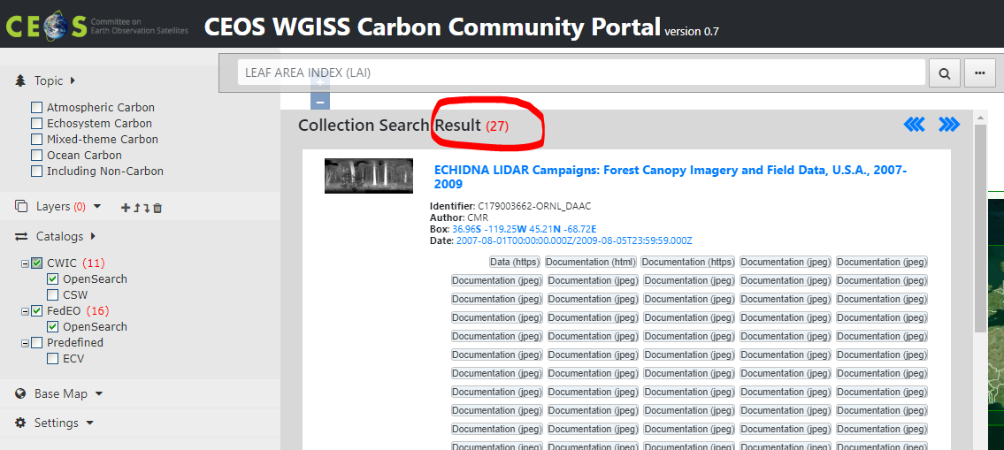
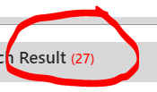
Temporal Constraint (1)
Collections
Use keyword = “LEAF AREA INDEX (LAI)”
Before
CWIC: 11
FedEO: 16

Slide 27
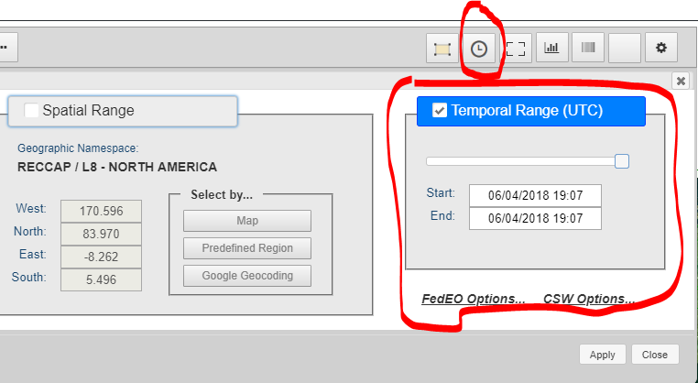
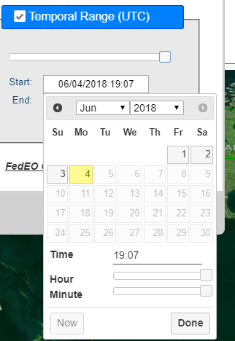
Temporal Constraint (2)
Collections
Use keyword = “LEAF AREA INDEX (LAI)”
Before
CWIC: 11
FedEO: 16
Turn on temporal Constraints
Button to on/off
Change the time range by using time bar or time picker
Toggle button to turn on/off
Temporal constraints
Dragging start or end
Time mark on the bar
Edit the time range
Using time picker

Slide 28
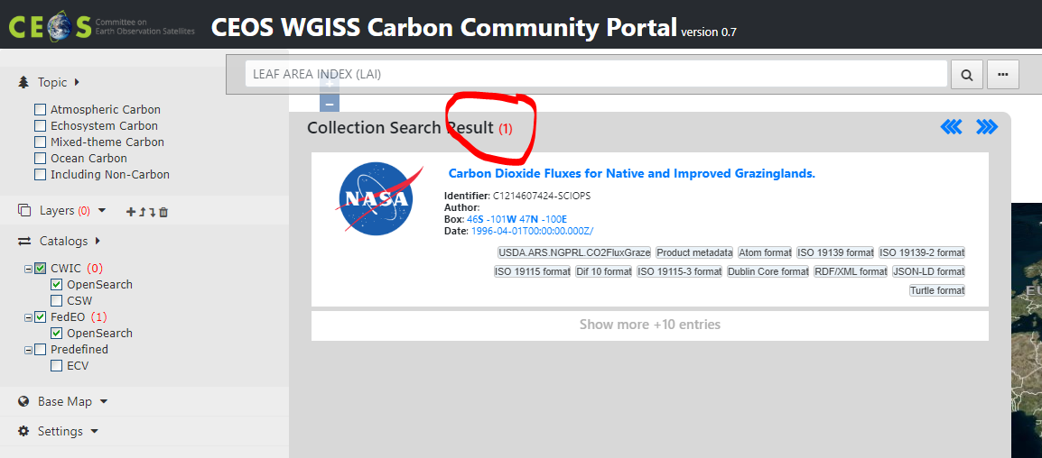
Temporal Constraint (3)
Collections
Use keyword = “LEAF AREA INDEX (LAI)”
Before
Total: 27
CWIC: 11
FedEO: 16
Turn on temporal Constraints
1/1/2017-10/15/2017
After
Total: 1
CWIC: 0
FedEO: 1

Slide 29
Carbon Special Interest Regions
Search and access data with predefined carbon regions
Notes:
TransCom:
http://transcom.project.asu.edu/transcom03_protocol_basisMap.php
http://transcom.project.asu.edu/images/smoothmap2_final_2.jpg
ECV
http://cci.esa.int/sites/default/files/06_CCI-Colocation2015_ECVInventory-1.1.pdf
http://ceos.org/document_management/Working_Groups/WGClimate/Meetings/WGClimate-6/WGClimate_ECV-Inventory-Questionnaire-Guide_v2-2_Feb2016.pdf
RECCAP
http://www.globalcarbonproject.org/reccap/

Slide 30
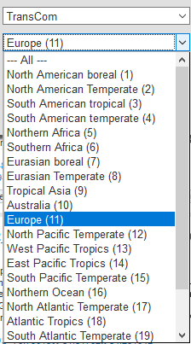
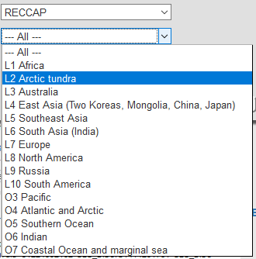
Carbon Study Regions
Special regions
Global
RECCAP (REgional Carbon Cycle Assessment and Processes) regions
TransCom (The Atmospheric Tracer Transport Model Intercomparison Project) regions

Slide 31
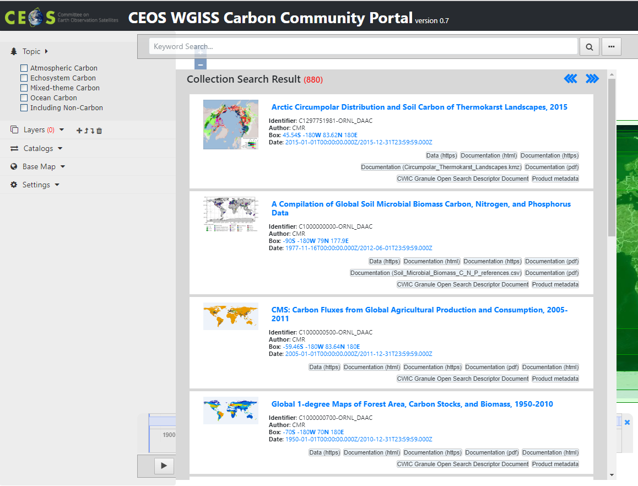
TransCom – Europe region -
Special region search
TransCom – Europe region

Slide 32
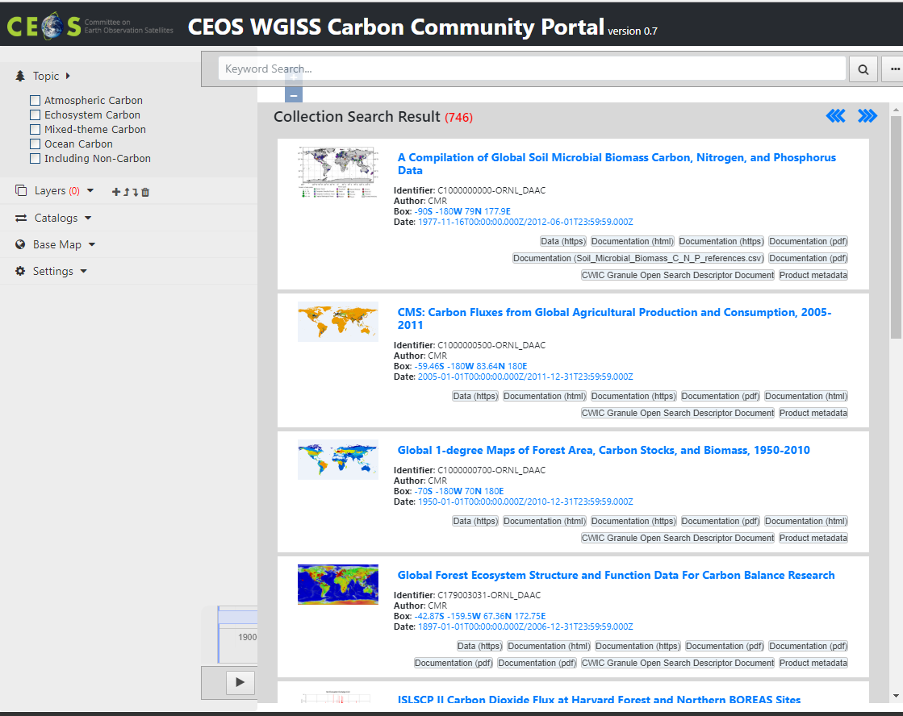
RECCAP – L5 Southeast Asia region -
Special region search
RECCAP – L5 Southeast Asia region

Slide 33
Carbon Special Interest Topic
Search and access data with predefined carbon topics

Slide 34
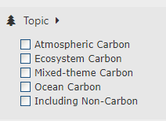
Carbon Topics
Special topics or interest area for carbon community
Predefined, topic-filtered search
Selectable in the left panel
Check and then do the search

Slide 35
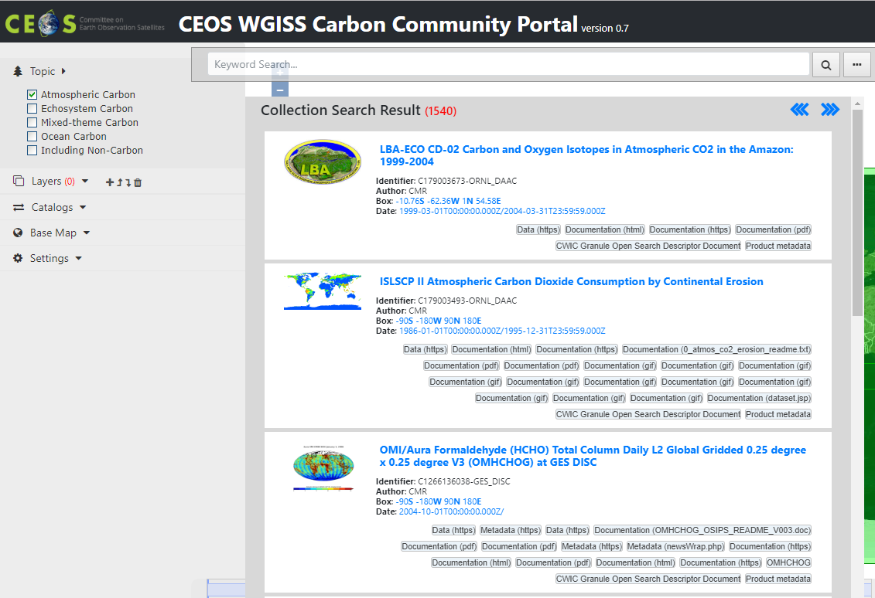
Carbon Topic - Atmospheric
Special topics or interest area for carbon community
Predefined, topic-filtered search
Carbon theme: Atmospheric Carbon

Slide 36
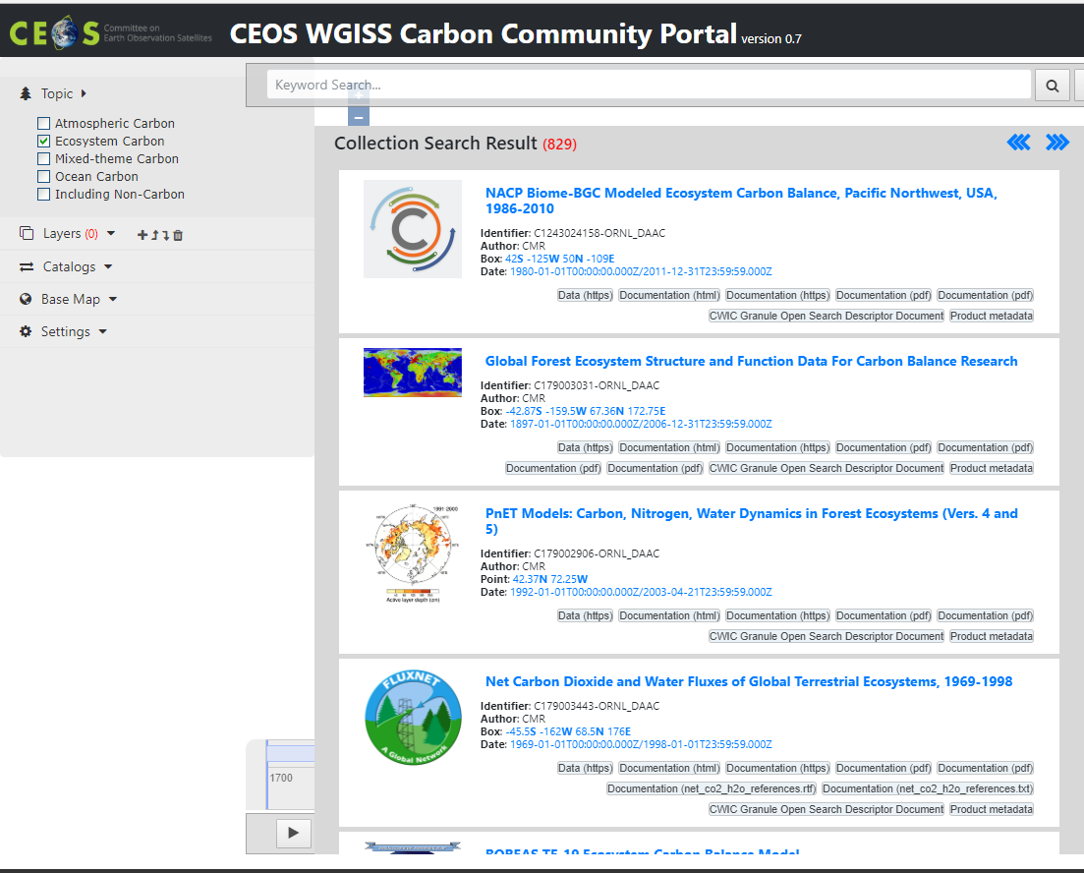
Carbon Topic - Ecosystem
Special topics or interest area for carbon community
Predefined, topic-filtered search
Carbon theme: Ecosystem Carbon

Slide 37
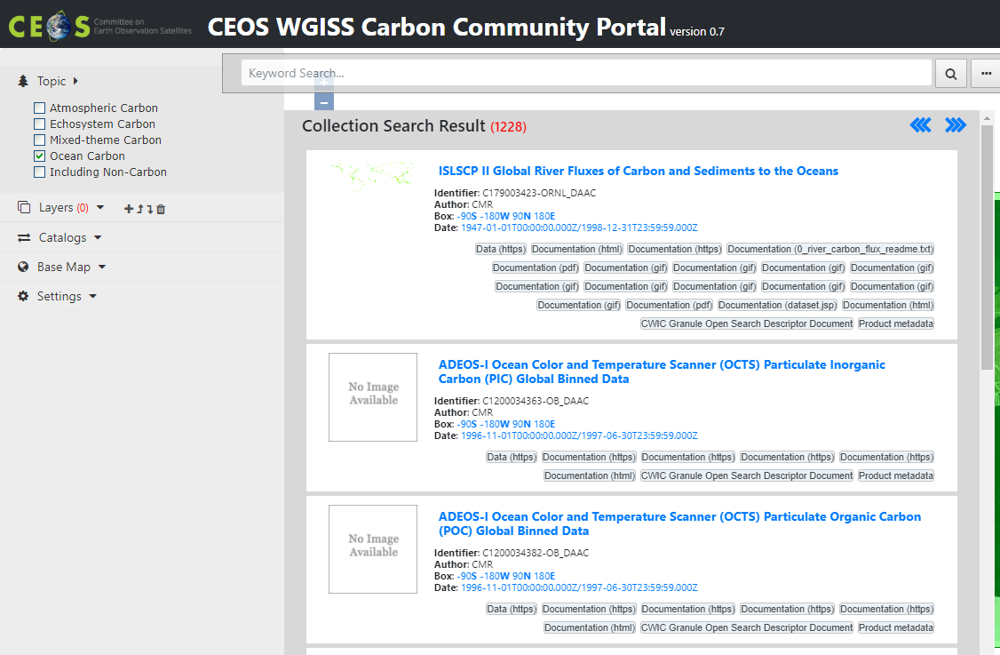
Carbon Topic – Ocean
Special topics or interest area for carbon community
Predefined, topic-filtered search
Special carbon topic: Ocean Carbon

Slide 38
GCMD keywords/acronym auto-completion
Search and access data with GCMD keywords/acronym auto-completion

Slide 39
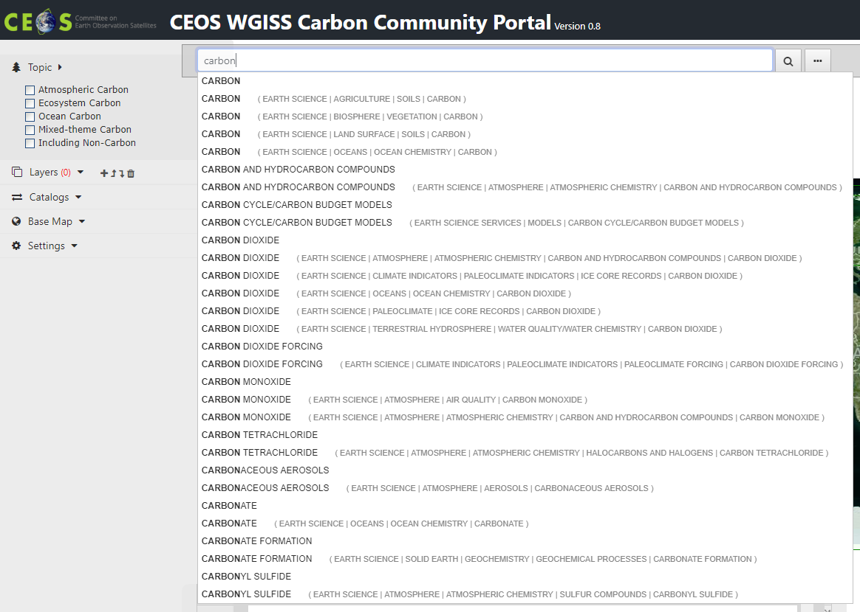
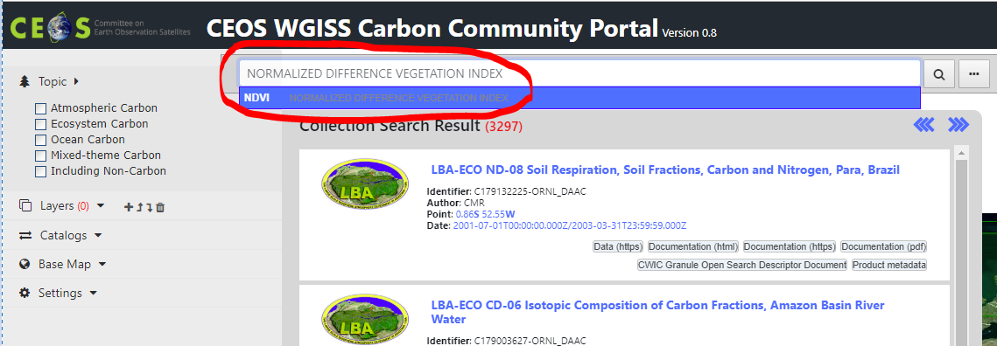
Keyword auto-completion
Keywords auto-completion
GCMD keyword auto-completion
Acronym auto-expansion

Slide 40
Visualization and Analytics
Use case
Display existing WMS/WMTS in the CWIC portal
Specifically GIBS WMS

Slide 41
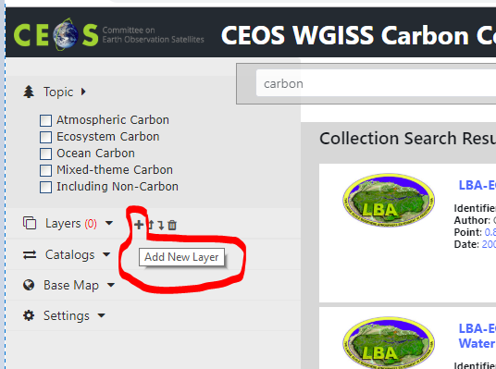
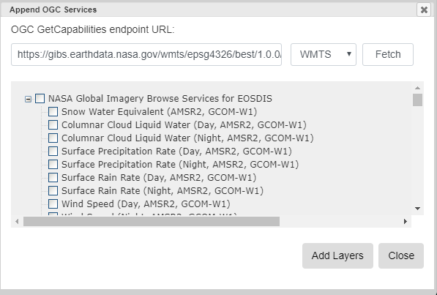
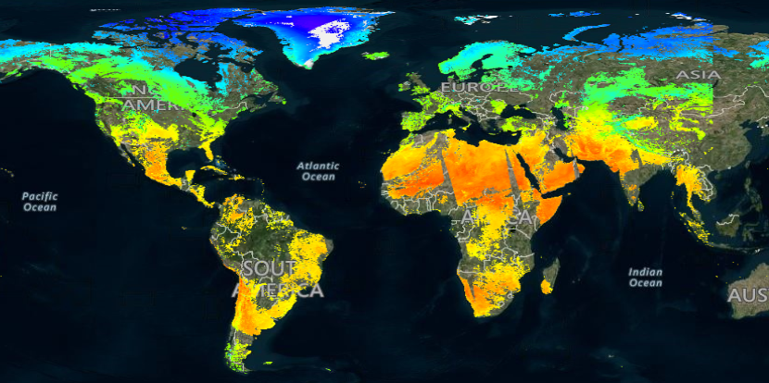
Display default layer from NASA GIBS
Access and display default layer – current day or the latest
Fetch from the GetCapabilities
Total renderable layers are 687
E.g. Land Surface Temperature (Day, MODIS, Aqua)

Slide 42
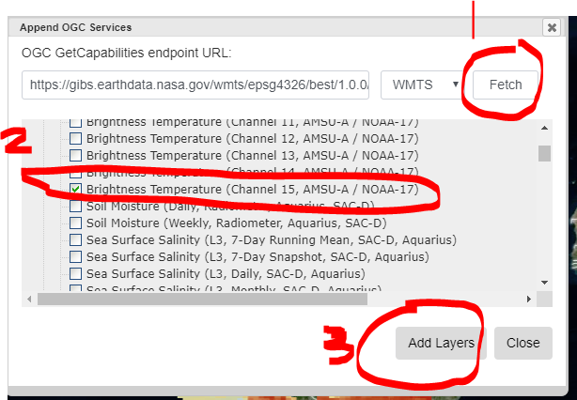
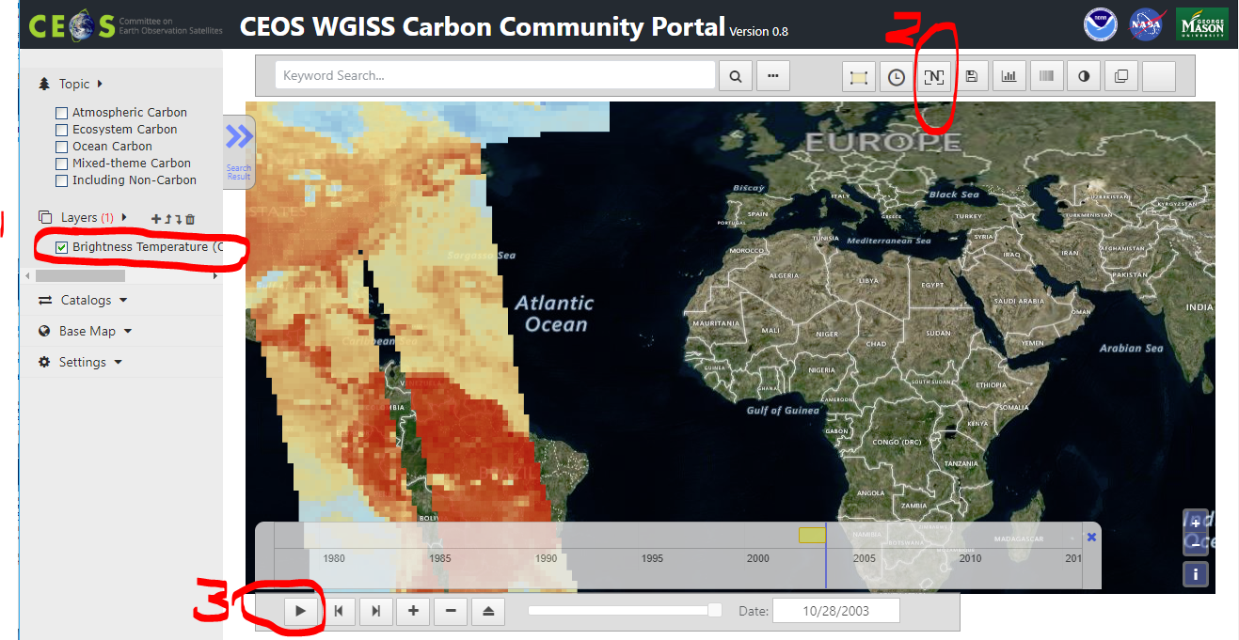
Animation with WMS/WMTS layers
Select the button to add WMS/WMTS layers
Add layers
Fetch
Check “Brightness Temperature (Channel 15, AMSU-A/NOAA-17)”
Add Layers
Play animation
Check it to display
Un-mask the cover
Play button

Slide 43
Visualization and Analytics
Scenario 1
Data collection found from CWIC

Slide 44
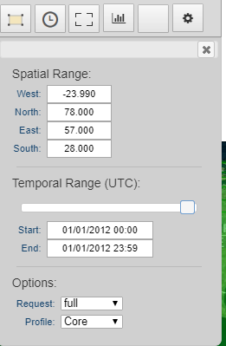
Discover, access, and display coverage (CWIC)
Spatial constraint: e.g. Predefined Region->Geographic namespace (RECCAP)->Region (L7 Europe)
Temporal constraint: 1/1/2012 00:00 (begin) - 1/1/2012 23:59 (end).
Topic constraint: Select Topic-> All
Keywords: MOD11A1 DAILY
Specific interest data collection: e.g. MODIS/Terra Land Surface Temperature/Emissivity Daily L3 Global 1km SIN Grid V006

Slide 45
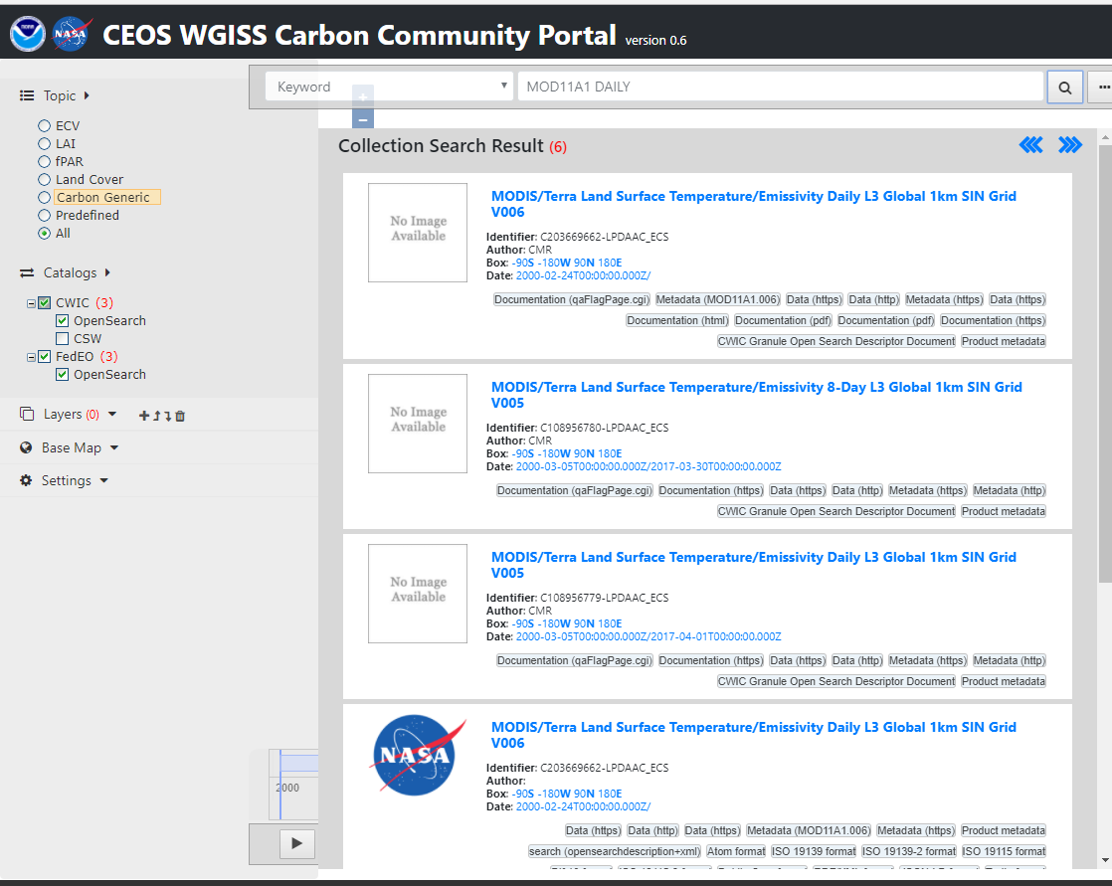
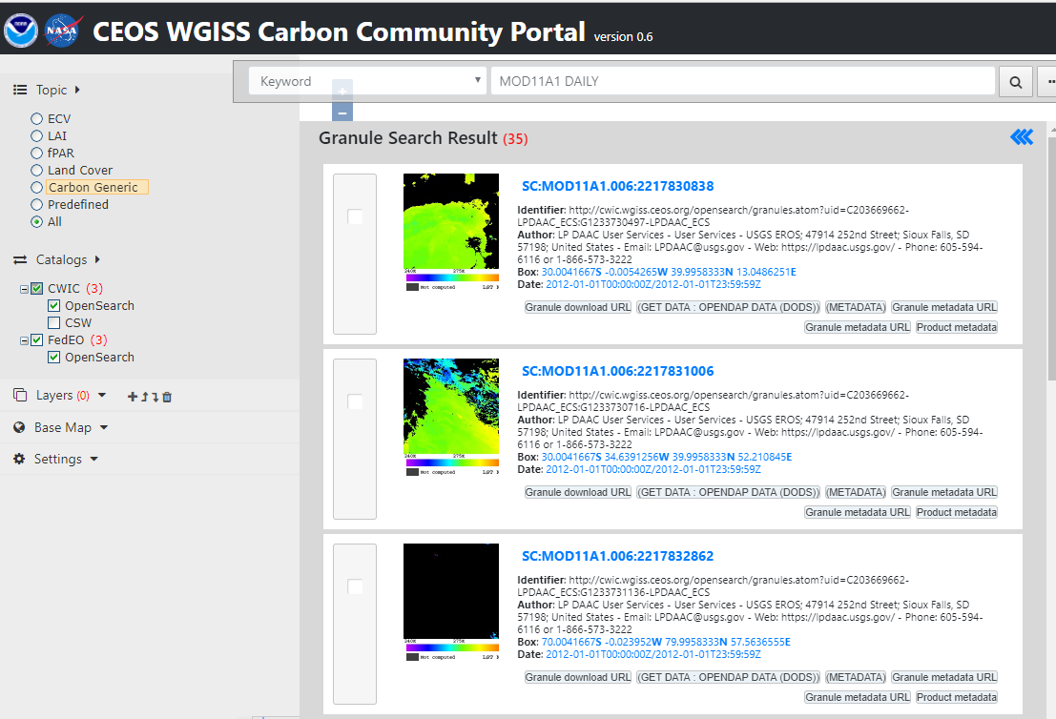
Discover, access, and display coverage (CWIC)
Specific interest data collection: e.g. MODIS/Terra Land Surface Temperature/Emissivity Daily L3 Global 1km SIN Grid V006
The first one in the list
Choose the collection
Select all granules by paging through all the matching 35 records

Slide 46
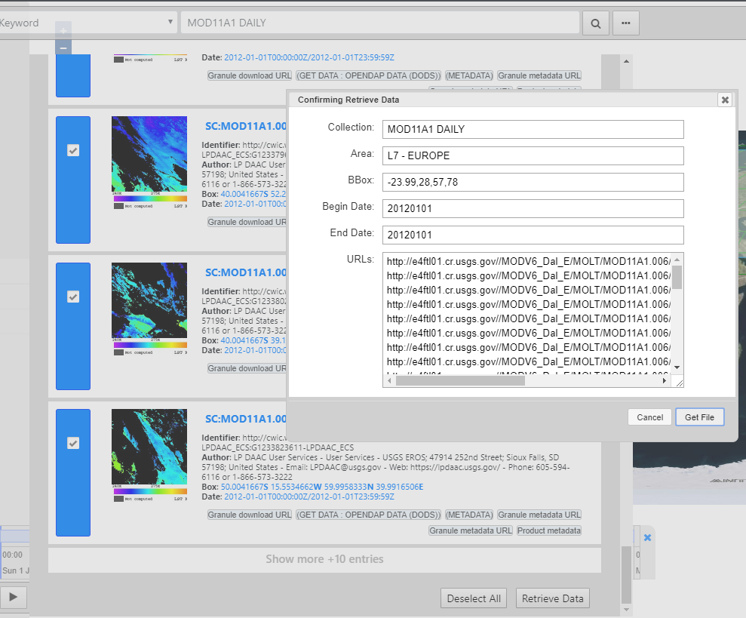
Discover, access, and display coverage (CWIC)
Retrieve all selected granules
All granules will be processed and mosaicked at the server
The mosaic data can be downloaded

Slide 47
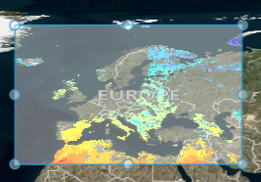
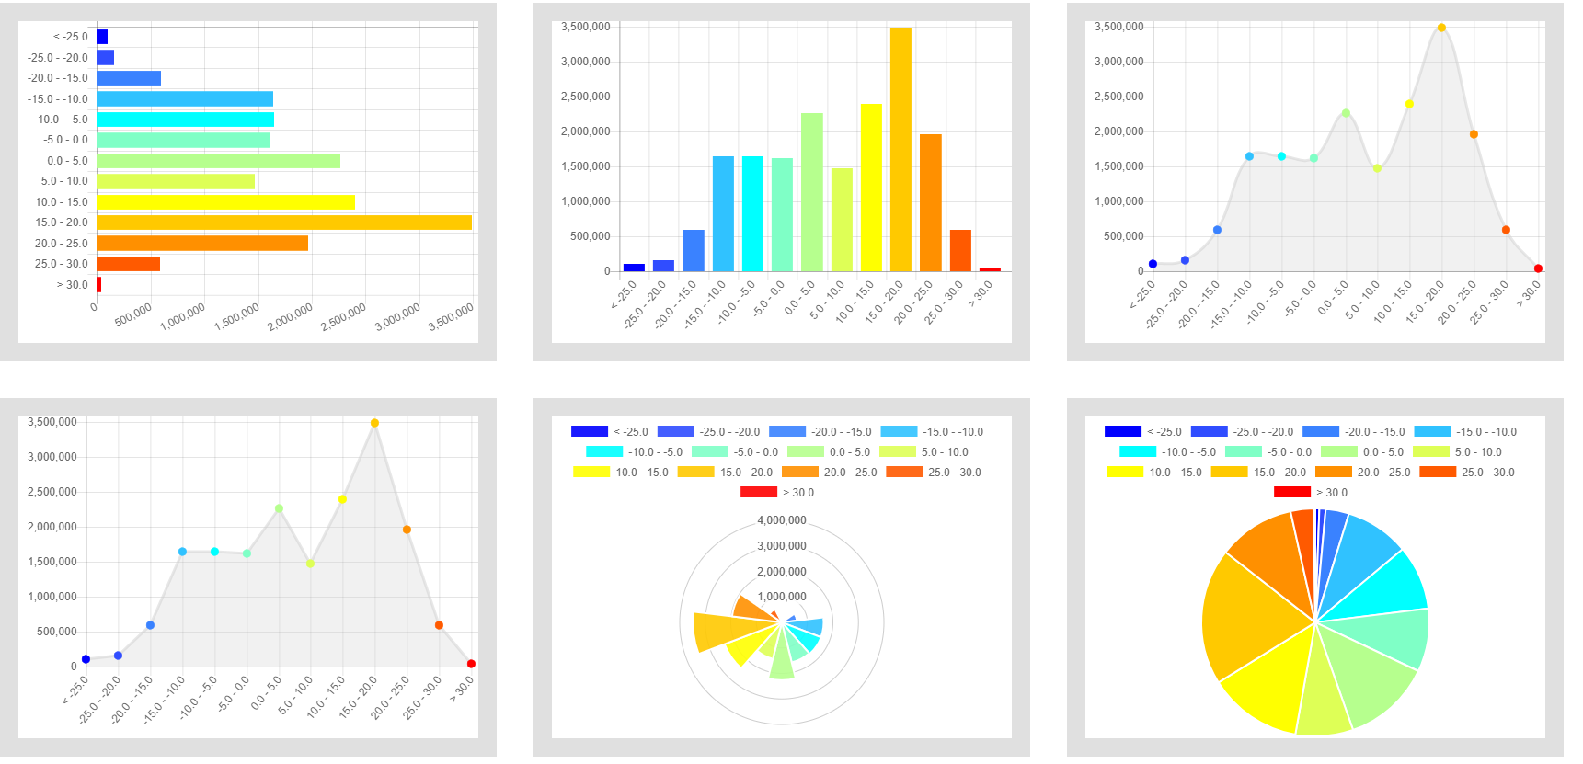
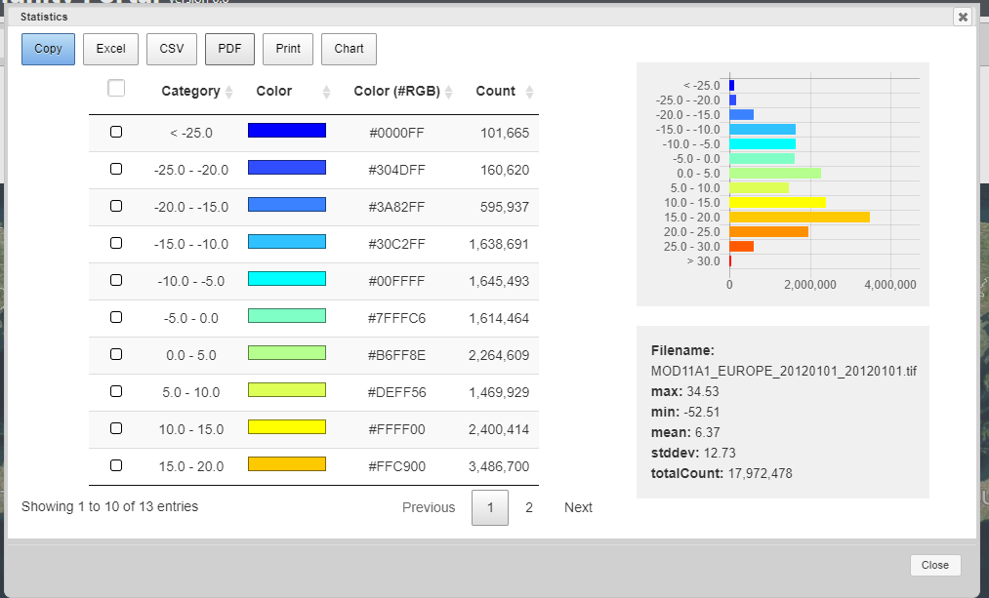
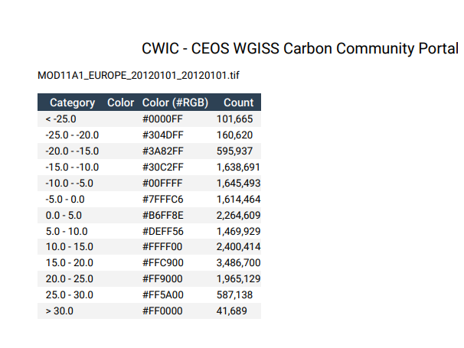
Discover, access, and display coverage (CWIC)
The mosaic data can be added as a layer for visualization
Statistics can be calculated
Export to CSV, PDF, Excel
Print/copy

Slide 48
Visualization and Analytics
Scenario 2
Data collection found from FedEO

Slide 49
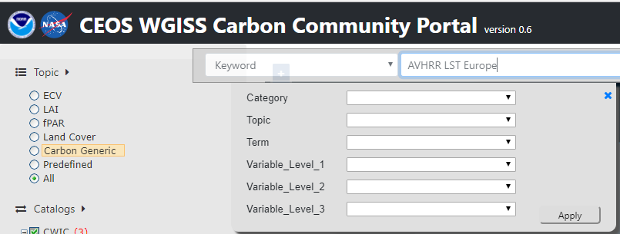
Discover, access, and display coverage (FedEO)
Spatial constraint: e.g. Region->Topic (RECCAP)->Region (L7 Europe)
Temporal constraint: 1/1/2012 00:00 (begin) - 1/1/2012 23:59 (end).
Topic constraint: Select Topic-> All
Keywords: AVHRR LST Europe
Specific interest data collection: e.g. AVHRR - Land Surface Temperature (LST) - Europe, Daytime

Slide 50
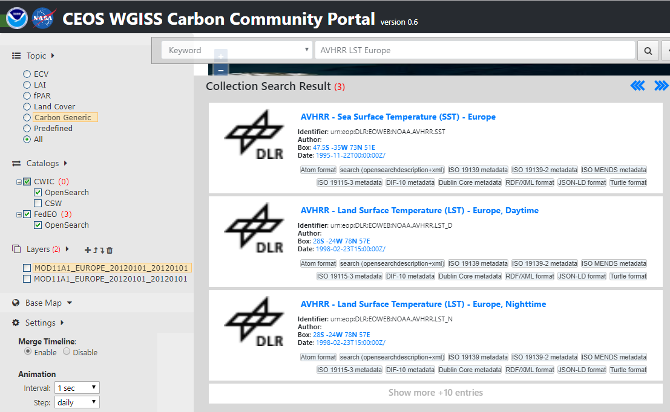
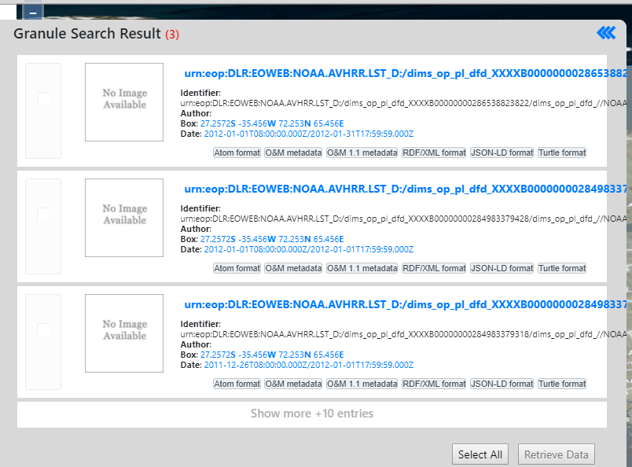
Discover, access, and display coverage (FedEO)
Specific interest data collection: e.g. AVHRR - Land Surface Temperature (LST) - Europe, Daytime
The second one in the list
Choose the collection
Select all granules

Slide 51
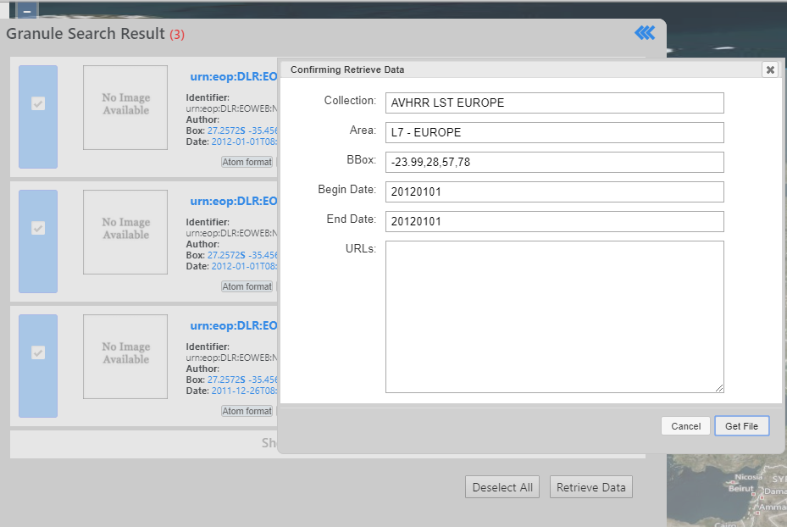
Discover, access, and display coverage (FedEO)
Retrieve all selected granules
All granules will be processed and mosaicked at the server
The mosaic data can be downloaded

Slide 52
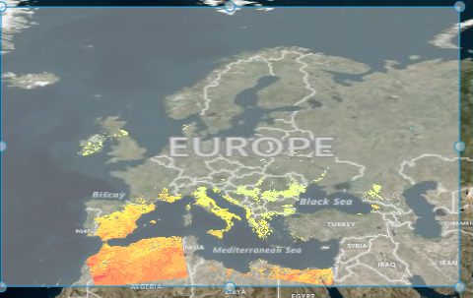
Discover, access, and display coverage (FedEO)
The mosaic data can be added as a layer for visualization
Statistics can be calculated
Export to CSV, PDF, Excel
Print/copy

Slide 53
Visualization and Analytics
Scenario 3
Data collection found for Carbon
Using 2016 May wildfire of Fort McMurray, Alberta, Canada as a scenario
taking analysis of monthly global Carbon Dioxide (CO2) product as an example
demonstrating functionality of carbon related data searching, retrieving, processing, visualization, and analysis of CWIC Carbon portal (https://gis.csiss.gmu.edu/carbon/cwictest/pages/main.html)

Slide 54
Discover, access, and display coverage (CWIC)
Keywords: AIRS3C2M
Temporal constraints: 5/1/2015 00:00 (begin) - 5/31/2015 23:59 (end)
In search results
Choose data collection of AIRS3C2M: AIRS/Aqua L3 Monthly CO2 in the free troposphere (AIRS-only) 2.5 degrees x 2 degrees V005 (First match)
Notes:
5/1/2016 00:00 (begin) - 5/31/2016 23:59 (end) is woking too

Slide 55
Discover, access, and display coverage (CWIC)
In found granule results
Select ALL
Retrieve Data
Get File

Slide 56
Discover, access, and display coverage (CWIC)
In processed results (continued)
Update Layer (change legend)
Click layer name
Click “Update Layer”
Click “Predefined Colorbars…”
After select the color, click “Apply”
Click “Update Layer”

Slide 57
Discover, access, and display coverage (CWIC)
In processed results
Download
Add Layer
Statistics

