Slide 1

Working Group on Information Systems and Services (WGISS)
Committee on Earth Observation Satellites
Iolanda Maggio, ESA
WGISS#46 Meeting
FDA-10 Inventory of software and tools
(open source)
DLR – Oberpfaffenhofen, Germany
25th October 2018

Slide 2

Open Source Software –
WHY!!
For space programmes OSS can provide cost savings and innovation
For industry it can provide ways to enter the market and cost reduction for development and maintenance of software products and tools
Make the program's code available to the public
Allow anyone to modify, enhance or re-engineer a program's code
Allow the creation of derivative works
Allow the program to be utilized for any purpose the user wishes
Improve collaboration
Allow reuse through code adaptation
Full Documentation Available
Unlimited use

Slide 3
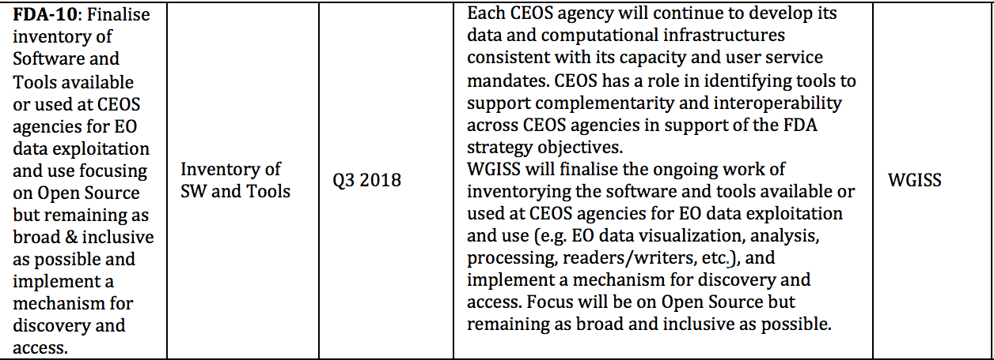
OSS in CEOS and WGISS Work Plan
OSS Inventory triggered by …

Slide 4
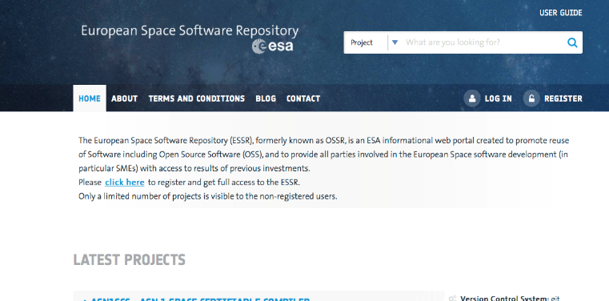
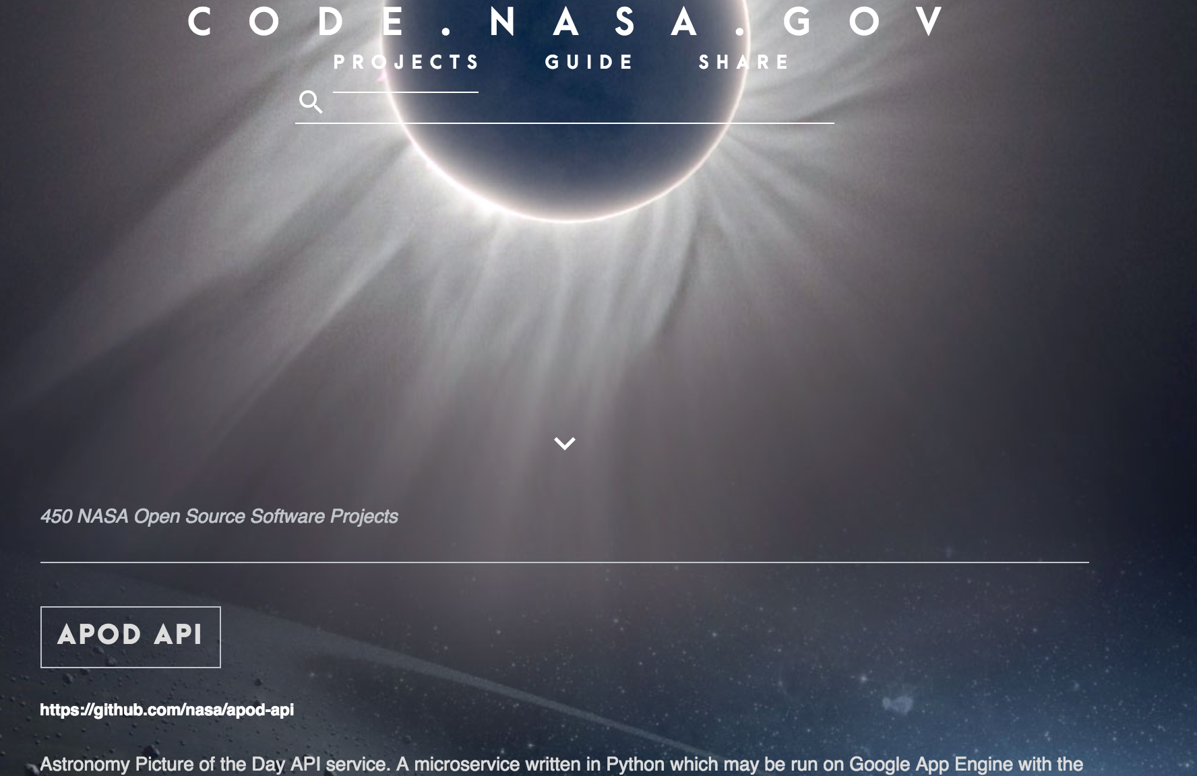
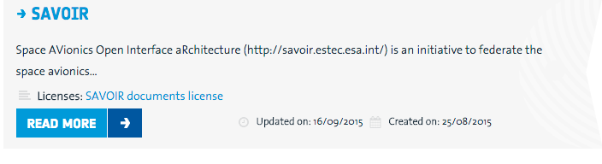
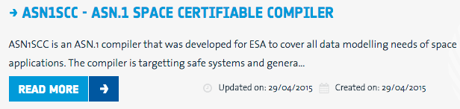
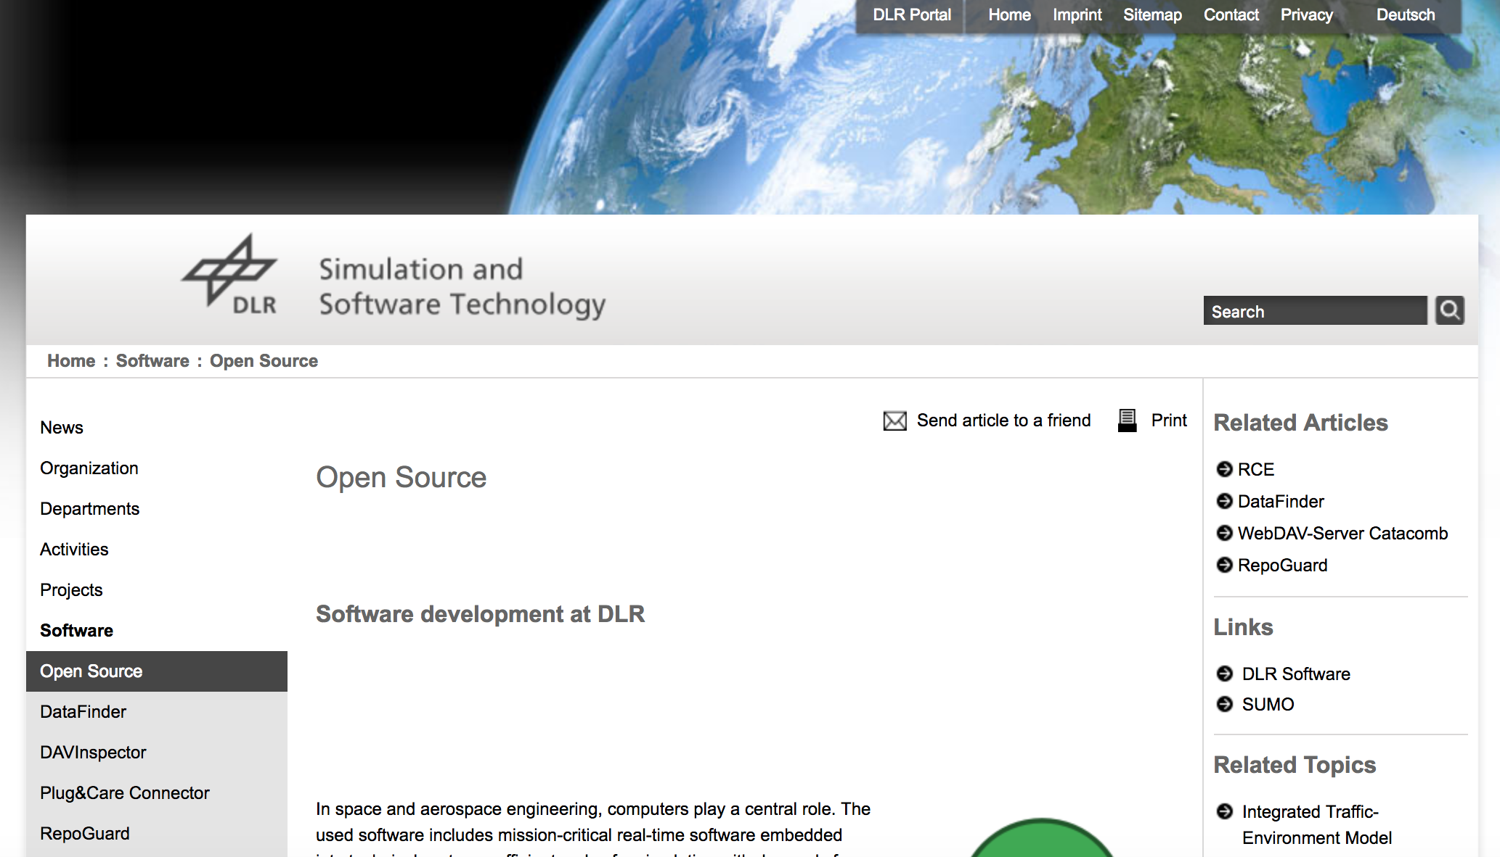
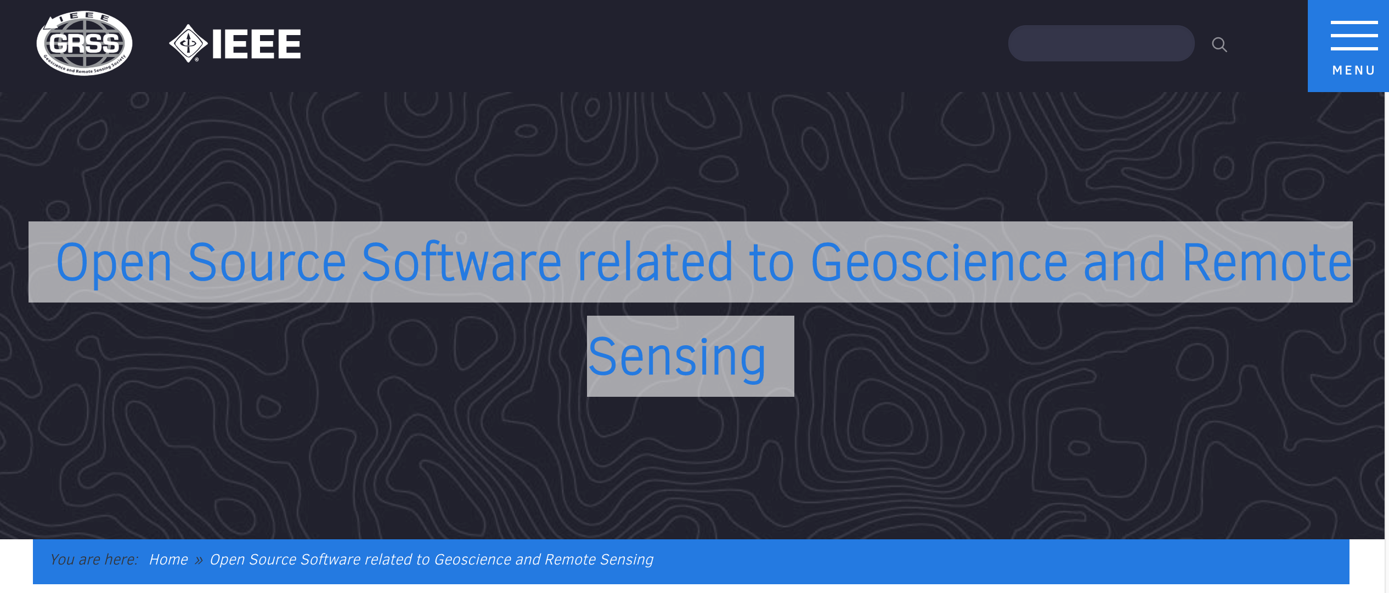
OSS in WGISS Agencies
https://code.nasa.gov/
https://essr.esa.int
https://www.dlr.de/sc/en/desktopdefault.aspx/tabid-5951/9688_read-19161/
http://www.grss-ieee.org/open-source-software-related-to-geoscience-and-remote-sensing/

Slide 5
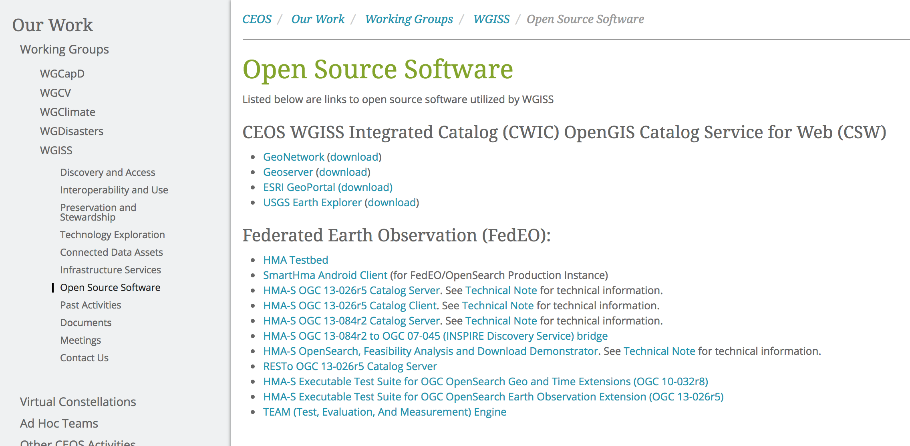
OSS in CEOS- WGISS
Open Source Software page to be moved into Interoperability and Use Area
Inventory DB to be implemented with search capabilities (November)

Slide 6
OSS Survey
OSS Survey in CEOS Agencies compiling the reports with relevant Metadata

Slide 7
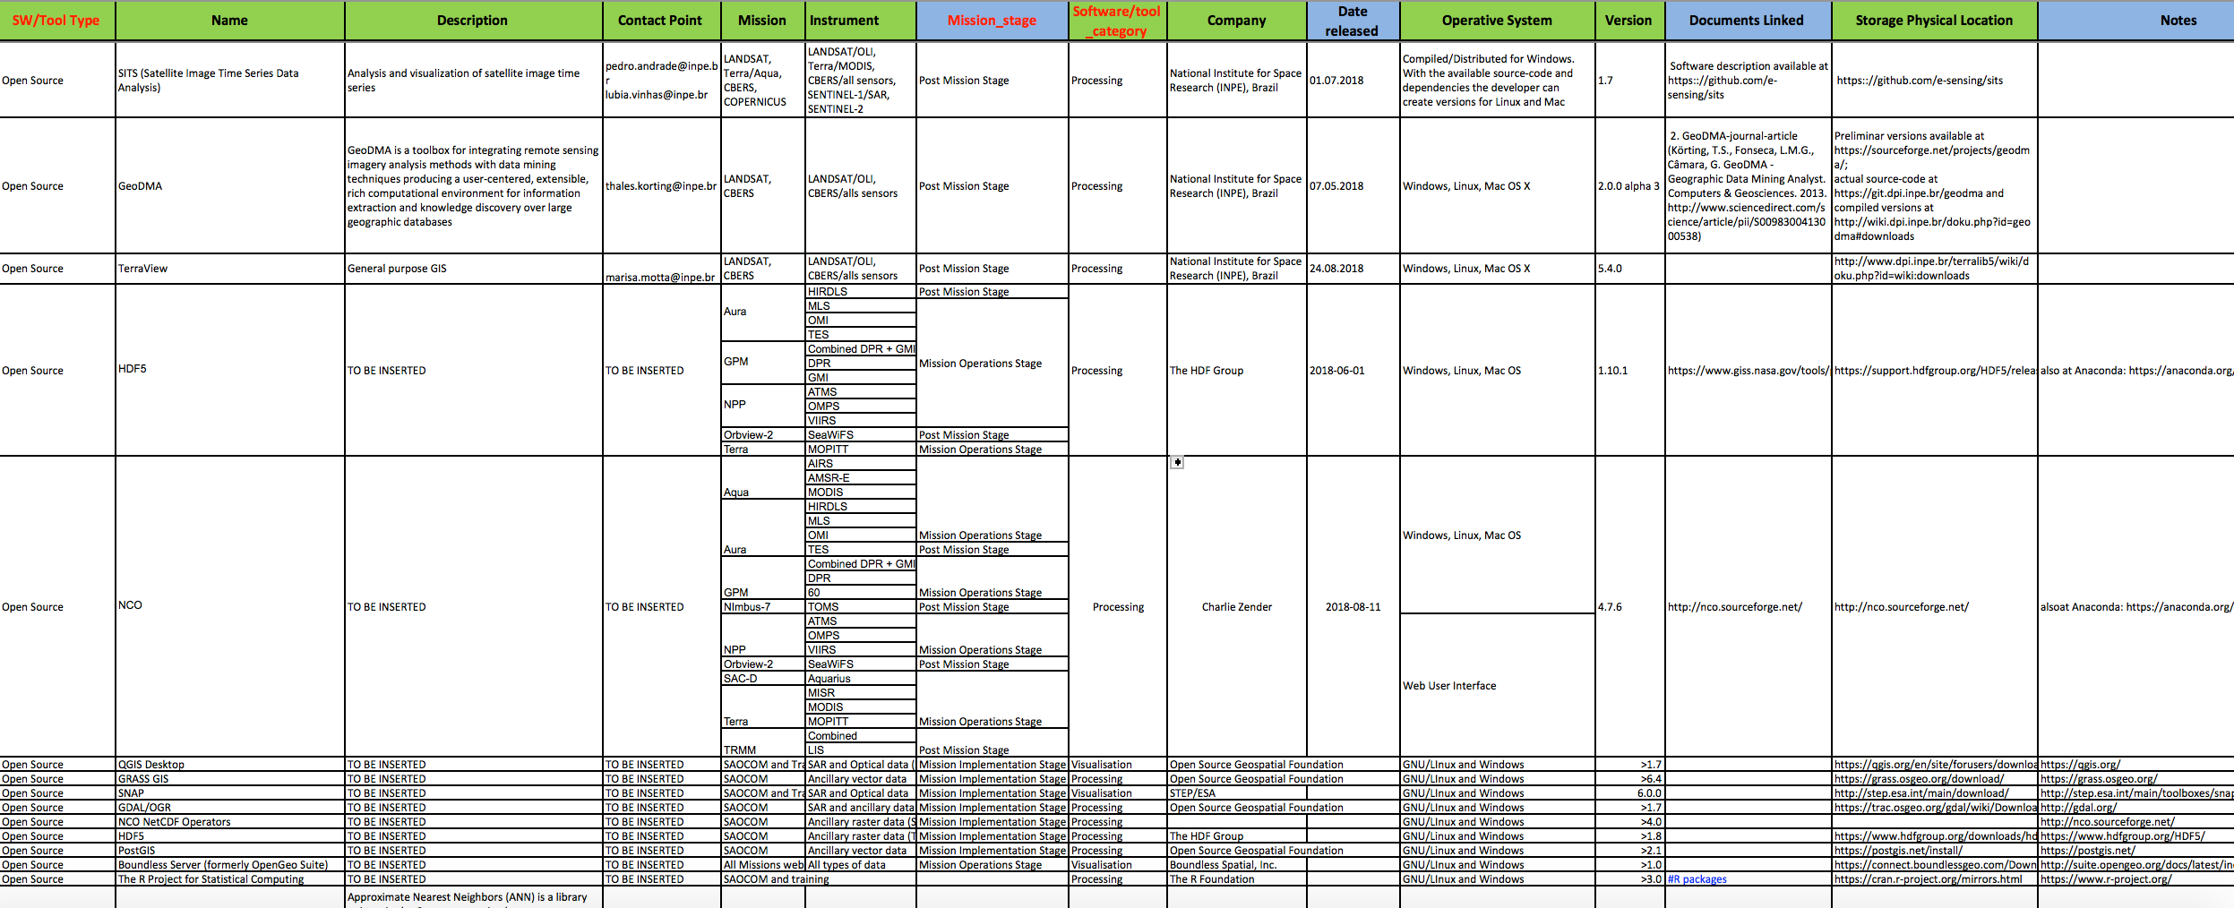
OSS Survey – First Results

Slide 8
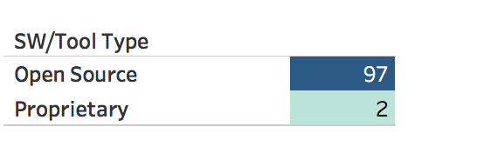
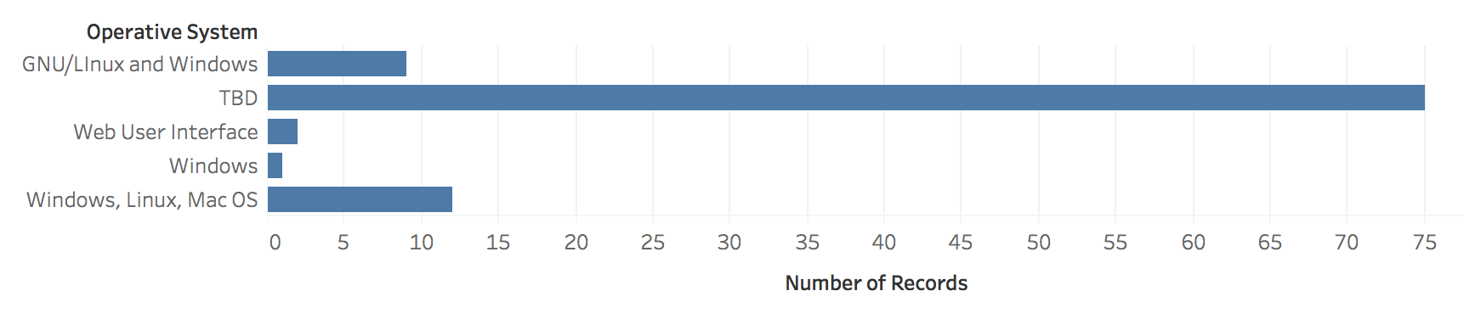
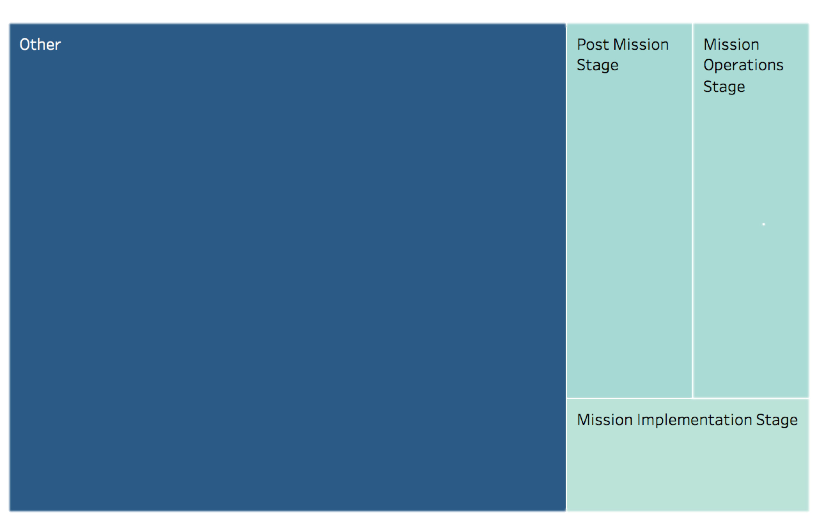
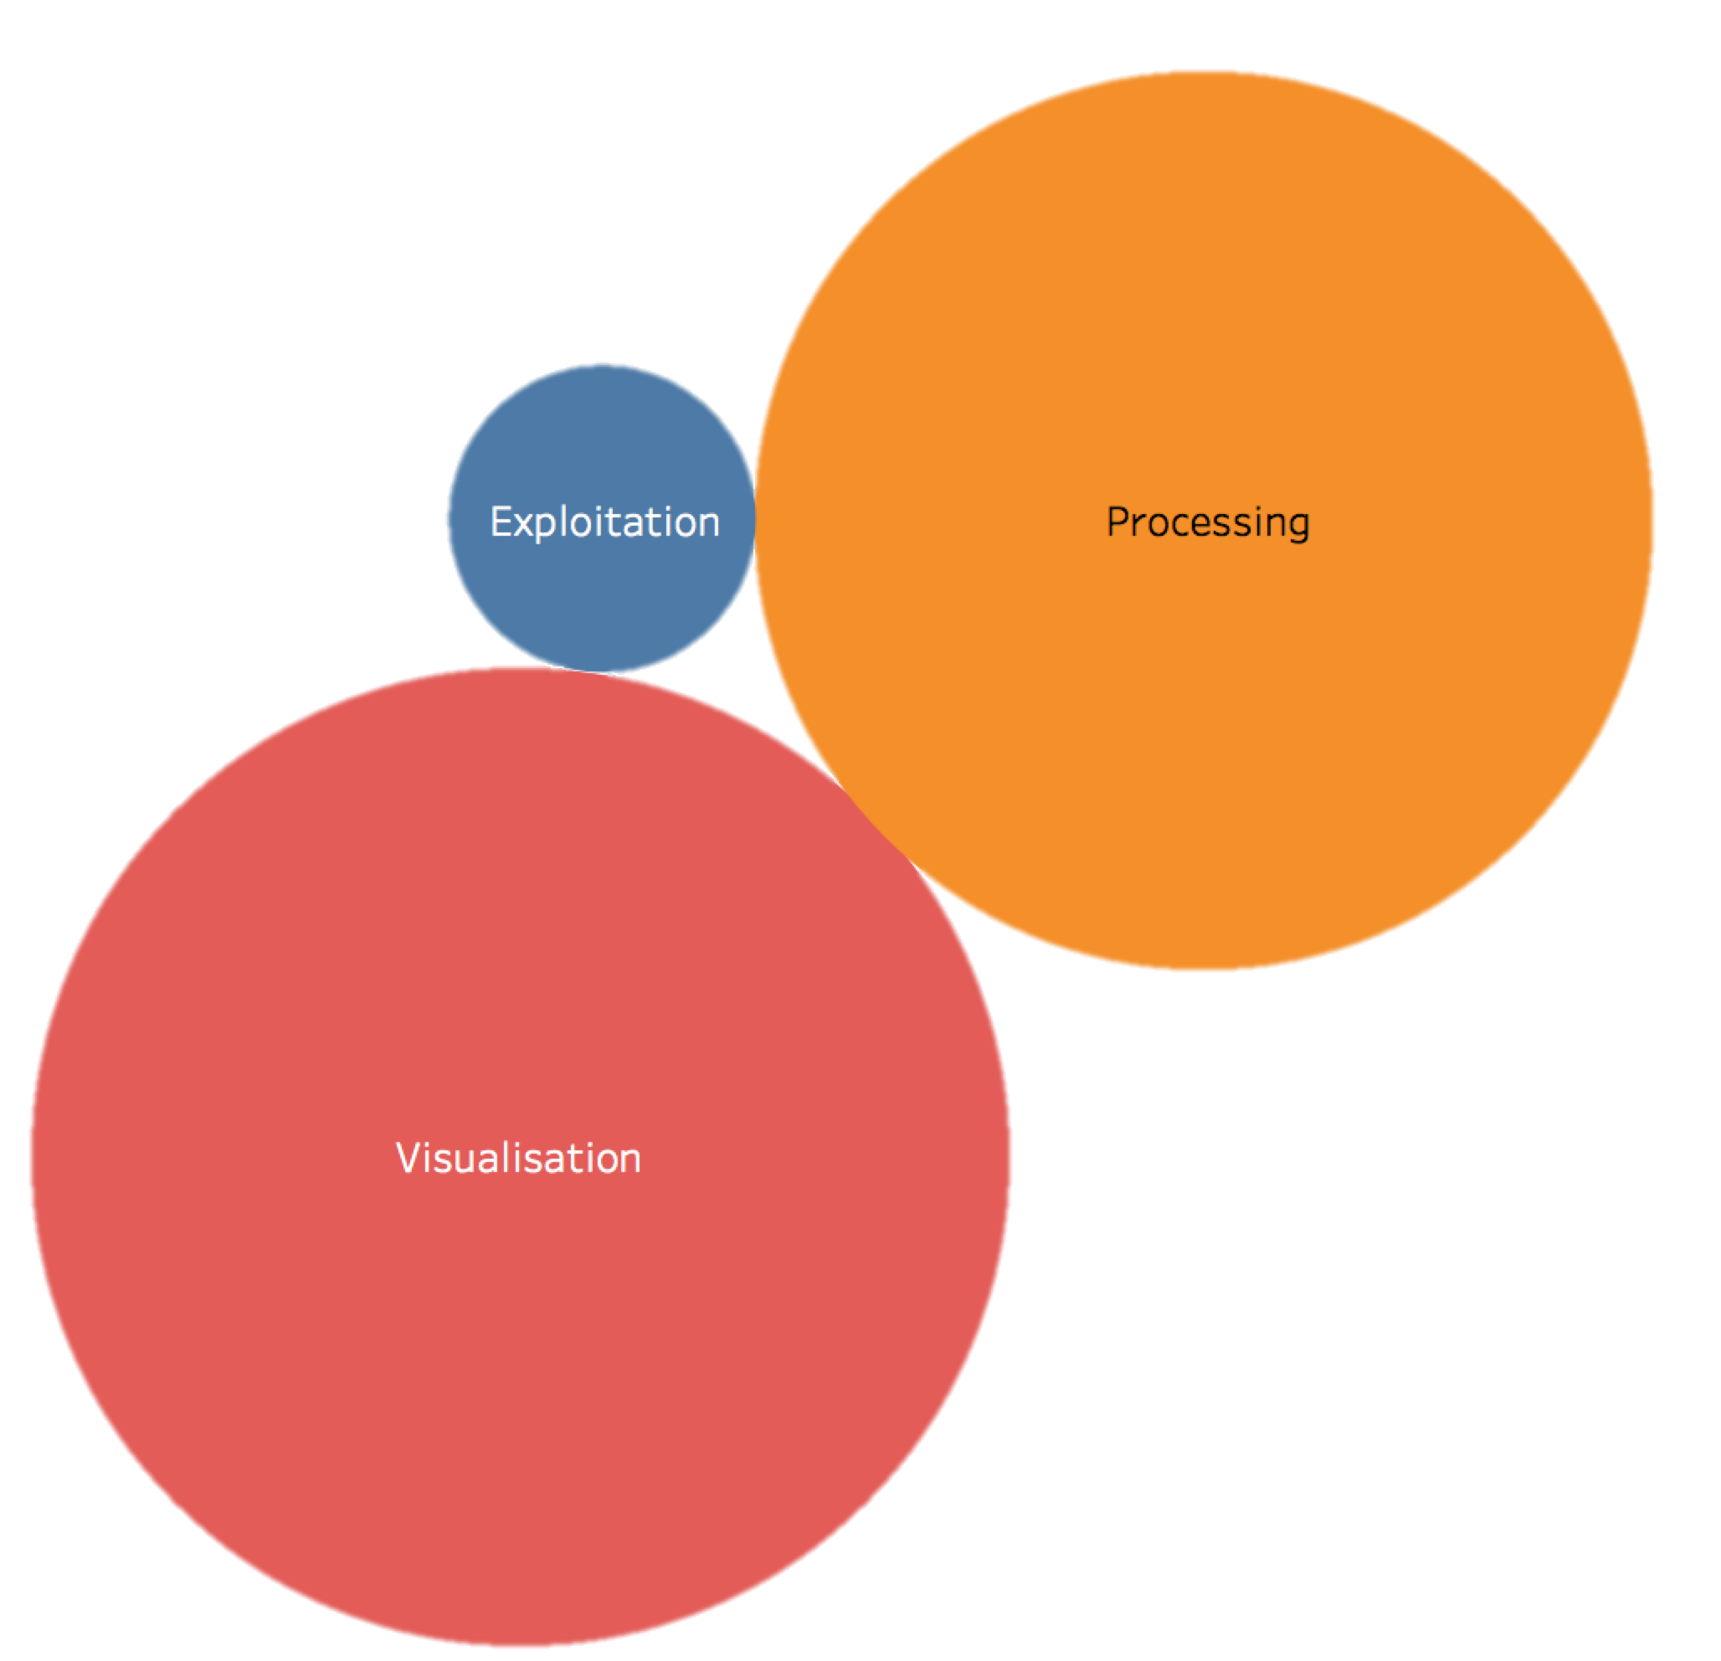
OSS Survey Statistics

Slide 9

OSS Inventory USE CASE

Slide 10


From user need to OSS Inventory utilization
WGISS OSS Inventory DB
USERS with OSS needs
The Sentinel Application Platform
(SNAP) architecture is ideal for
Earth Observation processing
and analysis

Slide 11
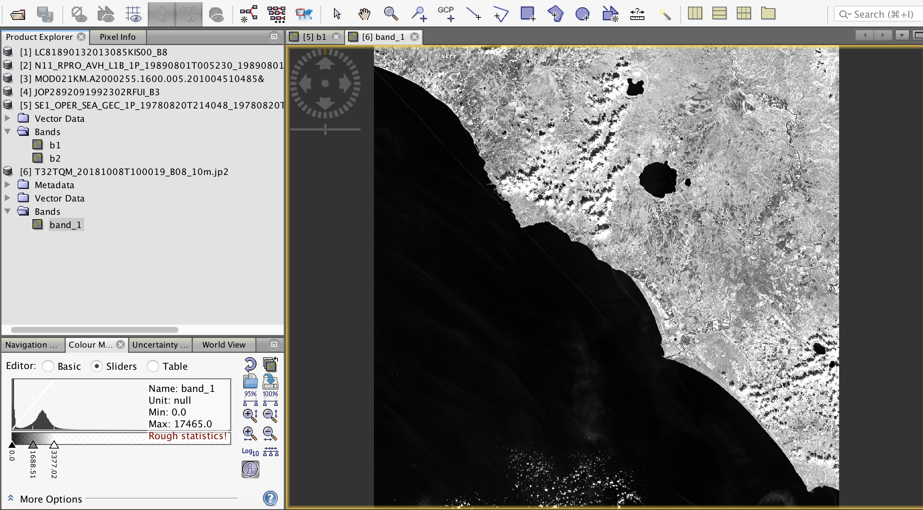
SNAP: application to other EO data

Slide 12
Feature Highlights
Common architecture for all Toolboxes
Very fast image display and navigation even of giga-pixel images
Graph Processing Framework (GPF): for creating user-defined processing chains
Advanced layer management allows adding and manipulation of new overlays such as images of other bands, images from WMS servers or ESRI shapefiles
Rich region-of-interest definitions for statistics and various plots
Easy bitmask definition and overlay
Flexible band arithmetic using arbitrary mathematical expressions
Accurate reprojection and ortho-rectification to common map projections,
Geo-coding and rectification using ground control points
Automatic SRTM DEM download and tile selection
Product library for scanning and cataloguing large archives efficiently
Multithreading and Multi-core processor support
Integrated WorldWind visualisation

Slide 13
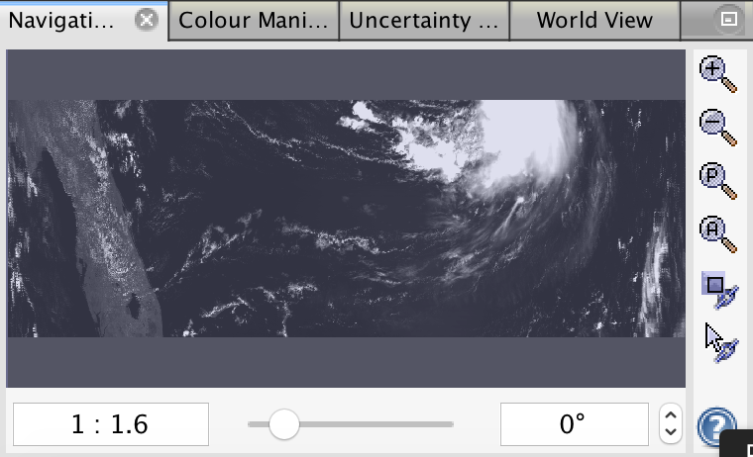
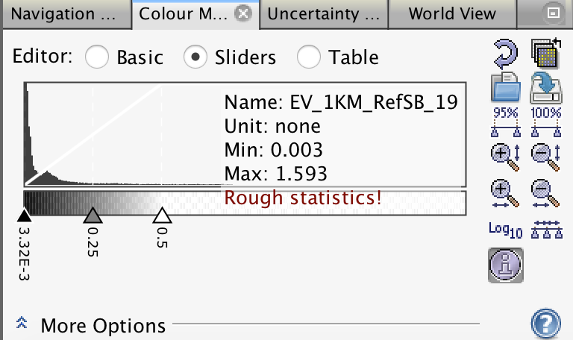
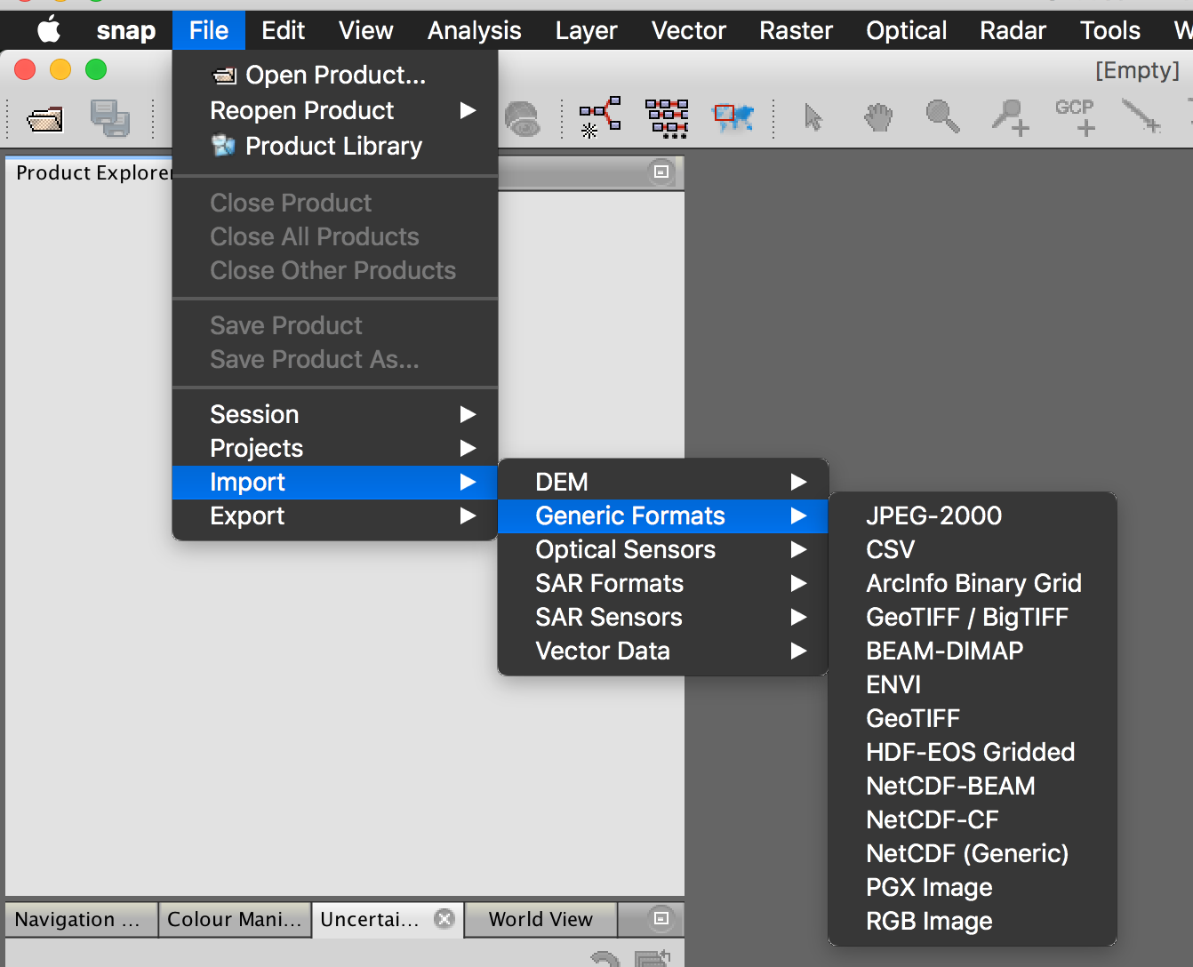
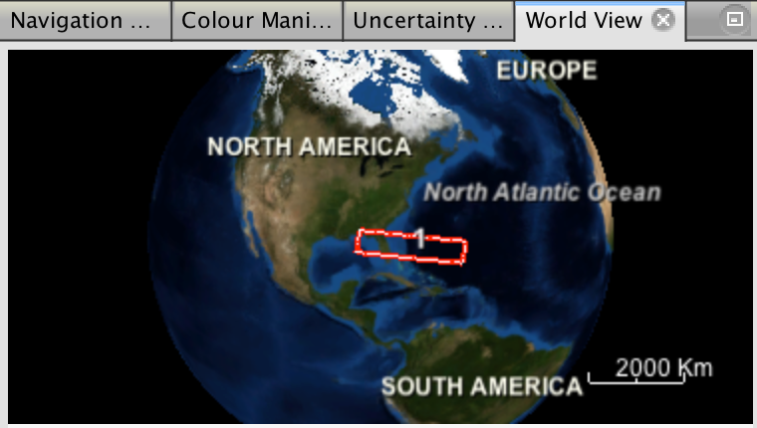
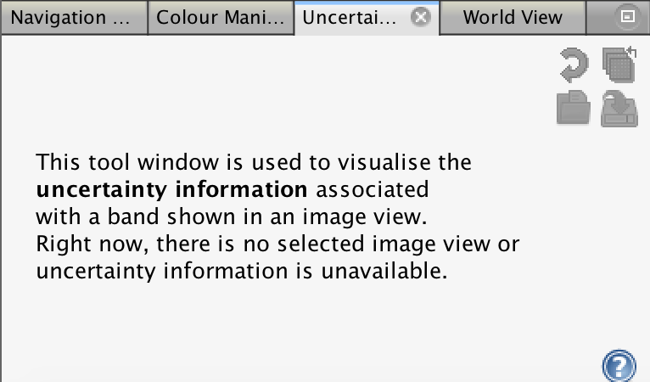
SNAP Technologies & Formats
NetBeans platform – desktop application framework
Install4J – multi-platform installation builder
GeoTools – geospatial tools library
GDAL – reading/writing raster and vector geospatial data formats
Jira – issue tracker
Git – version control system, hosted by GitHub

Slide 14
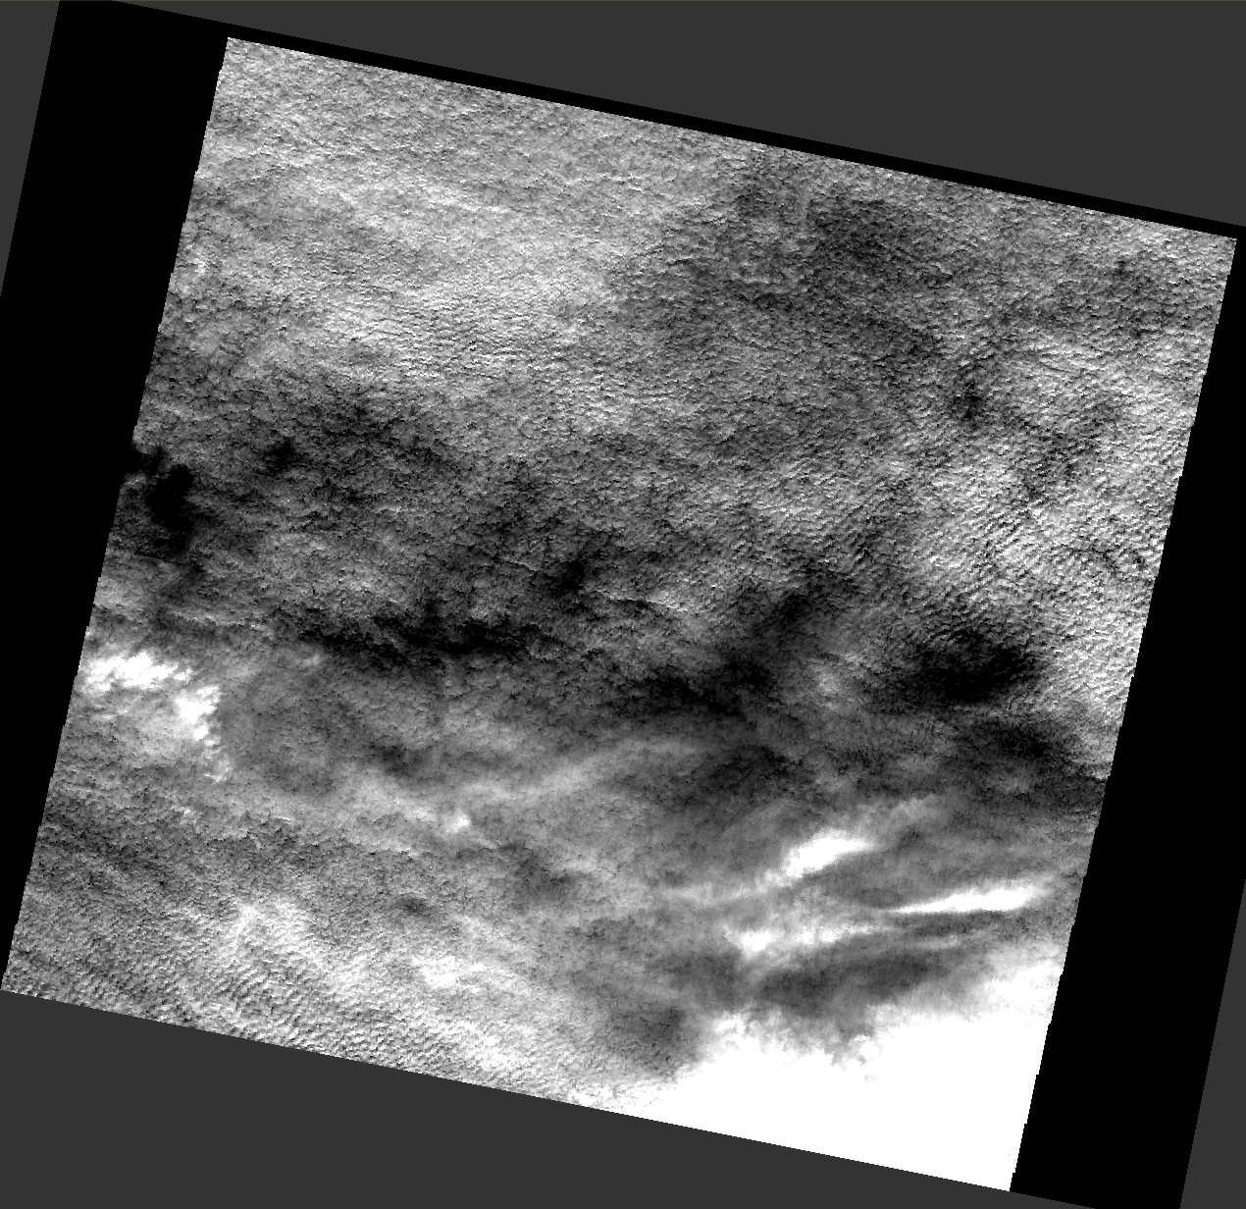
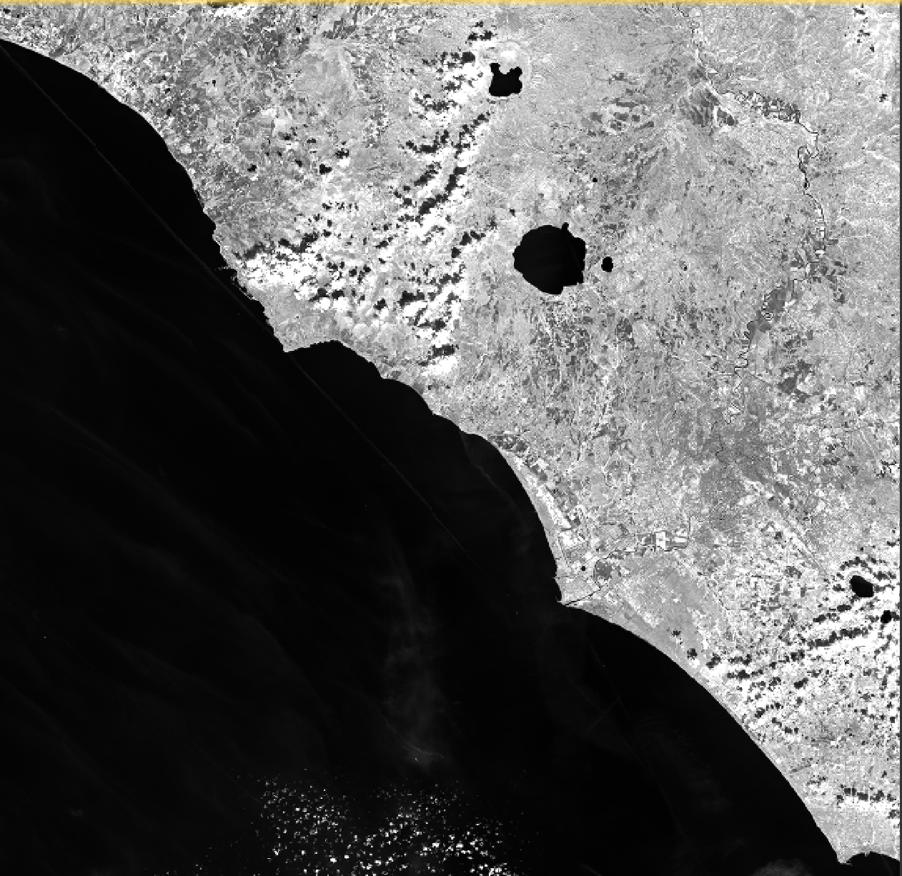
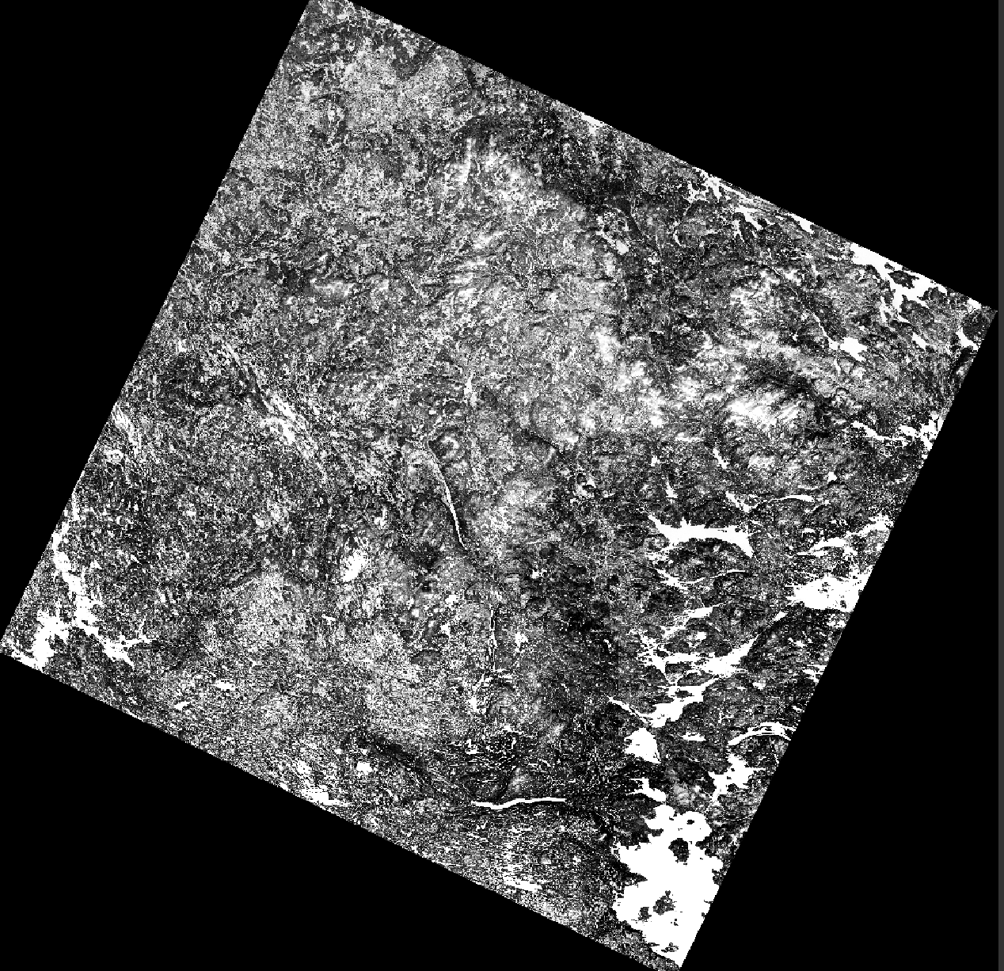
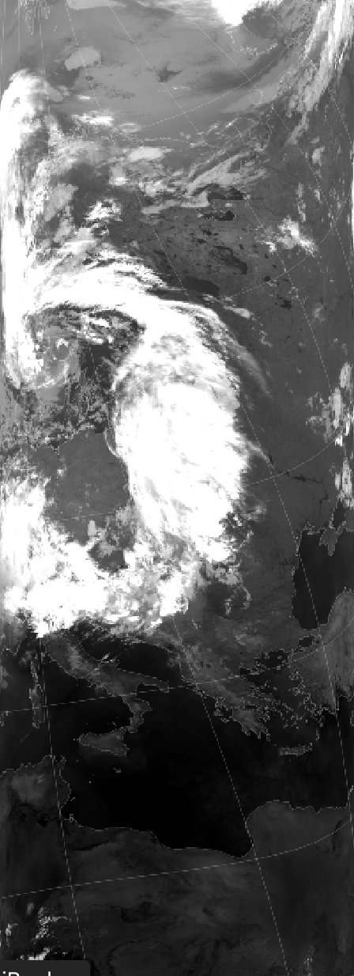
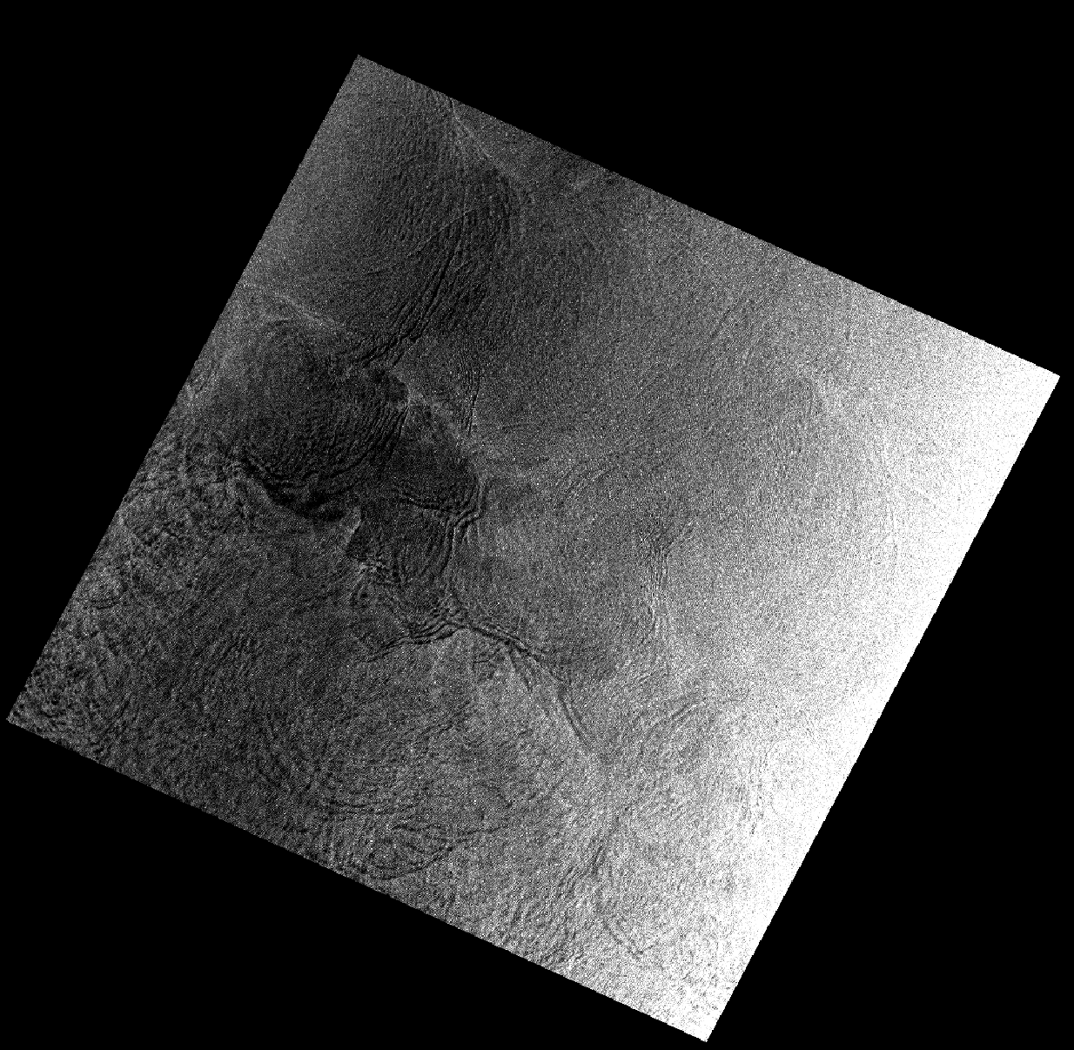
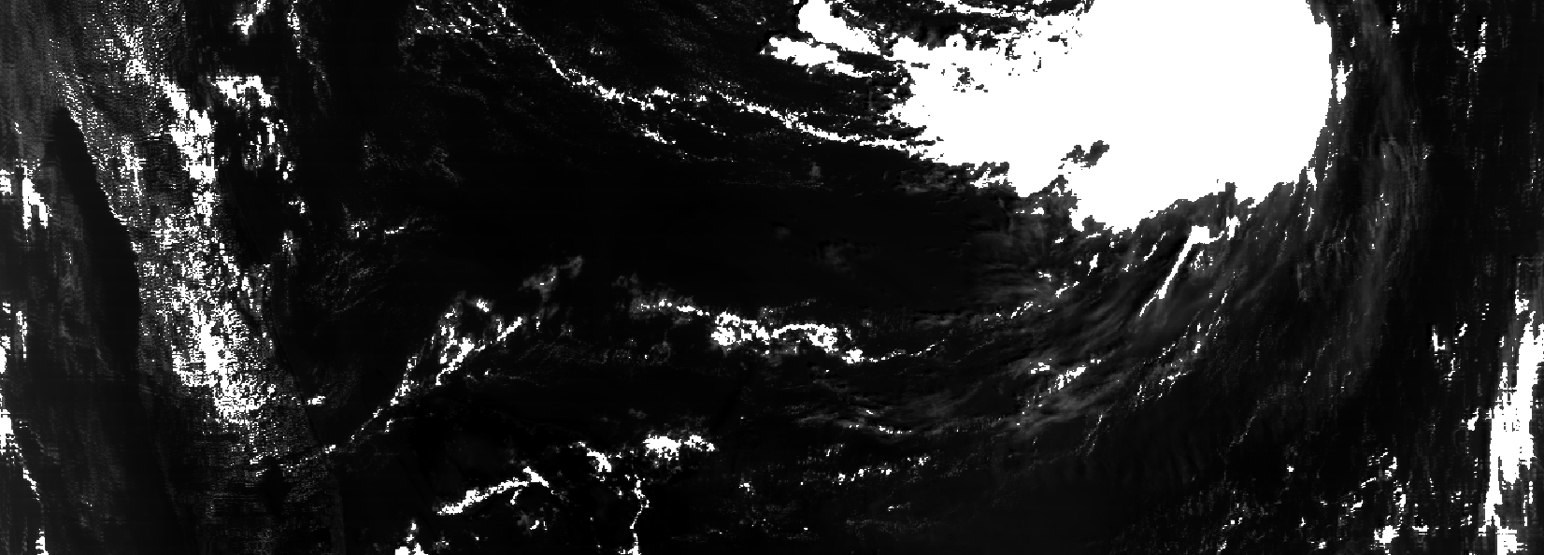
Few examples
Sentinel
Landsat
JERS
AVHRR
Modis
SEASAT

Slide 15


