Slide 1

Working Group on Information Systems and Services (WGISS)
Committee on Earth Observation Satellites
Mirko Albani, ESA, WGISS Chair
WGISS#46 Meeting
FDA-09: Inventory and characterize existing FDAs
DLR – Oberpfaffenhofen, Germany
25th October 2018

Slide 2
Background
FDA-9: Inventory and characterise existing FDAs operated by both public and private entities including the standards and approaches they use (e.g. Data Cubes, Exploitation Platforms, Copernicus DIAS, etc.).
As CEOS agencies are defining their processing and data dissemination standards, they seek to apply and follow international standards and best practices, including those generated by WGISS. This does not only concern common standards in terms of catalogs, metadata, terminology, and semantics, but it also involves interoperability standards for data discovery and download and for EO data analysis Application Programming Interfaces (APIs), as well as common interface standards such as INSPIRE, OGC, and W3C, and interoperability with other data access services (e.g., European Data Portal, international, GEOSS). WGISS will inventory and review existing standards and approaches in use by different FDA systems and platforms at CEOS agencies (e.g. Data Cubes, Exploitation Platforms, Copernicus DIAS, etc).
Notes:
@ Mirko, con Raz stavamo rivedendo bene la descrizione dell’azione. Tutto e’ focalizzato sulla compliance degli standards piuttosto che sulle piattaforme. Secondo noi per rispondere a tale azione per ogni campo tipo discovery, processing, etc bisognerebbe mettere un campo con lo standards usato. Siamo sicuri di non essere andati fuori tema? Basta l’unica colonna per indicare la compliance sugli standards?

Slide 3
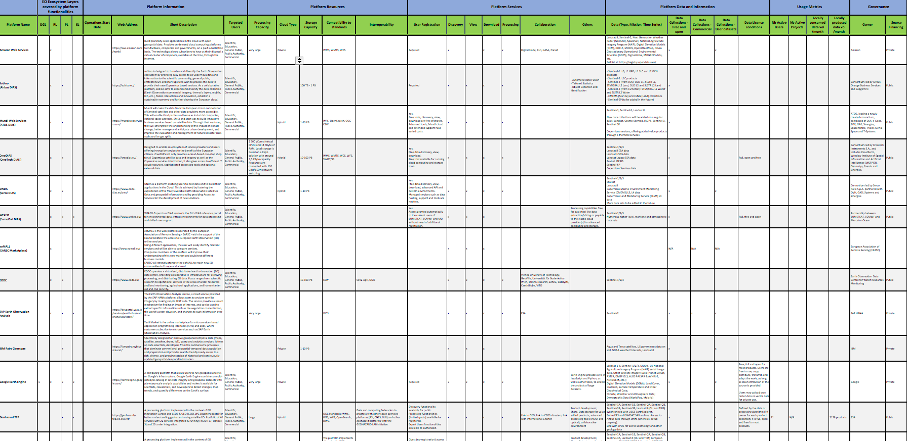

Inventory Table
Approximately 65% information completed

Slide 4
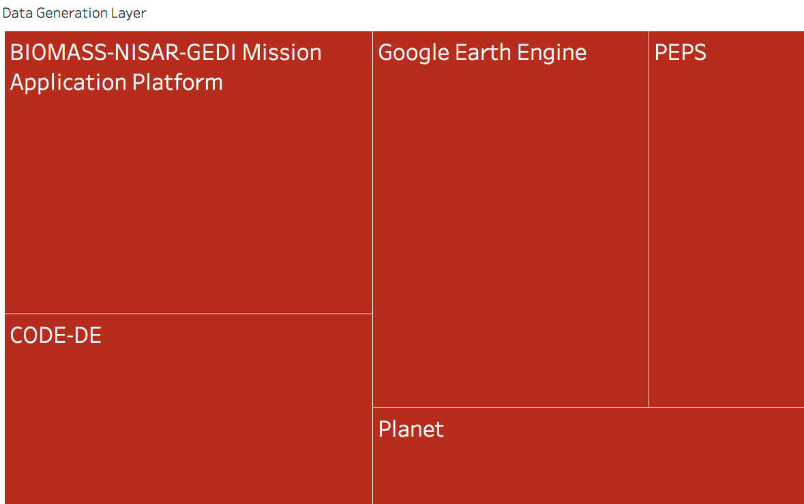
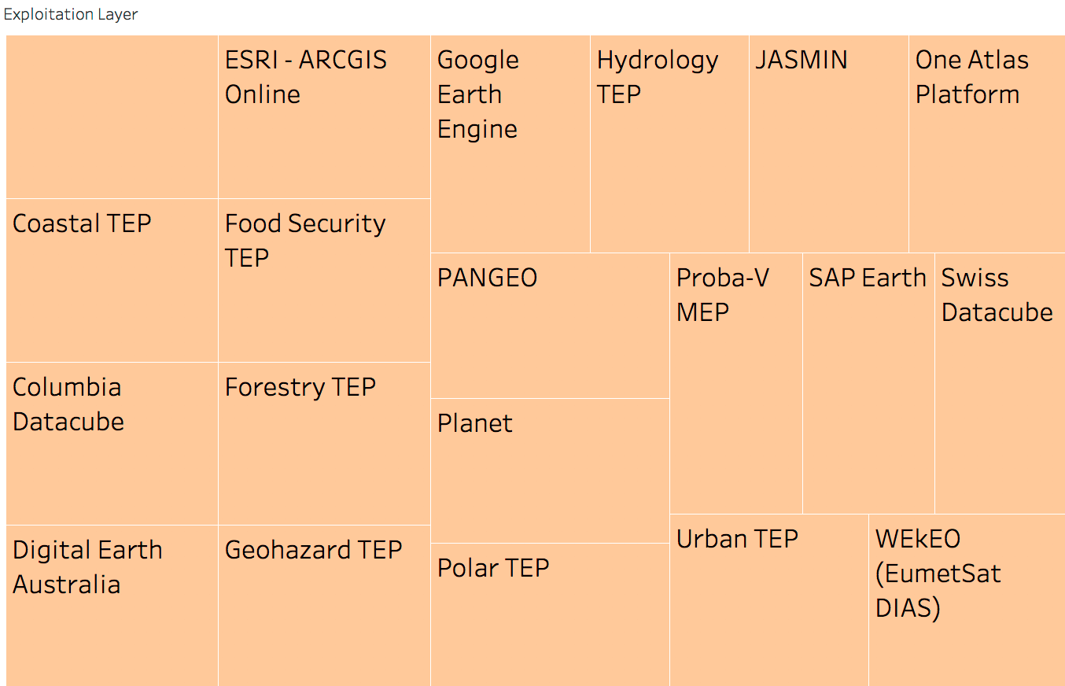
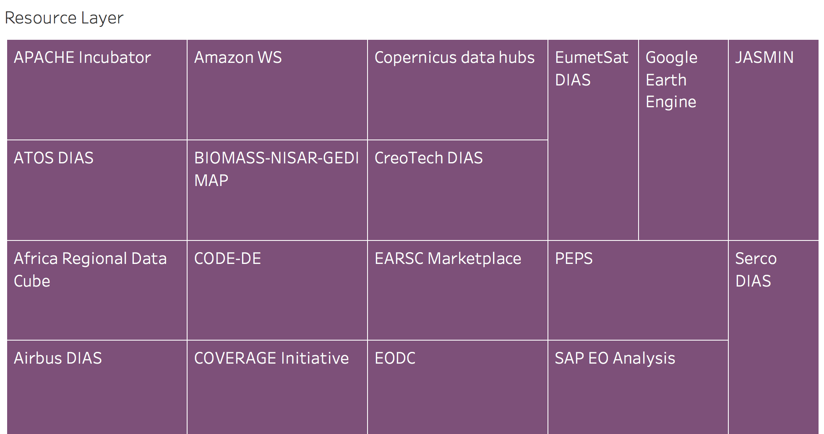
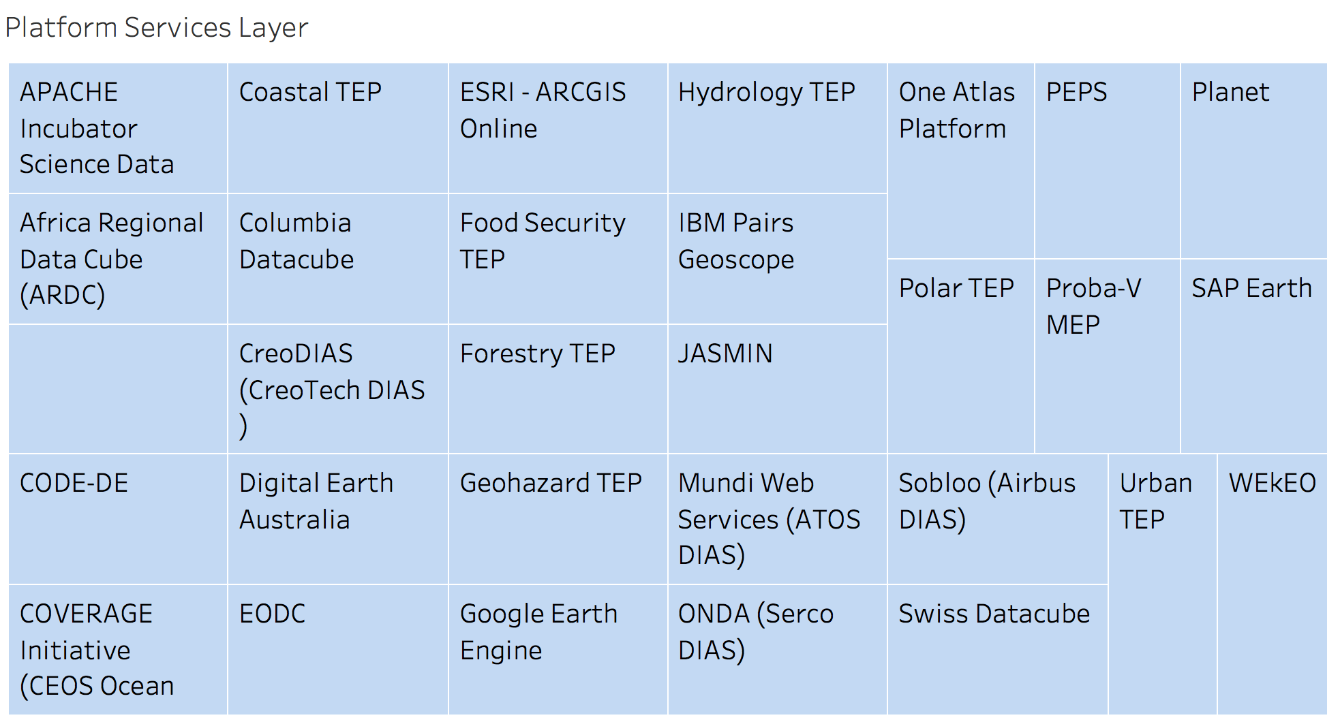
First Outcomes
BIOMASS
BIOMASS

Slide 5
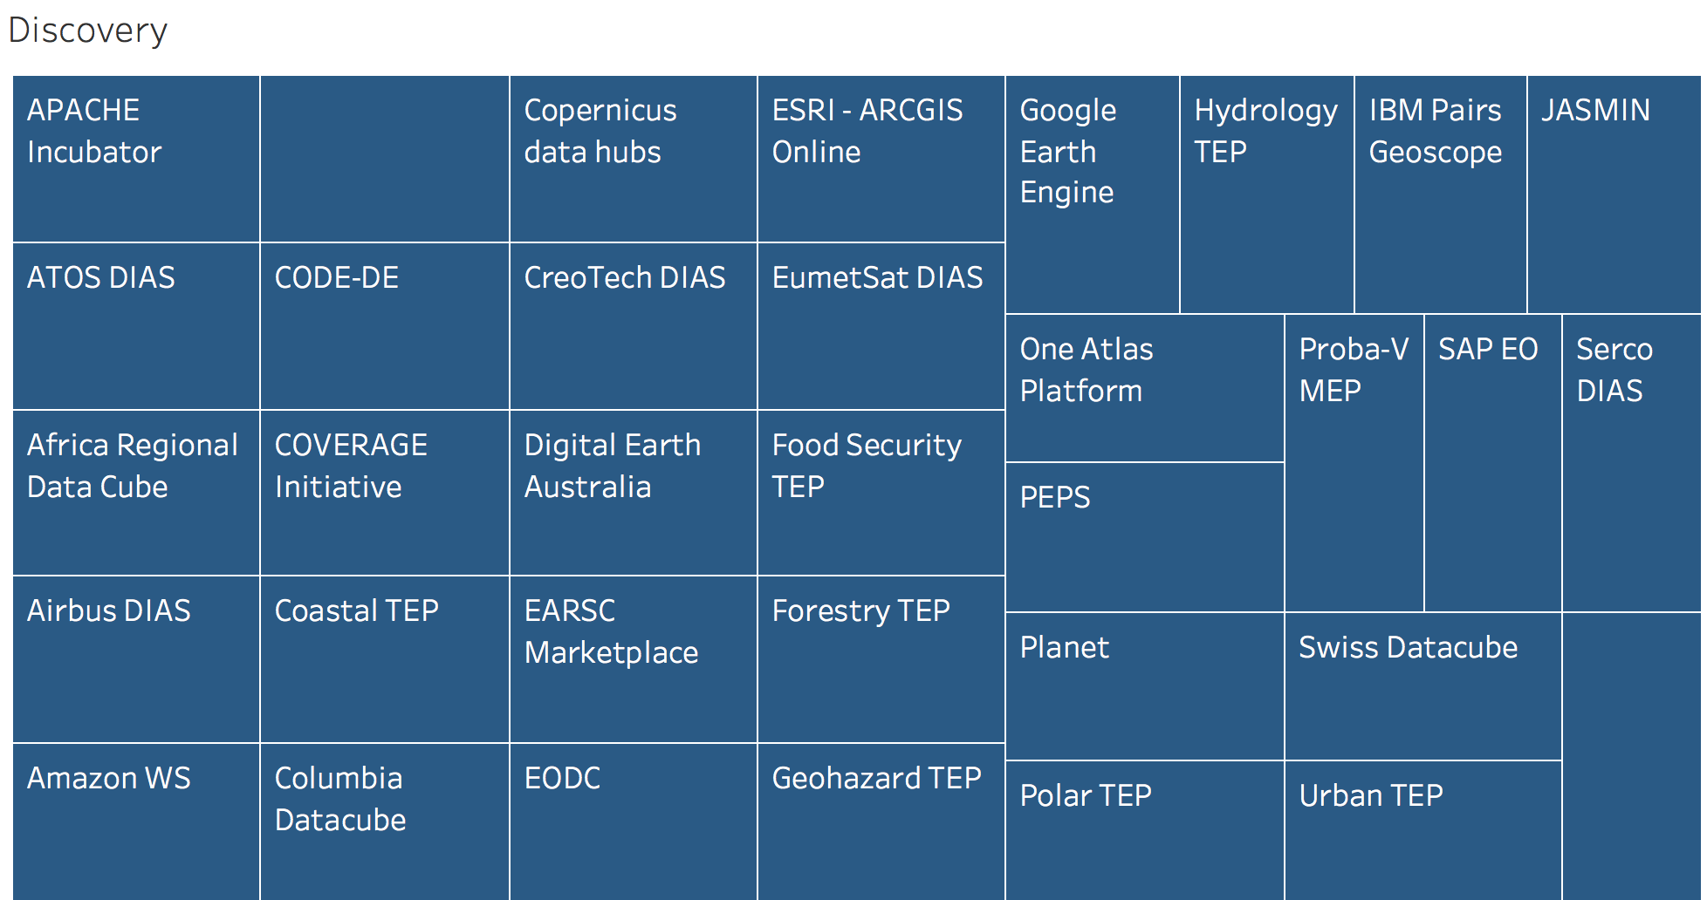
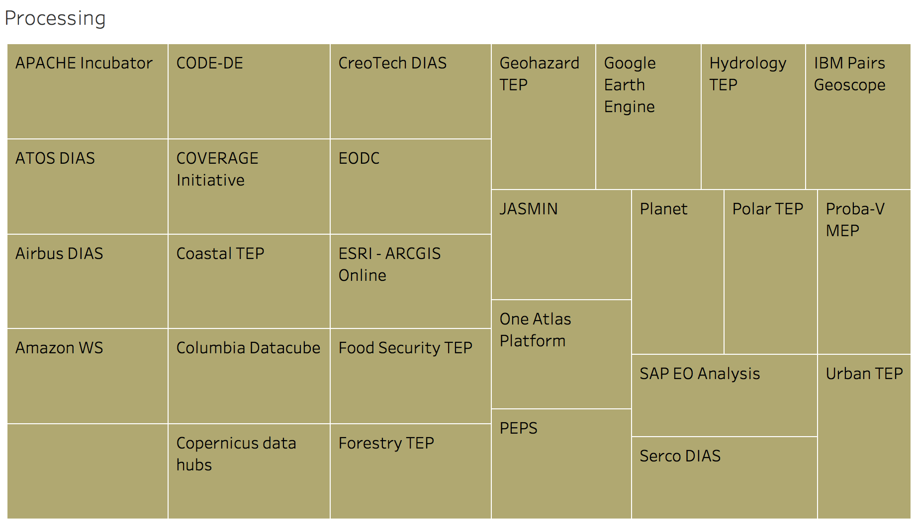
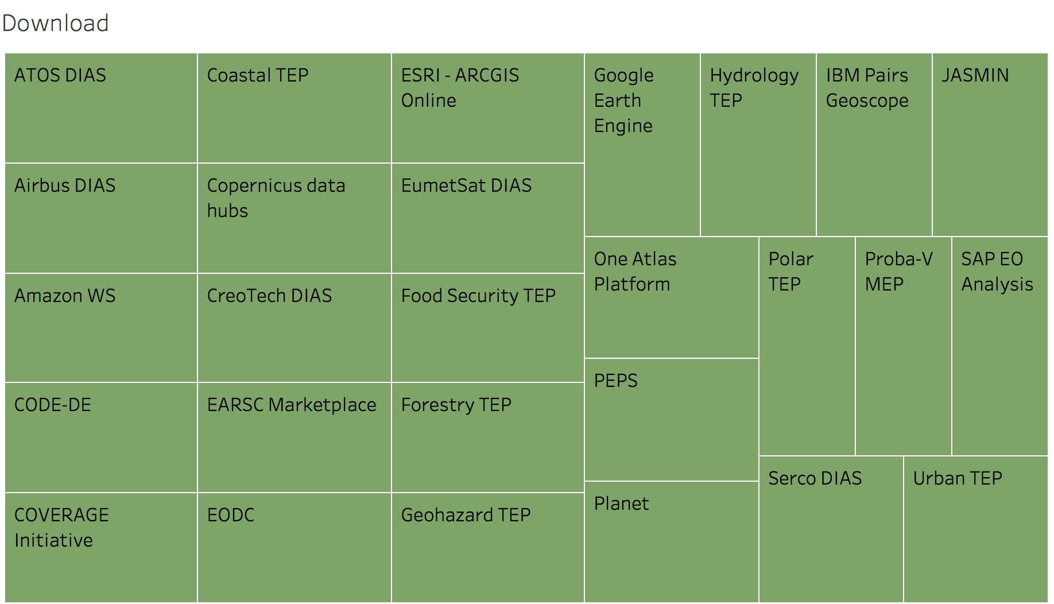
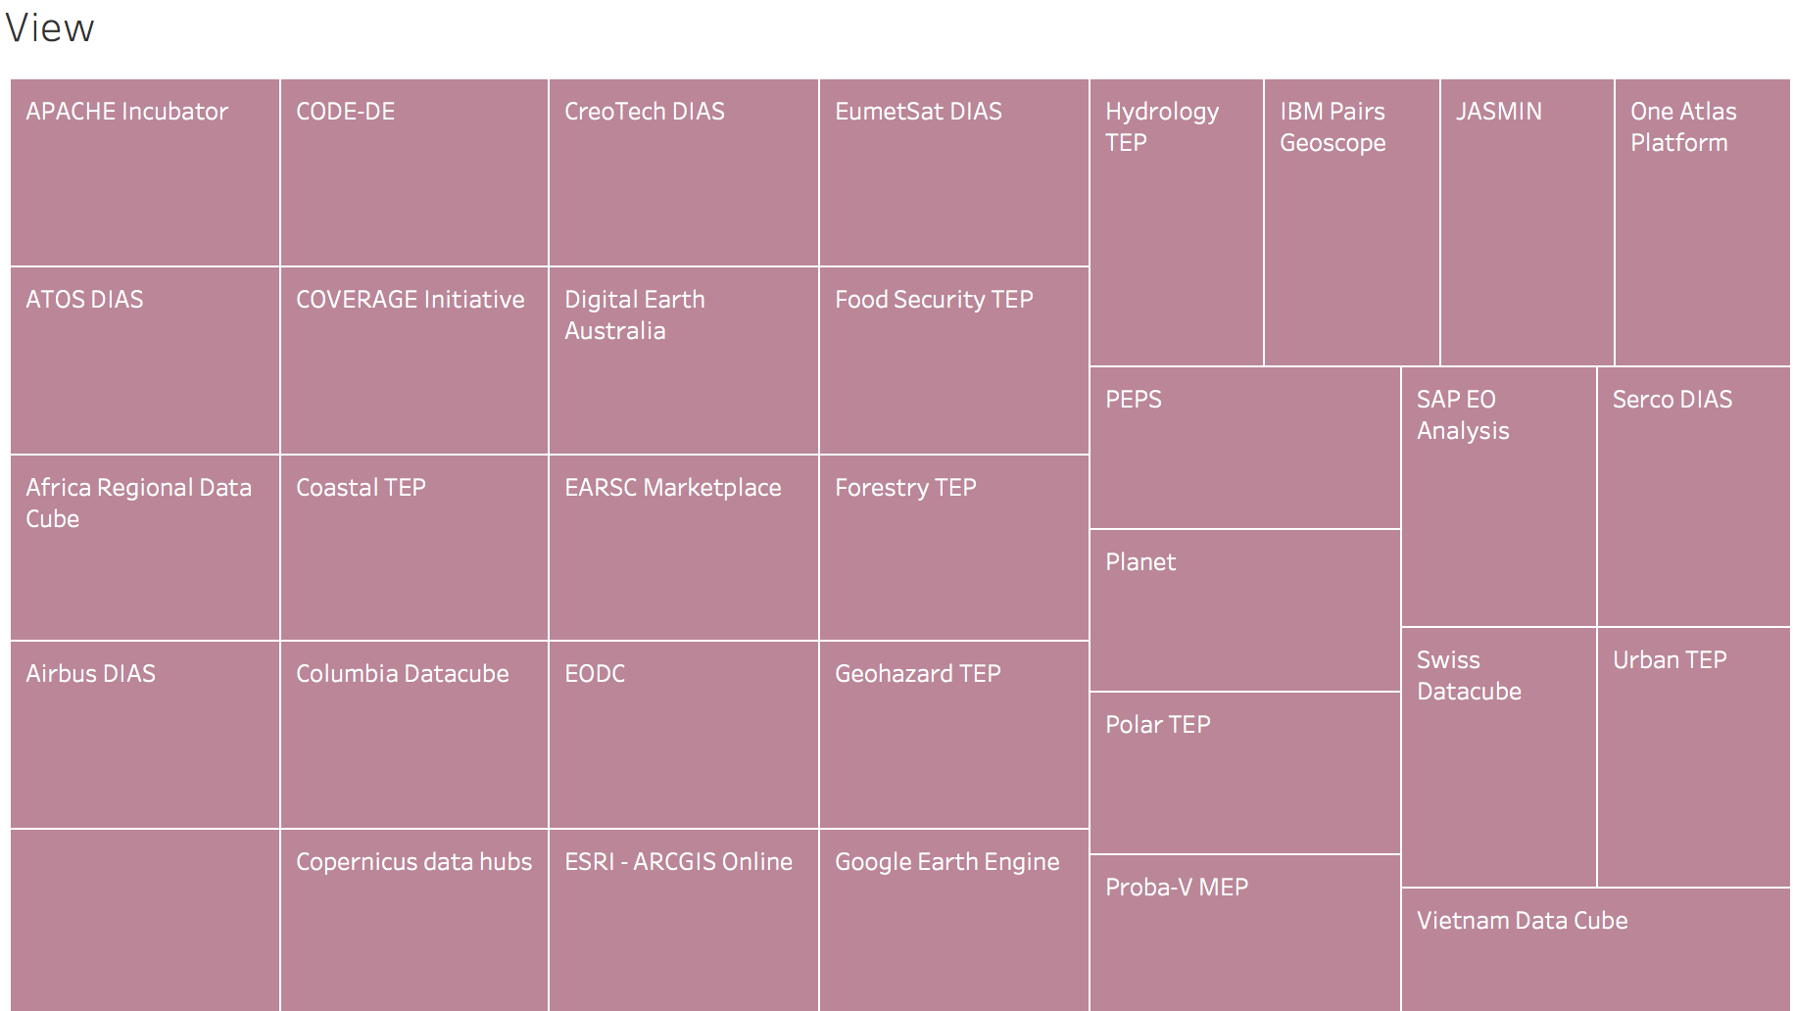
First Outcomes
BIOMASS
VIETNAM
DATA
CUBE
BIOMASS
BIOMASS

Slide 6
Few Survey Numbers
Layers
Data Generation Layer
5
Resource Layer
18
Platform Services Layer
30
Exploitation Layer
20
Functions
Discovery
34
Processing
28
View
33
Download
27
BIOMASS

Slide 7

NEXT STEPS
Inventory to be circulated to WGISS Members
            Due date: 25th of October
            Feedback from WGISS Members
            Due date: Mid of November
            Inventory Finalization (V1) by end December
BIOMASS

Slide 8
NEXT WGISS MEETING - IDEAS
Selection of a subset of FDA inventoried elements (e.g. Data Cubes, TEPs)
Identification of a set of high priority use cases
Organization of a 1-2 days hands-on workshop to:
                Demonstrate capabilities/functionalities wrt identified use cases
                Identify commonalities between FDA elements & interfaces
                Confirm mapping wrt Common Reference Architecture
                Define way forward for FDA elements contribution to CEOS objectives and stable visibility in the CEOS context
                Address FDA elements interoperability aspects
BIOMASS

Slide 9

Contact:
Mirko.Albani@esa.int

